Slide 1


Portrayal of Surface Tension
P M V Subbarao
Professor
Mechanical Engineering Department
Forces Leading New Innovations in 21st Century

Slide 2


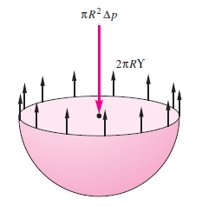
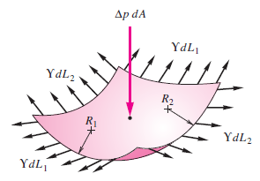
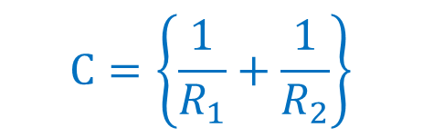
Fluid Pressure Surface Tension in Curved Surfaces
Spherical Organ
2πσR
σdL₁
σdL₂
σdL₂
σdL₁
The Young-Laplace (Y-L) equation is an elegant restatement of the balance of forces acting on a Fluid Surface in Equilibrium.
In general, the mean curvature at a surface point is given in terms of its principal radii of curvature R₁ and R₂ by the expression:
$$C=\left\{\frac{1}{R_{1}}+\frac{1}{R_{2}}\right\}$$

Slide 3
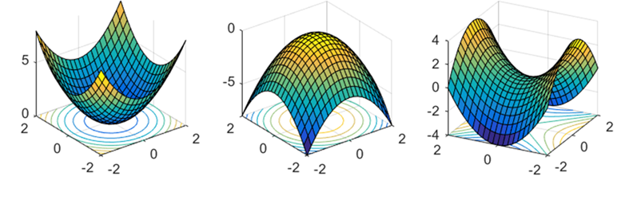
Fluid Pressure Surface Tension in Curved Surfaces
Concave surface
Convex surface
Saddle Point surface
It is to be noted that; the principal radii of curvature R₁ and R₂ are;
positive for a convex surface
negative for a concave surface.
For a saddle point, one principal radius is positive and the other negative.

Slide 4
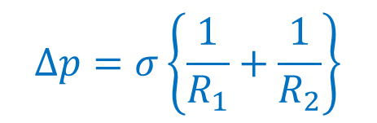
Fluid Pressure Surface Tension in Curved Surfaces
Concave surface
Convex surface
Saddle Point surface
The Young-Laplace equation gives the pressure difference Δp across the liquid surface at any point in terms of the surface tension γ and the two principal radii of curvatures at that point.
A force balance normal to the surface will show that the pressure increase on the concave side is
$$∆p=σ\left\{\frac{1}{R_{1}}+\frac{1}{R_{2}}\right\}$$

Slide 5
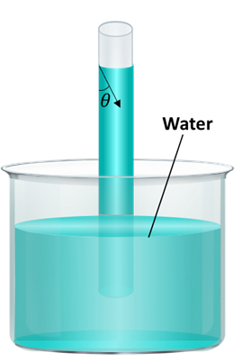
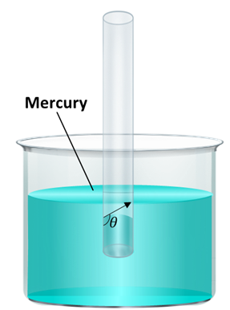
Surface Tension as Capillary Action
Every system in this universe spontaneously moves towards equilibrium.
Capillarity broadly refers to the interfacial interaction between liquid and another medium arising from cohesion within the liquid.

Slide 6
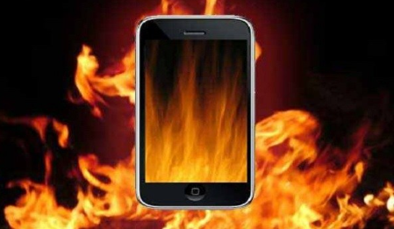
Challenge in Field-use of Smart Phones
Around 1990 introduction of compact, high-performance communication devices such as smart phones were invented

Slide 7

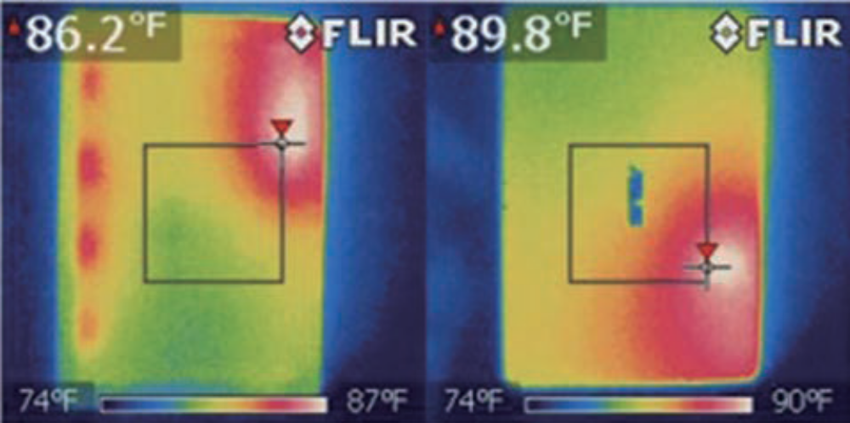
Thermo-graphic view of a smart phone skin temperature
After 10 min of gaming operation.

Slide 8
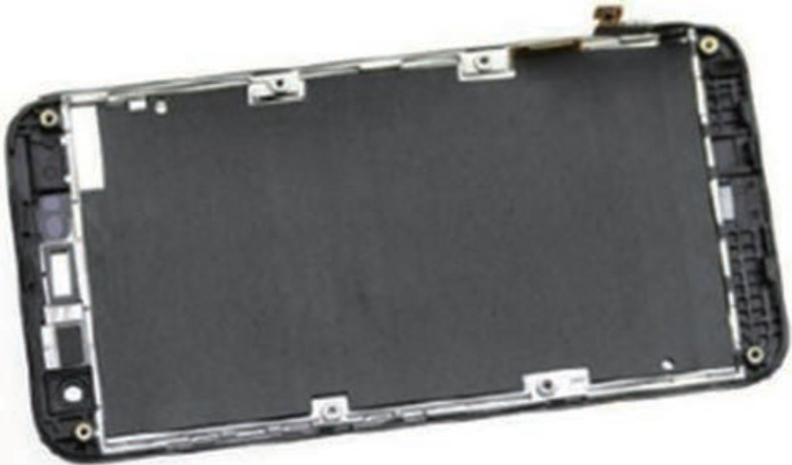
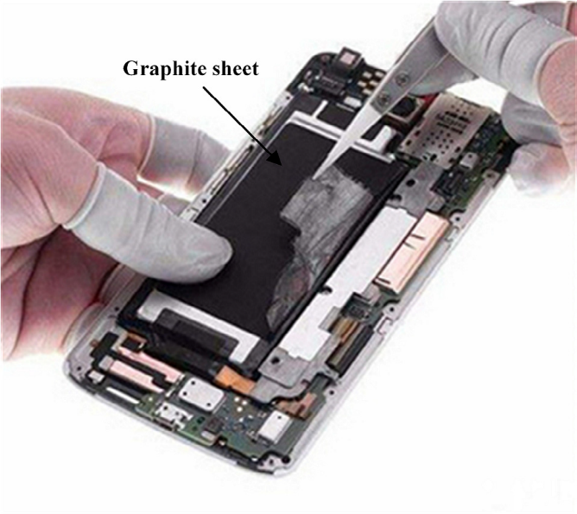
Thermal Management System for Smart Phone: Pre 2010
A common thermal management system for smart phones uses a graphite sheet (having high in plane thermal conductivity) in combination with a metal plate (Mg, Al, SUS, Cu etc.)
This solution has its limitation due to high heat dissipation as well as high cost of the graphite when considering the high-volume production.

Slide 9
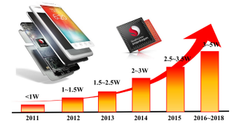
Power consumption of CPU processors of mobile phones

Slide 10
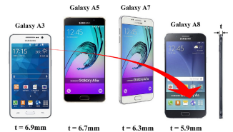
Variation in thickness of SAMSUNG smartphones.

Slide 11
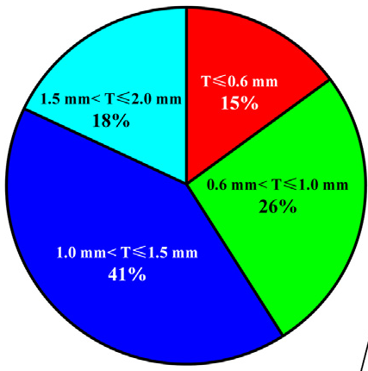
21st Century Developments : Thickness of cooling systems

Slide 12
Thin Cooling Systems For Better Thermal Management
In response to the problem of current solution of graphite sheet, an analogical solutions were to be explored.

Slide 13
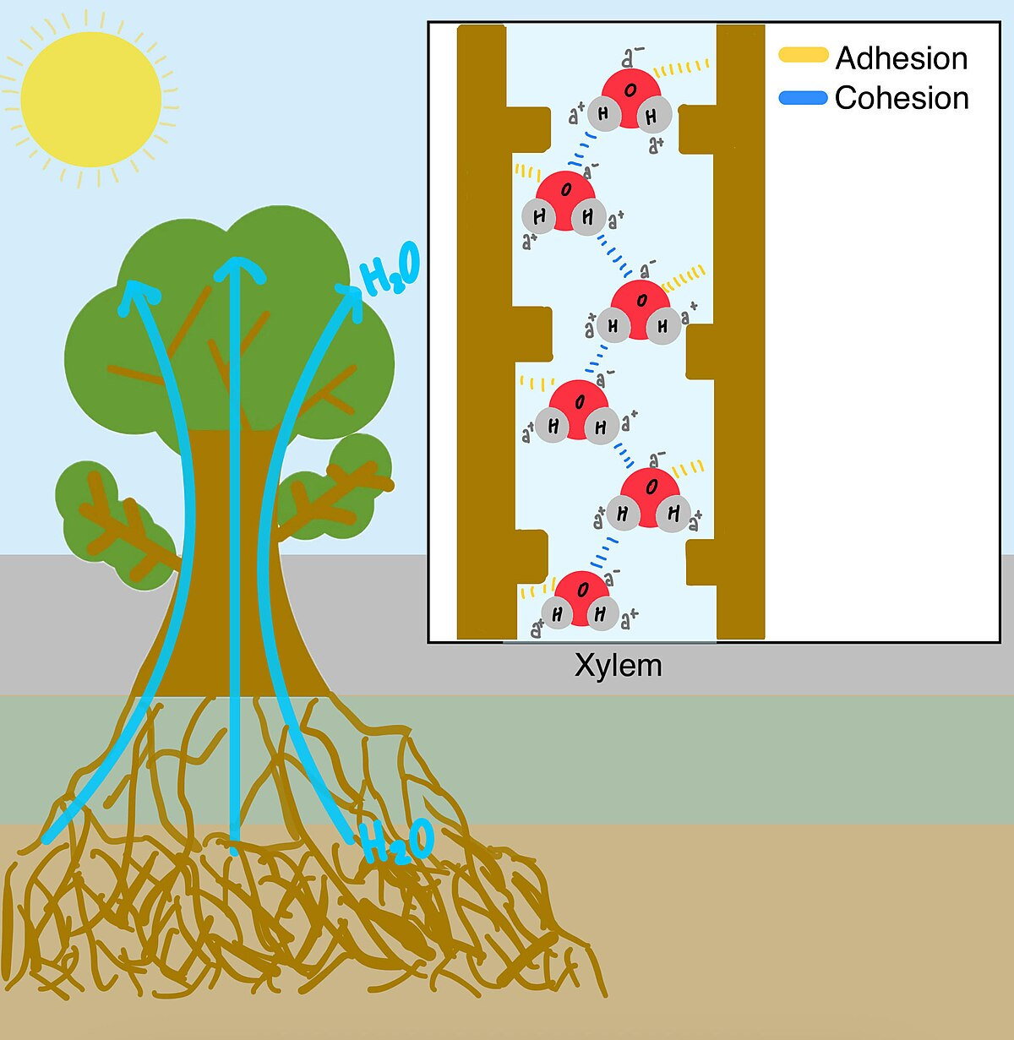
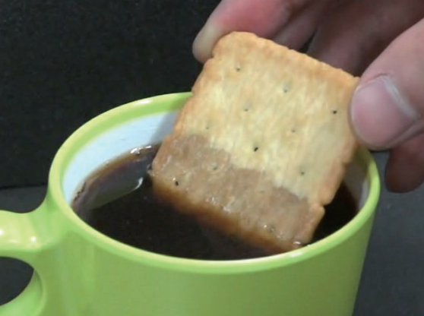
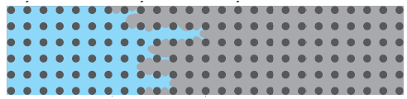

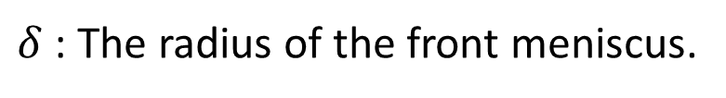
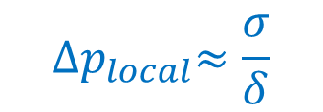

Surface Tension in Nature
partially saturated
Fully saturated
Dry
$$δ$$
$${∆p}_{local}≈\frac{σ}{δ}$$
$δ$ : The radius of the front meniscus.

Slide 14
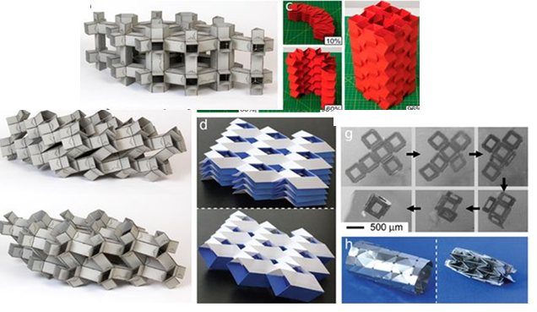
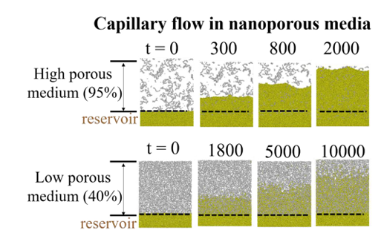
Creation of Porous Structures

Slide 15
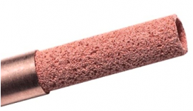

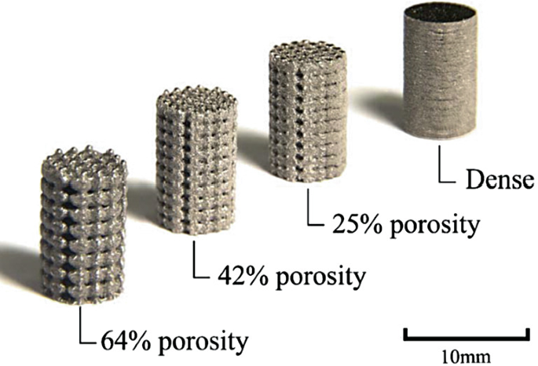
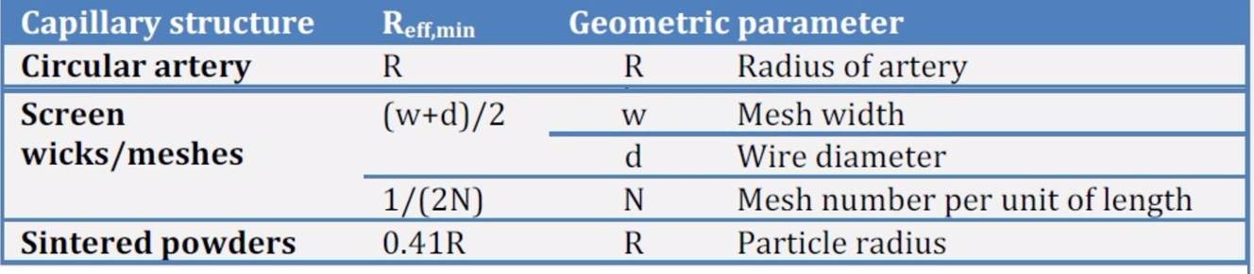
Capillary Flow of Liquid through A 3D Irregular Curve
Porous Metal tubes
Saturated with volatile Liquid

Slide 16
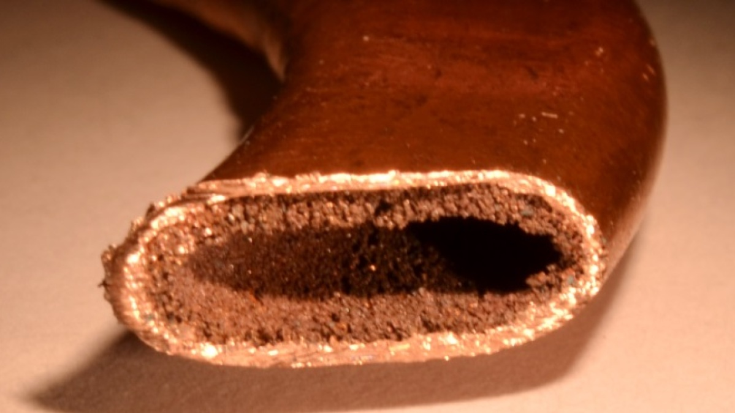
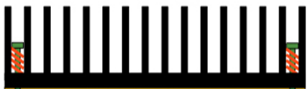




Heat Pipe Heat Sinks
Condenser
Evaporative Cooler
Adiabatic Transport of Vapor
Capillary Transport of liquid

Slide 17
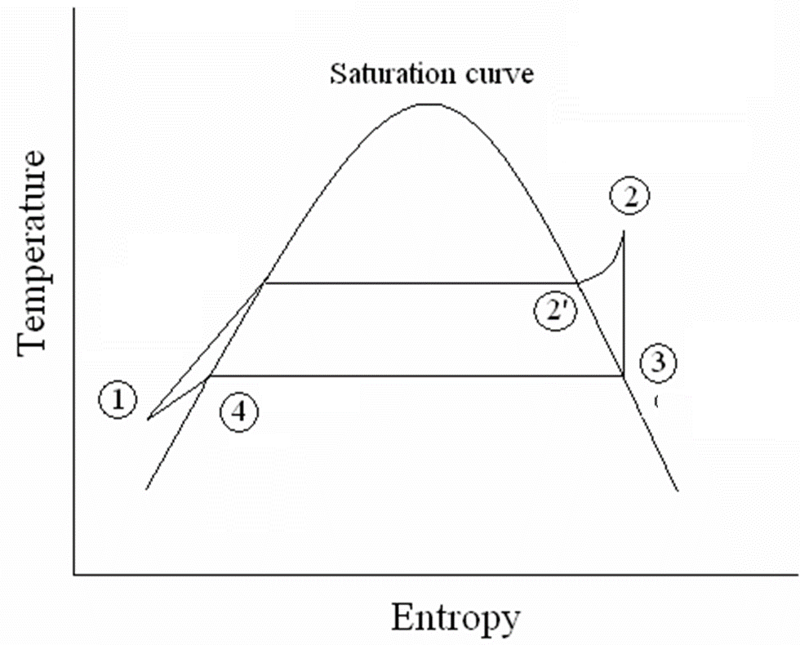
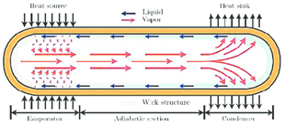
Ideal Thermodynamic Cycle for a Heat Pipe
Evaporator
Adiabatic pipe section
Condenser
wick

Slide 18
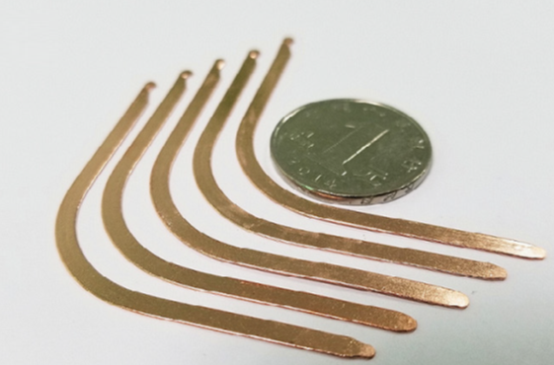
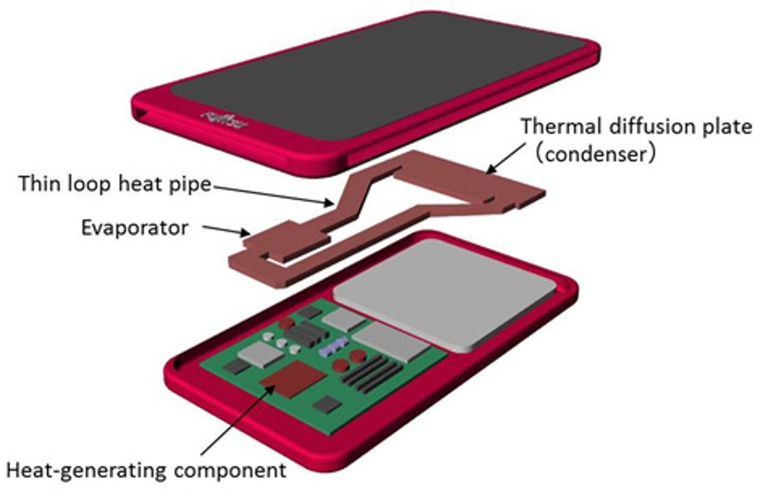
Ultra-thin flat-plate heat pipes
Flattened heat pipe

Slide 19
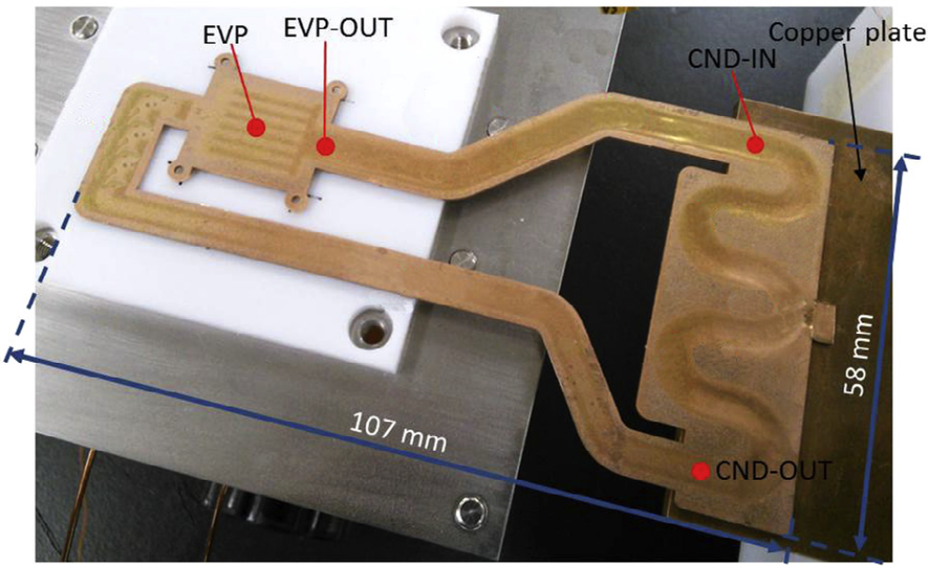
Dimensions of a Typical UTHP

Slide 20
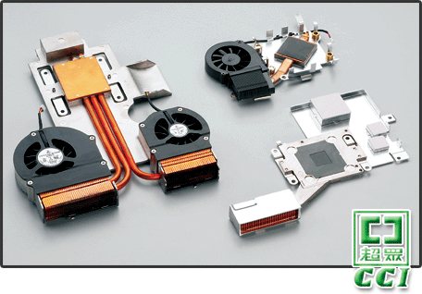
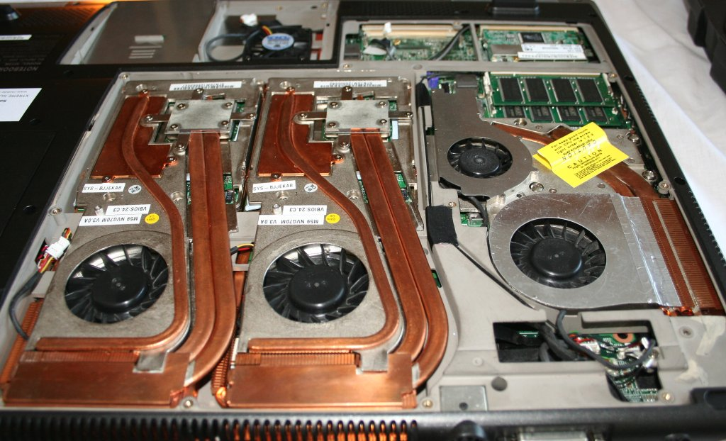
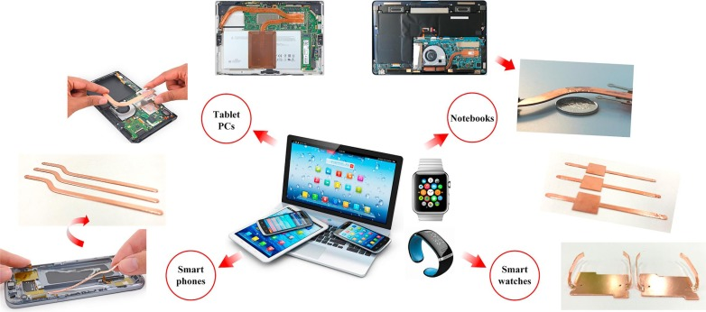
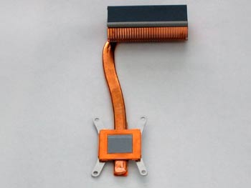
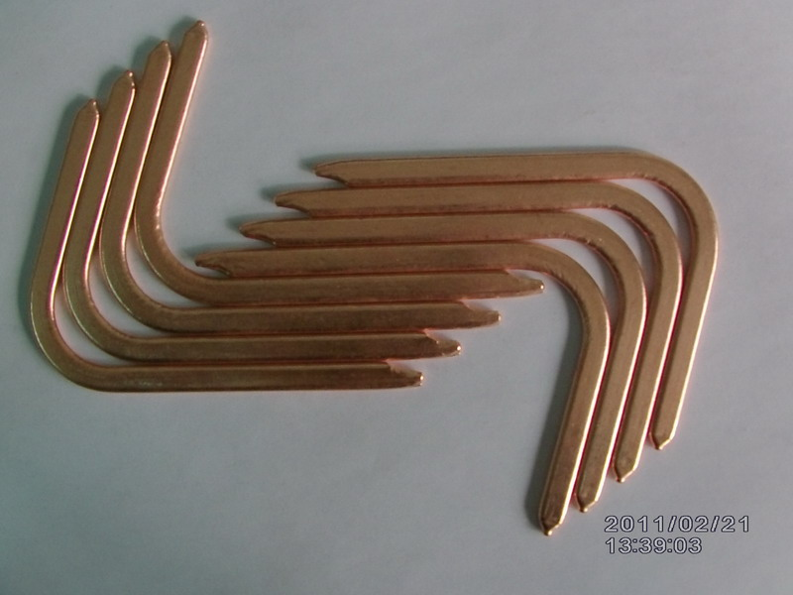
Portrayal of Surface Tension In Modern Electronics

Slide 21
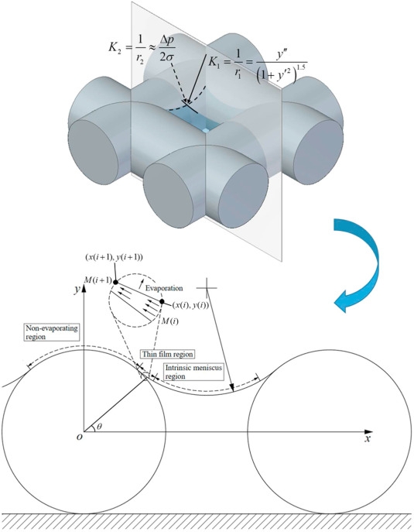
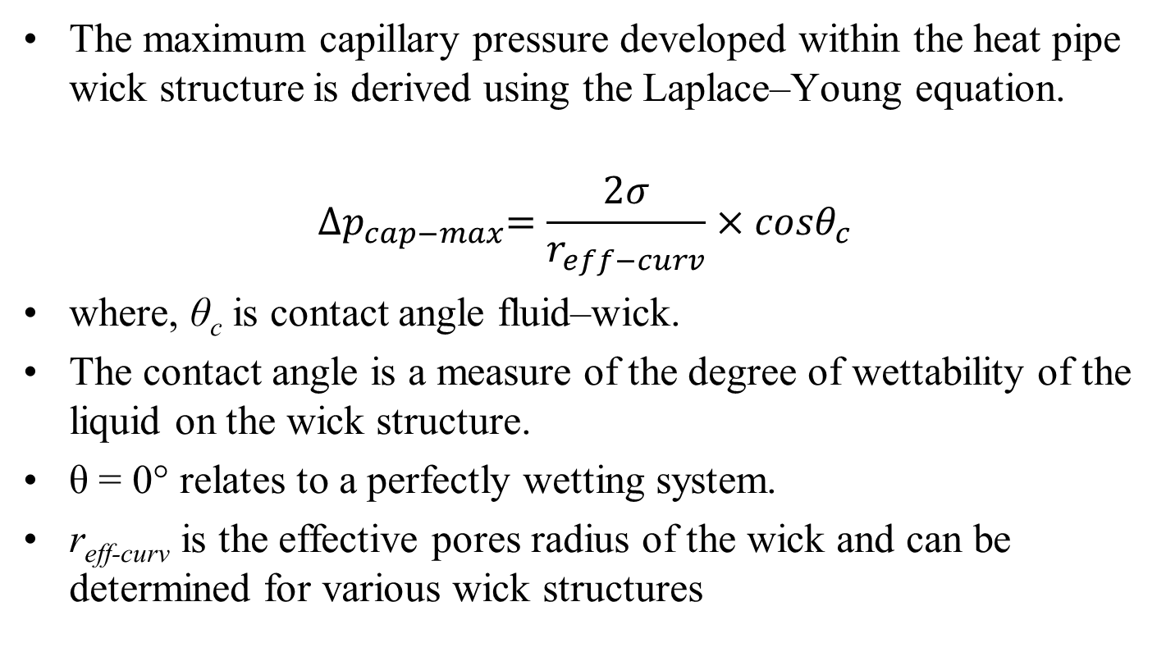
Cooling Driving Pressure in a Heat Pipe
The maximum capillary pressure developed within the heat pipe wick structure is derived using the Laplace–Young equation.
$${∆p}_{cap−max}=\frac{2σ}{r_{eff−curv}}×cosθ_{c}$$
where, θ_{c} is contact angle fluid–wick.
The contact angle is a measure of the degree of wettability of the liquid on the wick structure.
θ = 0° relates to a perfectly wetting system.
r_{eff-curv} is the effective pores radius of the wick and can be determined for various wick structures

Slide 22
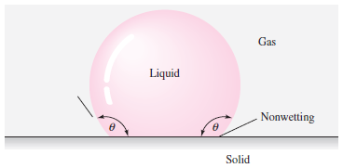
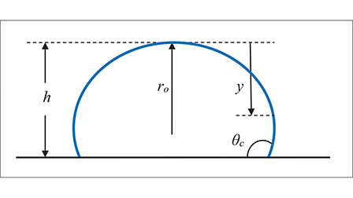
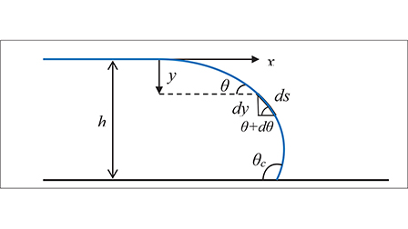
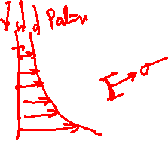
Surface Effect & Contact Angle
The third important surface effect is the contact angle , which appears when a liquid interface intersects with a solid surface, as:
The force balance would then involve both σ &θ_{c}.
https://pubs.aip.org/aapt/pte/article/60/5/358/2844435/A-Fresh-Look-at-the-Young-Laplace-Equation-and-Its

Slide 23
Surface Effect & Contact Angle
If the contact angle is less than 90°, the liquid is said to wet the solid;
if θ > 90 °, the liquid is termed nonwetting.
For a clean mercury–air–glass interface, 130 °.

Slide 24
Surface Effect & Contact Angle
The contact angle is sensitive to the actual physicochemical conditions of the solid–liquid interface.

Slide 25
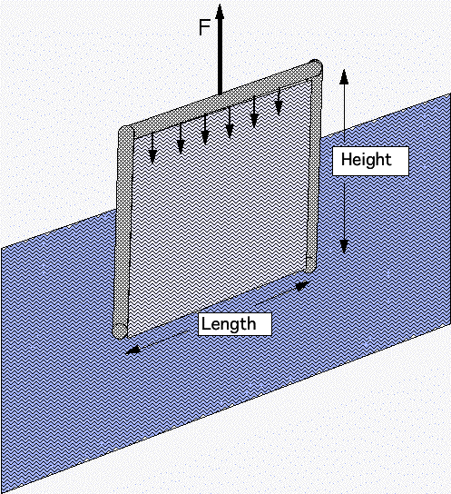
Stretching of a Liquid Film
Self study….

Slide 26
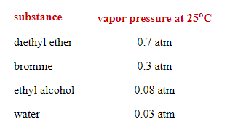
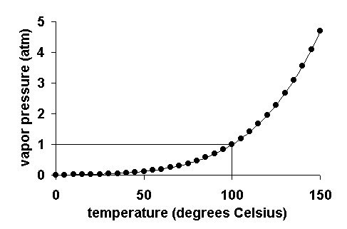
Vapor Pressure
Vapor pressure is the pressure at which a liquid boils and is in equilibrium with its own vapor.
If the liquid pressure applied is greater than the vapor pressure, the only exchange between liquid and vapor is evaporation at the interface.
If the liquid pressure falls below the vapor pressure, vapor bubbles begin to appear in the liquid.

Slide 27

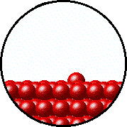
The Microscopic View of Vapor Pressure
When a solid or a liquid evaporates to a gas in a closed container, the molecules cannot escape.
Some of the gas molecules will eventually strike the condensed phase and condense back into it.
When the rate of condensation of the gas becomes equal to the rate of evaporation of the liquid or solid, the amount of gas, liquid and/or solid no longer changes.
The gas in the container is in equilibrium with the liquid or solid.
The pressure exerted by the gas in equilibrium with a solid or liquid in a closed container at a given temperature is called the vapor pressure.

Slide 28
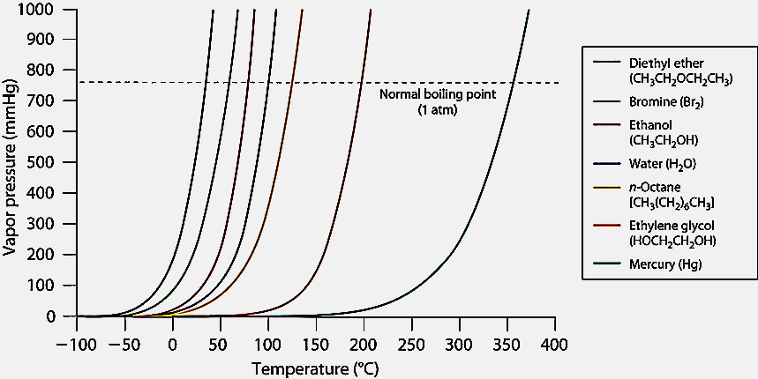
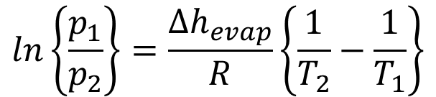
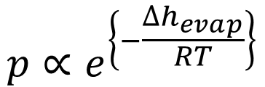
Vapor Pressure
How to develop a mathematical model for the pressure increase as a function of temperature?
Experiments showed that the vapor pressure P and temperature T are related.
$$p∝e^{\left\{−\frac{∆h_{evap}}{RT}\right\}}$$
Clausius-Clapeyron Equation
A simple relationship can be found by integrating above Equation between two pressure-temperature endpoints:
$$ln\left\{\frac{p_{1}}{p_{2}}\right\}=\frac{∆h_{evap}}{R}\left\{\frac{1}{T_{2}}−\frac{1}{T_{1}}\right\}$$

Slide 29
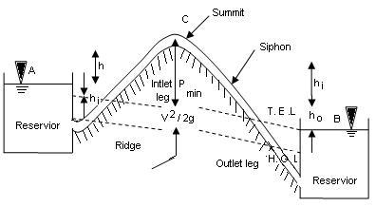
Vapor Pressure in Fluid Mechanics
When the liquid pressure is dropped below the vapor pressure due to construction of a flow device or Fluid Machine, a flow phenomenon known as cavitation is initiated.
If water is accelerated from rest to about 15.5 m/s², its pressure drops by about 101 kPa.
This is known as cavitation.

Slide 30



Cavitation & Highspeed Submarines

Slide 31



Cavitation & Highspeed Submarines
$$p_{local}$$
The dimensionless parameter describing flow-induced boiling is the cavitation number
$$Ca=\frac{p_{local}−p_{v}}{\frac{1}{2}ρV_{1}^{2}}$$

Slide 32




Broad Classification of Forms of Energy
Energy
Potential Energy
Kinetic Energy
Microscopic Potential Energy
Macroscopic Potential Energy
Microscopic Kinetic Energy
Macroscopic Kinetic Energy
Sum of Microscopic Potential and Kinetic Energies
$$Internal \text{Energy}\text{, }U$$
$$\text{Gibbs} \text{Free} \text{Energy}\text{, }G$$
$$Enthalpy,H$$
$$\text{Helmholtz} \text{Energy}\text{, }Ω$$

Slide 33



The Principle of Dimensional Homogeneity
In Fluid Mechanics and in any general engineering and science;
All equations must be dimensionally homogeneous.
Each additive term in an equation must have the same dimensions.
Each term of this equation signifies energy of fluid parcel per unit volume
Each term of this equation signifies energy of fluid parcel per unit mass.
Each term of this equation signifies head equivalent of energy.

