Slide 1


Fluid Properties Responsible for Non-inertial Forces-2
P M V Subbarao
Professor
Mechanical Engineering Department
Forces Unequivocally Related to Molecular Mechanics

Slide 2


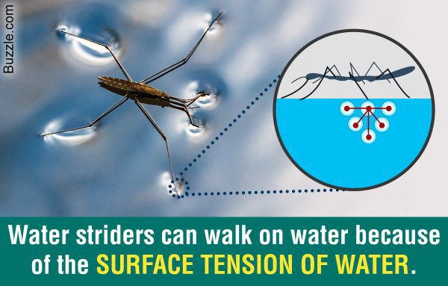


A mysterious Property to Generate Non-Inertial Force in Fluids

Slide 3
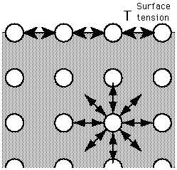
Surface Tension of Liquids
Molecules at the surface loose the complete spherical symmetry and hence less dense to attract each other.
Molecules deep within the liquid will have spherical symmetry of cohesive forces among each other because of their close packing.

Slide 4

Surface Tension of Fluids
The attraction creates a force on the surface that tries to minimize its area.
Since half of their neighbors are missing, the mechanical effect is that the surface is in tension.
This surface effect in fluid mechanics is accounted with the concept of surface tension.

Slide 5
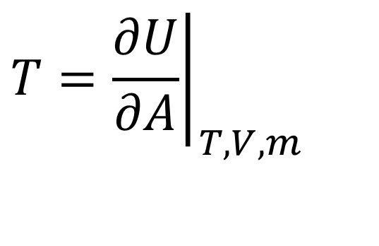
Energy Perspective of Surface Tension
The relative change in internal energy of a control mass w.r.t. change in surface area at constant temperature, volume.
$$T={\left.\frac{∂U}{∂A}\right|}_{T,V,m}$$
Law of a Nature:
The tendency to minimize surface energy is a defining factor in the morphology and composition of surfaces and interfaces.
This Is important for Liquids.

Slide 6
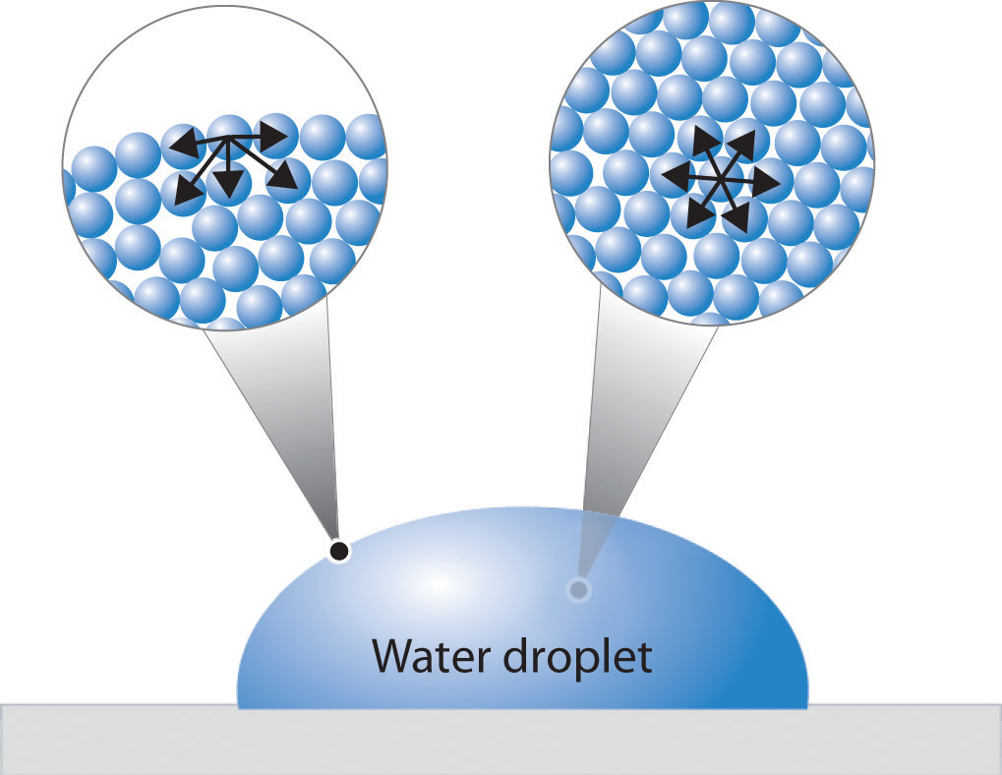
Values of Surface Energy for Selected Materials
Material | gJ/m²
Tungsten (solid) | 2.9
Iron (solid) | 2.2
Iron (liquid) | 1.9
MgO | 1.2
Mercury (liquid) | 0.5
Water | 0.07
Acetic acid | 0.03
Nitrogen (liquid) | 0.01
Helium (liquid) | 0.0003
Volatility decreases with increase in surface energy

Slide 7
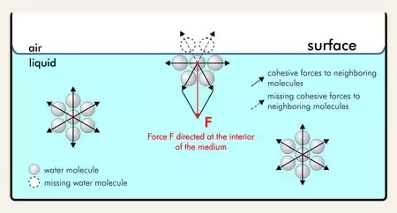
Surface Tension between A Liquid & A Gas
A liquid, being unable to expand freely, will form an interface with a second liquid or gas.
Fluid mechanics of surface tension have several applications in modern biology, cooling of highspeed electronics…….

Slide 8
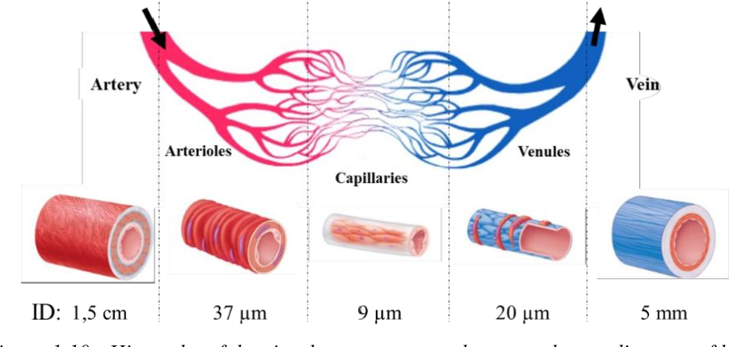
Analogical Study of Surface Tension
Blood vessels are made of soft material and carries high pressure blood wrt their ambience!

Slide 9
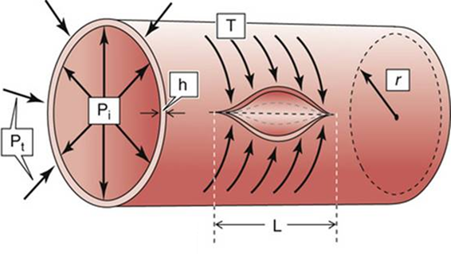
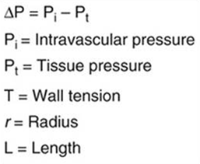
Physiological Fluid Mechanics of Blood Vessels

Slide 10
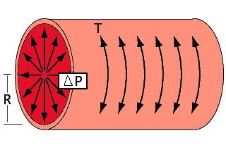
Surface Tension in Blood Vessels
A section of blood vessel is modelled as a cylinder of radius R and length L.
The wall supplies an inward force, and the blood supplies an outward pressure.
Infinitesimal work purporting to be done by blood on vessel:
This is known as Distending work.
$$δW=Δp×dV=Δp×2πrLdr$$

Slide 11
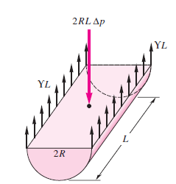
Surface Tension in Blood Vessels
The Distending work.
$$δW_{dist}=Δp×dV=Δp×2πrLdr$$
This work is stopped by the work of the constricting force (T)is done over a displacement in the circumferential axis.
σL
σL
$$δW_{cons}=T×dA=T×2πrdr$$
The work in this case is virtual!
Based on the principles of virtual work and conservation of energy—at equilibrium—the distending work is the same as the constricting work.
The constriction force has the magnitude surface tension of the blood vessel material!

Slide 12
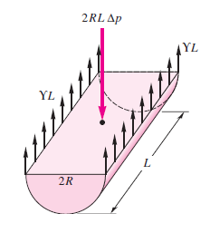

Fluid Pressure-Surface Tension in Curved Surfaces
σL
σL
The pressure increase in the interior of a liquid cylinder/sphere
is balanced by two surface-tension forces:
$$2RL∆p=2σL$$
$$∆p=\frac{σ}{R}$$

Slide 13
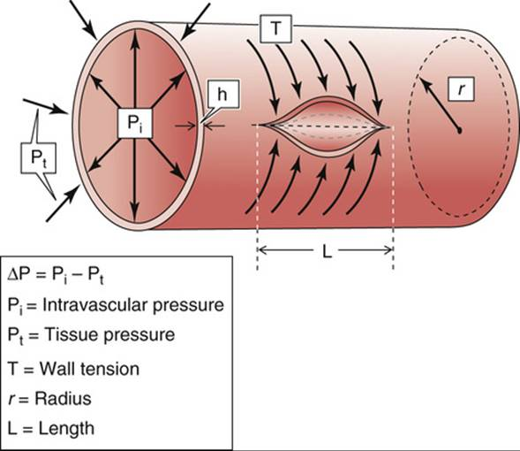
Geometry of Actual Blood Vessel and Surface Tension
$$2RL∆p=4σL$$
$$∆p=\frac{2σ}{R}$$

Slide 14
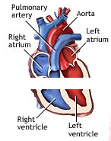
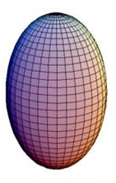
Bio-fluid Mechanics and Surface Tension in Complex Organs

Slide 15
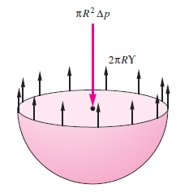
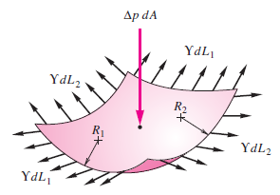
Fluid Pressure & Surface Tension in Curved Surfaces
Spherical surface
2πσR
σdL₁
σdL₂
σdL₂
σdL₁
The general case of an arbitrarily curved interface whose principal radii of curvature are R₁and R₂.
The relation between surface geometry and pressure difference across the interface provides the key concept in understanding a large collection of phenomena in physiology & hydrostatics.

Slide 16
Fluid Pressure Surface Tension in Curved Surfaces
Spherical Organ
2πσR
σdL₁
σdL₂
σdL₂
σdL₁
The Young -Laplace equation combines the physical intuition of Thomas Young (1805) with the mathematical brilliance of Pierre-Simon Laplace (1806) to link the curvature of a fluid surface to the pressure jump across it.
The equation embodies a foundational concept in the study of fluids.

Slide 17


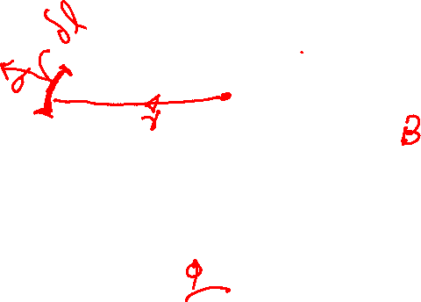
Fluid Pressure Surface Tension in Curved Surfaces
D
P
A
D
C
R₁
R₂
φ
At the point A, an element δl of the boundary line is subjected to a force σδl!?!?
N

Slide 18
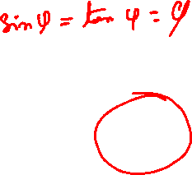
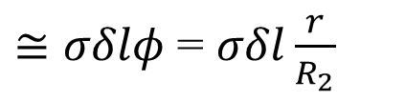

Fluid Pressure Surface Tension in Curved Surfaces
Consider projection of the force σδl along the normal PN:
D
P
r
A
$$σδlsinφ$$
D
For small radius, r
C
R₁
R₂
φ
$≅σδlφ$ = $σδl\frac{r}{R_{2}}$
N

Slide 19
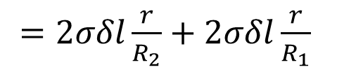
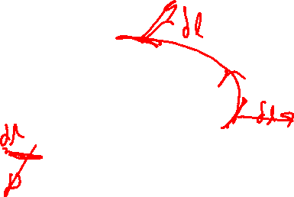
Fluid Pressure Surface Tension in Curved Surfaces
D
P
r
A
D
C
R₁
Consider three more elements of δl along the boundary line at B, C, D.
The sum of projections of forces A,B, C, and D along PN is they will contribute with a force of
R₂
φ
N
$=2σδl\frac{r}{R_{2}}+2σδl\frac{r}{R_{1}}$

Slide 20
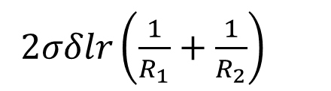
Fluid Pressure Surface Tension in Curved Surfaces
D
P
$2σδlr\left(\frac{1}{R_{1}}+\frac{1}{R_{2}}\right)$
r
A
D
Above sum is independent of choice of elements.
C
R₁
R₂
φ
N
Euler Theorem: The sum of the curvatures of two orthogonal normal sections is constant and equal to the sum of the curvatures of the principal sections.

Slide 21
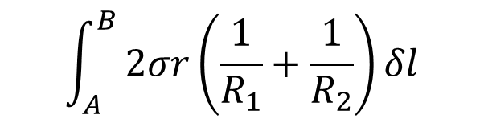
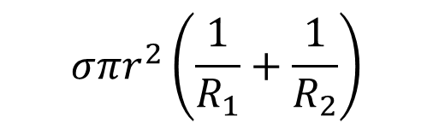
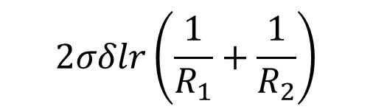
Fluid Pressure Surface Tension in Curved Surfaces
D
$$2σδlr\left(\frac{1}{R_{1}}+\frac{1}{R_{2}}\right)$$
P
r
A
D
C
R₁
R₂
φ
Since four orthogonal elements are considered, the integration is made over one quarter of a revolution to give
N
$$\int_{A}^{B}{2σr\left(\frac{1}{R_{1}}+\frac{1}{R_{2}}\right)δl}$$
$$σ{πr}^{2}\left(\frac{1}{R_{1}}+\frac{1}{R_{2}}\right)$$

Slide 22
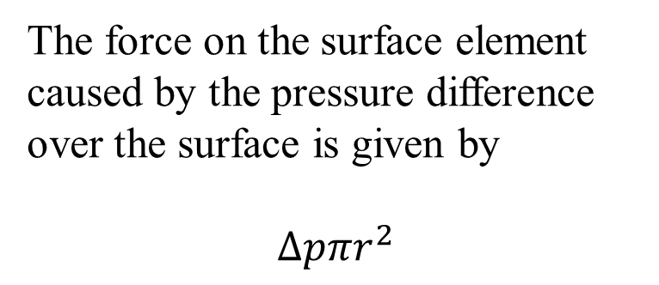
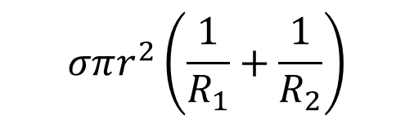
Fluid Pressure Surface Tension in Curved Surfaces
$$σπr^{2}\left(\frac{1}{R_{1}}+\frac{1}{R_{2}}\right)$$
D
P
r
A
D
C
R₁
The force on the surface element caused by the pressure difference over the surface is given by
$$∆pπr^{2}$$
R₂
φ
N

Slide 23
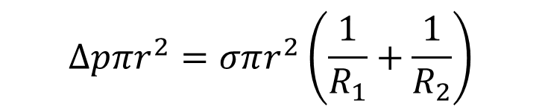
Fluid Pressure Surface Tension in Curved Surfaces
$$σπr^{2}\left(\frac{1}{R_{1}}+\frac{1}{R_{2}}\right)$$
D
P
r
A
D
C
R₁
R₂
The Young-Laplace equation is the condition for equilibrium and existence of a curved surface and written as:
φ
N
$$∆pπr^{2}=σπr^{2}\left(\frac{1}{R_{1}}+\frac{1}{R_{2}}\right)$$

Slide 24

Fluid Pressure Surface Tension in Curved Surfaces
D
P
r
A
D
C
R₁
R₂
The Young-Laplace equation is
φ
$$\frac{∆p}{σ}=\left(\frac{1}{R_{1}}+\frac{1}{R_{2}}\right)$$
N

