Slide 1


Fluid Properties Responsible for Non-inertial Forces-1
P M V Subbarao
Professor
Mechanical Engineering Department
Forces Unequivocally Related to Molecular Mechanics

Slide 2


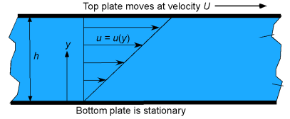

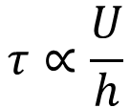
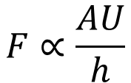
Shearing of a Fluid System
Remember that maintaining a velocity gradient and the shear stresses in a fluid requires continuous application of a force; if the force were to stop, the shear stresses would become zero.
Maintaining this gradient requires the application of a force!
Plate experiences zero acceleration for any value of Force F!
$$F∝\frac{AU}{h}$$
The shear stress (tangential force per unit area of the plate), τ
$$τ∝\frac{U}{h}$$

Slide 3
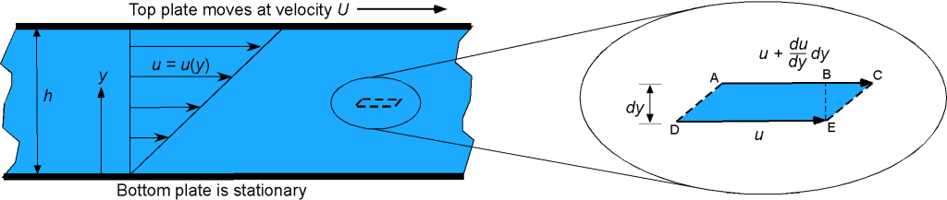
Classic Fluid Flow Application of Viscosity
To explain this previous point further, consider a fluid element as it flows in a fluid with a velocity gradient, as shown in the right-side figure above

Slide 4
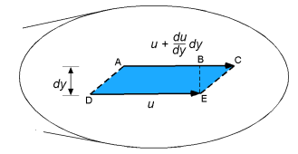
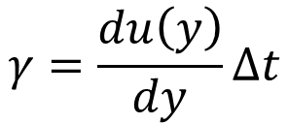
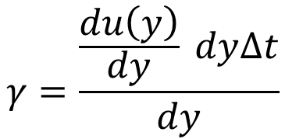
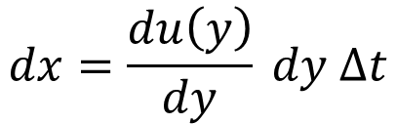
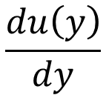
Classic Fluid Flow Application of Viscosity
As the upper surface of the element is moving faster than the lower surface,
$$\frac{du\left(y\right)}{dy}$$
The velocity gradient, is positive.
So, over some time, dt the upper AC surface will travel further than the lower surface DE by a distance
The strain , γ is defined as
$$dx=\frac{du\left(y\right)}{dy} dy ∆t$$
$$γ=\frac{\frac{du\left(y\right)}{dy} dy∆t}{dy}$$
$$γ=\frac{du\left(y\right)}{dy}∆t$$

Slide 5
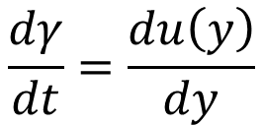
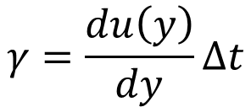
Classic Fluid Flow Application of Viscosity
$$γ=\frac{du\left(y\right)}{dy}∆t$$
$$\frac{dγ}{dt}=\frac{du\left(y\right)}{dy}$$
For an infinitesimal time, dt

Slide 6

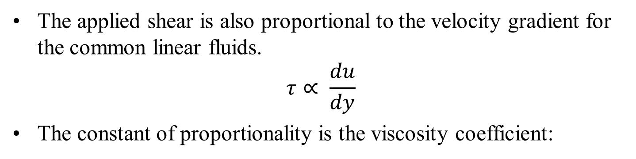

Modern Statement of Newtons Law of Viscosity
The applied shear is also proportional to the velocity gradient for the common linear fluids.
$$τ∝ \frac{du}{dy}$$
The constant of proportionality is the viscosity coefficient:
$$τ=μ \frac{du}{dy}$$
This equation must be dimensionally homogeneous.
This conditions gives dimensions of viscosity as stress–time: {FTL⁻² } or {M(LT⁾⁻¹}, with units as Pa.s.
The linear fluids that follow above equation are called Newtonian fluids, after Sir Isaac Newton, who first postulated this resistance law in 1687

Slide 7
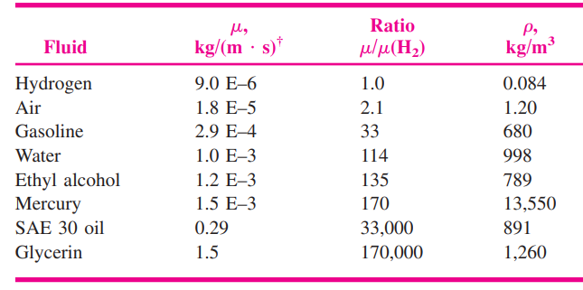
Viscosity : A Thermodynamic Property
The viscosity of Newtonian fluids is a true thermodynamic property and varies with temperature and pressure.
Also known as absolute viscosity or dynamic viscosity.
At a given state (p, T) there is a vast range of values among the common fluids.

Slide 8
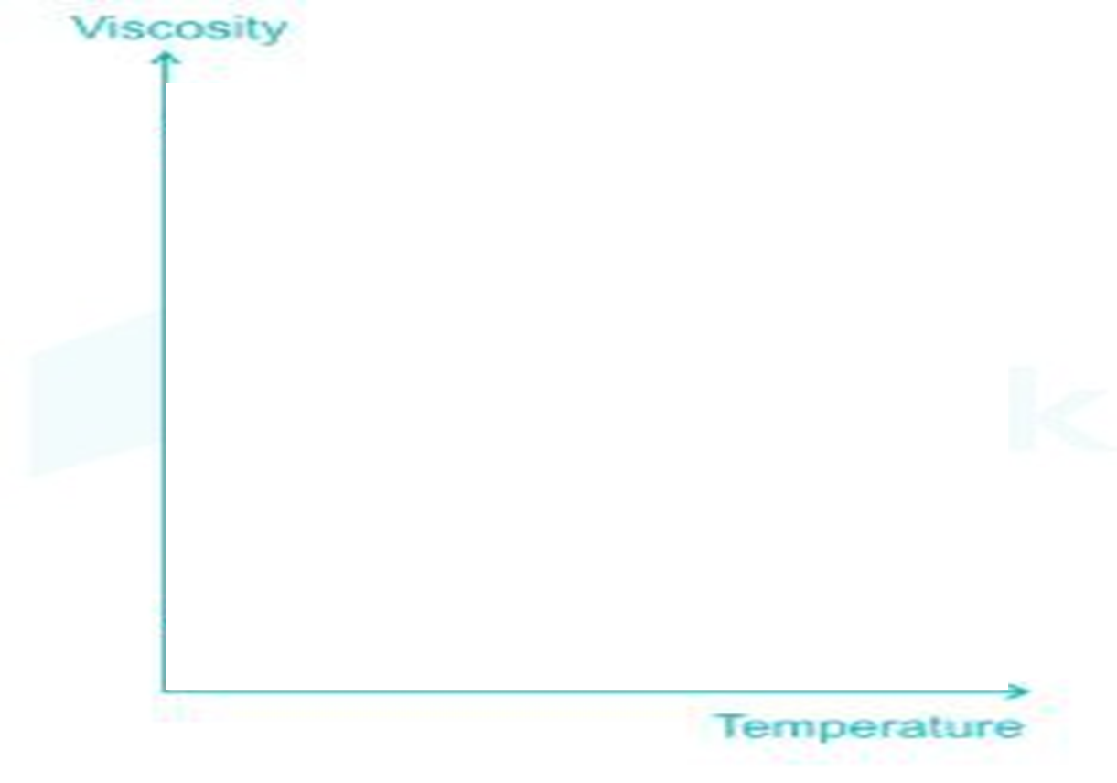
Effect of Temperature on Viscosity of Fluids
Liquids
Gases

Slide 9
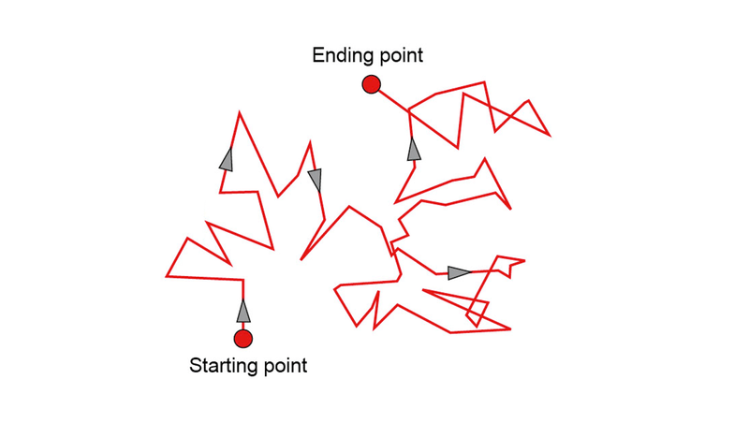

Random Walk Driven by Thermal Energy
Viscosity can be defined by considering individual particles undergoing Brownian motion in a fluid media.
Brownian motion is described as an effective random walk of each individual particle driven by thermal energy.

Slide 10
Microscopic View of Viscosity of Fluids
The molecular theory attempts to explain the viscosity using three main factors….
S.No | Details of A Factor | Significance in Liquids | Significance in Gases
1. | The distribution of the nearest molecules surrounding a given molecule and the other. | Very High | Significant
2. | The intermolecular potential between this pair of molecules. | Very High, Attractive Force | Zero to mild attractive /repulsive forces
3. | Fluid molecules always move in a random order with a finite value of average travel distance. | Mild or less Significant. | High

Slide 11
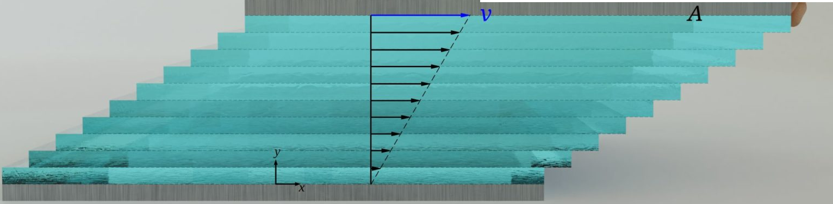
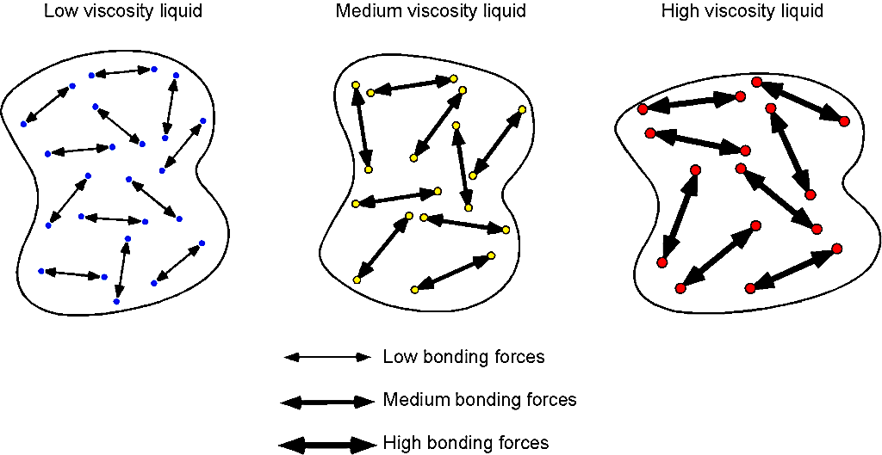
Microscopic View of Viscosity of Liquids
If two adjacent layers of fluid move with different velocities, each will tend to drag the other due to this intermolecular attraction.
F

Slide 12
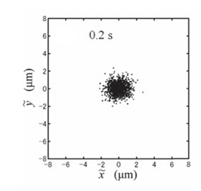
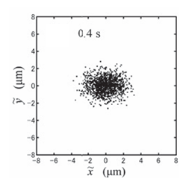
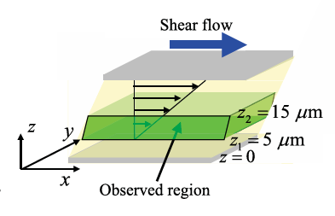
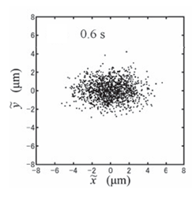
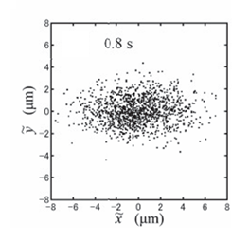
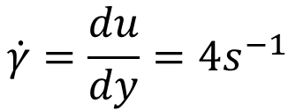
Brownian Motion under A Strain Rate
$$\dot{γ}=\frac{du}{dy}=4s^{−1}$$

Slide 13
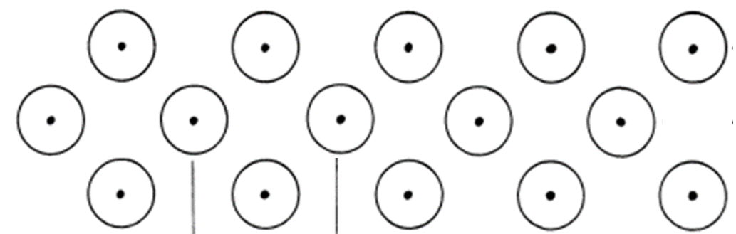

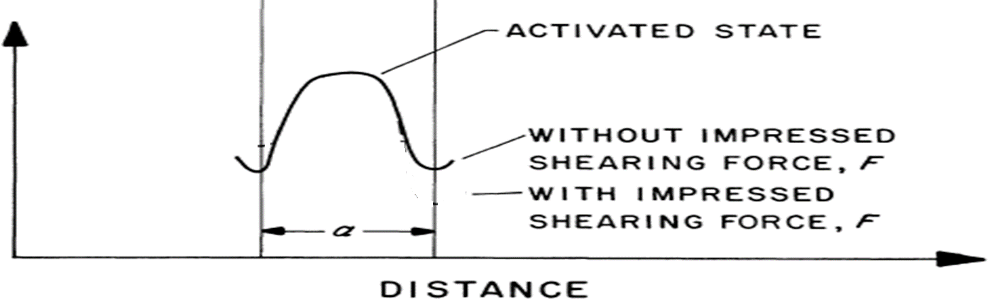
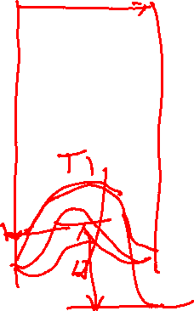
Rate Process Theory of Viscosity of Liquids
F
Potential energy

Slide 14
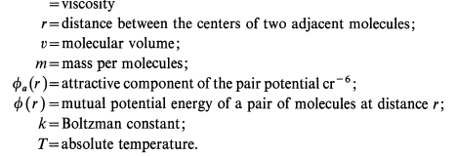

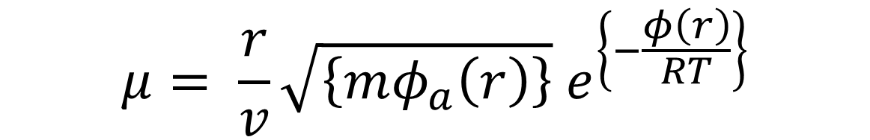
Microscopic View of Viscosity of Liquids
The molecular theory-based expression for viscosity:
$$μ= \frac{r}{v}\sqrt{\left\{mφ_{a}\left(r\right)\right\}}{ e}^{\left\{−\frac{φ\left(r\right)}{RT}\right\}}$$
$$μ$$
F

Slide 15
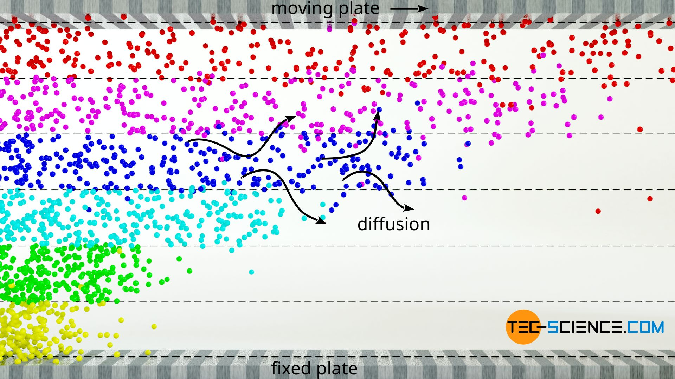
Microscopic View of Viscosity of Gases
Consider a gas system between a fixed and movable plates.
Initially both the plates are stationary.
Apply a force F on top plate at time t=0
F

Slide 16
Microscopic View of Viscosity of Gases
The slowing down effect of fluid layers in gases is mainly due to the momentum transfer of the gas molecules when they diffuse from a slower layer into a faster layer.
This process also takes place in liquids, but it is negligible compared to the decelerating effect due to the intermolecular forces.
F
https://www.tec-science.com/wp-content/uploads/2020/09/en-gases-liquids-fluid-mechanics-viscosity-ideal-gas-momentum-transfer.mp4

Slide 17
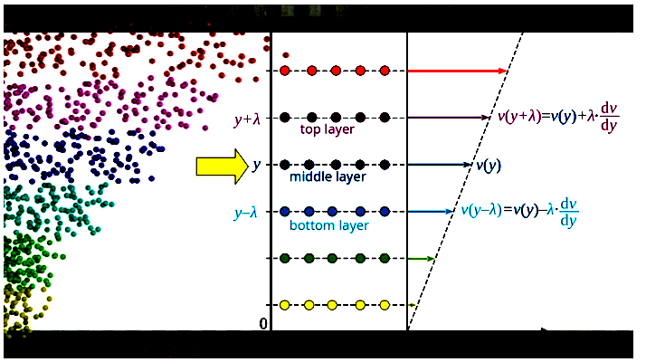
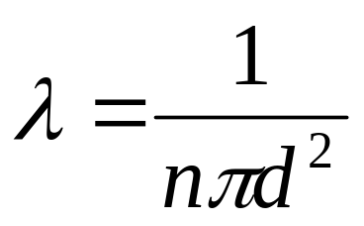
Microscopic View of Viscosity of Gases
F
$$μ=2{\dot{n}}_{A}mλ$$
Viscosity of ideal gases:
https://www.tec-science.com/thermodynamics/kinetic-theory-of-gases/viscosity-of-an-ideal-gas/

Slide 18
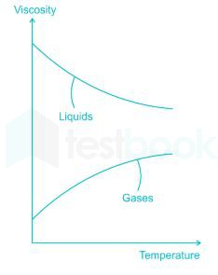
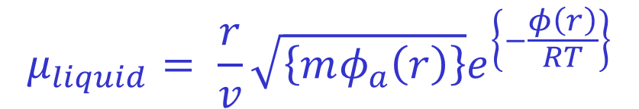

Effect of Temperature on Viscosity of Fluids
$$μ_{liquid}= \frac{r}{v}\sqrt{\left\{mφ_{a}\left(r\right)\right\}}e^{\left\{−\frac{φ\left(r\right)}{RT}\right\}}$$
Liquids
$$μ_{gas}=2{\dot{n}}_{A}mλ$$
Gases

Slide 19

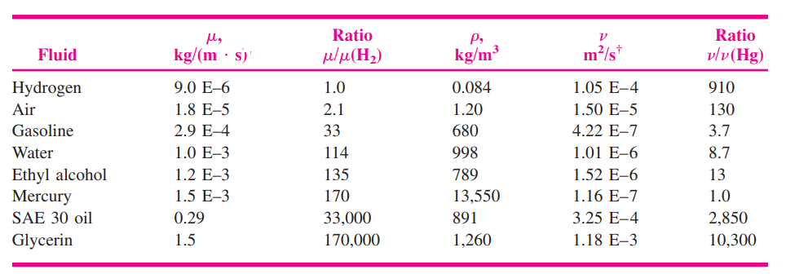

Reynolds View of Viscosity
Kinematic Viscosity
Why should mass be included in lubricity characteristics of Fluid?

Slide 20
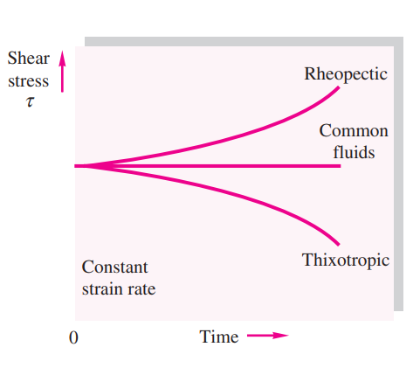
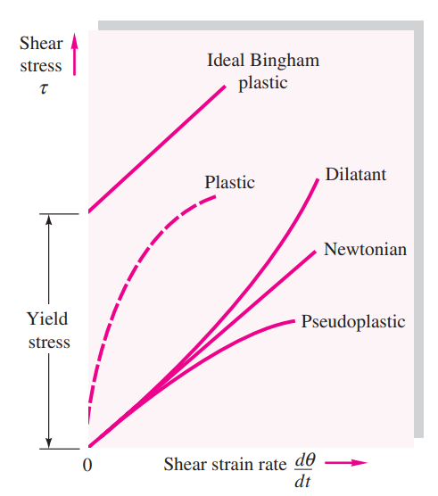

Nonnewtonian Fluids
Fluids that do not follow the linear law of viscosity are called nonnewtonian and are treated in books on rheology

Slide 21
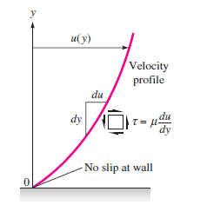
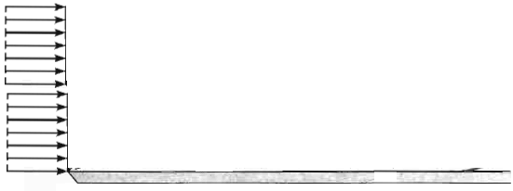
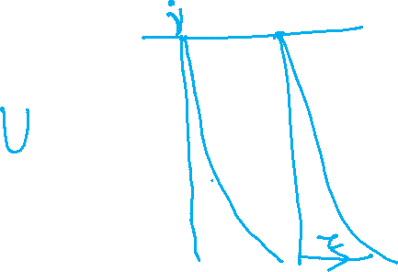
Viscosity as A source of Velocity Distribution
The strain angle θ(t) created due to viscosity is not the main concern in fluid mechanics.
Viscosity is considered as another source of velocity distribution or normal velocity gradients.
Shear stress is proportional to the slope of the velocity profile and is greatest at the wall.

Slide 22
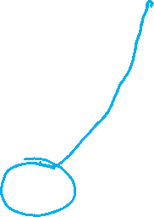
Wall and Flow Interactions
At the wall, the velocity u is zero relative to the wall.
This is called the no-slip condition.
This is a characteristic of viscous (real) fluid flows at low Kn.

