Slide 1

Criteria for Validity of Continuum in Fluid Mechanics
P M V Subbarao
Professor
Mechanical Engineering Department
Suitable Condition to Define Macroscopic Properties of A Fluid Systems…

Slide 2


How to decide the value of smallest valid size of the fluid parcel for Continuum Approach?
How to develop a criteria?
Any reference size?

Slide 3

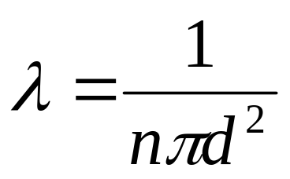
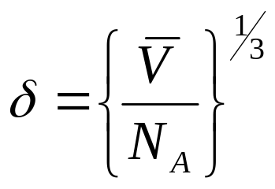
A Reference Microscopic Flow Dimension
Mean Free Path is identified as the smallest dimensions of gaseous Flow.
MFP is the distance travelled by gaseous molecules between collisions.
Lattice Spacing is identified as the smallest dimensions of liquid Flow.
Mean free path :
Lattice Dimension:
d : diameter of the molecule
V is the molar volume
N_{A} : Avogadro’s number.
n : molar density of the fluid, number molecules/m³

Slide 4
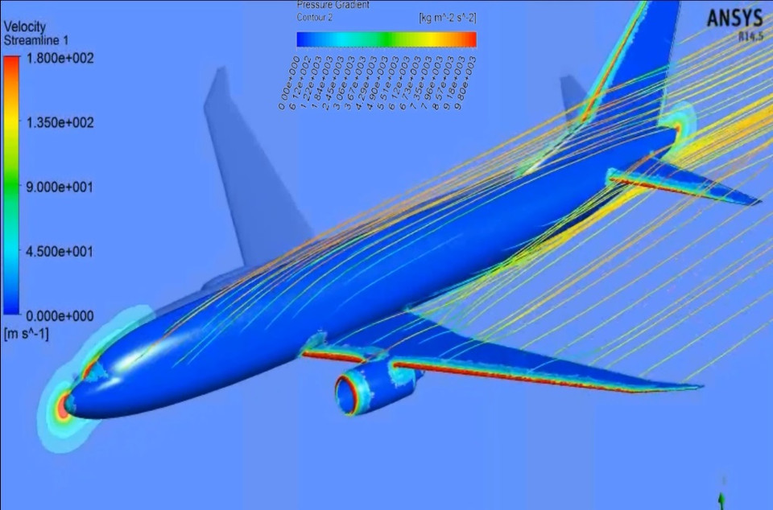
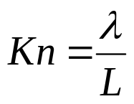
Condition for the Validity of Continuum Approach
Average size of the system being studied: L
Knudsen defined a non-dimensional distance as the ratio of mean free path of the gas to the characteristic dimension of the system.
This is called “Knudsen number”

Slide 5
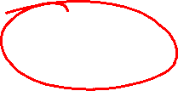
Classification of Flow Regimes
Based on the Knudsen number magnitude, flow regimes can be classified as follows :
Continuum Regime : Kn < 0.001
Slip Flow Regime : 0.001 < Kn < 0.1
Transition Regime : 0.1 < Kn < 10
Free Molecular Regime : Kn > 10

Slide 6
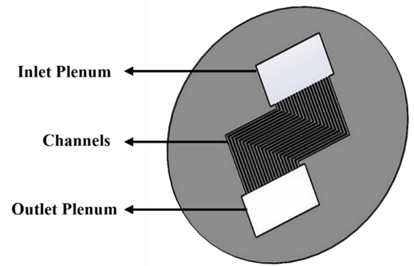

My Research on Slip Flow Regime
Optical images of the microchannel
Knudsen number 0.0662 to 0.0805
Devices | Dimensions L (µm) W (µm) H (µm) | Aspect ratio No. of channels
Wafer 1 | 25200 393.96 1.03 | 0.0026 20
Uncertainty: ± 1 ± 0.005
Maximum Surface roughness : 9.57 (± 0.01) nm

Slide 7
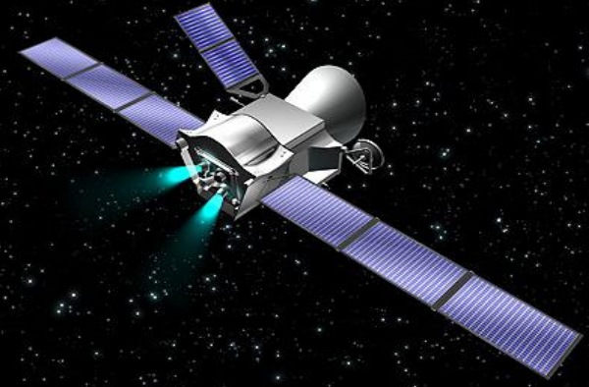
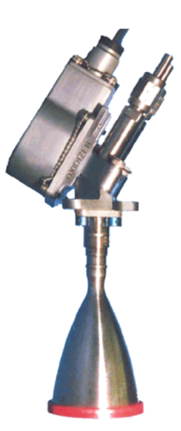
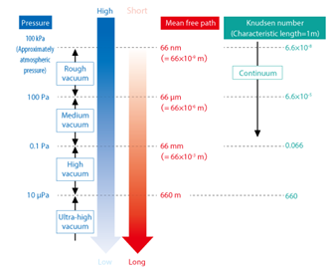
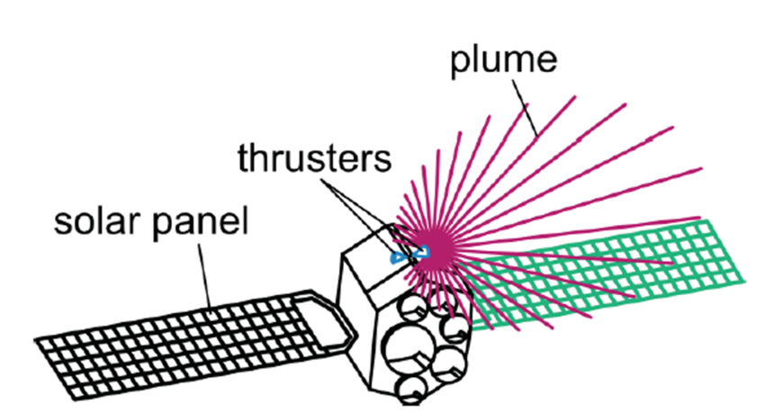
Micro-thrusters For Artificial Satellites
A thruster is a spacecraft propulsion device used for orbital station-keeping, attitude control, or long-duration, low-thrust acceleration.

Slide 8
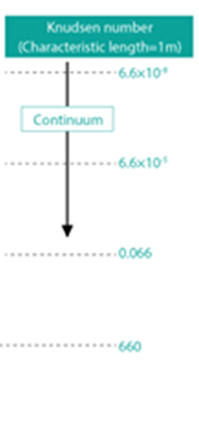
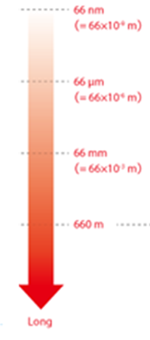
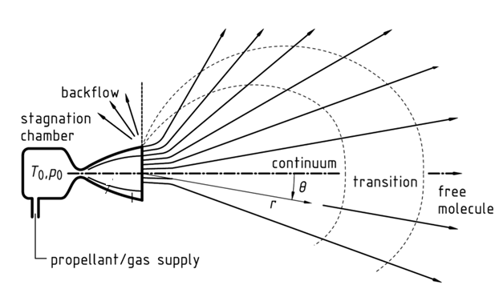
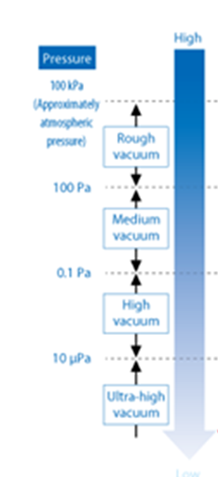
Typical plume flow regimes of Micro thruster in vacuum
https://epic-src.eu/wp-content/uploads/EP-Activities-at-ESA-EPIC-2018-Munich.pdf

Slide 9
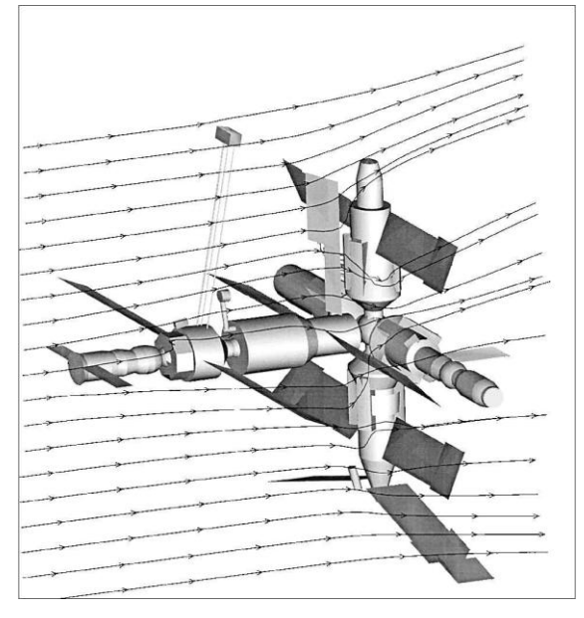
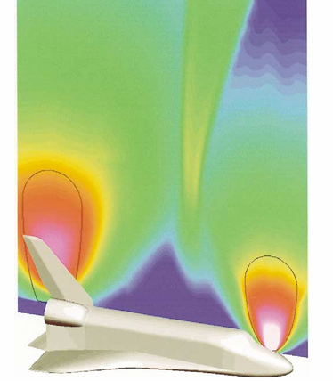
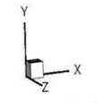
Plume Flow Filed Around a Space Station
Mir space station
Manufacturer: Energia
Orbit height: 358 km
Speed on orbit: 7.69 km/s
Plume flow fields are generated by space Shuttle.

Slide 10
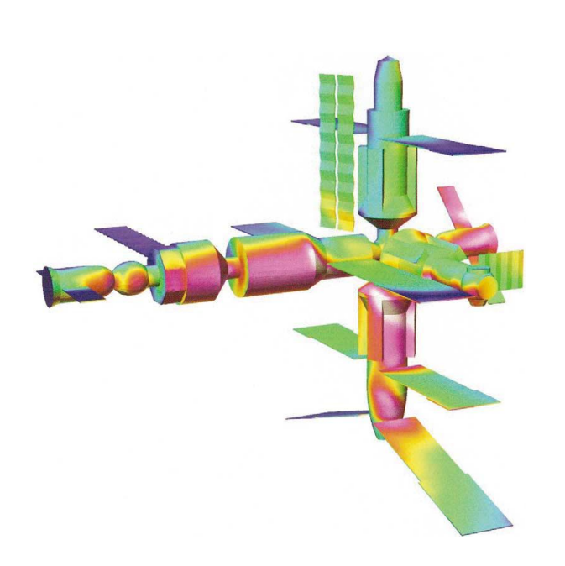
Plume Flow Filed Generated By A Space Shuttle & Forces on A Space Station
Mir space station
Molecular Dynamic Simulations are used for Estimation of Impingement Loads on Space Station is essential for control operations.
Surface pressure on Mir space station

Slide 11
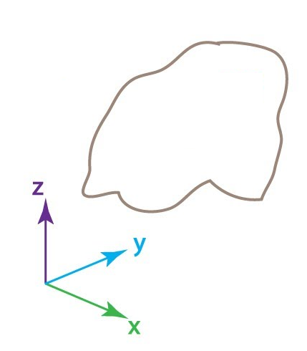
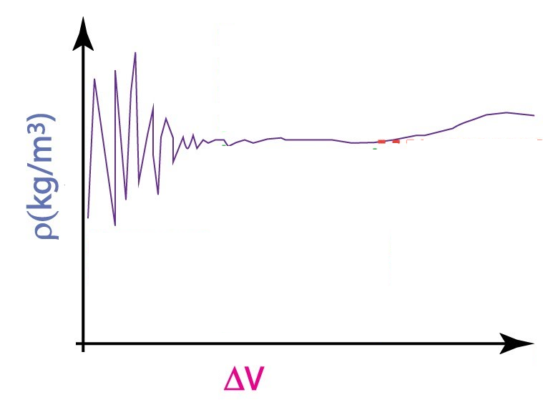
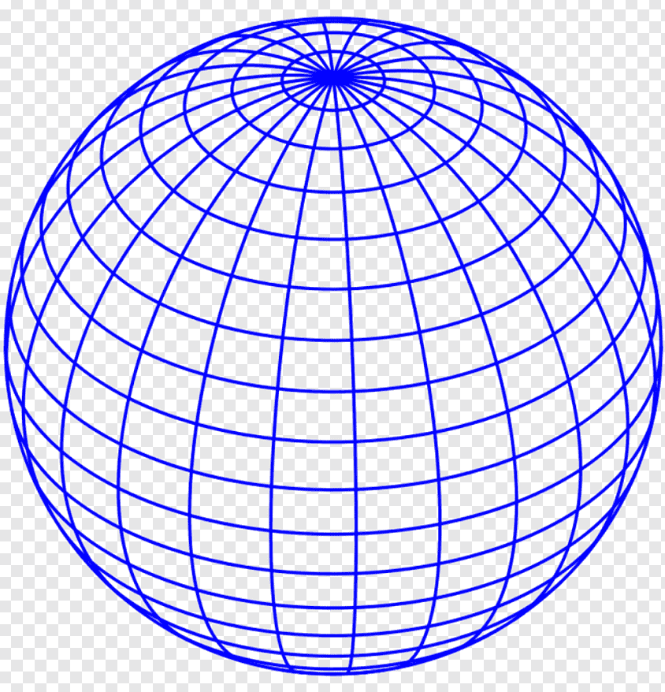


Scope of Our Course
Density is a measure of the amount of mass per unit volume of a substance.
Definition of Density:
Estimation of Density at a point in a fluid:
Fluid System
$$ρ\left(x,y,z \right)=\lim_{∆V→valid value}\frac{∆m}{∆V}$$
$$∆V$$
Kn < 0.001

Slide 12

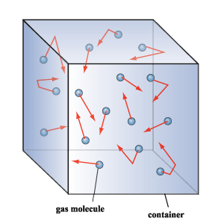
Continuum Approach:
Temperature of a Fluid/solid at a Point.
Microscopic analysis of Engineering (Macroscopic) View & Continuum Approach
Fluid Molecules

Slide 13
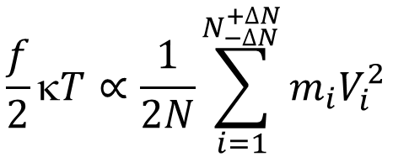
Temperature and Microscopic Kinetic Energy
Boltzmann Equation by Maxwell:
For a fluid inside a valid size of volume (as a point):
Absolute Kelvin Temperature is proportional to average kinetic energy of atoms in a system containing ideal gas.
When N number of atoms/molecules with f number of DoF collide, they tend on the average, to equalize kinetic energy spreads equally over all atoms.
This is called thermal equilibrium.

Slide 14
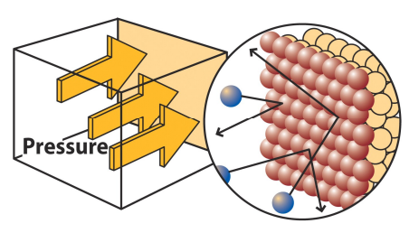
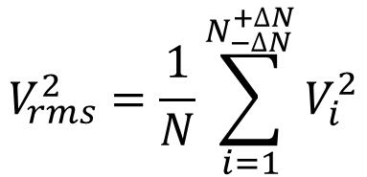
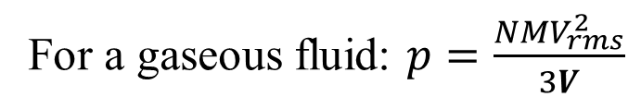
Fluid Pressure
A fluid contained in a vessel exerts a pressure on its walls.
The microscopic origin of pressure is collisions that occur between fluid molecules and the walls of the vessel in which they are contained.
A microscopic picture of pressure:
p is related to the molar mass (M) and the squared average velocity (v²_{rms}) of the fluid particles:
$$V_{rms}^{2}=\frac{1}{N}\sum_{i=1}^{N_{−∆N}^{+∆N}}{V_{i}^{2}}$$
For a gaseous fluid: $p=\frac{NMV_{rms}^{2}}{3V}$

Slide 15
Thermodynamic, Transport & Kinematic Properties of a Fluid
The three most common thermodynamic properties:
Density, Temperature and Pressure
These three are regular companions of the velocity vector in flow analyses.
Four derived thermodynamic properties
Internal energy, Enthalpy, Specific heats cp and cv
Two important derived Transport Properties:
Coefficient of viscosity and Thermal conductivity
The three most common kinematic properties:
Displacement, Velocity & Acceleration.

Slide 16
Density, Specific Weight & Specific Gravity
A mass will have a weight W on planets, Satellites…..
Weight is (Only) the means of measuring mass!
The specific weight of a fluid: Weight per unit volume.
Density and specific weight are simply related by gravitational acceleration (gravity) on any planet/satellite.
Mass is essential to create inertia and hence acceleration!
Specific gravity, denoted by SG, is the ratio of a fluid density to a standard reference fluid, usually water at 4°C (for liquids) and air (for gases)

Slide 17
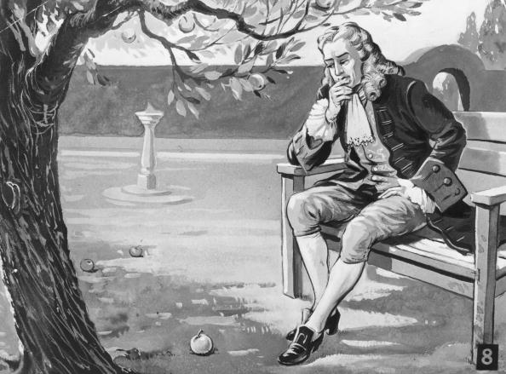
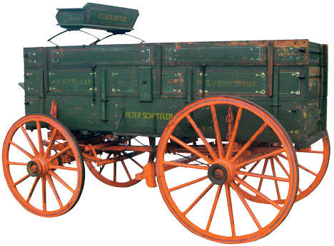
Newton: An Explorer of Force Creation???
Newton developed the theories of gravitation in 1666, when he was only 23 years old.
Some twenty years later, in 1686, he presented his three laws of motion in the
"Principia Mathematica Philosophiae Naturalis.“

Slide 18
Fluid Properties Responsible for Non-inertial Forces
Newton’s Search for More Forces for Human Development

Slide 19
Lubricity (Slipperiness) of Fluids
In 1687, Newton paid attention to fluid flow and proposed following hypothesis in latin:
In 1729, Andrew Motte translated this hypothesis as:
The resistance arising from the want of lubricity (lack of slipperiness) in the parts of a fluid, is, other things being equal, proportional to velocity with which parts of the fluid separated from one another.

Slide 20
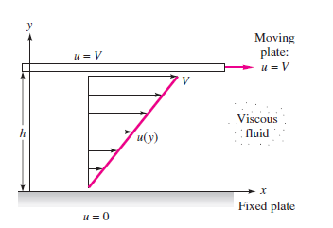
Newton’s View of the Strain in a Fluid
Newton performed experiments like that shown in the figure above with a fluid of depth h between a moving upper plate and a stationary lower plate.
A flow containing a velocity gradient in one direction with the velocity in the fluid increasing moving up from one point to another

Slide 21
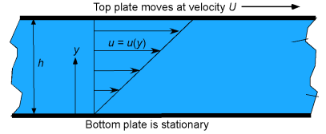
Shear Force in a Fluid
The upper (faster) layer draws the lower (slower) layer along through a force on the lower layer.
So, there must be a shear force in the fluid between the layers.
Simultaneously, the lower layer tends to retard the upper layer by an equal and opposite force

Slide 22
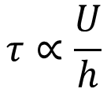
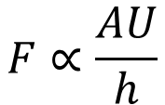
Shear in a Fluid
Remember that maintaining a velocity gradient and the shear stresses in a fluid requires continuous application of a force; if the force were to stop, the shear stresses would become zero.
Maintaining this gradient requires the application of a force!
Plate experiences zero acceleration for any value of Force F!
$$F∝\frac{AU}{h}$$
The shear stress (tangential force per unit area of the plate), τ
$$τ∝\frac{U}{h}$$

