Slide 1

Analysis of Flow in Supersonic Flights & Missiles
P M V Subbarao
Professor
Mechanical Engineering Department
Aerodynamic Shapes can Tame the Normal Shock for Better Use!!!

Slide 2


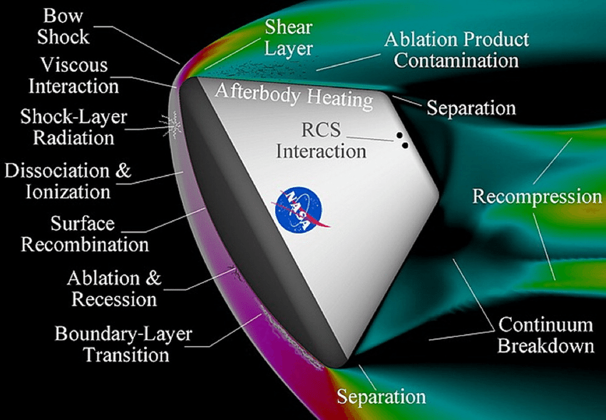
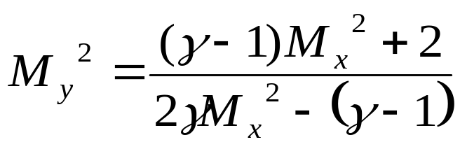
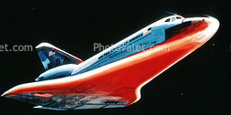
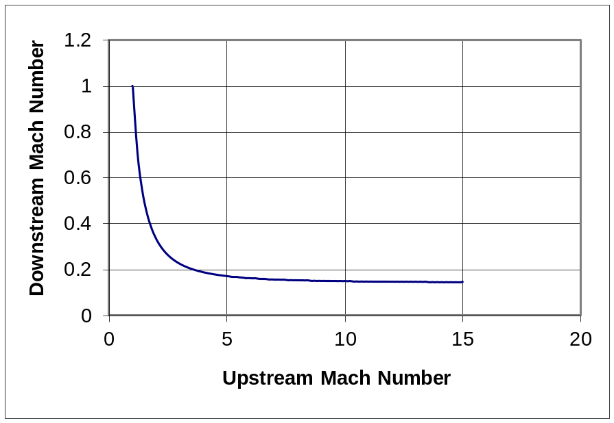
Flow Past High Angle Objects
x
y
Severity of the shock is proportional to Mach number of the flight !!!

Slide 3
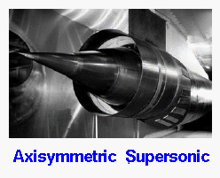
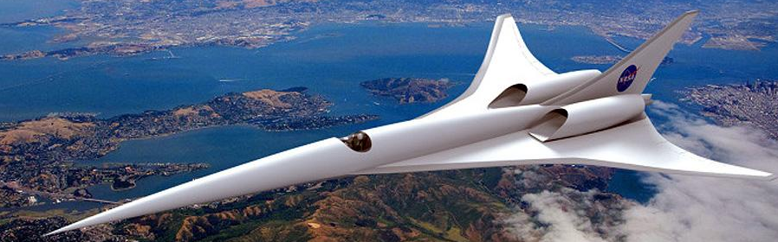
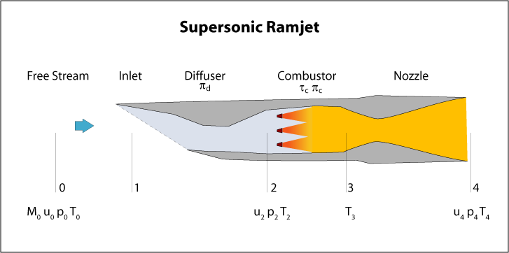
Supersonic Vehicles

Slide 4
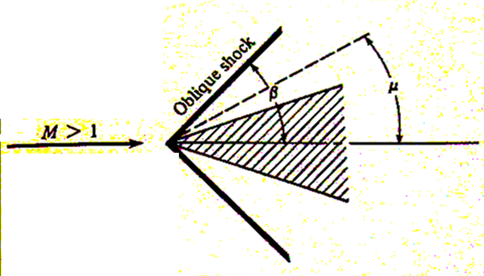



Oblique Shock Wave
• When supersonic object is smaller than a “bluff body”, shockwave can be weaker than NS but stronger than the Mach wave.
This is called as Oblique shock wave
$$β≥μ$$
$$β≥ θ$$
• θ -- turning angle or
“wedge angle”
β -- shock angle

Slide 5
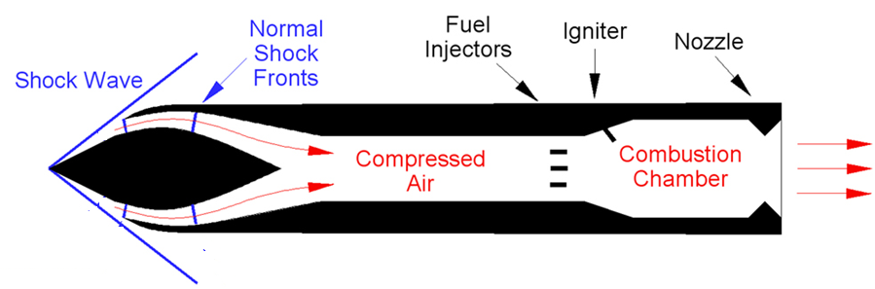
A Supersonic Ramjet (Missile)
x
y
What is the relation between x & y ???
What about another Thought Experiment ???

Slide 6
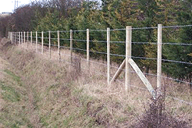
Oblique Shock is a Barbed Wire Fence
Tangential velocity is Constant across an oblique Shock wave…
Apply Normal Shock relations to only normal velocity ….

Slide 7
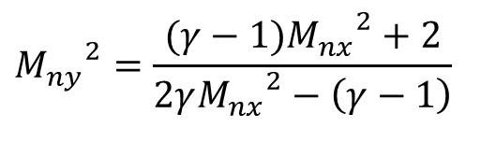
Geometrical Description of An Oblique Shock Wave
Oblique shock is a normal shock for Normal component of Upstream Flow
x
y
Mt_{x}
β
M_{x}
Mn_{x}=M_{x}sin(β )
$${M_{ny}}^{2}=\frac{(γ−1){M_{nx}}^{2}+2}{2γ{M_{nx}}^{2}−\left(γ−1\right)}$$
β−θ
Mn_{x}
M_{y}
Mt_{y} =Mt_{x}
M_{x}
Mn
y
β−θ
θ

Slide 8
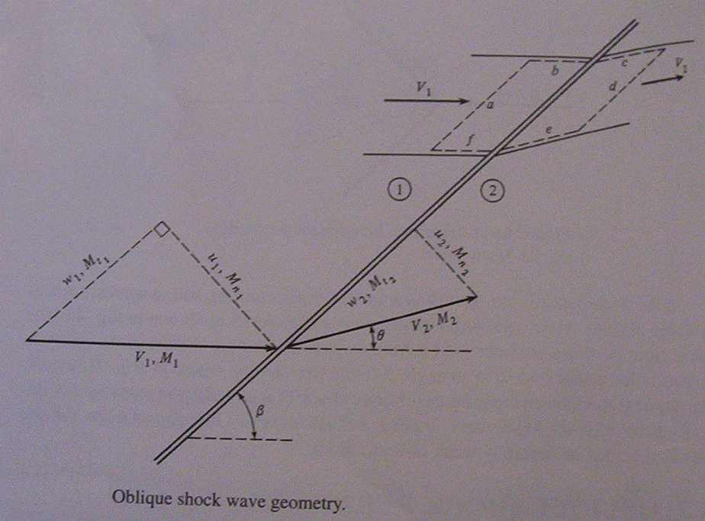
An oblique sock is a normal Shock to Normal Velocity Component
V_{x} & M_{x}
V_{y} & M_{y}
w_{x} & M_{tx}
u_{x} & M_{nx}
u_{y} & M_{ny}
w_{y} & M_{ty}
V_{y} & M_{y}
V_{x} & M_{x}
Mn_{x}=M_{x}sin(β )
Mt_{x}=M_{x}cos(β)
⎛
(
γ
−
1
)
⎞
⎜
1
+
M
n
2
⎟
⎝
2
x
⎠
M
n
=
(
)
y
⎛
γ
−
1
⎞
⎜
γ
M
n
2
−
⎟
⎝
x
2
⎠

Slide 9
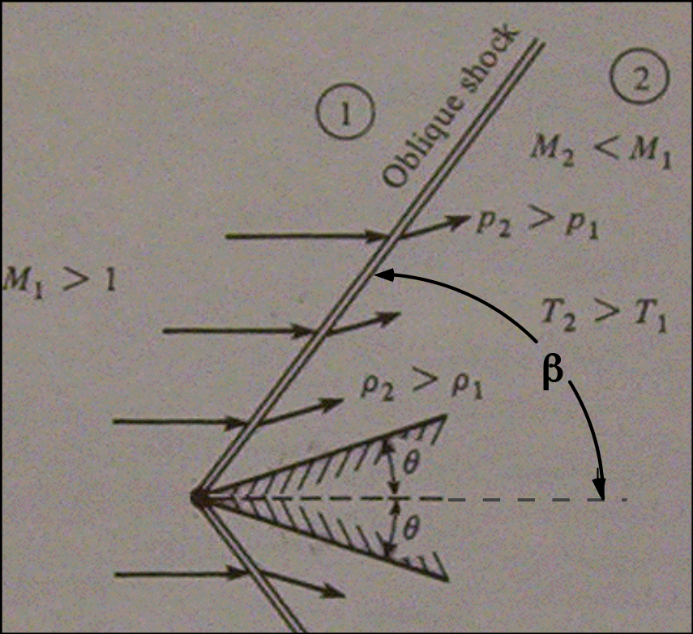





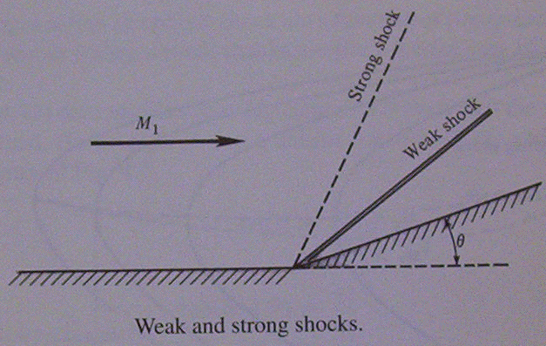


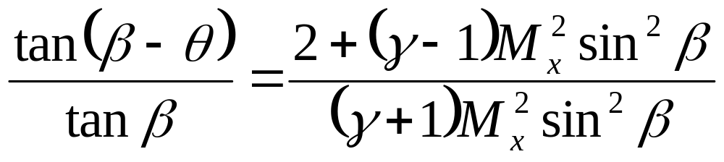
Determination of Oblique Shock Wave Angle
• Properties across Oblique Shock wave ~ f(M_{x}, β)
• θ is the geometric angle that “forces” the flow thru OS.
• Relate θ to β !?!?!
M_{x}

Slide 10

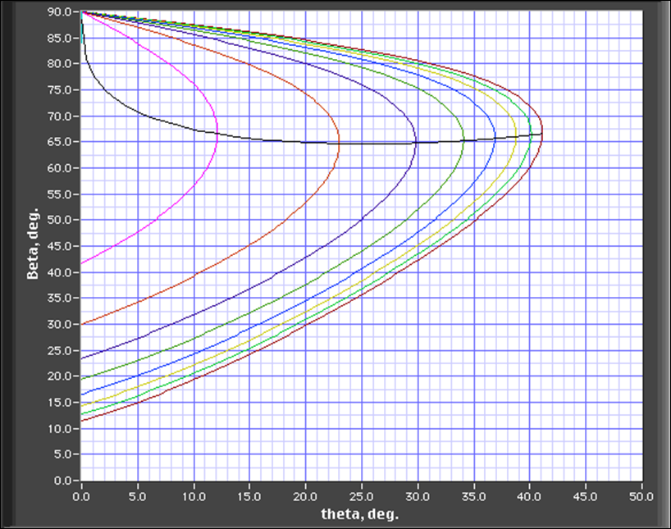
Oblique Shock Wave Angle Chart
M_{x}=5.0
_{max}
curve
M_{x}=3.0
M_{x}=1.5
M_{x}=2.0
M_{x}=2.5
M_{x}=4.0

Slide 11
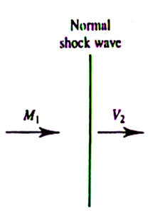
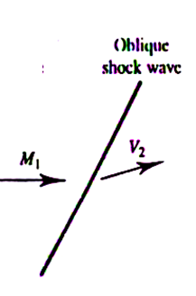
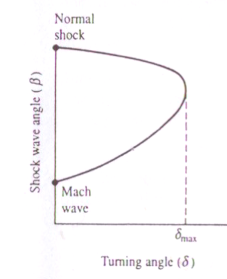
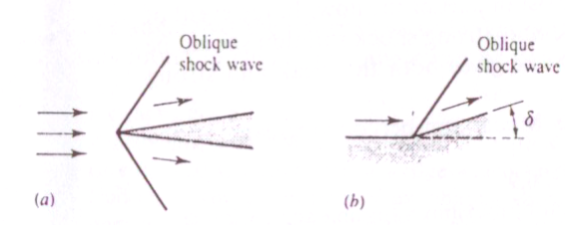
Limiting Cases of Oblique Shock Wave
θ_{max}
θ

Slide 12
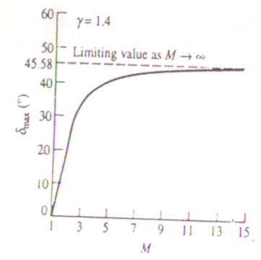
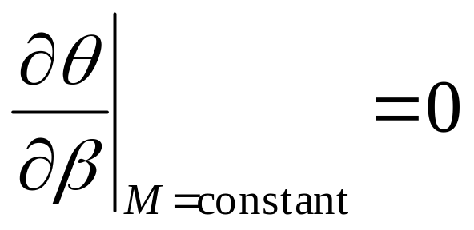
Maximum Turning Angle
θ_{max}

Slide 13
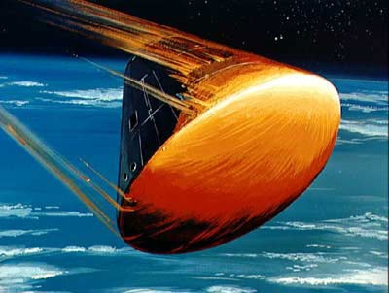
Highest Angle Objects

Slide 14
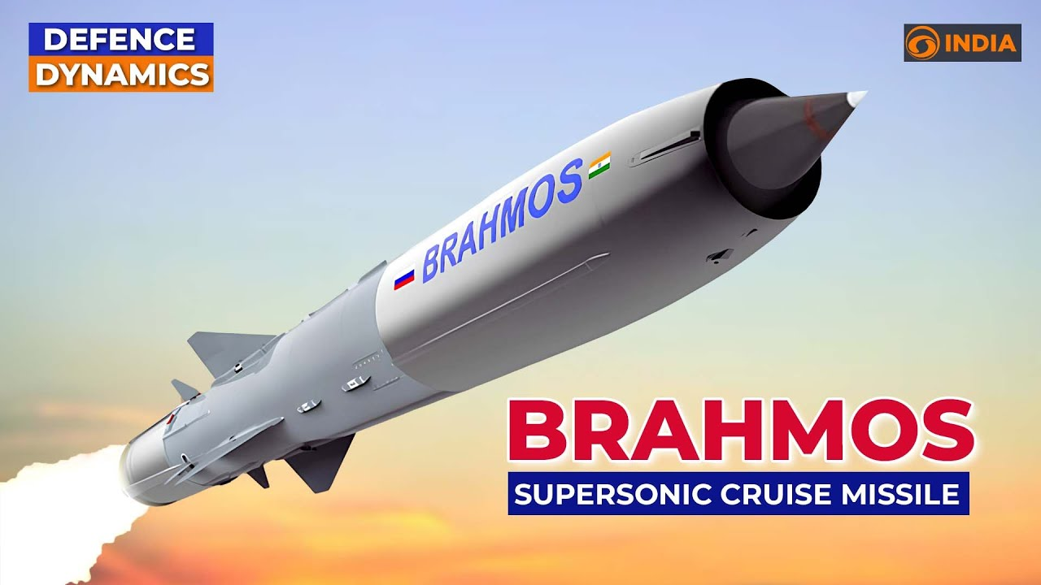
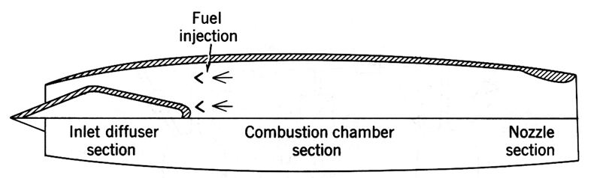
BrahMos Missile
India’s BrahMos Missile: A Versatile, High-Speed Weapon with Global Demand
The BrahMos is a medium-range ramjet supersonic cruise missile that can be launched from submarines, ships, fighter aircraft or TEL.
The BrahMos is notably the fastest supersonic cruise missile in the world
$$F_{Thrust}={\dot{M}}_{jet} −{\dot{M}}_{Air}+A_{jet}\left(p_{jet}−p_{amb}\right)$$

Slide 15
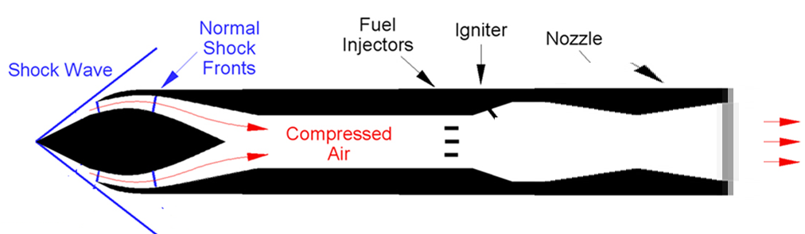
Internal and External Flow in Supersonic Missiles
Supersonic
Nozzle
CC
Subsonic
Flow

Slide 16
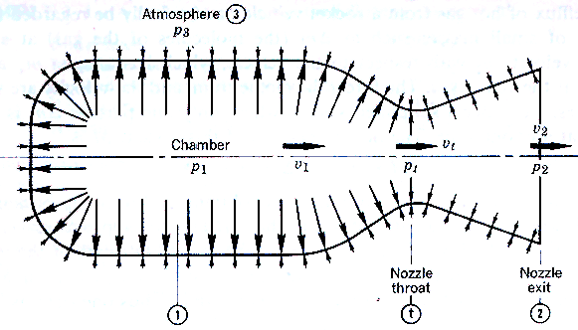
Rocket Engines: No Ambient Air Supply

Slide 17
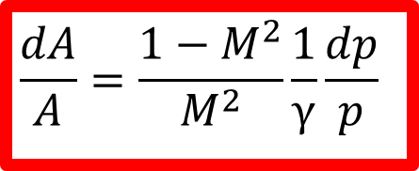
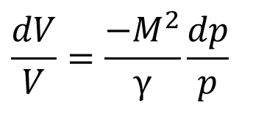
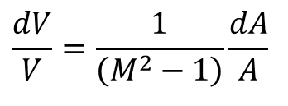
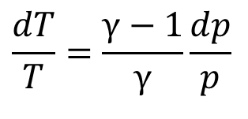
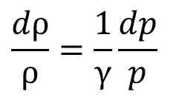
Generation of Supersonic velocity from High Pressure : Isentropic Devices
$$\frac{dV}{V}=\frac{−M^{2}}{γ}\frac{dp}{p}$$
$$\frac{dA}{A}=\frac{1−M^{2}}{M^{2}}\frac{1}{γ}\frac{dp}{p}$$
$$\frac{dρ}{ρ}=\frac{1}{γ}\frac{dp}{p}$$
$$\frac{dV}{V}=\frac{1}{\left(M^{2}−1\right)}\frac{dA}{A}$$
$$\frac{dT}{T}=\frac{γ−1}{γ}\frac{dp}{p}$$

Slide 18
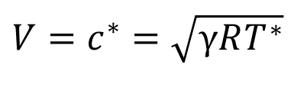
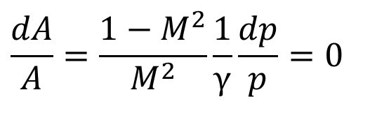
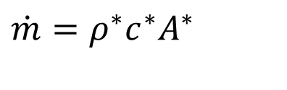
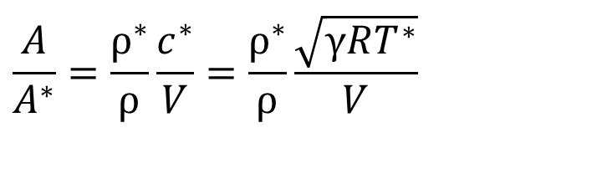
Isentropic Gas dynamic of Throat
$$\frac{dA}{A}=\frac{1−M^{2}}{M^{2}}\frac{1}{γ}\frac{dp}{p}=0$$
At M =1
Minimum Area = A* : Also called throat
$$V=c^{∗}=\sqrt{γRT^{∗}}$$
For a given mass flow rate:
$$\dot{m}=ρ^{∗}c^{∗}A^{∗}$$
$$\frac{A}{A^{∗}}=\frac{ρ^{∗}}{ρ}\frac{c^{∗}}{V}=\frac{ρ^{∗}}{ρ}\frac{\sqrt{γRT^{∗}}}{V}$$

Slide 19
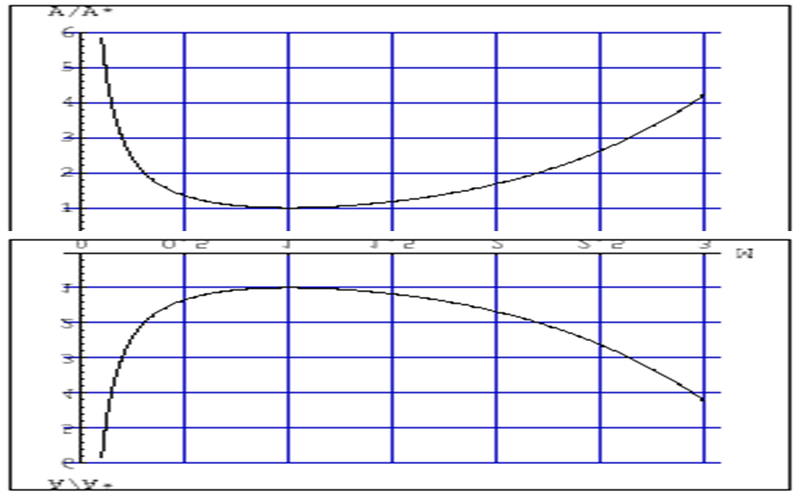
Geometry of Isentropic Diffuser/Nozzle

