Slide 1
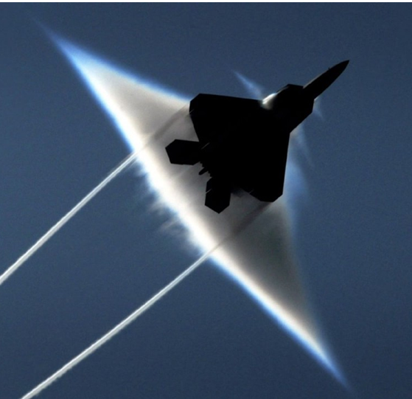

Analysis of Shocks & High-Speed Flow Systems
P M V Subbarao
Professor
Mechanical Engineering Department
Another Puzzle to Catch the fourth Irreversibility!!!

Slide 2


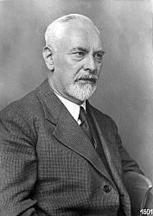

Prandtl View of Highspeed Bluff Bodies
The first theories about supersonic shock waves and flow came from Prandtl and Theodore Meyer, one of his students, in 1908.
Four decades before the first supersonic aircraft was launched.
He didn’t continue working on this theory till the 1920s.
Adolf Buseman worked with Prandtl to developed a method for designing a supersonic nozzle in 1929.
Ludwig Prandtl

Slide 3
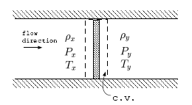
Prandtl – Meyer Analysis of A Shock
A control volume for this analysis is shown, and the gas flows from left to right.
The control volume is having a very narrow width.
No chemical reactions.
There is no friction or heat loss across this CV.
No work transfer is possible as this is so narrow.
The increase of the entropy is fundamental to any thing that happens in this world.

Slide 4
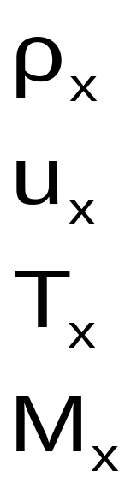
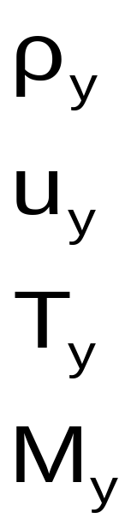
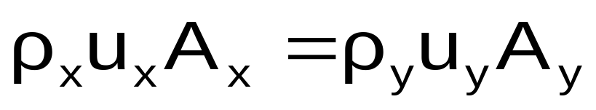
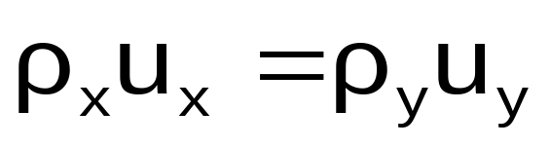
Conservation of Mass Applied to 1 D Steady Flow
X
Y
Conservation of mass:
The area of the disturbance is not varying in flow direction.
Conservation of momentum: The momentum is the quantity that remains constant because there are no external forces.

Slide 5
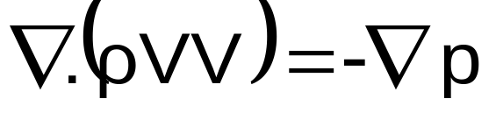
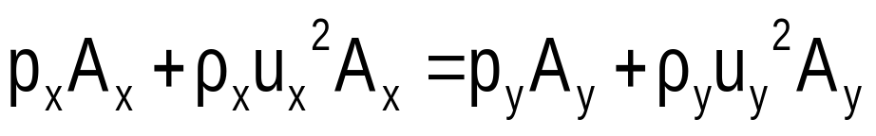
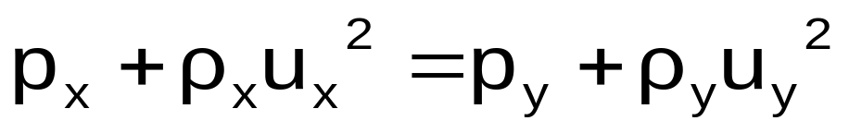
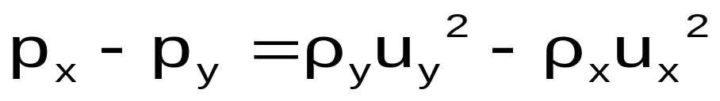
Conservation of Momentum : 1 D Steady Inviscid Flow
Steady, inviscid 1-D Flow, Body Forces are negligible
The area of the disturbance is constant.

Slide 6
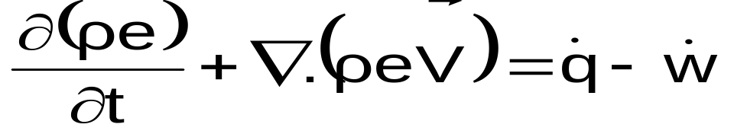
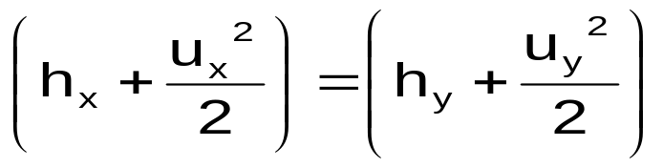
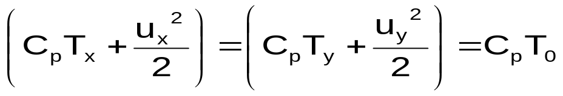
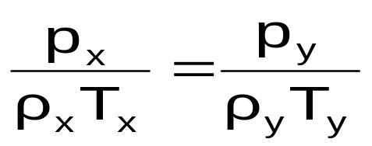

Conservation of Energy : 1 D Steady Flow
Steady flow with negligible Body Forces and no work transfer in an adiabatic flow
For calorically perfect gas:
The equation of state for perfect gas reads

Slide 7

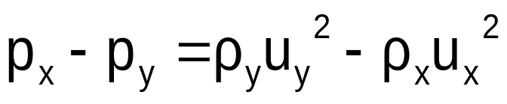

Summary of Equations
Conservation of mass :
Conservation of momentum :
Conservation of Energy :
The equation of state for perfect gas :

Slide 8
Solution of Simultaneous Equations
If the conditions upstream are known, then there are four unknown conditions downstream.
A system of four unknowns and four equations is solvable.
There exist two solutions because of the quadratic nature of the equations.
These two possible solutions may or may not be feasible.
Thermodynamics dictates the feasibility of these solutions.
Changes in pressure, temperature, volume cannot guarantee the feasibility of solution.
The only tool that helps in identifying the feasible solution is change in entropy.
For the adiabatic process, the entropy must increase or remain constant.

Slide 9
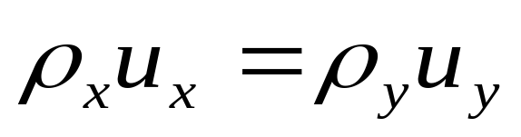
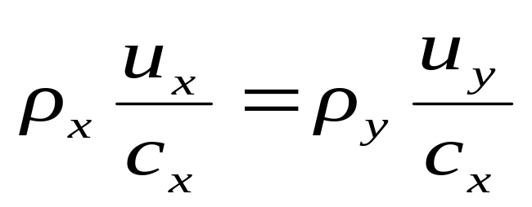
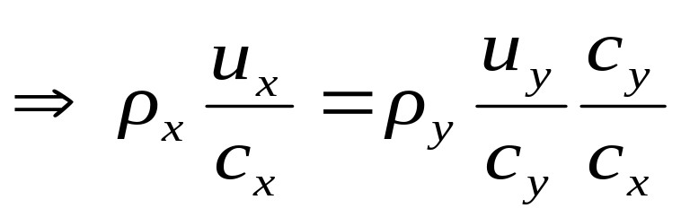
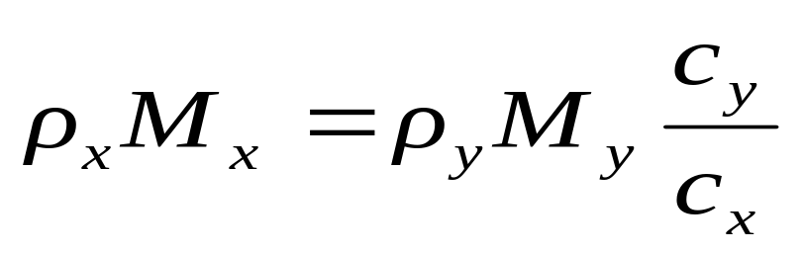
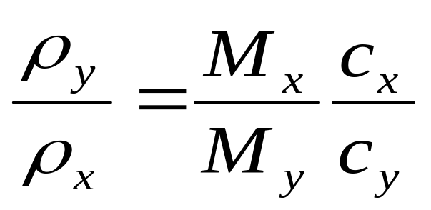
Machization of Simultaneous Equations : Step 1
Conservation of mass:
Dividing this equation by c_{x}

Slide 10
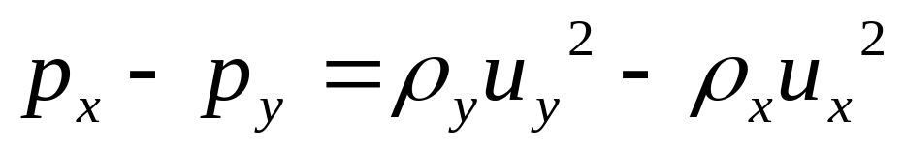
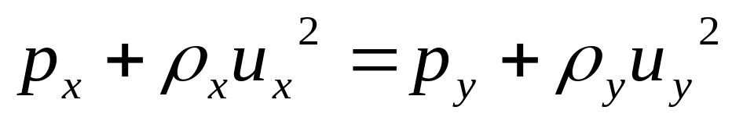
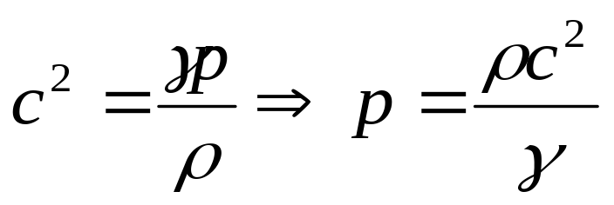
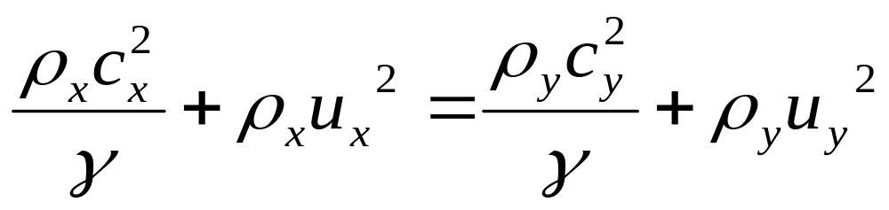
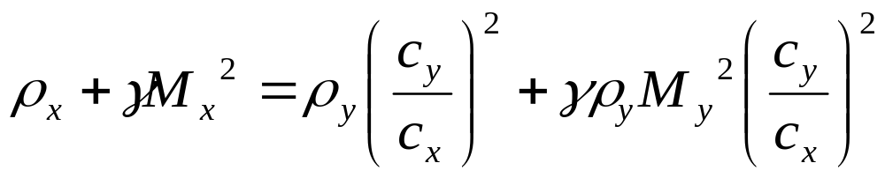
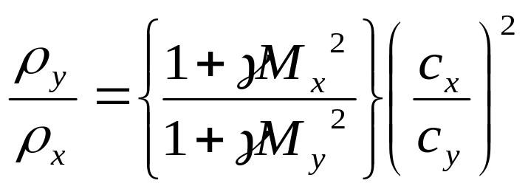
Machization of Momentum Conservation : Step 2
Conservation of momentum:
Dividing this through by c_{x}²/γ

Slide 11
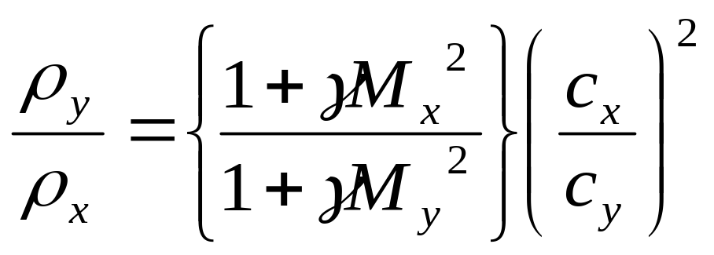

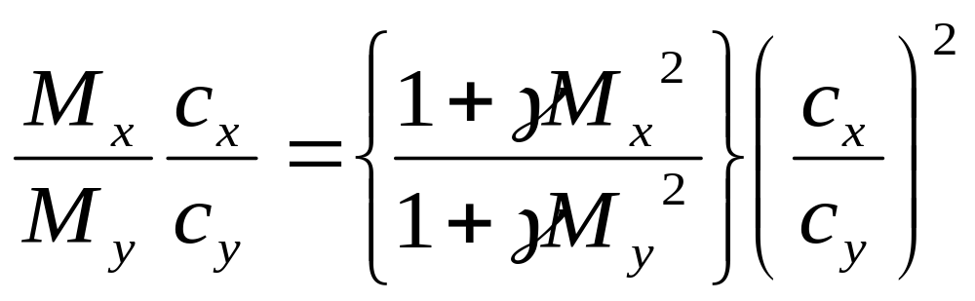
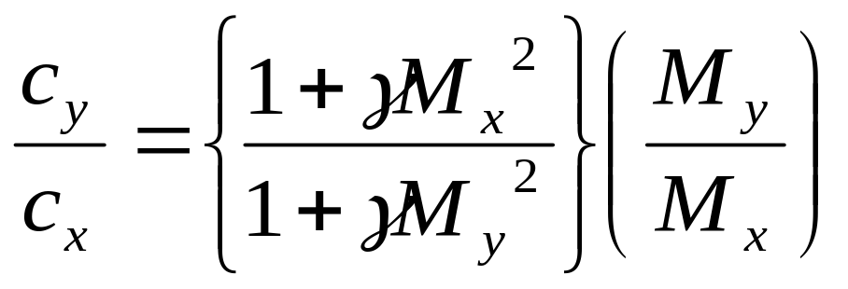
Merging of Mass & Momentum Conservation Equations : Step 3
&

Slide 12
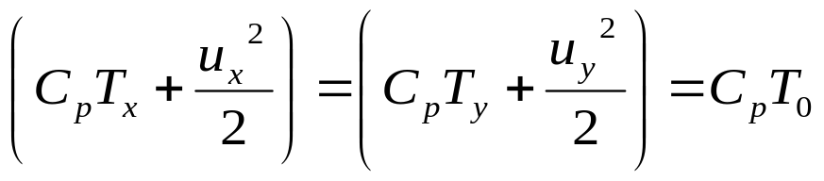
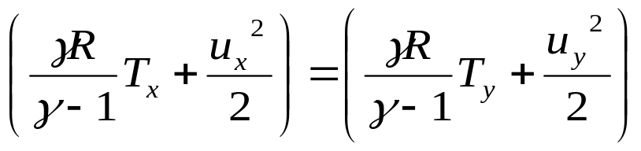
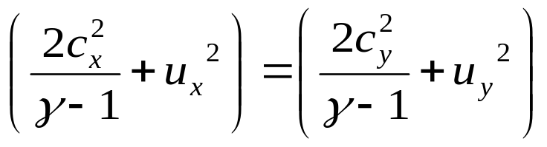
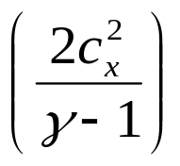
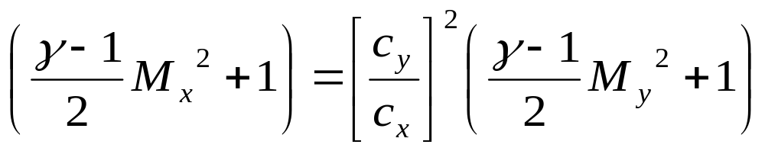
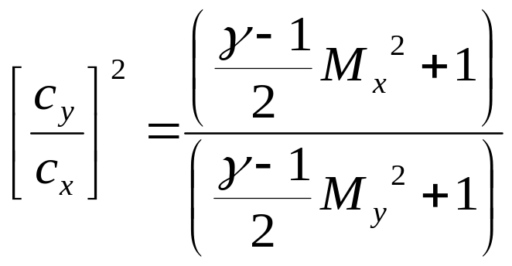
Machization of Conservation of energy : step 4
Dividing this by

Slide 13
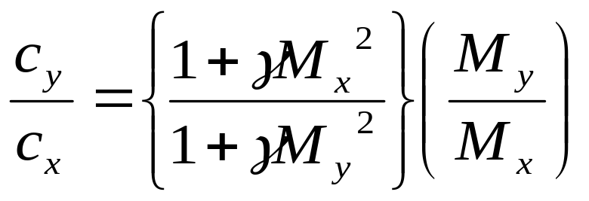
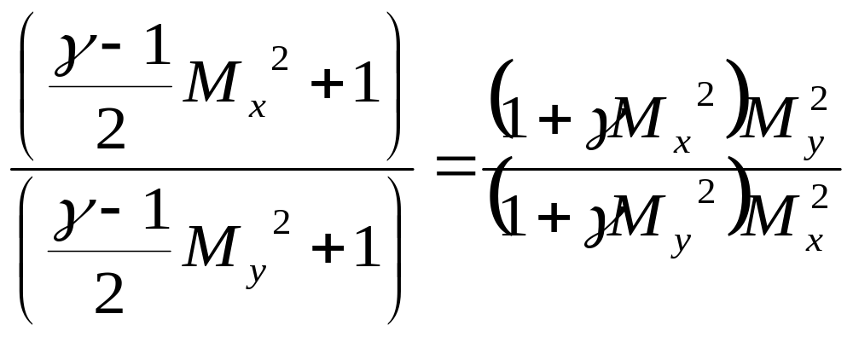

The Unified Equation : Step 5
Simplified Energy Equation :
Combined Mass & Momentum Equation :
Combined Mass, Momentum and Energy Conservation :

Slide 14
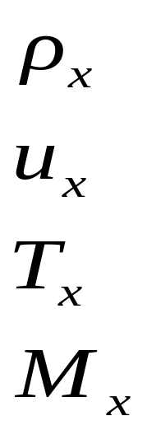
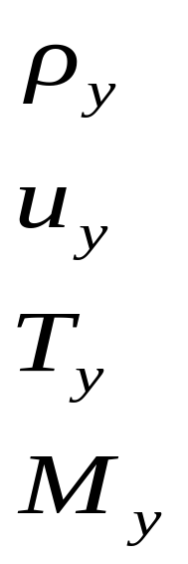

Combined Mass, Momentum and Energy Conservation

Slide 15
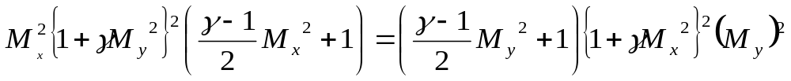
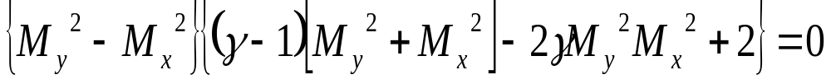
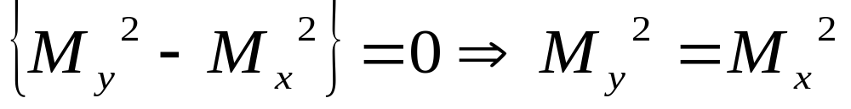
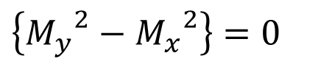
Discovery of The Ghost
$$\left\{{M_{y}}^{2}−{M_{x}}^{2}\right\}=0$$
$\left\{\left(γ−1\right)\left[{M_{y}}^{2}+{M_{x}}^{2}\right]−2γ{M_{y}}^{2}{M_{x}}^{2}+2\right\}=0$
Reversible flow : Isentropic flow process from x to y:

Slide 16
1940-50’s Flying Story
Cruising at High Altitudes ?!?!?!
Aircrafts were trying to approach high altitudes for a better fuel economy.
This led to numerous crashes for unknown reasons.
These included:
The Mitsubishi Zero was infamous for a peculiar unknown problem, and several attempts to fix it only made the problem worse.
In the case of the Super-marine Spitfire, the wings suffered from low torsional stiffness.
The P-38 Lightning suffered from a particularly dangerous interaction of the airflow between the wings and tail surfaces in the dive that made it difficult to "pull out“.
Flutter due to the formation of thin high -pressure line on curved surfaces was another major problem, which led most famously to the breakup of de Havilland Swallow and death of its pilot, Geoffrey de Havilland, Jr.

Slide 17


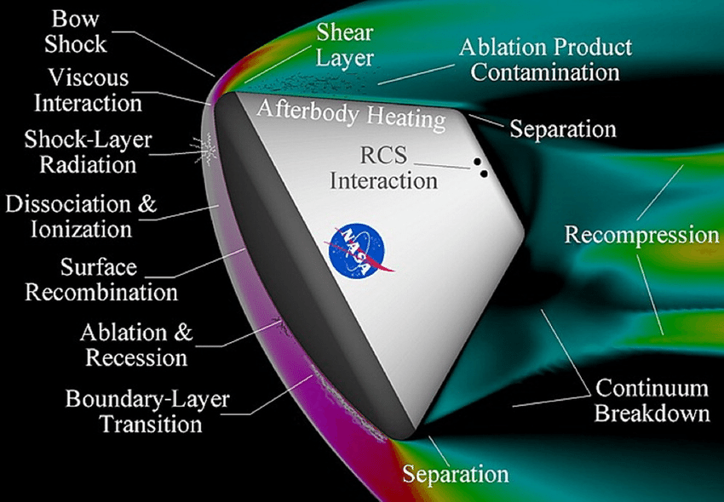
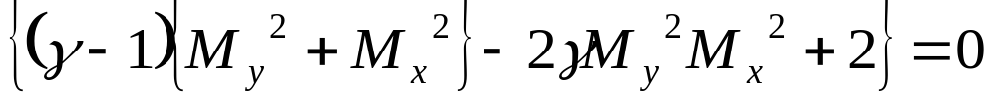
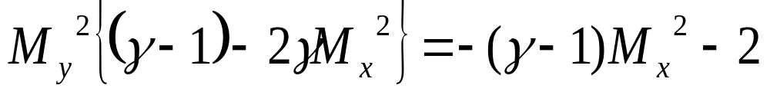
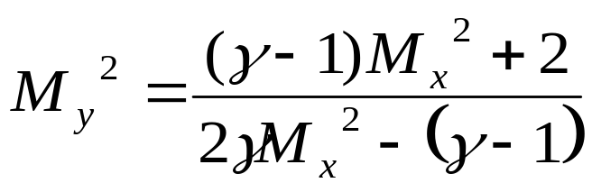
The Mercurial Danger
x
y
Shows existence of an Irreversibility between x & y,
The Existence of Normal Shock !!!!
This equation relates the downstream Mach number to the upstream Mach Number across an unknown Ghost.
This Ghost is named as “Normal Shock”
It can be used to derive pressure ratio, the temperature ratio, and density ratio across a Normal Shock.

Slide 18
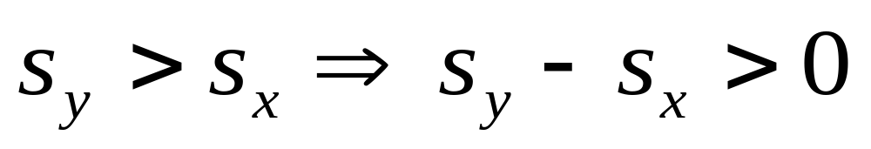
Feasibility of Normal Shock
The flow across the shock is adiabatic and the stagnation temperature is constant across a shock.
The existence of an irreversible shock will result in an increase of entropy.

Slide 19
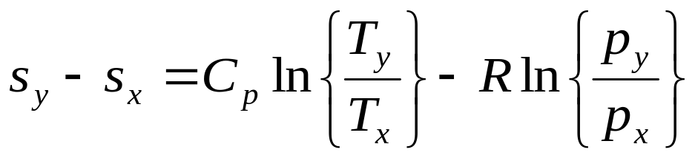




Change in entropy for a perfect gas
Obtain ratios of thermodynamic parameters across NS.
&

Slide 20



An Ultimate Measure for Possibility of a Fantasy
Shock is possible only in supersonic flows
Infeasible
An inviscid supersonic flow can become irreversible !!!
M_{x}

Slide 21


The Nature of Irreversible Phenomenon
γ = constant=1.4
M_{y}
M_{x}

Slide 22


Mach Number Vs Static Pressure : Normal Shock

Slide 23


Mach Number Vs Density : Normal Shock

Slide 24


Mach Number Vs Static Temperature : Normal Shock

Slide 25

Mach Number Vs Entropy Generation : Normal Shock

Slide 26


Highest Angle Objects

Slide 27



Supersonic Vehicles

