Slide 1

Mach’s View of Highspeed Flows
P M V Subbarao
Professor
Mechanical Engineering Department
True Understanding of Moving Fast!
Strong Connection between Macroscopic & Microscopic Kinetic Energies!!!

Slide 2



Limitless Flow Systems
Sky is the Limit ….

Slide 3
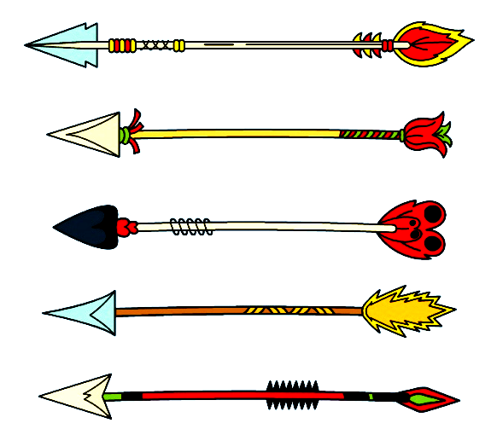
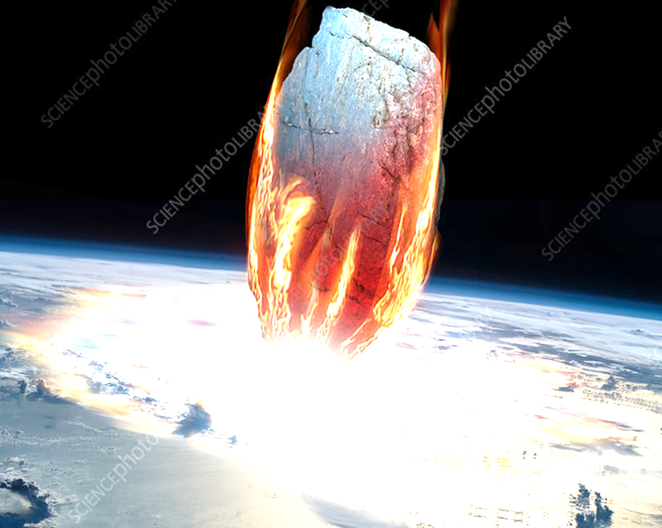
Two Dubious Extreme Speed Flyers
Flying of near zero thickness object at high speeds : Ufology: The Science of UFOs.
Flying of Large/bluff object at high speeds : Motion of Space Vehicles & Asteroids.

Slide 4
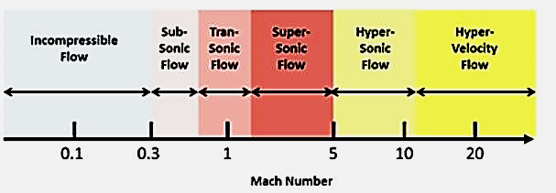
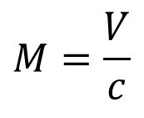
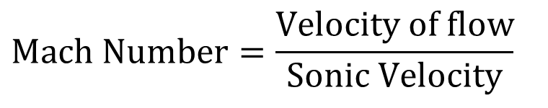
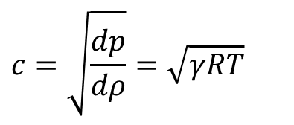
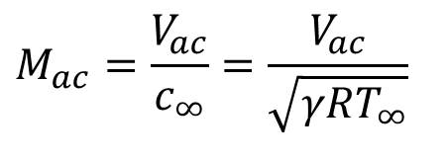
Mach Number : A True Measure of High-speed Flow Systems
$$\text{Mach} \text{Number}=\frac{\text{Velocity} \text{of} \text{flow}}{\text{Sonic} \text{Velocity}}$$
$$M=\frac{V}{c}$$
For an ideal and calorically perfect gas:
$$c=\sqrt{\frac{dp}{dρ}}=\sqrt{γRT}$$
$$M_{ac}=\frac{V_{ac}}{c_{∞}}=\frac{V_{ac}}{\sqrt{γRT_{∞}}}$$
Mach number of a flight

Slide 5
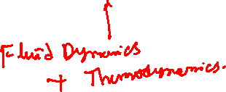
Mach Number : A Parameter to Select Suitable Applications
Ma <0.2 : Incompressible Flow Systems : Strong importance of Laminar & Turbulent Flows :
0.2 < Ma <0.9 : Compressible Subsonic Systems : Medium to mild attention to Laminar & Turbulent Flows.
0.9 < Ma <1.05 : Transonic Systems : Better to avoid…
1.05 < Ma < 2.0 : Supersonic Systems : Essential for National Security
Ma > 2.0 : Hypersonic Systems : Means for Space Exploration
Development of An Engineering Science called Gas Dynamics.

Slide 6
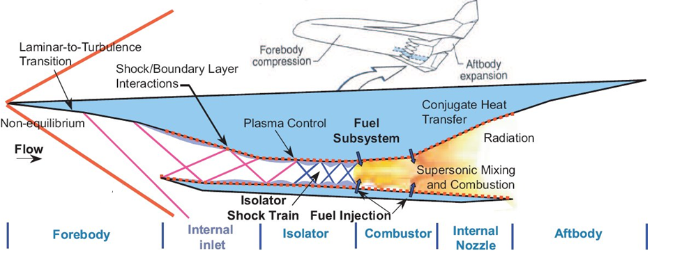
Hypersonic Flyers: Internal & External Compressible Flows

Slide 7
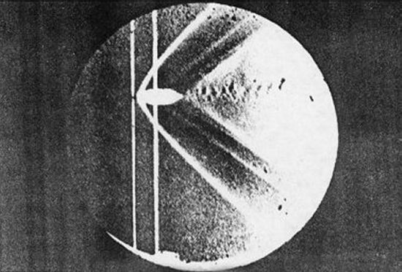
Mach’s experiments
Mach was actually the first person in history to develop a method for visualizing the flow passing over an object at very high speeds.
He was also the first to understand the fundamental principles that govern high speed flow and their impact on aerodynamics.
Ernst Mach's photo of a bullet in supersonic flight
"Photographische Fixierung der durch Projektile in der Luft eingeleiten Vorgange" that he presented to the Academy of Sciences in Vienna in 1887.

Slide 8
Mach’s Two Extreme Flyers
Cruising of point or zero degree conical object at high speeds : Concept of Mach Cone.
Flying of Large/180 degree conical object at high speeds : generation of A discontinuity.

Slide 9



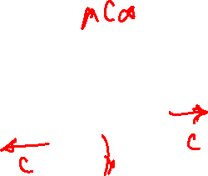
Travel of An Infinitesimal Object in A Fluid :: A Thought Experiment
• An object moves through a fluid medium generates pressure waves.
• Pressure waves travel out at the speed of sound.
The value of sonic speed depends on fluid properties.
• If the object is traveling significantly slower than sonic velocity, then pressure waves travel out uniformly similar to waves on the surface of a pond.

Slide 10
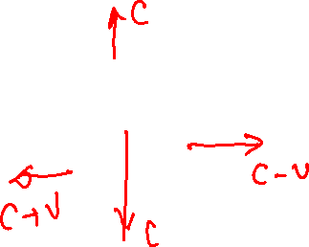
Moving Object in A Fluid : V_{obj} < C∞
• When the speed of the object is less than the sonic speed, the relative speed of pressure waves w.r.t. to the object are slower in the direction of object travel. .

Slide 11
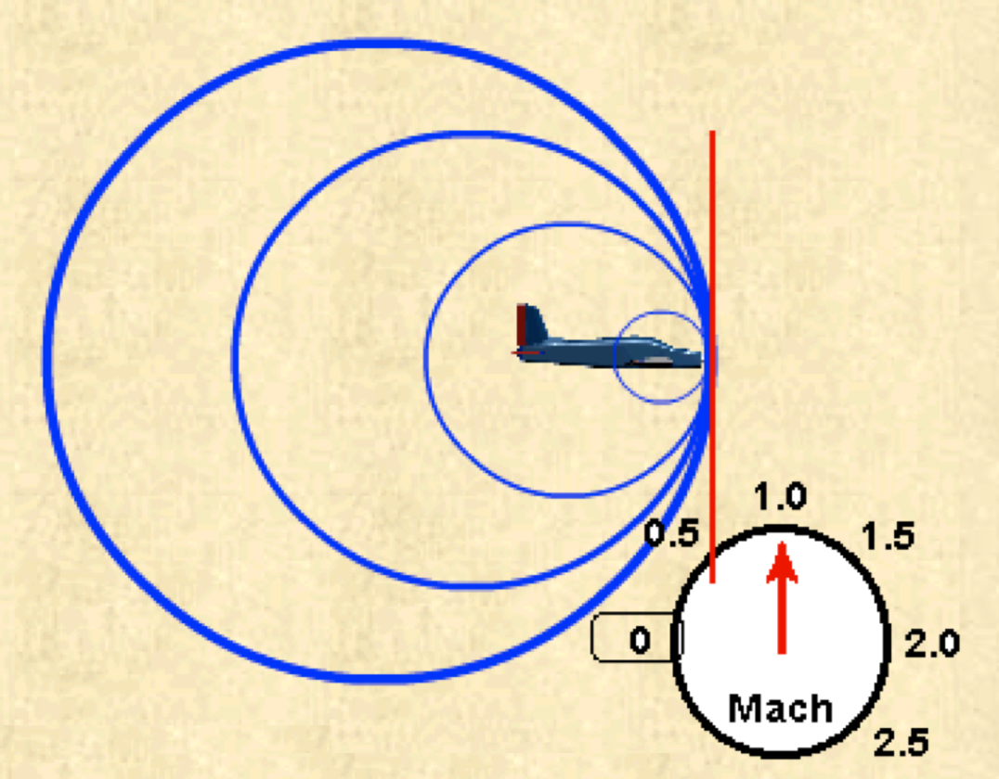
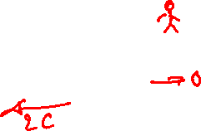
Moving Object in A Fluid : : V_{obj} = C∞
• As the object approaches the speed of sound, it begins to catch up with the pressure waves and creates an infinitesimally weak flow discontinuity just ahead of the aircraft

Slide 12
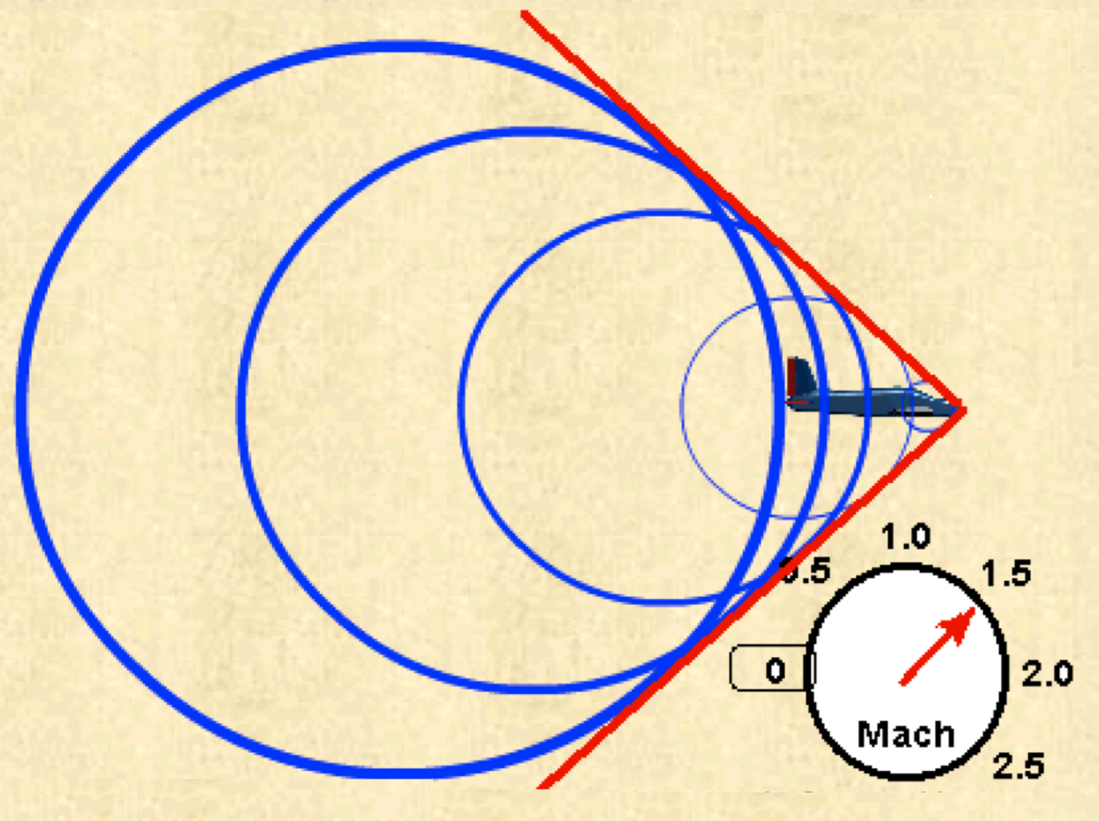

Moving Object in A Fluid : V_{obj} > C∞
• As the vehicle breaks the speed of sound, the infinitesimally weak Shock waves begin to add up along a “Mach Line” and form a strong pressure wave with highly compressed air, called a shockwave.

Slide 13
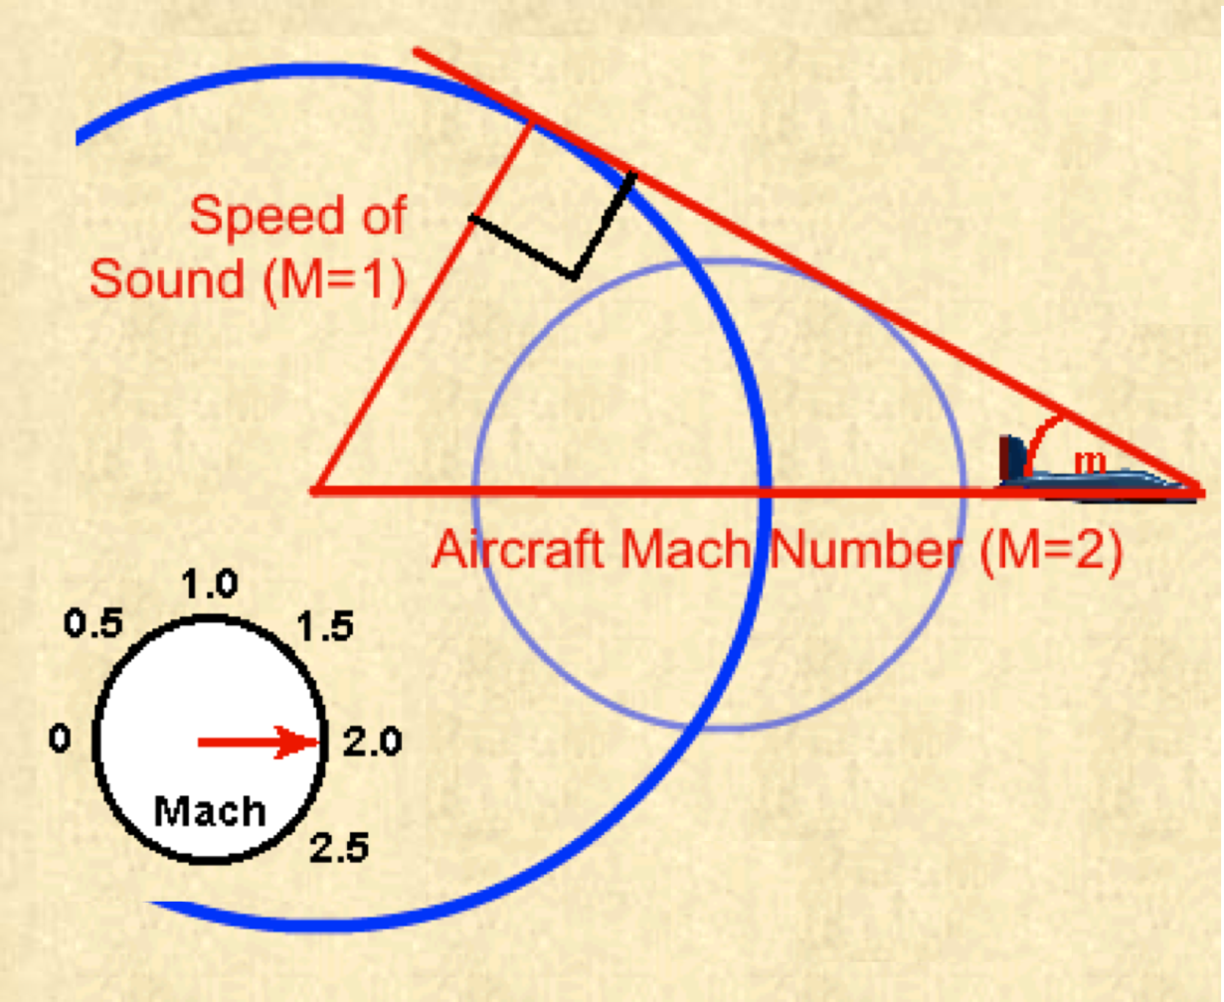


Travel of a Highspeed Object & Mach’s Cone
• As Mach number increases, the strength of the Cone increases and the Angle of the shockwave becomes increasingly severe
C∞
$$μ$$
Speed of Aircraft = V_{ac}

Slide 14
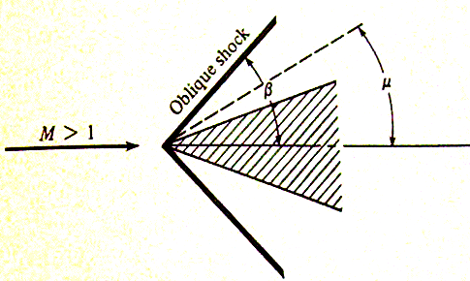

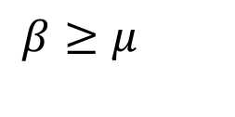
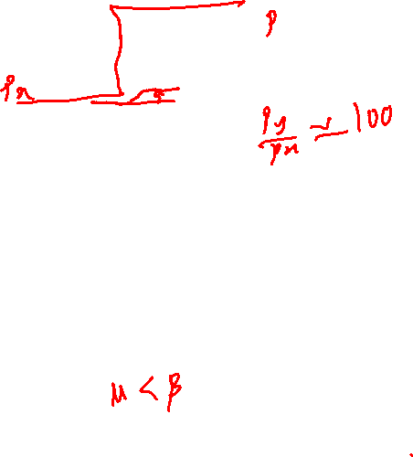
Mach’s Waves to Oblique Shock Wave
• When generating object is larger than a “point”, shockwave is stronger than mach wave …. Oblique shock wave
For same velocity of the object, Shock angle is larger than Mach Angle.
$$θ$$
$$β≥μ$$
• β -- shock angle
• θ -- turning or “wedge (cone) angle”

Slide 15
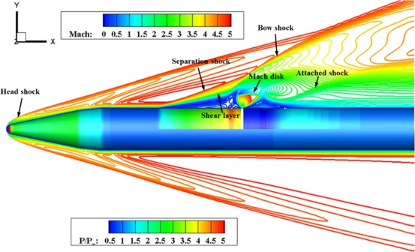
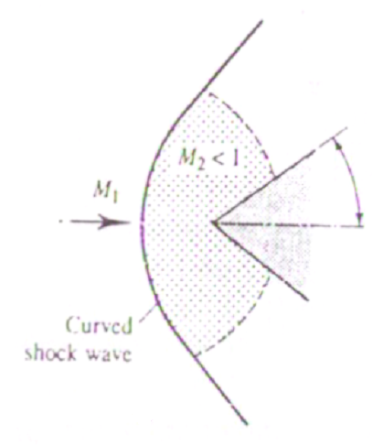
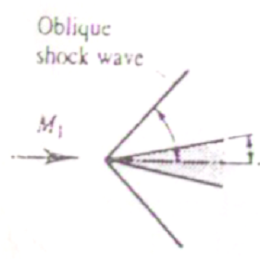


High Angle Objects
Fine-size Sleek Bodies at supersonic Speeds
Bluff Bodies at supersonic Speeds

Slide 16
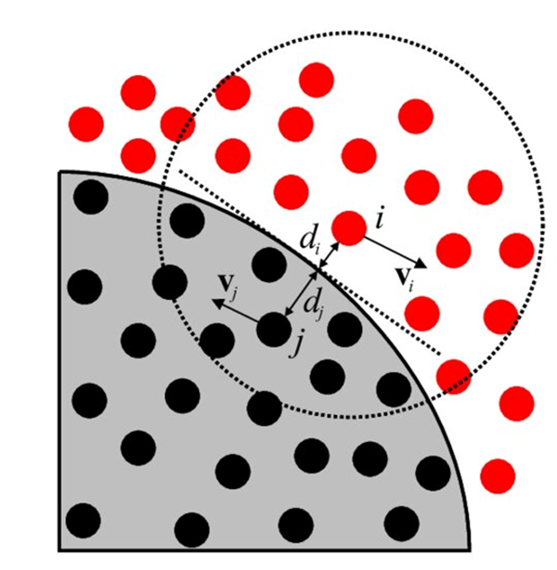
High Speed Gas Parcels Coming to Rest
Consider a case of a high velocity fluid system is approaching a finite size moving object.
Fluid Particles
Relative to the object, the far field fluid particles are moving at a relative velocity of the object.
The fluid particles attain a state of relative stagnation at solid surface.
This is known as no-slip condition in all viscous (real) flows.
Solid object

Slide 17
High Speed Gas Parcels Coming to Rest
Due to no-slip condition the fluid particle reaches zero relative velocity (stagnation) condition at the wall of the object.
Stagnation property is defined as property of a highspeed fluid, when it isentropically come to rest (relative to surface).
Stagnation enthalpy, it is defined as the maximum available microscopic energy of a fluid.

Slide 18
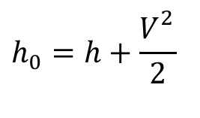
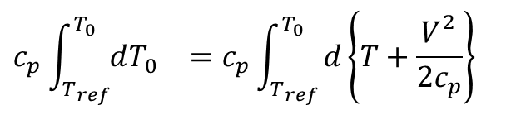
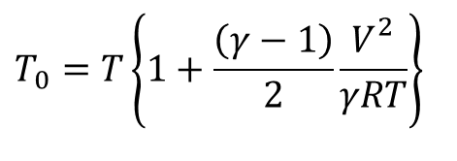
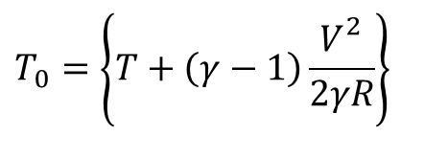
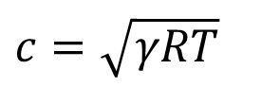
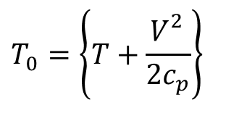
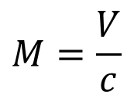
Stagnation Properties (Perfect Gas)
Define Stagnation Enthalpy is due to conversion of entire macroscopic kinetic energy into microscopic kinetic energy.
Assume this as an isentropic process.
$$h_{0}=h+\frac{V_{}^{2}}{2}$$
$$c_{p}{\int_{T_{ref}}^{T_{0}}{dT_{0}}}_{}=c_{p}{\int_{T_{ref}}^{T_{0}}{d\left\{T+\frac{V_{}^{2}}{2c_{p}}\right\}}}_{}$$
$$T_{0}=\left\{T+\frac{V_{}^{2}}{2c_{p}}\right\}$$
$$T_{0}=\left\{T+\left(γ−1\right)\frac{V_{}^{2}}{2γR}\right\}$$
$$T_{0}=T\left\{1+\frac{\left(γ−1\right)}{2}\frac{V_{}^{2}}{γRT}\right\}$$
For a perfect gas, the speed of sound is :
$$c=\sqrt{γRT}$$
$$M=\frac{V}{c}$$

Slide 19
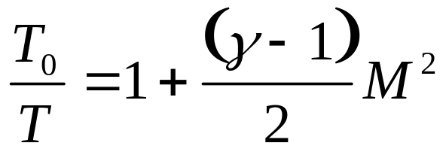
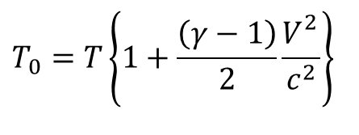
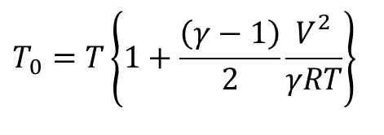
Stagnation Temperature of A Gas Flow
$$T_{0}=T\left\{1+\frac{\left(γ−1\right)}{2}\frac{V_{}^{2}}{γRT}\right\}$$
$$T_{0}=T\left\{1+\frac{\left(γ−1\right)}{2}\frac{V_{}^{2}}{c^{2}}\right\}$$
In general, for an adiabatic Flow Field at M, the Stagnation Temperature is defined by the relationship
Stagnation Temperature is constant throughout an adiabatic flow field.
This is the maximum possible temperature.
T₀ is also sometimes referred to as Total Temperature
T is sometimes referred to as Static Temperature

Slide 20
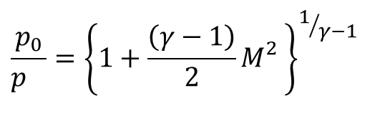
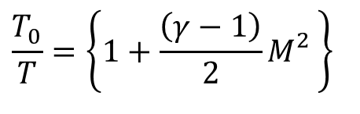
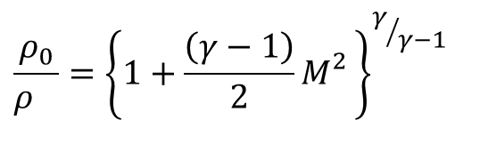
Engineering Importance of Stagnation Temperature
• Fluid particles reaching a stagnation condition is an isentropic process and hence:
$$\frac{T_{0}}{T}=\left\{1+\frac{\left(γ−1\right)}{2}M_{}^{2}\right\}$$
Re-entry of Space Craft
$$\frac{p_{0}}{p_{}}={\left\{1+\frac{\left(γ−1\right)}{2}M_{}^{2}\right\}}^{1/{γ−1}}$$
$$\frac{ρ_{0}}{ρ_{}}={\left\{1+\frac{\left(γ−1\right)}{2}M_{}^{2}\right\}}^{γ/{γ−1}}$$

Slide 21
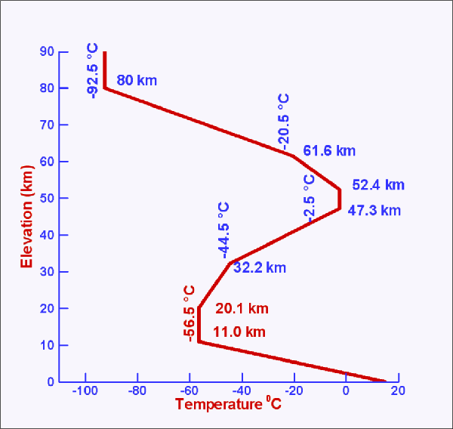
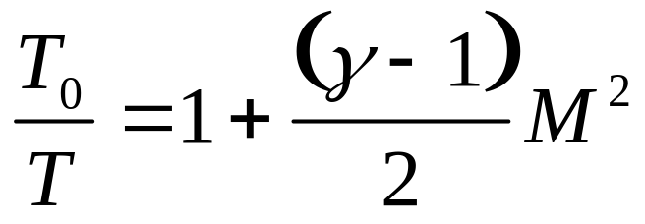
Mach’s Analysis of Highspeed Bluffbody
A reentering Space craft is at an altitude of 61.2 km achieves a Mach number of ~ 18.
T∞ ~ 243 K
~18.0 Mach Number

Slide 22
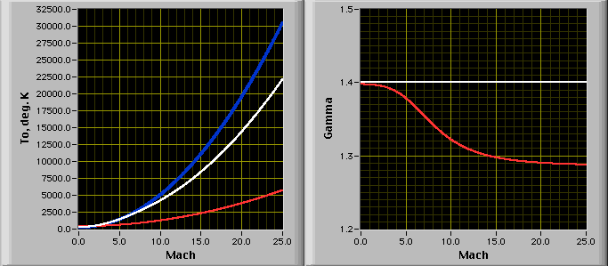
Computation of Stagnation Temperature at High Mach Numbers
T∞ ~ 243 K
Ideal gas with
Variable Properties
Perfect gas
Real gas to Plasma

Slide 23

Rentering Space Craft

