Slide 1

Continuum Hypothesis for Definition of Properties in Fluid Mechanics
P M V Subbarao
Professor
Mechanical Engineering Department
An Engineering Discussion on (Macroscopic) Properties for Analysis of Fluid Systems…

Slide 2


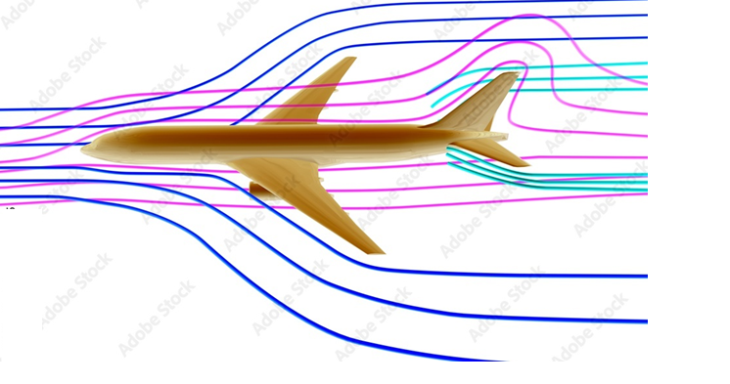
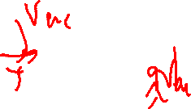
Secondary Dimensions and Units
Secondary Dimension: Derived using primary dimensions.
A scientific law is essential to define any secondary dimensions.
The most crucial secondary dimension in fluid mechanics is The Force.
Force is directly related to mass, length, and time,
Created by Newton’s second law.
Force equals the time rate of change of momentum or, for constant mass for a (closed system).
A cruising Aircraft
Change in rate of momentum between two or among more locations from an open system. (Open System)

Slide 3
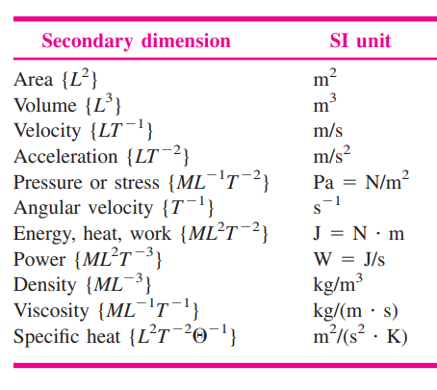
List of Secondary Dimensions

Slide 4
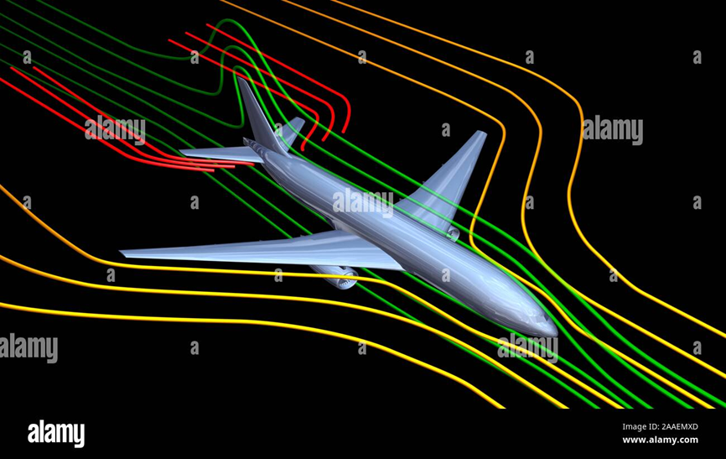
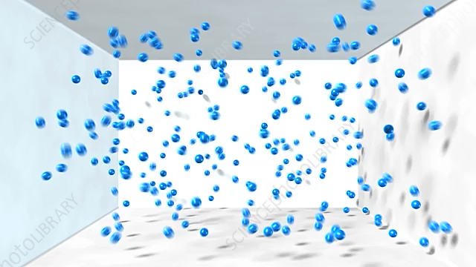
Mercurialness in Defining Dimensions For Fluids

Slide 5

Visualization of A Fluid
Hermann Muller, a teacher, fostered Max Planck's ability to visualize physics.
Müller considered Visualization as a "vital weapon" for physicists.
Maxwell’s Distribution (1860) followed by Boltzmann's refinement (1870) were the best examples for Visulization of Physics.
Max Planck changed physics and our understanding of the world forever

Slide 6

The Continuum Hypothesis
The fluid is treated as being a continuous field of matter.
This is referred as the Continuum Approach or the Continuum Hypothesis.
This Continuum Hypothesis believes that values for density, velocity, acceleration, viscosity or energy at any point in a fluid domain exist and valid for design and development.
On a real engineering scale, observing the effects in a continuum gives rise to more steady and repeatable data.
The continuum hypothesis is essential in classical fluid mechanics.
However, Every fluid is discontinuous when looking at the atomic/molecular scale!!!

Slide 7
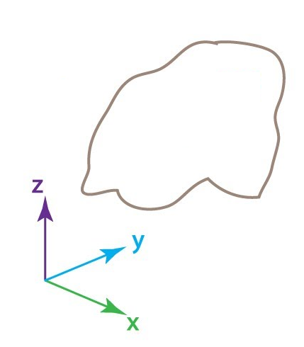
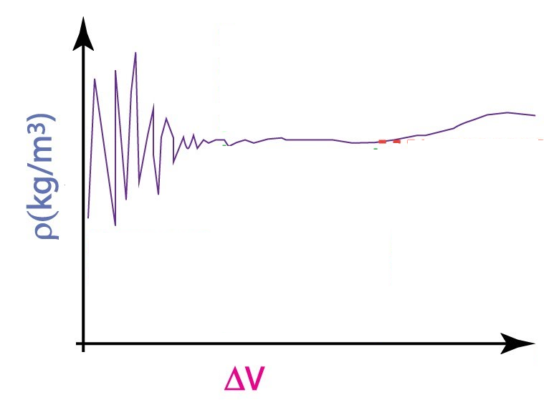
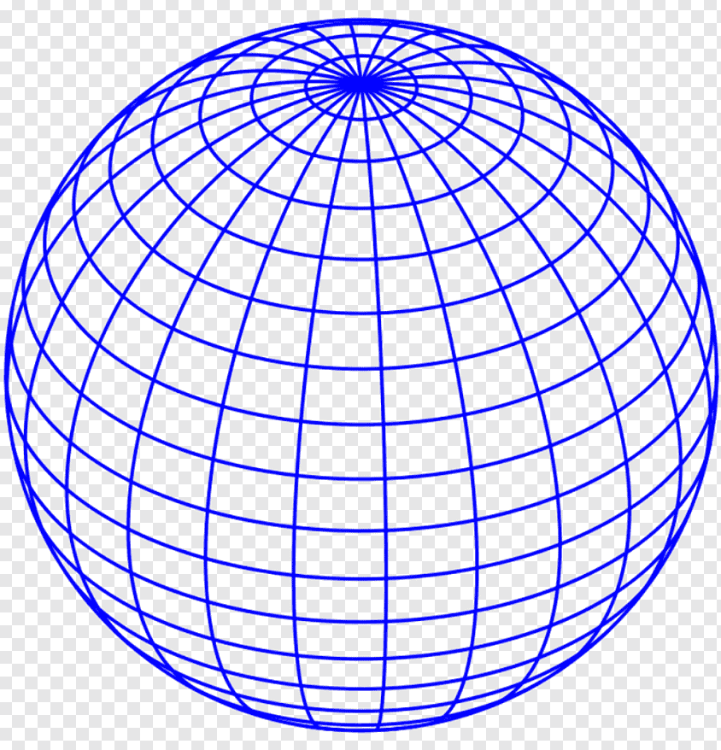




Mathematical Implementation of Continuum Hypothesis
Density is a measure of the amount of mass per unit volume of a substance.
Definition of Density:
Estimation of Density at a point in a fluid:
Fluid System
$$ρ\left(x,y,z \right)=\lim_{∆V→valid value}\frac{∆m}{∆V}$$
$$∆V$$

Slide 8

Mathematical Implementation of Continuum Hypothesis
Definition of Density:
$$ρ\left(x,y,z \right)=\lim_{∆V→valid value}\frac{∆m}{∆V}$$
At Standard Temperature and Pressure conditions (STP) the valid volume is μm³ for air.
This tiny volume has about 30 million molecules!

Slide 9
The Continuum Hypothesis & Valid Volume
The existence of this “Valid Volume” limit is established by considering the definition of density as mass per unit volume.
The volume size has an enormous influence on the calculated value of density.
Too small a volume, the value of calculated density fluctuates.
Too big a volume might mean that density itself is varying significantly within the region of interest.
As seemed before there is a limit on valid volume.

Slide 10
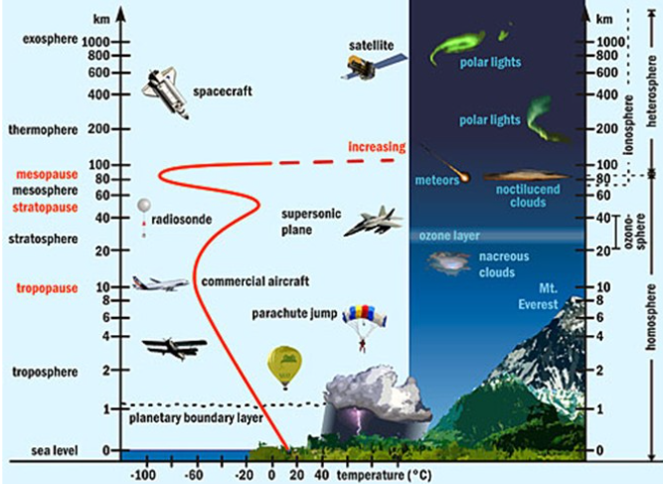
Macroscopic Uncertainty
Varying Temperature of Atmosphere

Slide 11
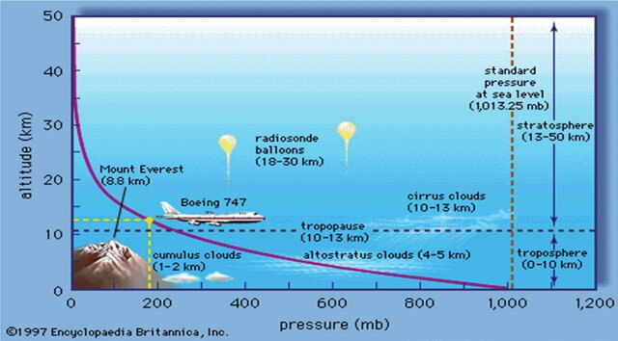
Macroscopic Uncertainty
Pressure of Atmosphere

Slide 12
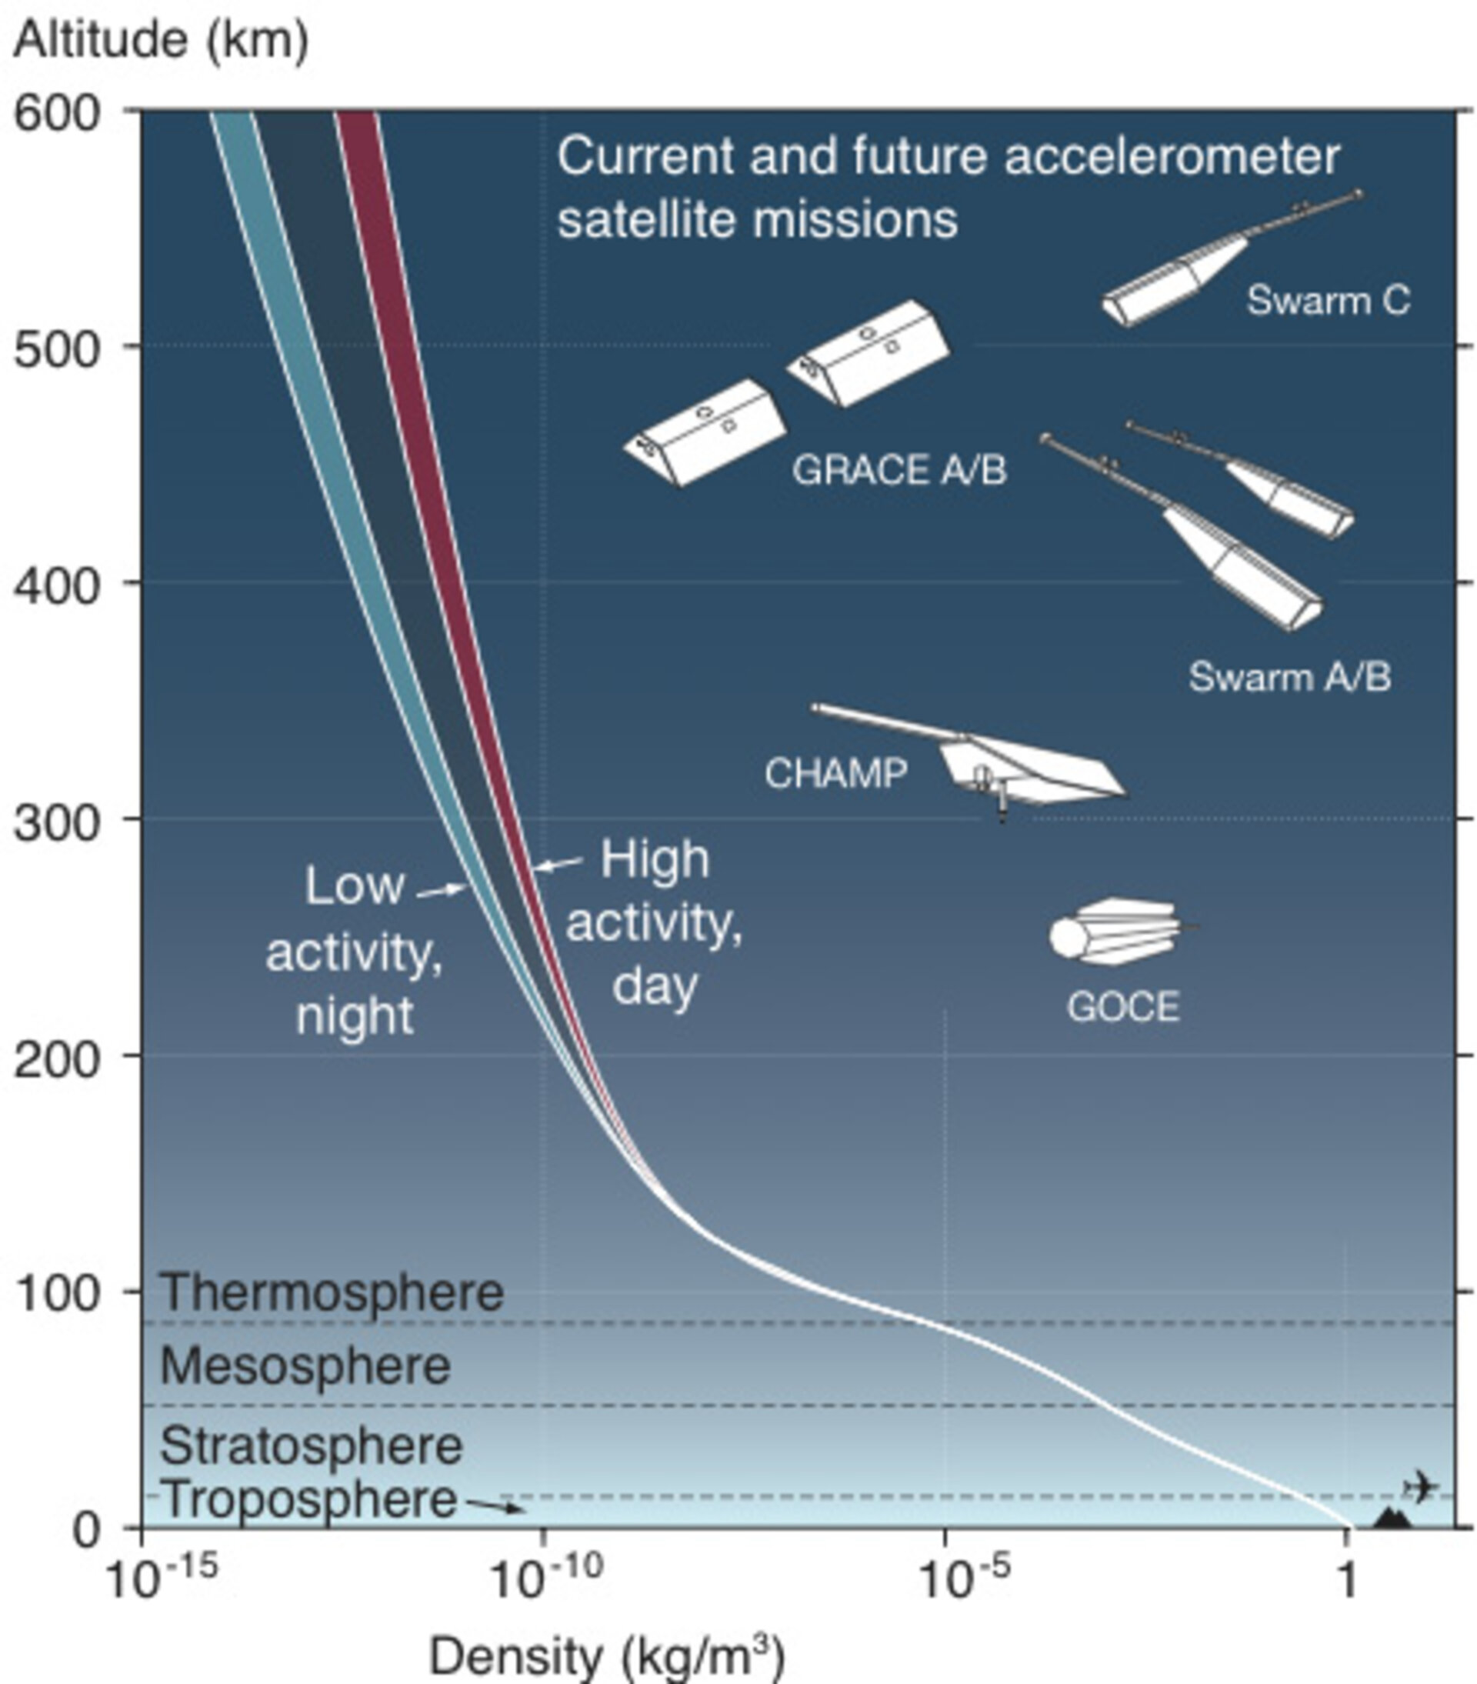
Macroscopic Uncertainty
Density of Atmosphere

Slide 13
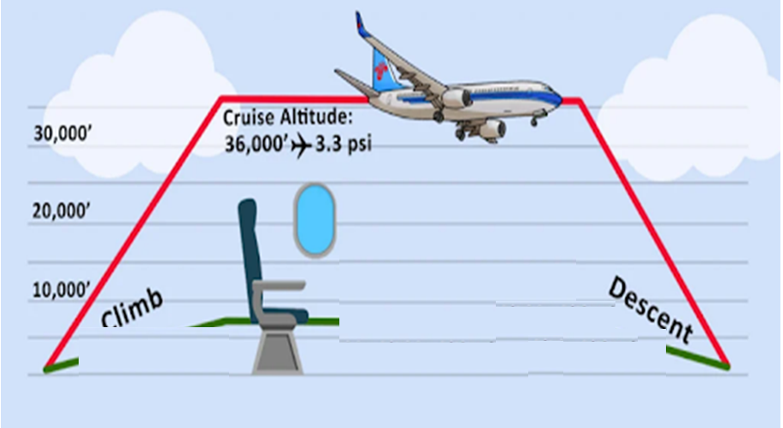
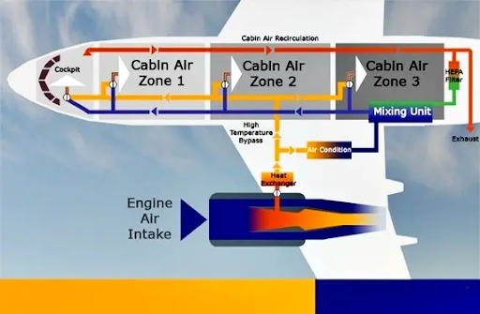
Engineering Challenges to Work with Varying Properties of Atmosphere

Slide 14
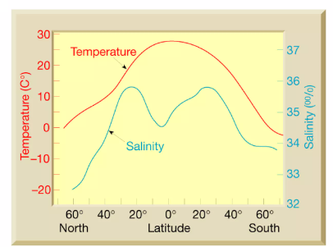
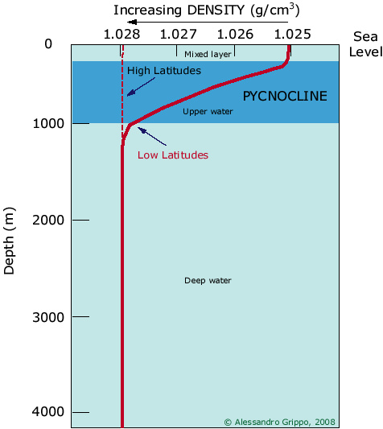
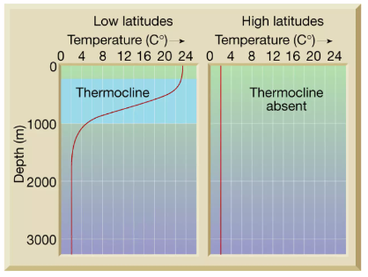
Mercurialness in Defining Dimensions For Fluids: Properties of Ocean

Slide 15
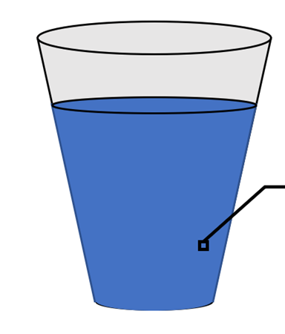
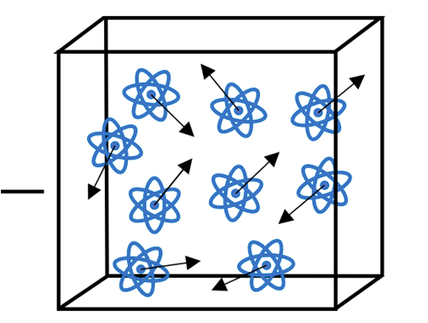
Discussion of The Continuum Approach
Properties describes at a “point” of fluid is actually a group of many molecules moving around randomly inside a molecular-scale volume.
Instead of perceiving each of these molecule’s properties, we perceive a type of average of these at a given “point”.

Slide 16
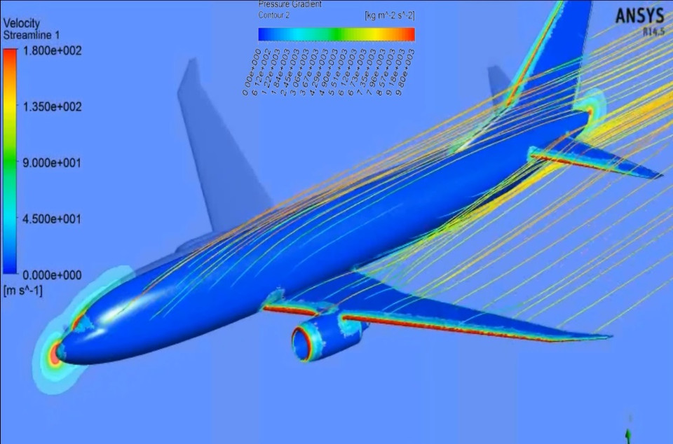
Sample Size for The Continuum Approach
Consider a spherical molecular “net” in a fluid

Slide 17

Validity of The Continuum Approach

Slide 18
Validity of The Continuum Approach

Slide 19

How to decide the value of smallest valid size of the fluid parcel?
How to develop a criteria?
Any reference size?

