Slide 1

Boundary Layer Theory for Aerofoil
P M V Subbarao
Professor
Mechanical Engineering Department
I I T Delhi
Source of High Drag on Aerodynamic Shpaes…..

Slide 2


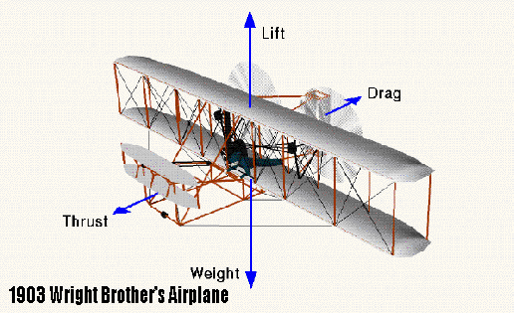
Boundary Layer Theory for Aerofoil
17th December 1903
A professor in Hanover, Germany delivered in a 10 minutes address in 1904 on this topic.

Slide 3
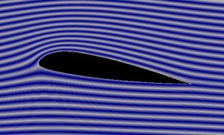
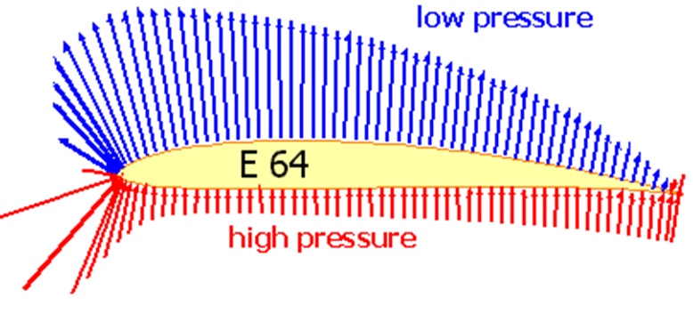

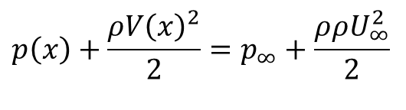
Euler Solution for An Aerofoil
$$∇^{2}ψ=0$$
$$p\left(x\right)+\frac{ρV{\left(x\right)}^{2}}{2}=p_{∞}+\frac{ρρU_{∞}^{2}}{2}$$

Slide 4
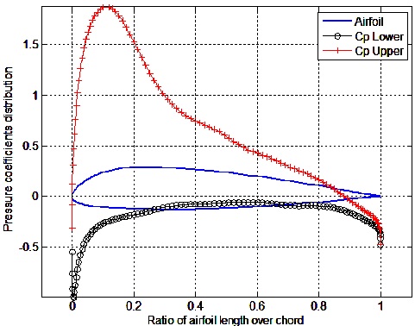

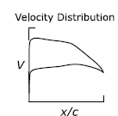
Essential Global Outcome of Euler Analysis
Airfoil geometry

Slide 5
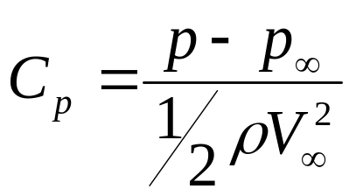
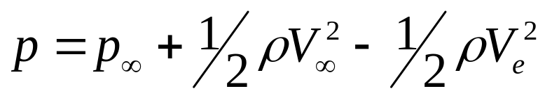
Surface Pressure Distributions
The aerodynamic performance of airfoil sections can be studied most easily by reference to the distribution of pressure over the airfoil.
This distribution is usually expressed in terms of the pressure coefficient:
C_{p} is the difference between local static pressure and freestream static pressure, non-dimensionalized by the freestream dynamic pressure.
Invoke Bernoulli's equation:

Slide 6
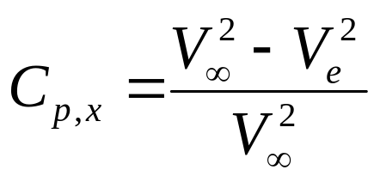
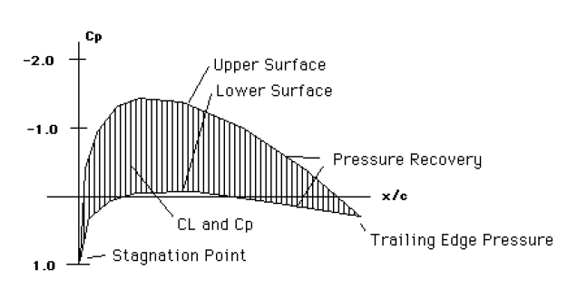
Airfoil Pressure Distributions

Slide 7
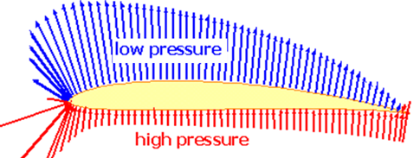
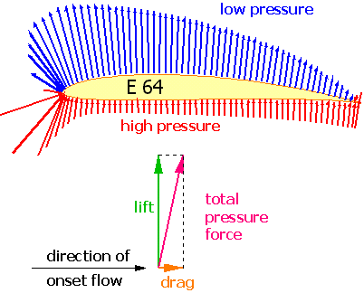
Superiority of Zero Weight Balloon

Slide 8
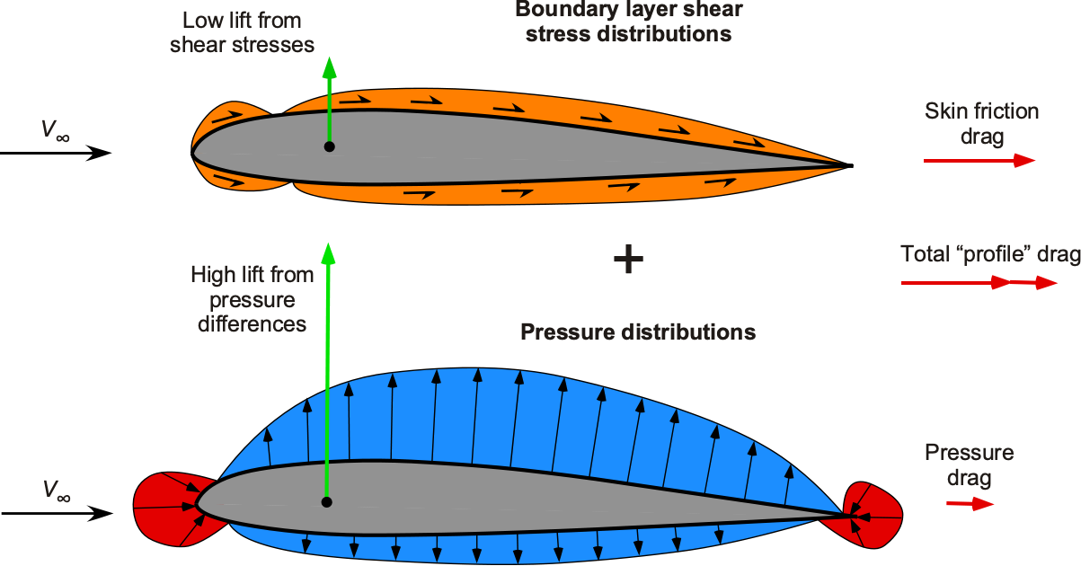
Aerodynamic Performance of an Aerofoil &
Boundary layer Effect: Solution of NS Equations
Wall Shape Effect: Solution of Euler Equation

Slide 9
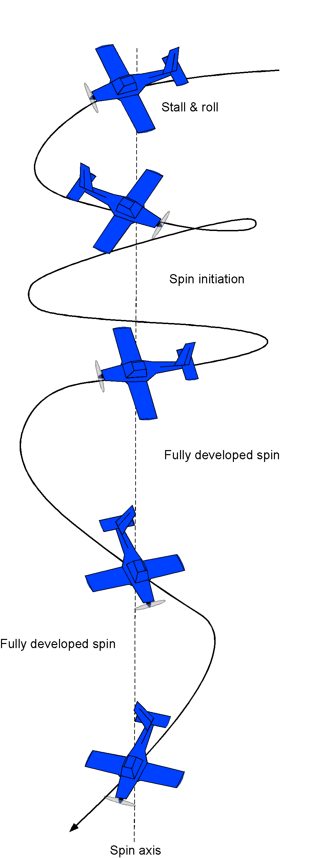
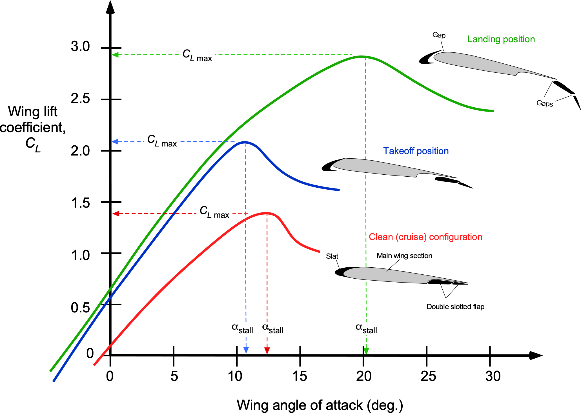
Angle of Attack & Stall

Slide 10
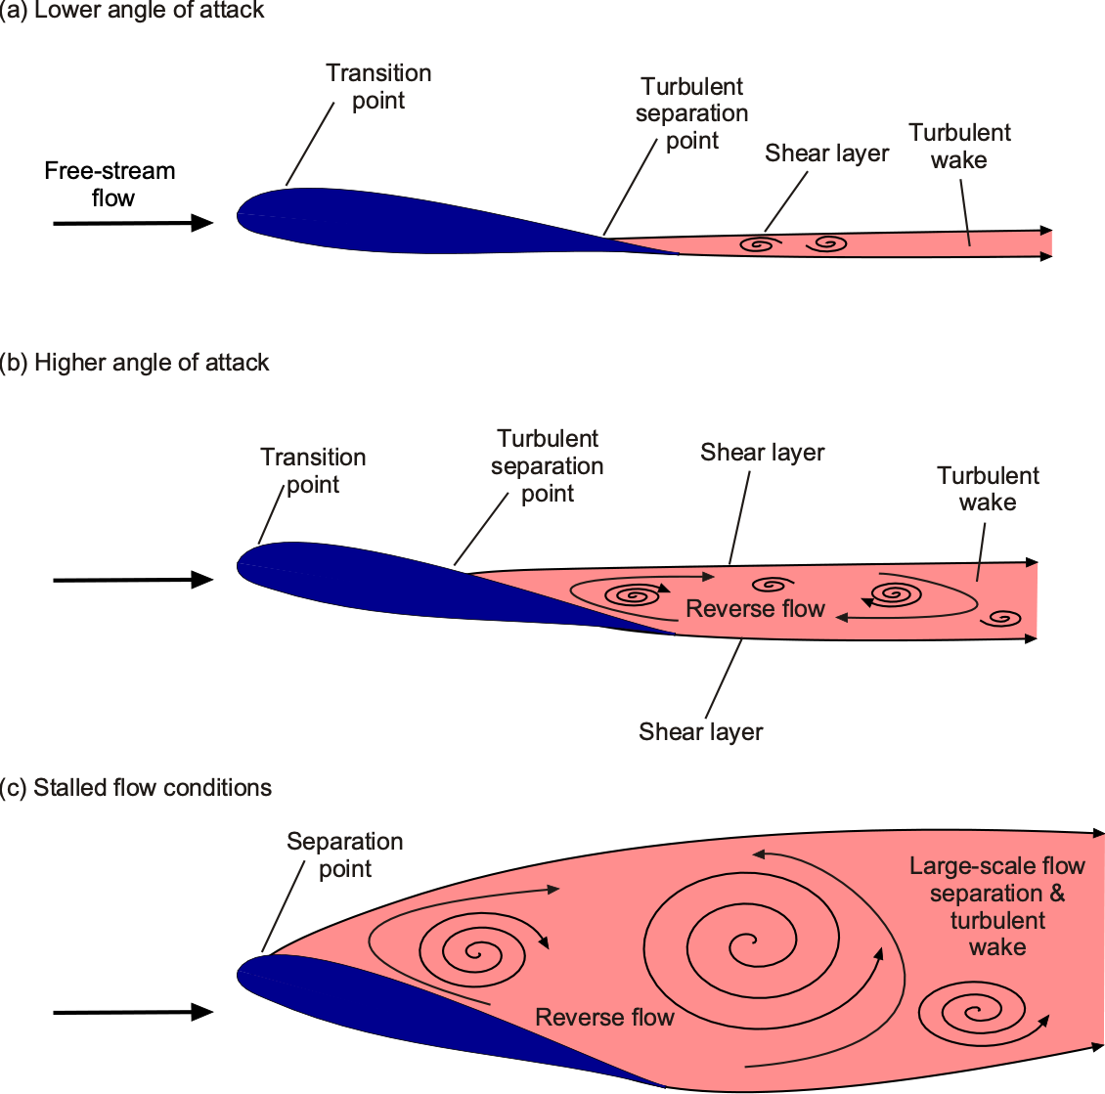
Complex Aerodynamics due to Boundary Layer on an Aerofoil

Slide 11
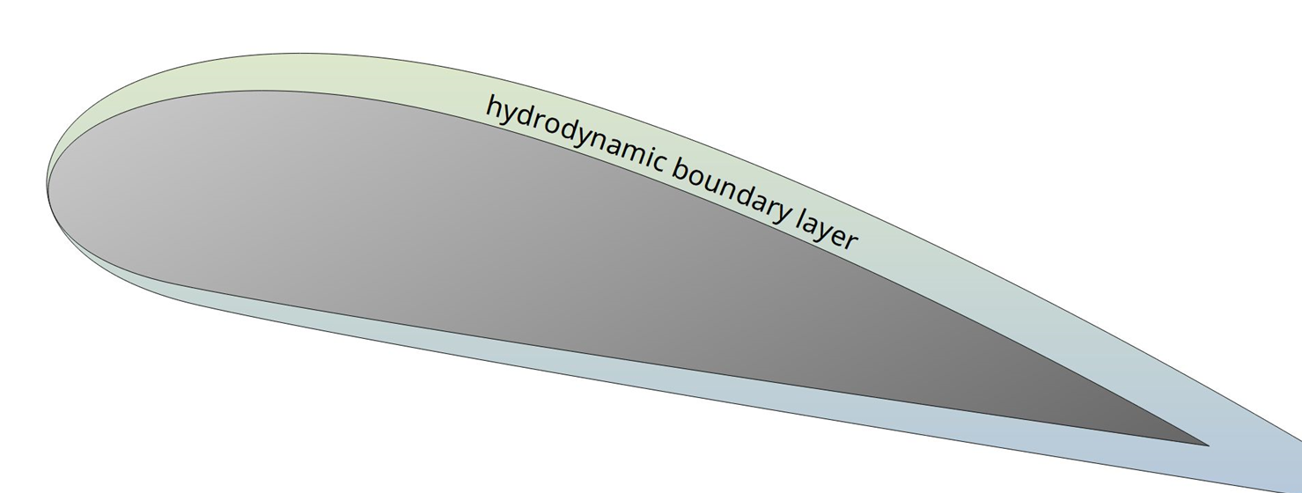
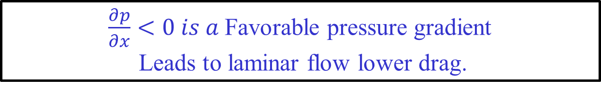
Aerofoil Boundary Layer
$\frac{∂p}{∂x}<0 is a$Favorable pressure gradient
Leads to laminar flow lower drag.

Slide 12
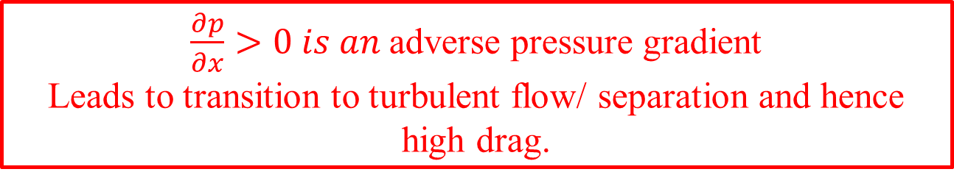
Extent of Wall Effect
$\frac{∂p}{∂x}>0 is an$adverse pressure gradient
Leads to transition to turbulent flow/ separation and hence high drag.

Slide 13
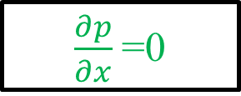
Extent of Wall Effect
$\frac{∂p}{∂x}$=0

Slide 14
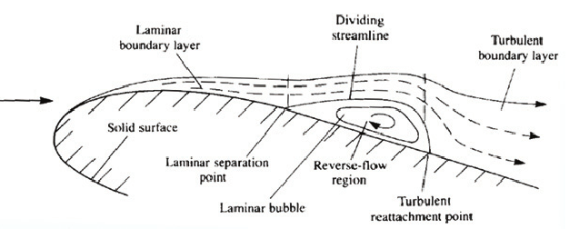
Boundary Layer on Suction Surface of an Aerofoil @ Low Reynolds Numbers

Slide 15
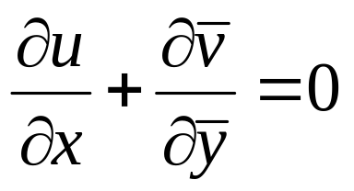
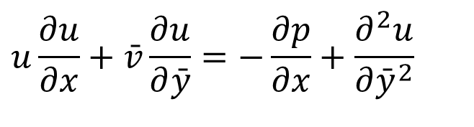
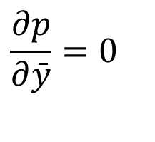
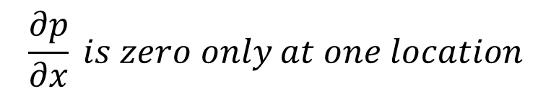
Prandtl’s 2D Boundary Layer Equations
The system of equations for Prandtl boundary-layer equations in stretched Cartesian co-ordinates.
$$u\frac{∂u}{∂x}+\bar{v}\frac{∂u}{∂\bar{y}}=−\frac{∂p}{∂x}+\frac{∂^{2}u}{∂{\bar{y}}^{2}}$$
$$\frac{∂p}{∂\bar{y}}=0$$
$$\frac{∂p}{∂x} is zero only at one location$$

Slide 16
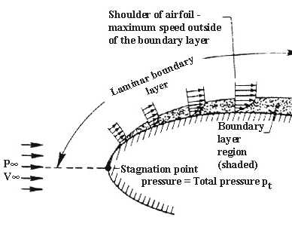
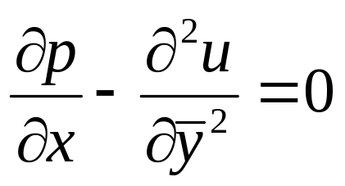
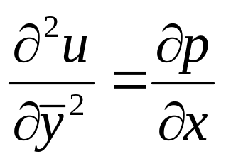
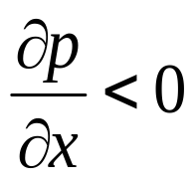
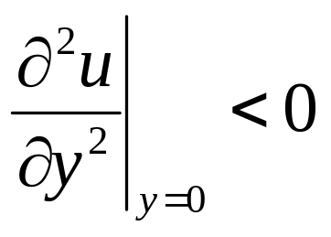

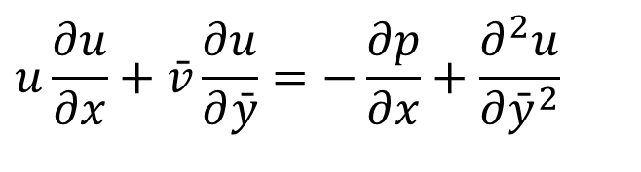
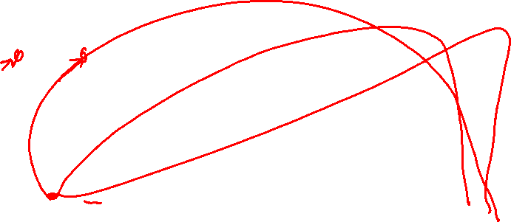
BL Equations at The Surface of Airfoil
$$u\frac{∂u}{∂x}+\bar{v}\frac{∂u}{∂\bar{y}}=−\frac{∂p}{∂x}+\frac{∂^{2}u}{∂{\bar{y}}^{2}}$$
If the external pressure gradient, , then,
at the wall
Must decrease faster as y increases

Slide 17
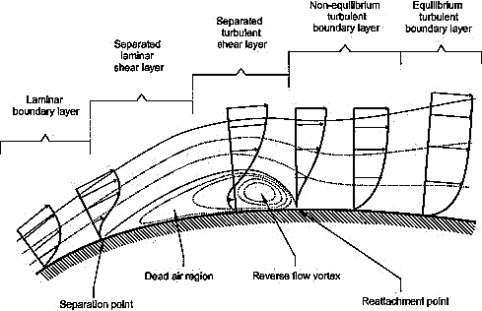
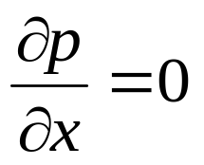
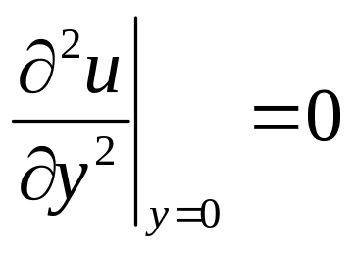
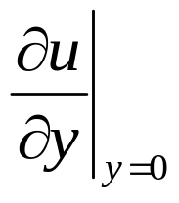
Zero Pressure Gradient Location on Suction Surface on An Airfoil
At zero pressure gradient location
at the wall
This is an inflexion point, which leads to onset of the sign change in ∂u/∂y
Will go to zero, as u is zero near surface

Slide 18
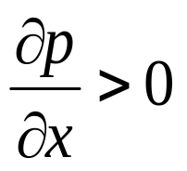
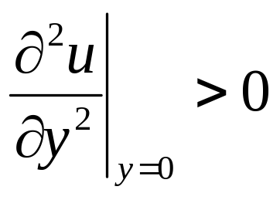
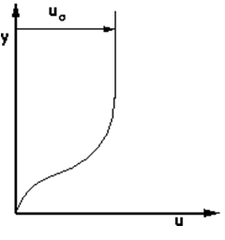
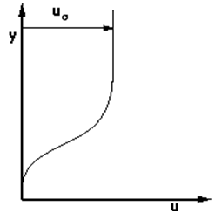
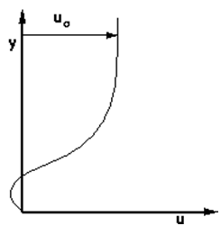
Adverse Pressure Gradient
If the external pressure gradient, , then,
at the wall
Must increase initially and then decrease as y increases
Increasing distance in downstream

Slide 19
Remarks on Prandtl’s Idea
The essence of Prandtl’s idea was discussed and agreed without any indication of possible problems in implementing it for an arbitrary body.
The function p(x), which is determined by the inviscid flow, is same for the boundary layer.
The main problem which will arise is that of boundary layer separation.
It turns out that this BL cannot be continued indefinitely attached to the surface of the body.

Slide 20
Remarks on Prandtl’s Idea
What can occur is:
  the ejection of vorticity into the free stream,
  a breaking away of the boundary layer from the surface, and
  the creation of free separation streamline.
Separation leads to of the stalling of an airfoil at high angles of attack.

Slide 21
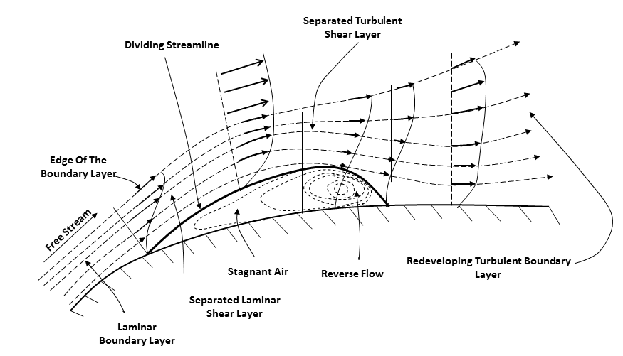
Adverse Pressure Gradient : Boundary Layer Separation
Laminar separation bubbles are caused by the inability of the boundary layer flow to make an early transition to turbulent flow.
Instead, the laminar flow separates before transition.
Flow separation creates a free shear flow.
Transition readily occurs in the free shear layer, and turbulent flow reattaches to the airfoil surface downstream of transition.
A Laminar separation bubble (LSB) is formed.

Slide 22
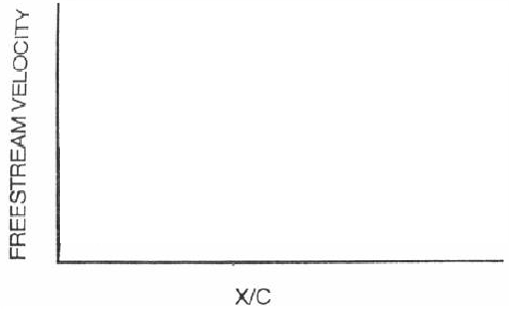
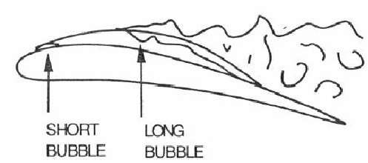
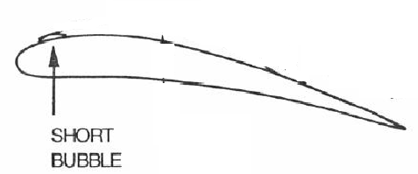
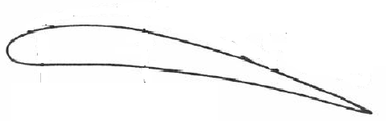
Laminar Separation Bubble in Aerofoil BL

Slide 23
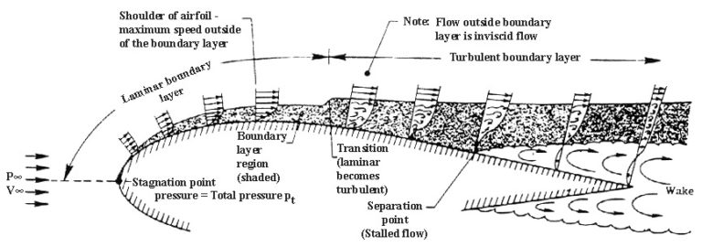
The Efficient Flow on Suction Side : Perfect Airfoil Shape
The flow on the suction side of an well behaving blade is expected to reach transition on the airfoil surface without the mechanism of a laminar separation bubble.
Prior to transition, the drag increases slowly, while downstream of transition the growth is more rapid and consistent with a turbulent boundary layer.
Such a flow is characterized by
The position of laminar–turbulent transition,
Transition length and
Diffusion rate.

Slide 24
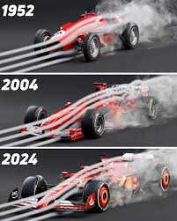
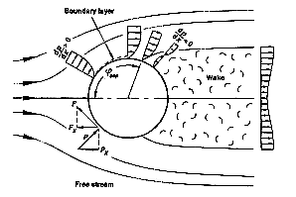
Bluff Body Boundary Layer

