Slide 1

Analysis of Turbulent Boundary Layers
P M V Subbarao
Professor
Mechanical Engineering Department
I I T Delhi
Tiny Vulnerable Zone of Infection & its Effect on Mean Flow…..

Slide 2


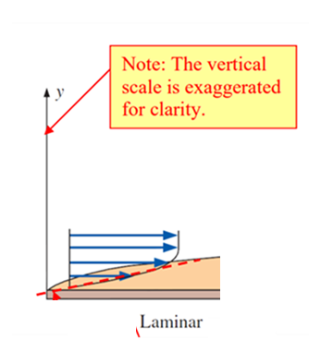
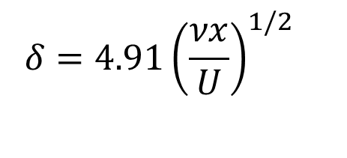
Evolution of Flat Plate Boundary Layer Thickness
The laminar flat-plate boundary layer eventually becomes turbulent at higher values of x.
$$δ=4.91{\left(\frac{νx}{U}\right)}^{1/2}$$
x

Slide 3
Evolution of Flat Plate Boundary Layer Thickness
There is no unique value for the x-location where this change to occur.
$$δ=4.91{\left(\frac{νx}{U}\right)}^{1/2}$$
x

Slide 4
Evolution of Flat Plate Boundary Layer Thickness
With care in polishing the wall and keeping the free stream quiet, one can delay the transition Reynolds number.
$$δ=4.91{\left(\frac{νx}{U}\right)}^{1/2}$$
x

Slide 5
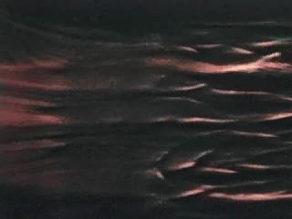
Receptivity of Boundary Layer to Disturbances

Slide 6
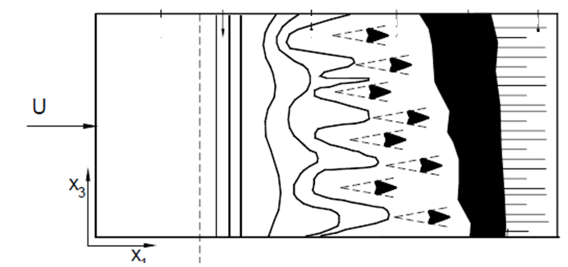
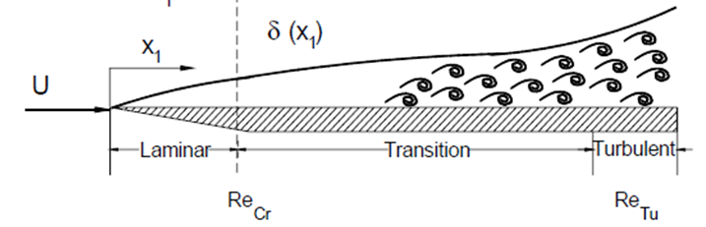
Sketch of transition process in the boundary layer along a flat Plate
A stable laminar flow is established that starts from the leading edge and extends to the point of inception of the unstable two-dimensional Tollmien-Schlichting waves.
Source: Fluid Mechanics for Engineers, A Graduate Textbook, Meinhard T. Schobeiri, 2010.

Slide 7
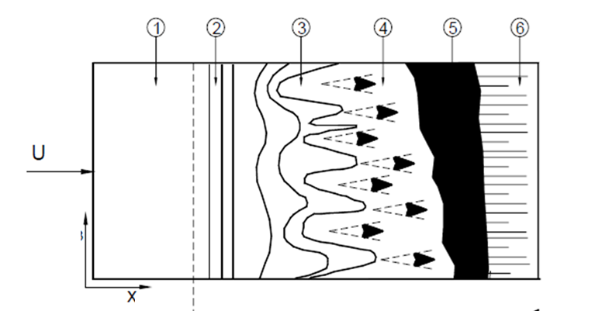
Sketch of transition process in the boundary layer along a flat Plate
Location 1: Stable Laminar Zone
z

Slide 8
Sketch of transition process in the boundary layer along a flat Plate
Location 2: Onset of the unstable One -dimensional Tollmien-Schlichting waves.
z

Slide 9
Sketch of transition process in the boundary layer along a flat Plate
Location 3: Onset of the unstable two-dimensional Tollmien-Schlichting waves.
z

Slide 10
Sketch of transition process in the boundary layer along a flat Plate
Location 3⁺: Bursts of turbulence in places with high vorticity
z

Slide 11
Sketch of transition process in the boundary layer along a flat Plate
Location 3⁺⁺Intermittent formation of turbulent spots (Horseshoe) with high vortical core at intense fluctuation.
z

Slide 12
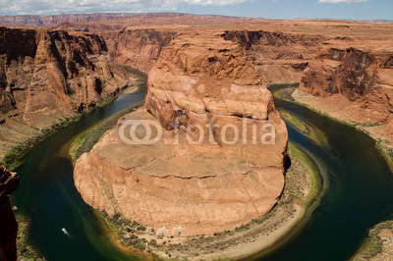
Hans Albert Einstein
(May 14, 1904 – July 26, 1973)
Hans Albert Einstein an avid sailor, frequently taking colleagues and family out for excursions on the San Francisco Bay.
On his many field trips and academic excursions, he took thousands of pictures, many of which he developed himself and presented as slide shows.
In 1988, the American Society of Civil Engineers created the Hans Albert Einstein Award to recognize outstanding achievements in erosion control, sedimentation and/or waterway development.

Slide 13
Sketch of transition process in the boundary layer along a flat Plate
Location 4: Development of unstable, three-dimensional waves and the formation of vortex cascades
z

Slide 14
Sketch of transition process in the boundary layer along a flat Plate
Zone 5: Coalescence of turbulent spots into a fully developed turbulent boundary layer.
z

Slide 15
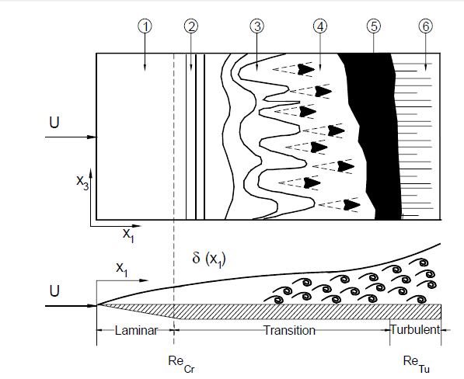
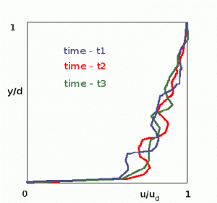
Sketch of transition process in the boundary layer along a flat Plate
Fully Developed Turbulent Zone
z

Slide 16
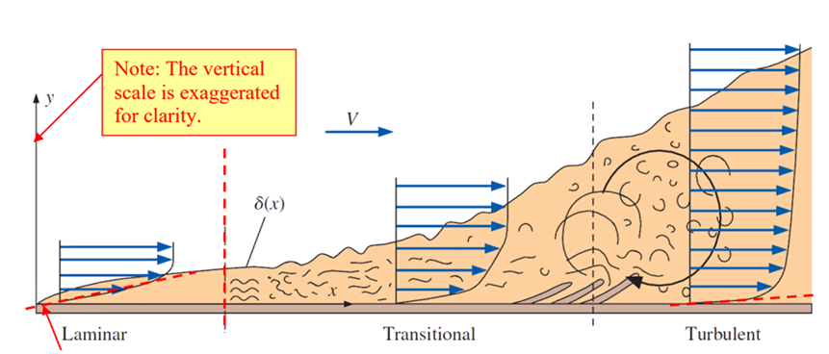
Evolution of Flat Plate Boundary Layer Thickness
Transition begins at some location x_{crit}, as shown in the figure.

Slide 17
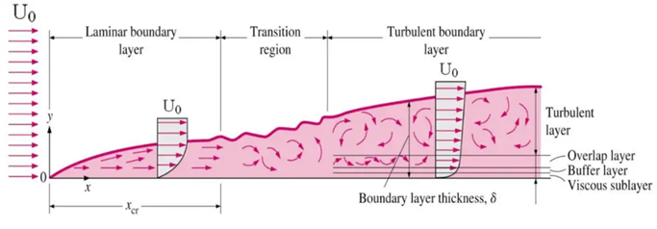

Transition of Boundary Layer
x_{crit} is determined by the critical Reynolds number, Re_{x,crit}.
For flow over a flat plate, transition from laminar to turbulent boundary layer occurs when Reynolds number at x exceeds Re_{x,crit} ~ 500,000.
The transition may occur earlier, but it is dependent especially on the surface roughness.
The turbulent boundary layer thickens more rapidly than the laminar boundary layer due to increased shear stress at the body surface.
For typical commercial surfaces and gusty free streams, a more realistic value is
$${Re}_{cr}=5×{10}^{5}$$

Slide 18
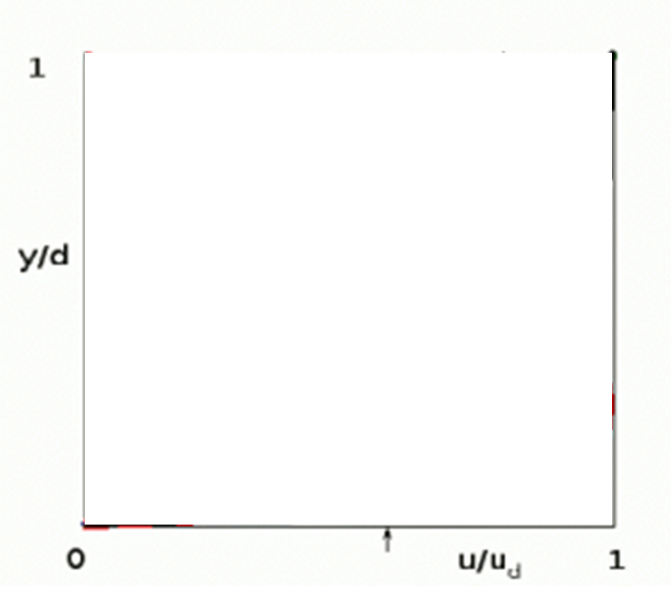
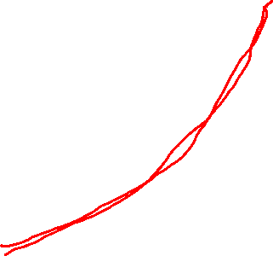
Turbulent Flat Plate Boundary Layers
Once the surface layer becomes unstable the flow breaks up into random turbulence.
The profile at a particular location is no longer fixed but varies with time.
In this case profiles can only be analysed as time averages with an associated level of turbulence at each height.
$$\frac{urms}{U}$$
$$\frac{\overline{u}\left(y\right)}{U}$$

Slide 19
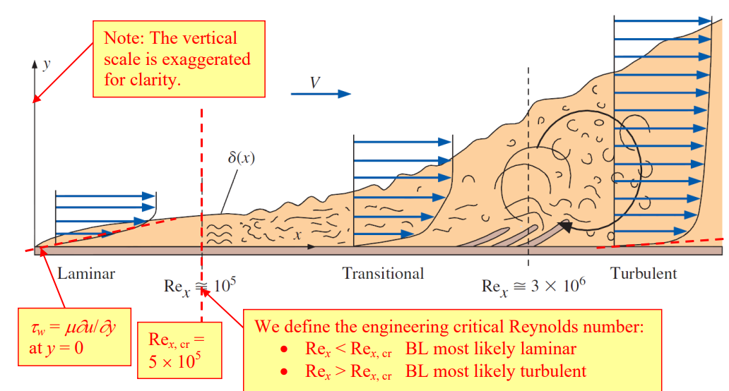
Holistic Picture of Flat Plate Boundary Layer
Velocity profile in a turbulent FPBL is defined using a simplified law
at large values of Re_{x} > 10⁷ , one-seventh-power law: $\frac{u}{U}={\left\{\frac{u}{U}\right\}}^{1/7}$

Slide 20
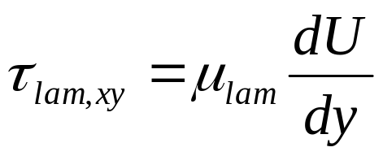
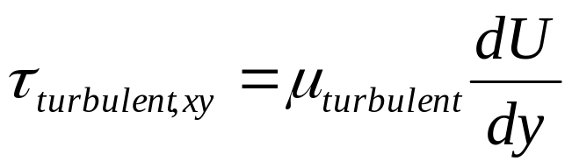
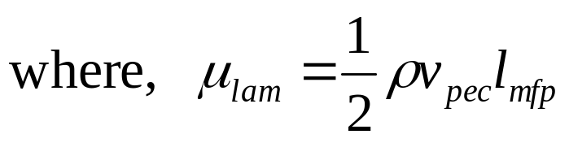
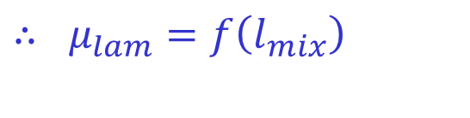
Laminar Vs Turbulent Viscosity
Prandtl was the first to present a working algebraic equation of turbulent viscosity that is applied to boundary layer flows.
The model is based on mixing length hypothesis deduced from experiments and is analogous, to some extent, to the mean free path in kinetic gas theory.
Molecular transport
Turbulent transport
$$∴ μ_{lam}=f\left(l_{mix}\right)$$

Slide 21
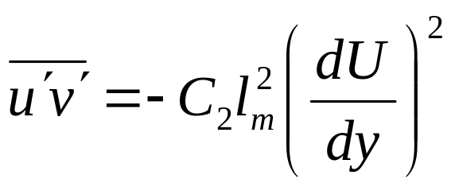
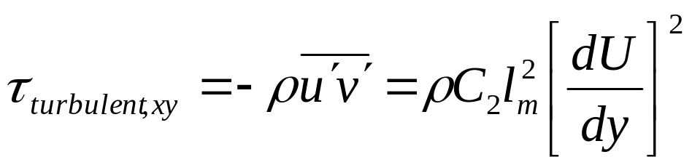
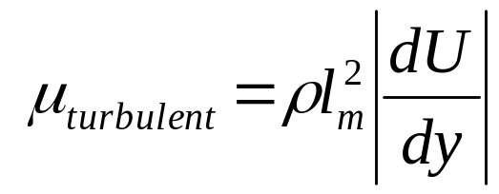
Prandtl Mixing Length Model
The component of the Reynolds stress tensor is function of mixing length as given:
The turbulent shear stress component becomes
This is the Prandtl mixing length hypothesis.
Prandtl deduced that the eddy viscosity can be expressed as

Slide 22
Estimation of Mixing Length
To find an algebraic expression for the mixing length l_{m}, several empirical correlations were suggested in literature.
The mixing length l_{m} does not have a universally valid character and changes from case to case.
Therefore it is not appropriate for three-dimensional flow applications.
However, it is successfully applied to boundary layer flow, fully developed duct flow and particularly to free turbulent flows.
Prandtl and many others started with analysis of the two-dimensional boundary layer infected by disturbance.
For wall flows, the main source of infection is wall.
The wall roughness contains many cavities and troughs, which infect the flow and introduce disturbances.

Slide 23
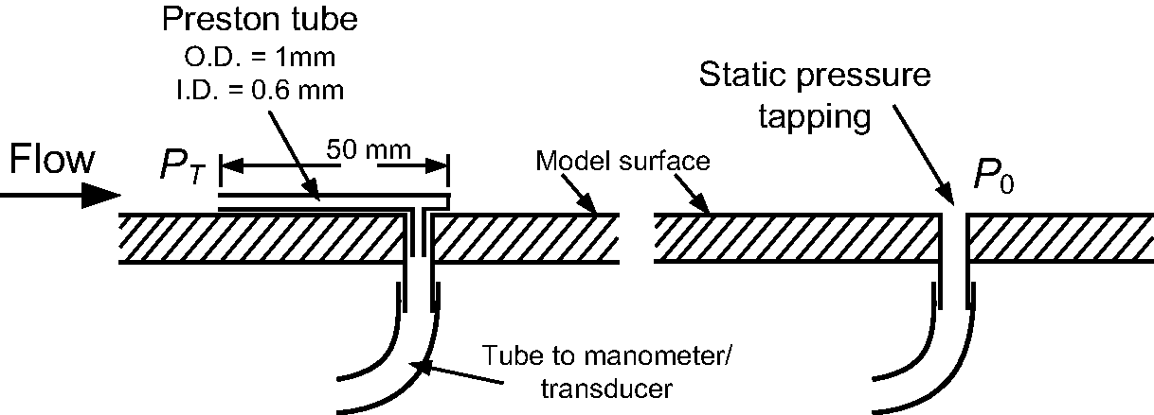
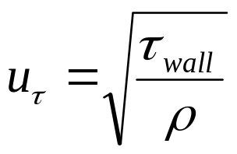
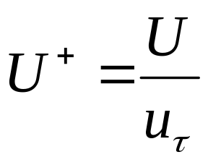
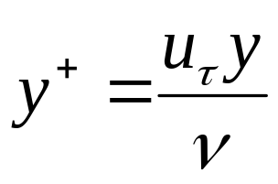
Quantification of Infection by Seeing the Effect
Develop simple experimental test rigs.
Measure wall shear stress.
Define wall friction velocity using the wall shear stress by the relation
Define non-dimensional boundary layer coordinates.

Slide 24
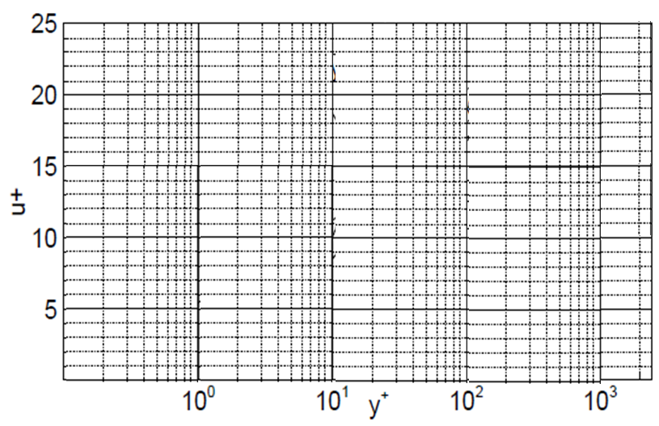
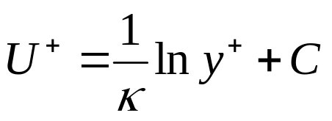

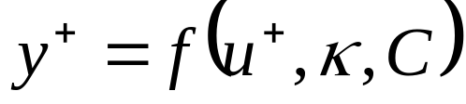
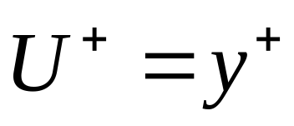
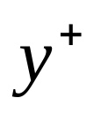
Approximation of velocity distribution for a fully turbulent 2D Boundary Layer

Slide 25
Approximation of velocity distribution for a fully turbulent 2D Boundary Layer
For a fully developed turbulent flow, the constants are experimentally found to be κ=0.41 and C=5.0.
Turbulent (logarithmic)Layer
Intermediate Layer
Laminar Sub Layer

Slide 26
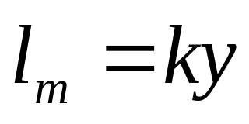
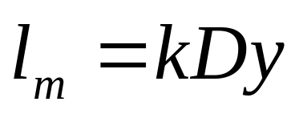
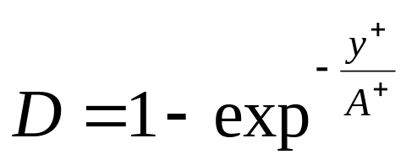
Measures for Mixing Length
Outside the viscous sublayer marked as the logarithmic layer, the mixing length is approximated by a simple linear function.
Accounting for viscous damping, the mixing length for the viscous sublayer is modeled by introducing a damping function D.
As a result, the mixing length in viscous sublayer:
The damping function D proposed by van Driest
with the constant A⁺ = 26 for a boundary layer at zero-pressure gradient.

Slide 27
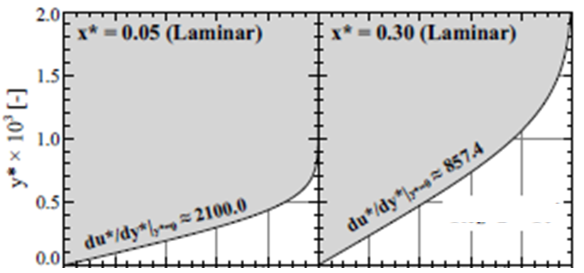
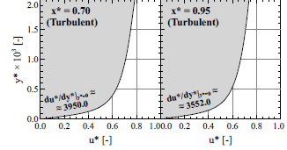
Computational Analysis of BL on A Flat Plate
Evolution of Velocity Profiles on a long Flat Plate with ${Re}_{L}=2×{10}^{6}$

Slide 28
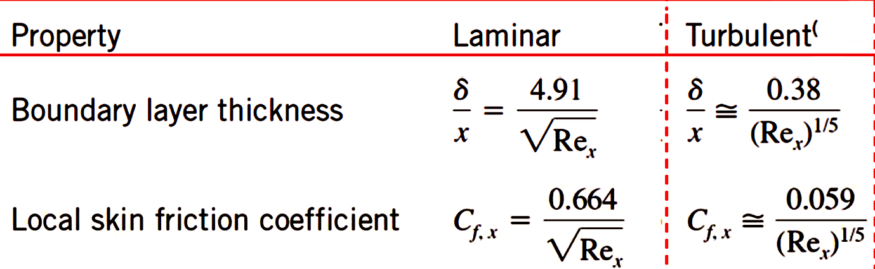
Summary of Engineering Relations for A FPBL

Slide 29
Summary of Engineering Relations for A FPBL
The integrated average skin friction coefficients for one side of a flat plate of length L.
The C_{f,L} applicable to the entire plate from x = 0 to x = L.
For Laminar Flow Region: $C_{f,L}=\frac{1.33}{\sqrt{{Re}_{L}}} for {Re}_{L}≤5×{10}^{5}$
For Turbulent Flow Region: $C_{f,L}=\frac{0.074}{\sqrt[5]{{Re}_{L}}} for {Re}_{L}>5×{10}^{5}$

Slide 30
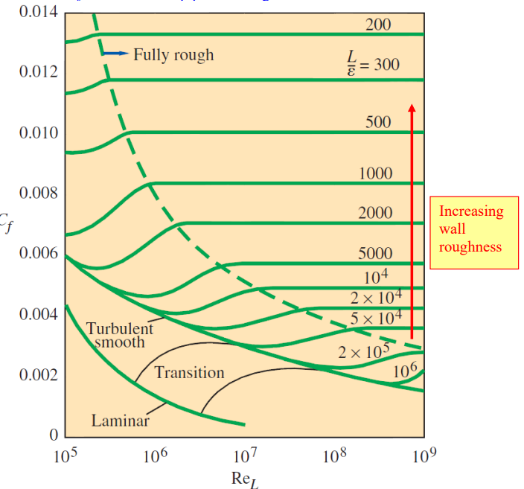
Turbulent Flat Plate Boundary Layers with wall Roughness:
For fully turbulent rough plate:
$$C_{f,L}={\left\{1.89−\frac{ε}{L}\right\}}^{−2.5}$$

