Slide 1

Analysis of Turbulent Pipe Flows
P M V Subbarao
Professor
Mechanical Engineering Department
I I T Delhi
Quantification of the Infection & its Effect on Mean Flow, Momentum Loss…..

Slide 2


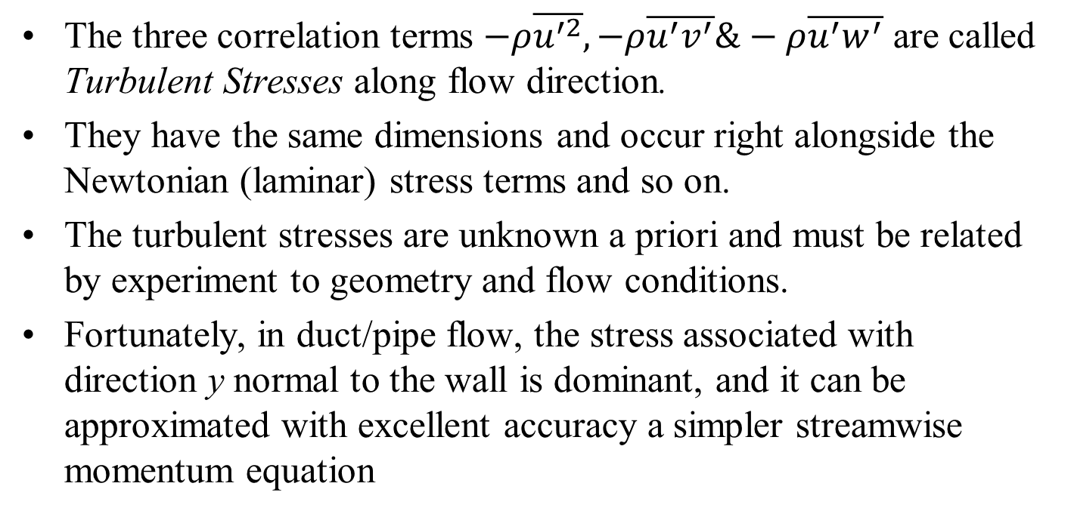
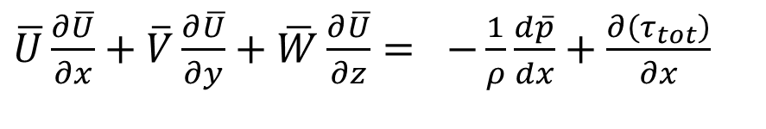
Turbulent Stresses
The three correlation terms $−ρ\overline{u^{′2}},−ρ\overline{u^{′}v^{′}}\&−ρ\overline{u^{′}w^{′}}$ are called Turbulent Stresses along flow direction.
They have the same dimensions and occur right alongside the Newtonian (laminar) stress terms and so on.
The turbulent stresses are unknown a priori and must be related by experiment to geometry and flow conditions.
Fortunately, in duct/pipe flow, the stress associated with direction y normal to the wall is dominant, and it can be approximated with excellent accuracy a simpler streamwise momentum equation
$\overline{U}\frac{∂\overline{U}}{∂x}+\overline{V}\frac{∂\overline{U}}{∂y}+\overline{W}\frac{∂\overline{U}}{∂z}=$ $−\frac{1}{ρ}\frac{d\overline{p}}{dx}+\frac{∂\left(τ_{tot}\right)}{∂x}$

Slide 3
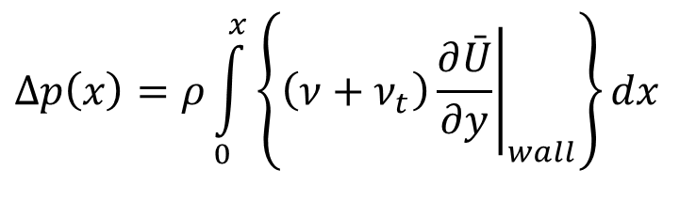
Turbulent flow: Enhanced Viscosity Flows due to High Inertia
Enhanced viscosity due to Turbulence is to be quantified using suitable modelling/experimentation:
$$τ_{total}=−ρ\left(v{\left.\frac{∂\bar{U}}{∂y}\right|}_{wall}−\overline{u^{′}v^{′}}\right)=ρ\left\{\left(ν+ν_{t}\right){\left.\frac{∂\bar{U}}{∂y}\right|}_{wall}\right\}$$
ν_{t} : Turbulent kinematic viscosity
Ū: Mean (time averaged) velocity of main flow
$$Δp\left(x\right)=ρ\int_{0}^{x}{\left\{\left(ν+ν_{t}\right){\left.\frac{∂\bar{U}}{∂y}\right|}_{wall}\right\}dx}$$

Slide 4
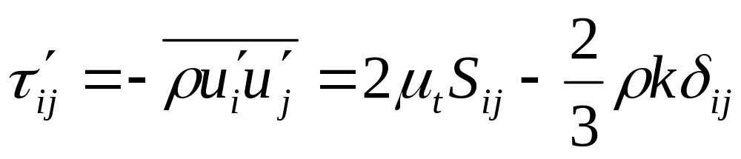
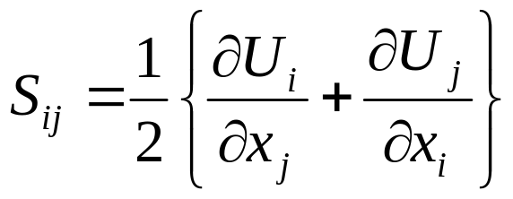
Turbulent-Viscosity Models
Eddy-viscosity models
Compute the Reynolds-stresses from explicit expressions of the mean strain rate and a turbulent (eddy) viscosity.
Boussinesq eddy-viscosity approximation
  The k term is a normal stress and is typically treated together with the pressure term.

Slide 5
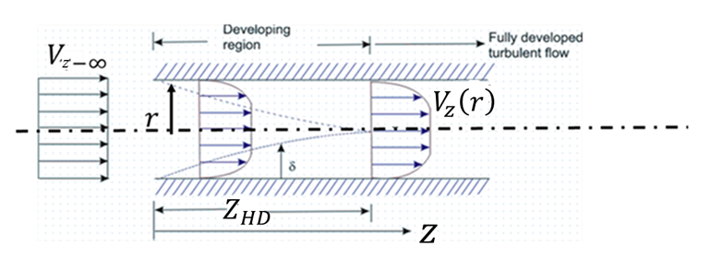
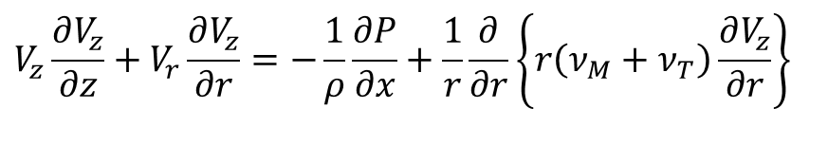
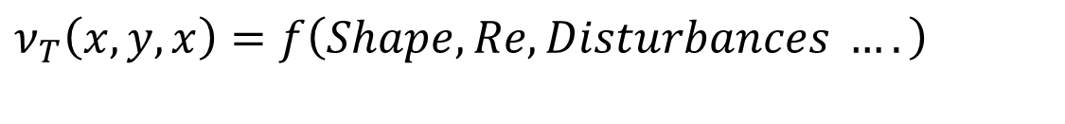
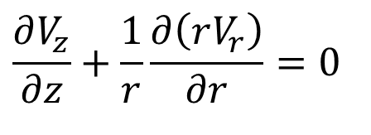
Reynolds Averaged Equations : Incompressible Steady Turbulent Pipe Flow Pipe
$$\frac{∂V_{z}}{∂z}+\frac{1}{r}\frac{∂\left(rV_{r}\right)}{∂r}=0$$
$$V_{z}\frac{∂V_{z}}{∂z}+V_{r}\frac{∂V_{z}}{∂r}=−\frac{1}{ρ}\frac{∂P}{∂x}+\frac{1}{r}\frac{∂}{∂r}\left\{r\left(ν_{M}+ν_{T}\right)\frac{∂V_{z}}{∂r}\right\}$$
$$ν_{T}\left(x,y,x\right)=f\left(Shape, Re, Disturbances ….\right)$$

Slide 6
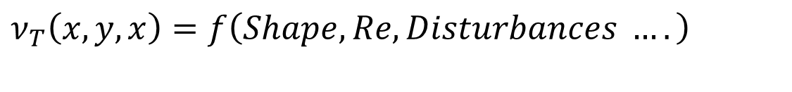
Estimation of Turbulent Viscosity
$$ν_{T}\left(x,y,x\right)=f\left(Shape, Re, Disturbances ….\right)$$
Estimation of turbulent (eddy) viscosity thru computer simulations using RANS is being tried for last 7 decades.
Popular Computation Fluid Dynamic methods are:
k-ε - RANS-type CFD.
k-ω – RANS-type CFD.
k- ω -SST
…….
NASA’s CFD Vision 2030 report, published in 2014: CFD calculations are either not fully trustworthy or too expensive making them a poor substitute for Real world use.

Slide 7
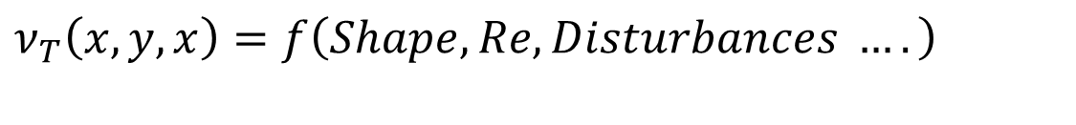
Machine Learning (ML)-RANS Integration
$$ν_{T}\left(x,y,x\right)=f\left(Shape, Re, Disturbances ….\right)$$
The core idea behind ML-RANS integration motivates the development of a surrogate turbulent (eddy) viscosity model to general cost-effect, accurate and fast use in Real World.
Data generation phase – Conventional CFD/Experimentation.
Training phase – Select and train a suitable ML.
Testing phase – Test for accuracy and speed.
Real World use – Final use of the product.

Slide 8
Machine Learning
$$ν_{T}\left(x,y,x\right)=f\left(Shape, Re, Disturbances ….\right)$$
Machine learning can be classified into three big categories:
Unsupervised ML
Semi-supervised ML
Supervised ML

Slide 9
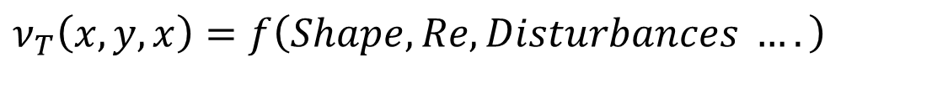
Supervised Machine Learning
$$ν_{T}\left(x,y,x\right)=f\left(Shape, Re, Disturbances ….\right)$$
Supervised ML is used to uncover relationships between a set of measurements and the target variables.
It can describe very complex nonlinear relations between measurements and the target variables and is superior to traditional algorithms.
Supervised ML makes use of the fact that it is often easier to train a system, an intended input-output behaviour.

Slide 10
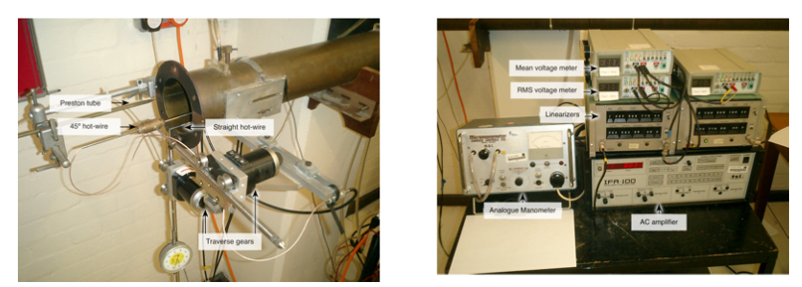
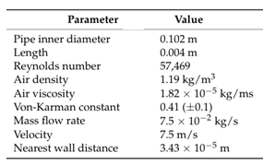
Machine Learning: Step 1
$$ν_{T}\left(x,y,x\right)=f\left(Shape, Re, Disturbances ….\right)$$

Slide 11
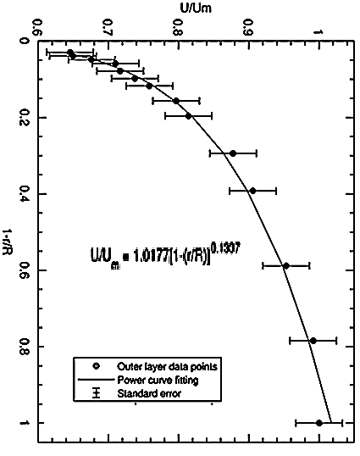
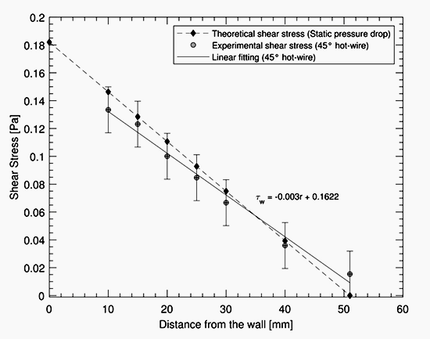
Average Velocity Profile

Slide 12
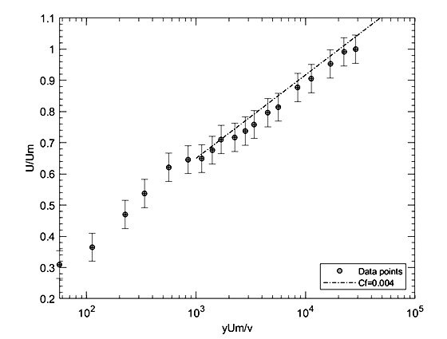
Average Velocity Profile

Slide 13
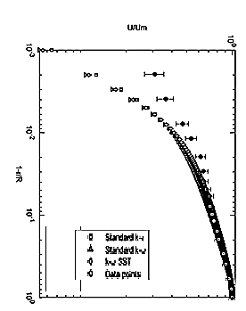
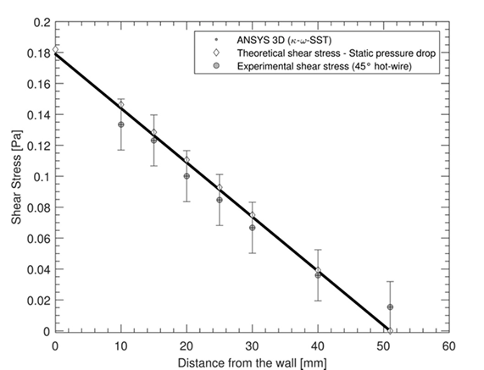
Average Velocity Profile

Slide 14
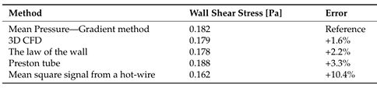
20th Century Studies: Turbulent Pipe Flows

Slide 15
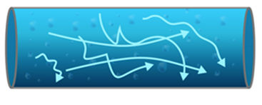
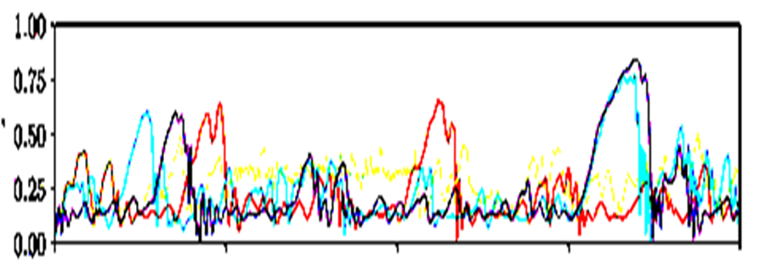
21st Century ML: Turbulent Pipe Flows

Slide 16
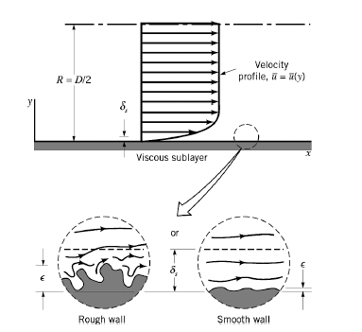
20th Century Industrial Practice :
Turbulent flow and Roughness of pipes
It is impossible to manufacture a perfectly smooth surface of a pipe.
Every pipe will have a non-zero surface roughness, based on material and manufacturing process.
Roughness of a pipe surface also influences the value of friction factor.
J. Nikuradse in 1933 conducted several experiments in artificially roughened pipes produced by gluing sand grains of known size onto pipe walls.

Slide 17
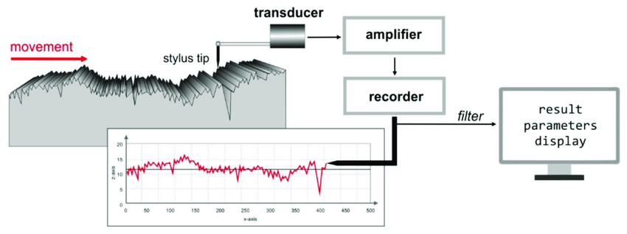
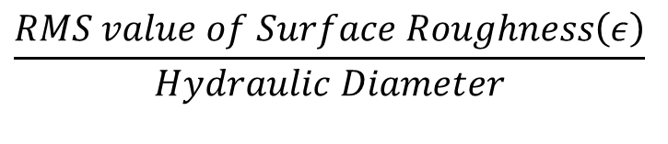
Quantification of Infection by seeing the Real Working System: Machine Learning
Develop simple experimental test rigs.
Measure pressure drop.
Two most important variables influencing the pressure drop per unit length are Reynolds number and Surface Roughness.
Define non-dimensional Surface Roughness variable as
$$\frac{RMS value of Surface Roughness\left(ε\right)}{Hydraulic Diameter}$$

Slide 18
General Pipes & Roughness
Pipe Material | Absolute Roughness, e
 | micron (unless noted)
Drawn brass | 1.5
Drawn copper | 1.5
Commercial steel | 45
Wrought iron | 45
asphalted cast iron | 120
galvanized iron | 150
cast iron | 260
wood stave | 0.2 to 0.9 mm
concrete | 0.3 to 3 mm
riveted steel | 0.9 to 9 mm

Slide 19
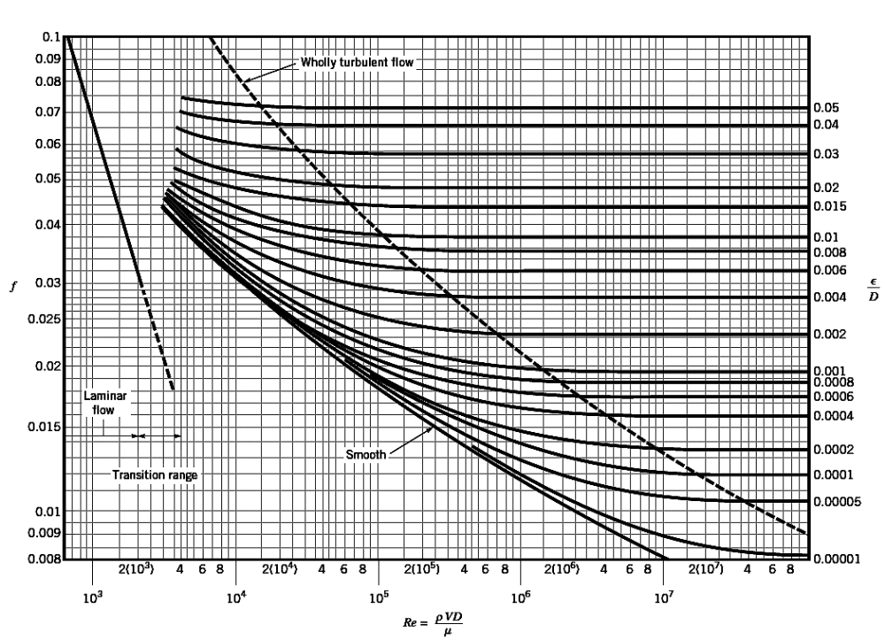
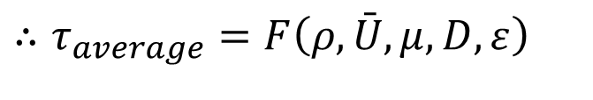
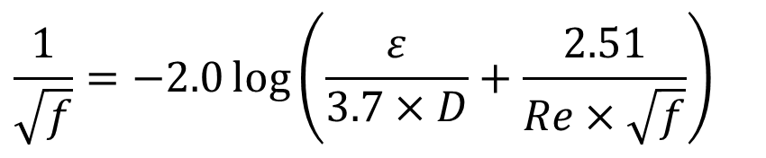
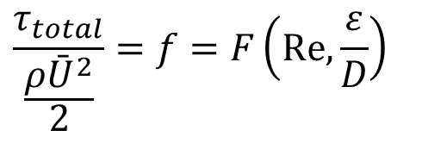
Turbulent flow and Roughness of pipes
A measure of the effective relative roughness of typical pipes on the friction factor is included as…..
$$∴τ_{average}=F\left(ρ,\bar{U},μ,D,ε\right)$$
where є is the wall-roughness height.
Use theory of similitude and carryout dimensional analysis:
$$\frac{τ_{total}}{\frac{ρ{\bar{U}}^{2}}{2}}=f=F\left(Re,{\frac{ε}{D}}\right)$$
Colebrook combined all data for turbulent flow in smooth as well as rough pipes into the following relation known as Colebrook equation
$$\frac{1}{\sqrt{f}}=−2.0\log\left(\frac{ε}{3.7×D}+\frac{2.51}{Re×\sqrt{f}}\right)$$

Slide 20
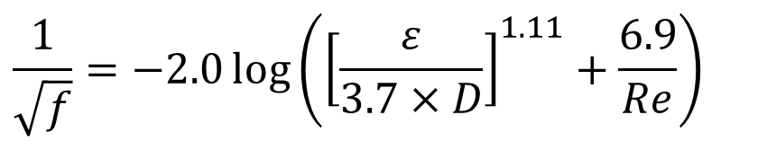
Turbulent flow and Roughness of pipes
$$\frac{1}{\sqrt{f}}=−2.0\log\left(\frac{ε}{3.7×D}+\frac{2.51}{Re×\sqrt{f}}\right)$$
This is Colebrook equation and is implicit in f , and determination of friction factor requires tedious iteration.
An approximate explicit relation for f is given by S.E. Haaland in 1983 as
$$\frac{1}{\sqrt{f}}=−2.0\log\left({\left[\frac{ε}{3.7×D}\right]}^{1.11}+\frac{6.9}{Re}\right)$$
The dimensionless parameter f is called the Darcy friction factor, after Henry Darcy.

Slide 21
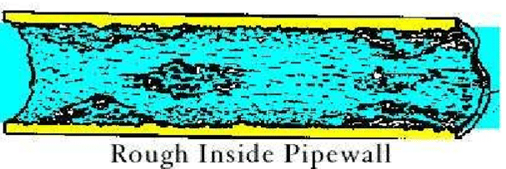
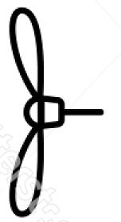
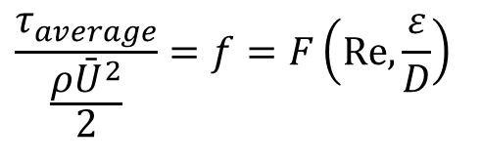
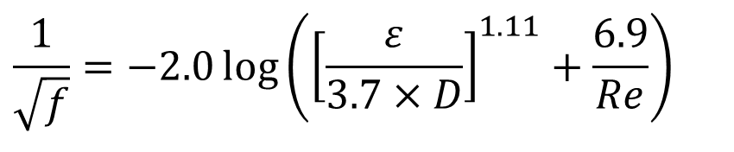
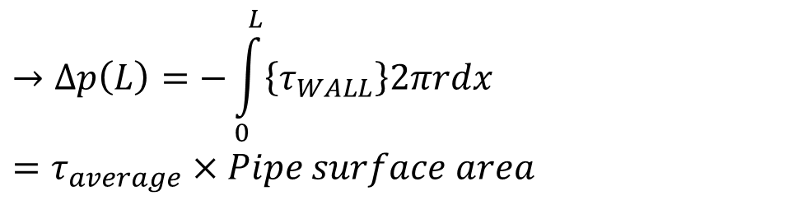
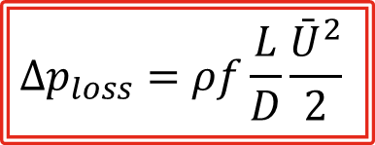
Condition for Steady flow with Wall Resistance
$$→Δp\left(L\right)=−\int_{0}^{L}{\left\{τ_{WALL}\right\}2πrdx}=τ_{average}×Pipe surface area$$
For Steady flow:
$$\frac{τ_{average}}{\frac{ρ{\bar{U}}^{2}}{2}}=f=F\left(Re,{\frac{ε}{D}}\right)$$
$$\frac{1}{\sqrt{f}}=−2.0\log\left({\left[\frac{ε}{3.7×D}\right]}^{1.11}+\frac{6.9}{Re}\right)$$
The desired expression for finding pressure loss is
$$Δp_{loss}=ρf\frac{L}{D}\frac{{\bar{U}}^{2}}{2}$$

