Slide 1

Turbulent Flows: Reynolds Averaging of NS Equations
P M V Subbarao
Professor
Mechanical Engineering Department
I I T Delhi
Quantification of the Infection & its Effect on Mean Flow, Momentum Loss…..

Slide 2


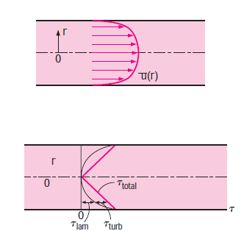
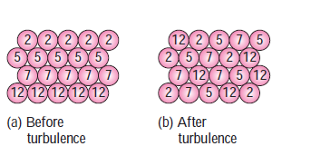
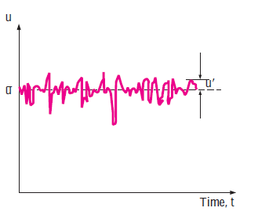
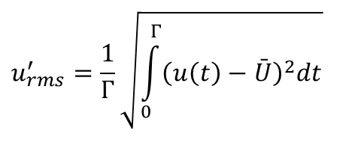
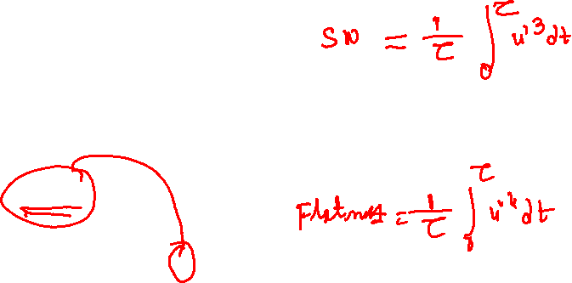
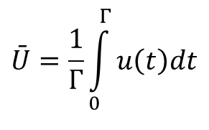
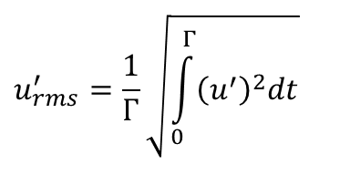
Increasing Inertia in Viscous Pipe Flows
Layers of fluid particles
Mean velocity flow
$$\bar{U}=\frac{1}{Γ}\int_{0}^{Γ}{u\left(t\right)dt}$$
Turbulence Level (rms Value):
$$u_{rms}^{′}=\frac{1}{Γ}\sqrt{\int_{0}^{Γ}{{\left(u\left(t\right)−\bar{U}\right)}^{2}dt}}$$
$$u_{rms}^{′}=\frac{1}{Γ}\sqrt{\int_{0}^{Γ}{{\left(u^{′}\right)}^{2}dt}}$$

Slide 3
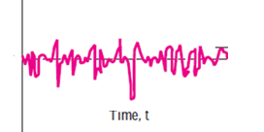
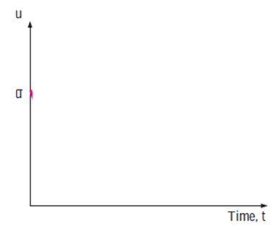
Increasing Inertia in Steady Viscous Pipe Flows
Instantaneous velocity in a steady turbulent pipe flow
+u(t)
Velocity fluctuations in a steady turbulent pipe flow
0
+u(t)
+U(t)
0
-u′(t)
0
Mean velocity in a steady turbulent pipe flow

Slide 4
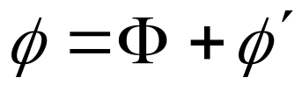
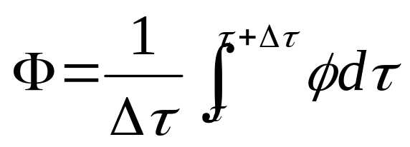
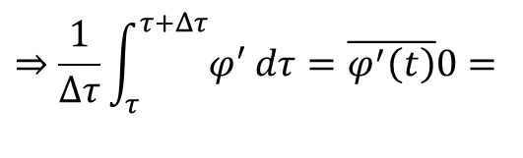
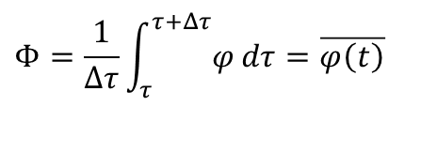
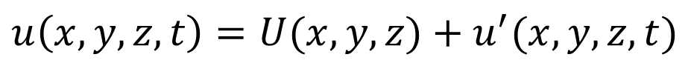
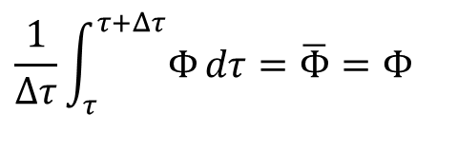
First Method of Analyzing Steady Turbulent Flow
Reynolds (1895) decomposed the velocity field into a time average
motion and a turbulent fluctuation
$$u\left(x,y,z,t\right)=U(x,y,z)+u^{′}(x,y,z,t)$$
- Likewise, any flow variable
φ stands for any scalar: u, v, w, T, p, where:
$$Φ=\frac{1}{Δτ}\int_{τ}^{τ+Δτ}{φ}dτ=\overline{φ\left(t\right)}$$
$$⇒\frac{1}{Δτ}\int_{τ}^{τ+Δτ}{φ^{′}}dτ=\overline{φ^{′}\left(t\right)}0=$$
Time averaged Scalar
$$\frac{1}{Δτ}\int_{τ}^{τ+Δτ}{Φ}dτ=\overline{Φ}=Φ$$

Slide 5
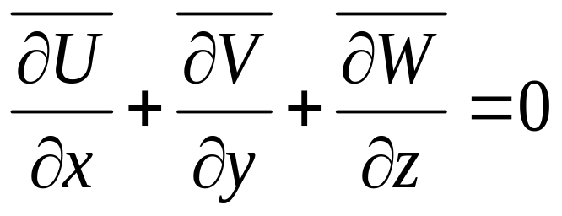
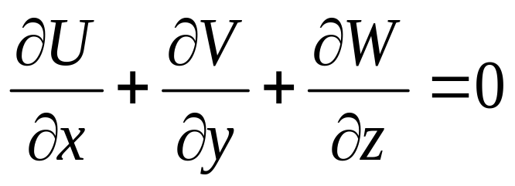
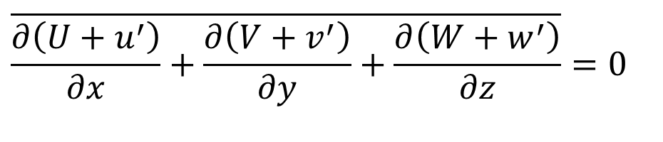

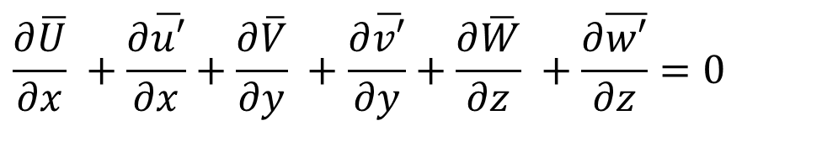
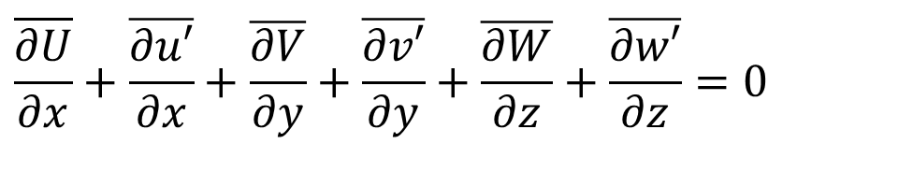
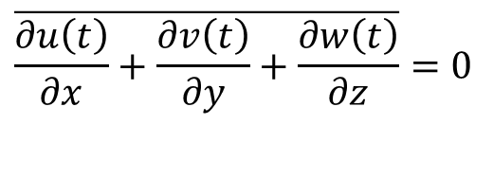
Reynolds Averaging of Continuity Equations: Steady Turbulent Pipe Flows
$$\overline{\frac{∂u\left(t\right)}{∂x}+\frac{∂v\left(t\right)}{∂y}+\frac{∂w\left(t\right)}{∂z}}=0$$
$$\overline{\frac{∂\left(U+u^{′}\right)}{∂x}+\frac{∂\left(V+v^{′}\right)}{∂y}+\frac{∂\left(W+w^{′}\right)}{∂z}}=0$$
$$\overline{\frac{∂U}{∂x}}+\overline{\frac{∂u′}{∂x}}+\overline{\frac{∂V}{∂y}}+\overline{\frac{∂v′}{∂y}}+\overline{\frac{∂W}{∂z}}+\overline{\frac{∂w′}{∂z}}=0$$
$$\frac{∂\overline{U}}{∂x} +\frac{∂\overline{u′}}{∂x}+\frac{∂\overline{V}}{∂y} +\frac{∂\overline{v′}}{∂y}+\frac{∂\overline{W}}{∂z} +\frac{∂\overline{w′}}{∂z}=0$$

Slide 6
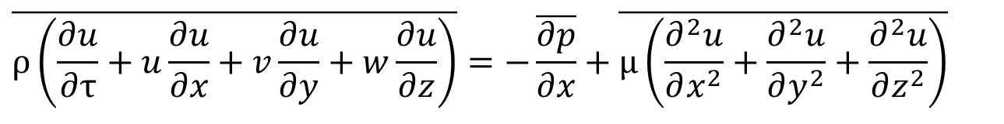
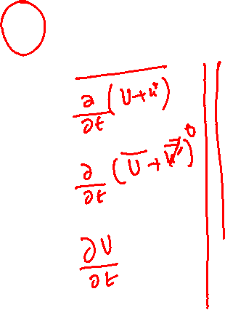
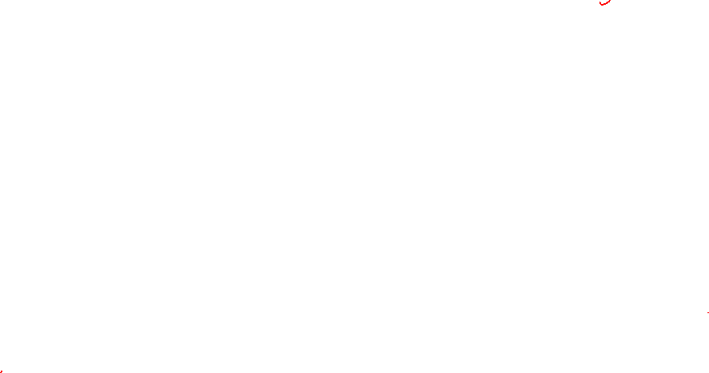
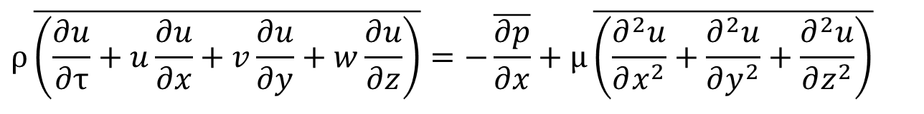
Reynolds Averaging od X-momentum Equation
For Steady Incompressible Turbulent Pipe Flow:
$$\overline{ρ\left(\frac{∂u}{∂τ}+u\frac{∂u}{∂x}+v\frac{∂u}{∂y}+w\frac{∂u}{∂z}\right)}=−\overline{\frac{∂p}{∂x}}+\overline{μ\left(\frac{∂^{2}u}{∂x^{2}}+\frac{∂^{2}u}{∂y^{2}}+\frac{∂^{2}u}{∂z^{2}}\right)}$$
$$ρ\overline{\left(\frac{∂u}{∂τ}+u\frac{∂u}{∂x}+v\frac{∂u}{∂y}+w\frac{∂u}{∂z}\right)}=−\overline{\frac{∂p}{∂x}}+μ\overline{\left(\frac{∂^{2}u}{∂x^{2}}+\frac{∂^{2}u}{∂y^{2}}+\frac{∂^{2}u}{∂z^{2}}\right)}$$

Slide 7
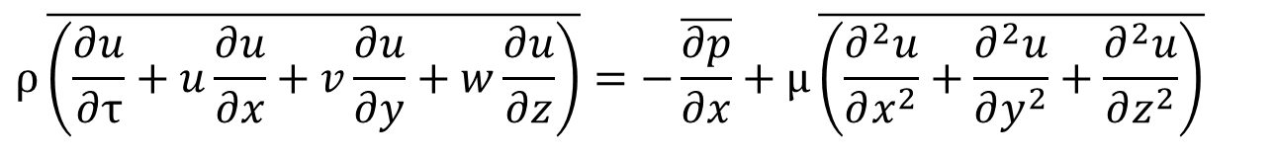
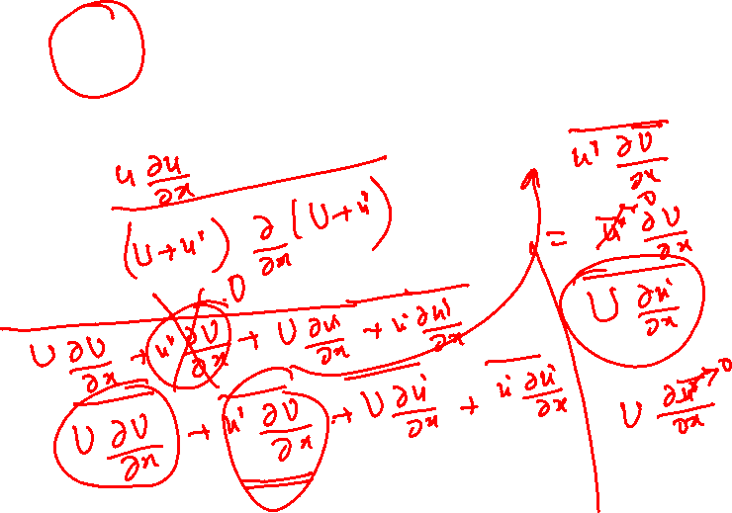
Reynolds Averaging od X-momentum Equation
For Steady Incompressible Turbulent Pipe Flow:
$$ρ\overline{\left(\frac{∂u}{∂τ}+u\frac{∂u}{∂x}+v\frac{∂u}{∂y}+w\frac{∂u}{∂z}\right)}=−\overline{\frac{∂p}{∂x}}+μ\overline{\left(\frac{∂^{2}u}{∂x^{2}}+\frac{∂^{2}u}{∂y^{2}}+\frac{∂^{2}u}{∂z^{2}}\right)}$$

Slide 8
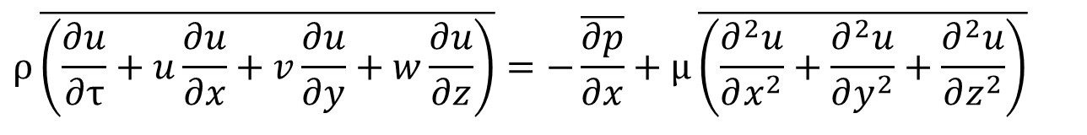
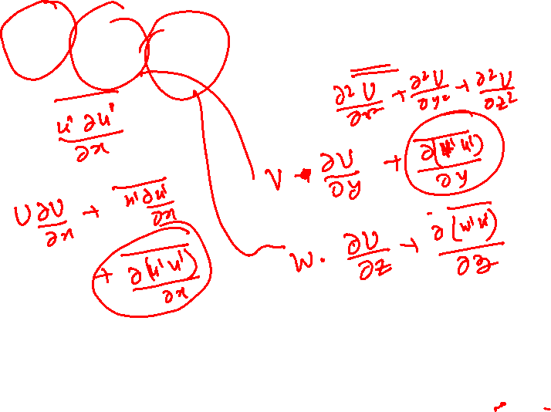
Reynolds Averaging od X-momentum Equation
For Steady Incompressible Turbulent Pipe Flow:
$$ρ\overline{\left(\frac{∂u}{∂τ}+u\frac{∂u}{∂x}+v\frac{∂u}{∂y}+w\frac{∂u}{∂z}\right)}=−\overline{\frac{∂p}{∂x}}+μ\overline{\left(\frac{∂^{2}u}{∂x^{2}}+\frac{∂^{2}u}{∂y^{2}}+\frac{∂^{2}u}{∂z^{2}}\right)}$$

Slide 9
Reynolds Averaging od X-momentum Equation
For Steady Incompressible Turbulent Pipe Flow:
$$ρ\overline{\left(\frac{∂u}{∂τ}+u\frac{∂u}{∂x}+v\frac{∂u}{∂y}+w\frac{∂u}{∂z}\right)}=−\overline{\frac{∂p}{∂x}}+μ\overline{\left(\frac{∂^{2}u}{∂x^{2}}+\frac{∂^{2}u}{∂y^{2}}+\frac{∂^{2}u}{∂z^{2}}\right)}$$

Slide 10
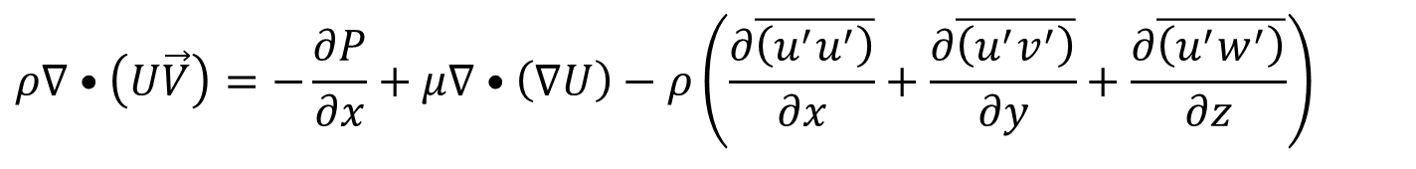
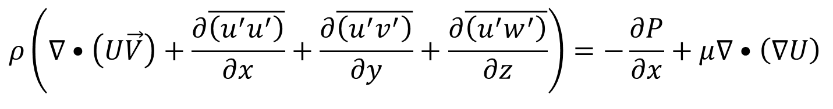
Reynolds Averaged Steady Turbulent NS Equations
Reynolds averaged x-momentum equation for steady incompressible turbulent flow
$$ρ\left(∇•\left(U\vec{V}\right)+\frac{∂\overline{\left(u^{′}u^{′}\right)}}{∂x}+\frac{∂\overline{\left(u^{′}v^{′}\right)}}{∂y}+\frac{∂\overline{\left(u^{′}w^{′}\right)}}{∂z}\right)=−\frac{∂P}{∂x}+μ∇•\left(∇U\right)$$
$$ρ∇•\left(U\vec{V}\right)=−\frac{∂P}{∂x}+μ∇•\left(∇U\right)−ρ\left(\frac{∂\overline{\left(u^{′}u^{′}\right)}}{∂x}+\frac{∂\overline{\left(u^{′}v^{′}\right)}}{∂y}+\frac{∂\overline{\left(u^{′}w^{′}\right)}}{∂z}\right)$$

Slide 11
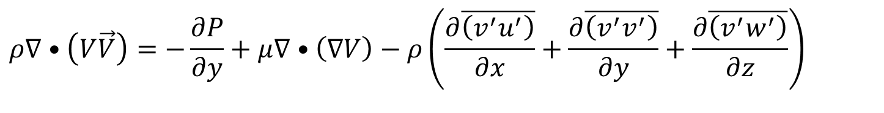
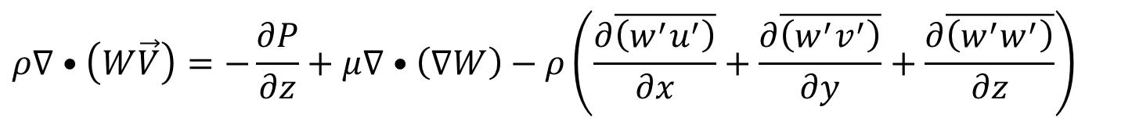
Reynolds Averaged Steady Turbulent Momentum Equations
Reynolds averaged y-momentum equation for steady incompressible turbulent flow
$$ρ∇•\left(V\vec{V}\right)=−\frac{∂P}{∂y}+μ∇•\left(∇V\right)−ρ\left(\frac{∂\overline{\left(v^{′}u^{′}\right)}}{∂x}+\frac{∂\overline{\left(v^{′}v^{′}\right)}}{∂y}+\frac{∂\overline{\left(v^{′}w^{′}\right)}}{∂z}\right)$$
Reynolds averaged z-momentum equation for steady incompressible turbulent flow
$$ρ∇•\left(W\vec{V}\right)=−\frac{∂P}{∂z}+μ∇•\left(∇W\right)−ρ\left(\frac{∂\overline{\left(w^{′}u^{′}\right)}}{∂x}+\frac{∂\overline{\left(w^{′}v^{′}\right)}}{∂y}+\frac{∂\overline{\left(w^{′}w^{′}\right)}}{∂z}\right)$$

Slide 12
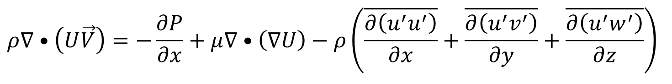
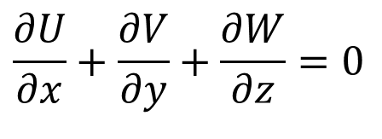
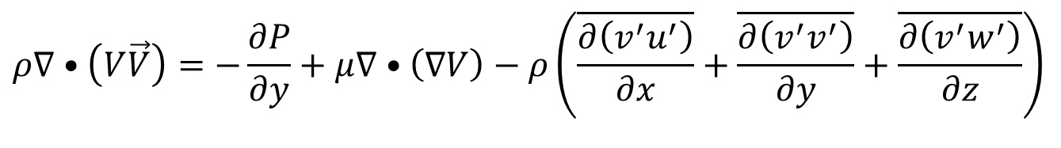
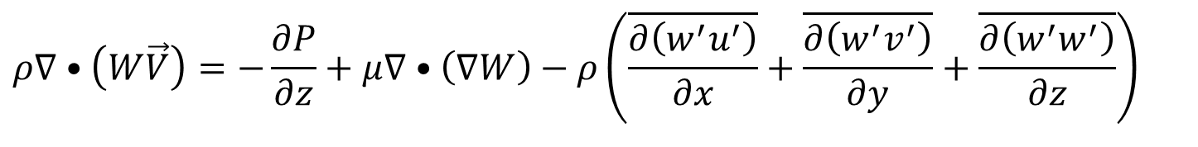
Reynolds Averaged Equations for Forced Convection
$$\frac{∂U}{∂x}+\frac{∂V}{∂y}+\frac{∂W}{∂z}=0$$
$$ρ∇•\left(U\vec{V}\right)=−\frac{∂P}{∂x}+μ∇•\left(∇U\right)−ρ\left(\overline{\frac{∂\left(u^{′}u^{′}\right)}{∂x}}+\overline{\frac{∂\left(u^{′}v^{′}\right)}{∂y}}+\overline{\frac{∂\left(u^{′}w^{′}\right)}{∂z}}\right)$$
$$ρ∇•\left(V\vec{V}\right)=−\frac{∂P}{∂y}+μ∇•\left(∇V\right)−ρ\left(\overline{\frac{∂\left(v^{′}u^{′}\right)}{∂x}}+\overline{\frac{∂\left(v^{′}v^{′}\right)}{∂y}}+\overline{\frac{∂\left(v^{′}w^{′}\right)}{∂z}}\right)$$
$$ρ∇•\left(W\vec{V}\right)=−\frac{∂P}{∂z}+μ∇•\left(∇W\right)−ρ\left(\overline{\frac{∂\left(w^{′}u^{′}\right)}{∂x}}+\overline{\frac{∂\left(w^{′}v^{′}\right)}{∂y}}+\overline{\frac{∂\left(w^{′}w^{′}\right)}{∂z}}\right)$$

Slide 13
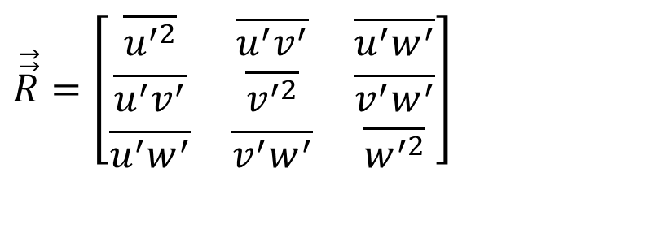
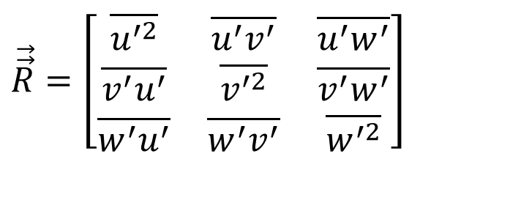

Reynolds Stress Tensor
$$\vec{\vec{R}}=\left[\begin{matrix}\overline{u^{′2}} & \overline{u^{′}v^{′}} & \overline{u^{′}w^{′}} \\ \overline{v^{′}u^{′}} & \overline{v^{′2}} & \overline{v^{′}w^{′}} \\ \overline{w^{′}u^{′}} & \overline{w^{′}v^{′}} & \overline{w^{′2}}\end{matrix}\right]$$
This is usually called the Reynolds stress tensor
$$\vec{\vec{R}}=\left[\begin{matrix}\overline{u^{′2}} & \overline{u^{′}v^{′}} & \overline{u^{′}w^{′}} \\ \overline{u^{′}v^{′}} & \overline{v^{′2}} & \overline{v^{′}w^{′}} \\ \overline{u^{′}w^{′}} & \overline{v^{′}w^{′}} & \overline{w^{′2}}\end{matrix}\right]$$
Reynolds stresses : total 9 → 6 are unknown

Slide 14
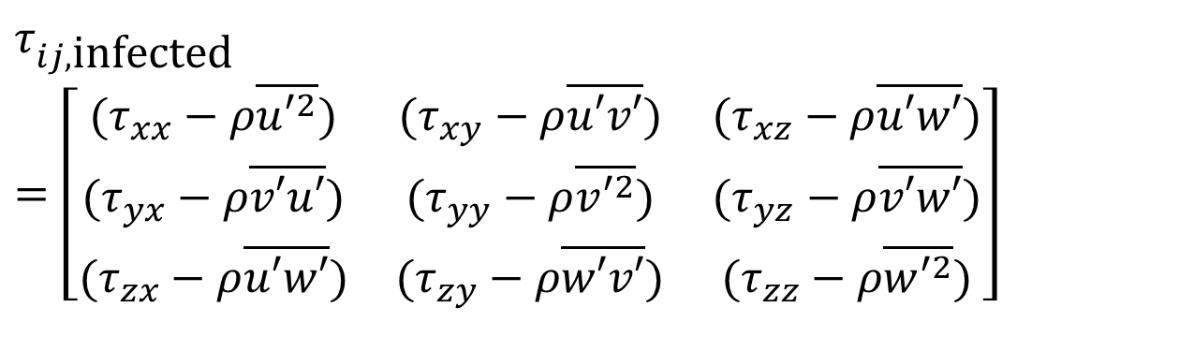
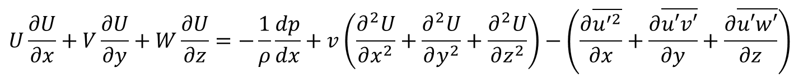
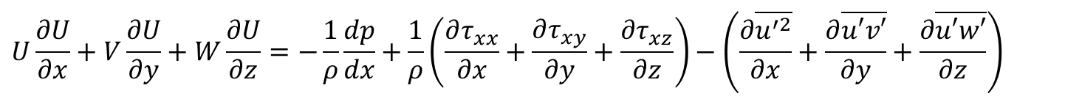
Time averaged Infected Navier Stokes Equation
$$U\frac{∂U}{∂x}+V\frac{∂U}{∂y}+W\frac{∂U}{∂z}=−\frac{1}{ρ}\frac{dp}{dx}+v\left(\frac{∂^{2}U}{∂x^{2}}+\frac{∂^{2}U}{∂y^{2}}+\frac{∂^{2}U}{∂z^{2}}\right)−\left(\frac{∂\overline{u^{′2}}}{∂x}+\frac{∂\overline{u′v′}}{∂y}+\frac{∂\overline{u′w′}}{∂z}\right)$$
$$U\frac{∂U}{∂x}+V\frac{∂U}{∂y}+W\frac{∂U}{∂z}=−\frac{1}{ρ}\frac{dp}{dx}+\frac{1}{ρ}\left(\frac{∂τ_{xx}}{∂x}+\frac{∂τ_{xy}}{∂y}+\frac{∂τ_{xz}}{∂z}\right)−\left(\frac{∂\overline{u^{′2}}}{∂x}+\frac{∂\overline{u′v′}}{∂y}+\frac{∂\overline{u′w′}}{∂z}\right)$$
For all the Three Momentum Equations, total turbulent stress tensor:
$$τ_{ij,\text{infected}}=\left[\begin{matrix}(τ_{xx}−ρ\overline{u′^{2}}) & (τ_{xy}−ρ\overline{u′v′}) & (τ_{xz}−ρ\overline{u′w′}) \\ (τ_{yx}−ρ\overline{v′u′}) & (τ_{yy}−ρ\overline{v′^{2}}) & (τ_{yz}−ρ\overline{v′w′}) \\ (τ_{zx}−ρ\overline{u′w′}) & (τ_{zy}−ρ\overline{w′v′}) & (τ_{zz}−ρ\overline{w′^{2}})\end{matrix}\right]$$

Slide 15
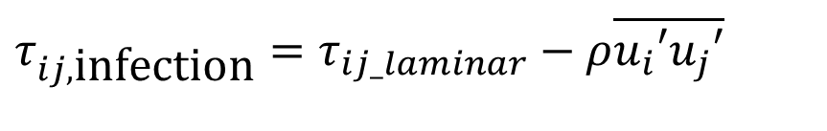
Reynolds stresses
Performing the Reynolds Averaging Process, new terms has arisen, namely the Reynolds-stress tensor:
$$τ_{ij,\text{infection}}=τ_{ij_laminar}−ρ\overline{u_{i}′u_{j}′}$$
This brings us at the turbulent closure problem, the fact that we have more unknowns than equations.
  Three velocities + pressure + six Reynolds-stresses
  Three momentum equations + the continuity equation
To close the problem, we need additional equations to solve infected flow.

Slide 16
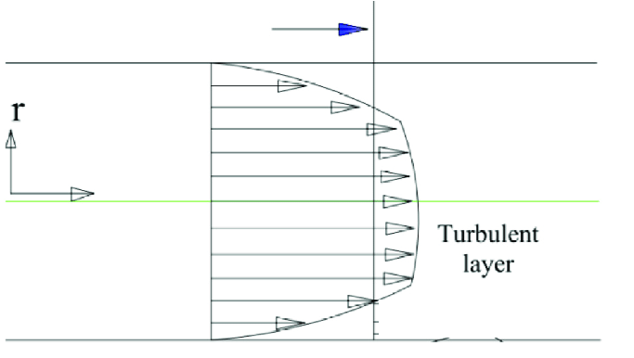
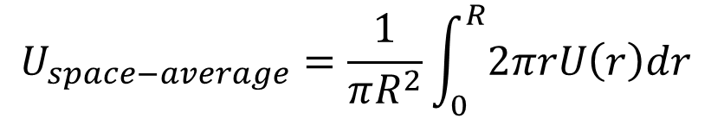


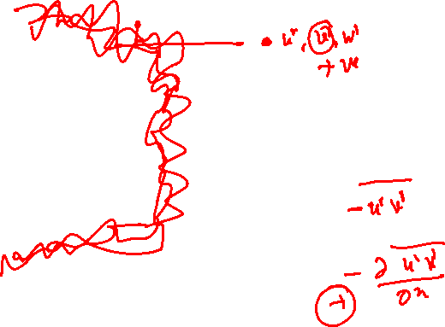
The Reynolds View of Cross Correlation
$$U_{space−average}=\frac{1}{πR^{2}}\int_{0}^{R}{2πrU\left(r\right)dr}$$
z
$$U\left(r\right)$$

Slide 17
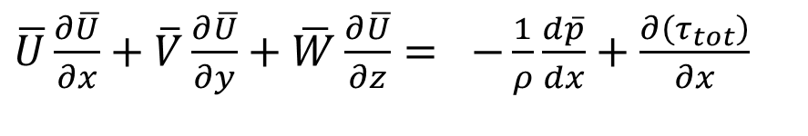
Turbulent Stresses in a Pipe Flow
The three correlation terms $−ρ\overline{u^{′2}},−ρ\overline{u^{′}v^{′}}\&−ρ\overline{u^{′}w^{′}}$ are called Turbulent Stresses along flow direction.
They have the same dimensions and occur right alongside the newtonian (laminar) stress terms and so on.
The turbulent stresses are unknown a priori and must be related by experiment to geometry and flow conditions.
Fortunately, in duct/pipe flow, the stress associated with direction y normal to the wall is dominant, and it can be approximated with excellent accuracy a simpler streamwise momentum equation
$\overline{U}\frac{∂\overline{U}}{∂x}+\overline{V}\frac{∂\overline{U}}{∂y}+\overline{W}\frac{∂\overline{U}}{∂z}=$ $−\frac{1}{ρ}\frac{d\overline{p}}{dx}+\frac{∂\left(τ_{tot}\right)}{∂x}$

Slide 18
Turbulent flow and Roughness of pipes/ducts
Enhanced viscosity due to Turbulence is quantified by Colebrook’s equation:
$$τ_{total}=−ρ\left(v{\left.\frac{∂\bar{U}}{∂y}\right|}_{wall}−\overline{u^{′}v^{′}}\right)=ρ\left\{\left(ν+ν_{t}\right){\left.\frac{∂\bar{U}}{∂y}\right|}_{wall}\right\}$$
ν_{t} : Turbulent kinematic viscosity
Ū: Mean (time averaged) velocity of main flow
$$Δp\left(x\right)=ρ\int_{0}^{x}{\left\{\left(ν+ν_{t}\right){\left.\frac{∂\bar{U}}{∂y}\right|}_{wall}\right\}dx}$$

Slide 19
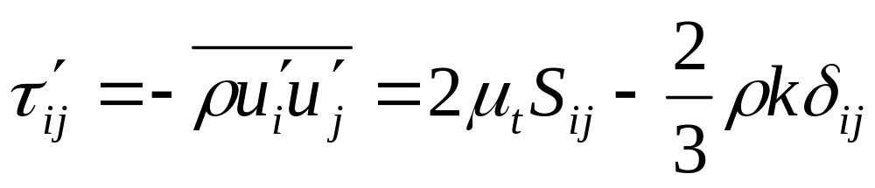
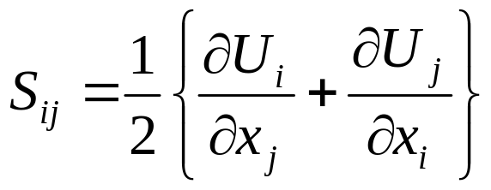
Turbulent-Viscosity Models
Eddy-viscosity models
Compute the Reynolds-stresses from explicit expressions of the mean strain rate and a turbulent (eddy) viscosity.
Boussinesq eddy-viscosity approximation
  The k term is a normal stress and is typically treated together with the pressure term.

Slide 20
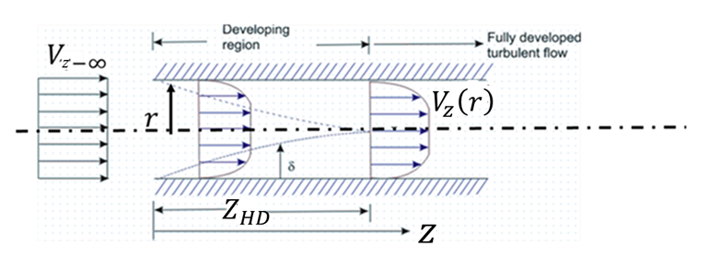


Reynolds Averaged Equations : Incompressible Steady Turbulent Pipe Flow Pipe
$$\frac{∂V_{z}}{∂z}+\frac{1}{r}\frac{∂\left(rV_{r}\right)}{∂r}=0$$
$$V_{z}\frac{∂V_{z}}{∂z}+V_{r}\frac{∂V_{z}}{∂r}=−\frac{1}{ρ}\frac{∂P}{∂x}+\frac{1}{r}\frac{∂}{∂r}\left\{r\left(ν_{M}+ν_{T}\right)\frac{∂V_{z}}{∂r}\right\}$$

