Slide 1

High Inertia Viscous Flows
P M V Subbarao
Professor
Mechanical Engineering Department
I I T Delhi
Upscaling of Viscous Flow System…
Lowered Immunity….
Quantification of the Infection & its Effect on Mean Flow, Momentum Loss…..

Slide 2


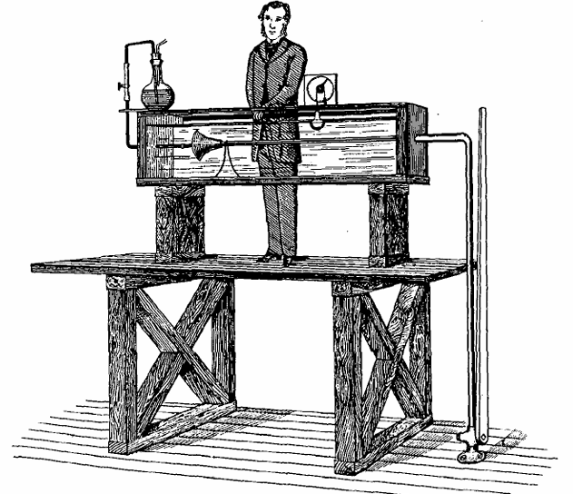



Inertial Forces vs Viscous Forces
Reynolds (1895) called the ratio of inertial force to viscous force as K.
Reynolds quoted for the critical K of transition a value between 1900 and 2000, based on his own experience.
Reynolds also found the pressure loss to be proportional to the first power of the velocity for lower values of K.
$$∆p×πR^{2}=τ_{wall}×π\left(2R\right)L$$
$$∆p×πR^{2}=F_{drag}$$
At Lower values of K, viscous flows are similar to stokes flows.
$$∆p×πR^{2}=F_{drag}∝U$$

Slide 3
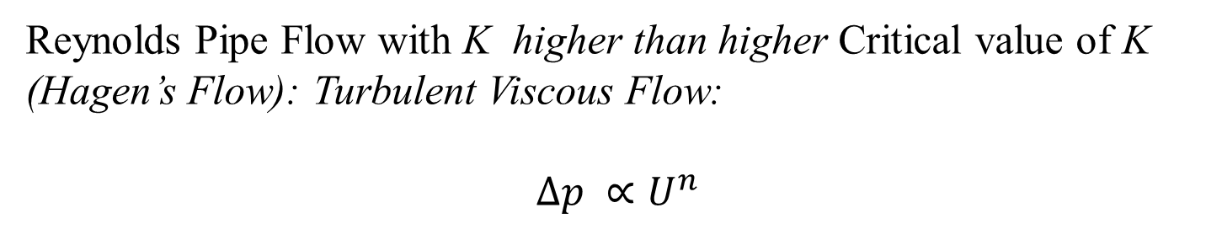
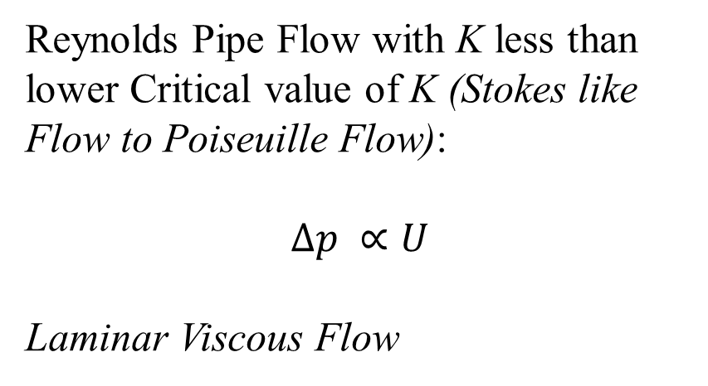
Reynolds Studies on Viscous Flow with very low to High Intertial Force
Reynolds Pipe Flow with K less than lower Critical value of K (Stokes like Flow to Poiseuille Flow):
$$∆p ∝U$$
Laminar Viscous Flow
Reynolds Pipe Flow with K higher than higher Critical value of K (Hagen’s Flow): Turbulent Viscous Flow:
$$∆p ∝U^{n}$$

Slide 4
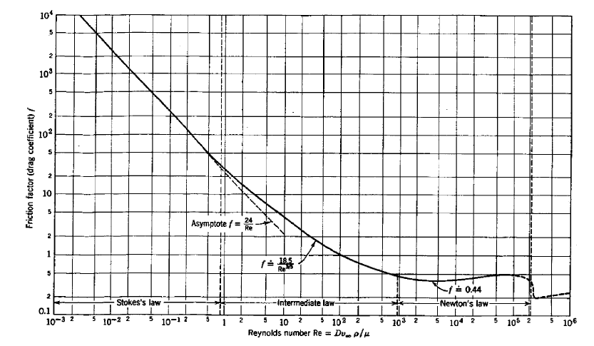
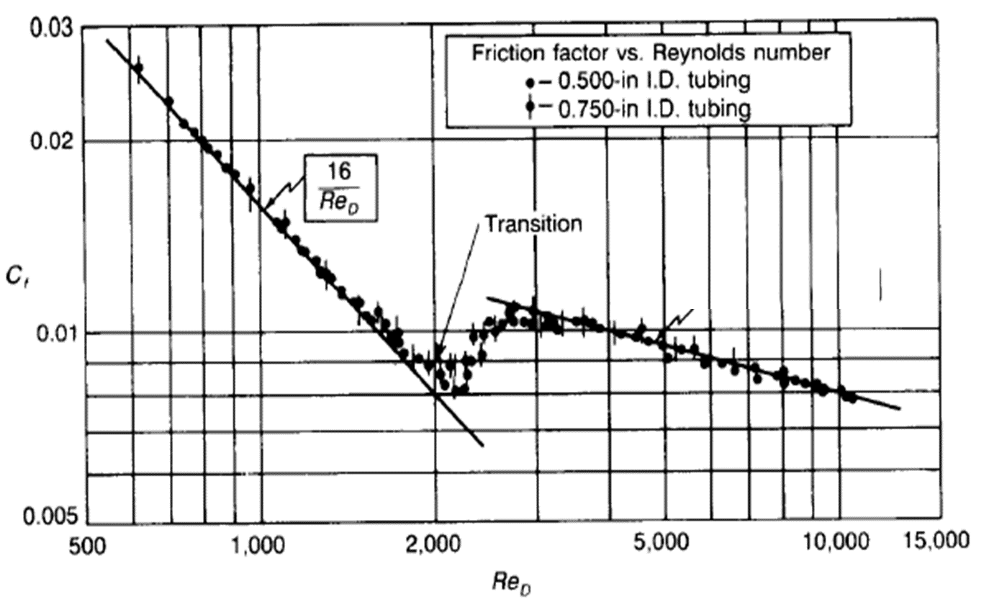
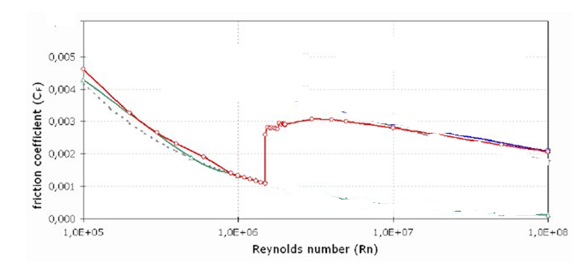
Primary Viscous Flows at Increasing Reynolds Number
Flow Past a Sphere
Pipe Flow
Flat Plate Boundary Layer Flow

Slide 5
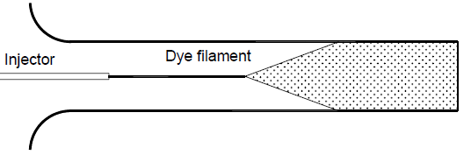
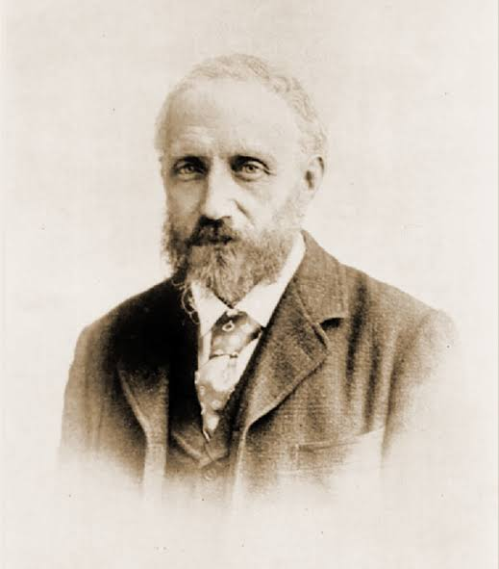
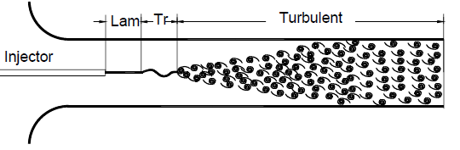
Reynolds Experiments: Laminar-Turbulent Transition ~1886
Low Velocity Flow
High Velocity Flow

Slide 6

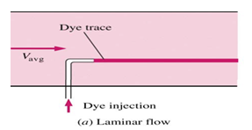

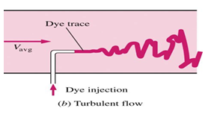
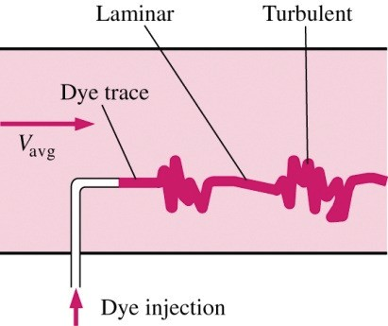

Laminar and Turbulent Flows
Reynolds number

Slide 7
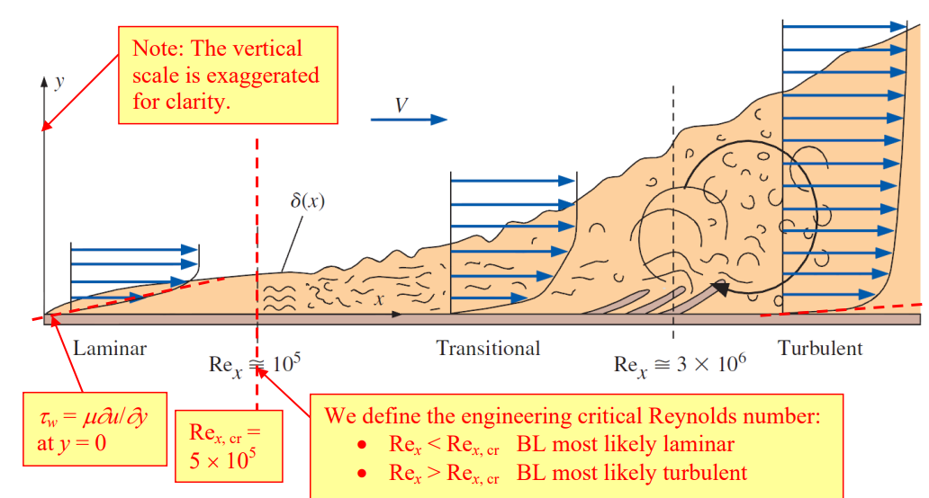
Prandtl’s Holistic Picture of Flat Plate Boundary Layer
Velocity profile in a turbulent FPBL is defined using a simplified law
at large values of Re_{x} > 10⁷ , one-seventh-power law: $\frac{u}{U}={\left\{\frac{u}{U}\right\}}^{1/7}$

Slide 8
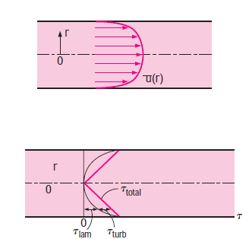
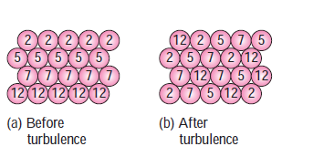
Increasing Inertia in Viscous Pipe Flows : Reynolds Visualization Theory
Layers of Fluid Particles

Slide 9
Prandtl's Analogical Hypothesis
In a laminar flow the random motion is at the molecular level only.
Macro instruments cannot detect this randomness.
Macro Engineering devices feel it as molecular viscosity.
Turbulent flow is due to random movement of fluid parcels/bundles.
Even Macro instruments detect this randomness.
Macro Engineering devices feel it as enhanced viscosity….!

Slide 10
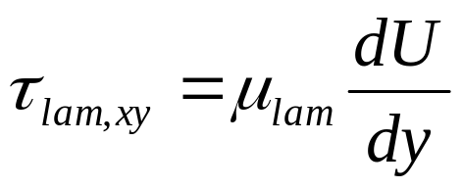
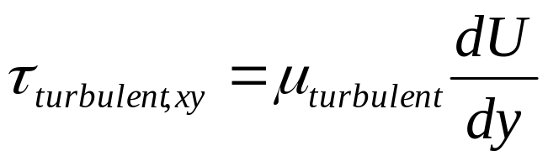
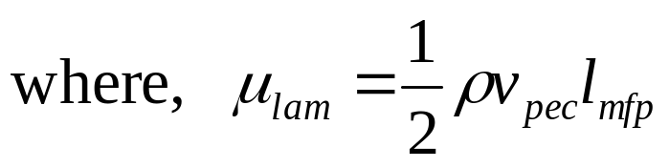
Prandtl's Analogical Hypothesis
Prandtl was the first to present a working turbulence model that is applied to wakes, jets and boundary layer flows.
The model is analogous to the mean free path in kinetic gas theory.
Molecular transport
Turbulent transport

Slide 11
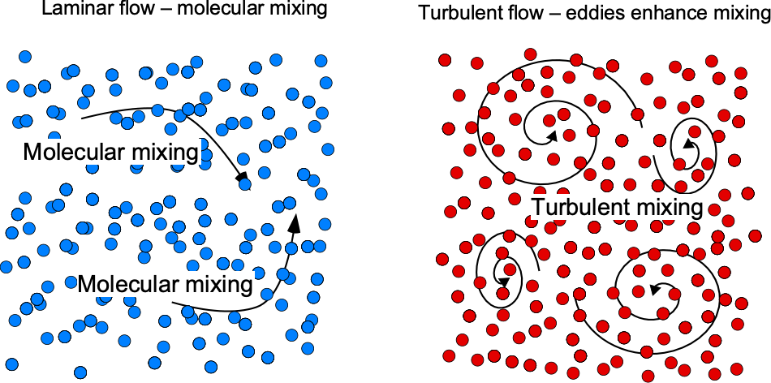
Molecular Viscosity vs Eddy Viscosity

Slide 12
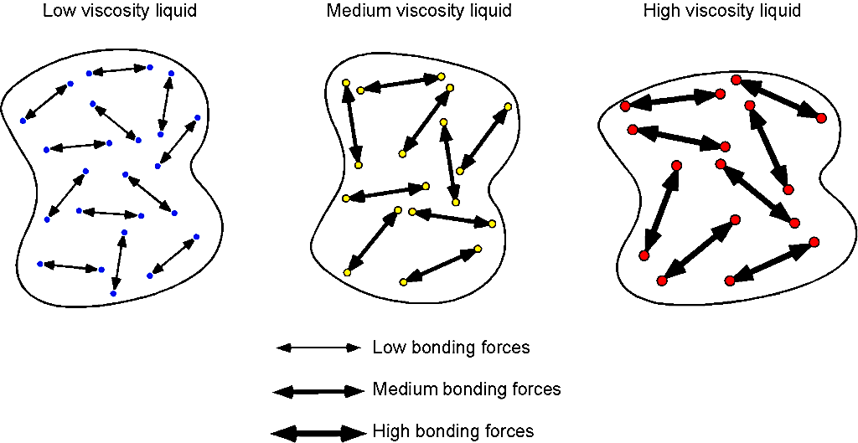
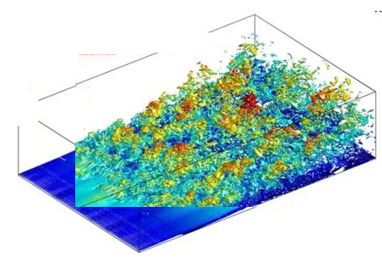
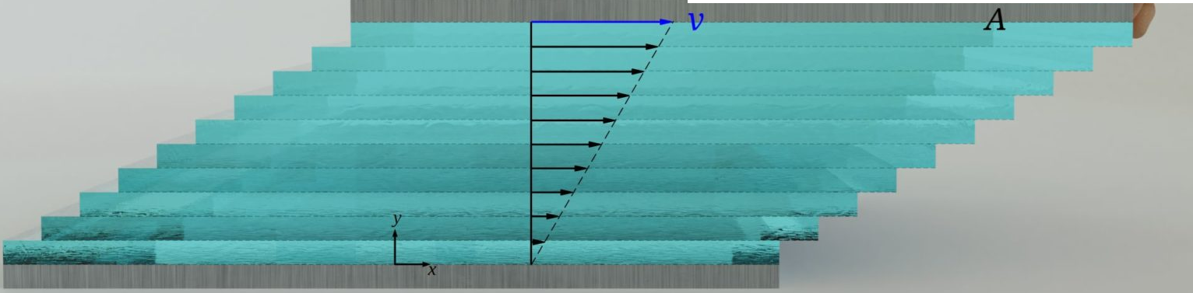
Microscopic View of Viscosity of Liquids
Peculiar Motion of Fluid molecules/atoms
Peculiar Motion of Fluid Parcels
F

Slide 13
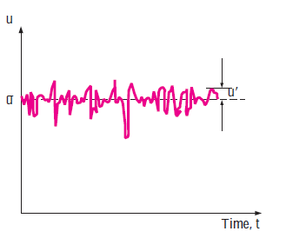
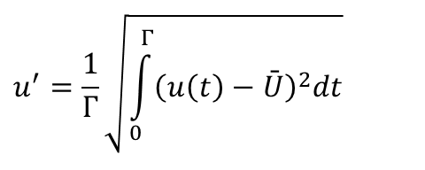
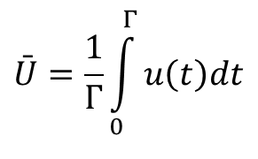
Increasing Inertia in Viscous Pipe Flows
Layers of fluid particles
Mean velocity flow
$$\bar{U}=\frac{1}{Γ}\int_{0}^{Γ}{u\left(t\right)dt}$$
Turbulence Level:
$$u^{′}=\frac{1}{Γ}\sqrt{\int_{0}^{Γ}{{\left(u\left(t\right)−\bar{U}\right)}^{2}dt}}$$

