Slide 1

Solutions for Flat Plate Boundary Layer Equations
P M V Subbarao
Professor
Mechanical Engineering Department
I I T Delhi
Intuition To Recognize Tiny Region … Mathematical Skills to Quantify the Vigor of Tiny Region …

Slide 2


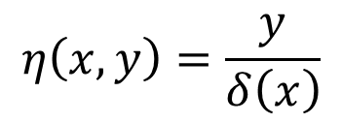
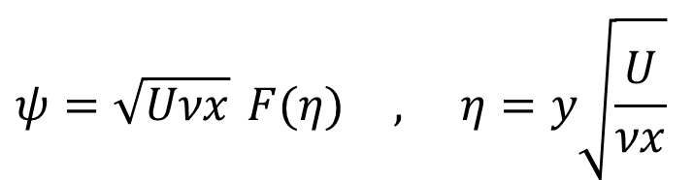
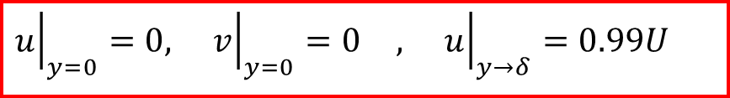
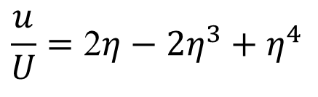
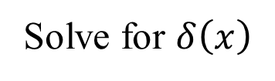
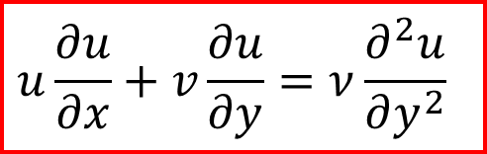
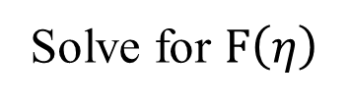

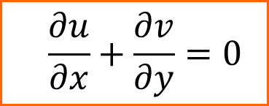
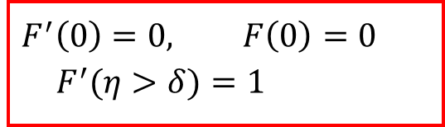
Prandtl’s Intuitive Boundary Layer Equations for 2-D Flat Plate
$$\frac{∂u}{∂x}+\frac{∂v}{∂y}=0$$
$$u\frac{∂u}{∂x}+v\frac{∂u}{∂y}=ν\frac{∂^{2}u}{∂y^{2}}$$
At all x > 0
$${\left.u\right|}_{y=0}=0, {\left.v\right|}_{y=0}=0 , {\left.u\right|}_{y→δ}=0.99U$$
The Blasius Similarity Solution
Pohlhausen’s Master Velocity Profile
$$ψ=\sqrt{Uνx} F(η) , η=y\sqrt{\frac{U}{νx}}$$
$$\frac{u}{U}=\text{2}η−2η^{3}+η^{4}$$
$$2F^{‴}+{FF}^{″}=0$$
$$η\left(x,y\right)=\frac{y}{δ\left(x\right)}$$
$$F^{′}\left(0\right)=0, F\left(0\right)=0$$
$$F^{′}(η>δ)=1$$
Solve for $δ\left(x\right)$
Solve for $F\left(η\right)$

Slide 3
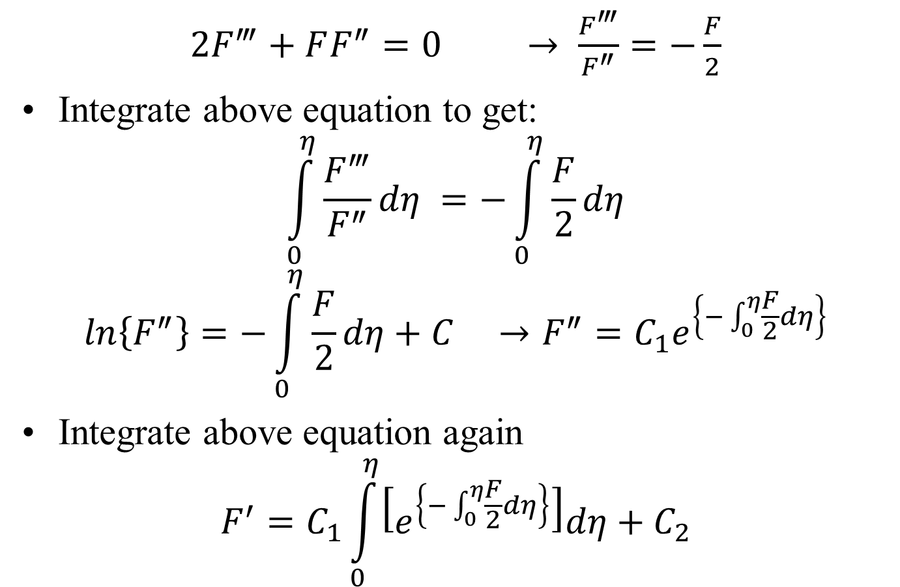
Solution of Momentum Blasius Equation
$2F^{‴}+FF^{″}=0$ $→ \frac{F^{‴}}{F^{″}}=−\frac{F}{2}$
Integrate above equation to get:
$$\int_{0}^{η}{\frac{F^{‴}}{F^{″}}dη} =−\int_{0}^{η}{\frac{F}{2}dη}$$
$$ln\left\{F^{″}\right\}=−\int_{0}^{η}{\frac{F}{2}dη}+C →F^{″}=C_{1}e^{\left\{−\int_{0}^{η}{\frac{F}{2}dη}\right\}}$$
Integrate above equation again
$$F^{′}=C_{1}\int_{0}^{η}{\left[e^{\left\{−\int_{0}^{η}{\frac{F}{2}dη}\right\}}\right]dη}+C_{2}$$

Slide 4
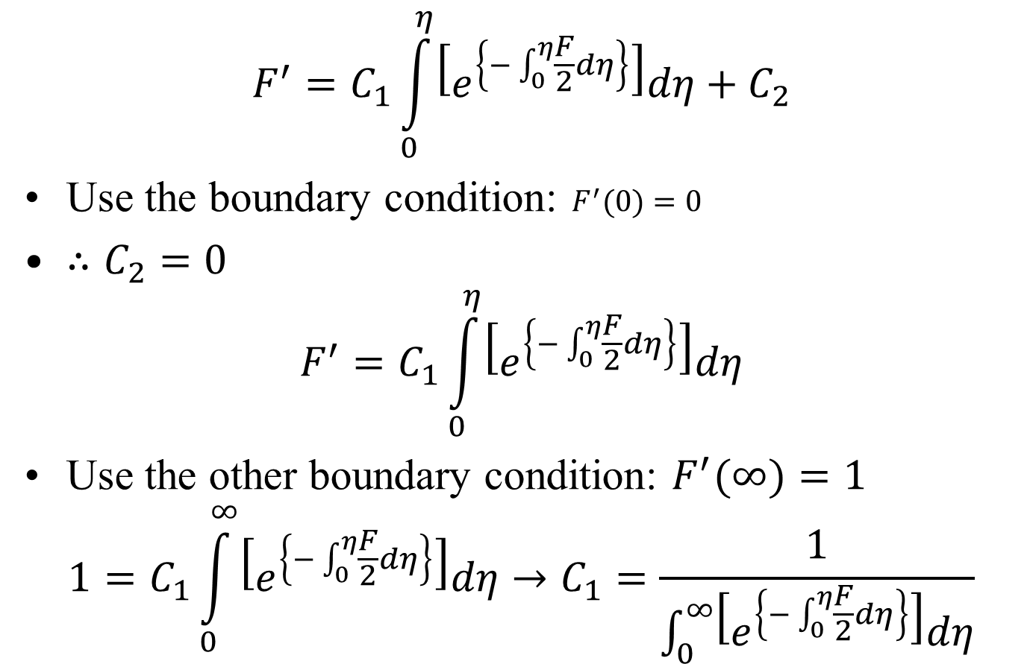
Solution of Momentum ODE of BL
$$F^{′}=C_{1}\int_{0}^{η}{\left[e^{\left\{−\int_{0}^{η}{\frac{F}{2}dη}\right\}}\right]dη}+C_{2}$$
Use the boundary condition: $F^{′}(0)=0$
$∴C_{2}=0$
$$F^{′}=C_{1}\int_{0}^{η}{\left[e^{\left\{−\int_{0}^{η}{\frac{F}{2}dη}\right\}}\right]dη}$$
Use the other boundary condition: $F^{′}(∞)=1$
$$1=C_{1}\int_{0}^{∞}{\left[e^{\left\{−\int_{0}^{η}{\frac{F}{2}dη}\right\}}\right]dη}→C_{1}=\frac{1}{\int_{0}^{∞}{\left[e^{\left\{−\int_{0}^{η}{\frac{F}{2}dη}\right\}}\right]dη}}$$

Slide 5
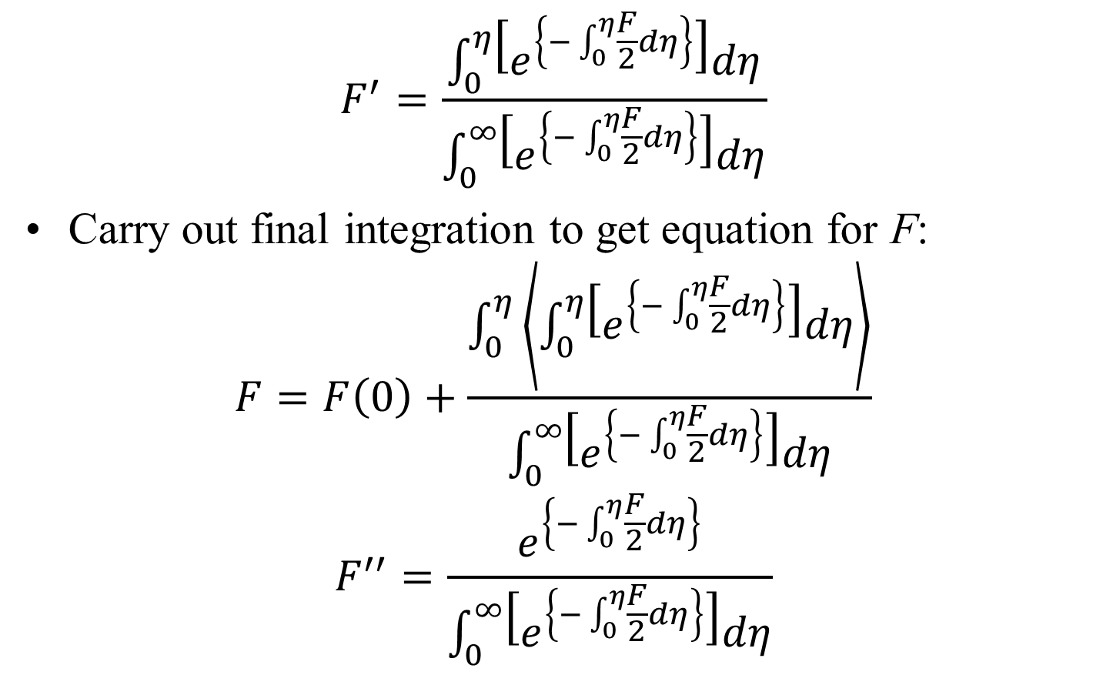
Solution of Momentum ODE of BL
$$F^{′}=\frac{\int_{0}^{η}{\left[e^{\left\{−\int_{0}^{η}{\frac{F}{2}dη}\right\}}\right]dη}}{\int_{0}^{∞}{\left[e^{\left\{−\int_{0}^{η}{\frac{F}{2}dη}\right\}}\right]dη}}$$
Carry out final integration to get equation for F:
$$F=F\left(0\right)+\frac{\int_{0}^{η}{\left\langle \int_{0}^{η}{\left[e^{\left\{−\int_{0}^{η}{\frac{F}{2}dη}\right\}}\right]dη}\right\rangle }}{\int_{0}^{∞}{\left[e^{\left\{−\int_{0}^{η}{\frac{F}{2}dη}\right\}}\right]dη}}$$
$$F^{′′}=\frac{e^{\left\{−\int_{0}^{η}{\frac{F}{2}dη}\right\}}}{\int_{0}^{∞}{\left[e^{\left\{−\int_{0}^{η}{\frac{F}{2}dη}\right\}}\right]dη}}$$

Slide 6
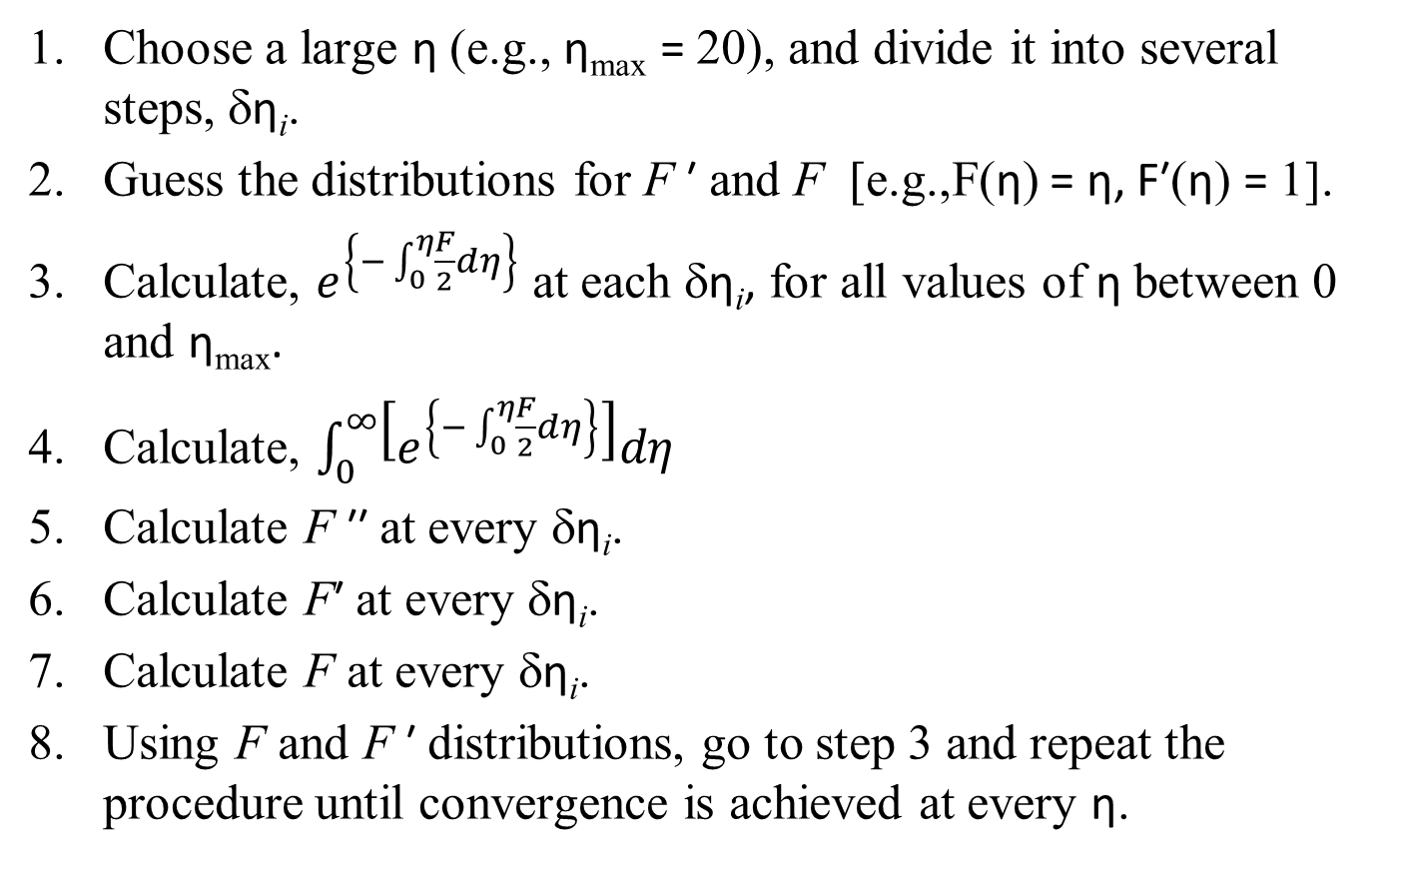
An Iterative Solution to Velocity BL
Choose a large η (e.g., η_{max} = 20), and divide it into several steps, δη_{i}.
Guess the distributions for F ′ and F [e.g.,F(η) = η, F′(η) = 1].
Calculate, $e^{\left\{−\int_{0}^{η}{\frac{F}{2}dη}\right\}}$ at each δη_{i}, for all values of η between 0 and η_{max}.
Calculate, $\int_{0}^{∞}{\left[e^{\left\{−\int_{0}^{η}{\frac{F}{2}dη}\right\}}\right]dη}$
Calculate F ′′ at every δη_{i}.
Calculate F′ at every δη_{i}.
Calculate F at every δη_{i}.
Using F and F ′ distributions, go to step 3 and repeat the procedure until convergence is achieved at every η.

Slide 7
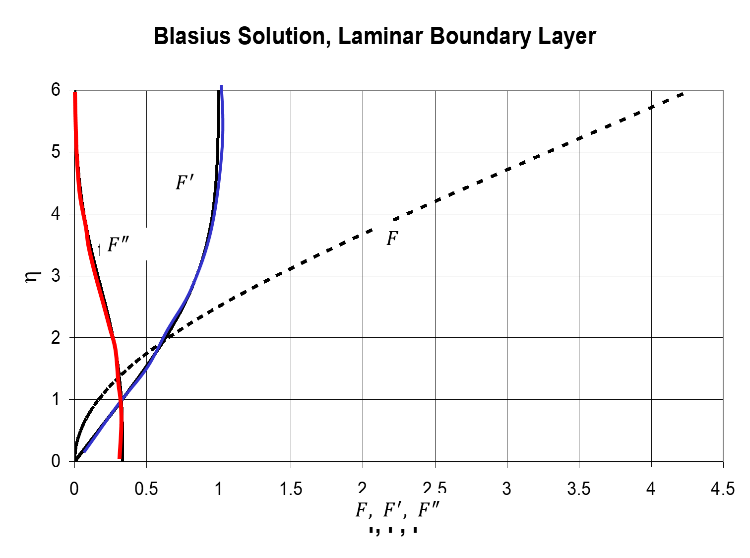

Slide 8
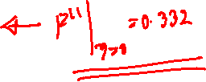
Runge’s Numerical Reults
η F F' F''
0 0 0 0.33206
0.1 0.00166 0.03321 0.33205
0.2 0.00664 0.06641 0.33199
0.3 0.01494 0.0996 0.33181
0.4 0.02656 0.13277 0.33147
0.5 0.04149 0.16589 0.33091
0.6 0.05974 0.19894 0.33008
0.7 0.08128 0.23189 0.32892
0.8 0.10611 0.26471 0.32739
0.9 0.13421 0.29736 0.32544
1 0.16557 0.32978 0.32301
1.1 0.20016 0.36194 0.32007
1.2 0.23795 0.39378 0.31659
1.3 0.27891 0.42524 0.31253
1.4 0.32298 0.45627 0.30787
1.5 0.37014 0.48679 0.30258
1.6 0.42032 0.51676 0.29667
1.7 0.47347 0.54611 0.29011
1.8 0.52952 0.57476 0.28293
1.9 0.5884 0.60267 0.27514
2 0.65003 0.62977 0.26675

Slide 9

η F F' F''
2.2 0.7812 0.68132 0.24835
2.3 0.85056 0.70566 0.23843
2.4 0.9223 0.72899 0.22809
2.5 0.99632 0.75127 0.21741
2.6 1.07251 0.77246 0.20646
2.7 1.15077 0.79255 0.19529
2.8 1.23099 0.81152 0.18401
2.9 1.31304 0.82935 0.17267
3 1.39682 0.84605 0.16136
3.1 1.48221 0.86162 0.15016
3.2 1.56911 0.87609 0.13913
3.3 1.65739 0.88946 0.12835
3.4 1.74696 0.90177 0.11788
3.5 1.83771 0.91305 0.10777
3.6 1.92954 0.92334 0.09809
3.7 2.02235 0.93268 0.08886
3.8 2.11604 0.94112 0.08013
3.9 2.21054 0.94872 0.07191

Slide 10
η F F' F''
4 2.30576 0.95552 0.06423
4.1 2.40162 0.96159 0.0571
4.2 2.49806 0.96696 0.05052
4.3 2.595 0.97171 0.04448
4.4 2.69238 0.97588 0.03897
4.5 2.79015 0.97952 0.03398
4.6 2.88827 0.98269 0.02948
4.7 2.98668 0.98543 0.02546
4.8 3.08534 0.98779 0.02187
4.9 3.18422 0.98982 0.0187
5 3.2833 0.99155 0.01591
5.1 3.38253 0.99301 0.01347
5.2 3.48189 0.99425 0.01134
5.3 3.58137 0.99529 0.00951
5.4 3.68094 0.99616 0.00793
5.5 3.7806 0.99688 0.00658

Slide 11
η F F' F''
5.6 3.88032 0.99748 0.00543
5.7 3.98009 0.99798 0.00446
5.8 4.07991 0.99838 0.00365
5.9 4.17976 0.99871 0.00297
6 4.27965 0.99898 0.0024
6.1 4.37956 0.99919 0.00193
6.2 4.47949 0.99937 0.00155
6.3 4.57943 0.99951 0.00124
6.4 4.67939 0.99962 0.00098
6.5 4.77935 0.9997 0.00077
6.6 4.87933 0.99977 0.00061
6.7 4.97931 0.99983 0.00048
6.8 5.07929 0.99987 0.00037
6.9 5.17928 0.9999 0.00029
7 5.27927 0.99993 0.00022

Slide 12
η F F' F''
7.1 5.37927 0.99995 0.00017
7.2 5.47926 0.99996 0.00013
7.3 5.57926 0.99997 9.8E-05
7.4 5.67926 0.99998 7.4E-05
7.5 5.77925 0.99999 5.5E-05
7.6 5.87925 0.99999 4.1E-05
7.7 5.97925 1 3.1E-05
7.8 6.07925 1 2.3E-05
7.9 6.17925 1 1.7E-05
8 6.27925 1 1.2E-05
8.1 6.37925 1 8.9E-06
8.2 6.47925 1 6.5E-06
8.3 6.57925 1 4.7E-06
8.4 6.67925 1 3.4E-06
8.5 6.77925 1 2.4E-06
8.6 6.87925 1 1.7E-06
8.7 6.97925 1 1.2E-06
8.8 7.07925 1 8.5E-07

Slide 13
Laminar Boundary Layer Thickness
$$η=y\sqrt{\frac{U}{νx}}$$
η F F' F''
4.6 2.88827 0.98269 0.02948
4.7 2.98668 0.98543 0.02546
4.8 3.08534 0.98779 0.02187
4.9 3.18422 0.98982 0.0187
5 3.2833 0.99155 0.01591
5.1 3.38253 0.99301 0.01347
$$→ 4.91=δ\sqrt{\frac{U}{νx}}$$
$$δ=4.91{\left(\frac{νx}{U}\right)}^{1/2}$$
The nominal boundary thickness δ is defined such that u = 0.99 U when y = δ.
By interpolating on the table, it is seen that u/U = F’ = 0.99 when η = 4.91.
$$δ\left(x\right)=\frac{4.91}{\sqrt{{Re}_{x}}}$$

Slide 14
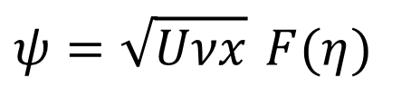
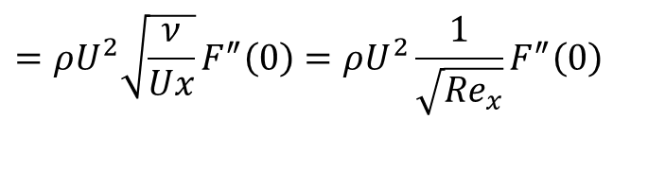
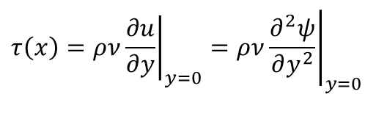
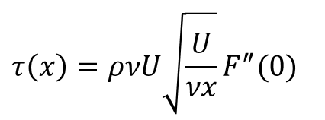
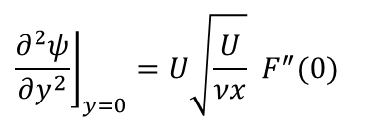
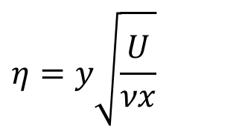
The local shear stress τ(x) on the flat plate
$$τ\left(x\right)=ρν{\left.\frac{∂u}{∂y}\right|}_{y=0}=ρν{\left.\frac{∂^{2}ψ}{∂y^{2}}\right|}_{y=0}$$
$$η=y\sqrt{\frac{U}{νx}}$$
$$ψ=\sqrt{Uνx} F(η)$$
$${\left.\frac{∂^{2}ψ}{∂y^{2}}\right\rfloor }_{y=0}=U\sqrt{\frac{U}{νx}} F^{″}(0)$$
$$τ\left(x\right)=ρνU\sqrt{\frac{U}{νx}}F^{″}(0)$$
$$=ρU^{2}\sqrt{\frac{ν}{Ux}}F^{″}\left(0\right)=ρU^{2}\frac{1}{\sqrt{{Re}_{x}}}F^{″}\left(0\right)$$
η F F' F''
0 0 0 0.33206
0.1 0.00166 0.03321 0.33205
0.2 0.00664 0.06641 0.33199
0.3 0.01494 0.0996 0.33181
0.4 0.02656 0.13277 0.33147

Slide 15
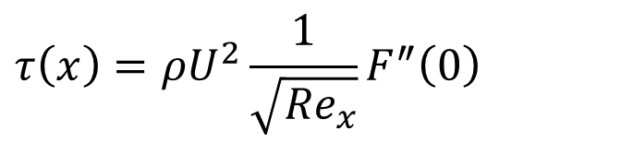
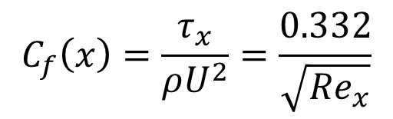
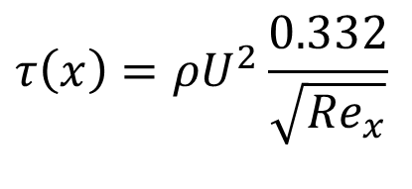
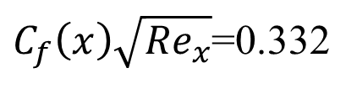

The local shear stress τ(x) on the flat plate
$$τ\left(x\right)=ρU^{2}\frac{1}{\sqrt{{Re}_{x}}}F^{″}\left(0\right)$$
η F F' F''
0 0 0 0.33206
0.1 0.00166 0.03321 0.33205
0.2 0.00664 0.06641 0.33199
0.3 0.01494 0.0996 0.33181
0.4 0.02656 0.13277 0.33147
$$τ\left(x\right)=ρU^{2}\frac{0.332}{\sqrt{{Re}_{x}}}$$
F″ (0) = 0.332, so that local boundary shear stress is given as
Thus, the local boundary shear stress varies as x^{-1/2}.
Local friction factor is defined as
$$C_{f}\left(x\right)=\frac{τ_{x}}{ρU^{2}}=\frac{0.332}{\sqrt{{Re}_{x}}}$$
$C_{f}\left(x\right)\sqrt{{Re}_{x}}$=0.332
$$or$$

Slide 16
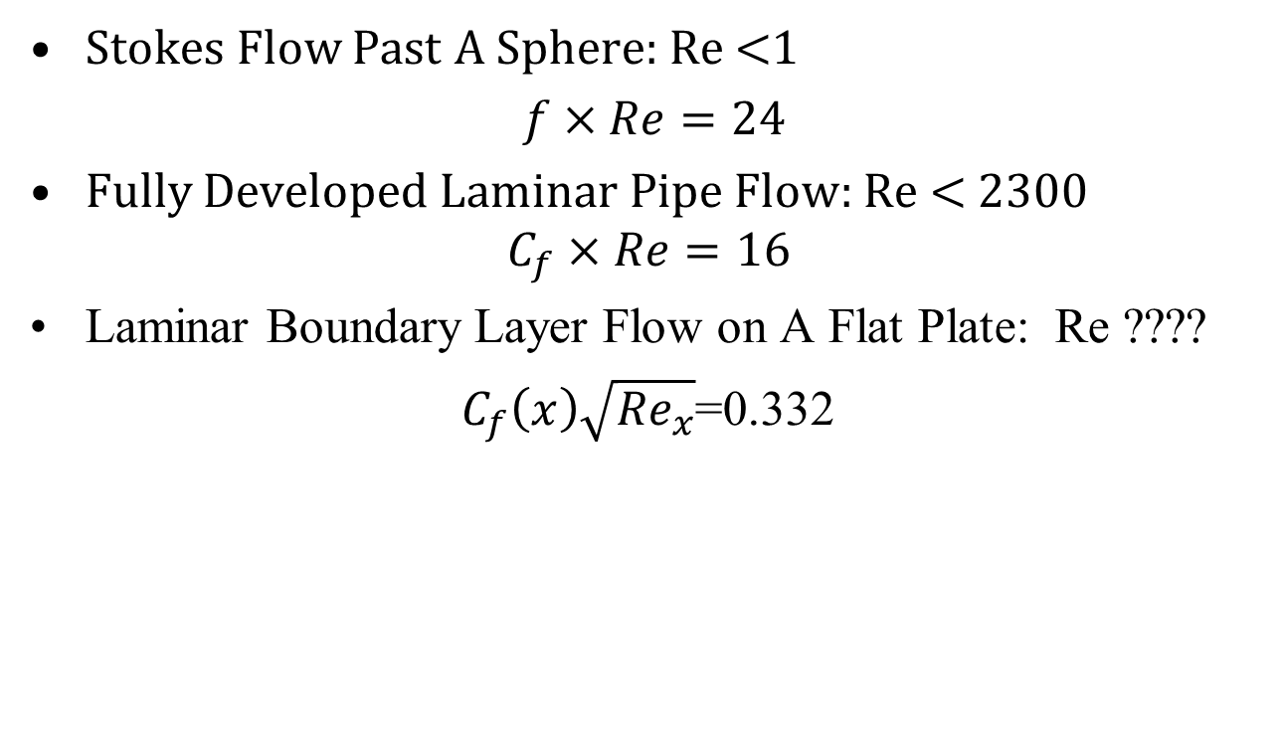
Primary Viscous Flows: Newton’s Wall Stress
Stokes Flow Past A Sphere: Re <1
$f×Re=24$
Fully Developed Laminar Pipe Flow: Re < 2300
$$C_{f}×Re=16$$
Laminar Boundary Layer Flow on A Flat Plate: Re ????
$C_{f}\left(x\right)\sqrt{{Re}_{x}}$=0.332

Slide 17
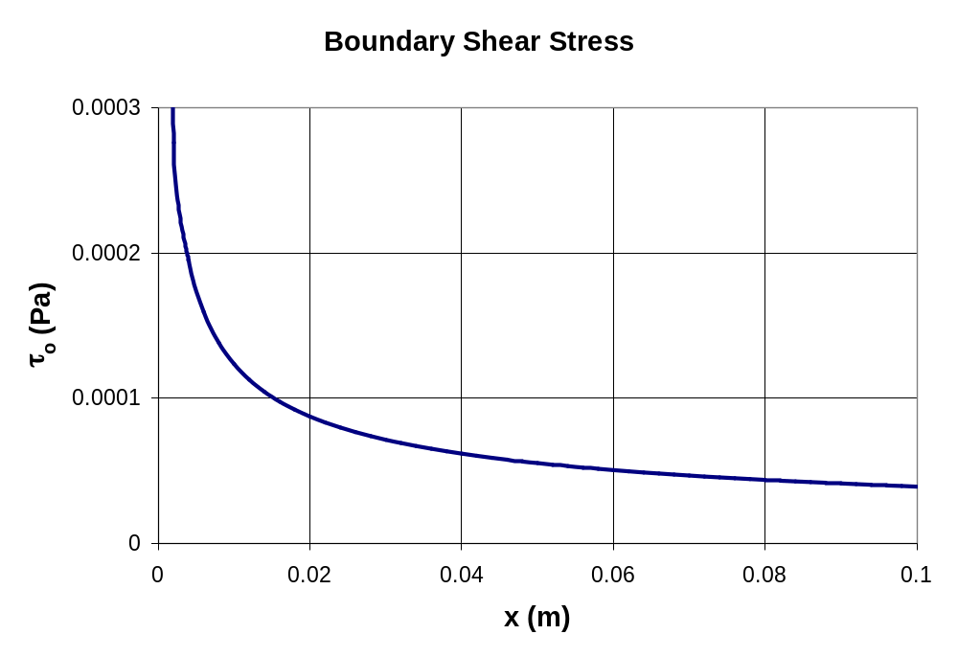
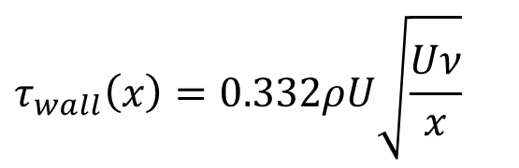
Variation of Local Wall Shear Stress along the Length: Water Flow on FP
$$τ_{wall}\left(x\right)=0.332ρU\sqrt{\frac{Uν}{x}}$$
U = 0.04 m/s
L = 0.1 m
ν = 1.5x10⁻⁵ m²/s
ρ = 1.2 kg/m³
(air)
Note that τ_{o} = ∞ at x = 0!

Slide 18
DRAG FORCE ON THE FLAT PLATE
Let the flat plate have length L and width b out of the page:
b
L
The shear stress τ (drag force per unit area) acting on one side of the plate is given as
$$τ_{o}=μ{\left.\frac{∂u}{∂y}\right|}_{y=0}$$
For a 2D plate, the total drag force F_{D} acting on the plate is given as
$$F_{D}=\int{τ_{}dA= }b\int_{0}^{L}{τ_{o}dx}$$

Slide 19
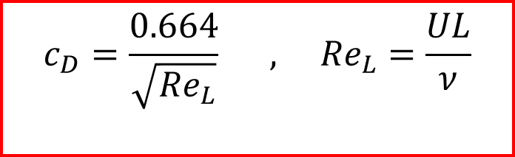
DRAG FORCE ON THE FLAT PLATE
The drag force is
$$F_{D}=b\int_{0}^{L}{τ_{o}dx}$$
$$=0.332ρbU\sqrt{Uν}\int_{0}^{L}{x^{−1/2}dx}$$
$$F_{D}=0.664ρU\sqrt{Uν}bL^{1/2}$$
$$c_{D}=\frac{F_{D}}{ρU^{2}bL}$$
Define non-dimensional drag as Coefficient of Drag:
$$c_{D}=\frac{0.664}{\sqrt{{Re}_{L}}} , {Re}_{L}=\frac{UL}{ν}$$

Slide 20
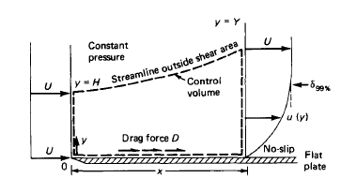
Pohlhausen’s Integral View
The control volume chosen for the analysis is enclosed by dashed lines.
This selection is not arbitrary but very clever.
Since velocity distributions are known only at the inlet and exit, it is imperative that the other two sides on the control volume be streamlines, where no mass or momentum crosses.

Slide 21
Impermeable Streamlines of A BL
The lower side should be the wall itself; hence the drag force will be exposed.
The upper side should be a streamline outside the shear layer, so that the viscous drag is zero along this line.

Slide 22
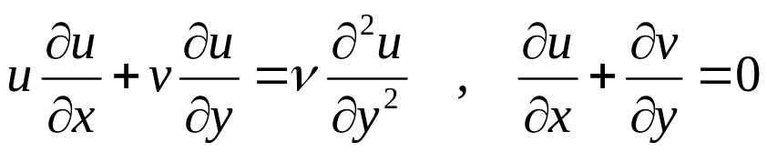
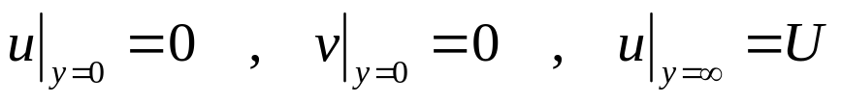
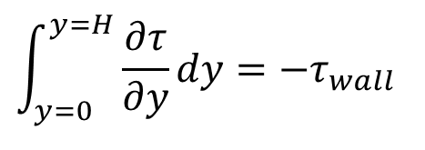
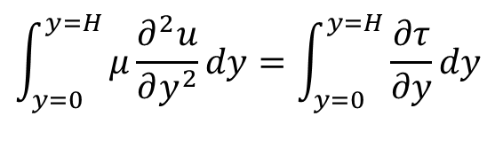
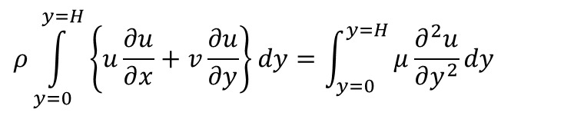
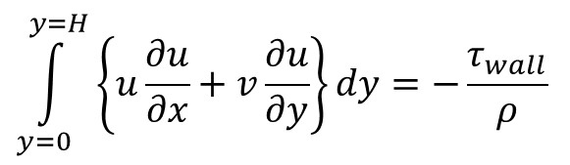
Integral View of A FPBL
Integral Method: Integrate the momentum equation along y-direction:
$$ρ\int_{y=0}^{y=H}{\left\{u\frac{∂u}{∂x}+v\frac{∂u}{∂y}\right\}dy}=\int_{y=0}^{y=H}{μ\frac{∂^{2}u}{∂y^{2}}}dy$$
$$\int_{y=0}^{y=H}{μ\frac{∂^{2}u}{∂y^{2}}}dy=\int_{y=0}^{y=H}{\frac{∂τ}{∂y}}dy$$
$$\int_{y=0}^{y=H}{\frac{∂τ}{∂y}}dy=−τ_{wall}$$
$$\int_{y=0}^{y=H}{\left\{u\frac{∂u}{∂x}+v\frac{∂u}{∂y}\right\}dy}=−\frac{τ_{wall}}{ρ}$$

Slide 23
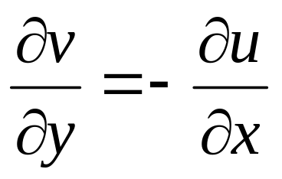
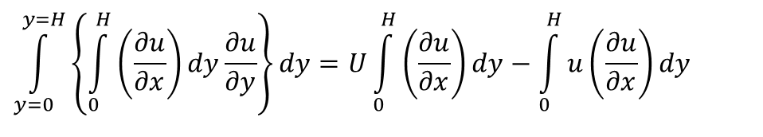
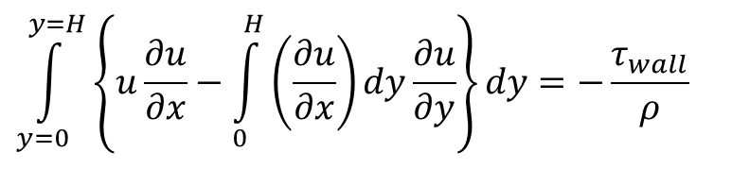

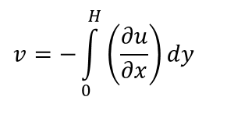
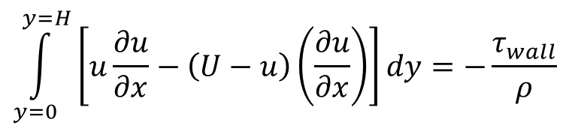
Transverse Integration of A FPBL
Using continuity equation :
$$v=−\int_{0}^{H}{\left(\frac{∂u}{∂x}\right)}dy$$
$$\int_{y=0}^{y=H}{\left\{u\frac{∂u}{∂x}−\int_{0}^{H}{\left(\frac{∂u}{∂x}\right)}dy\frac{∂u}{∂y}\right\}dy}=−\frac{τ_{wall}}{ρ}$$
The partial integration of the second term of the left side of above equation gives:
$$\int_{y=0}^{y=H}{\left\{\int_{0}^{H}{\left(\frac{∂u}{∂x}\right)}dy\frac{∂u}{∂y}\right\}dy}=U\int_{0}^{H}{\left(\frac{∂u}{∂x}\right)}dy−\int_{0}^{H}{u\left(\frac{∂u}{∂x}\right)}dy$$
$$\int_{y=0}^{y=H}{\left[u\frac{∂u}{∂x}−\left(U−u\right)\left(\frac{∂u}{∂x}\right)\right]dy}=−\frac{τ_{wall}}{ρ}$$
$$\int_{y=0}^{y=H}{\frac{∂}{∂x}\left\{u\left(U−u\right)\right\}dy}=\frac{τ_{wall}}{ρ}$$

Slide 24
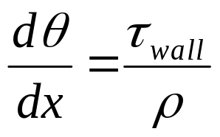
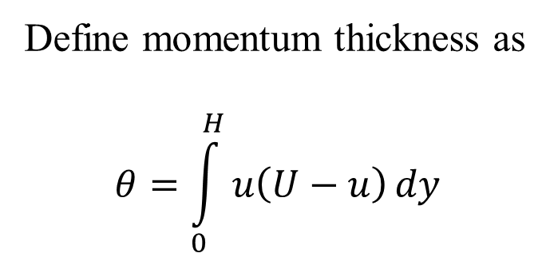

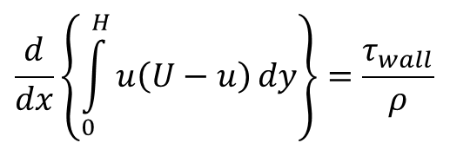
Transverse Integration of Momentum Equation of A FPBL
$$\int_{y=0}^{y=H}{\frac{∂}{∂x}\left\{u\left(U−u\right)\right\}dy}=\frac{τ_{wall}}{ρ}$$
$$\frac{d}{dx}\left\{\int_{0}^{H}{u\left(U−u\right)}dy\right\}=\frac{τ_{wall}}{ρ}$$
Define momentum thickness as
$$θ=\int_{0}^{H}{u\left(U−u\right)}dy$$

Slide 25
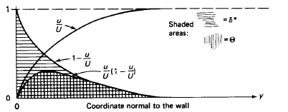
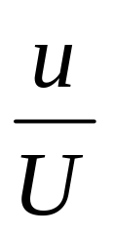
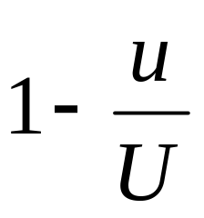
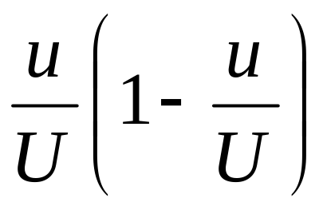
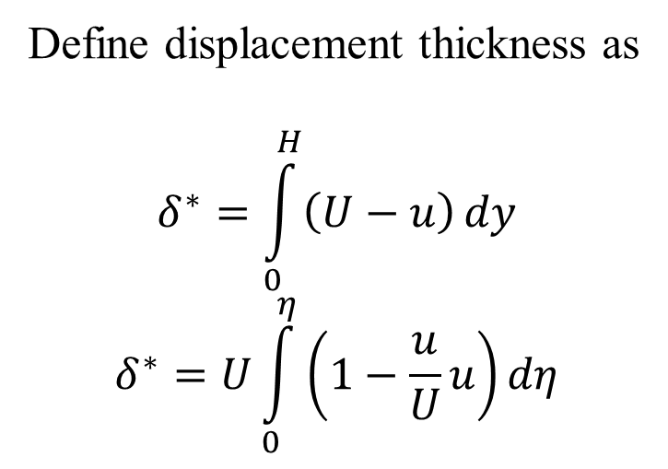
Physical Interpretation of θ
Define displacement thickness as
$$δ^{∗}=\int_{0}^{H}{\left(U−u\right)}dy$$
$$δ^{∗}=U\int_{0}^{η}{\left(1−\frac{u}{U}u\right)}dη$$

Slide 26
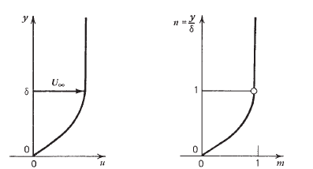






Pohlhausen’s Master Velocity Profile
$$\frac{dθ}{dx}=\frac{τ_{wall}}{ρ}$$
$$η\left(x,y\right)=\frac{y}{δ\left(x\right)}$$
$$\frac{u}{U}=\text{2}η−2η^{3}+η^{4}$$
$$τ_{wall}=μ{\left.\frac{∂u}{∂y}\right|}_{y=0}=μU{\left.\frac{∂\left\{\frac{u}{U}\right\}}{∂η}×\frac{∂η}{∂y}\right|}_{η=0}$$
$$τ_{wall}=μ{\left.\frac{∂u}{∂y}\right|}_{y=0}=2\frac{μU}{δ}$$
$$\frac{dθ}{dx}=2\frac{νU}{δ}$$

Slide 27

Momentum Thickness
$$θ=\int_{0}^{H}{u\left(U−u\right)}dy$$
$$\frac{u}{U}=\text{2}η−2η^{3}+η^{4}$$
$$η\left(x,y\right)=\frac{y}{δ\left(x\right)}$$
$$θ=δU^{2}\int_{0}^{1}{\frac{u}{U}\left(1−\frac{u}{U}\right)}dη =δU^{2}\int_{0}^{1}{\left\{\text{2}η−2η^{3}+η^{4}\right\}\left(1−\text{2}η+2η^{3}−η^{4}\right)}dη$$
$$θ=\frac{37}{315}×δU^{2}$$

Slide 28

ODE for Thickness of FPBL
  $$\frac{dθ}{dx}=2\frac{νU}{δ} → \frac{dδ}{dx}=\frac{630}{37}\frac{ν}{Uδ}$$
  $$\frac{dδ}{dx}=\frac{630}{37}\frac{ν}{Uδ}$$
$$δdδ=\frac{630}{37}\frac{ν}{U}dx$$
$$\frac{δ^{2}}{2}=\frac{630}{37}×\frac{νx}{U}+C$$
$$δ=\frac{5.84x}{\sqrt{{Re}_{x}}}$$

Slide 29


ODE for Thickness of FPBL
$$δ=\frac{5.84x}{\sqrt{{Re}_{x}}}$$
$$τ_{wall}\left(x\right)=2\frac{μU}{δ} →τ_{wall}\left(x\right)=0.34246\frac{μU}{x}×\sqrt{{Re}_{x}}$$
Blasius Solution:
$$τ\left(x\right)=ρU^{2}\frac{0.332}{\sqrt{{Re}_{x}}}$$

Slide 30

Holistic Picture of Flat Plate Boundary Layer
Velocity profile in a turbulent FPBL is defined using a simplified law
at large values of Re_{x} > 10⁷ , one-seventh-power law: $\frac{u}{U}={\left\{\frac{u}{U}\right\}}^{1/7}$

