Slide 1

Analysis of Boundary Layer Flow Equations
P M V Subbarao
Professor
Mechanical Engineering Department
I I T Delhi
Intuition To Recognize Tiny Region … Mathematical Skills to Quantify the Vigor of Tiny Region …

Slide 2


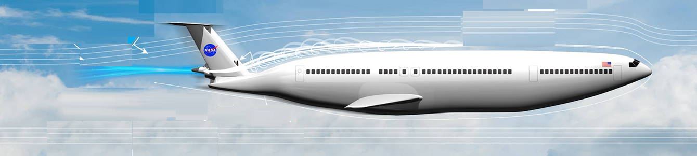




Thin Layer has A Strong Impact on A Large Flow System

Slide 3
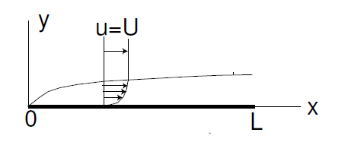
Zero Pressure Gradient (Flat Plate) Boundary Layer
Prandtl’s boundary layer equations for flat plate:
$$\frac{∂u}{∂x}+\frac{∂v}{∂y}=0$$
$$u\frac{∂u}{∂x}+v\frac{∂u}{∂y}−ν\frac{∂^{2}u}{∂y^{2}}=0$$
Subject to the conditions:
$$u=v=0 \text{at} y=0 ∨x>0$$
$$u→U as y→ ∨x>0$$
How to find a solution for a non-linear partial differential equation?

Slide 4
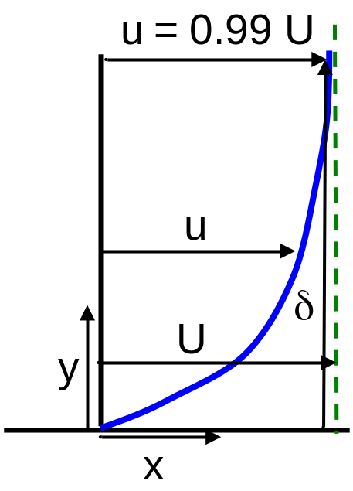
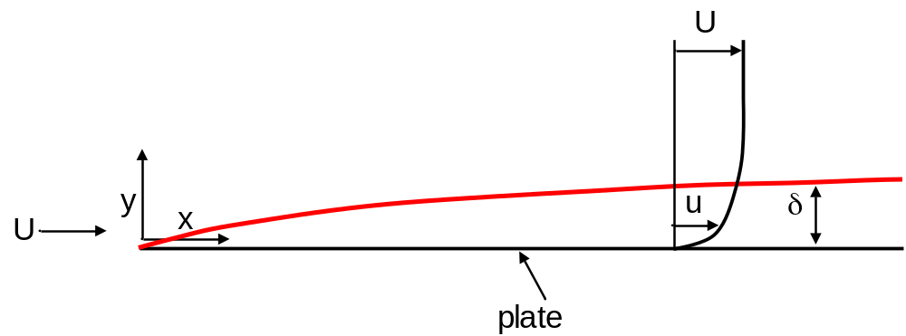
Nominal Boundary Layer Thickness
Until now we have not given a precise definition for boundary layer thickness.
δ, the nominal boundary thickness, is defined to be the value of y at which u = 0.99 U.
$${\left.u(x,y)\right|}_{y=δ}=0.99U$$
The choice 0.99 is arbitrary; we could have chosen 0.98 or 0.995 or whatever we find reasonable for obtaining solution with acceptable accuracy.

Slide 5
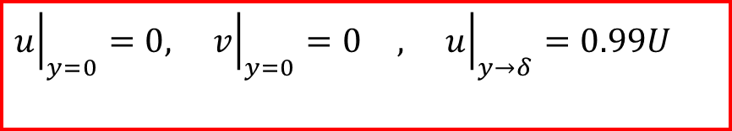
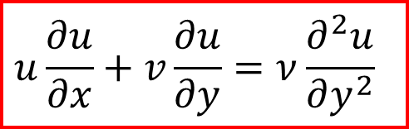
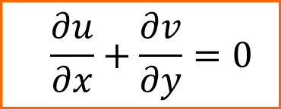
2-D Flat Plate Boundary Layer Equations & Boundary Conditions
$$\frac{∂u}{∂x}+\frac{∂v}{∂y}=0$$
$$u\frac{∂u}{∂x}+v\frac{∂u}{∂y}=ν\frac{∂^{2}u}{∂y^{2}}$$
At all x > 0
$${\left.u\right|}_{y=0}=0, {\left.v\right|}_{y=0}=0 , {\left.u\right|}_{y→δ}=0.99U$$

Slide 6
Prandtl’s Novel PDEs Needs Solution
1904
Prandtl's first PhD student, Heinrich Blasius derived the seminal 1908 solution for laminar flow over a flat plate.
In 1913, Karl Pohlhausen moved to Gottingen to study under Carl Runge.
Pohlhausen was attracted to Ludwig Prandtl, who quickly became and remained his hero and idol.
Pohlhausen joined von Karman (postdoc) to find another method of solution to BL equations.
1908: Blasius Similarity Solution to BL Flows.
1921: Karman- Pohlhausen’s Integral Solutions to BL Flows

Slide 7
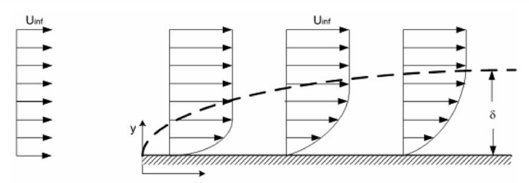
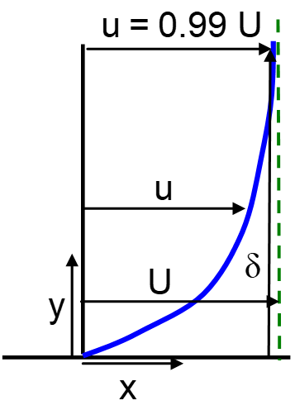

Is the Intuition Infused by Teacher to Students
δ
L
$$u\frac{∂u}{∂x}+v\frac{∂u}{∂y}=ν\frac{∂^{2}u}{∂y^{2}}$$

Slide 8
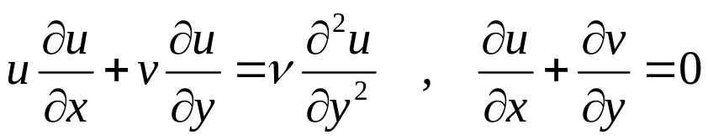
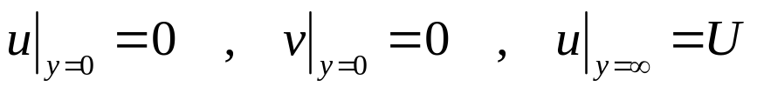
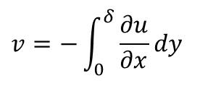
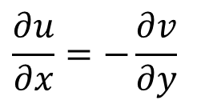
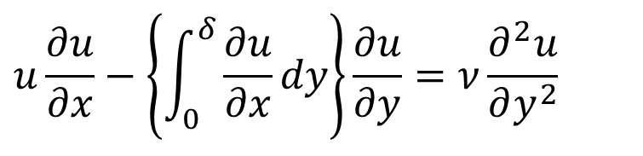
Pohlhausen’s Master Velocity Profile
$$\frac{∂u}{∂x}=−\frac{∂v}{∂y}$$
$$v=−\int_{0}^{δ}{\frac{∂u}{∂x}dy}$$
$$u\frac{∂u}{∂x}−\left\{\int_{0}^{δ}{\frac{∂u}{∂x}dy}\right\}\frac{∂u}{∂y}=ν\frac{∂^{2}u}{∂y^{2}}$$
An Integra-partial Differential equation.

Slide 9
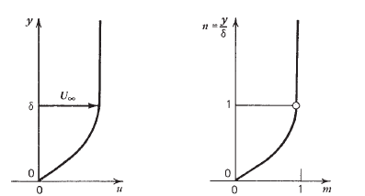
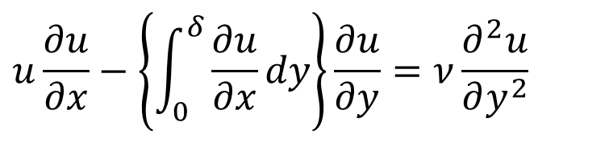
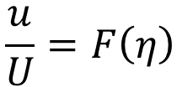
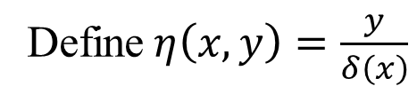
Pohlhausen’s Master Velocity Profile
$$u\frac{∂u}{∂x}−\left\{\int_{0}^{δ}{\frac{∂u}{∂x}dy}\right\}\frac{∂u}{∂y}=ν\frac{∂^{2}u}{∂y^{2}}$$
Define$η\left(x,y\right)=\frac{y}{δ\left(x\right)}$
$$\frac{u}{U}=F\left(η\right)$$
$F\left(η\right)$ = $\sum_{i=0}^{4}{a_{i}η_{i}^{4}}=a_{0}+a_{1}η+a_{2}η^{2}+a_{3}η^{3}+a_{4}η^{4}$

Slide 10
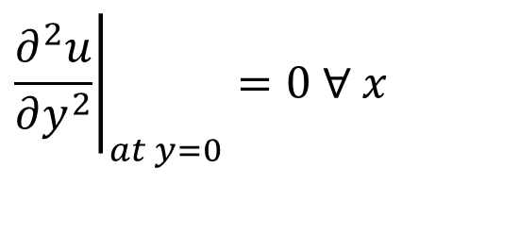

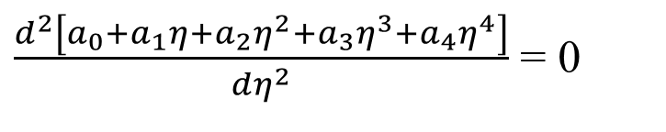
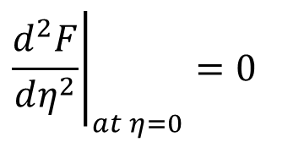
Near the Wall BL Equation
$$u\frac{∂u}{∂x}−\left\{\int_{0}^{δ}{\frac{∂u}{∂x}dy}\right\}\frac{∂u}{∂y}=ν\frac{∂^{2}u}{∂y^{2}}$$
$${\left.\frac{∂^{2}u}{∂y^{2}}\right|}_{at y=0}=0 ∀ x$$
$${\left.\frac{d^{2}F}{dη^{2}}\right|}_{at η=0}=0$$
Impose wall B.L. equation on Master Profile
$\frac{d^{2}\left[a_{0}+a_{1}η+a_{2}η^{2}+a_{3}η^{3}+a_{4}η^{4}\right]}{dη^{2}}$ = 0
$$→a_{2}=0$$

Slide 11

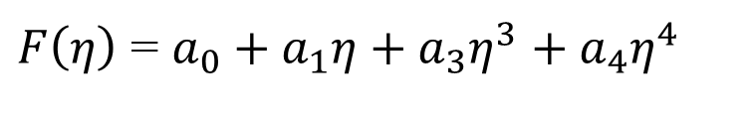
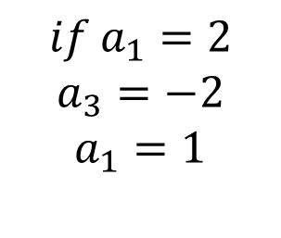

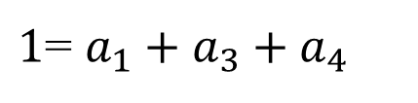
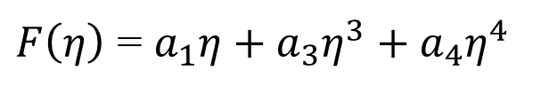

Pohlhausen’s Master Velocity Profile
$F\left(η\right)$ = $a_{0}+a_{1}η+a_{3}η^{3}+a_{4}η^{4}$
$$→a_{0}=0$$
$F\left(η\right)$ = $a_{1}η+a_{3}η^{3}+a_{4}η^{4}$
$1$= $a_{1}+a_{3}+a_{4}$
$F\left(η\right)$ = $a_{1}η+a_{3}η^{3}+\left(1−a_{1}−a_{3}\right)η^{4}$
$$if{ a}_{1}=2$$
$$a_{3}=−2$$
$$a_{1}=1$$
Is it possible to guess above Variables?
Fluid Mechanics as Puzzle Game!

Slide 12
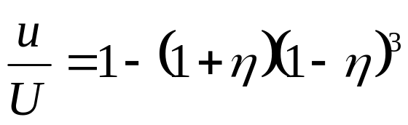


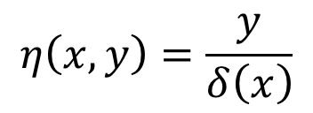
Pohlhausen’s Master Velocity Profile
$F\left(η\right)$ = $a_{0}+a_{1}η+a_{3}η^{3}+a_{4}η^{4}$
$F\left(η\right)$ = 2$η−2η^{3}+η^{4}$
$F\left(η\right)$ = 2$η−2η^{3}+η^{4}$
$$η\left(x,y\right)=\frac{y}{δ\left(x\right)}$$

Slide 13
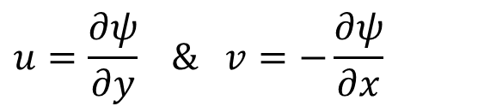
Blasius Solution to Reduce the Number of Dependent Variables
$$u\frac{∂u}{∂x}+v\frac{∂u}{∂y}=ν\frac{∂^{2}u}{∂y^{2}} , \frac{∂u}{∂x}+\frac{∂v}{∂y}=0$$
$${\left.u\right|}_{y=0}=0 , {\left.v\right|}_{y=0}=0 , {\left.u\right|}_{y=∞}=0.99U$$
$$u=\frac{∂ψ}{∂y} \& v=−\frac{∂ψ}{∂x}$$
Introduce Stream function, ψ(x, y).
Note that the stream function satisfies continuity identically.
$$\frac{∂ψ}{∂y}\frac{∂^{2}ψ}{∂x∂y}−\frac{∂ψ}{∂x}\frac{∂^{2}ψ}{∂y^{2}}=ν\frac{∂^{3}ψ}{∂y^{3}}$$
$${\left.\frac{∂ψ}{∂y}\right|}_{y=0}=0 , {\left.\frac{∂ψ}{∂x}\right|}_{y=0}=0 , {\left.\frac{∂ψ}{∂y}\right|}_{y=∞}=0.99U$$

Slide 14
Is the Variations of u(y) along x-direction are Dissimilar??
δ
L
$$\frac{∂ψ}{∂y}\frac{∂^{2}ψ}{∂x∂y}−\frac{∂ψ}{∂x}\frac{∂^{2}ψ}{∂y^{2}}=ν\frac{∂^{3}ψ}{∂y^{3}}$$

Slide 15
Discovery of Similarity Variable by The Method of Guessing
$$\frac{∂ψ}{∂y}\frac{∂^{2}ψ}{∂x∂y}−\frac{∂ψ}{∂x}\frac{∂^{2}ψ}{∂y^{2}}=ν\frac{∂^{3}ψ}{∂y^{3}}$$
The truth of boundary layer physics is
$$\frac{u}{U}=f(η)$$
The boundary layer velocity profile may be varying along only one direction (η ) in an unknown plane!
$$∴ψ=F(η)$$
$$where,η=g(x,y)$$
F is a similarity function.
Is it possible to guess above functions.
Fluid Mechanics as Puzzle Game!

Slide 16
Discovery of Similarity Variable by The Method Of Guessing
$$\frac{∂ψ}{∂y}\frac{∂^{2}ψ}{∂x∂y}−\frac{∂ψ}{∂x}\frac{∂^{2}ψ}{∂y^{2}}=ν\frac{∂^{3}ψ}{∂y^{3}}$$
F is a similarity function.
$$ψ=F(η)$$
$$u=\frac{∂ψ}{∂y}=F^{′}(η)\frac{∂η}{∂y}$$
$$\frac{∂η}{∂y}=???$$
The constraint of Puzzle:
We want our stream function to give us a velocity u = ∂ψ/∂y satisfying the similarity variable!

Slide 17
The Puzzle Solved by Blasius
The intuition proposed by Prandtl was used as the starting idea by Blasius:
$$δ\left(x\right)=C{\left(\frac{νx}{U}\right)}^{m}$$
Blasius definition of η is
$$η=\frac{y}{δ\left(x\right)}=\frac{y}{C{\left(\frac{νx}{U}\right)}^{m}}$$
The first part of puzzle is now just to guess suitable values of m and C
$$η=y\sqrt{\frac{U}{νx}}$$

Slide 18
The Puzzle Solved by Blasius
$$η=y\sqrt{\frac{U}{νx}}$$
$$u=\frac{∂ψ}{∂y}$$
Blasius reckoned a Stream Function, such that, non-dimensional u in transformed plane is as simple as possible.
$$ψ=\sqrt{Uνx} F(η)$$
Blasius Stream Function:
x and y are independent of each other and recalling the evaluation of ∂η/∂y,
$$u=\frac{∂ψ}{∂y}$$
$$\frac{u}{U}=F^{′}(η)$$
But this does not mean that we are done.
We must solve for the function F(η).

Slide 19
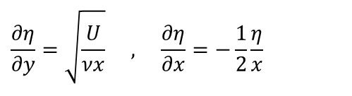
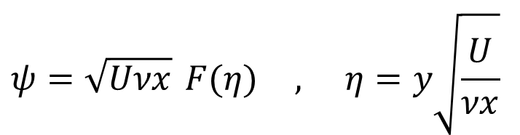
Summary of Conversions
$$ψ=\sqrt{Uνx} F(η) , η=y\sqrt{\frac{U}{νx}}$$
$$\frac{∂η}{∂y}=\sqrt{\frac{U}{νx}} , \frac{∂η}{∂x}=−\frac{1}{2}\frac{η}{x}$$
$$\frac{∂ψ}{∂y}=UF^{′}(η)$$
$$\frac{∂^{3}ψ}{∂y^{3}}=U\frac{U}{νx}F^{‴}(η)$$
$$\frac{∂ψ}{∂y}\frac{∂^{2}ψ}{∂x∂y}−\frac{∂ψ}{∂x}\frac{∂^{2}ψ}{∂y^{2}}=ν\frac{∂^{3}ψ}{∂y^{3}}$$
$$\frac{∂^{2}ψ}{∂y^{2}}=U\sqrt{\frac{U}{νx}} F^{″}(η)$$
$$\frac{∂^{2}ψ}{∂x∂y}=−\frac{1}{2}\frac{U}{x}ηF^{″}(y)$$
$$\frac{∂ψ}{∂x}=\frac{1}{2}\sqrt{\frac{Uν}{x}}\left[F(η)−ηF^{′}(η)\right]$$

Slide 20
Blasius ODE governing Flat Plate BL
$$\frac{∂ψ}{∂y}\frac{∂^{2}ψ}{∂x∂y}−\frac{∂ψ}{∂x}\frac{∂^{2}ψ}{∂y^{2}}=ν\frac{∂^{3}ψ}{∂y^{3}}$$
$$2\frac{d^{3}F}{dη^{3}}+F\frac{d^{2}F}{dη^{2}}=0$$
$$2F^{‴}+{FF}^{″}=0$$

Slide 21
Blasius ODE & BOUNDARY CONDITIONS
$$2F^{‴}+{FF}^{″}=0$$
The boundary conditions are
$${\left.u at the wall= \frac{∂ψ}{∂y}\right|}_{y=0}=0→F^{′}\left(0\right)=0 ,$$
$${\left.v at the wall= \frac{∂ψ}{∂x}\right|}_{y=0}=0 →F\left(0\right)=0 ,$$
$${\left.u at the Edge of BL\frac{∂ψ}{∂y}\right|}_{y=δ}=U →F^{′}\left(η>δ\right)>0.99$$

