Slide 1

Inertial (Non-Creeping) Fluid flows : Boundary Layer Theory
P M V Subbarao
Professor
Mechanical Engineering Department
I I T Delhi
Need to Identify & Quantity The Viscous Region due to the Wall …

Slide 2



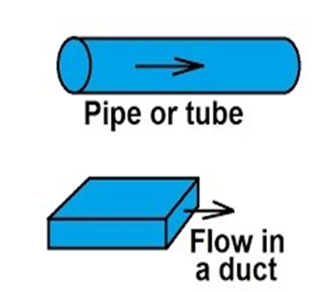
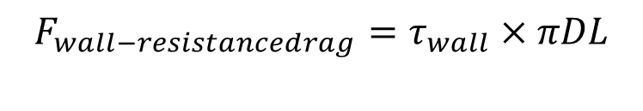

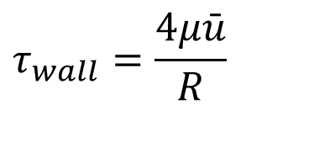

Study of Flows : Complete Influence of Wall
Stokes Flow in 1851
Hagen & Poiseuille : !839 & 1841
Reynolds : 1886
$$τ_{wall}=\frac{4μ\bar{u}}{R}$$
$F_{total−drag}=$ $6πμaU$
$$F_{wall−resistancedrag}=τ_{wall}×πDL$$
$$F_{wall−resistancedrag}=8πμ\overline{u}L$$

Slide 3
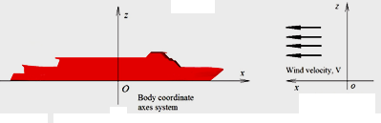
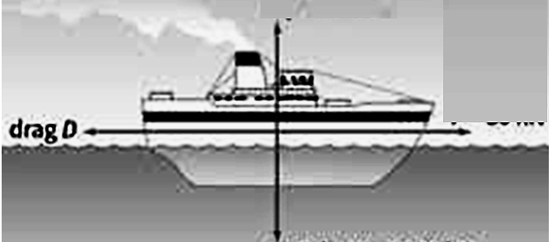
Commercial Need of Viscous Drag
Drag Force is proportional to Length of a Ship!!!
Experiments of Froude (1872) on a thin fiat plate towed through still water made it clear that the frictional resistance does not vary as the length but at a smaller rate.

Slide 4
The Main Concern
On the motion of a fluid with higher Inertia in Viscous Flows…..
Ludwig Prandtl presented a paper at the Third International Congress of Mathematicians in August, 1904, at Heidelberg.
Published in the Proceedings of the Congress in the following year (1905).

Slide 5
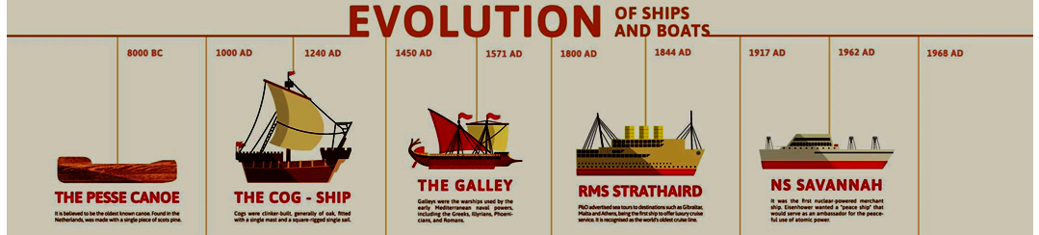
Evolution & Growth of ships

Slide 6
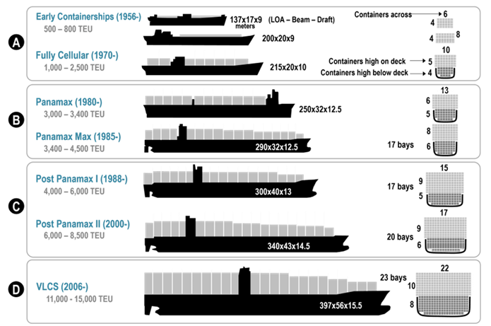
Growth of containerships

Slide 7
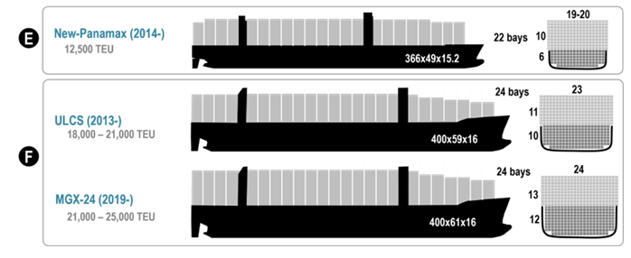
Growth of containerships

Slide 8

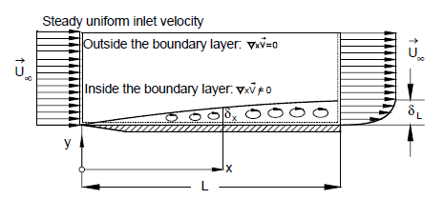
Visualization of Wall Affected Region in High-speed Flows
Based on his experimental observations, A Genius Intuitively concluded that effect of the viscosity is confined to a thin viscous layer that he called, the boundary layer.

Slide 9
An Ingenious Lecture
A professor in Hanover, Germany delivered in a 10 minutes address in 1904 on this topic.
This concept is a classic example of an applied science greatly influencing the development of mathematical methods of wide applicability.
Prof. Ludwig Prandtl.
Prandtl had done experiments in the flow of water over bodies, and sought to understand the effect of the small viscosity on the flow.
Realizing that the no-slip condition had to apply at the surface of the body, his observations led him to the conclusion that the flow was decelerated in a thin layer adjacent to the rigid surface.
The boundary layer.

Slide 10
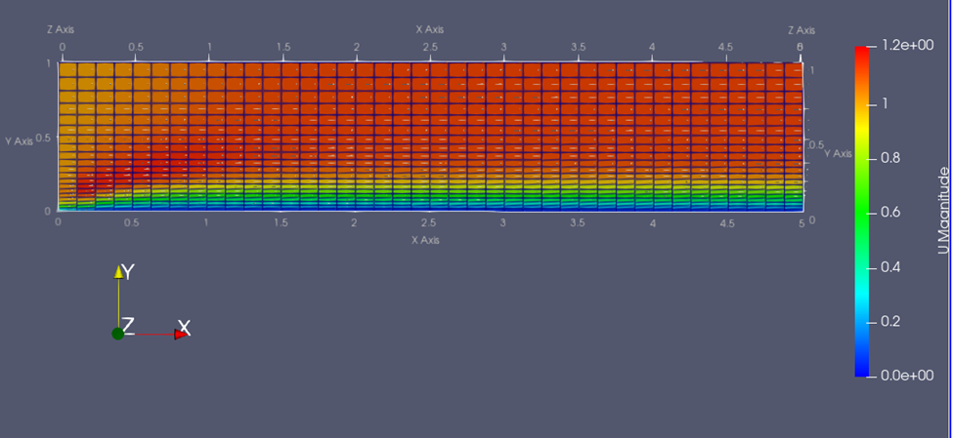
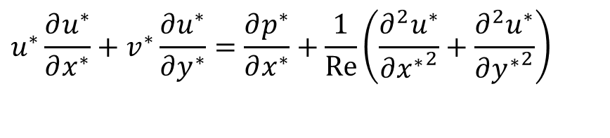
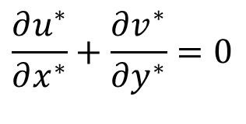
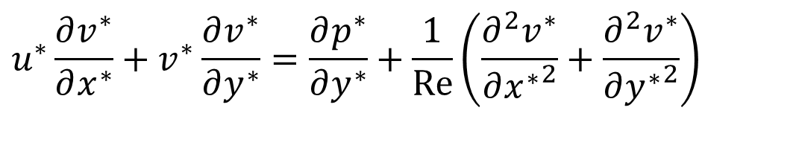
21st Century Computer Simullations
Steady State Incompressible Flow past a Flat plate
$$u^{∗}\frac{∂u^{∗}}{∂x^{∗}}+v^{∗}\frac{∂u^{∗}}{∂y^{∗}}=\frac{∂p^{∗}}{∂x^{∗}}+\frac{1}{Re}\left(\frac{∂^{2}u^{∗}}{∂{x^{∗}}^{2}}+\frac{∂^{2}u^{∗}}{∂{y^{∗}}^{2}}\right)$$
X-momentum:
Y-momentum:
$$u^{∗}\frac{∂v^{∗}}{∂x^{∗}}+v^{∗}\frac{∂v^{∗}}{∂y^{∗}}=\frac{∂p^{∗}}{∂y^{∗}}+\frac{1}{Re}\left(\frac{∂^{2}v^{∗}}{∂{x^{∗}}^{2}}+\frac{∂^{2}v^{∗}}{∂{y^{∗}}^{2}}\right)$$
Continuity Equation:
$$\frac{∂u^{∗}}{∂x^{∗}}+\frac{∂v^{∗}}{∂y^{∗}}=0$$

Slide 11
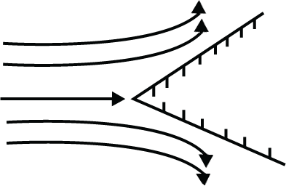

Ideal Flow Past a Planar Wedge
Wedge flow resembles the flow that divides at the front side (or leading edge) of an object (ship hull or aerofoil).
It is a reasonable model for the flow over the leading portion of certain objects (airfoils).
The flow impinges on an object with a stagnation point at the wedge vertex and then accelerates along the top and bottom surfaces as the streamlines converge.
Planar potential flow around a wedge is described by
$$W\left(z\right)=Az^{−n}$$

Slide 12
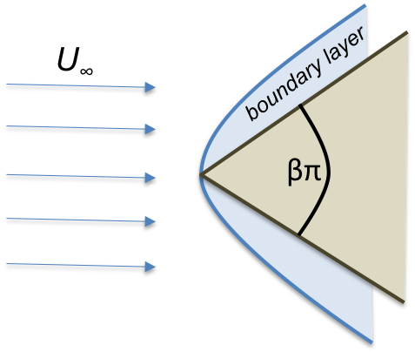
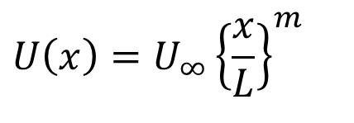
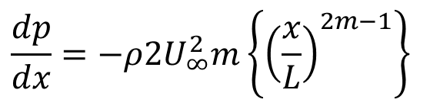
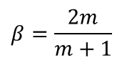
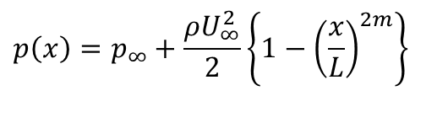
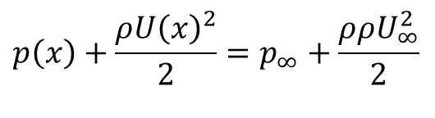
Potential Flow Past a Wedge
Euler’s velocity equation outside the Boundary layer
$$U\left(x\right)=U_{∞}{\left\{\frac{x}{L}\right\}}^{m}$$
$$β=\frac{2m}{m+1}$$
Use Bernoulli's equation with Euler’s velocity to get the pressure at the edge of Boundary layer
$$p\left(x\right)+\frac{ρU{\left(x\right)}^{2}}{2}=p_{∞}+\frac{ρρU_{∞}^{2}}{2}$$
$$\frac{dp}{dx}=−ρ2U_{∞}^{2}m\left\{{\left(\frac{x}{L}\right)}^{2m−1}\right\}$$
$$p\left(x\right)=p_{∞}+\frac{ρU_{∞}^{2}}{2}\left\{1−{\left(\frac{x}{L}\right)}^{2m}\right\}$$
In a Prandtls BL flow, Euler’s velocity is valid at the edge of BL.

Slide 13
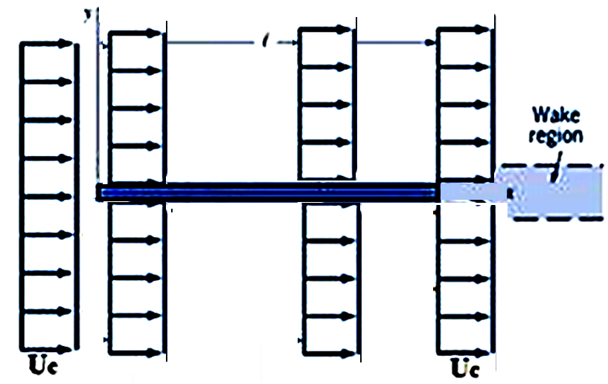
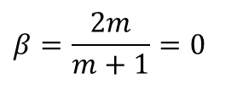
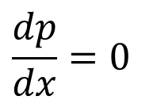
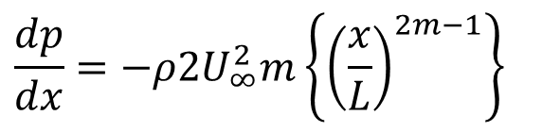
Potential flow Past A 2-D Zero Angle Wedge
$$\frac{dp}{dx}=−ρ2U_{∞}^{2}m\left\{{\left(\frac{x}{L}\right)}^{2m−1}\right\}$$
$$β=\frac{2m}{m+1}=0$$
For m = 0
$$\frac{dp}{dx}=0$$
Pressure is uniform all over the flat plate and same as upstream pressure!

Slide 14
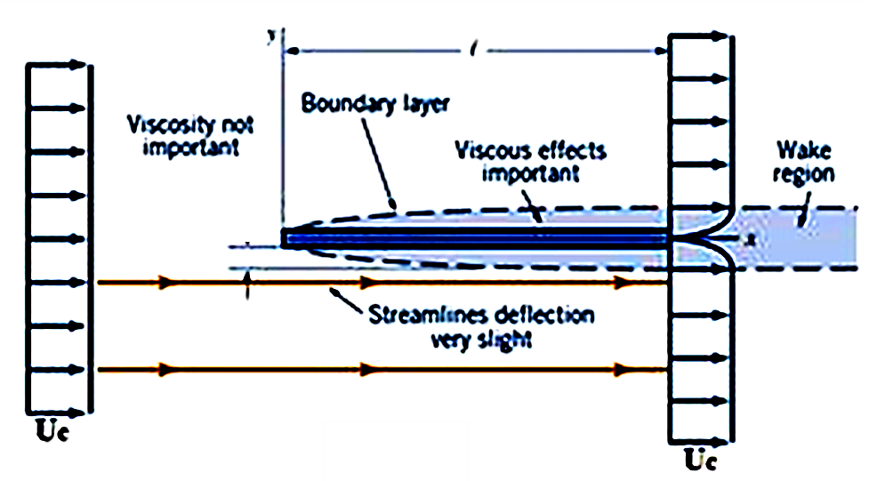
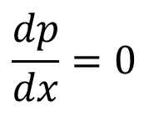
2-D Laminar Boundary Layer Flow past A Zero Angle Wedge
$$\frac{dp}{dx}=0$$
Pressure is uniform all over the flat plate and same as upstream pressure!

Slide 15
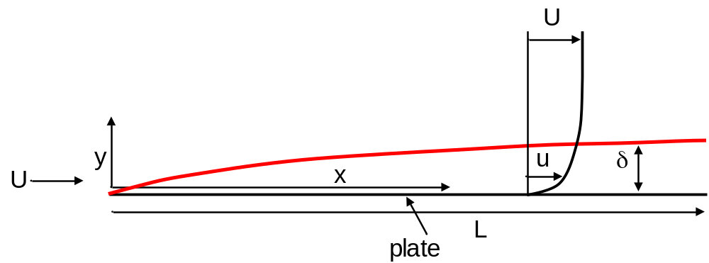
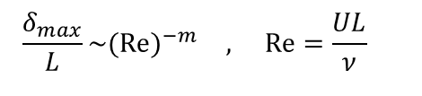
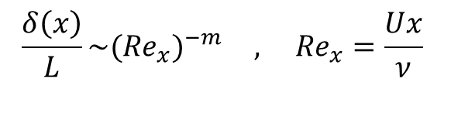
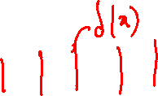
Streamwise Variation of Flat Plate Boundary Layer Thickness
Consider a plate of length L.
Based on the Boundary Layer visualizations studies, boundary layer grows slowly along flow direction.
Hence, maximum value of δ_{max} is expected to vary as
$$\frac{δ_{max}}{L}\sim (Re)^{−m} , Re=\frac{UL}{ν}$$
Similarly, the local value of δ(x) is estimated as
$$\frac{δ\left(x\right)}{L}\sim ({Re}_{x})^{−m} , {Re}_{x}=\frac{Ux}{ν}$$
Re_{x} : Local Reynolds Number

Slide 16
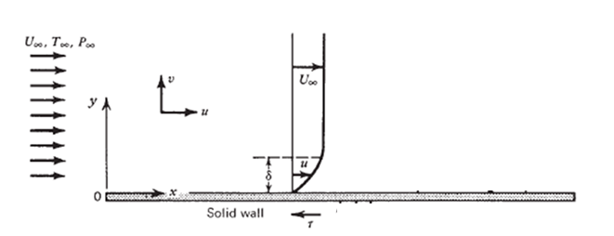
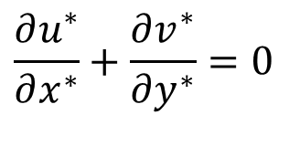
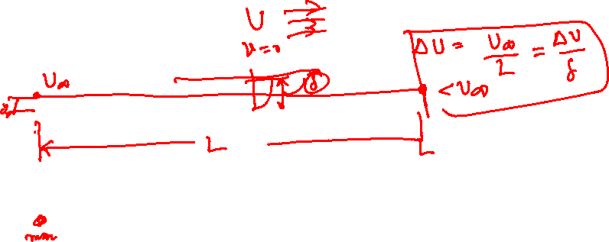
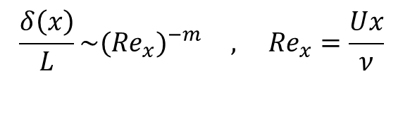
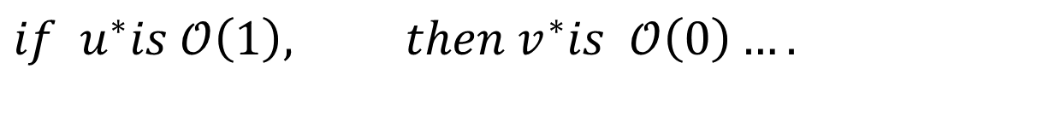
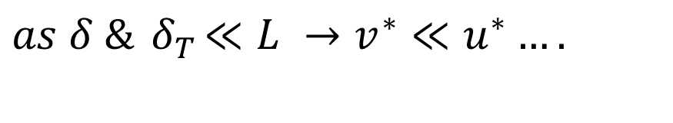
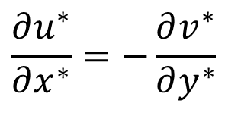
Order of Magnitude Analysis For A Thin Boundary Layer
$$\frac{∂u^{∗}}{∂x^{∗}}+\frac{∂v^{∗}}{∂y^{∗}}=0$$
Continuity Equation:
$$\frac{∂u^{∗}}{∂x^{∗}}=−\frac{∂v^{∗}}{∂y^{∗}}$$
Prandtl’s Intuitional Fluid Mechanics
$$\frac{δ\left(x\right)}{L}\sim ({Re}_{x})^{−m} , {Re}_{x}=\frac{Ux}{ν}$$
$$as δ \&{ δ}_{T}≪L →v^{∗}≪u^{∗}….$$
$$if u^{∗}is 𝒪\left(1\right), then{ v}^{∗}is 𝒪\left(0\right)….$$

Slide 17
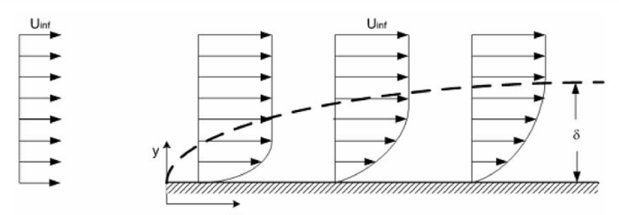
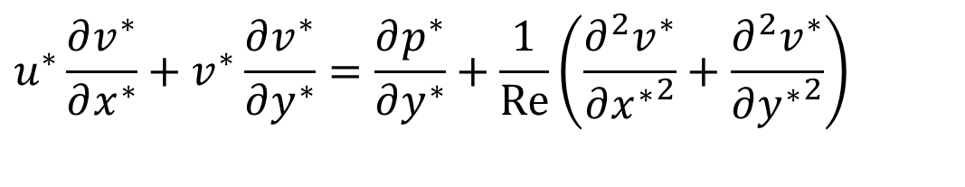
Order of Magnitude Analysis & Intuition
δ
L
Y-momentum:
$$u^{∗}\frac{∂v^{∗}}{∂x^{∗}}+v^{∗}\frac{∂v^{∗}}{∂y^{∗}}=\frac{∂p^{∗}}{∂y^{∗}}+\frac{1}{Re}\left(\frac{∂^{2}v^{∗}}{∂{x^{∗}}^{2}}+\frac{∂^{2}v^{∗}}{∂{y^{∗}}^{2}}\right)$$
Euler pressure field is same in the entire boundary layer!
As pressure field is known, No need to solve Y-momentum equation…

Slide 18
Order of Magnitude Analysis
$$δ≪L →v^{∗}≪u^{∗}$$
δ
$$if u^{∗}is 𝒪\left(1\right),$$
$$then{ v}^{∗}is 𝒪\left(0\right)….$$
L
X-momentum for a flat plate:
0
O(0)
If O(1)
$$u^{∗}\frac{∂u^{∗}}{∂x^{∗}}+v^{∗}\frac{∂u^{∗}}{∂y^{∗}}=−\frac{∂p^{∗}}{∂x^{∗}}+\frac{1}{Re}\left(\frac{∂^{2}u^{∗}}{∂{x^{∗}}^{2}}+\frac{∂^{2}u^{∗}}{∂{y^{∗}}^{2}}\right)$$

Slide 19
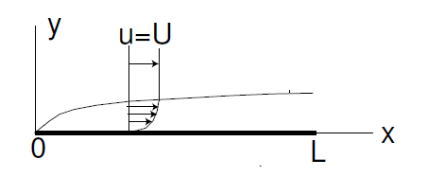
Zero Pressure Gradient Boundary Layer
Prandtl’s boundary layer equations for flat plate:
$$\frac{∂u}{∂x}+\frac{∂v}{∂y}=0$$
$$u\frac{∂u}{∂x}+v\frac{∂u}{∂y}−ν\frac{∂^{2}u}{∂y^{2}}=0$$
Subject to the conditions:
$$u=v=0 \text{at} y=0 ∨x>0$$
$$u→U as y→ ∨x>0$$
How to find a solution for a non-linear partial differential equation?

Slide 20
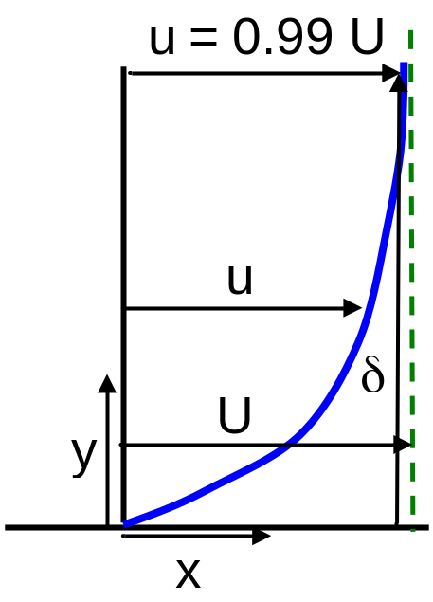
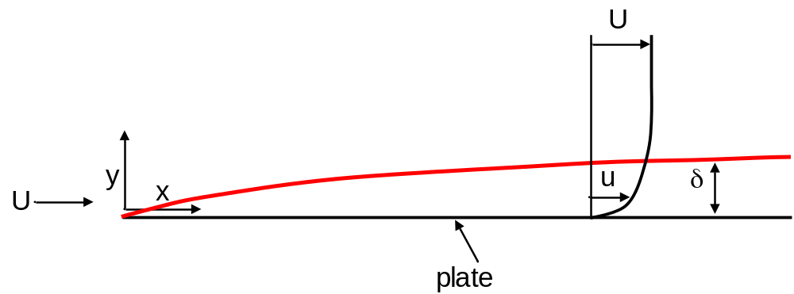
Nominal Boundary Layer Thickness
Until now we have not given a precise definition for boundary layer thickness.
δ, the nominal boundary thickness, is defined to be the value of y at which u = 0.99 U.
$${\left.u(x,y)\right|}_{y=δ}=0.99U$$
The choice 0.99 is arbitrary; we could have chosen 0.98 or 0.995 or whatever we find reasonable for obtaining solution with acceptable accuracy.

Slide 21
2-d Flat Plate Boundary Layer Equations Similarity
$$\frac{∂u}{∂x}+\frac{∂v}{∂y}=0$$
$$u\frac{∂u}{∂x}+v\frac{∂u}{∂y}=ν\frac{∂^{2}u}{∂y^{2}}$$
$${\left.u\right|}_{y=0}=0, {\left.v\right|}_{y=0}=0 , {\left.u\right|}_{y→δ}=0.99U$$
At all x > 0

