Slide 1

Pipe Friction : Laminar Flow
P M V Subbarao
Professor
Mechanical Engineering Department
I I T Delhi
Pump: Supports Pressure Loss in Pipes……

Slide 2


Characteristics of Poiseuille Flow
Like the Stokes flow problems, the acceleration terms vanish here, taking the density with them.
These flows are true creeping flows in the sense that they are independent of density.
The Reynolds number is not even a required parameter
There is no characteristic velocity U and no axial length scale L either, since we are supposedly far from the entrance or exit.
The proper scaling of Poiseuille Equation should include μ, dp/dx, and some characteristic pipe diameter, d.

Slide 3
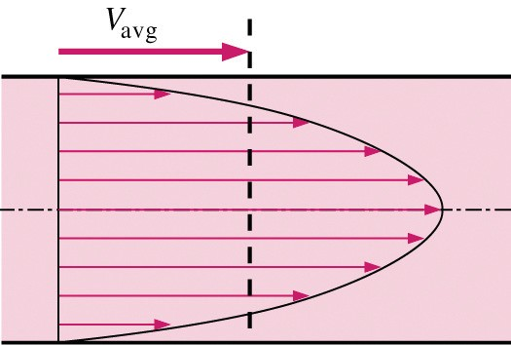
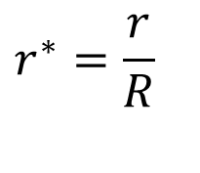
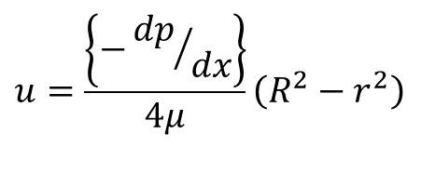
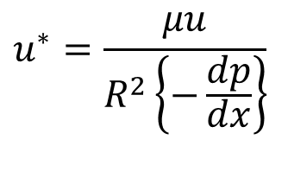
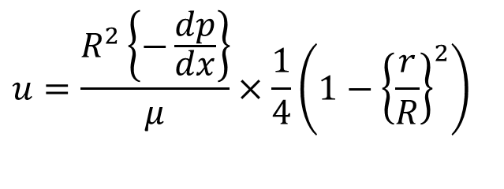
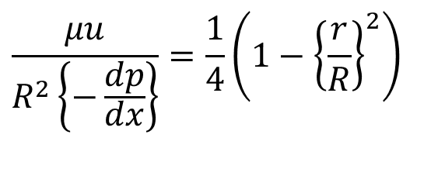
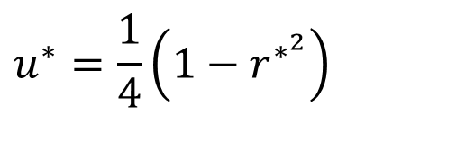
Solution to Macro Engineering No-Slip Hagen-Poiseuille Flow
$$u^{∗}=\frac{1}{4}\left(1−r^{∗^{2}}\right)$$
$$u^{∗}=\frac{μu}{R^{2}\left\{−\frac{dp}{dx}\right\}}$$
$$r^{∗}=\frac{r}{R}$$
$$\frac{μu}{R^{2}\left\{−\frac{dp}{dx}\right\}}=\frac{1}{4}\left(1−{\left\{\frac{r}{R}\right\}}^{2}\right)$$
$$u=\frac{R^{2}\left\{−\frac{dp}{dx}\right\}}{μ}×\frac{1}{4}\left(1−{\left\{\frac{r}{R}\right\}}^{2}\right)$$
The velocity distribution generated by a given value of pressure gradient in a fully developed pipe flow is a paraboloid of revolution about the centerline.
$$u=\frac{\left\{−{dp}/{dx}\right\}}{4μ}\left(R^{2}−r^{2}\right)$$
This is called as the Poiseuille paraboloid.

Slide 4
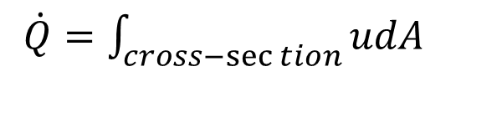
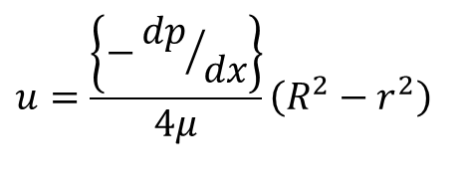
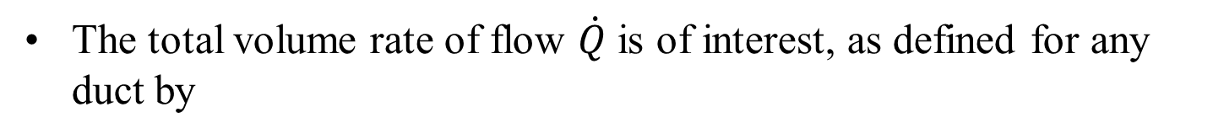
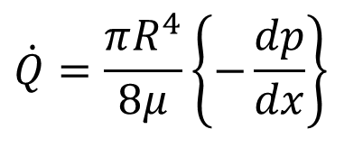
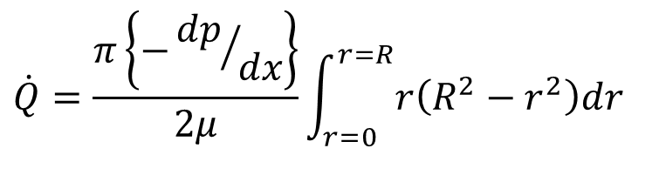
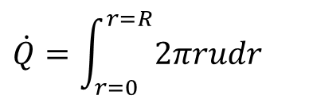
The Capacity of A Pipe
The total volume rate of flow $\dot{Q}$ is of interest, as defined for any duct by
$\dot{Q}=\int_{cross−\sec{t}ion}{udA}$
$$\dot{Q}=\int_{r=0}^{r=R}{2πrudr}$$
$$u=\frac{\left\{−{dp}/{dx}\right\}}{4μ}\left(R^{2}−r^{2}\right)$$
$$\dot{Q}=\frac{π\left\{−{dp}/{dx}\right\}}{2μ}\int_{r=0}^{r=R}{r\left(R^{2}−r^{2}\right)dr}$$
$$\dot{Q}=\frac{πR^{4}}{8μ}\left\{−\frac{dp}{dx}\right\}$$

Slide 5
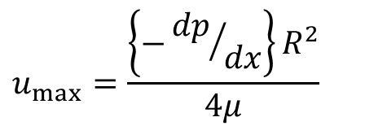
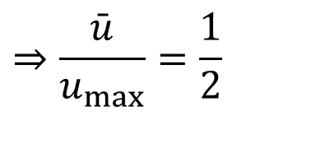
Mean & Maximum Flow Velocities in Pipe
The maximum velocity occurs at the center, r=0.
$$u_{max}=\frac{\left\{−{dp}/{dx}\right\}R^{2}}{4μ}$$
The mean velocity is defined by
$$\bar{u}=\frac{\frac{πR^{4}}{8μ}\left\{−\frac{dp}{dx}\right\}}{πR^{2}}=\frac{R^{2}}{8μ}\left\{−\frac{dp}{dx}\right\}$$
$$\bar{u}=\frac{\dot{Q}}{A}$$
$$⇒\frac{\bar{u}}{u_{max}}=\frac{1}{2}$$

Slide 6
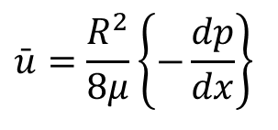
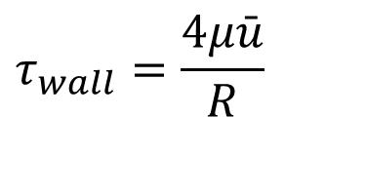
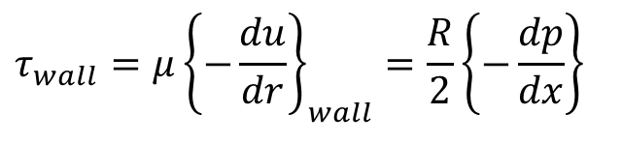
Wall Shear Stress vs Pressure Gradient
$$τ_{wall}=μ{\left\{−\frac{du}{dr}\right\}}_{wall}$$
The wall shear stress is given by
$$u=\frac{\left\{−{dp}/{dx}\right\}}{4μ}\left(R^{2}−r^{2}\right)$$
$$\frac{du}{dr}=\frac{\left\{{dp}/{dx}\right\}r}{2μ}$$
$$τ_{wall}=μ{\left\{−\frac{du}{dr}\right\}}_{wall}=\frac{R}{2}\left\{−\frac{dp}{dx}\right\}$$
$$\bar{u}=\frac{R^{2}}{8μ}\left\{−\frac{dp}{dx}\right\}$$
$$τ_{wall}=\frac{4μ\bar{u}}{R}$$

Slide 7
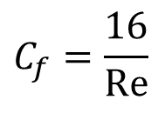
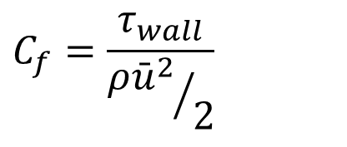
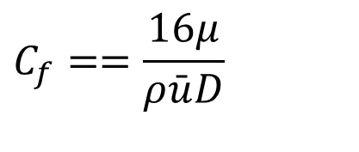
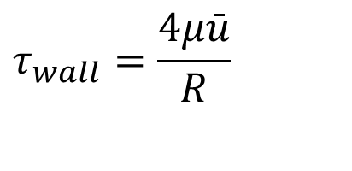
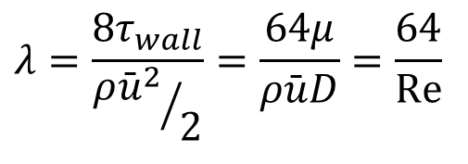
Non-Dimensional Friction Factor
$$τ_{wall}=\frac{4μ\bar{u}}{R}$$
τ_{w} is proportional to mean velocity.
It is customary, to nondimensionalize wall shear with the kinetic energy per unit volume (pipe dynamic pressure).
$$C_{f}=\frac{τ_{wall}}{{ρ{\bar{u}}^{2}}/2}$$
$$C_{f}==\frac{16μ}{ρ\bar{u}D}$$
This is called as standard Fanning friction factor, or skin-friction coefficient.
$$C_{f}=\frac{16}{Re}$$
Another definition is also in common use for friction factor in the literature:
$$λ=\frac{8τ_{wall}}{{ρ{\bar{u}}^{2}}/2}=\frac{64μ}{ρ\bar{u}D}=\frac{64}{Re}$$
Darcy Friction Factor

Slide 8
Fully Developed non-circular Duct Flow
X-momentum equation for steady incompressible flow:
$$ρ\left\{u\frac{∂u}{∂x}+v\frac{∂u}{∂y}+w\frac{∂u}{∂z}\right\}=−\frac{∂p}{∂x}+μ\left\{\left(\frac{∂^{2}u}{∂x^{2}}+\frac{∂^{2}u}{∂y^{2}}+\frac{∂^{2}u}{∂z^{2}}\right)\right\}$$
For x > L_{e}, the velocity becomes purely axial and varies only with the lateral coordinates.
v = w = 0 and u = u(y,z).
The flow is then called fully developed flow.
$$0=−\frac{∂p}{∂x}+μ\left\{\left(\frac{∂^{2}u}{∂y^{2}}+\frac{∂^{2}u}{∂z^{2}}\right)\right\}$$
$$μ\left\{\left(\frac{∂^{2}u}{∂y^{2}}+\frac{∂^{2}u}{∂z^{2}}\right)\right\}=\frac{∂p}{∂x}$$

Slide 9
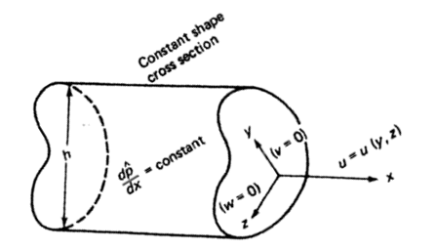
Fully Developed Duct Flow
For fully developed incompressible flow.
For fully developed flow, the continuity and momentum equations for incompressible flow are simplified as:
$$μ\left\{\frac{∂^{2}u}{∂^{2}y}+\frac{∂^{2}u}{∂^{2}z}\right\}=\frac{∂p}{∂x}$$
$$\frac{∂u}{∂x}=0 \&\frac{∂p}{∂y}=\frac{∂p}{∂z}=0$$
With

Slide 10
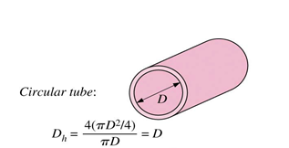
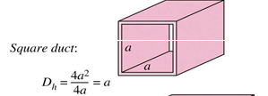
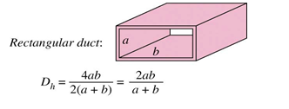
Characteristic Dimension: Hydraulic diameter
Poiseuille defined a characteristic dimension and named as Hydraulic Diameter, D_{h}
$$D_{h}= \frac{4×Flow Area}{Flow Perimeter}$$
A=Area
P= Perimeter
$$D_{h}= \frac{4A}{P}$$

Slide 11
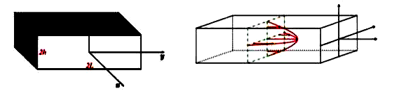
Dimensionless variables for Poiseuille Duct Flow
$$y^{∗}=\frac{y}{D_{h}}$$
$$z^{∗}=\frac{z}{D_{h}}$$
$$u^{∗}=\frac{μu}{D_{h}^{2}\left\{−\frac{dp}{dx}\right\}}$$
Dimensionless Hagen-Poiseuille Equation:
$$\left\{\frac{∂^{2}u^{∗}}{∂y^{∗2}}+\frac{∂^{2}u^{∗}}{∂z^{∗2}}\right\}=−1$$

Slide 12
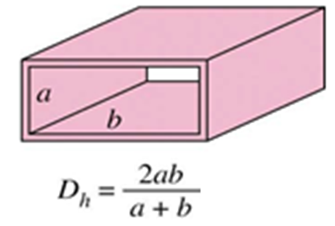
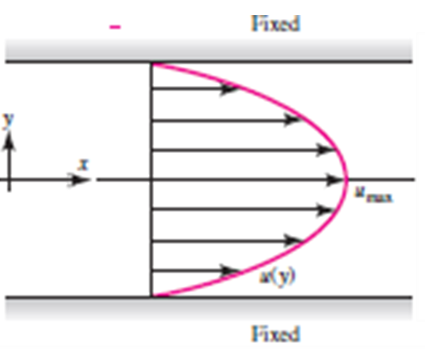


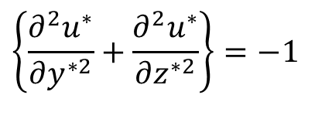
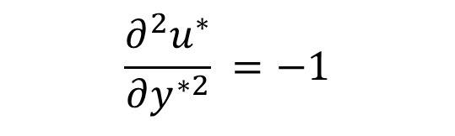
Fully Developed Flow Through A Duct
Consider two-dimensional (fully Developed) incompressible viscous flow between in a duct.
Dimensionless Hagen-Poiseuille Equation:
$$\left\{\frac{∂^{2}u^{∗}}{∂y^{∗2}}+\frac{∂^{2}u^{∗}}{∂z^{∗2}}\right\}=−1$$
$$y=+a$$
For a duct with b >> a, it is modelled as viscous flow between parallel plates distance 2a apart, as
$$\frac{∂^{2}u^{∗}}{∂y^{∗2}} =−1$$
$$y=−a$$

Slide 13
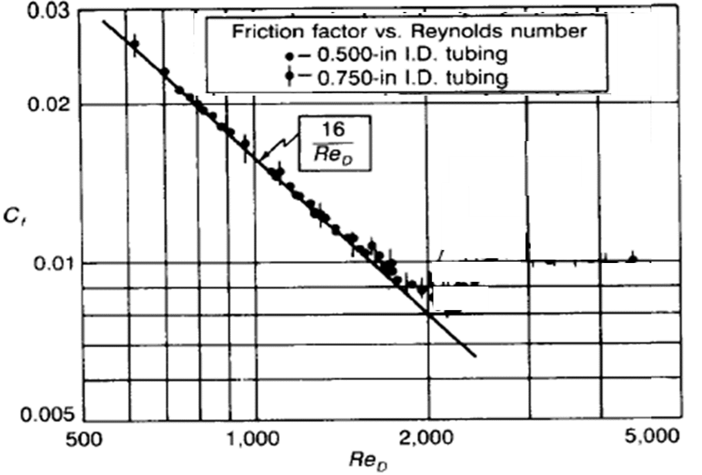
Theory Vs Engineering Pipe Flows
$$C_{f}$$

Slide 14
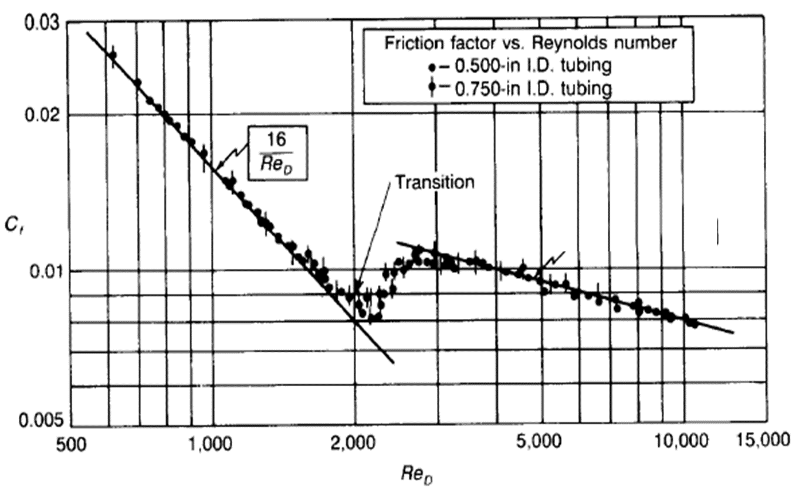
Hagen’s Blurring Experimental Results

Slide 15
The Overshadowed Ultimate Truth
In an 1854 paper, Hagen noted that the difference between low velocity and high velocity flows was clearly visible.
There was a secondary jet getting generated at higher velocity.
This jet was visualized in flow through glass tubes.
Hagen introduced sawdust particles and found that these particles were either “moved axially” or, at higher Q, “came into whirling motion.”
Unfortunately, his achievements were somewhat overshadowed by the more widely publicized 1840 tube-flow studies of J. L. M. Poiseuille, the French physician.

Slide 16
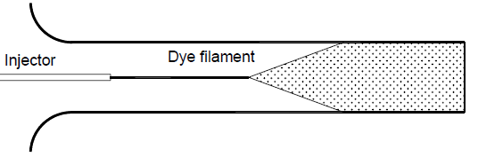
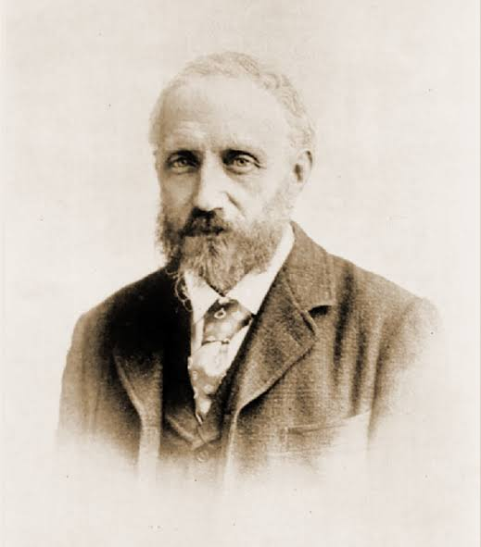
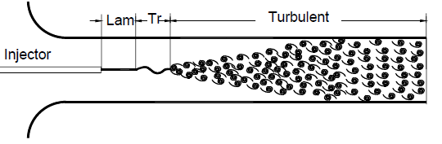
Reynolds Experiments: Laminar-Turbulent Transition ~1886
Low Velocity Flow
High Velocity Flow

Slide 17
Can a given physical state withstand a disturbance and still return to its original state?
Reynolds Query on The Sudden Change

Slide 18
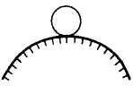
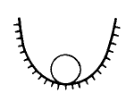


Stability of a Physical State
Stable
Unstable
neutral stability
Stable for small disturbances but unstable for large ones

Slide 19

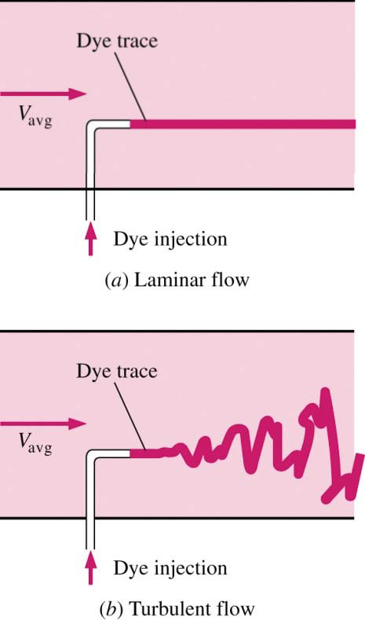

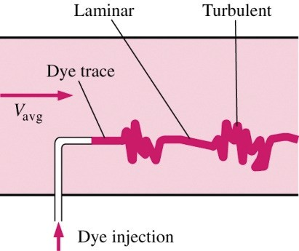
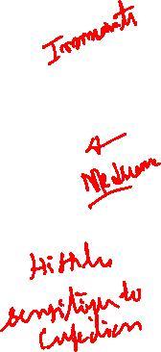
Laminar and Turbulent Flows
Reynolds number

Slide 20
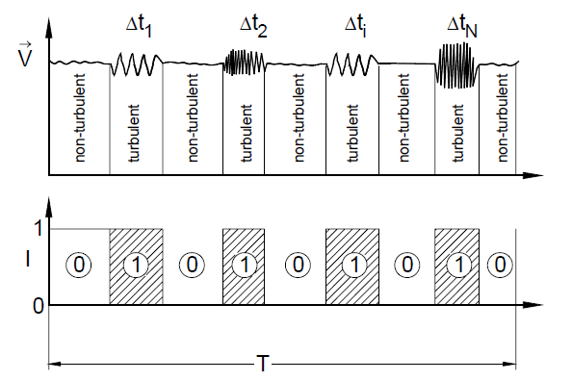
Hagen’s Blurring Experimental Results

