Slide 1

The Idiosyncratic Property of Fluids
Continuously Deforming substance
P M V Subbarao
Professor
Mechanical Engineering Department
First Level Appreciation of Fluids for Productive Pedagogy…

Slide 2


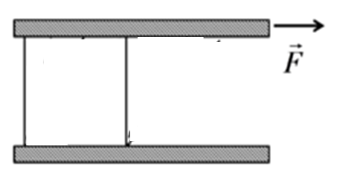
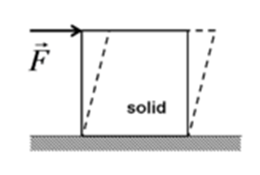
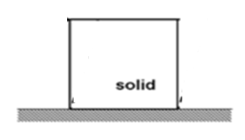

Solids vs Fluids : Ingenuous View
FLUID
FLUID
FLUID
FLUID
A solid resists an applied force by static deformation.
A fluid continually deforms (flows) under an applied shear force regardless of the magnitude of the applied stress.

Slide 3
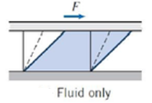
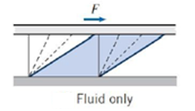
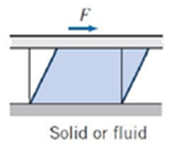
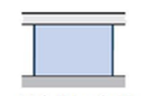
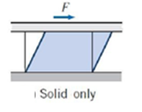
Engineering View: Bountiful Nature of Fluids
Apply a Force F at time t=0
at time t=Δt
for time t >Δt
A fluid continually deforms (flows) under an applied shear force regardless of the magnitude of the applied stress.

Slide 4
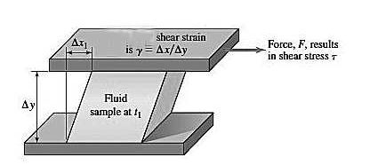
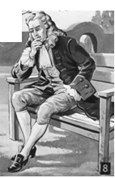

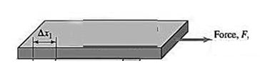
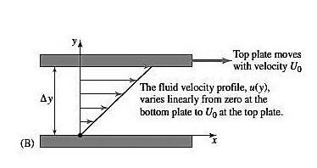
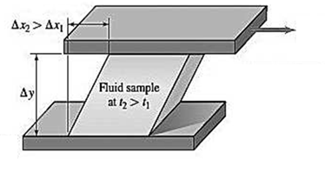
Continuously & Adaptively Deforming Fluids
A fluid Smartly/adaptively deforms (flows) under an applied shear force regardless of the magnitude of the applied stress - Newton

Slide 5
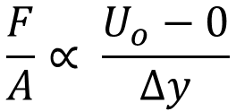
An Exclusive Force only Fluids can Generate…. by Newton
The resistance arising from the want of lubricity (lack of slipperiness) in the parts of a fluid, is, other things being equal, proportional to velocity with which parts of the fluid separated from one another.
Force required for constant velocity of the plate on fluid body:
$$\frac{F}{A}∝ \frac{U_{o}−0}{∆y}$$
The proportionality constant is a property of fluid!?!?!

Slide 6
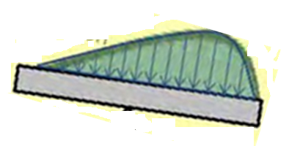
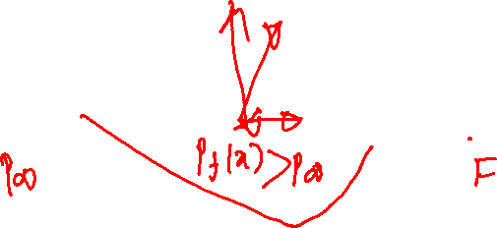

Engineering Use of Deformation : Productive Pedagogy
In 1886, Osborne Reynolds’ carried out groundbreaking work, known as hydrodynamic lubrication theory .
He laid the groundwork for understanding how hydrodynamic pressure can generate a vertical force!
This theory, rooted in fluid mechanics, has evolved over more than a century with significant advancements in practical applications.
$$U_{o}$$

Slide 7
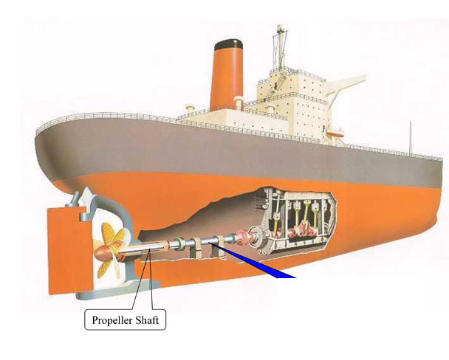
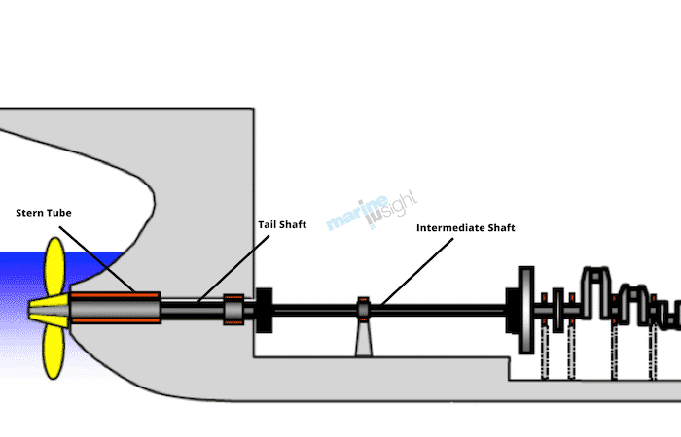
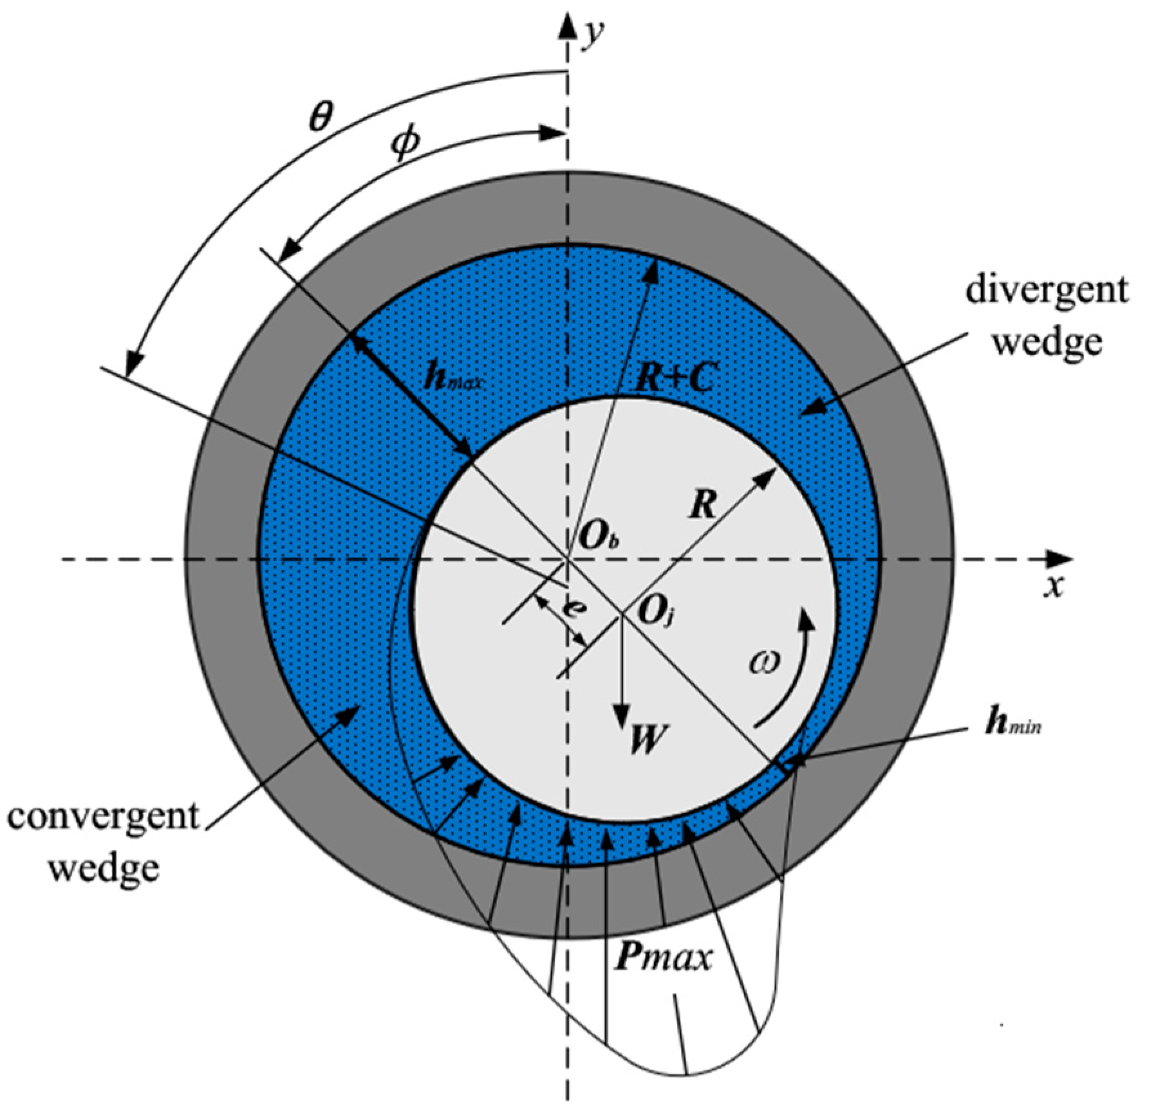
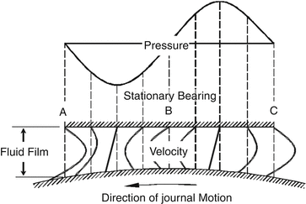
Reynolds Ingenious use of Deformation : Productive Pedagogy

Slide 8


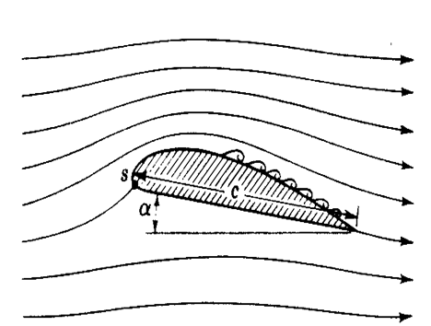
Development of an Ultimate Fluid Machine

Slide 9
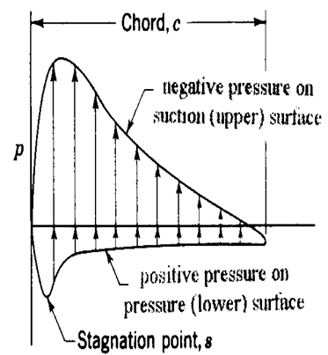
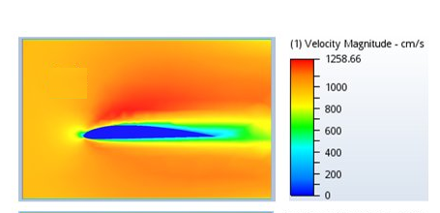
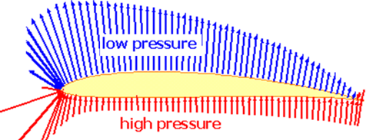
Exotic Use of Continuously Deforming Fluid

Slide 10
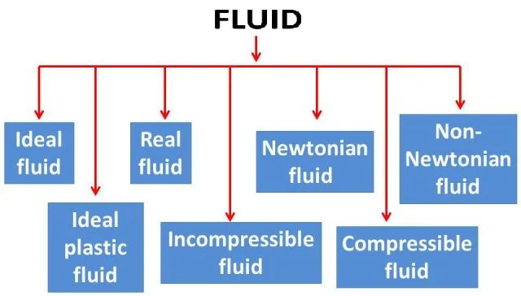
Nature of Deformation & First Level of Fluid Classification

Slide 11
A Broad View of Fluids
A First level engineering fluid mechanics problems deal with Clear Fluids.
These are the common liquids, such as water, oil, mercury, gasoline, and alcohol,
the common gases, such as air, helium, hydrogen, and steam, in their common temperature and pressure ranges.
There are many borderline cases:
Apparently “solid” substances: Asphalt and lead resist shear stress for short periods but deform slowly and exhibit definite fluid behavior over long periods.
Colloid and slurry mixtures resist small shear stresses but “yield” at large stress and begin to flow as fluids.

Slide 12
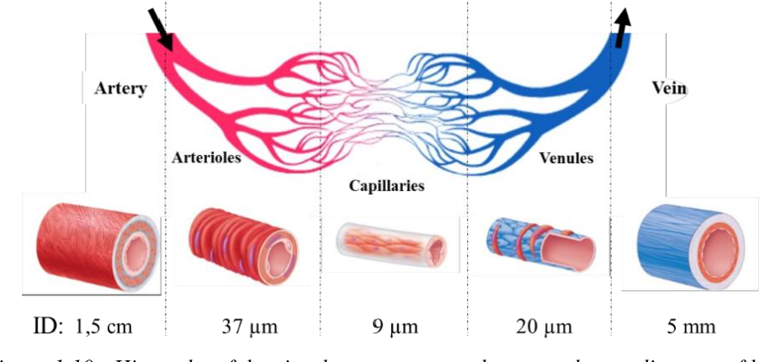
A Broad View of Fluids – Non-clear Liquids
Blood is not a Clear Fluid! But 80% is water (Clear Fluid)

Slide 13
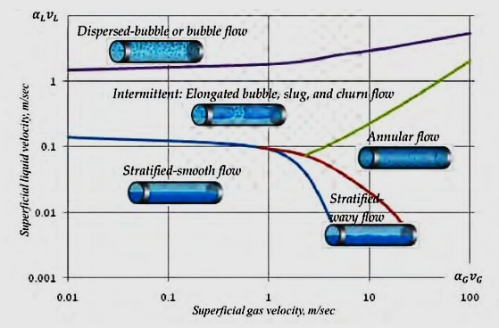
A Broad View of Fluids: Multiphase Flows
Liquids and gases can coexist in two-phase mixtures, such as steam–water mixtures or water with entrapped air bubbles.
Muliti-Phase Fluid Dynamics is a specialized subject to present the analysis of such multiphase flows.

Slide 14
What is the basic information required to quantify the Deformation action of a fluid?

Slide 15
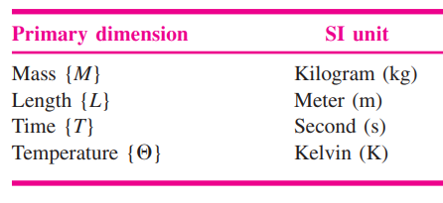
Dimensions and Units For Fluids
A dimension is the measure by which a physical variable is expressed quantitatively.
A unit is a particular way of attaching a number to the quantitative dimension.
Primary Dimension: Basic Dimensions from which all other dimensions can be derived.
In fluid mechanics, there are only four PDs: mass, length, time, and temperature.

