Slide 1

Boundary Conditions to Solve NS Equations
P M V Subbarao
Professor
Mechanical Engineering Department
I I T Delhi
Most Important Information Needed from Actual Flow Systems…

Slide 2


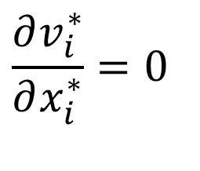
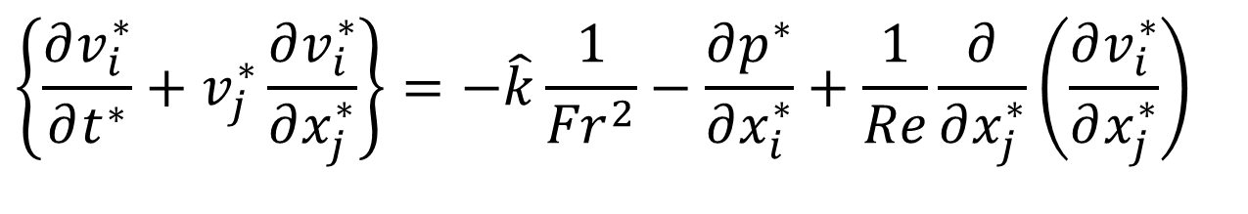
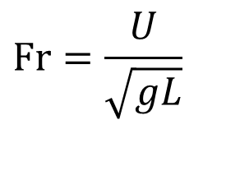
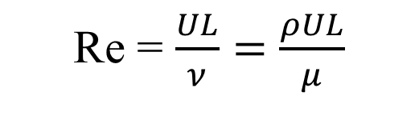
Non-dimensional form of Incompressible NS Equation
$$\frac{∂v_{i}^{∗}}{∂x_{i}^{∗}}=0$$
Continuity Equation:
NS Equations:
$$\left\{\frac{∂v_{i}^{∗}}{∂t^{∗}}+v_{j}^{∗}\frac{∂v_{i}^{∗}}{∂x_{j}^{∗}}\right\}=−\hat{k}\frac{1}{{Fr}^{2}}−\frac{∂p^{∗}}{∂x_{i}^{∗}}+\frac{1}{Re}\frac{∂}{∂x_{j}^{∗}}\left(\frac{∂v_{i}^{∗}}{∂x_{j}^{∗}}\right)$$
Reynolds Number:
Froude Number:
$$Fr=\frac{U}{\sqrt{gL}}$$
Re = $\frac{UL}{ν}=$ $\frac{ρUL}{μ}$

Slide 3
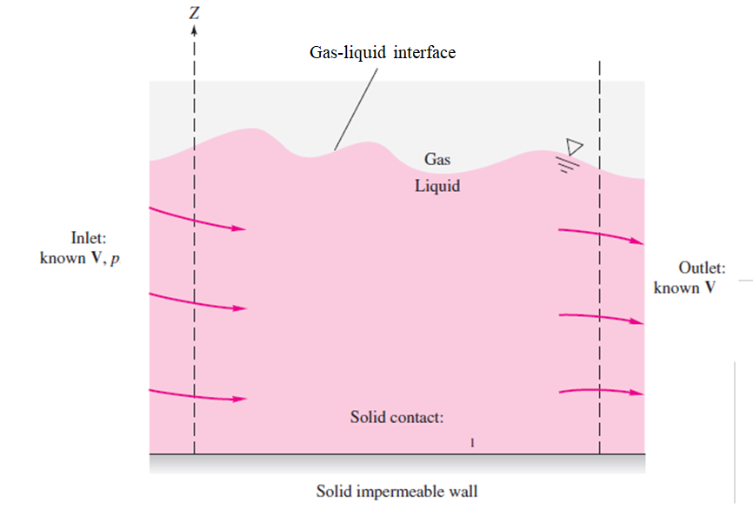
Boundaries of A General Viscous Fluid Flow Problem

Slide 4
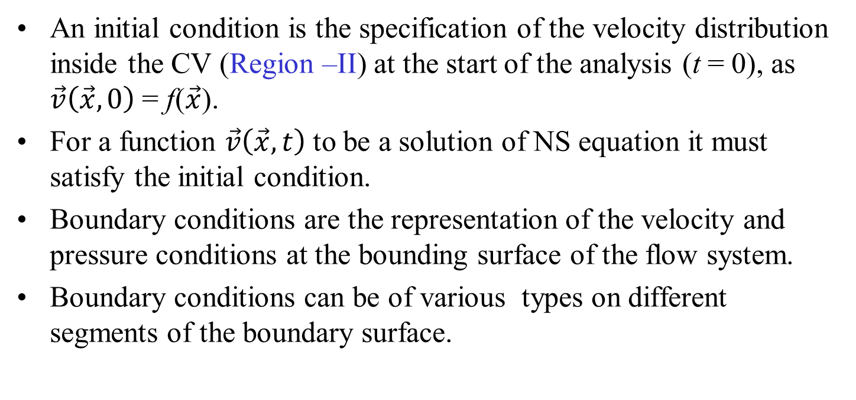
Initial & Boundary Conditions
An initial condition is the specification of the velocity distribution inside the CV (Region –II) at the start of the analysis (t = 0), as $\vec{v}\left(\vec{x},0\right)$ = f($\vec{x}$).
For a function $\vec{v}\left(\vec{x},t\right)$to be a solution of NS equation it must satisfy the initial condition.
Boundary conditions are the representation of the velocity and pressure conditions at the bounding surface of the flow system.
Boundary conditions can be of various types on different segments of the boundary surface.

Slide 5
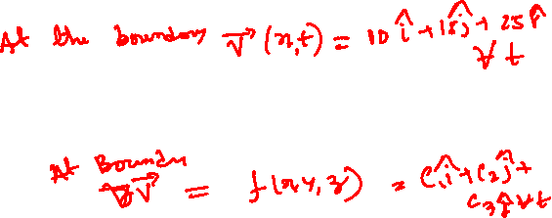
General Classification of Boundary Conditions to analyze Real Flows
Dirichlet Boundary Conditions: Peter Gustav Lejeune Dirichlet (1805–1859), who studied the problem of solving partial differential equations with fixed values on the boundary The boundary conditions in any flow analysis are expressed in terms of the velocity or pressure at the boundary.
Neumann Boundary Conditions: The boundary conditions are expressed in terms of the velocity gradient at the boundary.
Mixed Boundary Conditions: A mixed boundary condition gives information about both the values of a velocity and the values of its derivative on the boundary of the domain.
Mixed boundary conditions are a combination of Dirichlet boundary conditions and Neumann boundary conditions.

Slide 6
General Classification of Boundary Conditions to analyze Real Flows
Dirichlet Boundary Conditions: Peter Gustav Lejeune Dirichlet (1805–1859), who studied the problem of solving partial differential equations with fixed values on the boundary.
Neumann Boundary Conditions: Named after mathematician Carl Neumann (1832–1925), who formulated this type of condition.
This BC specifies the value of the derivative of a function on the boundary of a domain.

Slide 7
General Classification of Boundary Conditions to analyze Real Flows
Mixed Boundary Conditions: The mixed boundary conditions were introduced in the late 19th and early 20th centuries.
Introduction of MBCs found for solving various applications of the Laplace equation.
Mixed boundary conditions are a combination of Dirichlet boundary conditions and Neumann boundary conditions.

Slide 8
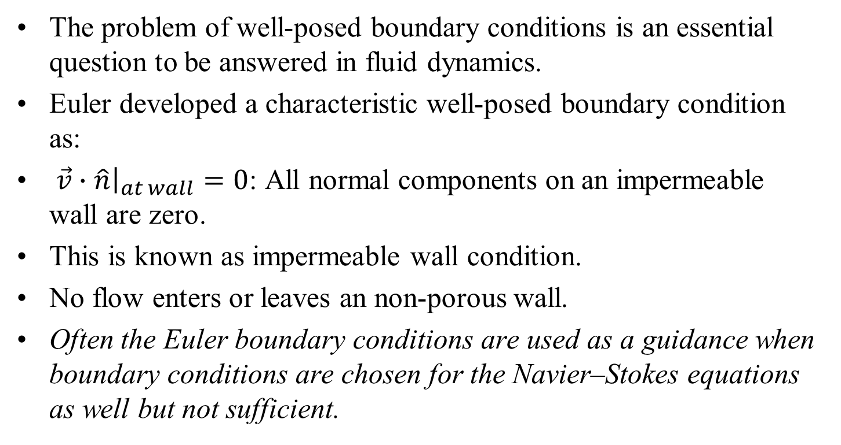
Euler’s Boundary Conditions
The problem of well-posed boundary conditions is an essential question to be answered in fluid dynamics.
Euler developed a characteristic well-posed boundary condition as:
${\left.\vec{v}∙\hat{n}\right|}_{at wall}=0$: All normal components on an impermeable wall are zero.
This is known as impermeable wall condition.
No flow enters or leaves an non-porous wall.
Often the Euler boundary conditions are used as a guidance when boundary conditions are chosen for the Navier–Stokes equations as well but not sufficient.

Slide 9
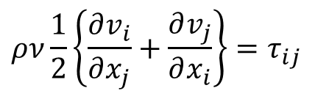
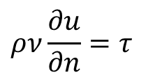
Neumann Boundary Condition
More general boundary conditions are used to define momentum flux exchanges between the wall and fluid near wall.
The simplest condition results when Newtons law of viscosity is valid
$$ρν\frac{∂u}{∂n}=τ$$
$$ρν\frac{1}{2}\left\{\frac{∂v_{i}}{∂x_{j}}+\frac{∂v_{j}}{∂x_{i}}\right\}=τ_{ij}$$
These Boundary conditions are the representation of the equilibrium of fluid particles at the bounding wall.
They measure the Tangential Momentum Exchange Rate between the near-wall fluid particles with wall.
How to know the value of this truth?
Truth Exists but not Always Known.

Slide 10
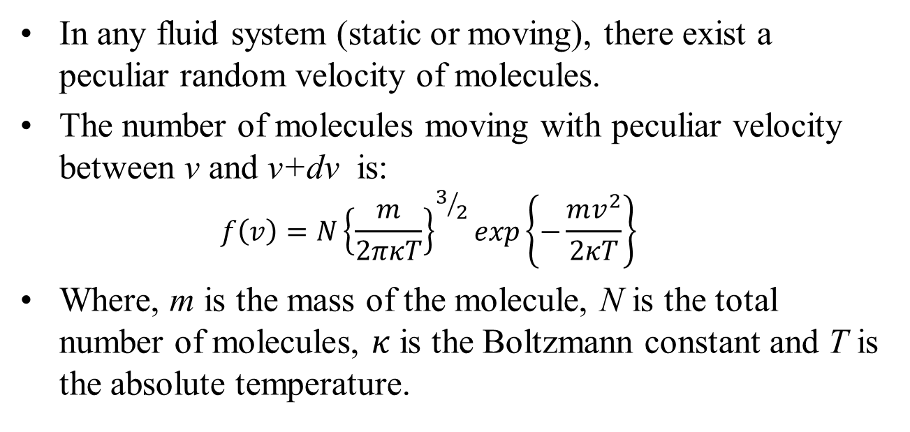
Maxwell Model on Nature of Molecular Motion in a Fluid System
In any fluid system (static or moving), there exist a peculiar random velocity of molecules.
The number of molecules moving with peculiar velocity between v and v+dv is:
  $$f\left(v\right)=N{\left\{\frac{m}{2πκT}\right\}}^{3/2}exp\left\{−\frac{mv^{2}}{2κT}\right\}$$
Where, m is the mass of the molecule, N is the total number of molecules, $κ$ is the Boltzmann constant and T is the absolute temperature.
A ground-breaking theory as it was the first time the matter had been considered to be probabilistic.
What about local velocities of fluid parcels in a flowing fluid?

Slide 11


Fluid and Wall Interactions in Viscous Flows
The Riddle of Fluid parcel Sticking to a non-porous Wall in Flow.
Consider an isolated fluid parcel.
When this parcel hits a wall of a solid body, its velocity abruptly changes.
v_{r}
u_{i}
u_{r}
$${\vec{v}}_{i}$$
v_{i}
This abrupt change in momentum of the patricle is achieved by an equal and opposite change in that of the wall or the body.
Φ_{i}
Φ_{r}
$${\vec{v}}_{r}$$

Slide 12



The Ideal Interaction : Max Well (1879)
This sudden change due to perfectly smooth surface (ideal surface) was defined by Max Well as Specular Reflection in 1879.
v_{r}
u_{i}
u_{r}
$${\vec{v}}_{i}$$
$$u_{r}=u_{i}$$
v_{i}
$$v_{r}={−v}_{i}$$
Tangential Momentum of the particle is conserved during an interaction with ideal surface!
$$Φ_{r}=Φ_{i}$$
Φ_{i}
Φ_{r}
$${\vec{v}}_{r}$$
The Slip is unbounded!!!!

Slide 13






An Irreversible Interaction : Max Well (1879)
When the particle hits a rough wall of a solid body, its tangential velocity also changes.
This sudden change due to a rough surface (real surface) was defined by Max Well as Diffusive Reflection in 1879.
v_{r}
u_{i}
u_{r}
$${\vec{v}}_{i}$$
v_{i}
$$u_{r}<u_{i}$$
Φ_{r}
$$v_{r}={−v}_{i}$$
$${\vec{v}}_{r}$$
The Slip is finite!
Φ_{i}
$$Φ_{r}<Φ_{i}$$

Slide 14
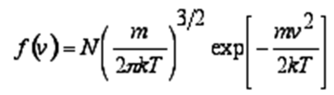
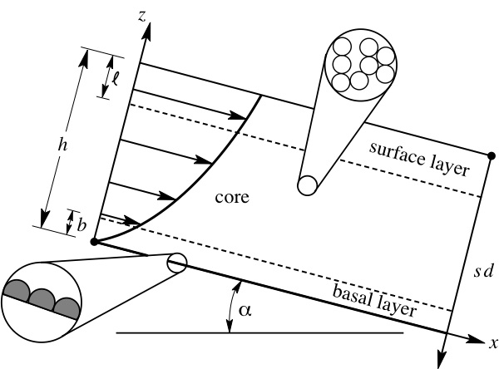
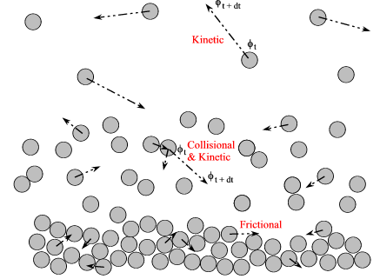
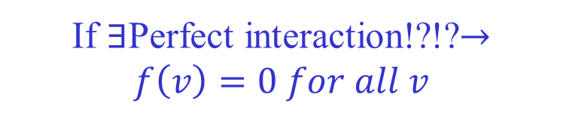
Kinetic Theory of Diffusive Solid Fluid Interaction
Relative Motion of Fluid particles near a Solid surface.
If $∃$Perfect interaction!?!?$→f\left(v\right)=0 for all v$

Slide 15
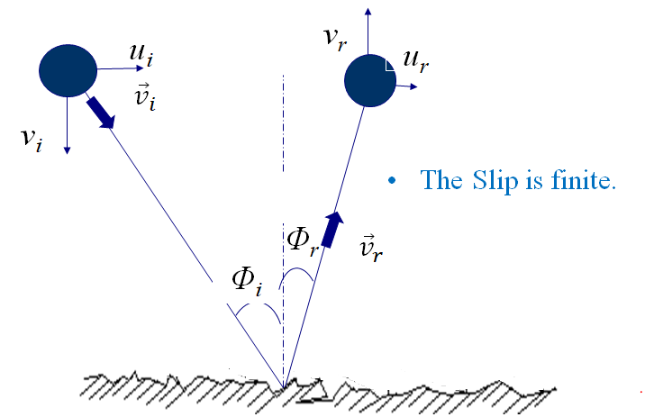
An Irreversible Interaction : Max Well (1879)
In the region very close to a solid surface, there are insufficient molecular-molecular and molecular-surface collisions over very small scale
What is the size of this scale ?.
Insufficient interactions fail to guarantee the occurrence of quasi thermodynamic equilibrium with wall/solid surface.

Slide 16
A Peculiar condition for fluid flow at Solid wall
Two characteristics of this near-surface region of a gas flow are the following:
First, there is a finite relative velocity of the gas at the surface (velocity slip).
Second, there exists a non-Newtonian stress/strain-rate relationship that extends a few molecular dimensions into the gas.
This region is known as the Knudsen layer or kinetic boundary layer.

Slide 17
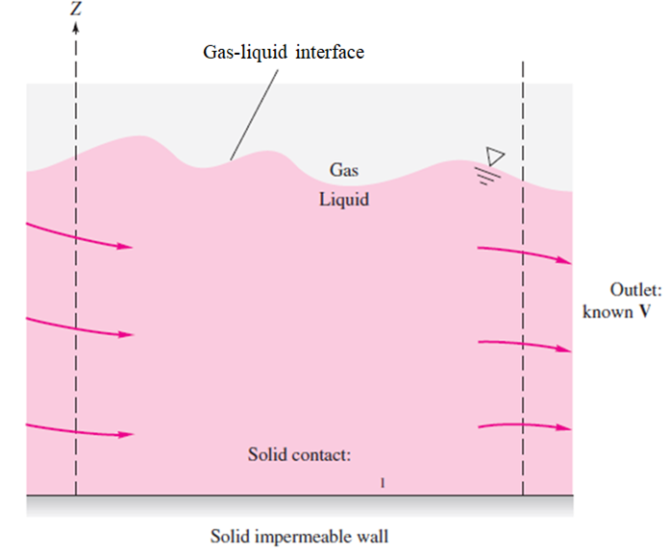
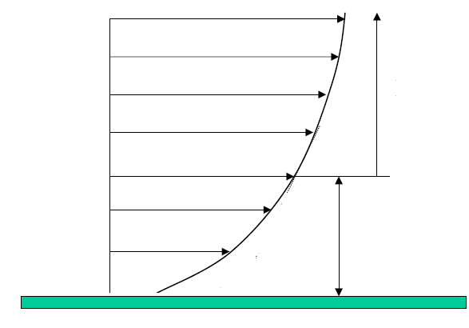
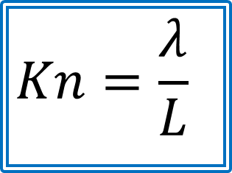


Knudsen Theory of Wall-Fluid Interactions
Knudsen defined a non-dimensional distance as the ratio of mean free path of the gas to the characteristic dimension of the system.
This is called “Knudsen number”
$$Kn=\frac{λ}{L}$$
$$Ο\left(L\right): \text{Characteritic} \text{Dimension}$$
$$Ο\left(λ\right): \text{Knudsen} \text{Layer}$$

Slide 18



Velocity Extrapolation Theory
$$Ο\left(L\right): \text{Characteritic} \text{Dimension}$$
$$Ο\left(λ\right): \text{Knudsen} \text{Layer}$$
The first fluid layer at one mean free path/lattice spacing..
u_{s}
λ
$${∴u}_{s}=u_{w}+aKn+bKn^{2}+........$$
u_{w}
Wall

Slide 19
Wall Boundary Conditions
Maxwell was the first to propose the boundary model that has been widely used in various modified forms.
Maxwell’s model is the most convenient and correct formulation.
Maxwell’s model assumes that the boundary surface is impenetrable.
The boundary model is constructed on the assumption that some fraction (1-α_{r}) of the incident fluid molecules are specularly reflected form the surface.
The remaining fraction α_{r} are reflected diffusely with a Maxwell distribution.
α_{r} gives the fraction of the tangential momentum of the incident molecules transmitted to the surface by all molecules.
This parameter is called the tangential momentum accommodation coefficient (σ).

Slide 20


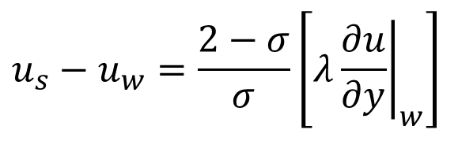



Slip Boundary conditions
Maxwell proposed the first order slip boundary condition for a dilute monoatomic gas given by:
$$u_{s}−u_{w}=\frac{2−σ}{σ}\left[λ{\left.\frac{∂u}{∂y}\right|}_{w}\right]$$
A Mixed Boundary Condition!
Where :
$$σ$$
Tangential momentum accommodation coefficient ( TMAC )
--
$$u_{s}$$
--
Velocity of gas adjacent to the wall
$$u_{w}$$
--
Velocity of wall
$$λ$$
--
Mean free path
$$\frac{∂u}{∂y}$$
--
Velocity gradient normal to the surface

Slide 21
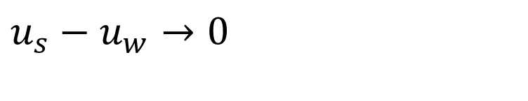
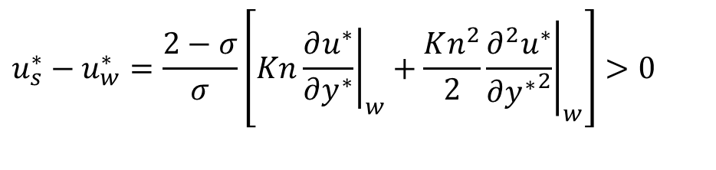
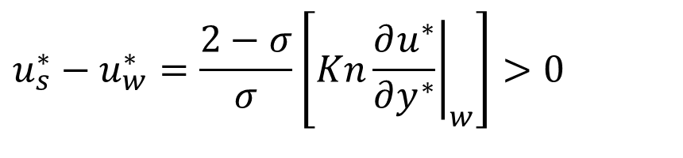
Regimes of Engineering Fluid Flows: Continuum Theory
Conventional engineering flows: Kn < 0.001
$$u_{s}−u_{w}→0$$
Micro Fluidic Devices : Kn < 0.1
$$u_{s}^{∗}−u_{w}^{∗}=\frac{2−σ}{σ}\left[Kn{\left.\frac{∂u^{∗}}{∂y^{∗}}\right|}_{w}\right]>0$$
Ultra Micro Fluidic Devices : Kn <1.0
$$u_{s}^{∗}−u_{w}^{∗}=\frac{2−σ}{σ}\left[Kn{\left.\frac{∂u^{∗}}{∂y^{∗}}\right|}_{w}+\frac{Kn^{2}}{2}{\left.\frac{∂^{2}u^{∗}}{∂{y^{∗}}^{2}}\right|}_{w}\right]>0$$

Slide 22
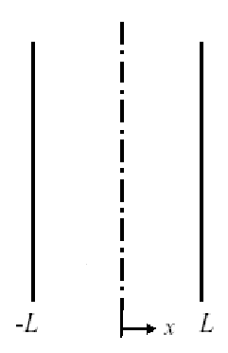

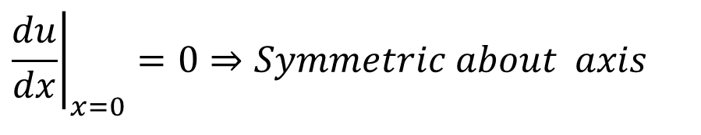
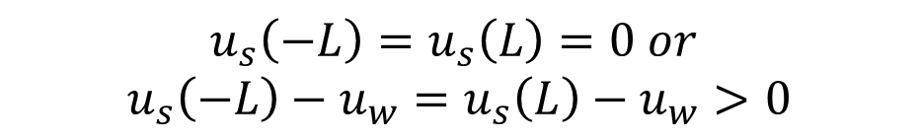
Symmetric Boundary Conditions
Symmetric Dirichlet Boundary Conditions:
$$u_{s}\left(−L\right)=u_{s}\left(L\right)=0 or$$
$$u_{s}\left(−L\right)−u_{w}=u_{s}\left(L\right)−u_{w}>0$$
Maximum Velocity occurs at the center of the duct.
The left and right parts of the duct are symmetric about the axis.
Modified Boundary Conditions
$${\left.\frac{du}{dx}\right|}_{x=0}=0⇒Symmetric about axis$$
$$u\left(L\right)=0 or$$
$$u\left(L\right)−u_{w}>0$$

Slide 23
Solution of A General Viscous Fluid Flow Problem
Most complex conditions occur at a liquid–gas interface, or free surface.
Vertical velocity across the interface must be equal.

Slide 24
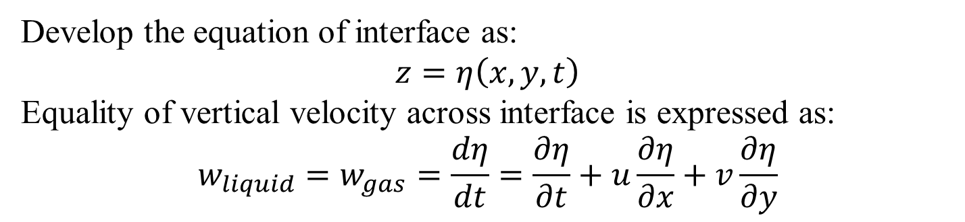
Solution of A General Viscous Fluid Flow Problem
Develop the equation of interface as:
$$z=η\left(x,y,t\right)$$
Equality of vertical velocity across interface is expressed as:
$$w_{liquid}=w_{gas}=\frac{dη}{dt}=\frac{∂η}{∂t}+u\frac{∂η}{∂x}+v\frac{∂η}{∂y}$$
This Boundary conditions is called the kinematic boundary condition.

