Slide 1

Dynamic Similarity & the Dimensionless Fluid Mechanics
P M V Subbarao
Professor
Mechanical Engineering Department
I I T Delhi
A Quantifiable Framework for Drawing Physical Parallels between Flow Systems of Disparate Scale…

Slide 2


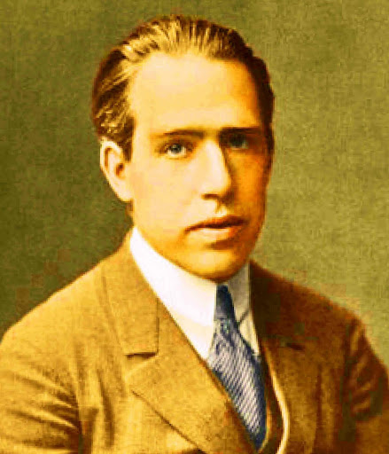
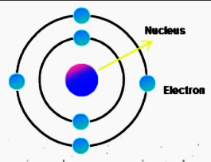
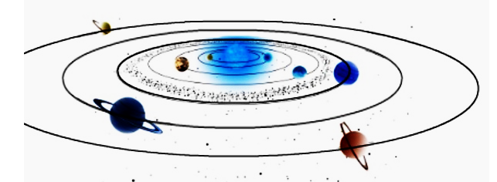
The Ultimate Physical Parallels!
Niels Henrik David Bohr
348 pm
287.46 billion km
This is known as “Extreme Art of Miniaturization”
287.46 billion km

Slide 3
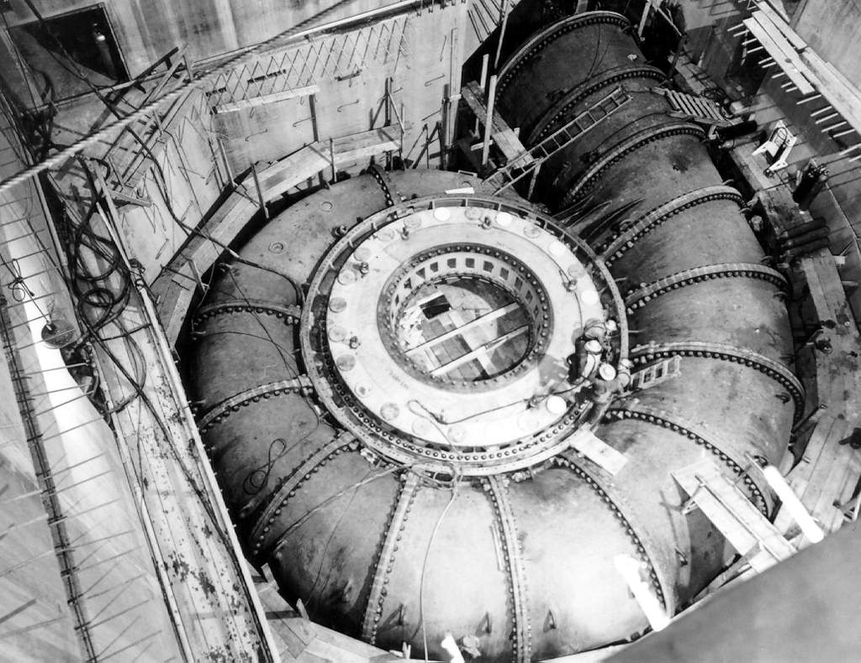
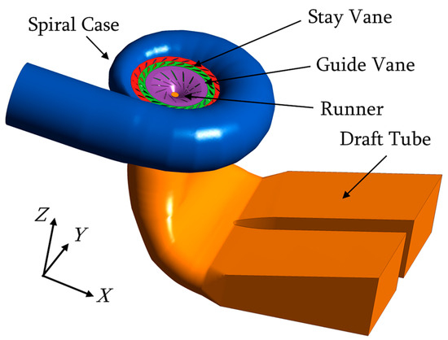
A Large Fluid machine similar to A Tiny Research Fluid machine
500 MW
~10 kW

Slide 4
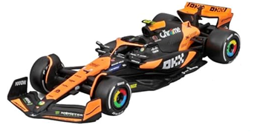
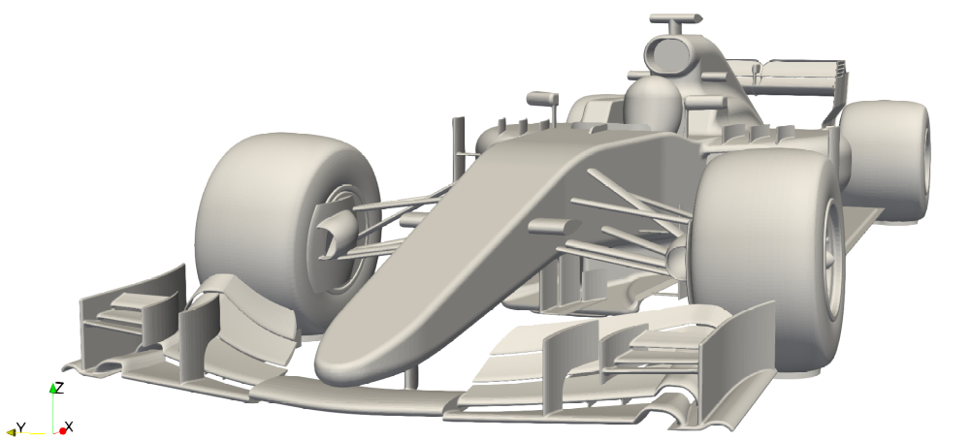
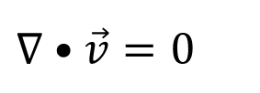
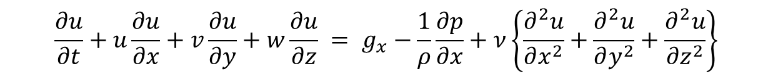
Major Dimensional Variables of Viscous Flows
Consider the Navier-Stokes equations with constant density it their dimensional form:
$$∇•\vec{v}=0$$
$$\frac{∂u}{∂t}+u\frac{∂u}{∂x}+v\frac{∂u}{∂y}+w\frac{∂u}{∂z} = g_{x}−\frac{1}{ρ}\frac{∂p}{∂x}+ν\left\{\frac{∂^{2}u}{∂x^{2}}+\frac{∂^{2}u}{∂y^{2}}+\frac{∂^{2}u}{∂z^{2}}\right\}$$
Consider highest expected velocity of a formula car as U.
Most important dimension of formula car as L.
These parameters are defined by Reynolds as velocity and length scales.
In the case of flow through a pipe, L might be a pipe diameter (D) and U the flow speed at the pipe inlet.

Slide 5
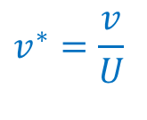

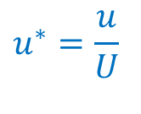

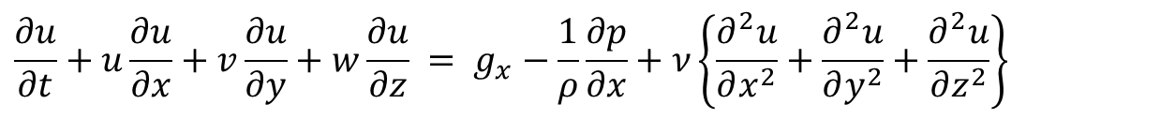


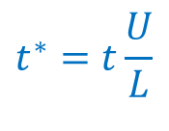
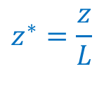
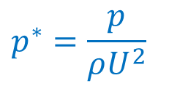
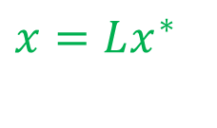
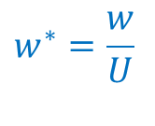

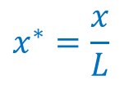
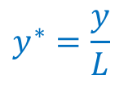

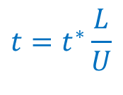
Non-Dimensionalization of Major Variables
Consider the Navier-Stokes equations with constant density it their dimensional form:
$$∇•\vec{v}=0$$
$$\frac{∂u}{∂t}+u\frac{∂u}{∂x}+v\frac{∂u}{∂y}+w\frac{∂u}{∂z} = g_{x}−\frac{1}{ρ}\frac{∂p}{∂x}+ν\left\{\frac{∂^{2}u}{∂x^{2}}+\frac{∂^{2}u}{∂y^{2}}+\frac{∂^{2}u}{∂z^{2}}\right\}$$
Define dimensionless variables as:
Substitute dimensional variable in terms of dimensionless variables:
$$u^{∗}=\frac{u}{U}$$
$$x^{∗}=\frac{x}{L}$$
$${u=Uu}^{∗}$$
$$x=Lx^{∗}$$
$$y=Ly^{∗}$$
$${v=Uv}^{∗}$$
$$v^{∗}=\frac{v}{U}$$
$$y^{∗}=\frac{y}{L}$$
$$t^{∗}=t\frac{U}{L}$$
$$z=Lz^{∗}$$
$$w^{∗}=\frac{w}{U}$$
$$z^{∗}=\frac{z}{L}$$
$${w=Uw}^{∗}$$
$$t=t^{∗}\frac{L}{U}$$
$$p^{∗}=\frac{p}{ρU^{2}}$$
$$p=ρU^{2}p^{∗}$$

Slide 6
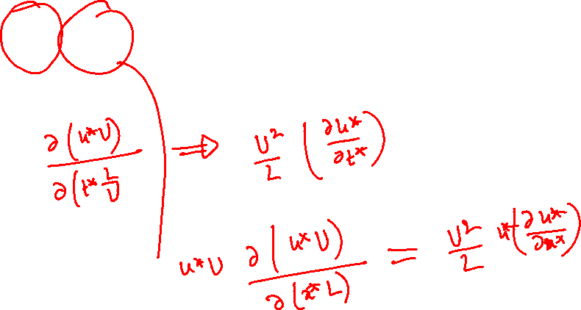
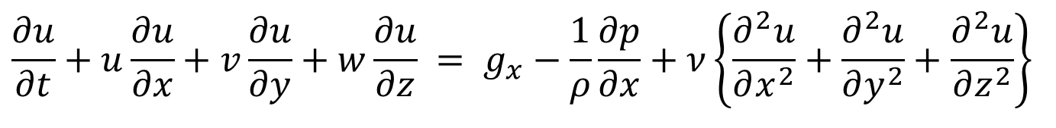
Non-dimensionalization of NS Equation
Consider x-momentum equation for an incompressible flow:
$$\frac{∂u}{∂t}+u\frac{∂u}{∂x}+v\frac{∂u}{∂y}+w\frac{∂u}{∂z} = g_{x}−\frac{1}{ρ}\frac{∂p}{∂x}+ν\left\{\frac{∂^{2}u}{∂x^{2}}+\frac{∂^{2}u}{∂y^{2}}+\frac{∂^{2}u}{∂z^{2}}\right\}$$
Substitute dimensional variable in terms of dimensionless variables:

Slide 7

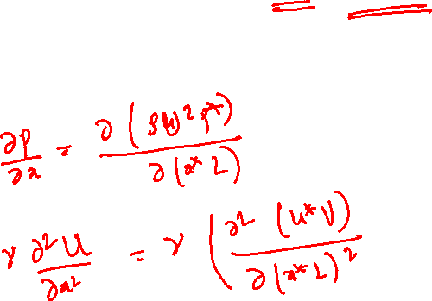
Non-dimensionalization of NS Equation
Consider x-momentum equation for an incompressible flow:
$$\frac{∂u}{∂t}+u\frac{∂u}{∂x}+v\frac{∂u}{∂y}+w\frac{∂u}{∂z} = g_{x}−\frac{1}{ρ}\frac{∂p}{∂x}+ν\left\{\frac{∂^{2}u}{∂x^{2}}+\frac{∂^{2}u}{∂y^{2}}+\frac{∂^{2}u}{∂z^{2}}\right\}$$
Substitute dimensional variable in terms of dimensionless variables:
$$p=ρU^{2}p^{∗}$$

Slide 8
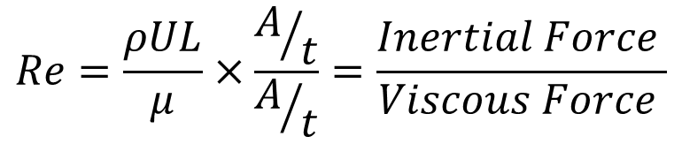
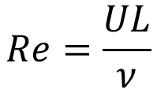

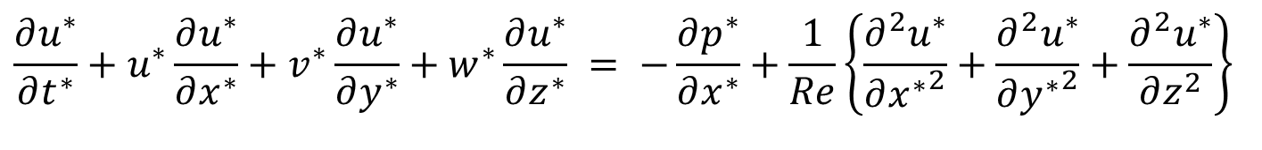
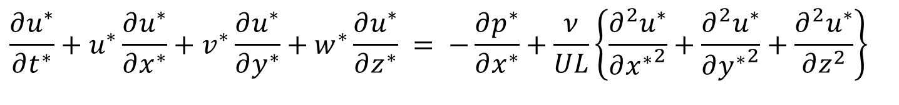
Non-dimensional form of NS Equation
Non-dimensional x-momentum equation for an incompressible flow:
$$\frac{∂u^{∗}}{∂t^{∗}}+u^{∗}\frac{∂u^{∗}}{∂x^{∗}}+v^{∗}\frac{∂u^{∗}}{∂y^{∗}}+w^{∗}\frac{∂u^{∗}}{∂z^{∗}} = −\frac{∂p^{∗}}{∂x^{∗}}+\frac{ν}{UL}\left\{\frac{∂^{2}u^{∗}}{∂{x^{∗}}^{2}}+\frac{∂^{2}u^{∗}}{∂{y^{∗}}^{2}}+\frac{∂^{2}u^{∗}}{∂z^{2}}\right\}$$
At the 4th International Congress of Mathematicians in Rome, Arnold Sommerfeld introduces a dimensionless number that he calls the Reynolds number, in tribute to Osborne Reynolds.
The Reynolds number, which appeared in what’s now known as the Orr– Sommerfeld equation, is among the most famous of all dimensionless numbers.
The Reynolds Number
$$Re=\frac{ρUL}{μ}×\frac{A/t}{A/t}=\frac{Inertial Force }{Viscous Force }$$
$$Re=\frac{UL}{ν}$$
$$\frac{∂u^{∗}}{∂t^{∗}}+u^{∗}\frac{∂u^{∗}}{∂x^{∗}}+v^{∗}\frac{∂u^{∗}}{∂y^{∗}}+w^{∗}\frac{∂u^{∗}}{∂z^{∗}} = −\frac{∂p^{∗}}{∂x^{∗}}+\frac{1}{Re}\left\{\frac{∂^{2}u^{∗}}{∂{x^{∗}}^{2}}+\frac{∂^{2}u^{∗}}{∂{y^{∗}}^{2}}+\frac{∂^{2}u^{∗}}{∂z^{2}}\right\}$$

Slide 9
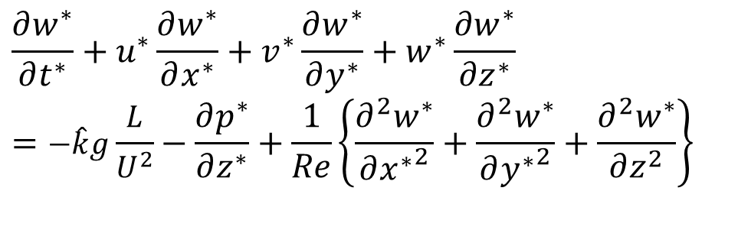
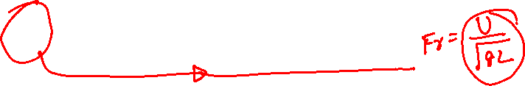
Non-dimensional form of NS Equation
Non-dimensional x-momentum equation for an incompressible flow:
$$\frac{∂u^{∗}}{∂t^{∗}}+u^{∗}\frac{∂u^{∗}}{∂x^{∗}}+v^{∗}\frac{∂u^{∗}}{∂y^{∗}}+w^{∗}\frac{∂u^{∗}}{∂z^{∗}} = −\frac{∂p^{∗}}{∂x^{∗}}+\frac{1}{Re}\left\{\frac{∂^{2}u^{∗}}{∂{x^{∗}}^{2}}+\frac{∂^{2}u^{∗}}{∂{y^{∗}}^{2}}+\frac{∂^{2}u^{∗}}{∂z^{2}}\right\}$$
Non-dimensional y-momentum equation for an incompressible flow:
$$\frac{∂u^{∗}}{∂t^{∗}}+u^{∗}\frac{∂v^{∗}}{∂x^{∗}}+v^{∗}\frac{∂v^{∗}}{∂y^{∗}}+w^{∗}\frac{∂v^{∗}}{∂z^{∗}} = −\frac{∂p^{∗}}{∂y^{∗}}+\frac{1}{Re}\left\{\frac{∂^{2}v^{∗}}{∂{x^{∗}}^{2}}+\frac{∂^{2}v^{∗}}{∂{y^{∗}}^{2}}+\frac{∂^{2}v^{∗}}{∂z^{2}}\right\}$$
Non-dimensional z-momentum equation for an incompressible flow:
$$\frac{∂w^{∗}}{∂t^{∗}}+u^{∗}\frac{∂w^{∗}}{∂x^{∗}}+v^{∗}\frac{∂w^{∗}}{∂y^{∗}}+w^{∗}\frac{∂w^{∗}}{∂z^{∗}}=−\hat{k}g\frac{L}{U^{2}}−\frac{∂p^{∗}}{∂z^{∗}}+\frac{1}{Re}\left\{\frac{∂^{2}w^{∗}}{∂{x^{∗}}^{2}}+\frac{∂^{2}w^{∗}}{∂{y^{∗}}^{2}}+\frac{∂^{2}w^{∗}}{∂z^{2}}\right\}$$

Slide 10
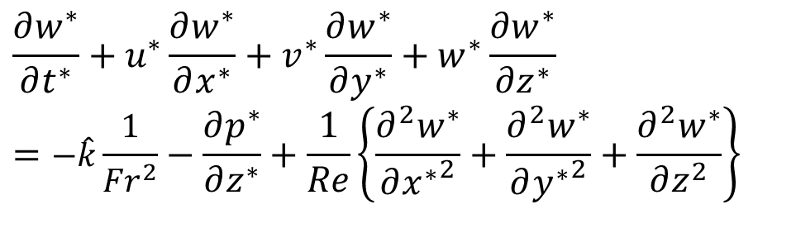
Non-dimensional form of NS Equation
Non-dimensional z-momentum equation for an incompressible flow:
$$\frac{∂w^{∗}}{∂t^{∗}}+u^{∗}\frac{∂w^{∗}}{∂x^{∗}}+v^{∗}\frac{∂w^{∗}}{∂y^{∗}}+w^{∗}\frac{∂w^{∗}}{∂z^{∗}}=−\hat{k}\frac{1}{{Fr}^{2}}−\frac{∂p^{∗}}{∂z^{∗}}+\frac{1}{Re}\left\{\frac{∂^{2}w^{∗}}{∂{x^{∗}}^{2}}+\frac{∂^{2}w^{∗}}{∂{y^{∗}}^{2}}+\frac{∂^{2}w^{∗}}{∂z^{2}}\right\}$$
The Froude number is a ratio of inertial and gravitational forces in fluid mechanics that was established by William Froude.
Origin: Froude, an Oxford University mathematician, was the first to derive equations for flow resistance in naval vessels.
His research on ship hulls led him to establish the Froude number as a way to predict the behavior of ships in water.

Slide 11
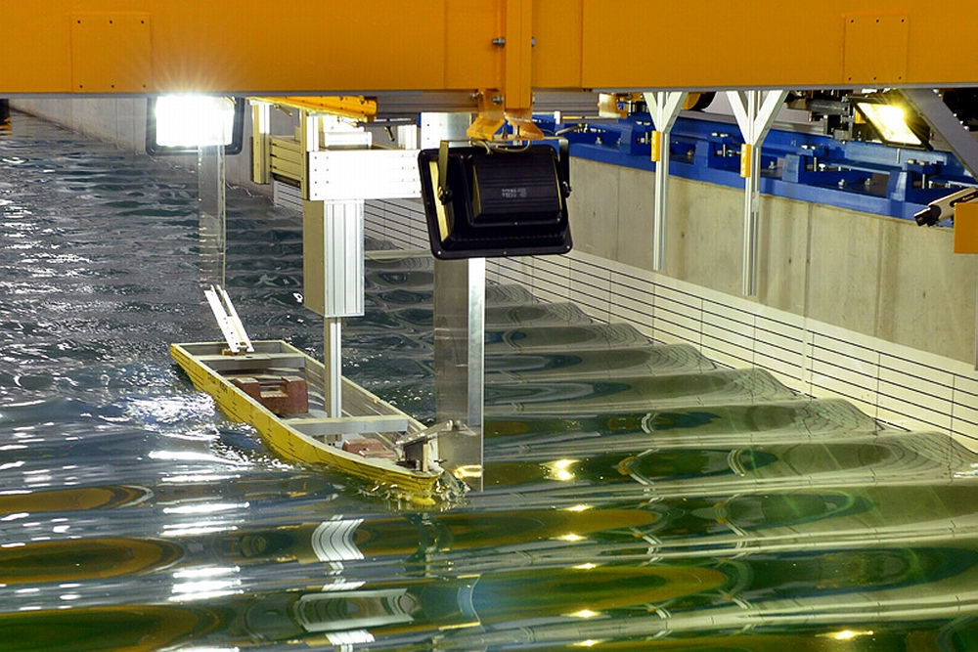
Non-dimensional form of NS Equation
Non-dimensional z-momentum equation for an incompressible flow:
$$\frac{∂w^{∗}}{∂t^{∗}}+u^{∗}\frac{∂w^{∗}}{∂x^{∗}}+v^{∗}\frac{∂w^{∗}}{∂y^{∗}}+w^{∗}\frac{∂w^{∗}}{∂z^{∗}}=−\hat{k}\frac{1}{{Fr}^{2}}−\frac{∂p^{∗}}{∂z^{∗}}+\frac{1}{Re}\left\{\frac{∂^{2}w^{∗}}{∂{x^{∗}}^{2}}+\frac{∂^{2}w^{∗}}{∂{y^{∗}}^{2}}+\frac{∂^{2}w^{∗}}{∂z^{2}}\right\}$$
Methods: Froude constructed scale models of ships that maintained a constant ratio of inertial and gravitational forces.
He validated his experiments with full-scale trials.
Applications
The Froude number is used to develop marine vessels and is analogous to the Mach number in compressible gas dynamics.
It is a fundamental principle of open-channel hydraulics.

Slide 12
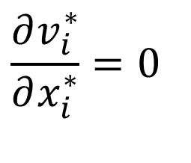
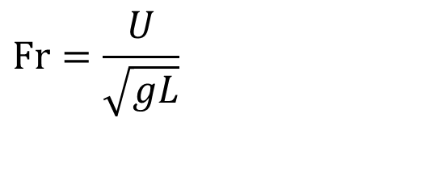
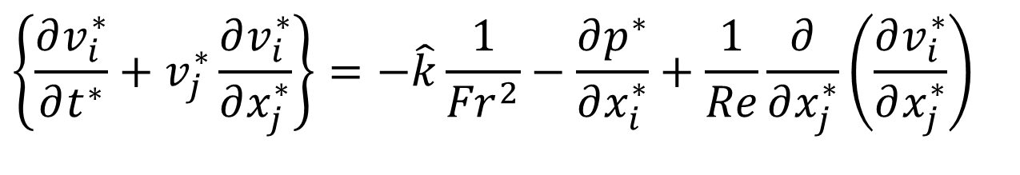
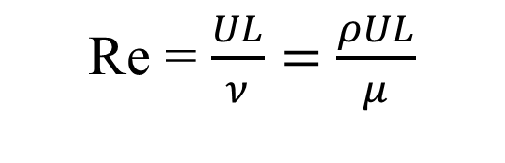
Non-dimensional form of Incompressible NS Equation
Reynolds Number:
Re = $\frac{UL}{ν}=$ $\frac{ρUL}{μ}$
$$Fr=\frac{U}{\sqrt{gL}}$$
Froude Number:
$$\frac{∂v_{i}^{∗}}{∂x_{i}^{∗}}=0$$
Continuity Equation:
Dimensionless NS Equations:
$$\left\{\frac{∂v_{i}^{∗}}{∂t^{∗}}+v_{j}^{∗}\frac{∂v_{i}^{∗}}{∂x_{j}^{∗}}\right\}=−\hat{k}\frac{1}{{Fr}^{2}}−\frac{∂p^{∗}}{∂x_{i}^{∗}}+\frac{1}{Re}\frac{∂}{∂x_{j}^{∗}}\left(\frac{∂v_{i}^{∗}}{∂x_{j}^{∗}}\right)$$
To be solved using valid Boundary Conditions

Slide 13
Importance of Reynolds Number
The Reynolds number Re is the only dimensionless parameter which is always important in simplifying the equations of fluid motion for various applications.
Reynoldsification helps in simplifying NS equations by ignoring less important terms.
Reynolds Number also advocates the importance of Dynamic Similarity.
This simplification helps in obtaining analytical solutions to engineering parameters like Coefficient of Drag.
Better understanding of the complexity of real fluid flow is achieved by fitting the situation into Reynolds framework.

Slide 14
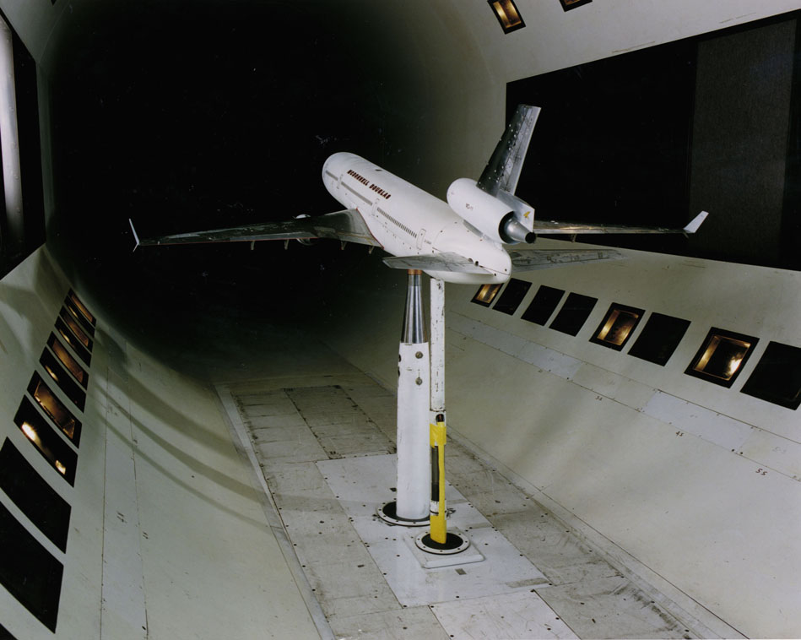
Dynamic Similarity for Economic Development of Airplanes
Sub-scale Model of would-be commercial flight is tested in a Wind tunnel

Slide 15
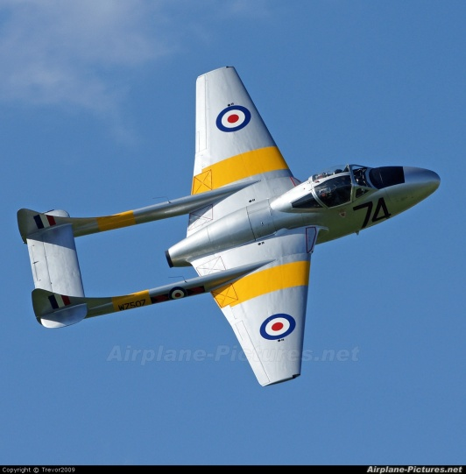
The Jet Plane Vampire
The first to exceed a speed of 500 miles per hour.
A total of 3,268 Vampires were built in 15 versions, including a twin-seat night fighter, trainer and a carrier-based aircraft designated Sea Vampire.
DH108 was a newer version was built and released for test.
Initially DH 108 behaved very nicely.
As the speed was stepped up in was unsuspectingly drawn closer to an invisible wall in the sky.
It was unknown to anyone.
One evening the pilot hit this wall and the plane was disappeared.

Slide 16
1940-50’s Flying Story
Cruising at High Altitudes ?!?!?!
Aircrafts were trying to approach high altitudes for a better fuel economy.
This led to numerous crashes for unknown reasons.
These included:
The Mitsubishi Zero was infamous for a peculiar unknown problem, and several attempts to fix it only made the problem worse.
In the case of the Super-marine Spitfire, the wings suffered from low torsional stiffness.
The P-38 Lightning suffered from a particularly dangerous interaction of the airflow between the wings and tail surfaces in the dive that made it difficult to "pull out“.
Flutter due to the formation of thin high -pressure line on curved surfaces was another major problem, which led most famously to the breakup of de Havilland Swallow and death of its pilot, Geoffrey de Havilland, Jr.

Slide 17
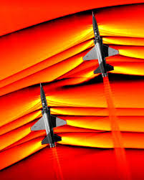
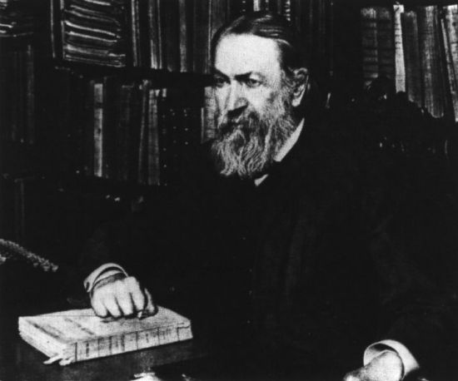
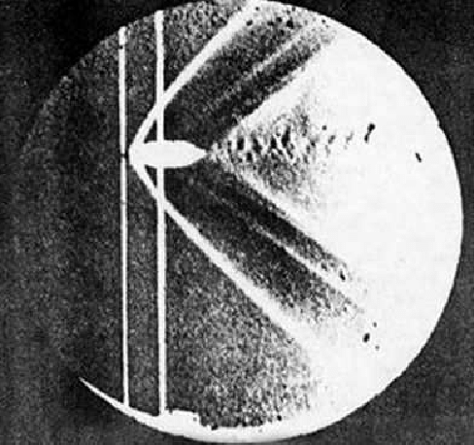
Thus Spake : Ernst Mach: 1857
It is highly an economical reason to think that the fastness of a flying machine is described in terms of velocity (km/hr) !!!!

Slide 18
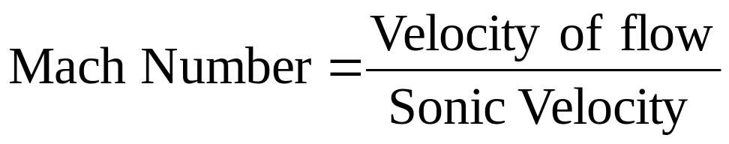
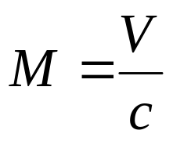
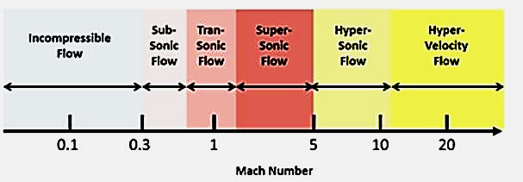
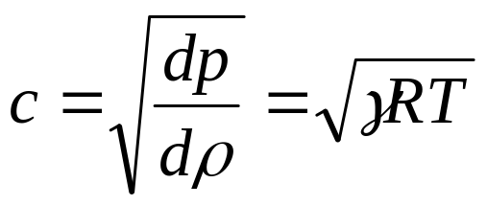
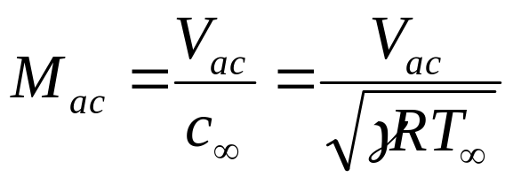
Mach Number : A True Measure of High-speed Flow Systems
For an ideal and calorically perfect gas:
Mach number of a flight

Slide 19
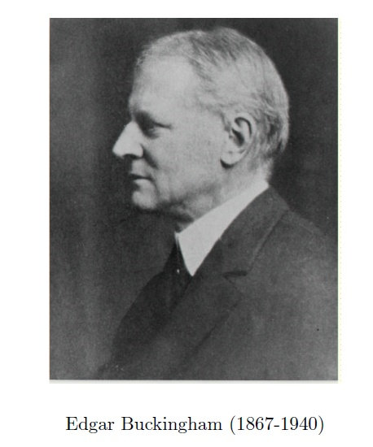
I often been impressed by the scanty attention paid even by original workers in physics to the great natural character of engineering sciences.
The principle of similitude.
Buckingham, E. The principle of similitude. Nature 96, 396-397 (1915).
Inspired Buckingham, E to describe a great secret of Engineering Sciences.

Slide 20
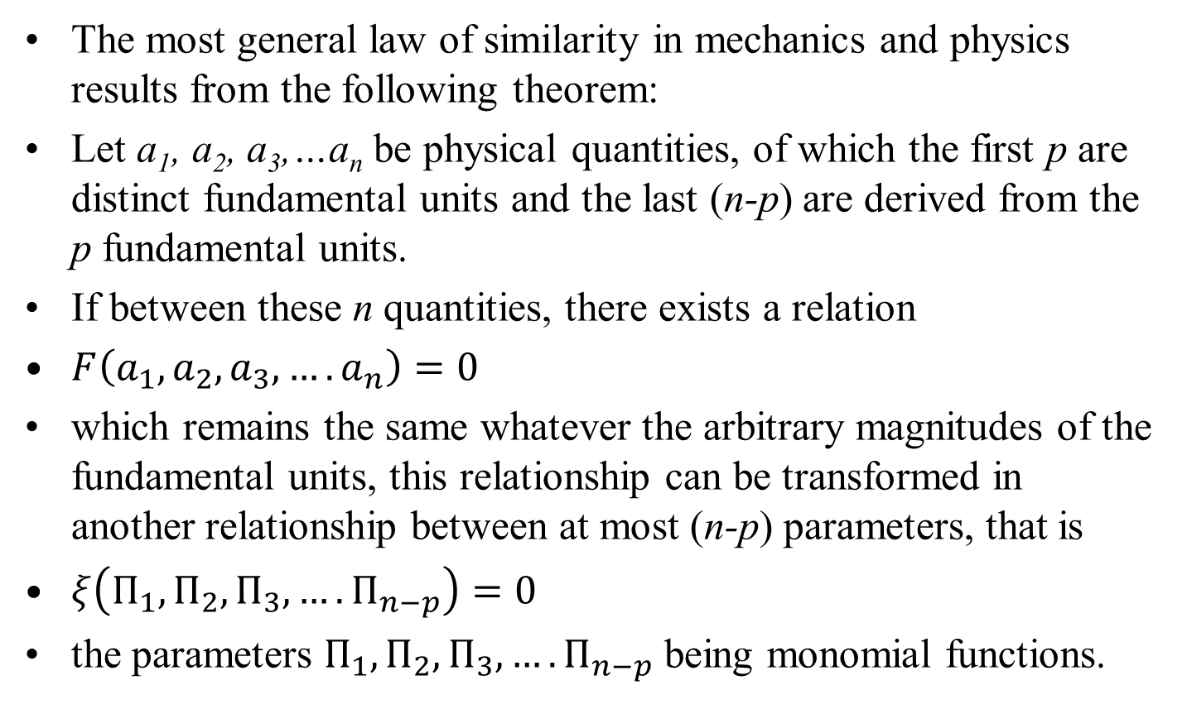
Buckingham Pi Theorem
The most general law of similarity in mechanics and physics results from the following theorem:
Let a₁, a₂, a₃,…a_{n} be physical quantities, of which the first p are distinct fundamental units and the last (n-p) are derived from the p fundamental units.
If between these n quantities, there exists a relation
$F\left(a_{1},a_{2},a_{3},….a_{n}\right)=0$
which remains the same whatever the arbitrary magnitudes of the fundamental units, this relationship can be transformed in another relationship between at most (n-p) parameters, that is
$ξ\left(Π_{1},Π_{2},Π_{3},….Π_{n−p}\right)=0$
the parameters $Π_{1},Π_{2},Π_{3},….Π_{n−p}$ being monomial functions.

Slide 21
Buckingham Pi Theorem
Mathematically
$$u_{1}=f\left(a_{1, }a_{2, }a_{3,…………}a_{n }\right)⊳Π_{1}=φ\left(Π_{2, }Π_{3,…………Π_{n−p }}\right)$$

Slide 22
Method of Developing Similitude Model
Most important step:
Assumes you know something about problem!
Required understanding of variables that govern problem and physical laws that apply.

Slide 23
Determination of Pi terms
List all (n) variables that are involved in the problem.
Typically have geometry effects (pipe radius, length),
fluid properties (density and viscosity),
external effects (gravity and pressure).
Variables in the list should be independent; no point in having pipe radius and area.
Decompose variables in terms of the basic dimensions.
Express each on in terms of primary dimensions (MLTθ)
Determine required number of Pi terms (each independent) – i.e. n-p

Slide 24
Method of Repeating Variables
Select p number of repeating variables (equal to number of dimensions).
All the reference dimensions must be included in list of repeating variables.
Each repeating variable must dimensionally be independent from the others.
It is not possible to form a dimensionless number from the repeating variables.
Form each pi terms by multiplying one of the non-repeating variables by the product of repeating variables
Repeat last step for all non-repeating variables
Check that all resulting Pi terms are dimensionless
Express in final form

Slide 25
Important Considerations
The second important step in an analysis is the listing of the relevant variables.
The rest is purely mechanical.
Some questions to consider is, How accurate is the desired answer?
Best to value simplicity ahead of precision.
Variable aspects are geometry Just lengths and angle (angles are
dimensionless).
Geometry invariably plays a role.

Slide 26
Important Considerations
Material properties: These would include density, viscosity, heat capacity.
These are parameters that relate external effects and their responses.
External effects: Anything that effects a change in the flow system, forces, pressures, gravity, velocities.
The categories are not rigid, it is a classication to help identify important quantities.
Note, if a variable is constant, it still needs to be included if it has any impact.
It is the dimensions that are important, not the specific values and whether they are constant.

Slide 27
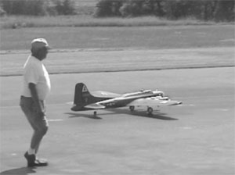

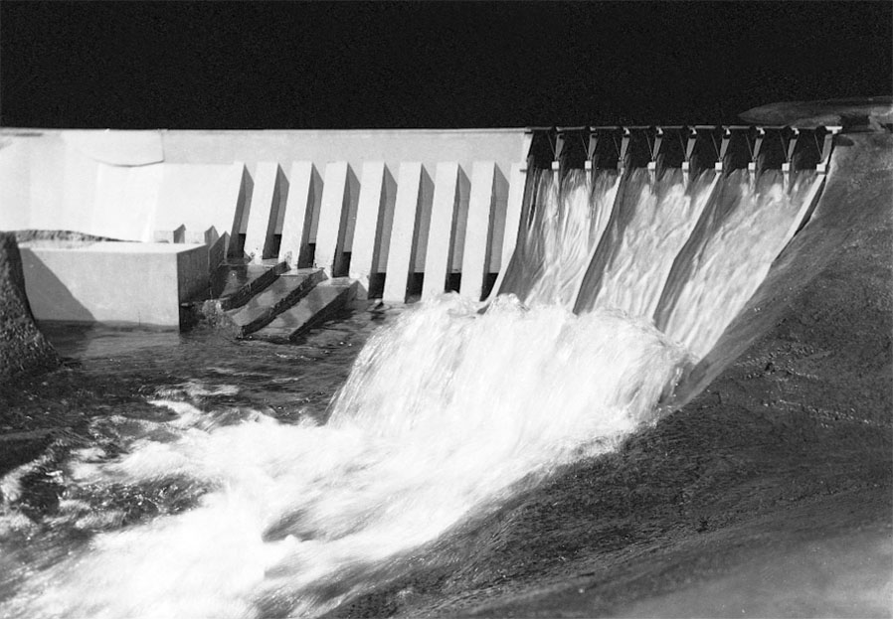
Modeling and Similitude
A model is a representation of a physical system that may be used to predict the behavior of the system in some desired respect, e.g.

Slide 28
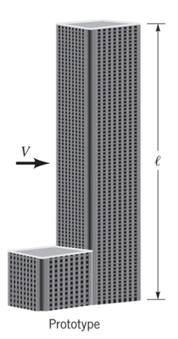

Prototype vs Model

Slide 29
Types of Similarity
Geometric (ratio of length scales the same)
Kinematic (velocity structures are the same)
Dynamic (force ratio is the same)
The best situation is: Get all dimensionless variables (Pi groups) the same between model and prototype. Then all similarities are preserved…..
Sometimes hard to achieve it all….

Slide 30



Flow around bodies
We are often interested in drag at high Reynolds number
Coefficient of drag
(what we want to measure in the lab)

Slide 31

Dimensionless Numbers
C_{D} – is dimensionless
Reynolds Number (ρ V l/μ)
Ratio of all length scales (l_{i}/l)
    e.g. in golf ball depth of dimples over diameter of ball
    In building width/height, window length/height, etc.
Using Pi Theorem
If the Reynolds numbers and length scale ratios are the same in the model as the actual case (prototype) C_{D} will the same

Slide 32



Relationship between Prototype and Model
We can now calculate the drag on the prototype from measurements on the model.

Slide 33



Flow with a Free Surface
Gravity Driven Flows (i.e. water flows down a hill)
As long as all other dimensionless numbers are matched between model and prototype Froude Number only matters (tough to do - e.g. Reynolds number – make large enough in both cases to not be important)

Slide 34


Preparedness for War or Space travel

Slide 35
Data – Problems with One Pi Term
If only one term exists, then according to the Pi Theorem we can say:
Π₁=C
Allows for a very nice relationship between variables and the constant can easily be fit from data….

Slide 36
Methods for Flow Analysis
There are three basic ways to attack a fluid flow problem.
All are equally important for Educational Pedagogy :
1. Control-volume, or integral analysis.
2. Infinitesimal system, or differential analysis.
3. Experimental study, or dimensional analysis.

