Slide 1

Analysis of Creeping Viscous Fluid Flows
P M V Subbarao
Professor
Mechanical Engineering Department
I I T Delhi
Flows Dominated by Viscous Forces ……

Slide 2


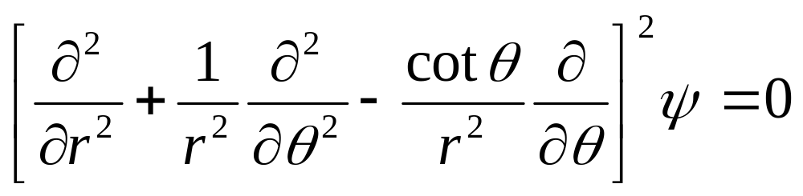
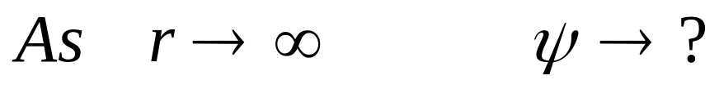



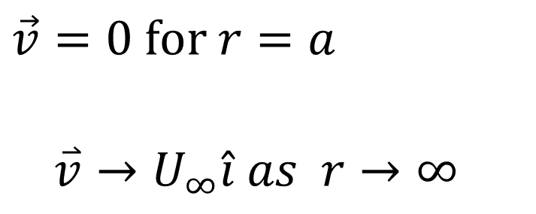
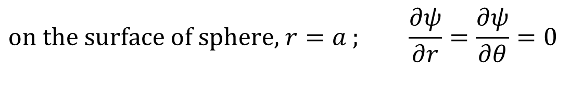
Stokes Equation and Boundary Conditions
$$\vec{v}=0 \text{for} r=a$$
$$\overset{⃑}{v}→U_{∞}\hat{i} as r→∞$$
$$r$$
$$φ$$
$$θ$$
The boundary conditions for stream function:
$$\text{on} \text{the} \text{surface} \text{of} \text{sphere}\text{, }r=a \text{;} \frac{∂ψ}{∂r}=\frac{∂ψ}{∂θ}=0$$

Slide 3
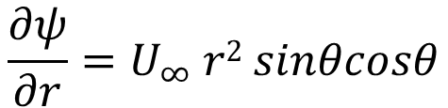
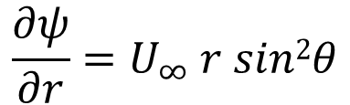
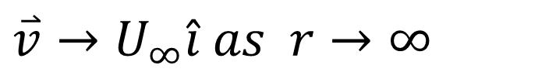
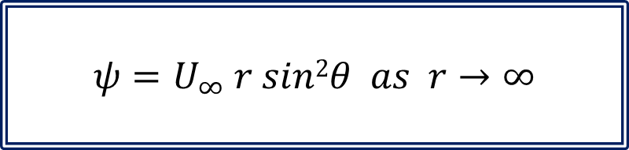
Far Field Boundary Condition for Stokes Flow past a Sphere
$$\overset{⃑}{v}→U_{∞}\hat{i} as r→∞$$
$$r$$
In spherical Co-ordinates:
$$φ$$
$$θ$$
$$\overset{⃑}{v}→U_{∞}cosθ \hat{i}r{−U}_{∞}sinθ \hat{i}θ as r→∞$$
$$\frac{∂ψ}{∂r}=U_{∞} r sin2θ$$
$$\frac{∂ψ}{∂r}=U_{∞} r2 sinθcosθ$$
$$ψ=U_{∞} r sin2θ as r→∞$$

Slide 4

Stokes Equation: The Biharmonic PDE
Biharmonic equations are fourth-order, elliptic partial differential equations (PDEs) used to model phenomena in continuum mechanics and fluid dynamics.
$$r$$
$$φ$$
$$θ$$
Their defining characteristic is that the solution satisfies Laplace's equation twice.
Meaning they are functions of functions whose second derivatives (or Laplacian) also satisfy Laplace's equation.
$$∴ψ\left(r,θ\right)=R\left(r\right)×Θ\left(θ\right)$$

Slide 5
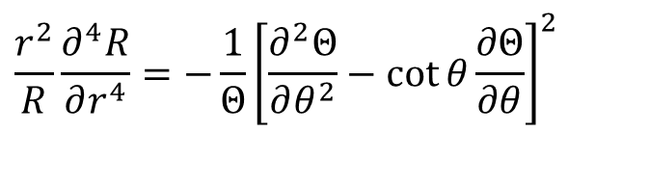
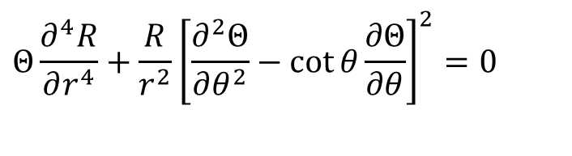
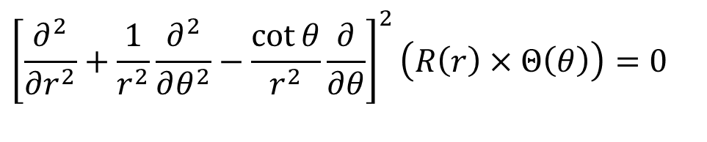
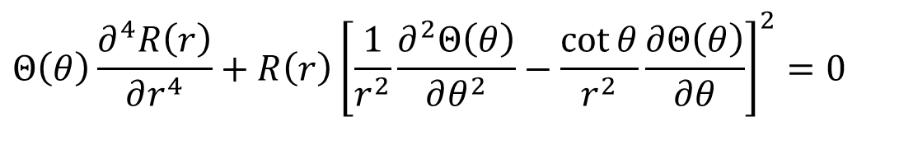
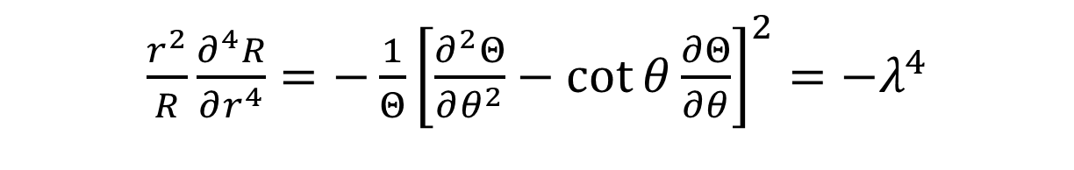
Solution of Stokes Equation
$$r$$
$${\left[\frac{∂^{2}}{∂r^{2}}+\frac{1}{r^{2}}\frac{∂^{2}}{∂θ^{2}}−\frac{\cot{θ}}{r^{2}}\frac{∂}{∂θ}\right]}^{2}\left(R\left(r\right)×Θ\left(θ\right)\right)=0$$
$$φ$$
$$θ$$
$${Θ\left(θ\right)\frac{∂^{4}R\left(r\right)}{∂r^{4}}+R\left(r\right)\left[\frac{1}{r^{2}}\frac{∂^{2}Θ\left(θ\right)}{∂θ^{2}}−\frac{\cot{θ}}{r^{2}}\frac{∂Θ\left(θ\right)}{∂θ}\right]}^{2}=0$$
$${Θ\frac{∂^{4}R}{∂r^{4}}+\frac{R}{r^{2}}\left[\frac{∂^{2}Θ}{∂θ^{2}}−\cot{θ}\frac{∂Θ}{∂θ}\right]}^{2}=0$$
$${\frac{r^{2}}{R}\frac{∂^{4}R}{∂r^{4}}=−\frac{1}{Θ}\left[\frac{∂^{2}Θ}{∂θ^{2}}−\cot{θ}\frac{∂Θ}{∂θ}\right]}^{2}$$
${\frac{r^{2}}{R}\frac{∂^{4}R}{∂r^{4}}=−\frac{1}{Θ}\left[\frac{∂^{2}Θ}{∂θ^{2}}−\cot{θ}\frac{∂Θ}{∂θ}\right]}^{2}=−λ^{4}$

Slide 6
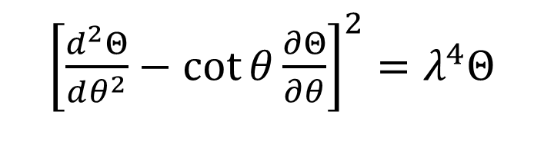
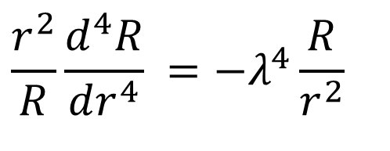
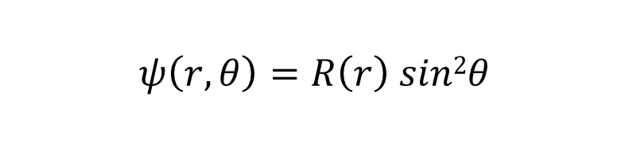
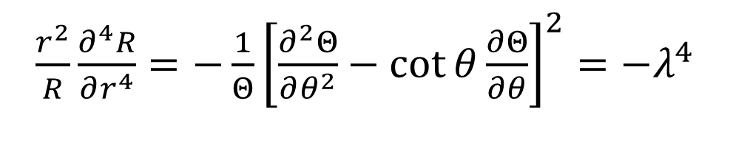
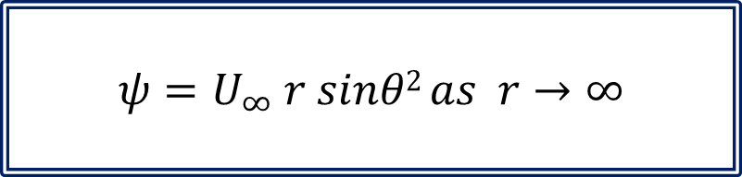
Stokes Equation as Simultaneous ODEs
${\frac{r^{2}}{R}\frac{∂^{4}R}{∂r^{4}}=−\frac{1}{Θ}\left[\frac{∂^{2}Θ}{∂θ^{2}}−\cot{θ}\frac{∂Θ}{∂θ}\right]}^{2}={−λ}^{4}$
$$r$$
$$φ$$
$$θ$$
$$\frac{r^{2}}{R}\frac{d^{4}R}{dr^{4}} ={−λ}^{4}\frac{R}{r^{2}}$$
${\left[\frac{d^{2}Θ}{dθ^{2}}−\cot{θ}\frac{∂Θ}{∂θ}\right]}^{2}=λ^{4}Θ$
$$ψ=U_{∞} r sinθ2 as r→∞$$
$$ψ\left(r,θ\right)=R\left(r\right) sin2θ$$

Slide 7
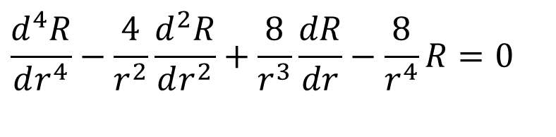
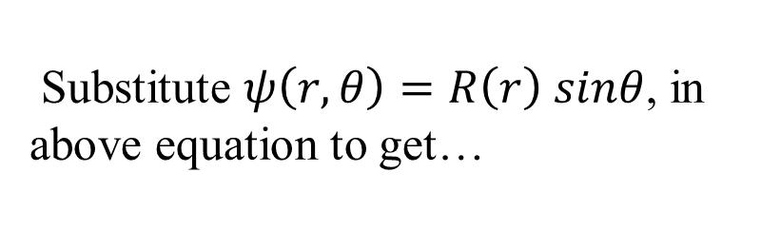
Stokes Equation: The Biharmonic PDE
$$r$$
$$φ$$
Substitute $ψ\left(r,θ\right)=R\left(r\right) sinθ$, in above equation to get…
$$θ$$
$$\frac{d^{4}R}{dr^{4}}−\frac{4}{r^{2}}\frac{d^{2}R}{dr^{2}}+\frac{8}{r^{3}}\frac{dR}{dr}−\frac{8}{r^{4}}R=0$$
Seeking a solution as a power series in r^{n}, to obtain the characteristic polynomial!
$$\left(n−2\right)\left(n−1\right)\left(n^{2}−3n−4\right)=0$$

Slide 8
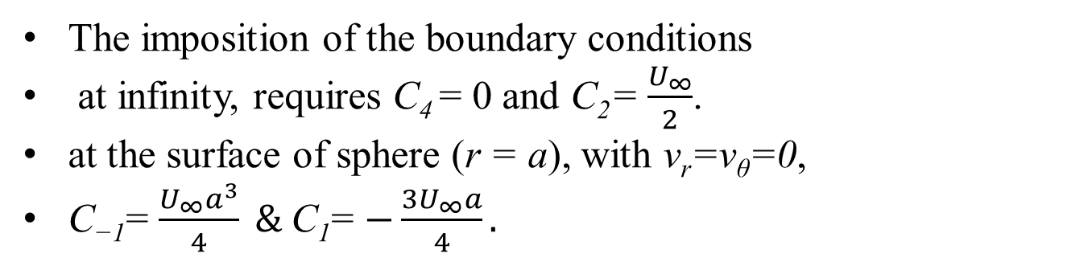
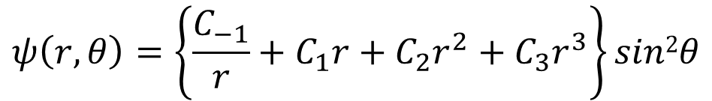
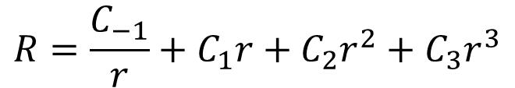
Stokes Equation: The Biharmonic PDE
$$R=\frac{C_{−1}}{r}+C_{1}r+C_{2}r^{2}+C_{3}r^{3}$$
$$ψ\left(r,θ\right)=\left\{\frac{C_{−1}}{r}+C_{1}r+C_{2}r^{2}+C_{3}r^{3}\right\}sin2θ$$
$$r$$
$$φ$$
$$θ$$
The imposition of the boundary conditions
at infinity, requires C₄ = 0 and C₂= $\frac{U_{∞}}{2}$.
at the surface of sphere (r = a), with v_{r}=v_{θ}=0,
C₋₁= $\frac{U_{∞}a^{3}}{4} \&$C₁= $−\frac{3U_{∞}a}{4}.$

Slide 9
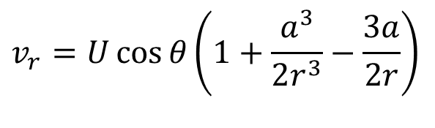
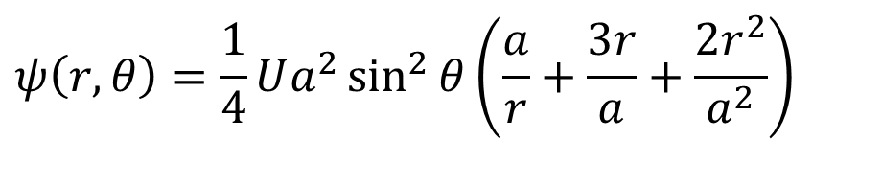
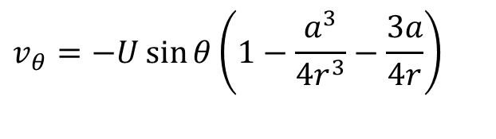
Stokes flow Past A sphere of Radius , a
Streamline equation for Stokes flow Past A sphere of Radius, a is:
$$ψ\left(r,θ\right)=\frac{1}{4}Ua^{2}\sin^{2}{θ}\left(\frac{a}{r}+\frac{3r}{a}+\frac{2r^{2}}{a^{2}}\right)$$
Inside the parentheses,
the first two terms together represent an inviscid flow past a sphere.
The third term is called the Stokeslet, representing the viscous correction.
The velocity components follow immediately
$$v_{r}=U\cos{θ}\left(1+\frac{a^{3}}{2r^{3}}−\frac{3a}{2r}\right)$$
$$v_{θ}=−U\sin{θ}\left(1−\frac{a^{3}}{4r^{3}}−\frac{3a}{4r}\right)$$

Slide 10
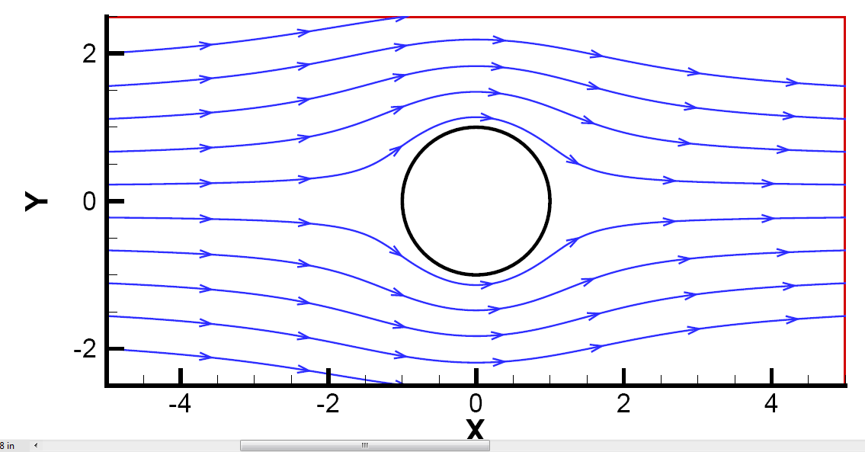
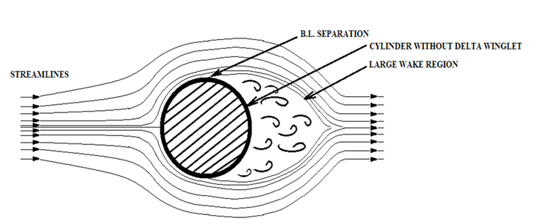
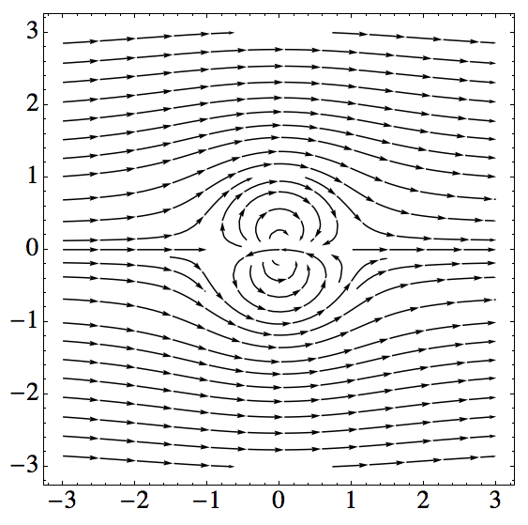

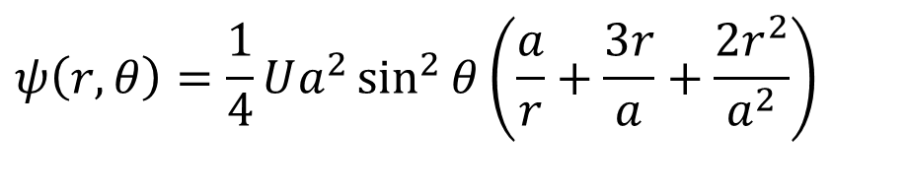
Stokes Flow past A Sphere
$$ψ\left(r,θ\right)=\frac{1}{4}Ua^{2}\sin^{2}{θ}\left(\frac{a}{r}+\frac{3r}{a}+\frac{2r^{2}}{a^{2}}\right)$$
Finite inertial force flow
Ideal Flow Past A Cylinder

Slide 11
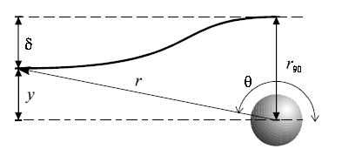
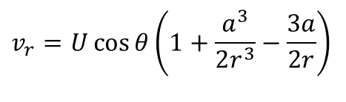
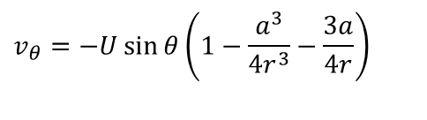
Severe Displacement of Streamlines in Stokes Flow
$$v_{r}=U\cos{θ}\left(1+\frac{a^{3}}{2r^{3}}−\frac{3a}{2r}\right)$$
$$v_{θ}=−U\sin{θ}\left(1−\frac{a^{3}}{4r^{3}}−\frac{3a}{4r}\right)$$
Since velocity disturbances only decay as 1/r , effects of the sphere blockage are felt even at rather large distances from it.

Slide 12
Properties of Stokes Solution
This celebrated solution has several extraordinary properties:
The streamlines and velocities are entirely independent of the fluid viscosity.
This is true of all creeping flows.
The streamlines possess perfect fore-and-aft symmetry.
The local velocity is everywhere retarded from its freestream value.
The effect of the sphere extends to enormous distances:
At r = 10a, the velocities are still about 10 percent below their free-stream values.

Slide 13
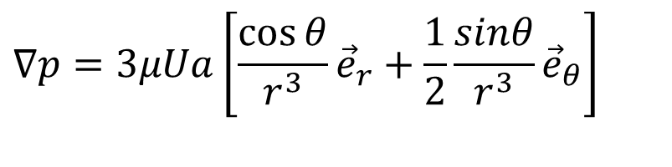
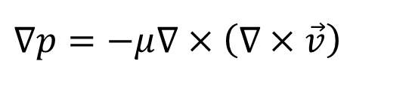
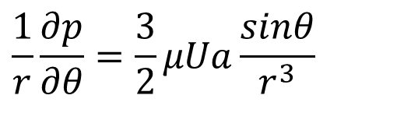
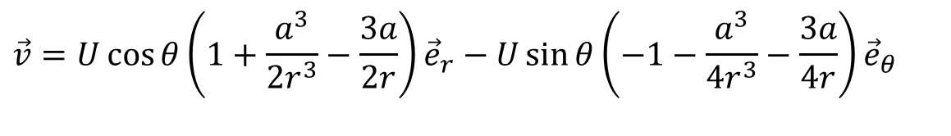
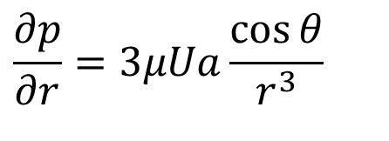


Pressure Field for an Immersed Sphere
Stokes Version of NS Equation:
$$μ∇^{2}\vec{v}=∇p$$
With
$$∇•\vec{v}=0$$
$$∇p=−μ∇×\left(∇×\vec{v}\right)$$
$$\vec{v}=U\cos{θ}\left(1+\frac{a^{3}}{2r^{3}}−\frac{3a}{2r}\right){\vec{e}}_{r}−U\sin{θ}\left(−1−\frac{a^{3}}{4r^{3}}−\frac{3a}{4r}\right){\vec{e}}_{θ}$$
$$∇p=3μUa\left[\frac{\cos{θ}}{r^{3}}{\vec{e}}_{r}+\frac{1}{2}\frac{sinθ}{r^{3}}{\vec{e}}_{θ}\right]$$
$$\frac{∂p}{∂r}=3μUa\frac{\cos{θ}}{r^{3}}$$
$$\frac{1}{r}\frac{∂p}{∂θ}=\frac{3}{2}μUa\frac{sinθ}{r^{3}}$$

Slide 14
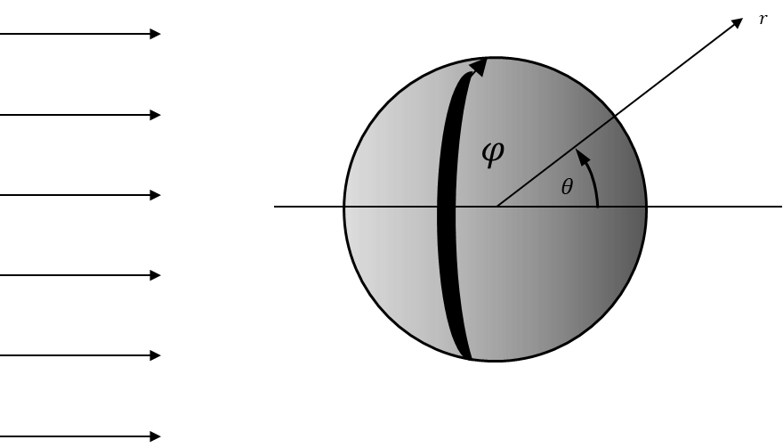
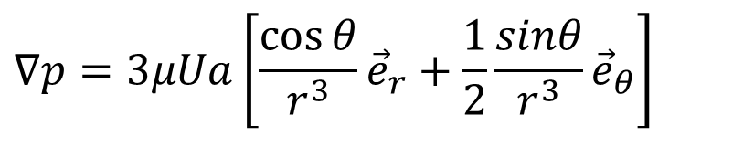
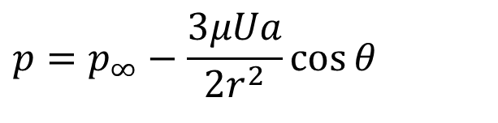
Evaluation of Pressure Field
$$∇p=3μUa\left[\frac{\cos{θ}}{r^{3}}{\vec{e}}_{r}+\frac{1}{2}\frac{sinθ}{r^{3}}{\vec{e}}_{θ}\right]$$
Integrating with respect to r from r=a to r→∞, we get
$$p=p_{∞}−\frac{3μUa}{2r^{2}}\cos{θ}$$
where p∞, is the uniform free stream pressure.
The pressure deviation is proportional to μ and antisymmetric.
Positive at the front and negative at the rear of the sphere
This creates a pressure Force on the sphere.

Slide 15
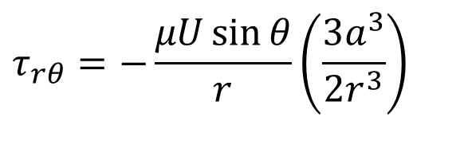
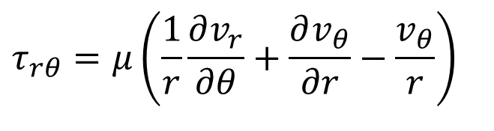
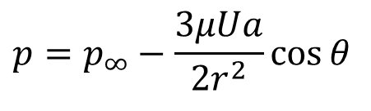
Stokes Shear Stress Field
There is a surface shear stress which creates a viscous force.
The shear-stress distribution in the fluid is given by
$$τ_{rθ}=μ\left(\frac{1}{r}\frac{∂v_{r}}{∂θ}+\frac{∂v_{θ}}{∂r}−\frac{v_{θ}}{r}\right)$$
$$τ_{rθ}=−\frac{μU\sin{θ}}{r}\left(\frac{3a^{3}}{2r^{3}}\right)$$
Pressure field or normal stress is
$$p=p_{∞}−\frac{3μUa}{2r^{2}}\cos{θ}$$

Slide 16

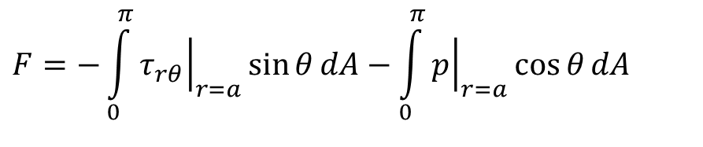
The Tangential Forces on Sphere
The tangential component of total force is always opposite to the direction of flow.
This is called as Drag.
The total drag is found by integrating pressure and shear around the surface:
$$F=−\int_{0}^{π}{{\left.τ_{rθ}\right|}_{r=a}}\sin{θ}dA−\int_{0}^{π}{{\left.p\right|}_{r=a}}\cos{θ}dA$$
$$dA=2πa^{2}\sin{θ}dθ$$
$$F=4πμaU+2πμaU=6πμaU$$
This is the famous sphere-drag formula of Stokes (1851).
Consists of two-thirds viscous force and one-third pressure force.
The formula is strictly valid only for Re << 1 but agrees with experiment up to about Re = 1.

Slide 17
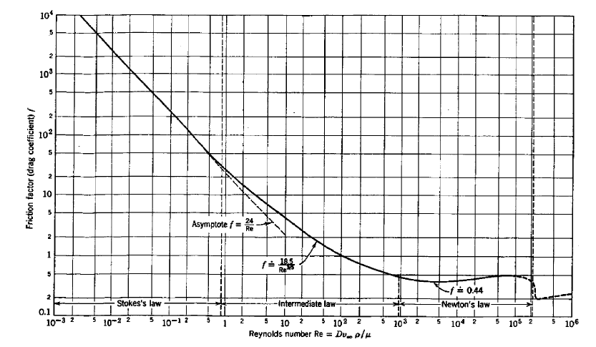
Experimental Validation of Stokes Solution

Slide 18

Other Three-Dimensional Body Shapes
In principle, a Stokes flow analysis is possible for any three-dimensional body shape, providing that one has the necessary analytical skill.
A number of interesting shapes are discussed in the literature.
Of particular interest is the drag of a circular disk:
Disk normal to the freestream:
Disk parallel to the freestream:

Slide 19
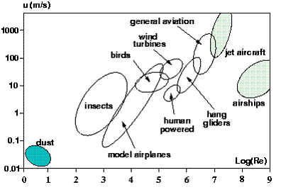
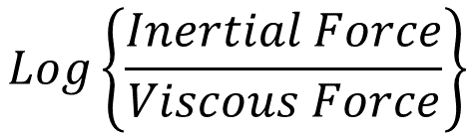
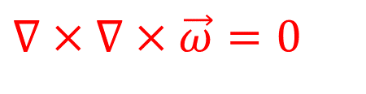
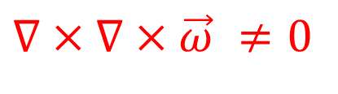

Catalogue of Flying Systems
$$\vec{ω}=∇×\vec{V}≠0$$
Creeping Regime
Inertial Regime
$$∇×∇×\vec{ω}=0$$
$$∇×∇×\vec{ω} ≠0$$
$$Log\left\{\frac{Inertial Force}{Viscous Force}\right\}$$

Slide 20



Catalogue of Real-World Flows
$$\vec{ω}=∇×\vec{V}≠0$$
$$\left\{\frac{Inertial Force}{Viscous Force}\right\}$$

Slide 21



Honor of Osborne Reynolds : Engineering of Mathematics
Consider the Navier-Stokes equations with constant density it their dimensional form:
$$∇•\vec{v}=0$$
$$\frac{∂u}{∂t}+u\frac{∂u}{∂x}+v\frac{∂u}{∂y}+w\frac{∂u}{∂z} = g_{x}−\frac{1}{ρ}\frac{∂p}{∂x}+ν\left\{\frac{∂^{2}u}{∂x^{2}}+\frac{∂^{2}u}{∂y^{2}}+\frac{∂^{2}u}{∂z^{2}}\right\}$$
Consider highest expected velocity of a formula car as U.
Most important dimension of formula car as L.
These parameters are defined by Reynolds as velocity and length scales.
In the case of flow through a pipe, L might be a pipe diameter (D) and U the flow speed at the pipe inlet.

