Slide 1

Analysis of Navier-Stokes Equations & Stokes First Solution
P M V Subbarao
Professor
Mechanical Engineering Department
I I T Delhi
Diagnosis for Better Understanding of Visous Effects…

Slide 2


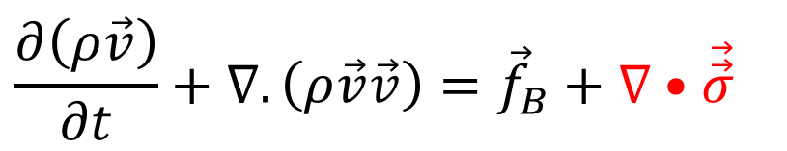
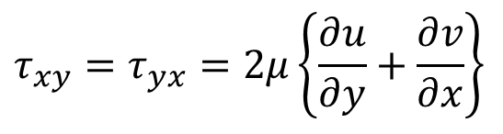
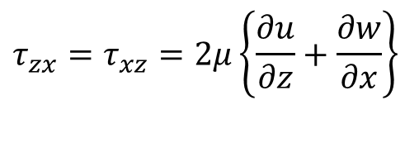
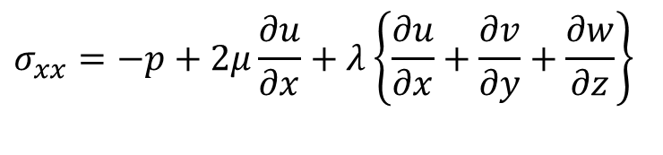
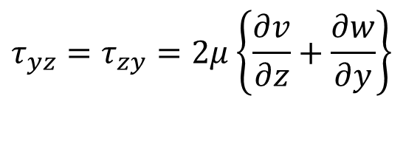
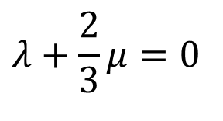
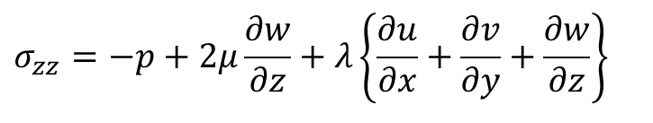
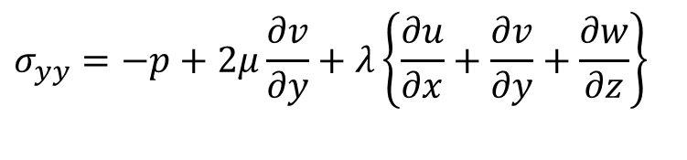
Stokes Model & Hypothesis
The general stress-strain rate law is known as Deformation law.
Given by Stokes (1845):.
$$σ_{xx}=−p+2μ\frac{∂u}{∂x}+λ\left\{\frac{∂u}{∂x}+\frac{∂v}{∂y}+\frac{∂w}{∂z}\right\}$$
$$τ_{xy}=τ_{yx}=2μ\left\{\frac{∂u}{∂y}+\frac{∂v}{∂x}\right\}$$
$$τ_{yz}=τ_{zy}=2μ\left\{\frac{∂v}{∂z}+\frac{∂w}{∂y}\right\}$$
$$σ_{yy}=−p+2μ\frac{∂v}{∂y}+λ\left\{\frac{∂u}{∂x}+\frac{∂v}{∂y}+\frac{∂w}{∂z}\right\}$$
$$σ_{zz}=−p+2μ\frac{∂w}{∂z}+λ\left\{\frac{∂u}{∂x}+\frac{∂v}{∂y}+\frac{∂w}{∂z}\right\}$$
$$τ_{zx}=τ_{xz}=2μ\left\{\frac{∂u}{∂z}+\frac{∂w}{∂x}\right\}$$
RTT for Local Momentum Balance:
$$\frac{∂\left(ρ\vec{v}\right)}{∂t}+∇.\left(ρ\vec{v}\vec{v}\right)={\vec{f}}_{B}+∇•\vec{\vec{σ}}$$
$$λ+\frac{2}{3}μ=0$$

Slide 3

Incompressible Flows : Conservation of Mass
The continuity equation for unsteady and compressible flow is:
$$\frac{∂ρ}{∂t}+\frac{∂\left(ρu\right)}{∂x}+\frac{∂\left(ρv\right)}{∂y}+\frac{∂\left(ρw\right)}{∂z}=0$$
Density remains constant for all types and levels of forces occurring in in an incompressible flows.
The continuity equation for unsteady incompressible flow is:
$$\frac{∂u}{∂x}+\frac{∂v}{∂y}+\frac{∂w}{∂z}=0$$
$$∇•\vec{v}=0$$

Slide 4
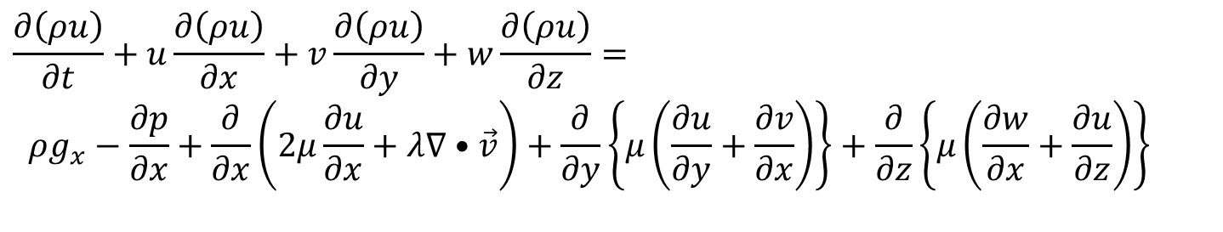
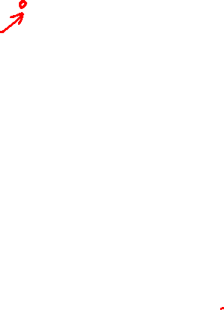
N-S Equations for Incompressible Flows
$$∇•\vec{v}=0$$
X-momentum Equation:
$$\frac{∂\left(ρu\right)}{∂t}+u\frac{∂\left(ρu\right)}{∂x}+v\frac{∂\left(ρu\right)}{∂y}+w\frac{∂\left(ρu\right)}{∂z}=$$
$$ρg_{x}−\frac{∂p}{∂x}+\frac{∂}{∂x}\left(2μ\frac{∂u}{∂x}+λ∇•\vec{v}\right)+\frac{∂}{∂y}\left\{μ\left(\frac{∂u}{∂y}+\frac{∂v}{∂x}\right)\right\}+\frac{∂}{∂z}\left\{μ\left(\frac{∂w}{∂x}+\frac{∂u}{∂z}\right)\right\}$$
The bulk viscosity(λ) cannot affect a truly incompressible fluid.
In fact, it does affect certain phenomena occurring in nearly incompressible fluids.
$$ρ\left\{\frac{∂u}{∂t}+u\frac{∂u}{∂x}+v\frac{∂u}{∂y}+w\frac{∂u}{∂z}\right\}=$$
$$ρg_{x}−\frac{∂p}{∂x}+\frac{∂}{∂x}\left(2μ\frac{∂u}{∂x}\right)+\frac{∂}{∂y}\left\{μ\left(\frac{∂u}{∂y}+\frac{∂v}{∂x}\right)\right\}+\frac{∂}{∂z}\left\{μ\left(\frac{∂w}{∂x}+\frac{∂u}{∂z}\right)\right\}$$

Slide 5
Incompressible Flows
X-momentum Equation for an incompressible flow is
$$ρ\left\{\frac{∂u}{∂t}+u\frac{∂u}{∂x}+v\frac{∂u}{∂y}+w\frac{∂u}{∂z}\right\}=$$
$$ρg_{x}−\frac{∂p}{∂x}+\frac{∂}{∂x}\left(2μ\frac{∂u}{∂x}\right)+\frac{∂}{∂y}\left\{μ\left(\frac{∂u}{∂y}+\frac{∂v}{∂x}\right)\right\}+\frac{∂}{∂z}\left\{μ\left(\frac{∂w}{∂x}+\frac{∂u}{∂z}\right)\right\}$$
$$ρ\left\{\frac{∂u}{∂t}+u\frac{∂u}{∂x}+v\frac{∂u}{∂y}+w\frac{∂u}{∂z}\right\}=$$
$$ρg_{x}−\frac{∂p}{∂x}+2μ\frac{∂^{2}u}{∂x^{2}}+μ\frac{∂^{2}u}{∂y^{2}}+μ\frac{∂^{2}v}{∂y∂x}+μ\frac{∂^{2}w}{∂z∂x}+μ\frac{∂^{2}u}{∂z^{2}}$$
$$ρ\left\{\frac{∂u}{∂t}+u\frac{∂u}{∂x}+v\frac{∂u}{∂y}+w\frac{∂u}{∂z}\right\}=$$
$$ρg_{x}−\frac{∂p}{∂x}+2μ\frac{∂^{2}u}{∂x^{2}}+μ\frac{∂^{2}u}{∂y^{2}}+μ\frac{∂^{2}u}{∂z^{2}}+μ\frac{∂}{∂x}\left(\frac{∂v}{∂y}+\frac{∂w}{∂z}\right)$$

Slide 6
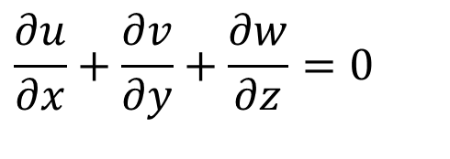
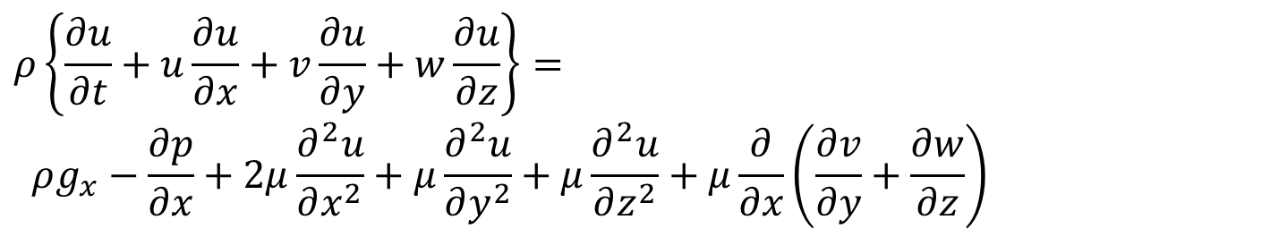
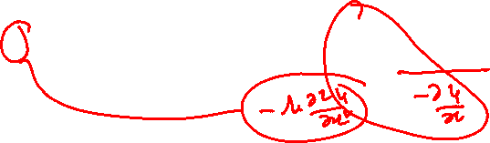
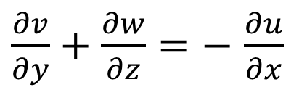
Incompressible Flows
$$ρ\left\{\frac{∂u}{∂t}+u\frac{∂u}{∂x}+v\frac{∂u}{∂y}+w\frac{∂u}{∂z}\right\}=$$
$$ρg_{x}−\frac{∂p}{∂x}+2μ\frac{∂^{2}u}{∂x^{2}}+μ\frac{∂^{2}u}{∂y^{2}}+μ\frac{∂^{2}u}{∂z^{2}}+μ\frac{∂}{∂x}\left(\frac{∂v}{∂y}+\frac{∂w}{∂z}\right)$$
The continuity equation for an incompressible flow is:
$$\frac{∂u}{∂x}+\frac{∂v}{∂y}+\frac{∂w}{∂z}=0$$
$\frac{∂v}{∂y}+\frac{∂w}{∂z}=−$ $\frac{∂u}{∂x}$
$$ρ\left\{\frac{∂u}{∂t}+u\frac{∂u}{∂x}+v\frac{∂u}{∂y}+w\frac{∂u}{∂z}\right\}= ρg_{x}−\frac{∂p}{∂x}+μ\left\{\frac{∂^{2}u}{∂x^{2}}+\frac{∂^{2}u}{∂y^{2}}+\frac{∂^{2}u}{∂z^{2}}\right\}$$

Slide 7
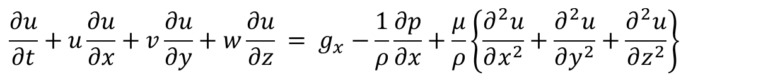
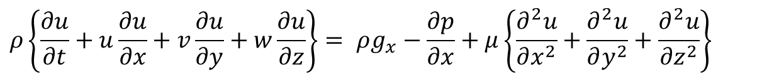
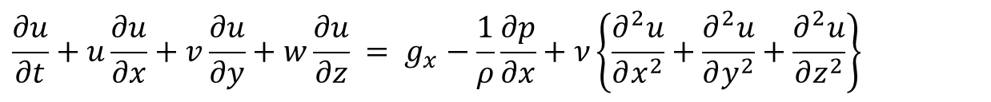
N-S Equations for Incompressible Flows
$$ρ\left\{\frac{∂u}{∂t}+u\frac{∂u}{∂x}+v\frac{∂u}{∂y}+w\frac{∂u}{∂z}\right\}= ρg_{x}−\frac{∂p}{∂x}+μ\left\{\frac{∂^{2}u}{∂x^{2}}+\frac{∂^{2}u}{∂y^{2}}+\frac{∂^{2}u}{∂z^{2}}\right\}$$
$$\frac{∂u}{∂t}+u\frac{∂u}{∂x}+v\frac{∂u}{∂y}+w\frac{∂u}{∂z} = g_{x}−\frac{1}{ρ}\frac{∂p}{∂x}+\frac{μ}{ρ}\left\{\frac{∂^{2}u}{∂x^{2}}+\frac{∂^{2}u}{∂y^{2}}+\frac{∂^{2}u}{∂z^{2}}\right\}$$
X-momentum Equation for an incompressible flow is
$$\frac{∂u}{∂t}+u\frac{∂u}{∂x}+v\frac{∂u}{∂y}+w\frac{∂u}{∂z} = g_{x}−\frac{1}{ρ}\frac{∂p}{∂x}+ν\left\{\frac{∂^{2}u}{∂x^{2}}+\frac{∂^{2}u}{∂y^{2}}+\frac{∂^{2}u}{∂z^{2}}\right\}$$

Slide 8
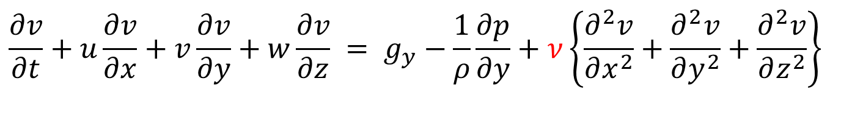
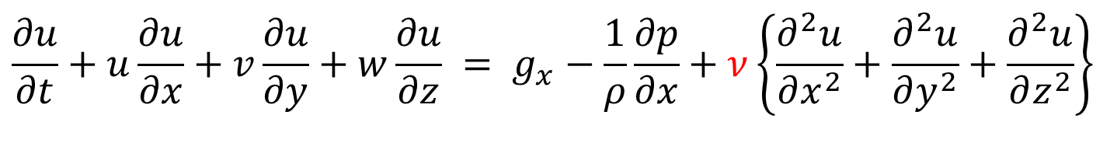
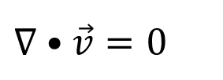
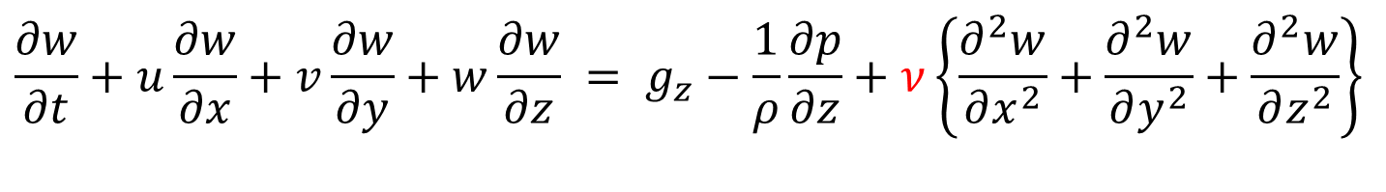

N-S Equations for Incompressible Flows
$$∇•\vec{v}=0$$
Conservation of Mass:
X-momentum Equation:
$$\frac{∂u}{∂t}+u\frac{∂u}{∂x}+v\frac{∂u}{∂y}+w\frac{∂u}{∂z} = g_{x}−\frac{1}{ρ}\frac{∂p}{∂x}+ν\left\{\frac{∂^{2}u}{∂x^{2}}+\frac{∂^{2}u}{∂y^{2}}+\frac{∂^{2}u}{∂z^{2}}\right\}$$
Y-momentum Equation:
$$\frac{∂v}{∂t}+u\frac{∂v}{∂x}+v\frac{∂v}{∂y}+w\frac{∂v}{∂z} = g_{y}−\frac{1}{ρ}\frac{∂p}{∂y}+ν\left\{\frac{∂^{2}v}{∂x^{2}}+\frac{∂^{2}v}{∂y^{2}}+\frac{∂^{2}v}{∂z^{2}}\right\}$$
Z-momentum Equation:
$$\frac{∂w}{∂t}+u\frac{∂w}{∂x}+v\frac{∂w}{∂y}+w\frac{∂w}{∂z} = g_{z}−\frac{1}{ρ}\frac{∂p}{∂z}+ν\left\{\frac{∂^{2}w}{∂x^{2}}+\frac{∂^{2}w}{∂y^{2}}+\frac{∂^{2}w}{∂z^{2}}\right\}$$
Viscous Force
Inertial Force
Pressure Force

Slide 9

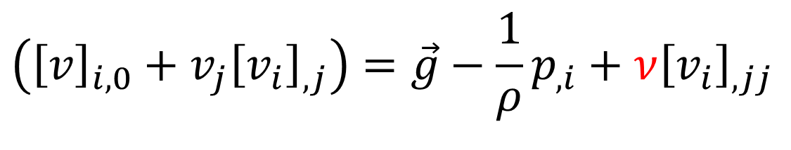
N-S Equations for Incompressible Flows:
Einstein Notation
$$v_{i,i}=0$$
Conservation of Mass:
N-S Equations:
$$\left({\left[v\right]}_{i,0}+v_{j}{\left[v_{i}\right]}_{,j}\right)=\vec{g}−\frac{1}{ρ}p_{,i}+ν{\left[v_{i}\right]}_{,jj}$$
Z-momentum Equation:

Slide 10
"Every high-school student learns that Millikan calculated the drag of an oil drop using the approximation developed by Stokes in 1851"
That fetched Nobel prize in 1923 to Robert Millikan.

Slide 11
The Stokes Flows
These are usually referred to as Creeping flows.
George Stokes initiated investigations into this class of fluid problems.
This general area of fluid dynamics as the Stokesian realm.
This is of extreme contrast to the theories of ideal inviscid flow, which might be termed as the Eulerian realm.

Slide 12
N-S Equations for Incompressible Flows
$$∇•\vec{v}=0$$
Conservation of Mass:
Euler Regime
Stokes Regime
X-momentum Equation:
$$\frac{∂u}{∂t}+u\frac{∂u}{∂x}+v\frac{∂u}{∂y}+w\frac{∂u}{∂z} = g_{x}−\frac{1}{ρ}\frac{∂p}{∂x}+ν\left\{\frac{∂^{2}u}{∂x^{2}}+\frac{∂^{2}u}{∂y^{2}}+\frac{∂^{2}u}{∂z^{2}}\right\}$$
Y-momentum Equation:
$$\frac{∂v}{∂t}+u\frac{∂v}{∂x}+v\frac{∂v}{∂y}+w\frac{∂v}{∂z} = g_{y}−\frac{1}{ρ}\frac{∂p}{∂y}+ν\left\{\frac{∂^{2}v}{∂x^{2}}+\frac{∂^{2}v}{∂y^{2}}+\frac{∂^{2}v}{∂z^{2}}\right\}$$
Z-momentum Equation:
$$\frac{∂w}{∂t}+u\frac{∂w}{∂x}+v\frac{∂w}{∂y}+w\frac{∂w}{∂z} = g_{z}−\frac{1}{ρ}\frac{∂p}{∂z}+ν\left\{\frac{∂^{2}w}{∂x^{2}}+\frac{∂^{2}w}{∂y^{2}}+\frac{∂^{2}w}{∂z^{2}}\right\}$$

Slide 13
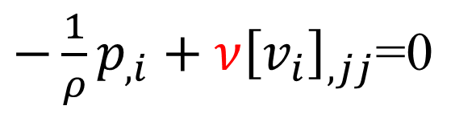

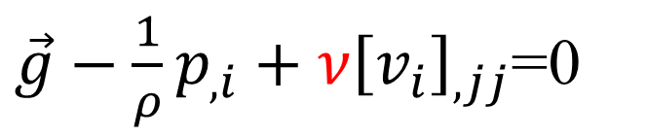
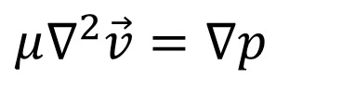

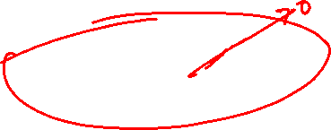
Stokes Equation for Viscous Flow Systems
The basic assumption of creeping flow was developed by Stokes (1851) in a seminal paper.
This states that density (inertia) terms are negligible in the momentum equation.
$$\left({\left[v\right]}_{i,0}+v_{j}{\left[v_{i}\right]}_{,j}\right)=\vec{g}−\frac{1}{ρ}p_{,i}+ν{\left[v_{i}\right]}_{,jj}$$
$\vec{g}−\frac{1}{ρ}p_{,i}+ν{\left[v_{i}\right]}_{,jj}$=0
Under non-gravitational field:
$−\frac{1}{ρ}p_{,i}+ν{\left[v_{i}\right]}_{,jj}$=0
$$μ∇^{2}\vec{v}=∇p$$
with
$$∇•\vec{v}=0$$

Slide 14

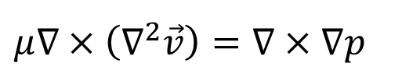
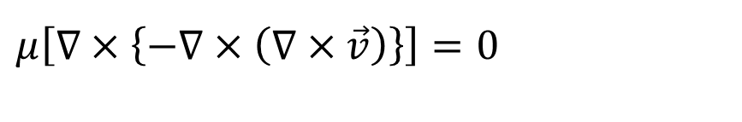




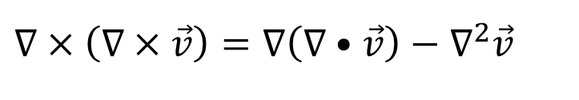
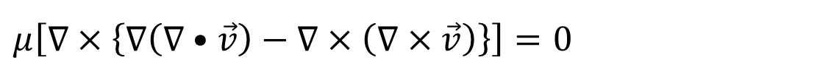
Vector Calculus Operations on Stokes Flow Equation
$$μ∇^{2}\vec{v}=∇p$$
With
$$∇•\vec{v}=0$$
Taking the curl of Stokes flow equation:
$$μ∇×\left(∇^{2}\vec{v}\right)=∇×∇p$$
Using the vector identity
$$∇×\left(∇×\vec{v}\right)=∇\left(∇•\vec{v}\right)−∇^{2}\vec{v}$$
$$μ\left[∇×\left\{∇\left(∇•\vec{v}\right)−∇×\left(∇×\vec{v}\right)\right\}\right]=0$$
$$μ\left[∇×\left\{−∇×\left(∇×\vec{v}\right)\right\}\right]=0$$
$$∇×∇×\left(∇×\vec{v}\right)=0$$
$$∇×∇×\vec{ω}=0$$
Any viscous flow, whose curl of curl of vorticity is zero is called as stokes flow or creeping flow.

Slide 15







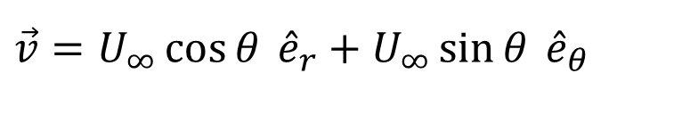
Uniform Flow Past A Sphere
Component of incident velocity in the radial direction,
$$∇×∇×\vec{ω}=0$$
$$U_{∞}\cos{θ}$$
$$r$$
$$φ$$
$$θ$$
Incident Velocity
$$\vec{v}=U_{∞}\hat{i}$$
Component of incident velocity in the θ - direction,
$$U_{∞}\sin{θ}$$
Uniform velocity in spherical system:
$$\vec{v}=U_{∞}\cos{θ} {\hat{e}}_{r}+U_{∞}\sin{θ} {\hat{e}}_{θ}$$

Slide 16
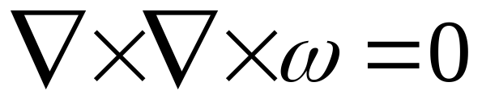
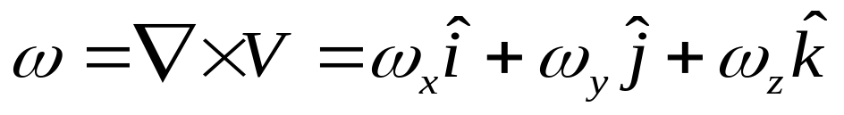
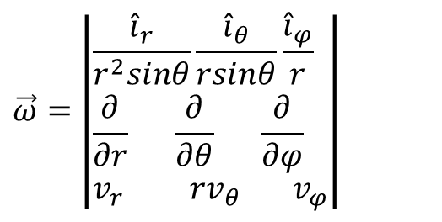
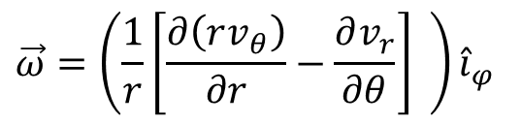
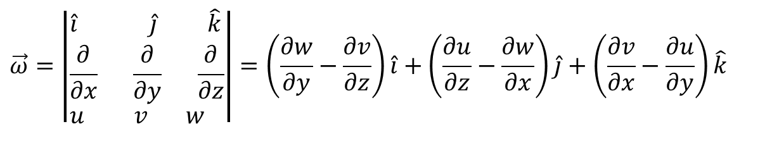
The Vorticity
Any viscous flow, whose curl of curl of vorticity is zero is called as stokes flow or creeping flow
Vorticity in cartesian system is:
$$\vec{ω}=\left|\begin{aligned}&\hat{i} \hat{j} \hat{k} \\ &\frac{∂}{∂x} \frac{∂}{∂y} \frac{∂}{∂z} \\ &u v w\end{aligned}\right|=\left(\frac{∂w}{∂y}−\frac{∂v}{∂z}\right)\hat{i}+\left(\frac{∂u}{∂z}−\frac{∂w}{∂x}\right)\hat{j}+\left(\frac{∂v}{∂x}−\frac{∂u}{∂y}\right)\hat{k}$$
$$\vec{ω}=\left|\begin{aligned}&\frac{{\hat{i}}_{r}}{r^{2}sinθ}\frac{{\hat{i}}_{θ}}{rsinθ}\frac{{\hat{i}}_{φ}}{r} \\ &\frac{∂}{∂r} \frac{∂}{∂θ} \frac{∂}{∂φ} \\ &v_{r} {rv}_{θ} v_{φ}\end{aligned}\right|$$
Vorticity in Spherical system is:
Sphere is an Axi-symmetric object:
For a flow past Sphere :
$$\vec{ω}=\left(\frac{1}{r}\left[\frac{∂\left(rv_{θ}\right)}{∂r}−\frac{∂v_{r}}{∂θ}\right] \right){\hat{i}}_{φ}$$

Slide 17
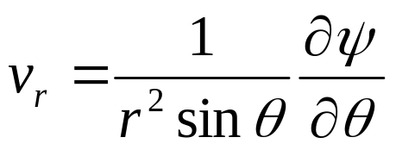
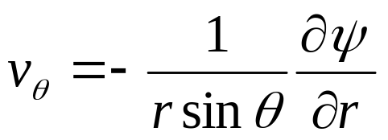
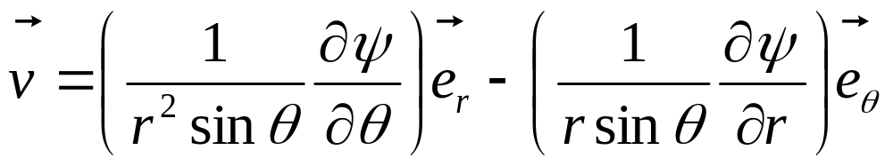
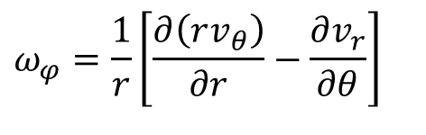
Vorticity, Stream Function & Velocity Vector for 2-D Flow in Spherical System
The only component of vorticity in this axisymmetric problem is ω_{ϕ} , and is given by
$$ω_{φ}=\frac{1}{r}\left[\frac{∂\left(rv_{θ}\right)}{∂r}−\frac{∂v_{r}}{∂θ}\right]$$
Strokes defined a stream function in spherical coordinate system (1851) as:
The stokes solution to be evaluated is:

Slide 18
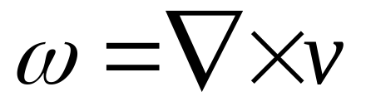
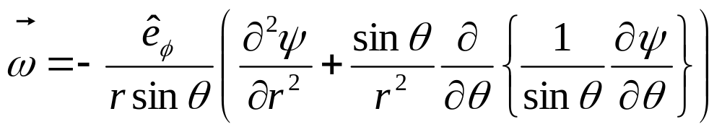
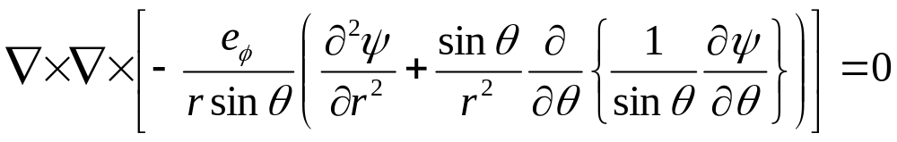
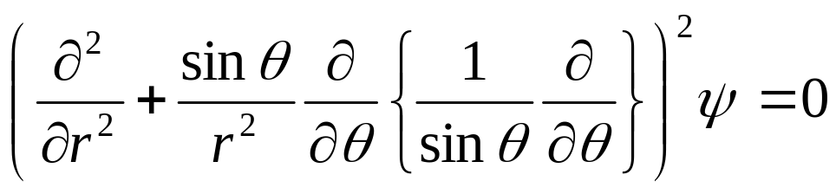
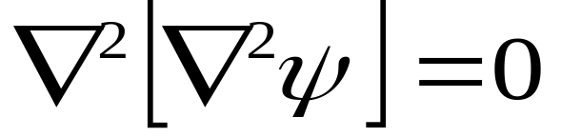
Stokes Flow in terms of Stream Function
the momentum equation as a scalar equation for ψ.
https://library.oapen.org/bitstream/handle/20.500.12657/58369/1/978-3-031-04683-4.pdf

Slide 19
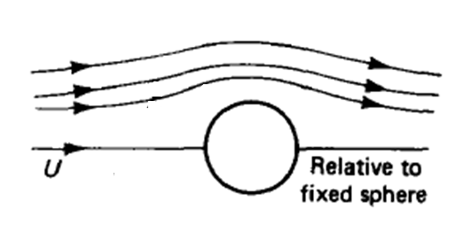
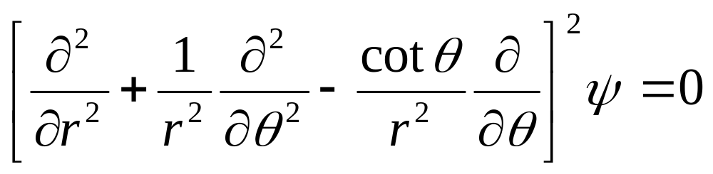
Qualitative Solution to Stokes Problem

Slide 20
Flow on the Surface of a Sphere As Predicted by Euler & Bernoulli
Superimposition of Uniform flow and a Doublet at (0,0).

Slide 21
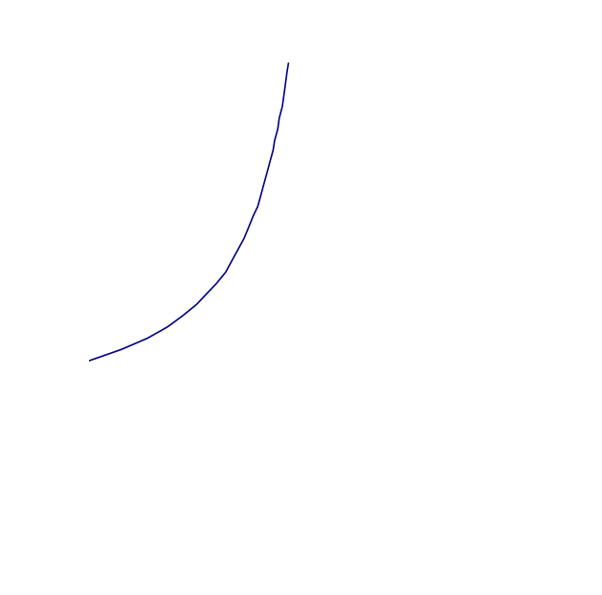
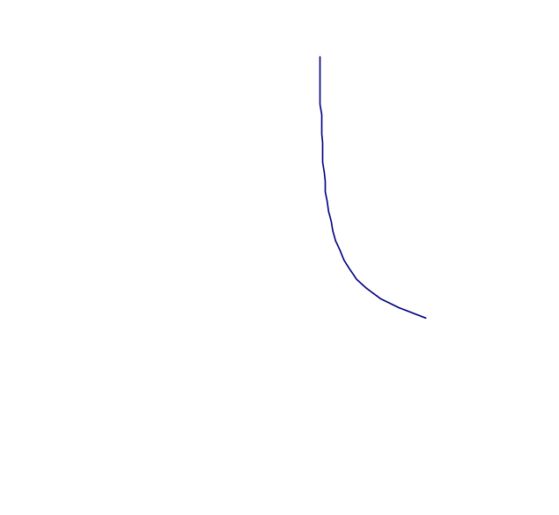
Imagination of Flow on the Surface of a Sphere
Stokes Imagination : Creeping Flow
Euler’s Imagination: Nonviscous Flow
Velocity
Larger velocity near the sphere is an inertial effect.

Slide 22
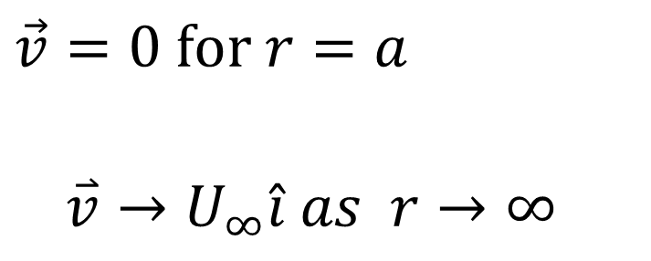


Boundary Conditions (B.C.s) for Flow around a Sphere
Stokes (Creeping) Flows
Euler Flows
$$\vec{v}=0 \text{for} r=a$$
$$\overset{⃑}{v}→U_{∞}\hat{i} as r→∞$$
$$v_{r}=0 \text{for} r=a$$
$$\overset{⃑}{v}→U_{∞}\hat{i} as r→∞$$
Slip is not allowed in stokes viscous flows
Slip is allowed in ideal flows.
In both cases there is symmetry about the φ -axis.
Thus (a) nothing depends on φ, and (b) there is no φ - velocity.
$${ v}_{r}=v_{r}\left(r,θ\right) \\ v_{θ}=v_{θ}\left(r,θ\right) \\ v_{φ}=0$$

Slide 23




Stokes Equation and Boundary Conditions
$$\vec{v}=0 \text{for} r=a$$
$$\overset{⃑}{v}→U_{∞}\hat{i} as r→∞$$
$$r$$
$$φ$$
$$θ$$
The boundary conditions
$$\text{on} \text{the} \text{surface} \text{of} \text{sphere}\text{, }r=a \text{;} \frac{∂ψ}{∂r}=\frac{∂ψ}{∂θ}=0$$
https://link.springer.com/book/10.1007/978-3-031-04683-4

