Slide 1

Localized Momentum Conservation for Viscous Fluid Flow Systems
P M V Subbarao
Professor
Mechanical Engineering Department
I I T Delhi
Models for Flows Subjected to Both Consecration & Damning of Surface forces…

Slide 2


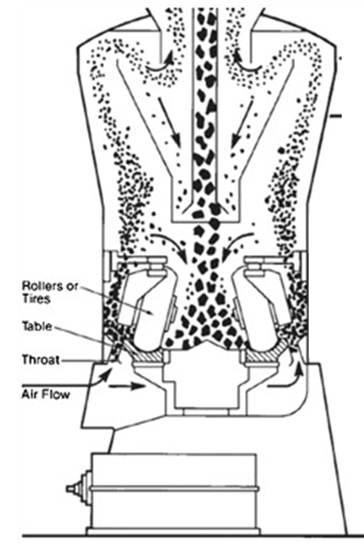
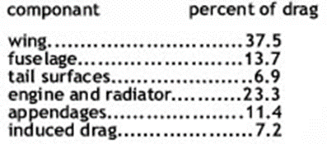
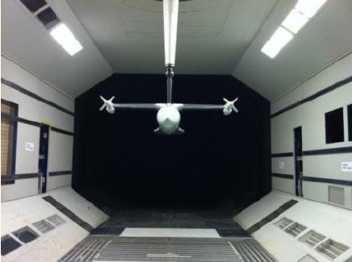
The Bliss and Curse of Viscous Forces
The Bliss: Fine cement particles are efficiently packed in bag
The Curse: A cruising flight also needs thrust!

Slide 3
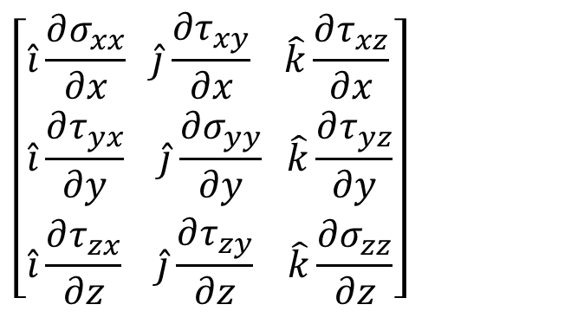
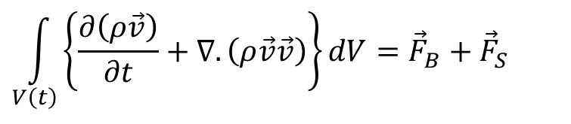
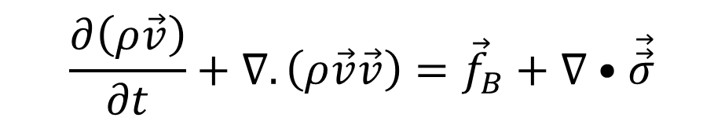
Differential Form of Momentum Conservation Equations for Fluid Flows
$$\int_{V\left(t\right)}{\left\{\frac{∂\left(ρ\vec{v}\right)}{∂t}+∇.\left(ρ\vec{v}\vec{v}\right)\right\}dV={\vec{F}}_{B}+{\vec{F}}_{S}}$$
Newton’s Second law For a CV:
Conservation of momentum for an Infinitesimal CV in A Fluid Flow
$$\frac{∂\left(ρ\vec{v}\right)}{∂t}+∇.\left(ρ\vec{v}\vec{v}\right)={\vec{f}}_{B}+∇•\vec{\vec{σ}}$$
$$\left[\begin{aligned}&\hat{i}\frac{∂σ_{xx}}{∂x} \hat{j}\frac{∂τ_{xy}}{∂x} \hat{k}\frac{∂τ_{xz}}{∂x} \\ &\hat{i}\frac{∂τ_{yx}}{∂y} \hat{j}\frac{∂σ_{yy}}{∂y} \hat{k}\frac{∂τ_{yz}}{∂y} \\ &\hat{i}\frac{∂τ_{zx}}{∂z} \hat{j}\frac{∂τ_{zy}}{∂z} \hat{k}\frac{∂σ_{zz}}{∂z}\end{aligned}\right]$$

Slide 4

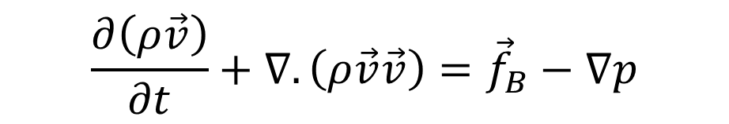


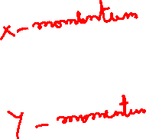
Differential Form of Momentum Conservation Equations for Ideal Fluid Flows
Conservation of momentum for an Infinitesimal CV in An Ideal Fluid Flow
$$\frac{∂\left(ρ\vec{v}\right)}{∂t}+∇.\left(ρ\vec{v}\vec{v}\right)={\vec{f}}_{B}−∇p$$
For an incompressible steady Ideal Fluid Flow :
$$∇.\left(\vec{v}\vec{v}\right)={\vec{f}}_{B}−∇p$$
If the flow is 2-D:
$$u\frac{∂u}{∂x}+v\frac{∂u}{∂y}=−\frac{∂p}{∂x}$$
$$u\frac{∂v}{∂x}+v\frac{∂v}{∂y}=−\frac{∂p}{∂y}$$

Slide 5
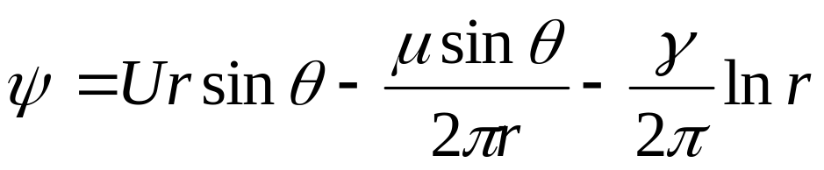
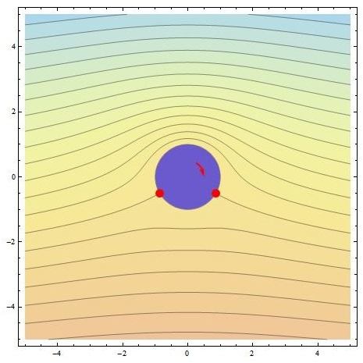
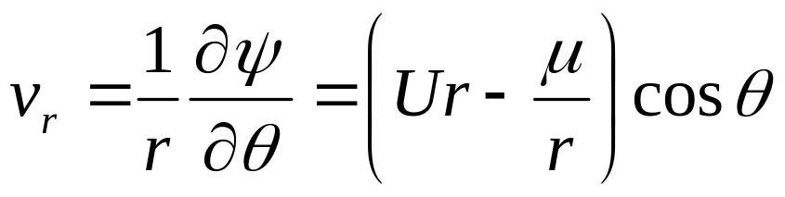
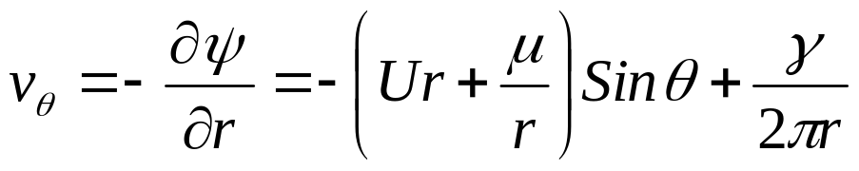
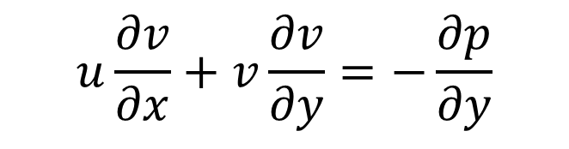
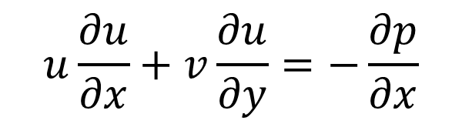
Example of Ideal Flows
$$u\frac{∂u}{∂x}+v\frac{∂u}{∂y}=−\frac{∂p}{∂x}$$
$$u\frac{∂v}{∂x}+v\frac{∂v}{∂y}=−\frac{∂p}{∂y}$$
Obtain an expression for p(x,y)

Slide 6
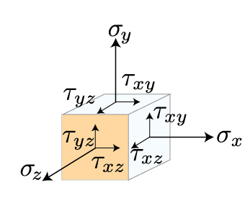
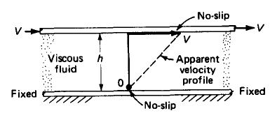
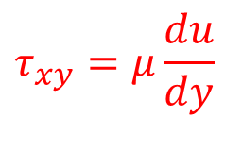
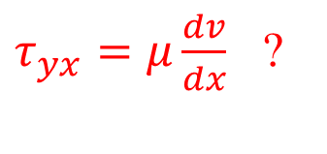
Fluid Mechanics as An Engineering Science
The knowledge of fluid flow cannot be called a discipline of engineering science until Isaac Newton published his famous work Philosophia Naturalis Principia Mathematica in 1687.
Newton stated in his principia that, for straight, parallel and uniform flow, the shear stress , between layers is proportional to the velocity gradient in the direction perpendicular to the layers.
$$τ_{xy}=μ\frac{du}{dy}$$
$τ_{yx}=μ\frac{dv}{dx}$ ?
Mathematicians treated Newton’s Law of viscosity was the most Frugal solution to highly complex truth.

Slide 7
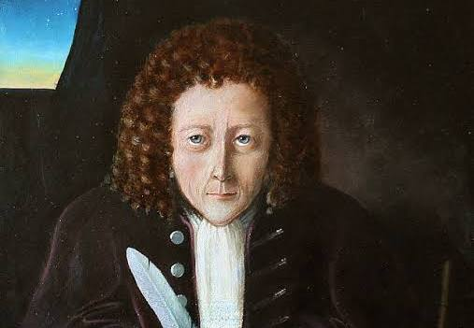
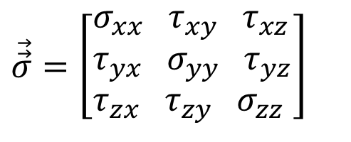
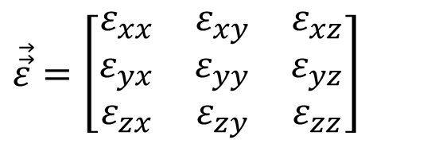
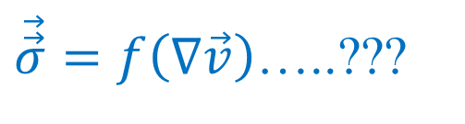
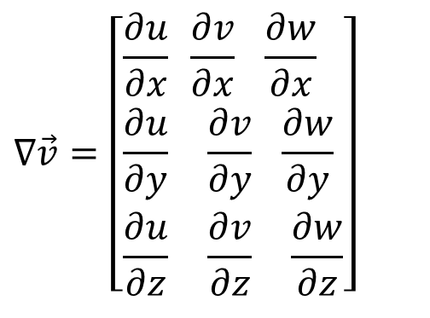
The Modeling Challenge
$$\vec{\vec{σ}}=\left[\begin{aligned}&σ_{xx} τ_{xy} τ_{xz} \\ &τ_{yx} σ_{yy} τ_{yz} \\ &τ_{zx} τ_{zy} σ_{zz}\end{aligned}\right]$$
1660: Robert Hooke discovered the relationship between force and displacement for elastic materials, stating it in a Latin anagram.
How to develop Relations among Stresses & Strain Rates ?
The velocity gradients are used to construct strain-rates (ε).
$$∇\vec{v}=\left[\begin{aligned}&\frac{∂u}{∂x} \frac{∂v}{∂x} \frac{∂w}{∂x} \\ &\frac{∂u}{∂y} \frac{∂v}{∂y} \frac{∂w}{∂y} \\ &\frac{∂u}{∂z} \frac{∂v}{∂z} \frac{∂w}{∂z}\end{aligned}\right]$$
$$\vec{\vec{ε}}=\left[\begin{matrix}ε_{xx} & ε_{xy} & ε_{xz} \\ ε_{yx} & ε_{yy} & ε_{yz} \\ ε_{zx} & ε_{zy} & ε_{zz}\end{matrix}\right]$$
$\vec{\vec{σ}}=f\left(∇\vec{v}\right)$…..???

Slide 8







Intellectual Description of An Unknown (Giant)
Each new discoverer either ignored or denigrated his predecessors’ contribution.
Each had his own way to justify their Model.
Each judged differently the kind of motion and the nature of the system to which it is applicable.

Slide 9
The First Five Renaissances of A Model for Frictional Flow Systems
Mathematicians recommenced the analysis of Frictional flows as very complex, and almost made sure that the solutions are unpredictable.
The early life of this equation was as fleeting as the foam on a wave crest.
Navier developed first model in1822 and this was not influential.
Models were rediscovered or re-derived at least four times,
Cauchy in 1823,
Poisson in 1829,
Saint-Venant in 1837
Stokes in 1845.

Slide 10
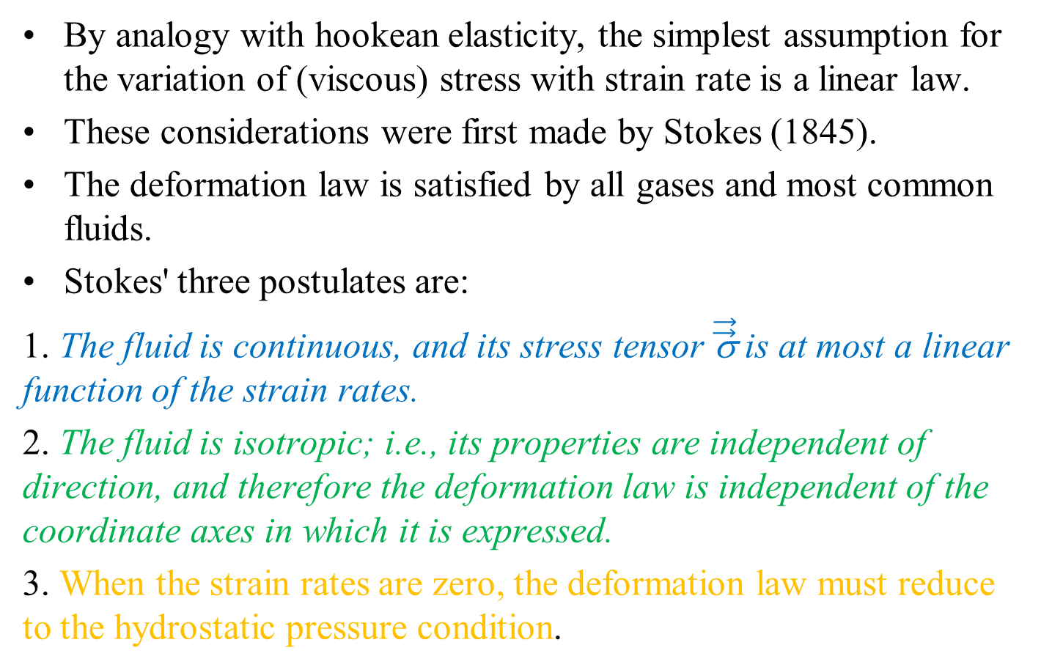
Deformation Postulates for a Newtonian Fluid Flow: By Stokes
By analogy with hookean elasticity, the simplest assumption for the variation of (viscous) stress with strain rate is a linear law.
These considerations were first made by Stokes (1845).
The deformation law is satisfied by all gases and most common fluids.
Stokes' three postulates are:
1. The fluid is continuous, and its stress tensor $\vec{\vec{\text{σ}}}$ is at most a linear function of the strain rates.
2. The fluid is isotropic; i.e., its properties are independent of direction, and therefore the deformation law is independent of the coordinate axes in which it is expressed.
3. When the strain rates are zero, the deformation law must reduce to the hydrostatic pressure condition.

Slide 11
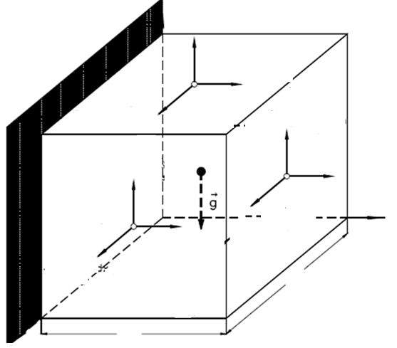
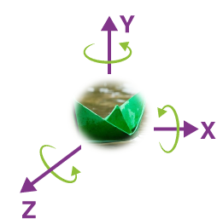










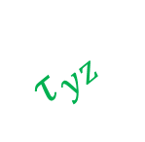

Fluid Parcel & Isotropy of Stress Tensor
The six shear stresses are not independent.
They must satisfy the local dynamic equilibrium of a fluid parcel.
Rotational equilibrium of a fluid parcel about its the center will give:
$$σ_{yy}$$
$$τ_{yx}$$
$$τ_{yz}$$
$$τ_{xy}$$
$$σ_{xx}$$
$$τ_{xz}$$
$$τ_{zy}$$
$$σ_{zz}$$
$$τ_{zx}$$
$$τ_{xy}=τ_{yx}$$
$$τ_{zx}=τ_{xz}$$
$$τ_{yz}=τ_{zy}$$

Slide 12
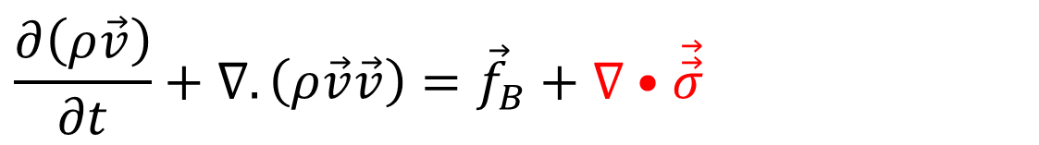
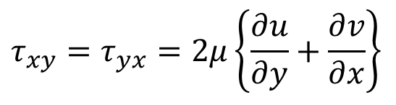
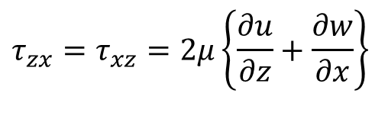
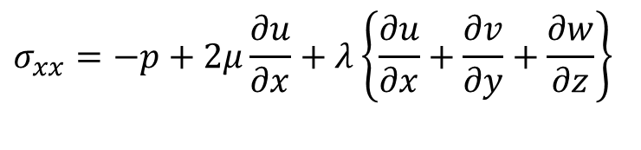
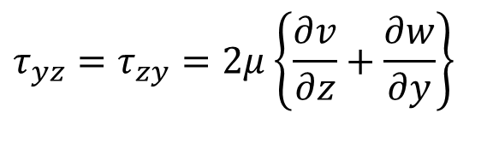
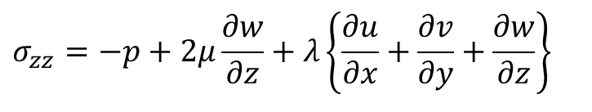
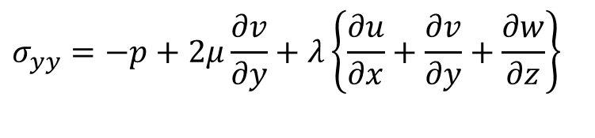
General Stress –Strain Rate law for a Newtonian viscous fluid
The general stress-strain rate law is known as Deformation law.
Given by Stokes (1845) & it is expressed in primitive flow variable as:.
$$σ_{xx}=−p+2μ\frac{∂u}{∂x}+λ\left\{\frac{∂u}{∂x}+\frac{∂v}{∂y}+\frac{∂w}{∂z}\right\}$$
$$τ_{xy}=τ_{yx}=2μ\left\{\frac{∂u}{∂y}+\frac{∂v}{∂x}\right\}$$
$$τ_{yz}=τ_{zy}=2μ\left\{\frac{∂v}{∂z}+\frac{∂w}{∂y}\right\}$$
$$σ_{yy}=−p+2μ\frac{∂v}{∂y}+λ\left\{\frac{∂u}{∂x}+\frac{∂v}{∂y}+\frac{∂w}{∂z}\right\}$$
$$σ_{zz}=−p+2μ\frac{∂w}{∂z}+λ\left\{\frac{∂u}{∂x}+\frac{∂v}{∂y}+\frac{∂w}{∂z}\right\}$$
$$τ_{zx}=τ_{xz}=2μ\left\{\frac{∂u}{∂z}+\frac{∂w}{∂x}\right\}$$
RTT for Local Momentum Balance:
$$\frac{∂\left(ρ\vec{v}\right)}{∂t}+∇.\left(ρ\vec{v}\vec{v}\right)={\vec{f}}_{B}+∇•\vec{\vec{σ}}$$

Slide 13
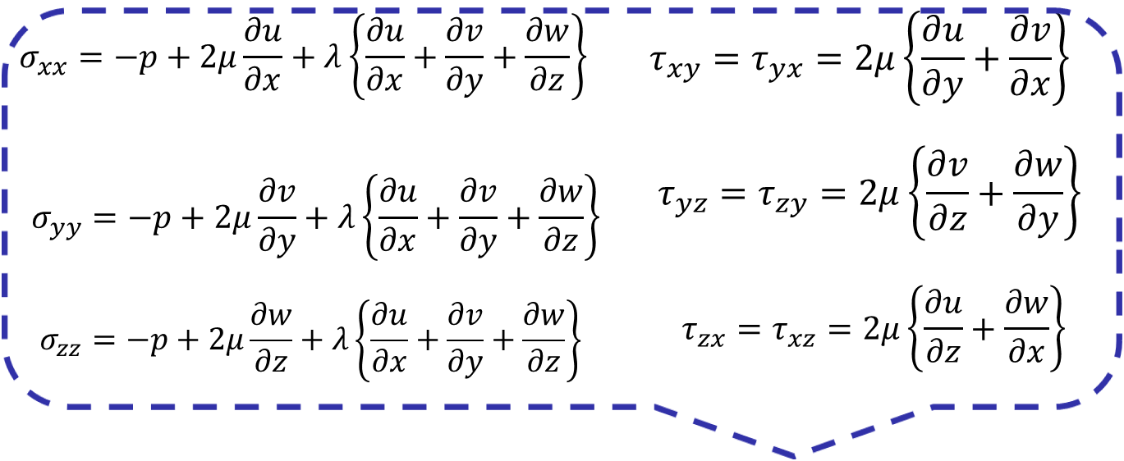
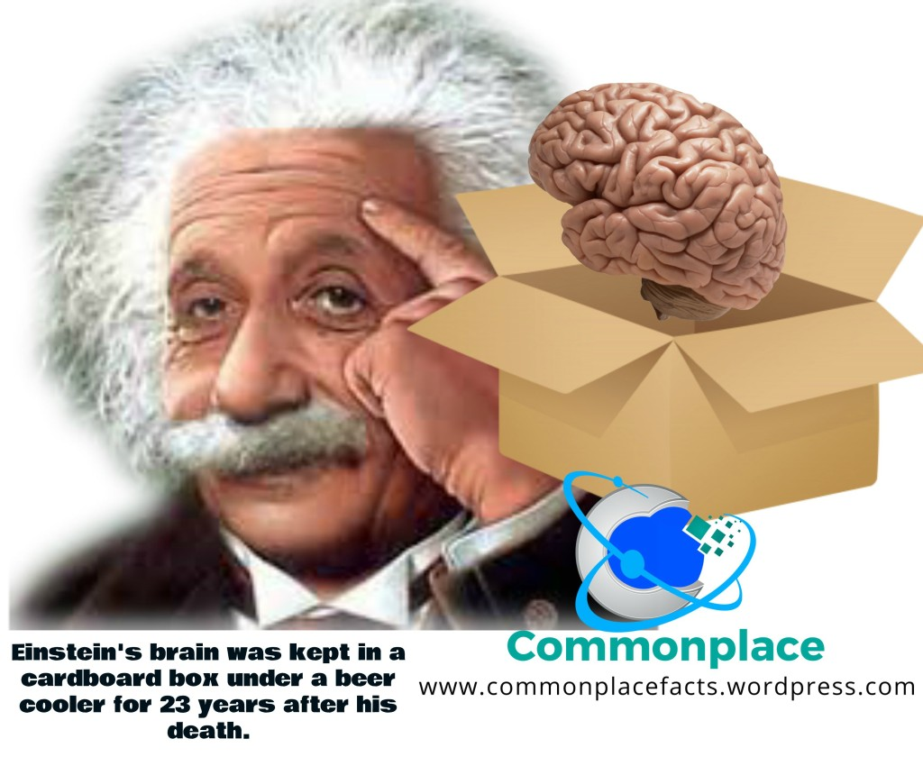
General Stress –Strain Rate (deformation) law for a viscous fluid
In his presentation of relativity theory, Einstein introduced an index-based notation in 1916, that has become widely used in physics.

Slide 14
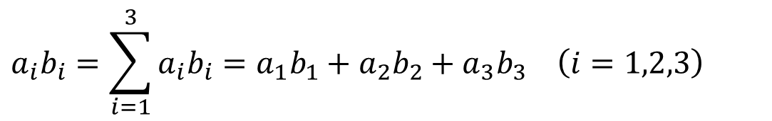
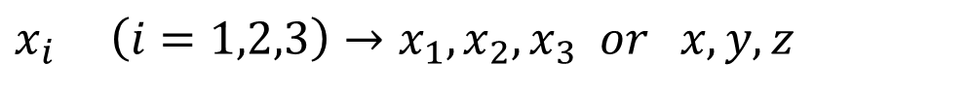
Einstein Notation : 1916
http://www.continuummechanics.org/cm/tensornotationbasic.html
Range convention: Whenever a subscript appears only once in a term, the subscript takes all possible values. E.g. in 3D space:
$$x_{i} \left(i=1,2,3\right)→x_{1},x_{2},x_{3} or x,y,z$$
Summation convention: Whenever a subscript appears twice in the same term the repeated index is summed over the index parameter space. E.g. in 3D space:
$$a_{i}b_{i}=\sum_{i=1}^{3}{a_{i}b_{i}}=a_{1}b_{1}+a_{2}b_{2}+a_{3}b_{3} \left(i=1,2,3\right)$$

Slide 15
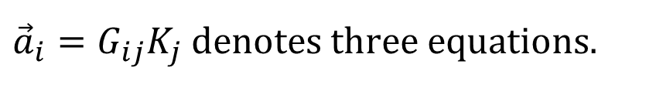
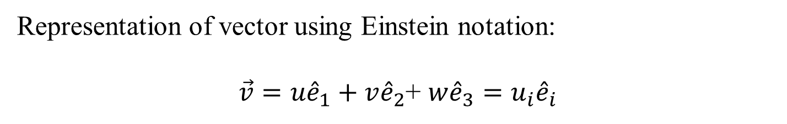
Non repeated subscripts
Representation of vector using Einstein notation:
$\vec{v}=u{\hat{e}}_{1}+v{\hat{e}}_{2}$+ ${w\hat{e}}_{3}=u_{i}{\hat{e}}_{i}$
Non repeated subscripts remain fixed during the summation.
E.g. in 3D space
$${\vec{a}}_{i}=G_{ij}K_{j} \text{denotes} \text{three} \text{equations}\text{.}$$
one for each i = 1, 2, 3 and j is the dummy index.

Slide 16
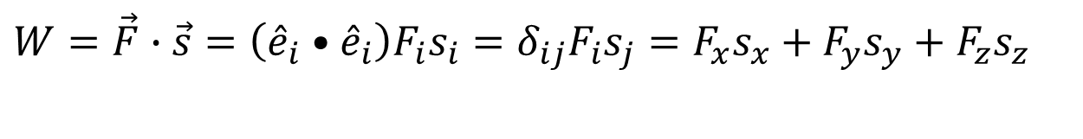
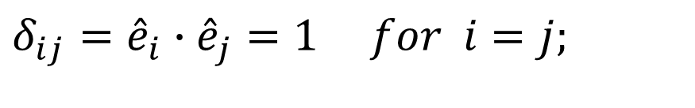
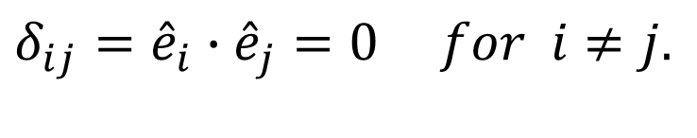
Kronecker delta
In Cartesian coordinate system, the scalar product of two unit vectors is called Kronecker delta, which is:
$$δ_{ij}={\hat{e}}_{i}∙{\hat{e}}_{j}=1 for i=j;$$
$$δ_{ij}={\hat{e}}_{i}∙{\hat{e}}_{j}=0 for i≠j.$$
Using the Kronecker delta, the work is represented as:
$$W=\vec{F}∙\vec{s}=\left({\hat{e}}_{i}•{\hat{e}}_{i}\right)F_{i}s_{i}=δ_{ij}F_{i}s_{j}=F_{x}s_{x}+F_{y}s_{y}+F_{z}s_{z}$$

Slide 17
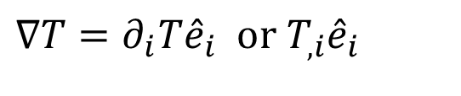
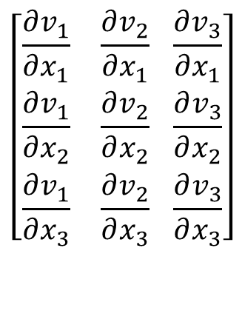
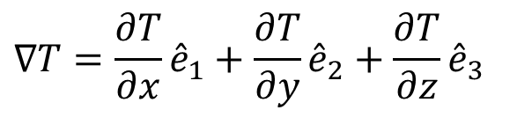


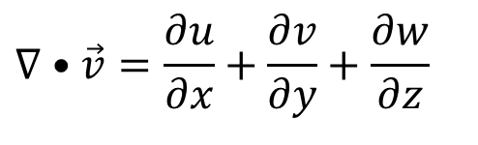
Einstein Notation : Vector Calculus
$$∇T=\frac{∂T}{∂x}{\hat{e}}_{1}+\frac{∂T}{∂y}{\hat{e}}_{2}+\frac{∂T}{∂z}{\hat{e}}_{3}$$
Gradient of a scalar, T
$$∇T=∂_{i}T{\hat{e}}_{i} \text{or} T_{,i}{\hat{e}}_{i}$$
Divergence of a vector
$$∇•\vec{v}=\frac{∂u}{∂x}+\frac{∂v}{∂y}+\frac{∂w}{∂z}$$
$$∇•\vec{v}=∂_{i}v_{i} \text{or} v_{i,i}$$
$$\left[\begin{aligned}&\frac{∂v_{1}}{∂x_{1}} \frac{∂v_{2}}{∂x_{1}} \frac{∂v_{3}}{∂x_{1}} \\ &\frac{∂v_{1}}{∂x_{2}} \frac{∂v_{2}}{∂x_{2}} \frac{∂v_{3}}{∂x_{2}} \\ &\frac{∂v_{1}}{∂x_{3}} \frac{∂v_{2}}{∂x_{3}} \frac{∂v_{3}}{∂x_{3}}\end{aligned}\right]$$
Gradient of a vector
$$∇\vec{v}=∂_{j}v_{i}{\hat{e}}_{i}{\hat{e}}_{j} \text{or} v_{i,j}{\hat{e}}_{i}{\hat{e}}_{j}$$

Slide 18
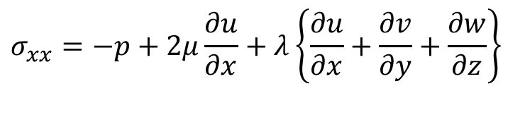

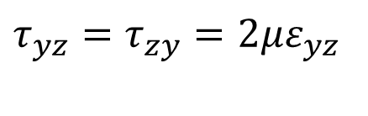
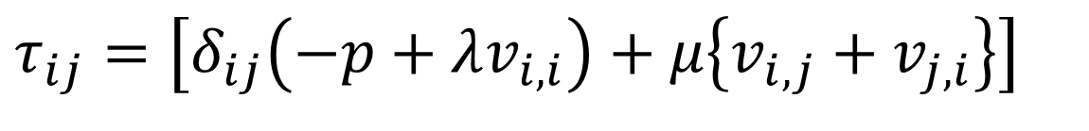



Stress Tensor in Einstein Notation
Consider indices namely, i and j.
Both i and j can take values x, y ,z ….
$$σ_{xx}=−p+2μ\frac{∂u}{∂x}+λ\left\{\frac{∂u}{∂x}+\frac{∂v}{∂y}+\frac{∂w}{∂z}\right\}$$
$$τ_{xy}=τ_{yx}=2με_{xy}$$
$$σ_{yy}=−p+2μ\frac{∂v}{∂y}+λ\left\{\frac{∂u}{∂x}+\frac{∂v}{∂y}+\frac{∂w}{∂z}\right\}$$
$$τ_{yz}=τ_{zy}=2με_{yz}$$
$$σ_{zz}=−p+2μ\frac{∂w}{∂z}+λ\left\{\frac{∂u}{∂x}+\frac{∂v}{∂y}+\frac{∂w}{∂z}\right\}$$
$$τ_{zx}=τ_{xz}=2με_{zx}$$
$$τ_{ij}=\left[δ_{ij}\left(−p+λv_{i,i}\right)+μ\left\{v_{i,j}+v_{j,i}\right\}\right]$$

Slide 19


N-S Equations in Einstein Notation
The Navier-Stokes equations, fundamental to the subject of viscous fluid flow.
Considerable economy is achieved by rewriting them as a single vector equation, using the indicia1 notation:
$$\frac{∂\left(ρ\vec{v}\right)}{∂t}+∇.\left(ρ\vec{v}\vec{v}\right)={\vec{f}}_{B}+∇•\vec{\vec{σ}}$$
$${\left[ρv\right]}_{i,0}+v_{j}{\left[ρv_{i}\right]}_{,j} =ρg_{i}+τ_{ij,i}$$

Slide 20





Thermodynamic Pressure Vs Mechanical Pressure
Stokes (1845) pointed out an interesting consequence of this general Equation.
By analogy with the strain relation, the sum of the three normal stresses σ_{xx} , σ_{yy} and σ_{zz} is a tensor invariant.
Define the mechanical pressure as the negative one-third of this sum.
Mechanical pressure is the average compression stress on the element.
$$σ_{xx}=−p+2με_{xx}+λ∇.\vec{v}$$
$$\bar{p}=−\frac{1}{3}\left\{σ_{xx}+σ_{yy}+σ_{zz}\right\}$$
$$σ_{yy}=−p+2με_{yy}+λ∇.\vec{v}$$
$$\bar{p}=p−\left(λ+\frac{2}{3}μ\right)∇.\vec{v}$$
$$σ_{zz}=−p+με_{zz}+λ∇.\vec{v}$$

Slide 21



Stokes Hypothesis
The mean pressure in a deforming viscous fluid is not equal to the thermodynamic property called pressure.
This distinction is rarely important, since ∇.$\vec{v}$ is usually very small in typical flow problems.
But the exact meaning of mechanical pressure has been a controversial subject for more than a century.
Stokes himself simplified and resolved the issue by an assumption:
$$λ+\frac{2}{3}μ=0$$
$$λ=−\frac{2}{3}μ$$
Above equation leads to
This relation, frequently called the Stokes’ relation,.
This is perfectly valid for monoatomic gases

