Slide 1

Localization of Conservation Laws
P M V Subbarao
Head & Professor
Mechanical Engineering Department
I I T Delhi
Finer Analysis of Field Variables……

Slide 2


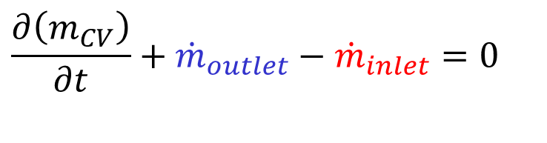
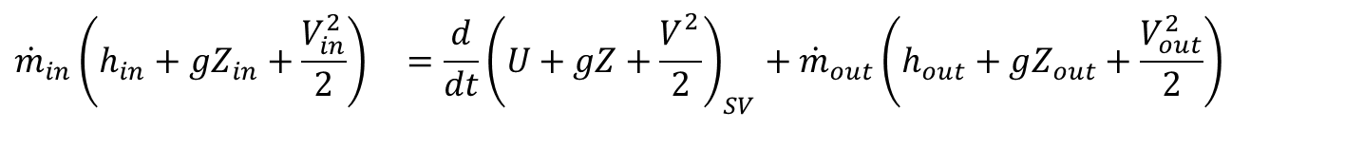
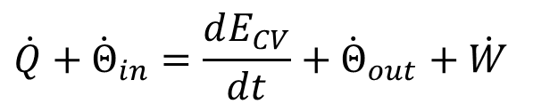
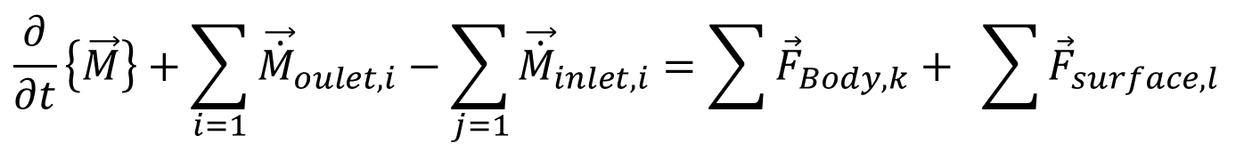
Conservation Laws for a finite CV
Global Conservation of Mass for a Finite CV:
$$\frac{∂\left(m_{CV}\right)}{∂t}+{\dot{m}}_{outlet}−{\dot{m}}_{inlet}=0$$
Global Conservation of Momentum for a Finite CV:
$$\frac{∂}{∂t}\left\{\vec{M}\right\}+\sum_{i=1}{{\vec{\dot{M}}}_{oulet,i}}−\sum_{j=1}{{\vec{\dot{M}}}_{inlet,i}}=\sum{{\vec{F}}_{Body,k}}+ \sum{{\vec{F}}_{surface,l}}$$
The first law of thermodynamics for a Finite CV:
$$\dot{Q}+{\dot{Θ}}_{in}=\frac{dE_{CV}}{dt}+{\dot{Θ}}_{out}+\dot{W}$$
$${\dot{m}}_{in}\left(h_{in}+gZ_{in}+\frac{V_{in}^{2}}{2}\right) =\frac{d}{dt}{\left(U+gZ+\frac{V_{}^{2}}{2}\right)}_{SV}+{\dot{m}}_{out}\left(h_{out}+gZ_{out}+\frac{V_{out}^{2}}{2}\right)$$

Slide 3
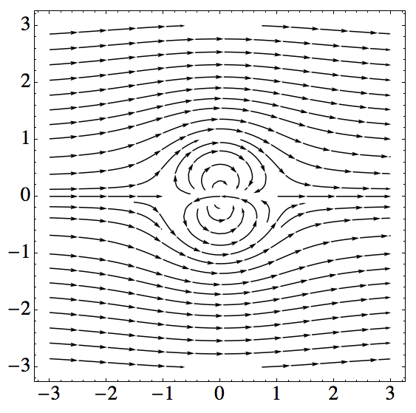
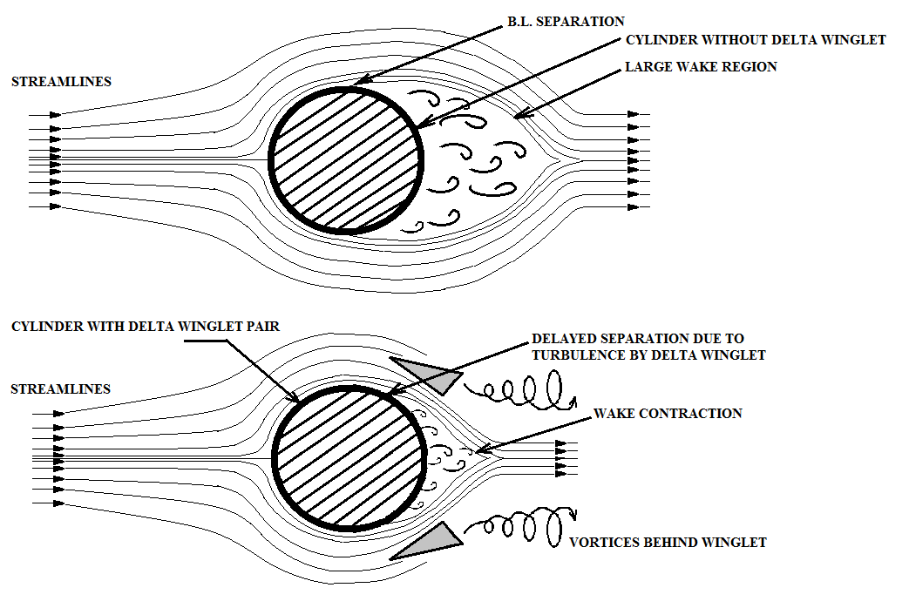

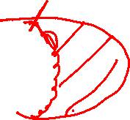
Need for Localization of Conservation Laws
Real Flow Past A Cylinder
Ideal Flow Past A Cylinder

Slide 4
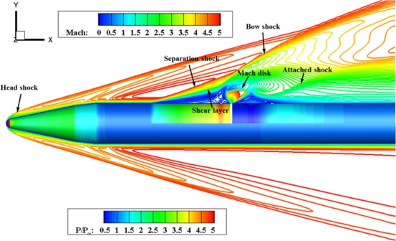
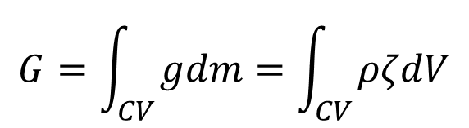
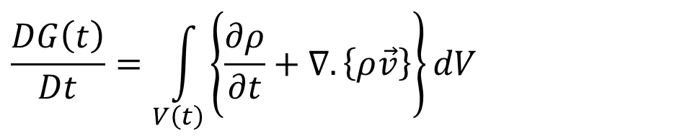
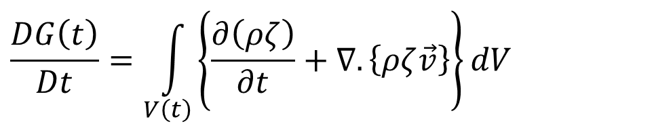
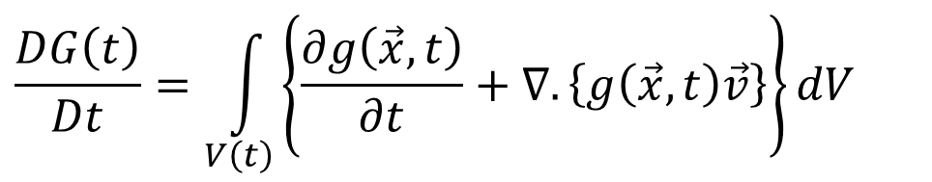
Conservation of Mass for an Infinitesimal CV in A Fluid Flow
Recall RTT with all terms as volume integrals:
$$\frac{DG\left(t\right)}{Dt}=\int_{V\left(t\right)}{\left\{\frac{∂g\left(\vec{x},t\right)}{∂t}+∇.\left\{g\left(\vec{x},t\right)\vec{v}\right\}\right\}dV}$$
$$G=\int_{CV}{gdm}=\int_{CV}{ρζdV}$$
Redefine
$$\frac{DG\left(t\right)}{Dt}=\int_{V\left(t\right)}{\left\{\frac{∂\left(ρζ\right)}{∂t}+∇.\left\{ρζ\vec{v}\right\}\right\}dV}$$
Consider ζ = 1, the conservation of mass for a CV is obtained as:
$$\frac{DG\left(t\right)}{Dt}=\int_{V\left(t\right)}{\left\{\frac{∂ρ}{∂t}+∇.\left\{ρ\vec{v}\right\}\right\}dV}$$

Slide 5
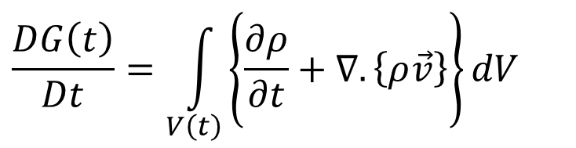
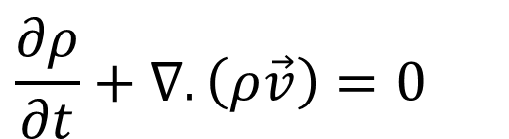
Continuity Equation for Fluid flows
Conservation of Mass for a Finite size Flow System:
$$\frac{DG\left(t\right)}{Dt}=\int_{V\left(t\right)}{\left\{\frac{∂ρ}{∂t}+∇.\left\{ρ\vec{v}\right\}\right\}dV}$$
This integral is zero for any size and shape of material volume.
Implies that the integrands in the brackets as a total must vanish identically.
This is known as continuity equation and for a general unsteady flow it is written as:
$$\frac{∂ρ}{∂t}+∇.\left(ρ\vec{v}\right)=0$$

Slide 6
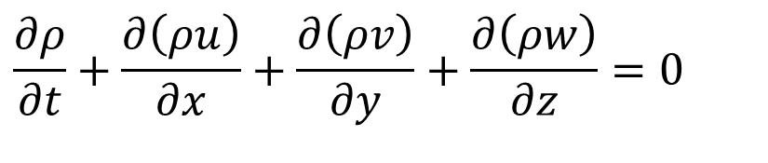
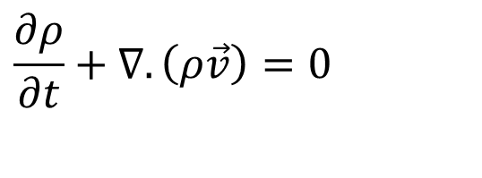
Continuity Equation in Cartesian System
$$\frac{∂ρ}{∂t}+∇.\left(ρ\vec{v}\right)=0$$
This Equation is a coordinate invariant equation.
Its index notation in the Cartesian coordinate system given is:
$$\frac{∂ρ}{∂t}+\frac{∂\left(ρu\right)}{∂x}+\frac{∂\left(ρv\right)}{∂y}+\frac{∂\left(ρw\right)}{∂z}=0$$

Slide 7
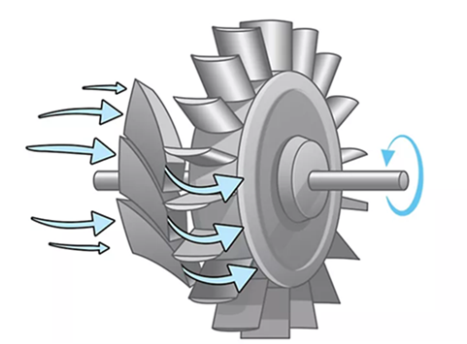
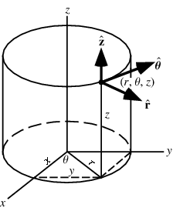
Continuity Equation in Cylindrical Polar Coordinates
Many flows which involve rotation or radial motion are best described in Cylindrical Polar Coordinates.

Slide 8
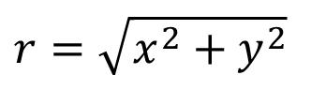
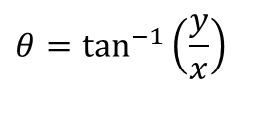
Continuity Equation in Cylindrical Polar Coordinates
In Cylindrical Polar Coordinates of a point P are r, θ and z.
The velocity components in these directions respectively are v_{r} ,v_{θ} and v_{z}.
Transformation between the Cartesian and the polar systems is provided by the relations,
$$r=\sqrt{x^{2}+y^{2}}$$
$$θ=\tan^{−1}\left(\frac{y}{x}\right)$$

Slide 9
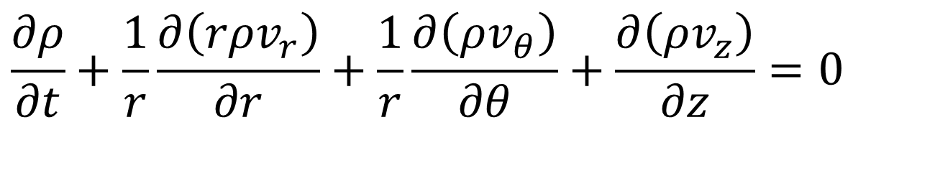
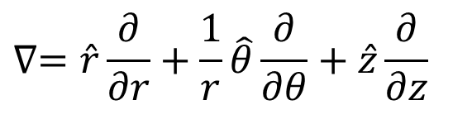
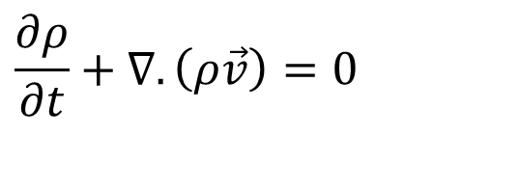
Continuity Equation in Cylindrical Polar Coordinates
$$\frac{∂ρ}{∂t}+∇.\left(ρ\vec{v}\right)=0$$
The gradient operator is given by,
$$∇=\hat{r}\frac{∂}{∂r}+\frac{1}{r}\hat{θ}\frac{∂}{∂θ}+\hat{z}\frac{∂}{∂z}$$
Therefore, the conservation of mass equation becomes,
$$\frac{∂ρ}{∂t}+\frac{1}{r}\frac{∂\left(rρv_{r}\right)}{∂r}+\frac{1}{r}\frac{∂\left(ρv_{θ}\right)}{∂θ}+\frac{∂\left(ρv_{z}\right)}{∂z}=0$$

Slide 10
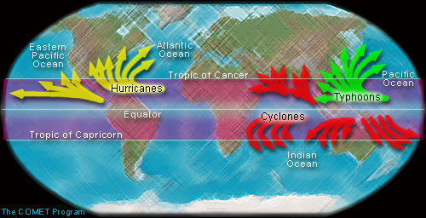
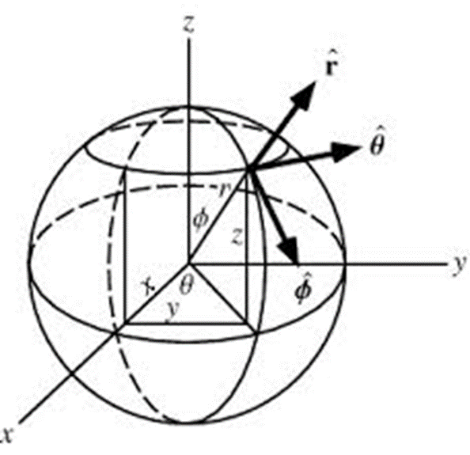
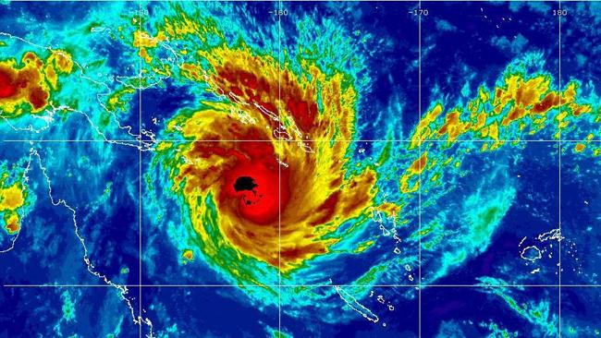
Continuity Equation in Cylindrical Polar Coordinates
Spherical polar coordinates are a system of curvilinear coordinates that are natural for describing atmospheric flows.

Slide 11
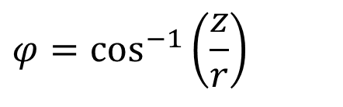
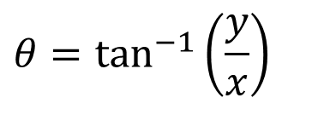
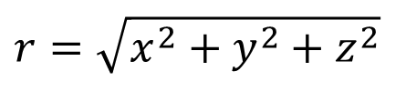
Continuity Equation in Cylindrical Polar Coordinates
Define θ to be the azimuthal angle in the x-y -plane from the x-axis with 0 ≤ θ < 2π .
φ to be the zenith angle and colatitude, with 0 ≤ φ < π
r to be distance (radius) from a point to the origin.
The spherical coordinates (r,θ,φ) are related to the Cartesian coordinates (x,y,z) by
$$θ=\tan^{−1}\left(\frac{y}{x}\right)$$
$$φ=\cos^{−1}\left(\frac{z}{r}\right)$$
$$r=\sqrt{x^{2}+y^{2}+z^{2}}$$

Slide 12
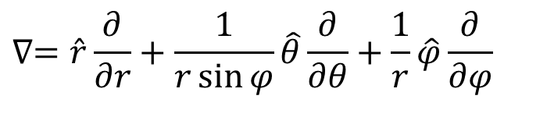
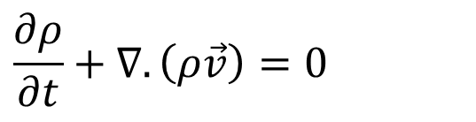
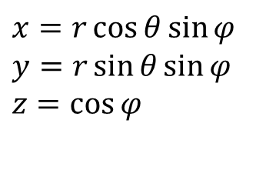
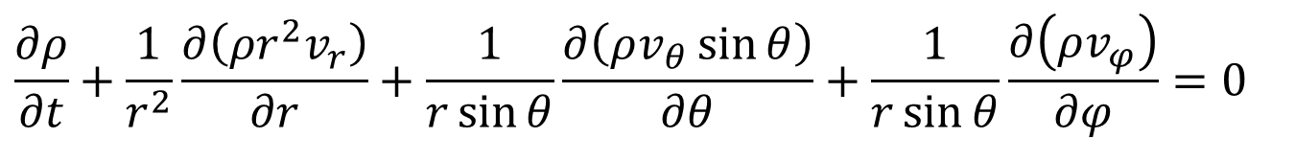
Transformation Function for CCS to SCS
$$\frac{∂ρ}{∂t}+∇.\left(ρ\vec{v}\right)=0$$
$$x=r\cos{θ}\sin{φ} \\ y=r\sin{θ}\sin{φ} \\ z=\cos{φ}$$
The gradient is
$$∇=\hat{r}\frac{∂}{∂r}+\frac{1}{r\sin{φ}}\hat{θ}\frac{∂}{∂θ}+\frac{1}{r}\hat{φ}\frac{∂}{∂φ}$$
Therefore, conservation of mass equation becomes,
$$\frac{∂ρ}{∂t}+\frac{1}{r^{2}}\frac{∂\left(ρr^{2}v_{r}\right)}{∂r}+\frac{1}{r\sin{θ}}\frac{∂\left(ρv_{θ}\sin{θ}\right)}{∂θ}+\frac{1}{r\sin{θ}}\frac{∂\left(ρv_{φ}\right)}{∂φ}=0$$

Slide 13
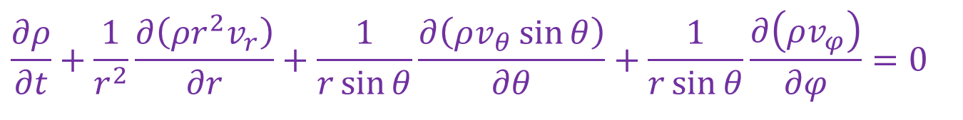
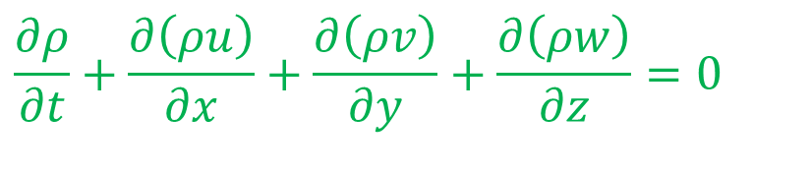
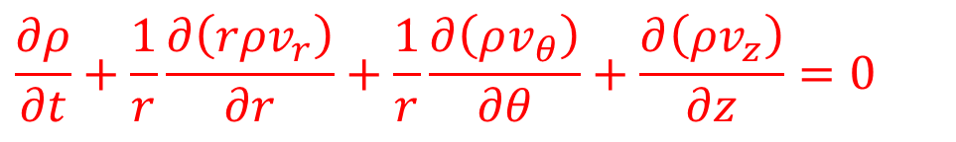
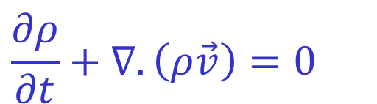
Continuity Equation for Fluid flows
Continuity Equation in coordinate invariant form is:
$$\frac{∂ρ}{∂t}+∇.\left(ρ\vec{v}\right)=0$$
In the Cartesian coordinate system, the continuity equation given as:
$$\frac{∂ρ}{∂t}+\frac{∂\left(ρu\right)}{∂x}+\frac{∂\left(ρv\right)}{∂y}+\frac{∂\left(ρw\right)}{∂z}=0$$
In the Cylindrical polar coordinate system, the continuity equation given as:
$$\frac{∂ρ}{∂t}+\frac{1}{r}\frac{∂\left(rρv_{r}\right)}{∂r}+\frac{1}{r}\frac{∂\left(ρv_{θ}\right)}{∂θ}+\frac{∂\left(ρv_{z}\right)}{∂z}=0$$
In the spherical polar coordinate system, the continuity equation given as:
$$\frac{∂ρ}{∂t}+\frac{1}{r^{2}}\frac{∂\left(ρr^{2}v_{r}\right)}{∂r}+\frac{1}{r\sin{θ}}\frac{∂\left(ρv_{θ}\sin{θ}\right)}{∂θ}+\frac{1}{r\sin{θ}}\frac{∂\left(ρv_{φ}\right)}{∂φ}=0$$

Slide 14
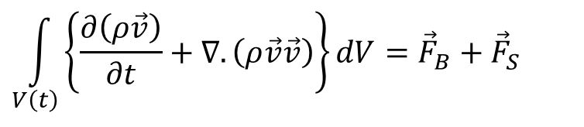
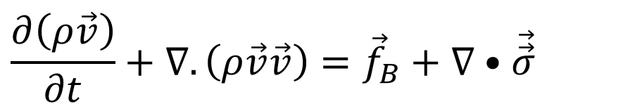
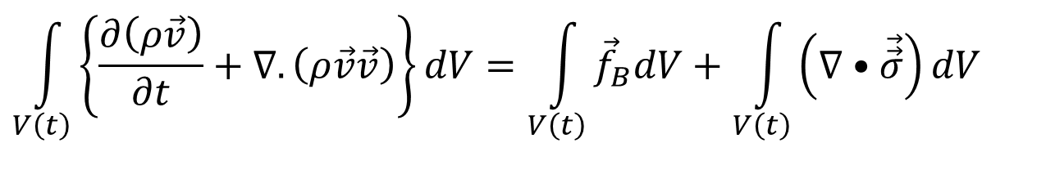
Differential Form of Momentum Conservation Equations for Fluid Flows
Newton’s Second law to a Finite Size Flow System :
$$\int_{V\left(t\right)}{\left\{\frac{∂\left(ρ\vec{v}\right)}{∂t}+∇.\left(ρ\vec{v}\vec{v}\right)\right\}dV={\vec{F}}_{B}+{\vec{F}}_{S}}$$
$$\int_{V\left(t\right)}{\left\{\frac{∂\left(ρ\vec{v}\right)}{∂t}+∇.\left(ρ\vec{v}\vec{v}\right)\right\}dV}=\int_{V\left(t\right)}{{\vec{f}}_{B}dV}+\int_{V\left(t\right)}{\left(∇•\vec{\vec{σ}}\right)dV}$$
Differential form of Conservation of Momentum to a Fluid System:
$$\frac{∂\left(ρ\vec{v}\right)}{∂t}+∇.\left(ρ\vec{v}\vec{v}\right)={\vec{f}}_{B}+∇•\vec{\vec{σ}}$$

Slide 15
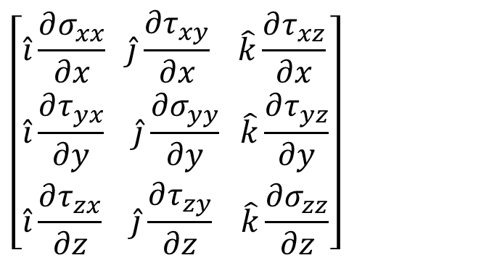
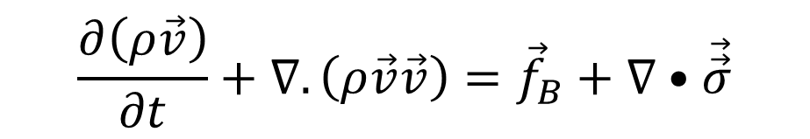
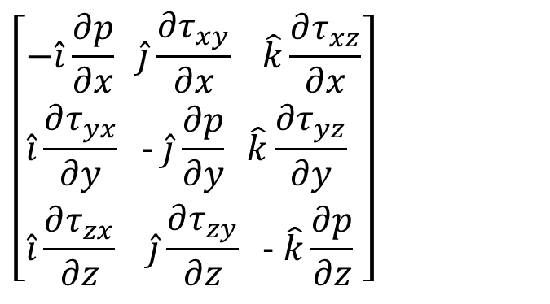
Shear Stress in Fluid Flows
Conservation of momentum for an Infinitesimal CV in A Fluid Flow
$$\frac{∂\left(ρ\vec{v}\right)}{∂t}+∇.\left(ρ\vec{v}\vec{v}\right)={\vec{f}}_{B}+∇•\vec{\vec{σ}}$$
$$\left[\begin{aligned}&−\hat{i}\frac{∂p}{∂x} \hat{j}\frac{∂τ_{xy}}{∂x} \hat{k}\frac{∂τ_{xz}}{∂x} \\ &\hat{i}\frac{∂τ_{yx}}{∂y} \text{−} \hat{j}\frac{∂p}{∂y} \hat{k}\frac{∂τ_{yz}}{∂y} \\ &\hat{i}\frac{∂τ_{zx}}{∂z} \hat{j}\frac{∂τ_{zy}}{∂z} \text{−} \hat{k}\frac{∂p}{∂z}\end{aligned}\right]$$
$$\left[\begin{aligned}&\hat{i}\frac{∂σ_{xx}}{∂x} \hat{j}\frac{∂τ_{xy}}{∂x} \hat{k}\frac{∂τ_{xz}}{∂x} \\ &\hat{i}\frac{∂τ_{yx}}{∂y} \hat{j}\frac{∂σ_{yy}}{∂y} \hat{k}\frac{∂τ_{yz}}{∂y} \\ &\hat{i}\frac{∂τ_{zx}}{∂z} \hat{j}\frac{∂τ_{zy}}{∂z} \hat{k}\frac{∂σ_{zz}}{∂z}\end{aligned}\right]$$

Slide 16
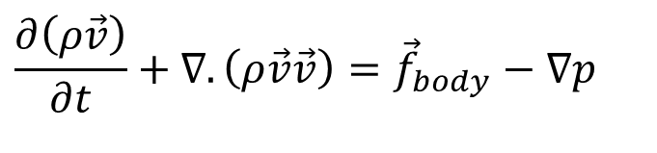
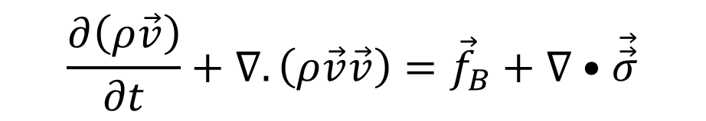
Frictionless Flow: The Bernoulli Equation
$$\frac{∂\left(ρ\vec{v}\right)}{∂t}+∇.\left(ρ\vec{v}\vec{v}\right)={\vec{f}}_{B}+∇•\vec{\vec{σ}}$$
Classic linear momentum analysis is a relation between pressure, velocity, and elevation in a frictionless flow is called as the Bernoulli equation.
It was stated in words in 1738 in a textbook by Daniel Bernoulli.
A complete derivation of the equation was given in 1755 by Leonhard Euler.
$$\frac{∂\left(ρ\vec{v}\right)}{∂t}+∇.\left(ρ\vec{v}\vec{v}\right)={\vec{f}}_{body}−∇p$$
Bernoulli equation is valid for regions of the flow that are nearly frictionless!?!?

Slide 17
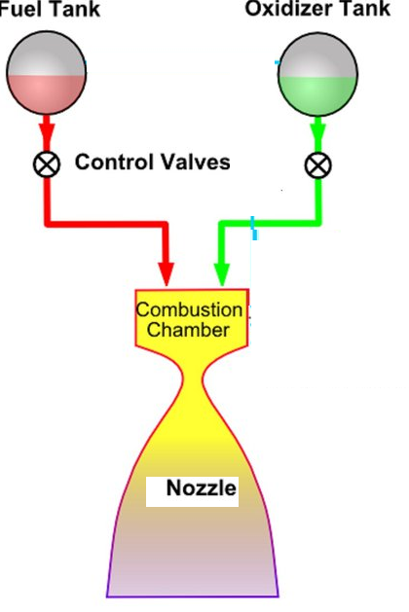

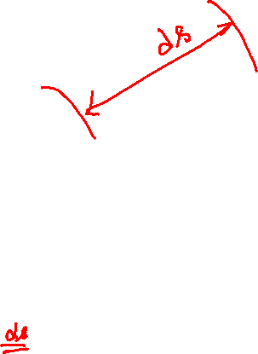
Frictionless Flow: The Bernoulli Equation
ρ, $\vec{V}$
p
τ = 0
τ = 0
p+dp
ρ+d ρ, $\vec{V}+d\vec{V}$

Slide 18
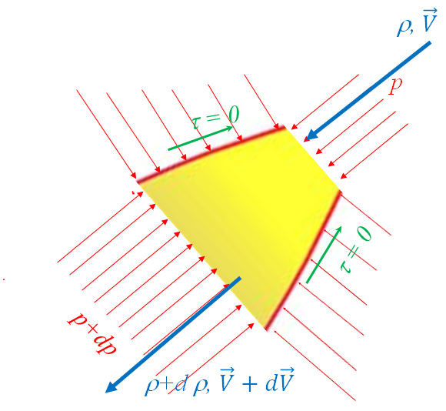
Conservation of Mass to Bernoulli’s Flow Element
The fluid element considered by Bernolulli here is an elemental fixed streamtube control volume of variable area A(s) and length ds.
s is the streamline direction.
The properties (ρ, V, p) may vary with s and time but are assumed to be uniform over the cross-section A.
$$θ$$
The streamtube orientation is arbitrary.
The change in elevation over ds is
$$dz=ds sinθ$$
Bernoulli treated every wall as a streamtube and neglected the friction and hence τ=0.

Slide 19
Conservation of Mass to Bernoulli’s Flow Element
Bernoulli considered the limit of a vanishingly small area such that the streamtube is equivalent to a streamline of the flow.
Bernoulli’s equation is valid for both stream tube and streamline.
$$θ$$
Bernoulli stated as holding “along a streamline” in frictionless flow.

Slide 20


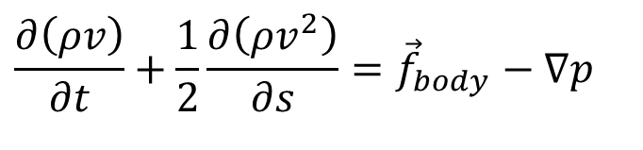
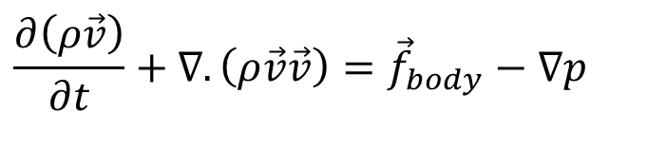

Conservation Momentum to Bernoulli’s Flow
$$\frac{∂\left(ρ\vec{v}\right)}{∂t}+∇.\left(ρ\vec{v}\vec{v}\right)={\vec{f}}_{body}−∇p$$
For a one-dimensional transient flow along Bernoulli’s streamline
$$\frac{∂\left(ρv\right)}{∂t}+\frac{1}{2}\frac{∂\left(ρv^{2}\right)}{∂s}={\vec{f}}_{body}−∇p$$
$$θ$$
$${\vec{f}}_{body}=ρg\frac{dz}{ds}$$
$$∇p=\frac{∂p}{∂s}$$
$$\frac{∂\left(ρv\right)}{∂t}+\frac{1}{2}\frac{∂\left(ρv^{2}\right)}{∂s}=ρg\frac{dz}{ds}−\frac{∂p}{∂s}$$

Slide 21




Conservation Momentum to Bernoulli’s Flow
$$\frac{∂\left(ρv\right)}{∂t}+\frac{1}{2}\frac{∂\left(ρv^{2}\right)}{∂s}=ρg\frac{dz}{ds}−\frac{∂p}{∂s}$$
Consider an incompressible flow
$$θ$$
$$ρ\frac{∂v}{∂t}+\frac{ρ}{2}\frac{d\left(v^{2}\right)}{ds}=ρg\frac{dz}{ds}−\frac{dp}{ds}$$

Slide 22
Frictionless Flow: The Bernoulli Equation
For a differential length of duct, ds
$$\frac{∂v}{∂t}ds+vdv+gdz+\frac{dp}{ρ}=0$$
This is Bernoulli’s equation for unsteady frictionless flow along a streamline

Slide 23
Frictionless Flow: The Bernoulli Equation
$$\frac{∂v}{∂t}ds+vdv+gdz+\frac{dp}{ρ}=0$$
For entire nozzle from inlet to exit
$$\int_{inlet}^{outlet}{\frac{∂v}{∂t}ds}+\int_{inlet}^{outlet}{vdv}+\int_{inlet}^{outlet}{gdz}+\int_{inlet}^{outlet}{A\frac{dp}{ρ}}=0$$

Slide 24
Frictionless Flow: The Bernoulli Equation
For entire nozzle from inlet to exit
$$\int_{inlet}^{outlet}{\frac{∂v}{∂t}ds}+\int_{inlet}^{outlet}{\frac{dp}{ρ}}+\left\{\frac{v_{o}^{2}−v_{i}^{2}}{2}\right\}+g\left\{z_{o}−z_{i}\right\}=0$$

Slide 25
Barotropic Fluids
A barotropic fluid is one in which surfaces of constant pressure and constant density are parallel.
In a barotropic fluid the density is constant along a constant pressure surface.
$$\frac{p}{ρ}=C$$
Bernoulli’s equation for a Barotropic fluid is:
$$\int_{inlet}^{outlet}{\frac{∂v}{∂t}ds}+\frac{1}{C}\int_{inlet}^{outlet}{\frac{dp}{p}}+\left\{\frac{v_{o}^{2}−v_{i}^{2}}{2}\right\}+g\left\{z_{o}−z_{i}\right\}=0$$
$$\int_{inlet}^{outlet}{\frac{∂v}{∂t}ds}+\frac{1}{C}\log_{e}\left\{\frac{p_{outlet}}{p_{inlet}}\right\}+\left\{\frac{v_{o}^{2}−v_{i}^{2}}{2}\right\}+g\left\{z_{o}−z_{i}\right\}=0$$

Slide 26
Bernoulli’s Model for Steady Incompressible Flows
Bernoulli’s Model for a general frictionless Flow:
$$\int_{inlet}^{outlet}{\frac{∂v}{∂t}ds}+\int_{inlet}^{outlet}{\frac{dp}{ρ}}+\left\{\frac{v_{o}^{2}−v_{i}^{2}}{2}\right\}+g\left\{z_{o}−z_{i}\right\}=0$$
For an incompressible flow change in density is negligible.
$$\int_{inlet}^{outlet}{\frac{∂v}{∂t}ds}+\frac{1}{ρ}\int_{inlet}^{outlet}{dp}+\left\{\frac{v_{o}^{2}−v_{i}^{2}}{2}\right\}+g\left\{z_{o}−z_{i}\right\}=0$$
$$\int_{inlet}^{outlet}{\frac{∂v}{∂t}ds}+\frac{p_{o}−p_{i}}{ρ}+\left\{\frac{v_{o}^{2}−v_{i}^{2}}{2}\right\}+g\left\{z_{o}−z_{i}\right\}=0$$
For a steady incompressible flow incompressible flow change in density is negligible.
$$\frac{p_{o}−p_{i}}{ρ}+\left\{\frac{v_{o}^{2}−v_{i}^{2}}{2}\right\}+g\left\{z_{o}−z_{i}\right\}=0$$
$$\frac{p_{o}}{ρ}+\frac{v_{o}^{2}}{2}+gz_{o}=\frac{p_{i}}{ρ}+\frac{v_{i}^{2}}{2}+{gz}_{i}=Constant$$

