Slide 1

Flow Systems for Energy Conversion
P M V Subbarao
Professor
Mechanical Engineering Department
I I T Delhi
Prime Movers for Human Development……

Slide 2


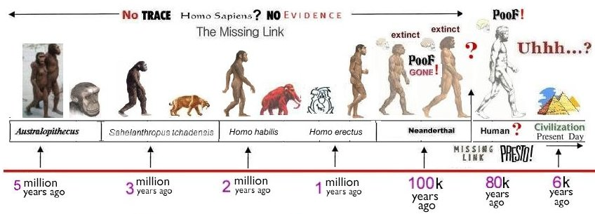
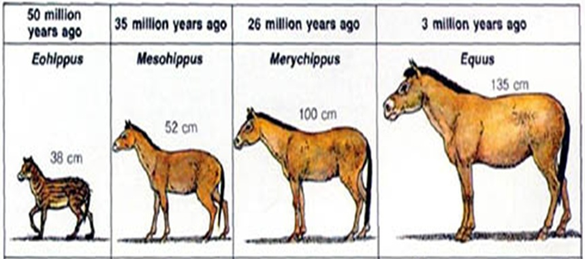
Human Evolution : Just Biological???

Slide 3

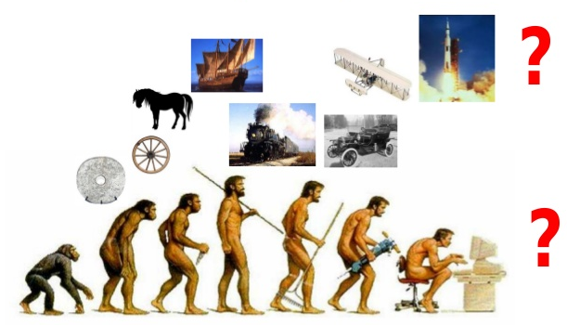
Outreach thru Energetic Evolution

Slide 4
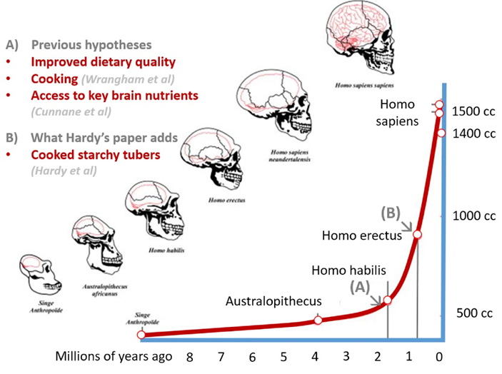
Energy Played/Plays A Vital Role in Human Evolution

Slide 5
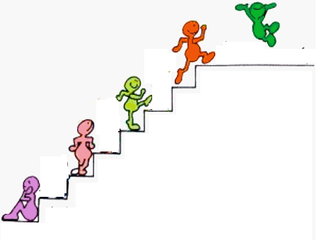
Human Evolution thru Energy Technologies
Silicon Era
Machine Free Era ???
Machines Era
Water Mills
Wind Mills
Heat Engines
Steam /gas turbines
Compound Tool Era
Single body Tool Era
Cattle as Energy Systems
Pre-historic Technology
Humans as Energy Systems
Pre-historic Energy Systems

Slide 6
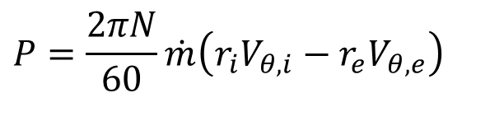
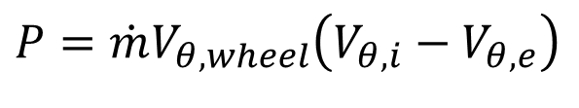


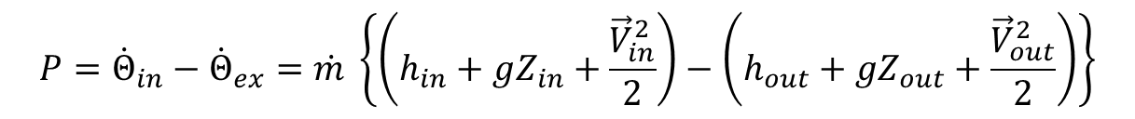

Power Generated by a Constant Speed Fluidmachine : Euler Equation
Euler’s Shaft Power Model:
$$P=τω=−Δ\dot{L}ω=\dot{m}ω\left(r_{i}V_{θ,i}−r_{e}V_{θ,e}\right)$$
$$P=\frac{2πN}{60}\dot{m}\left(r_{i}V_{θ,i}−r_{e}V_{θ,e}\right)$$
$$If r_{e}=r_{i}$$
$$P=\dot{m}V_{θ,wheel}\left(V_{θ,i}−V_{θ,e}\right)$$
A change in Whirl/Angular Velocity of fluid can only establish Power Exchange between fluid and wheel in a turbo-machine !
First of thermodynamics for an isentropic SSSF machine:
$${P=\dot{Θ}}_{in}−{\dot{Θ}}_{ex}=\dot{m} \left\{\left(h_{in}+gZ_{in}+\frac{{\vec{V}}_{in}^{2}}{2}\right)−\left(h_{out}+gZ_{out}+\frac{{\vec{V}}_{out}^{2}}{2}\right)\right\}$$
Confluence of first law with Euler equation?
$$\dot{m} \left\{\left(h_{in}+gZ_{in}+\frac{{\vec{V}}_{in}^{2}}{2}\right)−\left(h_{out}+gZ_{out}+\frac{{\vec{V}}_{out}^{2}}{2}\right)\right\}=\frac{2πN}{60}\dot{m}\left(r_{i}V_{θ,i}−r_{e}V_{θ,e}\right)$$

Slide 7
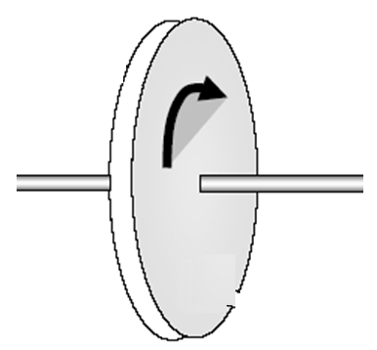
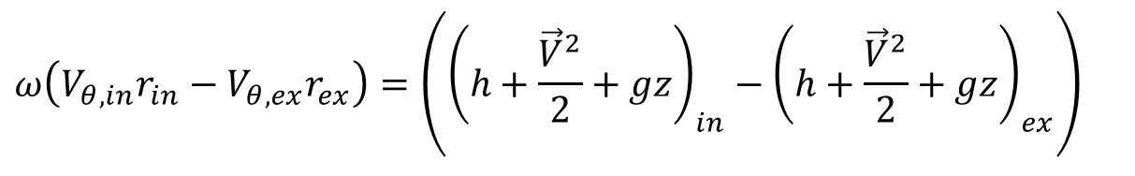
An Essential Action Across of A Fluid-machine
A Turbomachine
$$ω\left(V_{θ,in}r_{in}−V_{θ,ex}r_{ex}\right)=\left({\left(h+\frac{{\vec{V}}^{2}}{2}+gz\right)}_{in}−{\left(h+\frac{{\vec{V}}^{2}}{2}+gz\right)}_{ex}\right)$$
$${P=\dot{Θ}}_{in}−{\dot{Θ}}_{out}$$
Fluid in
$${\dot{Θ}in=\dot{m}in\left(h+\frac{{\vec{V}}^{2}}{2}+gz\right)}_{in}$$
Fluid out
$${\dot{Θ}out=\dot{m}out\left(h+\frac{{\vec{V}}^{2}}{2}+gz\right)}_{out}$$
$$\vec{V}=V_{r}\hat{r}+V_{θ}\hat{θ}+V_{z}\hat{k}$$

Slide 8
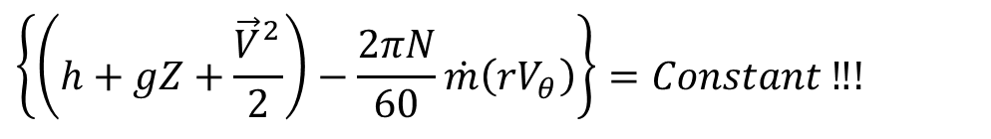
Conservation Quantity in An Energy Conversion Flow System
$$\left\{\left(h_{in}+gZ_{in}+\frac{{\vec{V}}_{in}^{2}}{2}\right)−\left(h_{out}+gZ_{out}+\frac{{\vec{V}}_{out}^{2}}{2}\right)\right\}=\frac{2πN}{60}\left(r_{i}V_{θ,i}−r_{e}V_{θ,e}\right)$$
$$\left\{\left(h+gZ+\frac{{\vec{V}}_{}^{2}}{2}\right)−\frac{2πN}{60}\dot{m}\left(rV_{θ}\right)\right\}=Constant ‼!$$
The algebraic sum of methalpy and angular momentum conserves in a turbomachine.
This is defined as ROTHALPY in Engineering of Turbomachines.

Slide 9
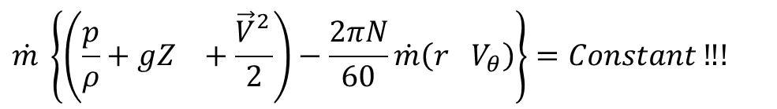
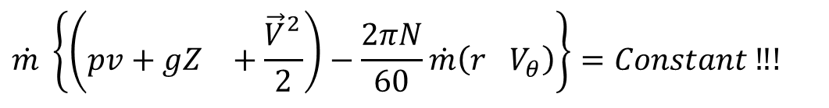
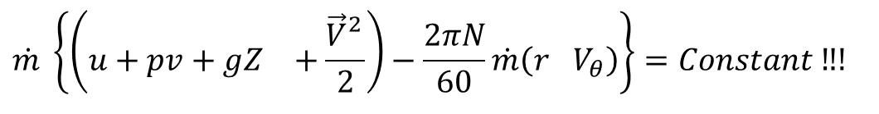
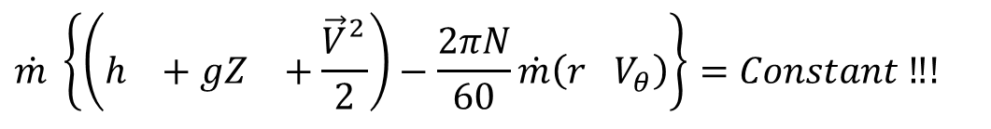
Conservation Quantity in Hydraulic Machines
$$\dot{m} \left\{\left(h_{}+gZ_{}+\frac{{\vec{V}}_{}^{2}}{2}\right)−\frac{2πN}{60}\dot{m}\left(r_{}V_{θ}\right)\right\}=Constant ‼!$$
$$\dot{m} \left\{\left(u+pv+gZ_{}+\frac{{\vec{V}}_{}^{2}}{2}\right)−\frac{2πN}{60}\dot{m}\left(r_{}V_{θ}\right)\right\}=Constant ‼!$$
Constant temperature fluidmachines are called as Hydraulic machines.
These machines work with incompressible fluids
$$\dot{m} \left\{\left(pv+gZ_{}+\frac{{\vec{V}}_{}^{2}}{2}\right)−\frac{2πN}{60}\dot{m}\left(r_{}V_{θ}\right)\right\}=Constant ‼!$$
$$\dot{m} \left\{\left(\frac{p}{ρ}+gZ_{}+\frac{{\vec{V}}_{}^{2}}{2}\right)−\frac{2πN}{60}\dot{m}\left(r_{}V_{θ}\right)\right\}=Constant ‼!$$

Slide 10
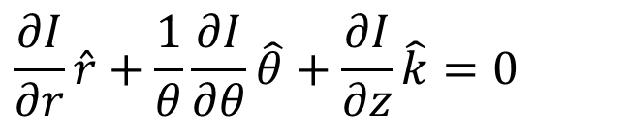
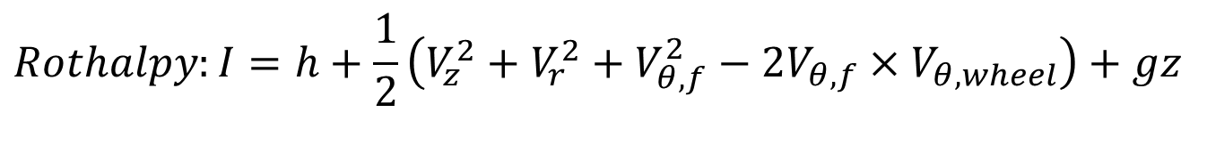
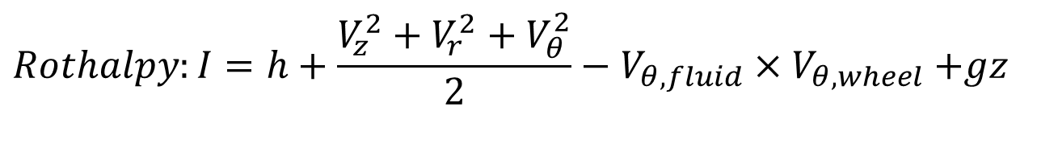
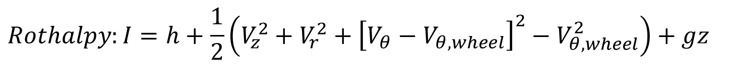
Novel Idea for Creation of Variety
$$Rothalpy:I=h+\frac{V_{z}^{2}+V_{r}^{2}+V_{θ}^{2}}{2}−V_{θ,fluid}{×V}_{θ,wheel}+gz$$
$$Rothalpy:I=h+\frac{1}{2}\left(V_{z}^{2}+V_{r}^{2}+V_{θ,f}^{2}−{2V}_{θ,f}{×V}_{θ,wheel}\right)+gz$$
$$Rothalpy:I=h+\frac{1}{2}\left(V_{z}^{2}+V_{r}^{2}+{\left[V_{θ}−V_{θ,wheel}\right]}^{2}−V_{θ,wheel}^{2}\right)+gz$$
Ideas for creation of a variety in turbo-machine.
$$∇I=0$$
$$\frac{∂I}{∂r}\hat{r}+\frac{1}{θ}\frac{∂I}{∂θ}\hat{θ}+\frac{∂I}{∂z}\hat{k}=0$$
Through flow Theory

Slide 11
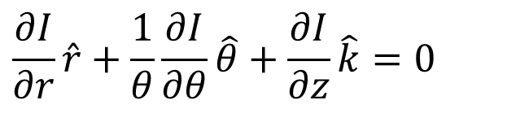

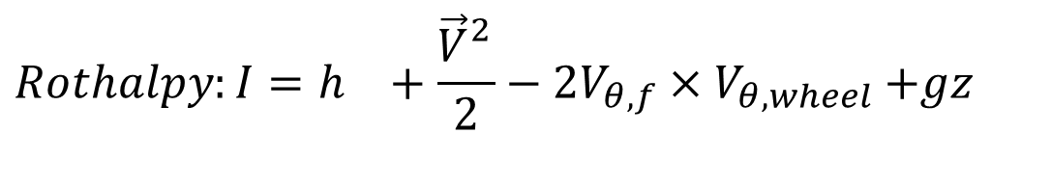

An Exclusive Theory for
Turbomachines
A Turbomachine
Along meridional path
$$∇I=0$$
$$\dot{P}$$
Fluid in
$$\frac{∂I}{∂r}\hat{r}+\frac{1}{θ}\frac{∂I}{∂θ}\hat{θ}+\frac{∂I}{∂z}\hat{k}=0$$
Through flow Theory
Fluid out
$$Rothalpy:I=h_{}+\frac{{\vec{V}}_{}^{2}}{2}−{2V}_{θ,f}{×V}_{θ,wheel}+gz$$

Slide 12
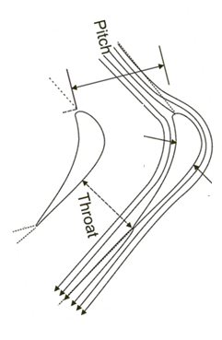
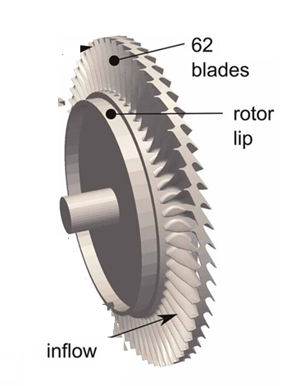
Geometrical Features of A Wheel

Slide 13
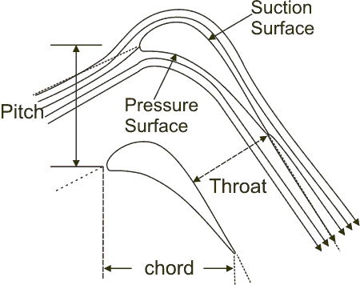
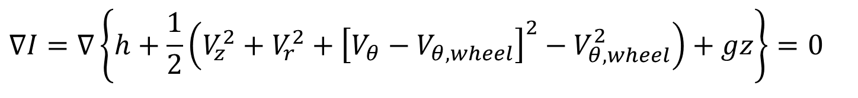
Wheel Tangential Velocity Vs Tangential Component of Fluid Velocity
Through Flow Theory
$$∇I=∇\left\{h+\frac{1}{2}\left(V_{z}^{2}+V_{r}^{2}+{\left[V_{θ}−V_{θ,wheel}\right]}^{2}−V_{θ,wheel}^{2}\right)+gz\right\}=0$$
V_{θ,wheel}
In maridional plane at mean radius of rotor
V_{θ}
V_{θ,wheel}
V_{r}
V_{z}
V_{a}

Slide 14
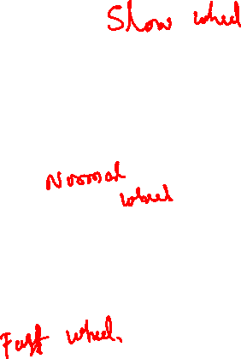
Rotor Speed Vs Inlet Whirl Velocity
V_{θi}
V_{θ,wheel}
V_{ri}
V_{zi}
V_{ai}
V_{θ,wheel}
V _{θ i}
V_{ri}
V_{ai}
V_{zi}
V_{θ,wheel}
V _{θ} i
V_{zi}
V_{ai}
V_{ri}

Slide 15
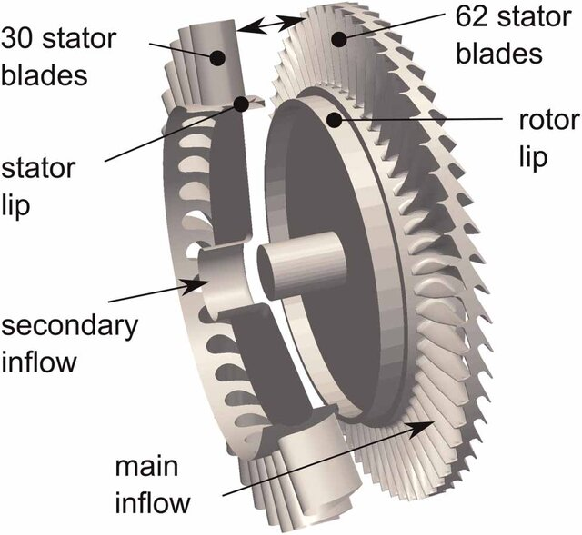
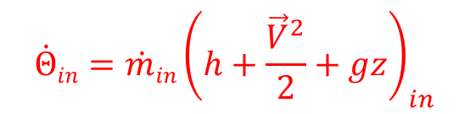
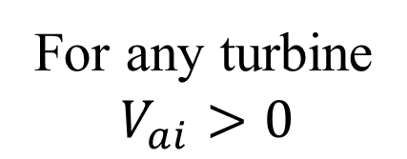
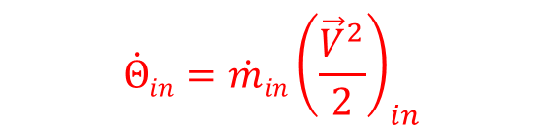
Need For A Stator/Nozzle
V_{θ,wheel}
V _{θ i}
V_{ri}
For any turbine
$$V_{ai}>0$$
V_{zi}
V_{ai}
Potential of A Resource:
$${\dot{Θ}in=\dot{m}in\left(h+\frac{{\vec{V}}^{2}}{2}+gz\right)}_{in}$$
Wind Power Potential:
$${\dot{Θ}in=\dot{m}in\left(\frac{{\vec{V}}^{2}}{2}\right)}_{in}$$
No need of stator/Nozzle!

Slide 16
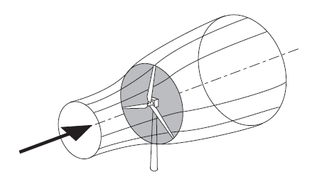
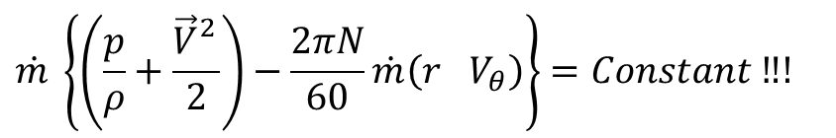
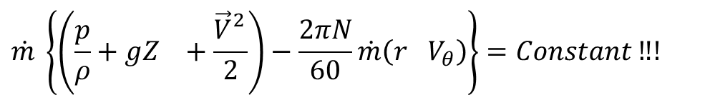
Conservation Quantity in Wind Turbine
$$\dot{m} \left\{\left(\frac{p}{ρ}+gZ_{}+\frac{{\vec{V}}_{}^{2}}{2}\right)−\frac{2πN}{60}\dot{m}\left(r_{}V_{θ}\right)\right\}=Constant ‼!$$
$$\dot{m} \left\{\left(\frac{p}{ρ}+\frac{{\vec{V}}_{}^{2}}{2}\right)−\frac{2πN}{60}\dot{m}\left(r_{}V_{θ}\right)\right\}=Constant ‼!$$

Slide 17
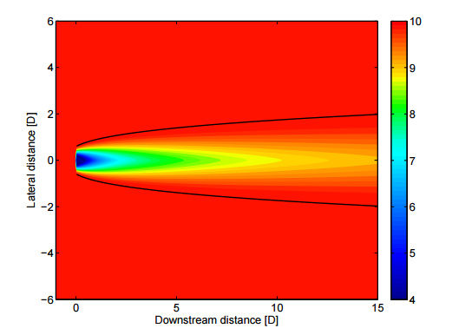
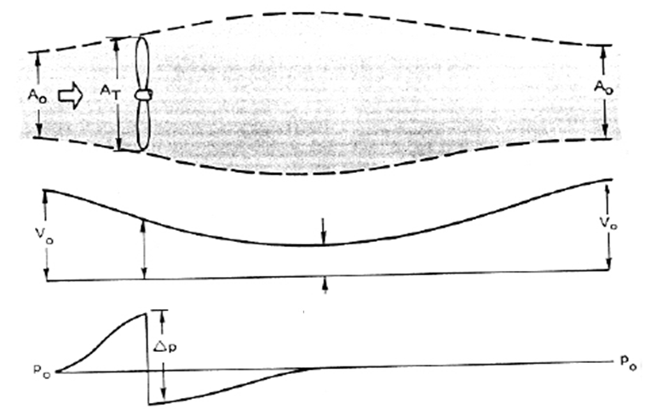
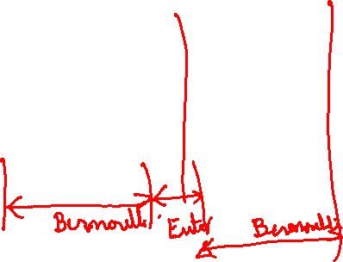
An Ultimate Philanthropy
A_{rotor}
The Mach number is small and the air density is thus constant and the axial velocity must decrease continuously from Vo to u1.

Slide 18
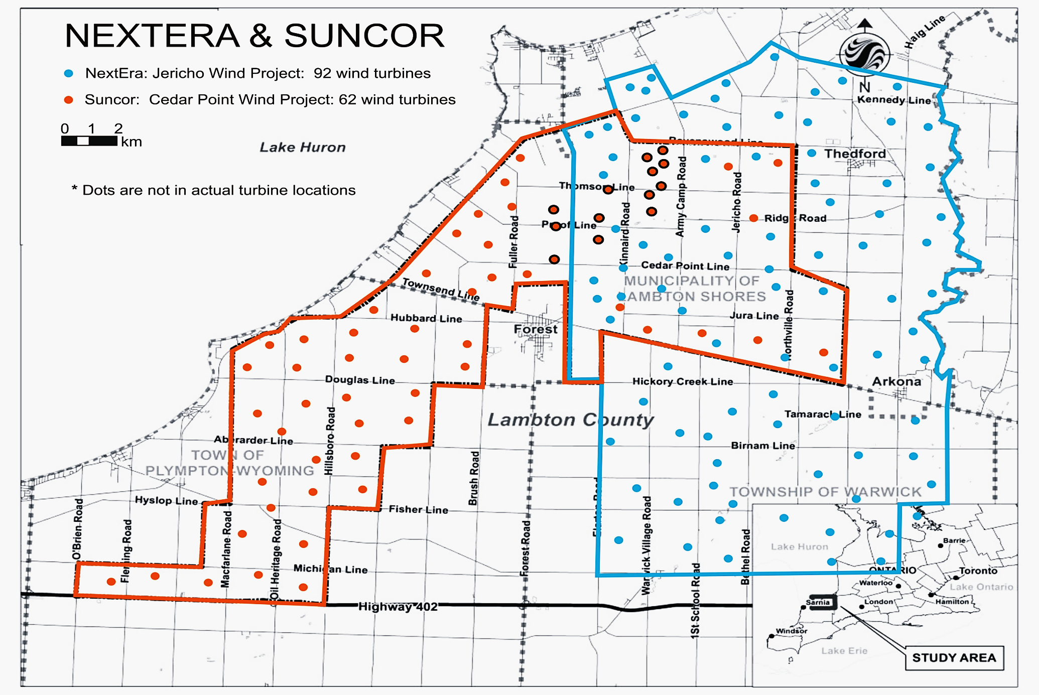

Micrositing of A Windfarm
Wind Power Potential:
$${\dot{Θ}in=\dot{m}in\left(\frac{{\vec{V}}^{2}}{2}\right)}_{in}$$
No need of stator/Nozzle!
Can’t Store…
Need to use as and when available….

Slide 19
Self Reading…..

Slide 20
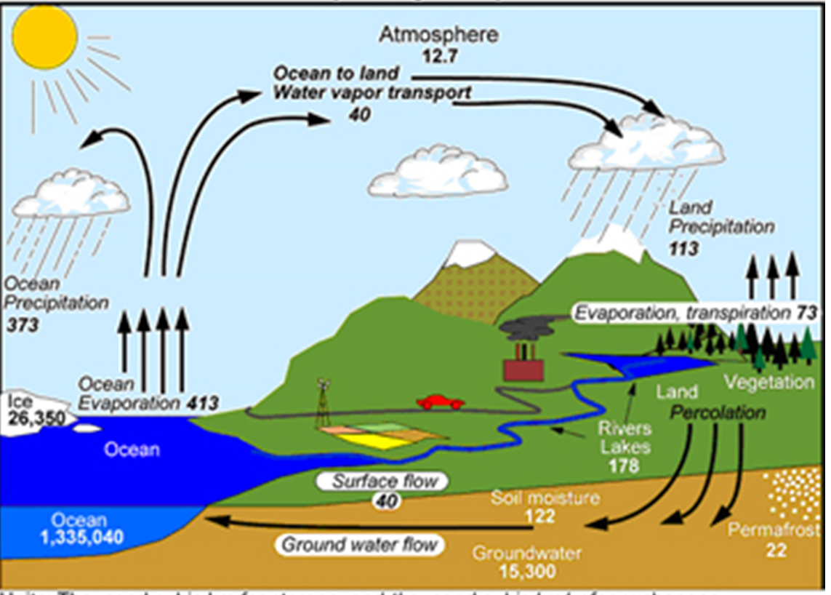
Hydrological Cycle

Slide 21
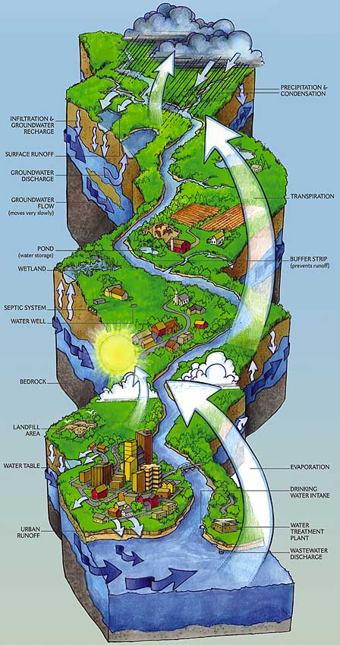
Catchment Area of A River

Slide 22


The West Flowing River: The Sharavathi
The river Sharavathi originates at a height of 730m near Ambuthirtha, in Shimoga district.
It flows in a north-west direction, in its long, 132-km journey.

Slide 23
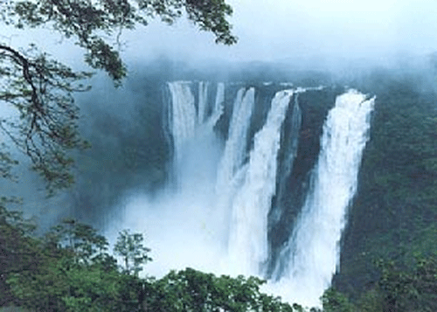
Jog Falls

Slide 24
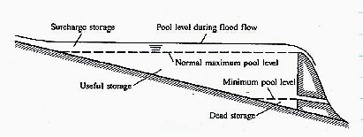
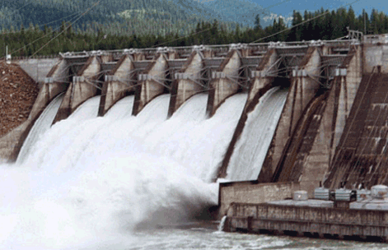

Creation of Reservoir of Potential Energy

Slide 25
Reservoirs
A reservoir is a manmade lake or structure used to store water.
A reservoir with dam has an uncontrolled inflow but a largely controlled outflow.
The water available for storage is totally a function of the natural stream flow.
Reservoir capacity is the max. volume of water that can be stored in the particular reservoir.
It is the normal maximum pool level behind a dam.
This can be calculated by using a topographic map of the region.

Slide 26
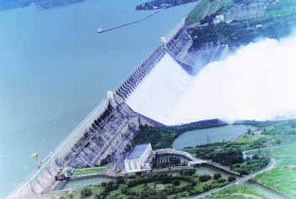
Reservoir Created using A DAM

Slide 27
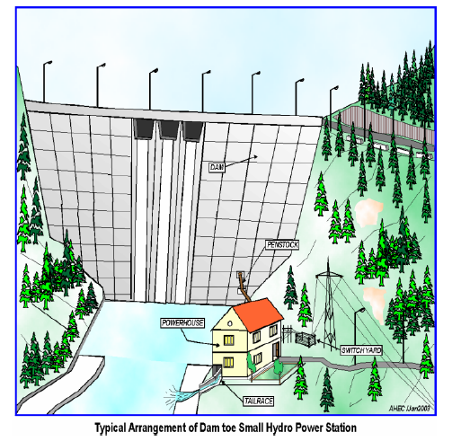
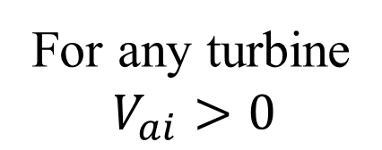
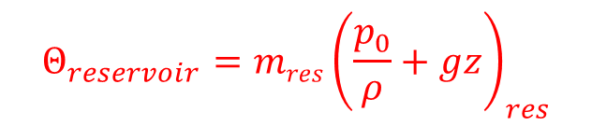
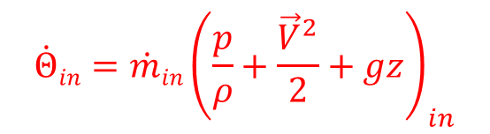
Storage plant (Impoundment plant)
Potential of A Hydraulic Resource:
$${\dot{Θ}in=\dot{m}in\left(\frac{p}{ρ}+\frac{{\vec{V}}^{2}}{2}+gz\right)}_{in}$$
$${Θ_{reservoir}=mres\left(\frac{p_{0}}{ρ}+gz\right)}_{res}$$
For any turbine
$$V_{ai}>0$$
An energy conversion device to convert potential energy to kinetic energy is essential.
This is known as Nozzle/stator.

Slide 28
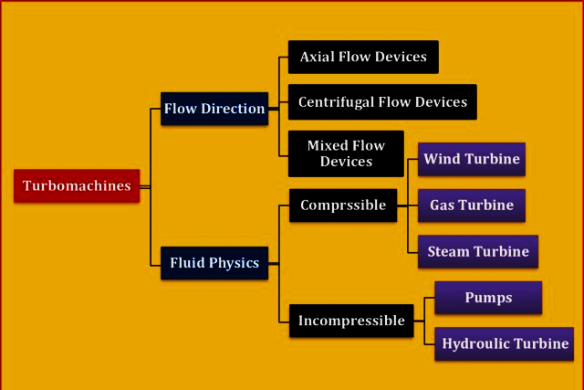
Turbomachines by Humans for Welfare of Humans & Globe

Slide 29
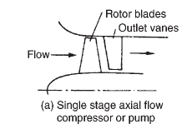
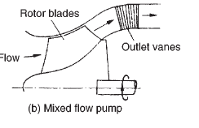


Various Types of Fluid-machines

Slide 30


Slide 31


HE Power House with Pelton Wheel

Slide 32



Projections of action by an Orthogonal Jet on a Pelton Bucket
A
B
C

Slide 33




Special Features of Bucket For Circumferential Arrangement on A Rim

Slide 34






Kinematics of Flow for Actual Bucket in flow plane
$$V_{w,i}=V_{jet}×\cos{α_{i}}$$
$$V_{a,i}=V_{jet}$$
$$V_{r,e}$$
$$V_{w,e}=U_{b}−V_{r,e}×\cos\left(180−β_{e}\right)$$
Euler torque equation:
$$τ=\dot{m}×r×\left(V_{w,i}−V_{w,o}\right)$$

Slide 35





Frictional Flow Past A Bucket
For a real flow past a bucket:
$$V_{r,e}<V_{r,i}⇒V_{r,e}=k_{b}×V_{r,i}$$
$$V_{w,e}=U_{b}−k_{b}×V_{r,i}×\cos\left(180−β_{e}\right)$$
$$V_{r,i}=\frac{V_{jet}×\cos{α_{i}}−U_{b}}{\cos{β_{i}}}$$
$$τ=\dot{m}×r×\left(V_{jet}×\cos{α_{i}}−\left(U_{b}−k_{b}\left\{\frac{V_{jet}×\cos{α_{i}}−U_{b}}{\cos{β_{i}}}\right\}\cos\left(180−β_{e}\right)\right)\right)$$
$$P=\dot{m}×U_{b}×\left(V_{jet}×\cos{α_{i}}−\left(U_{b}−k_{b}\left\{\frac{V_{jet}×\cos{α_{i}}−U_{b}}{\cos{β_{i}}}\right\}\cos\left(180−β_{e}\right)\right)\right)$$

Slide 36


Stator & Rotor Pair in a Hydraulic Turbomachine
For stator/Nozzle U_{blade} =0
$$Total Methalpy : p_{0}+ρgz=p+\frac{{ρ\vec{V}}^{2}}{2}+ρgz=constant$$
For rotors :
$$Rothalpy:I=p_{0}−V_{θ}U_{blade}+gz=\text{constant}$$

Slide 37


The Francis Turbine
It is a reaction turbine developed by an English born American Engineer, Sir J.B. Francis.

Slide 38



The Kaplan Turbine

Slide 39





Turbomachines working with Vapors/Gas
$$Rothalpy:I=h+\frac{V_{x}^{2}+V_{r}^{2}+V_{θ}^{2}}{2}−V_{θ}U_{blade}+gz$$
$$gz≈\text{constant}$$
For vapors and gases$:I=h+\frac{V_{z}^{2}+V_{r}^{2}+V_{θ}^{2}}{2}−V_{θ}U_{blade}$
$$I=\int{c_{p}\left(p,T\right)dT}+\frac{V_{z}^{2}+V_{r}^{2}+V_{θ}^{2}}{2}−V_{θ}U_{blade}=\text{constant}$$
For an ideal gas as a working fluid:
$$I=\int{c_{p}\left(T\right)dT+\frac{V_{z}^{2}+V_{r}^{2}+V_{θ}^{2}}{2}}−V_{θ}U_{blade}=\text{constant}$$

Slide 40


Turbomachines working with Perfect Gas
For simple compressible fluid: Like Inert Gas
$$I=c_{p}\int{dT+\frac{V_{z}^{2}+V_{r}^{2}+V_{θ}^{2}}{2}}−V_{θ}U_{blade}=\text{constant}$$
The Fourth Generation Nuclear Power Plants

Slide 41

An Advanced Nuclear Power Plant

Slide 42




Conservation Laws for a finite CV
Global Conservation Mass for a Finite CV:
$$\frac{∂\left(m_{CV}\right)}{∂t}+{\dot{m}}_{outlet}−{\dot{m}}_{inlet}=0$$
Global Conservation of Momentum for a Finite CV:
$$\frac{∂}{∂t}\left\{\vec{M}\right\}+\sum_{i=1}{{\vec{\dot{M}}}_{oulet,i}}−\sum_{j=1}{{\vec{\dot{M}}}_{inlet,i}}=\sum{{\vec{F}}_{Body,k}}+ \sum{{\vec{F}}_{surface,l}}$$
The first law of thermodynamics for a Finite CV:
$$\dot{Q}+{\dot{Θ}}_{in}=\frac{dE_{CV}}{dt}+{\dot{Θ}}_{out}+\dot{W}$$
$${\dot{m}}_{in}\left(h_{in}+gZ_{in}+\frac{V_{in}^{2}}{2}\right) =\frac{d}{dt}{\left(U+gZ+\frac{V_{}^{2}}{2}\right)}_{SV}+{\dot{m}}_{out}\left(h_{out}+gZ_{out}+\frac{V_{out}^{2}}{2}\right)$$

Slide 43



Need for Localization of Conservation Laws

Slide 44





Conservation of Mass for an Infinitesimal CV in A Fluid Flow
Recall RTT with all terms as volume integrals:
$$\frac{DG\left(t\right)}{Dt}=\int_{V\left(t\right)}{\left\{\frac{∂g\left(\vec{x},t\right)}{∂t}+∇.\left\{g\left(\vec{x},t\right)\vec{v}\right\}\right\}dV}$$
$$G=\int_{CV}{ζdm}=\int_{CV}{ρζdV}$$
Redefine
$$\frac{DG\left(t\right)}{Dt}=\int_{V\left(t\right)}{\left\{\frac{∂\left(ρζ\right)}{∂t}+∇.\left\{ρζ\vec{v}\right\}\right\}dV}$$
Consider ζ = 1, the conservation of mass for a CV is obtained as:
$$\frac{DG\left(t\right)}{Dt}=\int_{V\left(t\right)}{\left\{\frac{∂ρ}{∂t}+∇.\left\{ρ\vec{v}\right\}\right\}dV}$$

Slide 45


Continuity Equation for Fluid flows
Recall RTT with all terms as volume integrals:
$$\frac{DG\left(t\right)}{Dt}=\int_{V\left(t\right)}{\left\{\frac{∂ρ}{∂t}+∇.\left\{ρ\vec{v}\right\}\right\}dV}$$
This integral is zero for any size and shape of material volume.
Implies that the integrands in the brackets as a total must vanish identically.
This is known as continuity equation and for a general unsteady flow it is written as:
$$\frac{∂ρ}{∂t}+∇.\left(ρ\vec{v}\right)=0$$

Slide 46


Continuity Equation in Cartesian System
$$\frac{∂ρ}{∂t}+∇.\left(ρ\vec{v}\right)=0$$
This Equation is a coordinate invariant equation.
Its index notation in the Cartesian coordinate system given is:
$$\frac{∂ρ}{∂t}+\frac{∂\left(ρu\right)}{∂x}+\frac{∂\left(ρv\right)}{∂y}+\frac{∂\left(ρw\right)}{∂z}=0$$

Slide 47



Continuity Equation in Cylindrical Polar Coordinates
Many flows which involve rotation or radial motion are best described in Cylindrical Polar Coordinates.
In this system coordinates for a point P are r, θ and z.
The velocity components in these directions respectively are v_{r} ,v_{θ} and v_{z}.
Transformation between the Cartesian and the polar systems is provided by the relations,
$$r=\sqrt{x^{2}+y^{2}}$$
$$θ=\tan^{−1}\left(\frac{y}{x}\right)$$

Slide 48


Continuity Equation in Cylindrical Polar Coordinates
The gradient operator is given by,
$$∇=\hat{r}\frac{∂}{∂r}+\frac{1}{r}\hat{θ}\frac{∂}{∂θ}+\hat{z}\frac{∂}{∂z}$$
Therefore, the conservation of mass equation becomes,
$$\frac{∂ρ}{∂t}+\frac{1}{r}\frac{∂\left(rρv_{r}\right)}{∂r}+\frac{1}{r}\frac{∂\left(ρv_{θ}\right)}{∂θ}+\frac{∂\left(ρv_{z}\right)}{∂z}=0$$

Slide 49




Continuity Equation in Cylindrical Polar Coordinates
Spherical polar coordinates are a system of curvilinear coordinates that are natural for describing atmospheric flows.
Define θ to be the azimuthal angle in the x-y -plane from the x-axis with 0 ≤ θ < 2π .
φ to be the zenith angle and colatitude, with 0 ≤ φ < π
r to be distance (radius) from a point to the origin.
The spherical coordinates (r,θ,φ) are related to the Cartesian coordinates (x,y,z) by
$$θ=\tan^{−1}\left(\frac{y}{x}\right)$$
$$φ=\cos^{−1}\left(\frac{z}{r}\right)$$
$$r=\sqrt{x^{2}+y^{2}+z^{2}}$$

Slide 50



Transformation Function for CCS to SCS
$$x=r\cos{θ}\sin{φ} \\ y=r\sin{θ}\sin{φ} \\ z=\cos{φ}$$
The gradient is
$$∇=\hat{r}\frac{∂}{∂r}+\frac{1}{r\sin{φ}}\hat{θ}\frac{∂}{∂θ}+\frac{1}{r}\hat{φ}\frac{∂}{∂φ}$$
Therefore, conservation of mass equation becomes,
$$\frac{∂ρ}{∂t}+\frac{1}{r^{2}}\frac{∂\left(ρr^{2}v_{r}\right)}{∂r}+\frac{1}{r\sin{θ}}\frac{∂\left(ρv_{θ}\sin{θ}\right)}{∂θ}+\frac{1}{r\sin{θ}}\frac{∂\left(ρv_{φ}\right)}{∂φ}=0$$

Slide 51




Continuity Equation for Fluid flows
Continuity Equation in coordinate invariant form is:
$$\frac{∂ρ}{∂t}+∇.\left(ρ\vec{v}\right)=0$$
In the Cartesian coordinate system, the continuity equation given as:
$$\frac{∂ρ}{∂t}+\frac{∂\left(ρu\right)}{∂x}+\frac{∂\left(ρv\right)}{∂y}+\frac{∂\left(ρw\right)}{∂z}=0$$
In the Cylindrical polar coordinate system, the continuity equation given as:
$$\frac{∂ρ}{∂t}+\frac{1}{r}\frac{∂\left(rρv_{r}\right)}{∂r}+\frac{1}{r}\frac{∂\left(ρv_{θ}\right)}{∂θ}+\frac{∂\left(ρv_{z}\right)}{∂z}=0$$
In the spherical polar coordinate system, the continuity equation given as:
$$\frac{∂ρ}{∂t}+\frac{1}{r^{2}}\frac{∂\left(ρr^{2}v_{r}\right)}{∂r}+\frac{1}{r\sin{θ}}\frac{∂\left(ρv_{θ}\sin{θ}\right)}{∂θ}+\frac{1}{r\sin{θ}}\frac{∂\left(ρv_{φ}\right)}{∂φ}=0$$

Slide 52



Differential Form of Momentum Conservation Equations for Fluid Flows
Newton’s Second law to a CV:
$$\int_{V\left(t\right)}{\left\{\frac{∂\left(ρ\vec{v}\right)}{∂t}+∇.\left(ρ\vec{v}\vec{v}\right)\right\}dV={\vec{F}}_{B}+{\vec{F}}_{S}}$$
$$\int_{V\left(t\right)}{\left\{\frac{∂\left(ρ\vec{v}\right)}{∂t}+∇.\left(ρ\vec{v}\vec{v}\right)\right\}dV}=\int_{V\left(t\right)}{{\vec{f}}_{B}dV}+\int_{V\left(t\right)}{\left(∇•\vec{\vec{σ}}\right)dV}$$
Differential form of Conservation of Momentum to a Fluid System:
$$\frac{∂\left(ρ\vec{v}\right)}{∂t}+∇.\left(ρ\vec{v}\vec{v}\right)={\vec{f}}_{B}+∇•\vec{\vec{σ}}$$

