Slide 1

Special Conservation Equations for Ideal Fluid-Machines
P M V Subbarao
Professor
Mechanical Engineering Department
I I T Delhi
Prime Movers for Human Development……

Slide 2


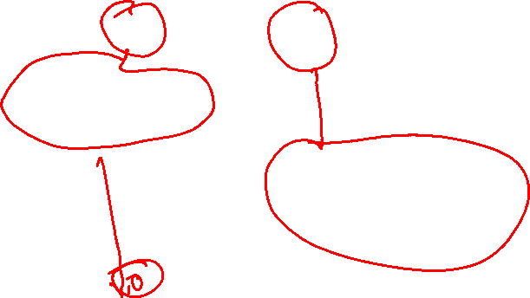
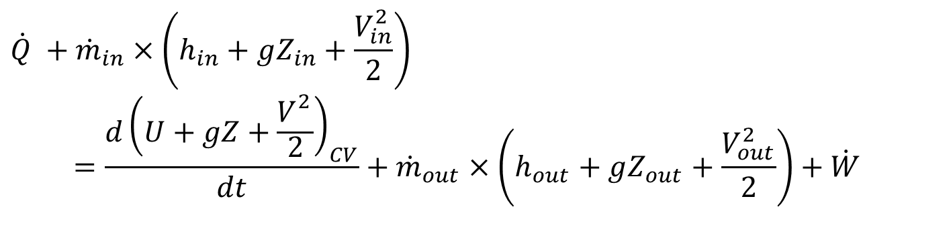
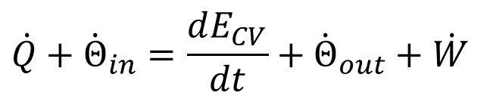
First Law of Thermodynamics for A Flow System as Rate Equation
The first law of thermodynamics for a CV as a rate equations obtained as
$$\dot{Q}+{\dot{Θ}}_{in}=\frac{dE_{CV}}{dt}+{\dot{Θ}}_{out}+\dot{W}$$
$$\dot{Q} +{\dot{m}}_{in}×\left(h_{in}+gZ_{in}+\frac{V_{in}^{2}}{2}\right) \\ =\frac{d{\left(U+gZ+\frac{V_{}^{2}}{2}\right)}_{CV}}{dt}+{\dot{m}}_{out}×\left(h_{out}+gZ_{out}+\frac{V_{out}^{2}}{2}\right)+\dot{W}$$
For a Fluid-machine running at SSSF:
$\dot{Q} +\dot{m}×\left(h_{in}+gZ_{in}+\frac{V_{in}^{2}}{2}\right)$ $=\dot{m}×\left(h_{out}+gZ_{out}+\frac{V_{out}^{2}}{2}\right)+\dot{W}$

Slide 3


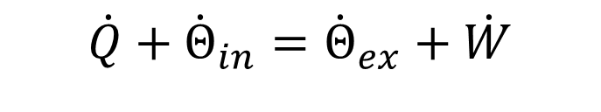
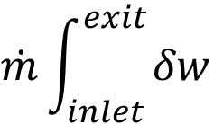

Conservation of Energy for SSSF
First Law for Steady Flow Steady State Fluidmachine:
$$\dot{Q}+{\dot{Θ}}_{in}={\dot{Θ}}_{ex}+\dot{W}$$
Consider an isentropic SSF Fluidmachine
$${\dot{Θ}}_{in}={\dot{Θ}}_{ex}+\dot{W}$$
$${\dot{W}=P=\dot{Θ}}_{in}−{\dot{Θ}}_{ex}$$
$$\dot{m}\int_{inlet }^{exit}{δw}$$

Slide 4
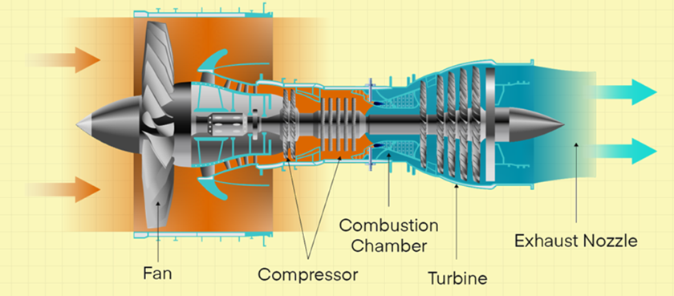

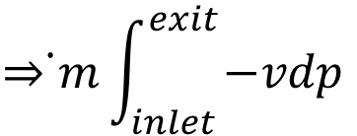
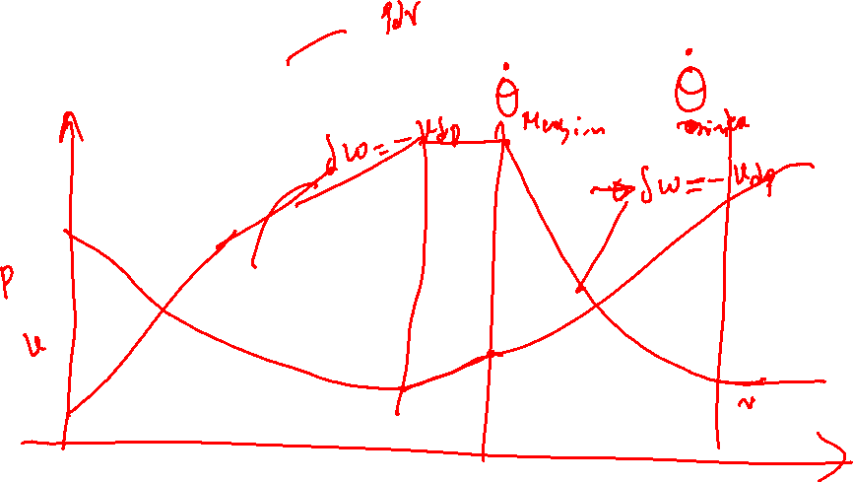
Rate of Work Transfer in A Fluidmachine
$${\dot{W}=P=\dot{Θ}}_{in}−{\dot{Θ}}_{ex}$$
$$\dot{m}\int_{inlet }^{exit}{δw}$$
$$\dot{⇒m}\int_{inlet }^{exit}{−vdp}$$

Slide 5
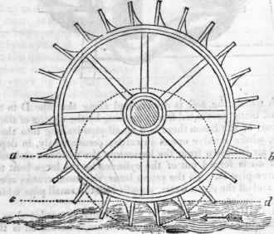
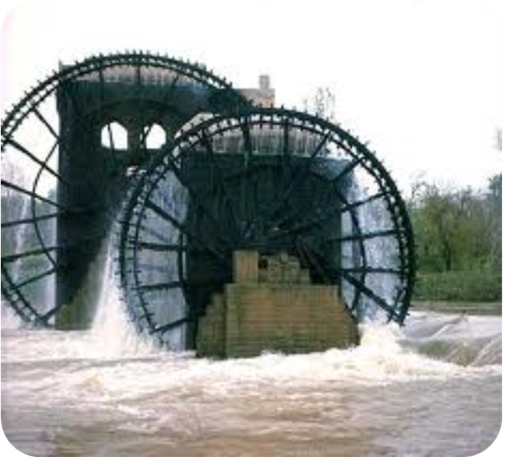
The Ancient Design : Undershot Water Wheel : 4000BC

Slide 6
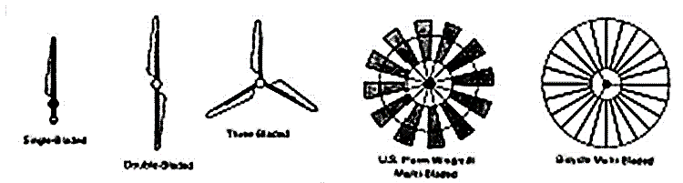
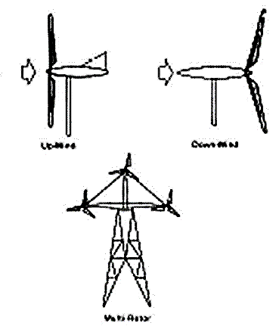
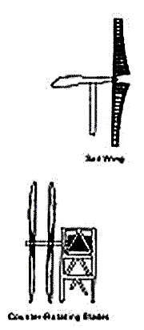
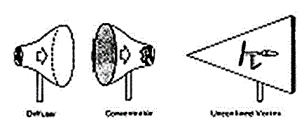
Various Designs of WIND TURBINES

Slide 7


Slide 8
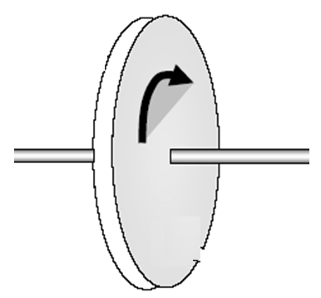
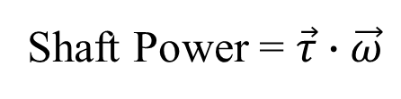
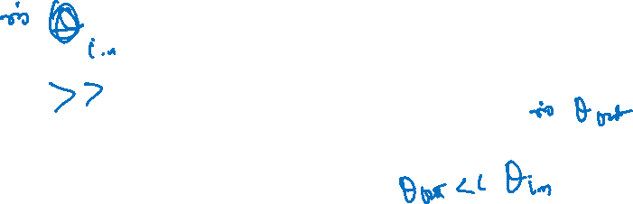
Thought Experiment: Fluid Dynamics of A Fluid Machine
पनचक्की
A Turbo-machine
Shaft Power = $\vec{τ}∙\vec{ω}$
Fluid in
Fluid out

Slide 9
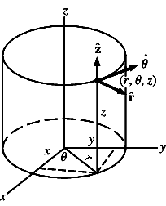
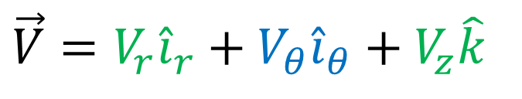
The Superiority of Vector Parameters in Cylindrical Coordinate System
Momentum interactions….
$$\vec{V}=V_{r}{\hat{i}}_{r}+V_{θ}{\hat{i}}_{θ}+V_{z}\hat{k}$$
Conversion of any component of Methalpy into Shaft Power
Facilitate Mass inflow/ouflow.

Slide 10
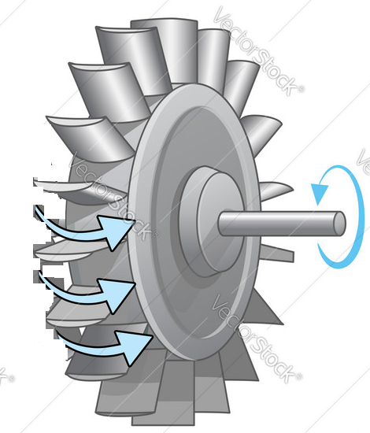
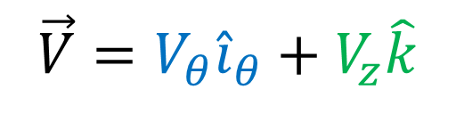
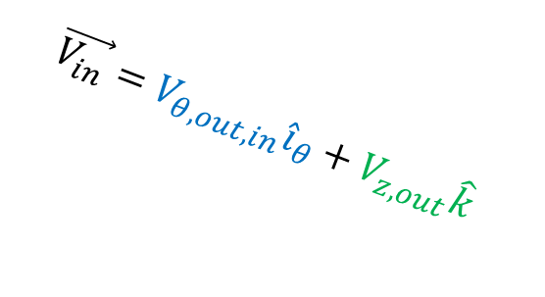
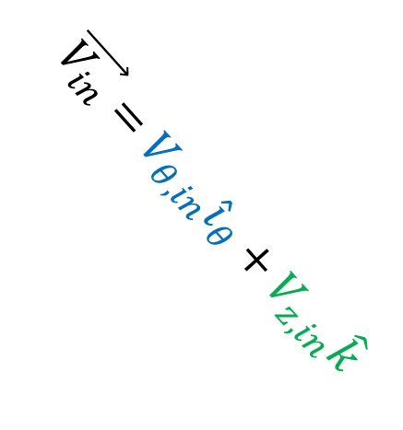
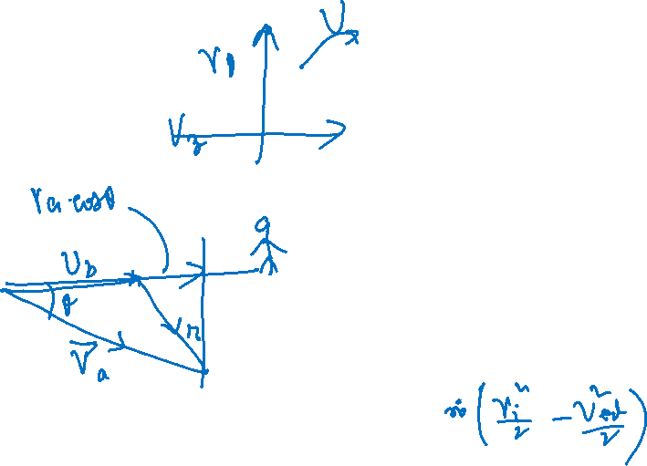
Euler’s Vision of A 2D Flow Vector
$$\vec{V_{in}}=V_{θ,in}{\hat{i}}_{θ}+V_{z,in}\hat{k}$$
$$\vec{V_{in}}=V_{θ,out,in}{\hat{i}}_{θ}+V_{z,out}\hat{k}$$
$$\vec{V}=V_{θ}{\hat{i}}_{θ}+V_{z}\hat{k}$$

Slide 11
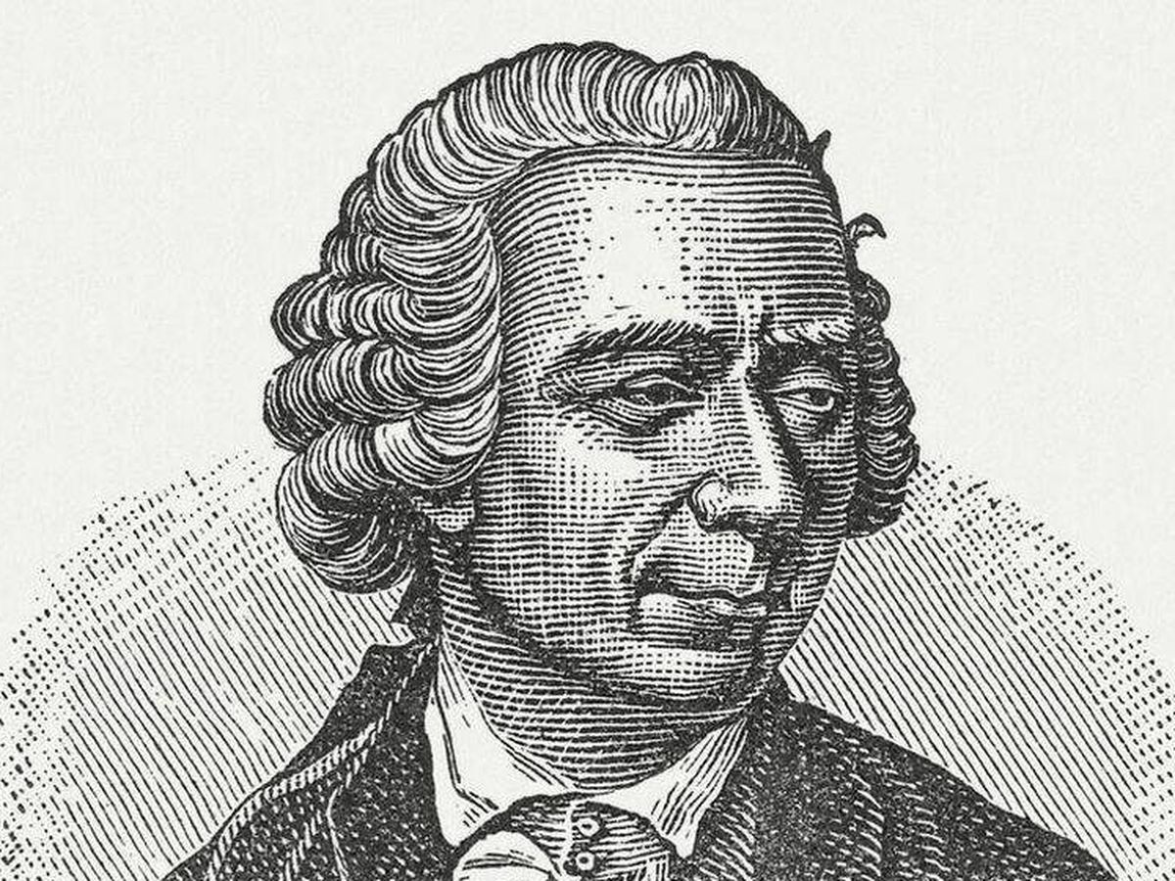
Euler Turbomachine Theory
Shaft output torque = Torque exerted by flow on the blade row = Rate of change of Angular momentum of fluid = τ

Slide 12




Mathematical Modeling of Euler Theory
For a steady flow through a turbo-machine:
Inlet rate of angular momentum :
$${\dot{L}}_{i}=\dot{m}r_{i}V_{θ,i}$$
Exit rate of angular momentum :
$${\dot{L}}_{e}=\dot{m}r_{e}V_{θ,e}$$
Change in Rate of angular momentum:
$$Δ\dot{L}=\dot{m}\left(r_{e}V_{θ,e}−r_{i}V_{θ,i}\right)$$
Reaction to Change in Rate of angular momentum is torque generated by the wheel
$$τ=−Δ\dot{L}=\dot{m}\left(r_{i}V_{θ,i}−r_{e}V_{θ,e}\right)$$

Slide 13
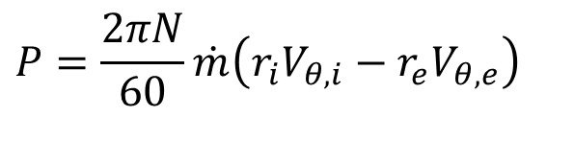

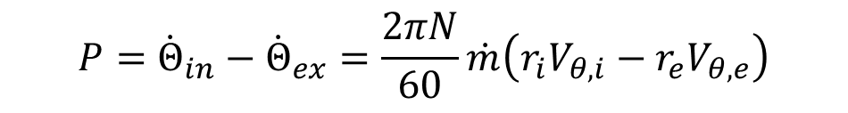
Power Generated by a Constant Speed Wheel
Shaft Power :
$$P=τω=−Δ\dot{L}ω=\dot{m}ω\left(r_{i}V_{θ,i}−r_{e}V_{θ,e}\right)$$
$$P=\frac{2πN}{60}\dot{m}\left(r_{i}V_{θ,i}−r_{e}V_{θ,e}\right)$$
A change in Whirl/Angular Velocity of fluid can only establish Power Exchange between fluid and rotor in a turbo-machine !
$${P=\dot{Θ}}_{in}−{\dot{Θ}}_{ex}=\frac{2πN}{60}\dot{m}\left(r_{i}V_{θ,i}−r_{e}V_{θ,e}\right)$$
Confluence of first law with Euler equation?
$$\dot{m} \left\{\left(h_{in}+gZ_{in}+\frac{{\vec{V}}_{in}^{2}}{2}\right)−\left(h_{out}+gZ_{out}+\frac{{\vec{V}}_{out}^{2}}{2}\right)=\frac{2πN}{60}\dot{m}\left(r_{i}V_{θ,i}−r_{e}V_{θ,e}\right)\right\}$$

