Slide 1

Further Discussions on Conservation Equations for Fluid Flows
P M V Subbarao
Professor
Mechanical Engineering Department
I I T Delhi
Closing Discussions on Conservation Laws for Control Volumes……

Slide 2

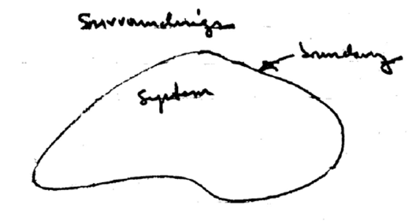
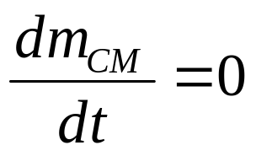
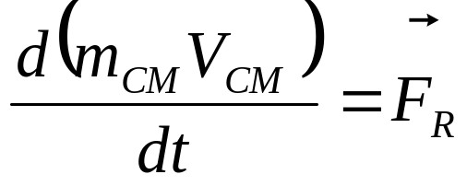
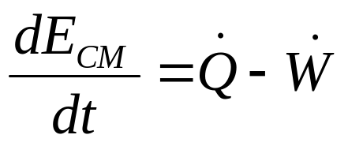
Rate Equations for Laws of Nature : Control Mass
Conservation of Mass :
Conservation of Momentum :
First law of thermodynamics :

Slide 3

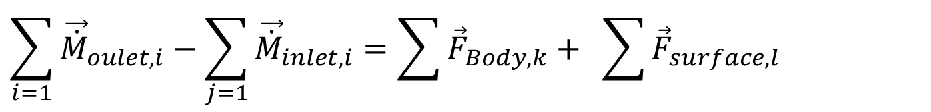
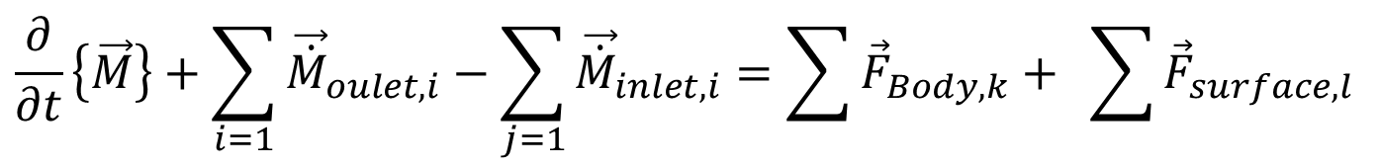
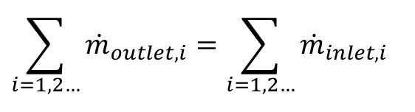
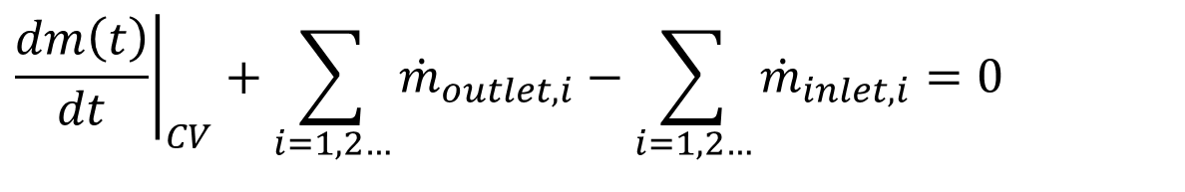
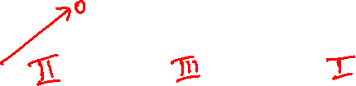
Conservation Equations for A Fluid System
Conservation of Mass:
$${\left.\frac{dm\left(t\right)}{dt}\right|}_{CV}+\sum_{i=1, 2…}{{\dot{m}}_{outlet,i}}−\sum_{i=1,2…}{{\dot{m}}_{inlet,i}}=0$$
For a steady state steady flow system:
$$\sum_{i=1, 2…}{{\dot{m}}_{outlet,i}}=\sum_{i=1,2…}{{\dot{m}}_{inlet,i}}$$
Conservation of Momentum
$$\frac{∂}{∂t}\left\{\vec{M}\right\}+\sum_{i=1}{{\vec{\dot{M}}}_{oulet,i}}−\sum_{j=1}{{\vec{\dot{M}}}_{inlet,i}}=\sum{{\vec{F}}_{Body,k}}+ \sum{{\vec{F}}_{surface,l}}$$
For a steady state steady flow system:
$$\sum_{i=1}{{\vec{\dot{M}}}_{oulet,i}}−\sum_{j=1}{{\vec{\dot{M}}}_{inlet,i}}=\sum{{\vec{F}}_{Body,k}}+ \sum{{\vec{F}}_{surface,l}}$$

Slide 4
Role of Surface Forces
The surface forces act to transport momentum across the boundaries of an infinitesimal element.
Tiny fluid parcels Carry momentum across in the appropriate direction.
In dilute gases (Kn ~1), the momentum transport occurs due to molecules randomly crossing the boundary.
Molecules carry momentum across in the appropriate direction.
Often referred to as the kinetic contribution to the stress.
In liquids, the transport of momentum can occur without physical translation of molecules via short-ranged forces acting between pairs of molecules on either side of the boundary.
Clearly, the total effect of short-ranged forces acting on a differential element is decided by its surface area rather than the volume.

Slide 5
The System of Surface Forces in Fluid Flows
Mechanical forces.
Electro-kinetic forces.
Electroosmosis Forces
Electrophoresis Forces

Slide 6
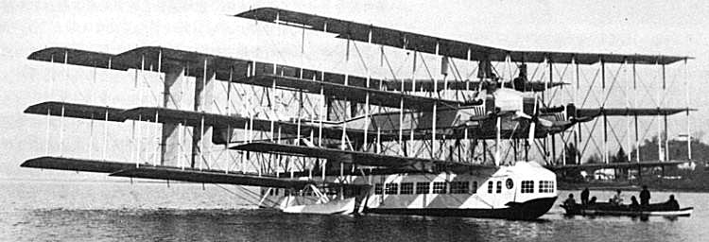
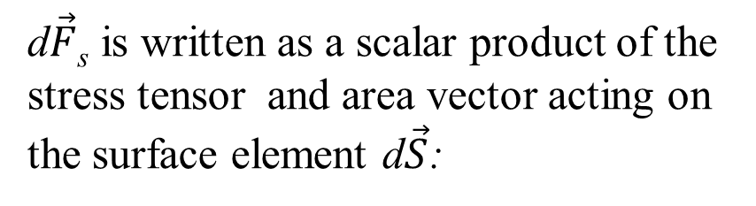
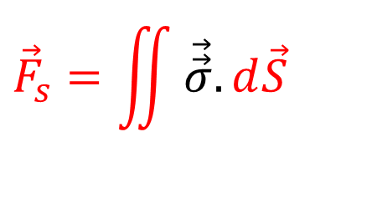
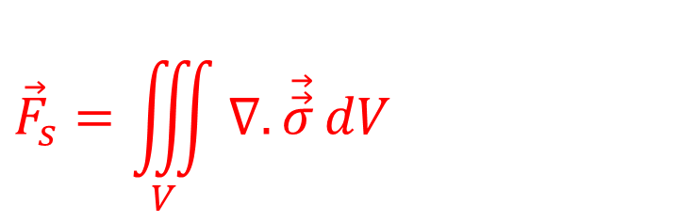
Surface Forces are at the Surface of Control Volume
$$\frac{∂}{∂t}\left\{\iiint_{V}{ρ\vec{v}dV}\right\}+\sum_{i=1}{\iint_{A_{exit}}{ρ\vec{v}\left(\vec{v}.d\vec{A}\right)}}−\sum_{j=}{\iint_{A_{inlet}}{ρ\vec{v}\left(\vec{v}.d\vec{A}\right){=\vec{F}}_{Body}+{\vec{F}}_{surface}}}$$
As discussed before, force is an extensive quantity and hence surface force is proportional to surface area.
$${\vec{F}}_{s}=\iint{\vec{\vec{σ}}.d\vec{S}}$$
For tiny Fluid parcels
d$\vec{F}$_{s} is written as a scalar product of the stress tensor and area vector acting on the surface element d$\vec{S}$:
If necessary,
$${\vec{F}}_{s}=\iiint_{V}{∇.\vec{\vec{σ}}}dV$$

Slide 7
The Fluid at Rest : Clue From Pascal’s First Law
From the definition of a fluid, the stresses parallel to planes must vanish if the fluid is at rest.
Thus, the shear stresses are zero, and the normal stresses become equal to the hydrostatic pressure:
$$σ_{xx}=σ_{yy}=σ_{zz}=−p$$
$$\text{Parallel} \text{component} \text{of} \text{stress} \text{are} \text{represented} \text{as} τ_{\text{xy}},τ_{\text{yz}},τ_{\text{zx}} \text{etc}\text{.,...}$$
$$τ_{\text{xy}}=τ_{\text{yz}}=τ_{\text{zx}}=0$$
We must ensure that the stresses in general flow reduce to this special case when the velocity is zero.

Slide 8
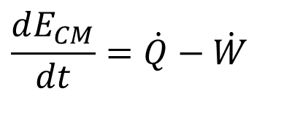
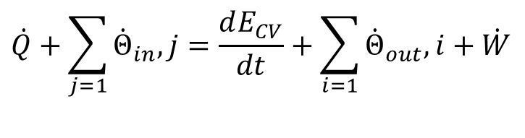
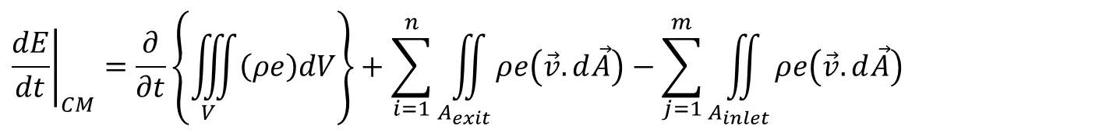
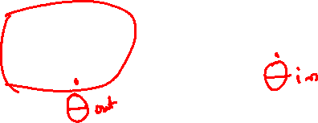
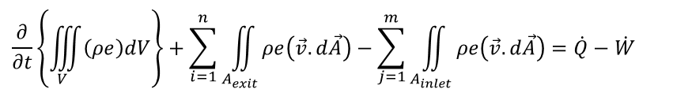
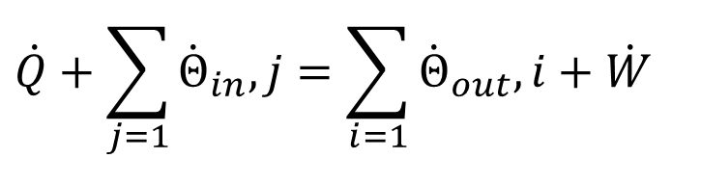
RTT of First Law for A Control Volume
$${\left.\frac{dG\left(t\right)}{dt}\right|}_{CM}=\frac{∂}{∂t}\left\{\iiint_{V}{\left(ρζ\right)dV}\right\}+\sum_{i=1}^{n}{\iint_{A_{exit}}{ρζ\left(\vec{v}.d\vec{A}\right)}}−\sum_{j=1}^{m}{\iint_{A_{inlet}}{ρζ\left(\vec{v}.d\vec{A}\right)}}$$
Consider a flow field with field variable value ζ= e and substitute the same in above equation.
$${\left.\frac{dE}{dt}\right|}_{CM}=\frac{∂}{∂t}\left\{\iiint_{V}{\left(ρe\right)dV}\right\}+\sum_{i=1}^{n}{\iint_{A_{exit}}{ρe\left(\vec{v}.d\vec{A}\right)}}−\sum_{j=1}^{m}{\iint_{A_{inlet}}{ρe\left(\vec{v}.d\vec{A}\right)}}$$
$$\frac{dE_{CM}}{dt}=\dot{Q}−\dot{W}$$
$$\frac{∂}{∂t}\left\{\iiint_{V}{\left(ρe\right)dV}\right\}+\sum_{i=1}^{n}{\iint_{A_{exit}}{ρe\left(\vec{v}.d\vec{A}\right)}}−\sum_{j=1}^{m}{\iint_{A_{inlet}}{ρe\left(\vec{v}.d\vec{A}\right)}}=\dot{Q}−\dot{W}$$
$$\dot{Q}+\sum_{j=1}{{\dot{Θ}}_{in},j}=\frac{dE_{CV}}{dt}+\sum_{i=1}{{\dot{Θ}}_{out},i}+\dot{W}$$
Essential for design of Fluid Machines
$$\dot{Q}+\sum_{j=1}{{\dot{Θ}}_{in},j}=\sum_{i=1}{{\dot{Θ}}_{out},i}+\dot{W}$$
For SSSF Fluid Machines

Slide 9
Broad Classification of Forms of Energy
Energy
Potential Energy
Kinetic Energy
Microscopic Potential Energy
Macroscopic Potential Energy
Microscopic Kinetic Energy
Macroscopic Kinetic Energy
Sum of Microscopic Potential and Kinetic Energies
$$Internal \text{Energy}\text{, }U$$
$$\text{Gibbs} \text{Free} \text{Energy}\text{, }G$$
$$Enthalpy,H$$
$$\text{Helmholtz} \text{Energy}\text{, }Ω$$

Slide 10
Energy of A Simple (Non-flowing) substance in a Thermodynamic System
$$E=μKE+μPE+KE+PE+........$$
$$E=U+KE+PE+........$$
Infinitesimal change in internal energy:
$$dE=dU+dKE+dPE+........$$
The first law of thermodynamics for a CM/ substance inside a CV (Region II)during an infinitesimal process
$$dU+dKE+dPE=δQ−δW$$
$$δQ =d{\left(U+mgZ+\frac{mV_{}^{2}}{2}\right)}_{Cm}+δW$$

Slide 11
Methalpy (Total Energy of A Simple Flowing Substance)
$$Θ=μKE+μPE+KE+PE+........$$
$$Θ=H+KE+PE+........$$
Infinitesimal change in Methalpy:
$$dΘ=dH+dKE+dPE+........$$
The first law of thermodynamics for a CV during an infinitesimal process, occurring in an infinitesimal time, δt
$$\dot{Q}×δt+{\dot{Θ}}_{in}×δt=dE_{CV}+{\dot{Θ}}_{out}×δt+\dot{W}×δt$$
$$δQ+{\dot{m}}_{in}×\left(h_{in}+gZ_{in}+\frac{V_{in}^{2}}{2}\right)×δt \\ =d{\left(U+gZ+\frac{V_{}^{2}}{2}\right)}_{SV}+{\dot{m}}_{out}×\left(h_{out}+gZ_{out}+\frac{V_{out}^{2}}{2}\right)×δt+δW$$

Slide 12
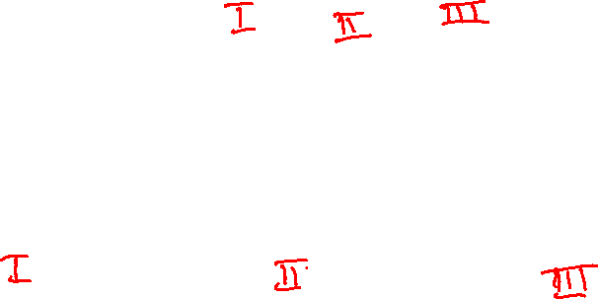
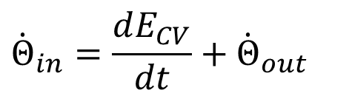
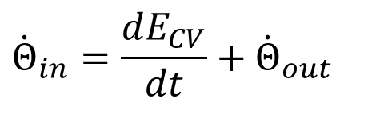
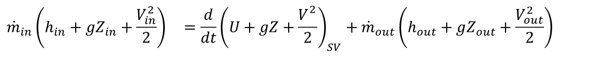
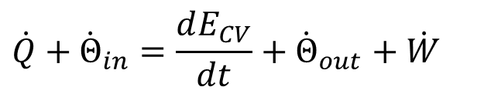
Bernoulli’s Equation as Conservation of Energy Equation for a CV
The first law of thermodynamics for a CV:
$$\dot{Q}+{\dot{Θ}}_{in}=\frac{dE_{CV}}{dt}+{\dot{Θ}}_{out}+\dot{W}$$
Consider an adiabatic flow system with no work transfer.
$${\dot{Θ}}_{in}=\frac{dE_{CV}}{dt}+{\dot{Θ}}_{out}$$
Rate equation for an adiabatic flow system with no work transfer.
$${\dot{Θ}}_{in}=\frac{dE_{CV}}{dt}+{\dot{Θ}}_{out}$$
Substitute the details of Methalpy and Energy in above equation .
$${\dot{m}}_{in}\left(h_{in}+gZ_{in}+\frac{V_{in}^{2}}{2}\right) =\frac{d}{dt}{\left(U+gZ+\frac{V_{}^{2}}{2}\right)}_{SV}+{\dot{m}}_{out}\left(h_{out}+gZ_{out}+\frac{V_{out}^{2}}{2}\right)$$

Slide 13
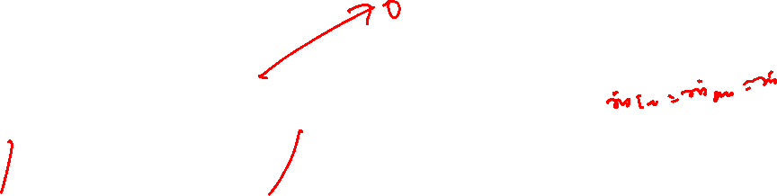
Bernoulli’s Equation as Conservation of Energy Equation for a CV
The first law of thermodynamics for an adiabatic CV with no work transfer is given as:
$${\dot{m}}_{in}\left(h_{in}+gZ_{in}+\frac{V_{in}^{2}}{2}\right) =\frac{d}{dt}{\left(U+gZ+\frac{V_{}^{2}}{2}\right)}_{SV}+{\dot{m}}_{out}\left(h_{out}+gZ_{out}+\frac{V_{out}^{2}}{2}\right)$$
$${\dot{m}}_{in}\left(u_{in}+{\left(pv\right)}_{in}+gZ_{in}+\frac{V_{in}^{2}}{2}\right) =\frac{d}{dt}{\left(U+gZ+\frac{V_{}^{2}}{2}\right)}_{SV}+{\dot{m}}_{out}\left(u_{out}+{\left(pv\right)}_{out}+gZ_{out}+\frac{V_{out}^{2}}{2}\right)$$
Bernoulli considered an isothermal flow and hence, change in internal energy is zero in all regions: u_{in}=u_{out}
$${\dot{m}}_{in}\left({\left(pv\right)}_{in}+gZ_{in}+\frac{V_{in}^{2}}{2}\right) =\frac{d}{dt}{\left(gZ+\frac{V_{}^{2}}{2}\right)}_{SV}+{\dot{m}}_{out}\left({\left(pv\right)}_{out}+gZ_{out}+\frac{V_{out}^{2}}{2}\right)$$
If above flow is steady:
$${\dot{m}}_{in}\left({\left(pv\right)}_{in}+gZ_{in}+\frac{V_{in}^{2}}{2}\right) ={\dot{m}}_{out}×\left({\left(pv\right)}_{out}+gZ_{out}+\frac{V_{out}^{2}}{2}\right)$$

Slide 14
Bernoulli’s Equation as Conservation of Energy Equation for a CV
The first law of thermodynamics for a steady frictionless isothermal flow with no heat and work transfer is given as:
$\left({\left(pv\right)}_{in}+gZ_{in}+\frac{V_{in}^{2}}{2}\right)=\left({\left(pv\right)}_{out}+gZ_{out}+\frac{V_{out}^{2}}{2}\right)$=Constant
$\left(\frac{p}{ρ}+gZ+\frac{V_{}^{2}}{2}\right)$ = Constant along a streamline in a frictionless flow with no heat transfer and work transfer!
∴Bernoulli’s Equation is a Conservation of Mechanical Energy Equation for a frictionless isothermal flow system!

