Slide 1

Surface Forces in Fluid Flows
P M V Subbarao
Professor
Mechanical Engineering Department
I I T Delhi
Forces as Reaction to Local Fluid Element Deformations and More……

Slide 2


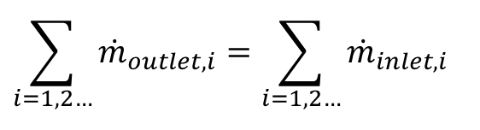
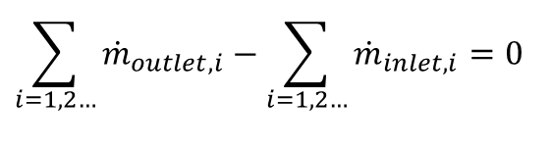
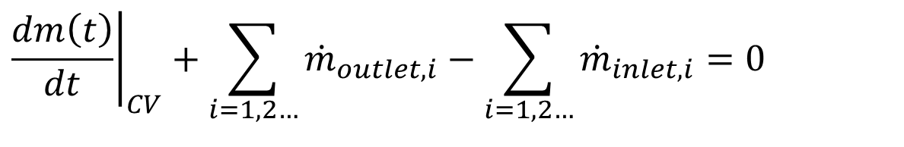
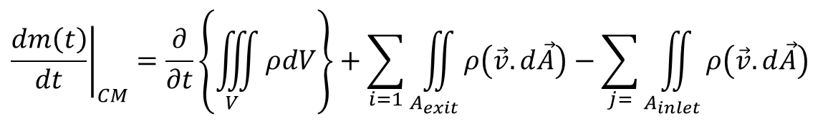
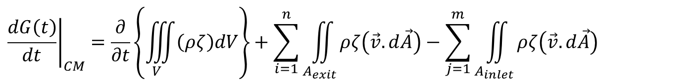
Conservation Equations for A CV using Reynolds Transformation
$${\left.\frac{dG\left(t\right)}{dt}\right|}_{CM}=\frac{∂}{∂t}\left\{\iiint_{V}{\left(ρζ\right)dV}\right\}+\sum_{i=1}^{n}{\iint_{A_{exit}}{ρζ\left(\vec{v}.d\vec{A}\right)}}−\sum_{j=1}^{m}{\iint_{A_{inlet}}{ρζ\left(\vec{v}.d\vec{A}\right)}}$$
Consider a flow field with field variable value ζ=1 and substitute the same in above equation.
$${\left.\frac{dm\left(t\right)}{dt}\right|}_{CM}=\frac{∂}{∂t}\left\{\iiint_{V}{ρdV}\right\}+\sum_{i=1}{\iint_{A_{exit}}{ρ\left(\vec{v}.d\vec{A}\right)}}−\sum_{j=}{\iint_{A_{inlet}}{ρ\left(\vec{v}.d\vec{A}\right)}}$$
$${\left.\frac{dm\left(t\right)}{dt}\right|}_{CV}+\sum_{i=1, 2…}{{\dot{m}}_{outlet,i}}−\sum_{i=1,2…}{{\dot{m}}_{inlet,i}}=0$$
For a steady state steady flow system:
$$\sum_{i=1, 2…}{{\dot{m}}_{outlet,i}}−\sum_{i=1,2…}{{\dot{m}}_{inlet,i}}=0$$
$$\sum_{i=1, 2…}{{\dot{m}}_{outlet,i}}=\sum_{i=1,2…}{{\dot{m}}_{inlet,i}}$$

Slide 3
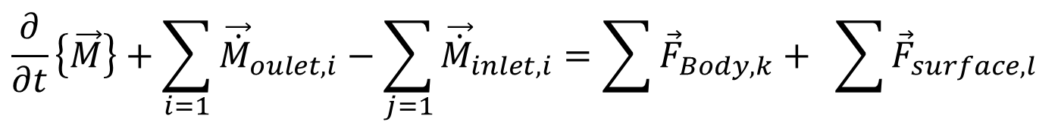
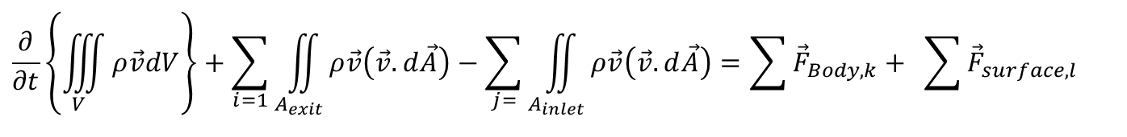
RTT for Conservation of Momentum
$${\left.\frac{dG\left(t\right)}{dt}\right|}_{CM}=\frac{∂}{∂t}\left\{\iiint_{V}{\left(ρζ\right)dV}\right\}+\sum_{i=1}^{n}{\iint_{A_{exit}}{ρζ\left(\vec{v}.d\vec{A}\right)}}−\sum_{j=1}^{m}{\iint_{A_{inlet}}{ρζ\left(\vec{v}.d\vec{A}\right)}}$$
Consider a flow field with field variable value ζ=$\vec{v}$ and substitute the same in above equation.
$$\frac{∂}{∂t}\left\{\iiint_{V}{ρ\vec{v}dV}\right\}+\sum_{i=1}{\iint_{A_{exit}}{ρ\vec{v}\left(\vec{v}.d\vec{A}\right)}}−\sum_{j=}{\iint_{A_{inlet}}{ρ\vec{v}\left(\vec{v}.d\vec{A}\right)=\sum{{\vec{F}}_{Body,k}}+ \sum{{\vec{F}}_{surface,l}} }}$$
$$\frac{∂}{∂t}\left\{\vec{M}\right\}+\sum_{i=1}{{\vec{\dot{M}}}_{oulet,i}}−\sum_{j=1}{{\vec{\dot{M}}}_{inlet,i}}=\sum{{\vec{F}}_{Body,k}}+ \sum{{\vec{F}}_{surface,l}}$$

Slide 4
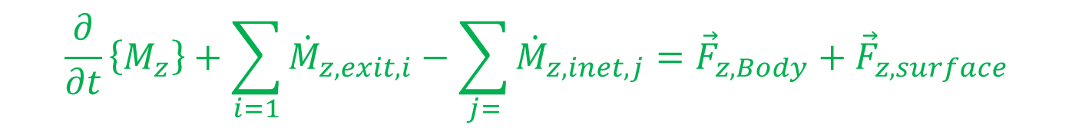
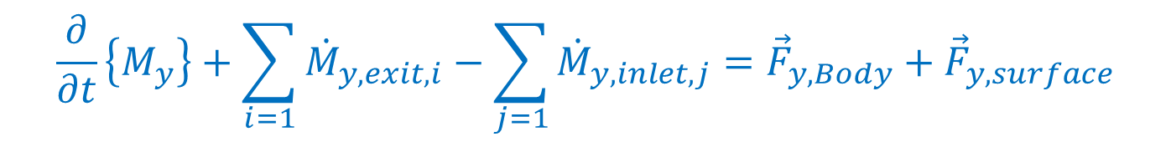
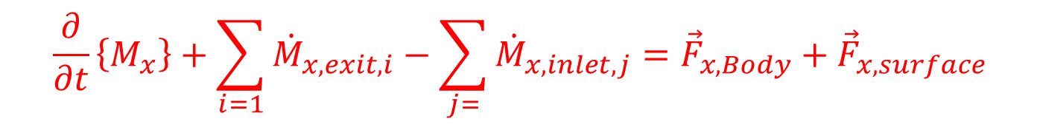
Components of Conservation of Momentum for Fluid Flows
X-Momentum Conservation Equation:
$$\frac{∂}{∂t}\left\{M_{x}\right\}+\sum_{i=1}{{\dot{M}}_{x,exit,i}}−\sum_{j=}{{\dot{M}}_{x,inlet,j}}={\vec{F}}_{x,Body}+{\vec{F}}_{x,surface}$$
Y-Momentum Conservation Equation:
$$\frac{∂}{∂t}\left\{M_{y}\right\}+\sum_{i=1}{{\dot{M}}_{y,exit,i}}−\sum_{j=1}{{\dot{M}}_{y,inlet,j}}={\vec{F}}_{y,Body}+{\vec{F}}_{y,surface}$$
Z-Momentum Conservation Equation:
$$\frac{∂}{∂t}\left\{M_{z}\right\}+\sum_{i=1}{{\dot{M}}_{z,exit,i}}−\sum_{j=}{{\dot{M}}_{z,inet,j}}={\vec{F}}_{z,Body}+{\vec{F}}_{z,surface}$$

Slide 5
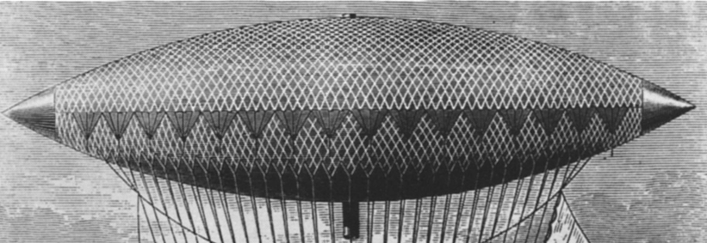
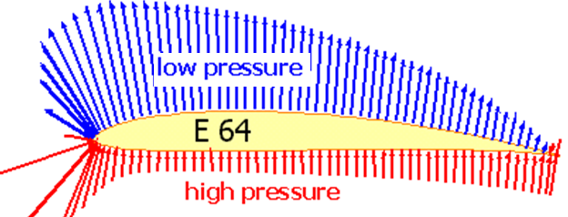
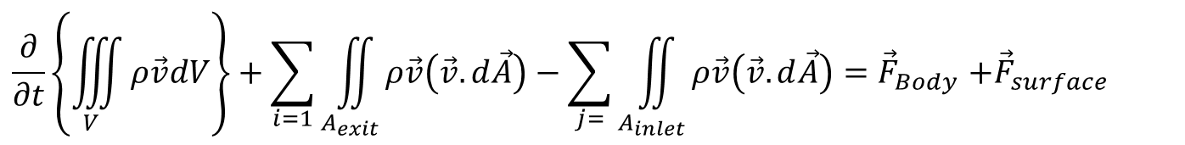
Body Force Vs Surface Forces
$$\frac{∂}{∂t}\left\{\iiint_{V}{ρ\vec{v}dV}\right\}+\sum_{i=1}{\iint_{A_{exit}}{ρ\vec{v}\left(\vec{v}.d\vec{A}\right)}}−\sum_{j=}{\iint_{A_{inlet}}{ρ\vec{v}\left(\vec{v}.d\vec{A}\right){=\vec{F}}_{Body}+{\vec{F}}_{surface}}}$$
Airship using Body Force
Flyer using Surface Force
The body force is proportional to volume of the system.
The body forces refer to long-ranged forces such as gravity.
The Surface force is proportional to surface area.
The Surface forces are short-ranged forces.

Slide 6
Body Force Vs Surface Forces
$$\frac{∂}{∂t}\left\{\iiint_{V}{ρ\vec{v}dV}\right\}+\sum_{i=1}{\iint_{A_{exit}}{ρ\vec{v}\left(\vec{v}.d\vec{A}\right)}}−\sum_{j=}{\iint_{A_{inlet}}{ρ\vec{v}\left(\vec{v}.d\vec{A}\right){=\vec{F}}_{Body}+{\vec{F}}_{surface}}}$$
Airship using Body Force
Flyer using Surface Force
Vary slowly with the distance between interacting elements.
Decay extremely rapidly with distance from a surface on the macroscopic scale.

Slide 7
Body Force Vs Surface Forces
$$\frac{∂}{∂t}\left\{\iiint_{V}{ρ\vec{v}dV}\right\}+\sum_{i=1}{\iint_{A_{exit}}{ρ\vec{v}\left(\vec{v}.d\vec{A}\right)}}−\sum_{j=}{\iint_{A_{inlet}}{ρ\vec{v}\left(\vec{v}.d\vec{A}\right){=\vec{F}}_{Body}+{\vec{F}}_{surface}}}$$
Airship using Body Force
Flyer using Surface Force
A consequence of this slow variation is that body forces act equally on all the matter within any infinitesimal element of CV
Surface forces can be anisotropic too.

Slide 8

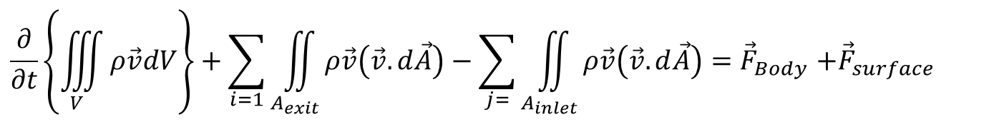



Vector form of Conservation of Momentum for Fluid Flows
$$\frac{∂}{∂t}\left\{\iiint_{V}{ρ\vec{v}dV}\right\}+\sum_{i=1}{\iint_{A_{exit}}{ρ\vec{v}\left(\vec{v}.d\vec{A}\right)}}−\sum_{j=}{\iint_{A_{inlet}}{ρ\vec{v}\left(\vec{v}.d\vec{A}\right){=\vec{F}}_{Body}+{\vec{F}}_{surface}}}$$
${\vec{F}}_{Body}$= $F_{x,Body}\hat{i} +F_{y,Body}\hat{ j}+F_{z,Body}\hat{k}$
${\vec{F}}_{surface}$= $F_{surface,x}\hat{i} +F_{surface,y}\hat{ j}+F_{surface,z}\hat{k}$
$$F_{surface,x} =F_{xx}+F_{yx}+F_{zx}$$

Slide 9
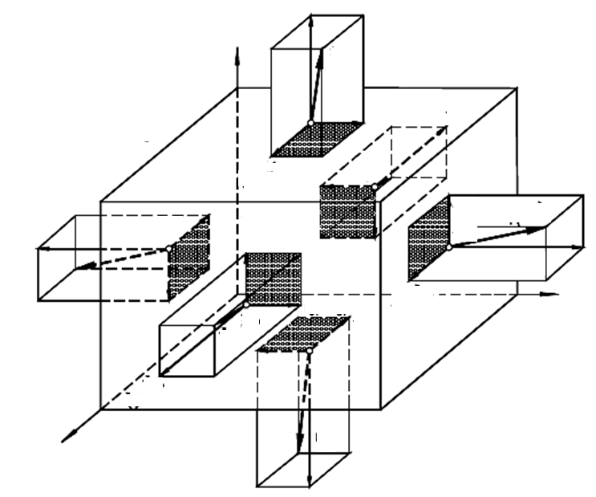
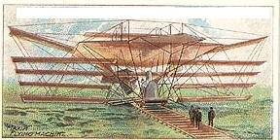

Surface Force as an Extensive Property
Recognize the intensive cause behind the extensive effect.
Step 1: The first index i refers to the axis, to which the fluid element surface is perpendicular.
The second index j indicates the direction of the force component.

Slide 10
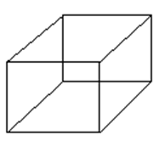
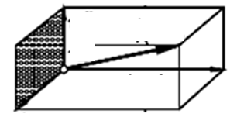
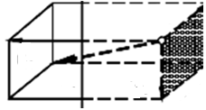
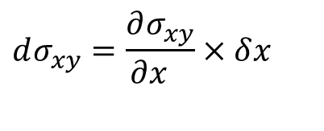

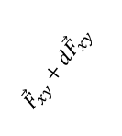
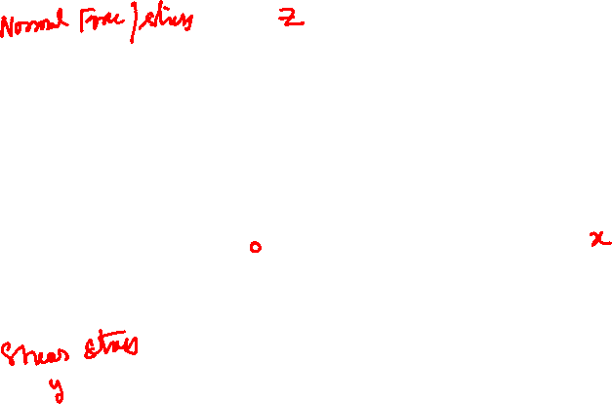
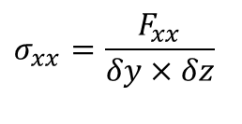
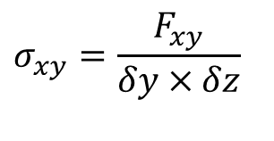



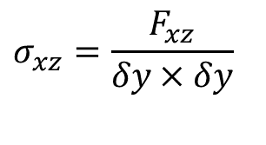


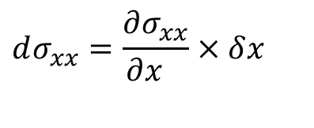


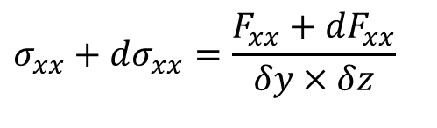
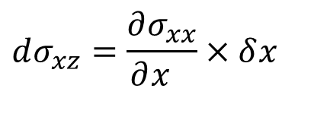


Force per unit area : An Important Tensor in Fluid Flows
$$σ_{xx}=\frac{F_{xx}}{δy×δz}$$
$$δx$$
$$σ_{xx}+dσ_{xx}=\frac{F_{xx}+dF_{xx}}{δy×δz}$$
$$δy$$
$$δz$$
$${\vec{F}}_{xy}+d{\vec{F}}_{xy}$$
$${\vec{F}}_{xy}$$
$${\vec{F}}_{x}+d{\vec{F}}_{x}$$
$${\vec{F}}_{xx}$$
$${\vec{F}}_{xx}+d{\vec{F}}_{xx}$$
$${\vec{F}}_{x}$$
$${\vec{F}}_{xz}$$
$${\vec{F}}_{xz}+d{\vec{F}}_{xz}$$
$$σ_{xz}=\frac{F_{xz}}{δy×δy}$$
$$dσ_{xy}=\frac{∂σ_{xy}}{∂x_{}}×δx_{}$$
$$dσ_{xx}=\frac{∂σ_{xx}}{∂x_{}}×δx_{}$$
$$dσ_{xz}=\frac{∂σ_{xx}}{∂x_{}}×δx_{}$$
$$σ_{xy}=\frac{F_{xy}}{δy×δz}$$

Slide 11
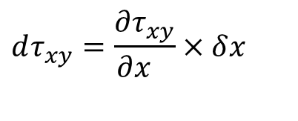


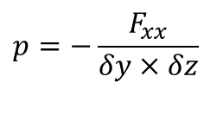
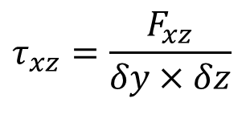

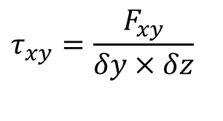
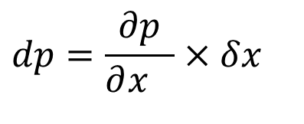

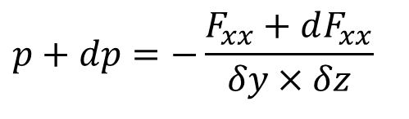
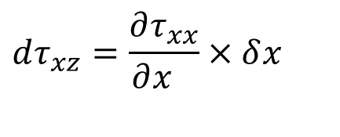

Pressure as Surface Force per unit area : A Component of Tensor in Fluid Flows
$$δx$$
$$p=−\frac{F_{xx}}{δy×δz}$$
$$δy$$
$$p+dp=−\frac{F_{xx}+dF_{xx}}{δy×δz}$$
$$δz$$
$${\vec{F}}_{xy}+d{\vec{F}}_{xy}$$
$${\vec{F}}_{xy}$$
$${\vec{F}}_{x}+d{\vec{F}}_{x}$$
$${\vec{F}}_{xx}+d{\vec{F}}_{xx}$$
$${\vec{F}}_{xx}$$
$${\vec{F}}_{x}$$
$${\vec{F}}_{xz}$$
$${\vec{F}}_{xz}+d{\vec{F}}_{xz}$$
$$dτ_{xy}=\frac{∂τ_{xy}}{∂x_{}}×δx_{}$$
$$τ_{xz}=\frac{F_{xz}}{δy×δz}$$
$$dp=\frac{∂p}{∂x_{}}×δx_{}$$
$$dτ_{xz}=\frac{∂τ_{xx}}{∂x_{}}×δx_{}$$
$$τ_{xy}=\frac{F_{xy}}{δy×δz}$$

Slide 12
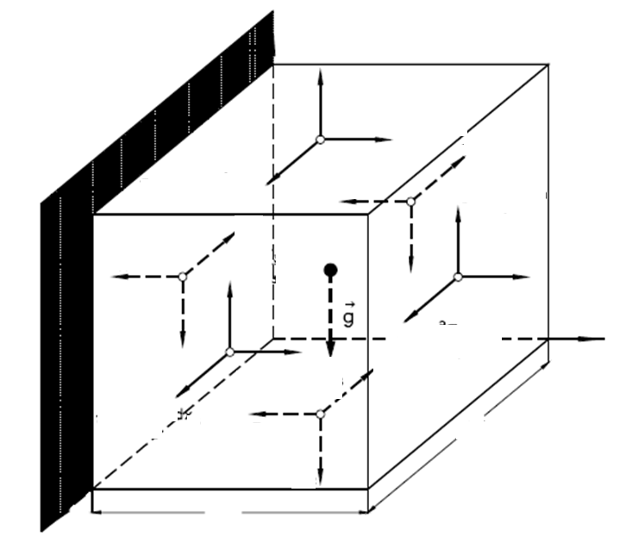
General Stress Condition on A Fluid Element

Slide 13
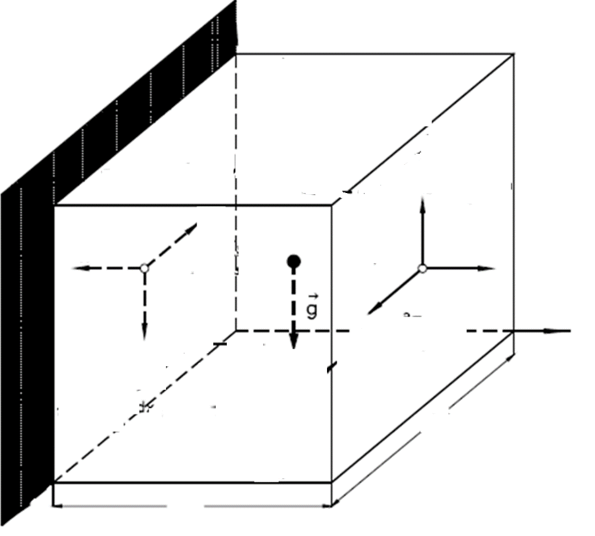

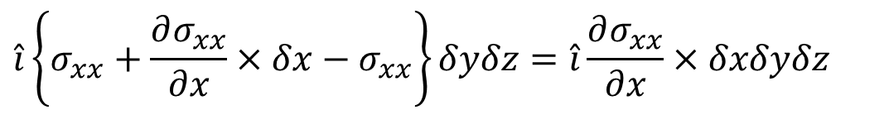
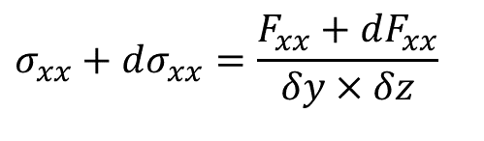
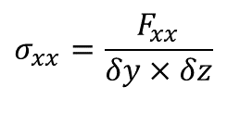
Force Balance on A Plane
Force Balance on Plane x in x direction:
$$\hat{i}\left\{σ_{xx}+\frac{∂σ_{xx}}{∂x}×δx−σ_{xx}\right\}δyδz=\hat{i}\frac{∂σ_{xx}}{∂x}×δxδyδz$$
z
$$=\hat{i}\frac{∂σ_{xx}}{∂x}×δV$$
$$σ_{xx}+dσ_{xx}=\frac{F_{xx}+dF_{xx}}{δy×δz}$$
$$σ_{xx}=\frac{F_{xx}}{δy×δz}$$
x
y

Slide 14
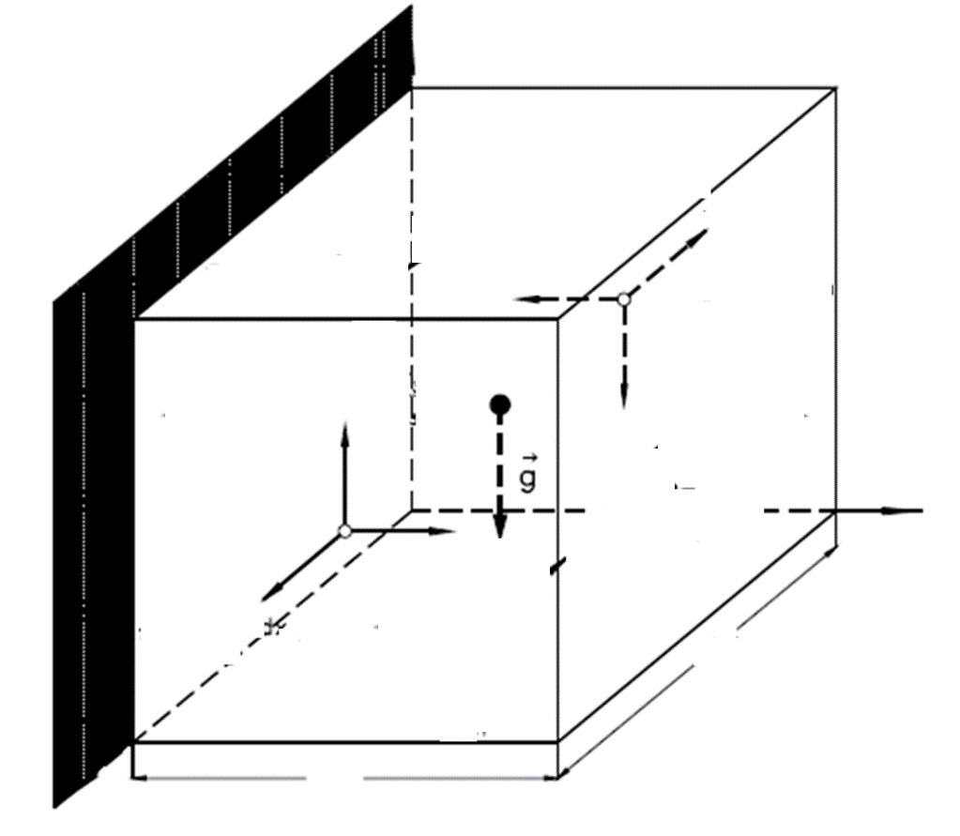
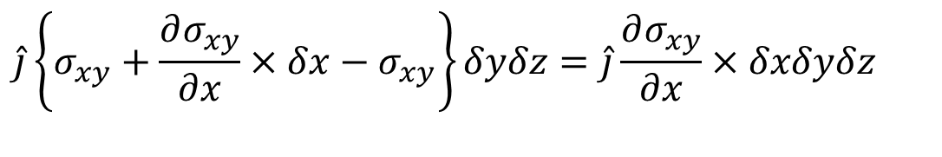
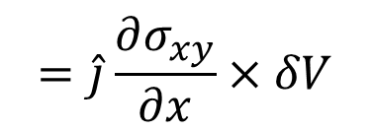
Force Balance on A Plane
Force Balance on Plane x in y direction:
$$\hat{j}\left\{σ_{xy}+\frac{∂σ_{xy}}{∂x}×δx−σ_{xy}\right\}δyδz=\hat{j}\frac{∂σ_{xy}}{∂x}×δxδyδz$$
$$=\hat{j}\frac{∂σ_{xy}}{∂x}×δV$$

Slide 15
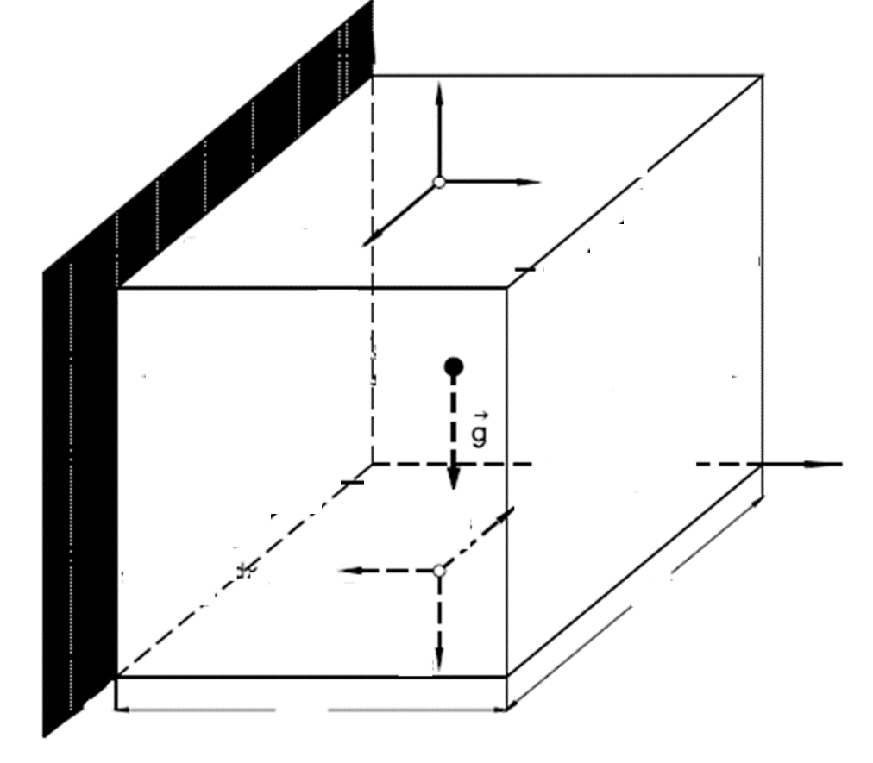
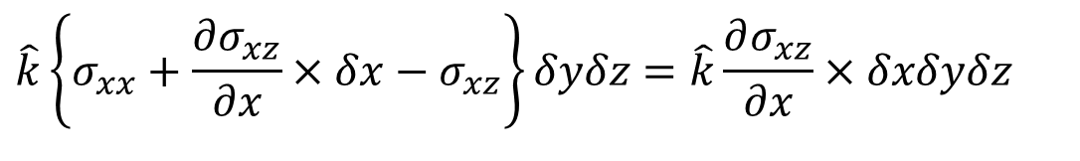
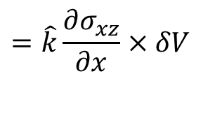
Force Balance on A Plane
Force Balance on Plane x in z direction:
$$\hat{k}\left\{σ_{xx}+\frac{∂σ_{xz}}{∂x}×δx−σ_{xz}\right\}δyδz=\hat{k}\frac{∂σ_{xz}}{∂x}×δxδyδz$$
$$=\hat{k}\frac{∂σ_{xz}}{∂x}×δV$$

Slide 16
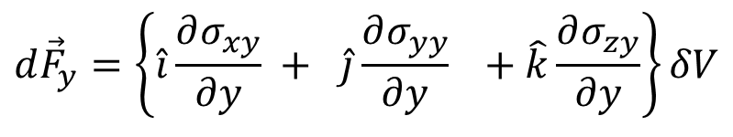
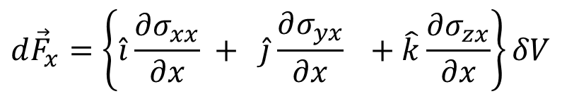
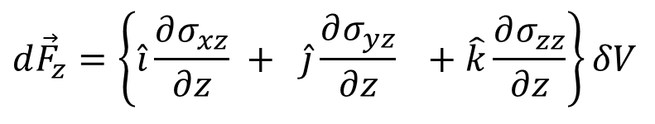
The Resultant Force on An Element
The resulting Force on Plane x:
$$d{\vec{F}}_{x}=\left\{\hat{i}\frac{∂σ_{xx}}{∂x} + \hat{j}\frac{∂σ_{yx}}{∂x} +\hat{k}\frac{∂σ_{zx}}{∂x}\right\}δV$$
The resulting Force on Plane y:
$$d{\vec{F}}_{y}=\left\{\hat{i}\frac{∂σ_{xy}}{∂y} + \hat{j}\frac{∂σ_{yy}}{∂y} +\hat{k}\frac{∂σ_{zy}}{∂y}\right\}δV$$
The resulting Force on Plane z:
$$d{\vec{F}}_{z}=\left\{\hat{i}\frac{∂σ_{xz}}{∂z} + \hat{j}\frac{∂σ_{yz}}{∂z} +\hat{k}\frac{∂σ_{zz}}{∂z}\right\}δV$$

Slide 17

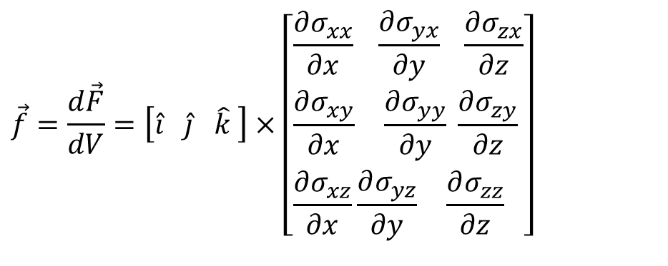

Force Balance on Differential Element
The total resulting force acting across the entire surface of an infinitesimal element is obtained by considering the nine components.
$$d\vec{F}=\left[\hat{i} \hat{j} \hat{k} \right]×\left[\begin{aligned}&\frac{∂σ_{xx}}{∂x} \frac{∂σ_{yx}}{∂y} \frac{∂σ_{zx}}{∂z} \\ &\frac{∂σ_{xy}}{∂x} \frac{∂σ_{yy}}{∂y} \frac{∂σ_{zy}}{∂z} \\ &\frac{∂σ_{xz}}{∂x}\frac{∂σ_{yz}}{∂y} \frac{∂σ_{zz}}{∂z}\end{aligned}\right]dV$$
Divide the resultant force by dV and obtain intensive equivalent of dF
$$\vec{f}=\frac{d\vec{F}}{dV}=\left[\hat{i} \hat{j} \hat{k} \right]×\left[\begin{aligned}&\frac{∂σ_{xx}}{∂x} \frac{∂σ_{yx}}{∂y} \frac{∂σ_{zx}}{∂z} \\ &\frac{∂σ_{xy}}{∂x} \frac{∂σ_{yy}}{∂y} \frac{∂σ_{zy}}{∂z} \\ &\frac{∂σ_{xz}}{∂x}\frac{∂σ_{yz}}{∂y} \frac{∂σ_{zz}}{∂z}\end{aligned}\right]$$

Slide 18



Stress is the Mother of Force
The stress is A tensor
It can be easily shown that
$$d\vec{F}=∇•\vec{\vec{σ}} dV$$
The above expression is a scalar differentiation of the second order stress tensor and is called the divergence of the tensor field.
We conclude that the net surface force acting on the surface of a fluid element is the divergence of its stress tensor.
The stress tensor is usually divided into its normal and shear stress parts.
$$\frac{d\vec{F}}{dV}=\left[\begin{aligned}&\hat{i}\frac{∂σ_{xx}}{∂x} \hat{j}\frac{∂τ_{xy}}{∂x} \hat{k}\frac{∂τ_{xz}}{∂x} \\ &\hat{i}\frac{∂τ_{yx}}{∂y} \hat{j}\frac{∂σ_{yy}}{∂y} \hat{k}\frac{∂τ_{yz}}{∂y} \\ &\hat{i}\frac{∂τ_{zx}}{∂z} \hat{j}\frac{∂τ_{zy}}{∂z} \hat{k}\frac{∂σ_{zz}}{∂z}\end{aligned}\right]$$
$${\vec{f}}_{surface}=∇•\vec{\vec{σ}}$$

Slide 19



The velocity & Pressure Field due to an Ideal Flow Past A Cylinder
Deformation of Streamlines due to a Cylindrical Body
p_{flow-near-surface <} p∞
p_{flow-near-surface} > p∞

Slide 20


The Pressure Field due to Flow Past A Cylinder
Streamlines

Slide 21



The velocity & Pressure Field due to an Ideal Flow Past A Rotating Cylinder
Deformation of Streamlines due to a Rotation Cylindrical Body
P_{flow-near-surface <} p∞
P_{flow-near-surface} > p∞

Slide 22

Magnus Effect in Aeronautics
Rotor airplane concept by Ernst Zeuzem

Slide 23

Magnus Effect in Aeronautics
1925
Span: 13m
Length: 8.6 m
Height: 2.7 m
Rotor diameter: 1.2 m
Rotating speed: 550–1600 rpm
Engine power: 550hp
OWE: 1050kg Payload: 550
Model Rotor-Zeuzem

Slide 24

Magnus Effect in Aeronautics
Rotor airplane concept by Gerhard Wilke

Slide 25




The velocity & Pressure Field due to an aerofoil

