Slide 1

History and Basics of Fluid Mechanics
P M V Subbarao
Professor
Mechanical Engineering Department
An Engineering Science to Create Forces for Human Development…

Slide 2




The Surprising Natural Fluid systems
Compared to solids fluids seem almost alive, magical.
They flow, change form to accommodate the surroundings, produce gurgling sounds, and refract light to produce shimmer.
There are few things that can match the majesty of a waterfall or the wind.
What causes (Primarily) fluids to flow?

Slide 3
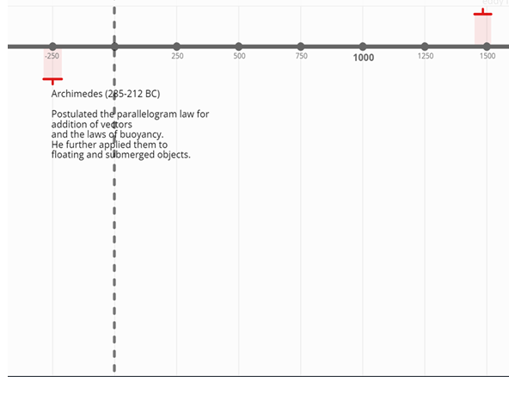
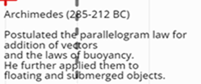
Timeline of Fluid Mechanics History : BC
https://time.graphics/line/414039

Slide 4
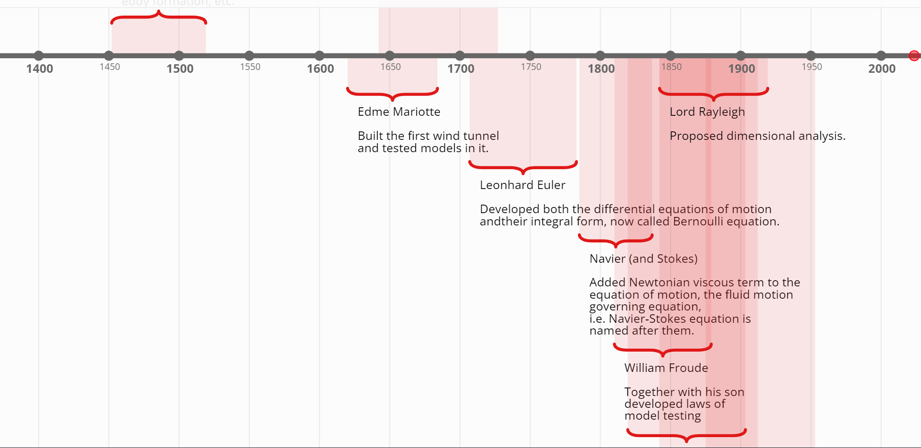
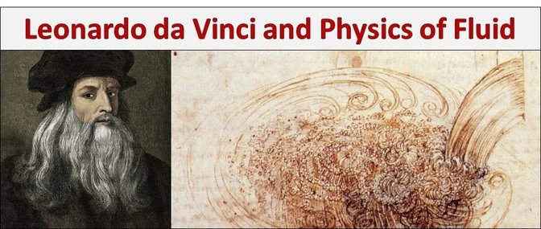
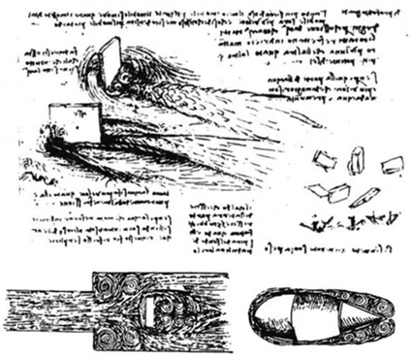
Timeline of Fluid Mechanics History:
15th Century
Father of Flow Visualization or Pictorial Fluid Dynamics
https://time.graphics/line/414039

Slide 5
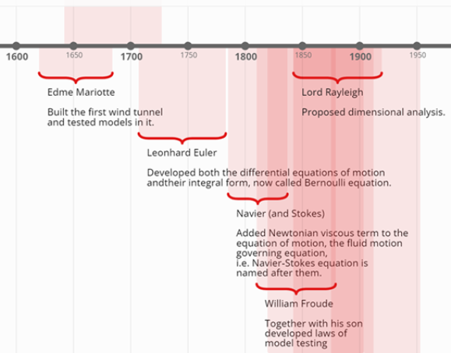
Timeline of Fluid Mechanics History: 16th Century
Mariotte is recognized for building the first wind tunnel, a device that allows for the study of airflow around objects.
Mariotte's wind tunnel work laid the groundwork for later advancements in aerodynamics and the design of aircraft.
https://time.graphics/line/414039

Slide 6
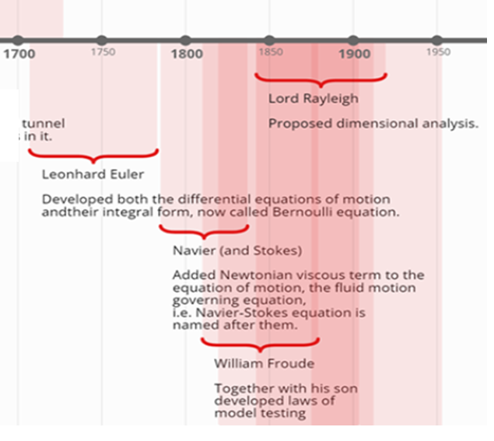

Timeline of Fluid Mechanics History:
17th to 19th Century
https://time.graphics/line/414039

Slide 7
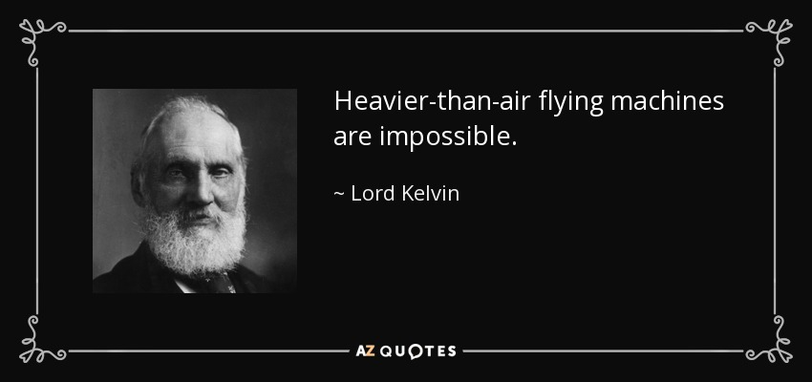
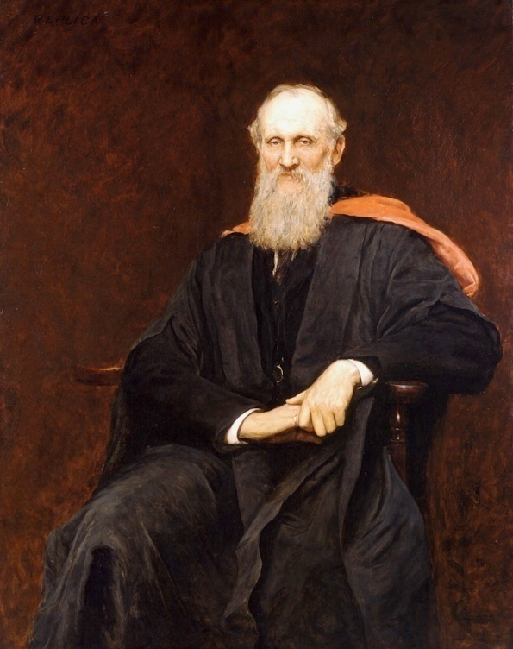
Now I think hydrodynamics is to be the root of all physical sciences,……...
William Thomson (Lord Kelvin)
(1824 --1907)

Slide 8
20th Century : The Shocking News in New York Times
1 million to 10 million years they might be able to make a plane that would fly ?!?!?!
People had dreamed of flying for many years.
The United States Army was trying to develop an airplane in 1903, but the plane wouldn't fly.
The New York Times wrote that maybe in
1 million to 10 million years they might be able to make a plane that would fly.
Only eight days later two men were successful in flying the first manned plane.
They were Wilbur Wright and his younger brother, Orville.

Slide 9
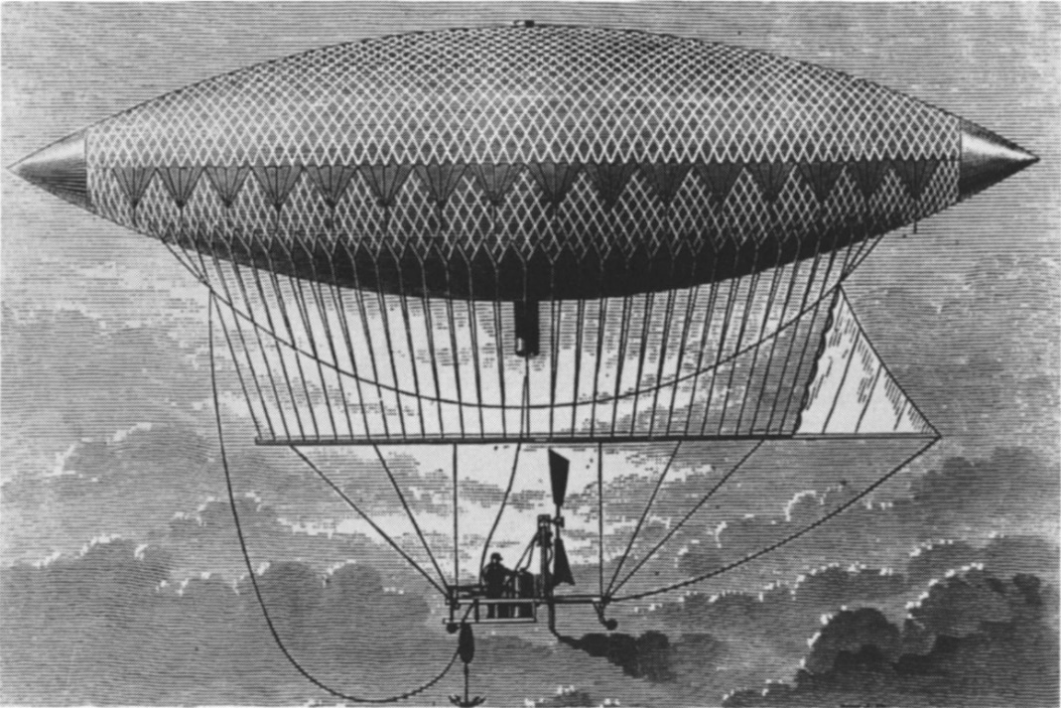
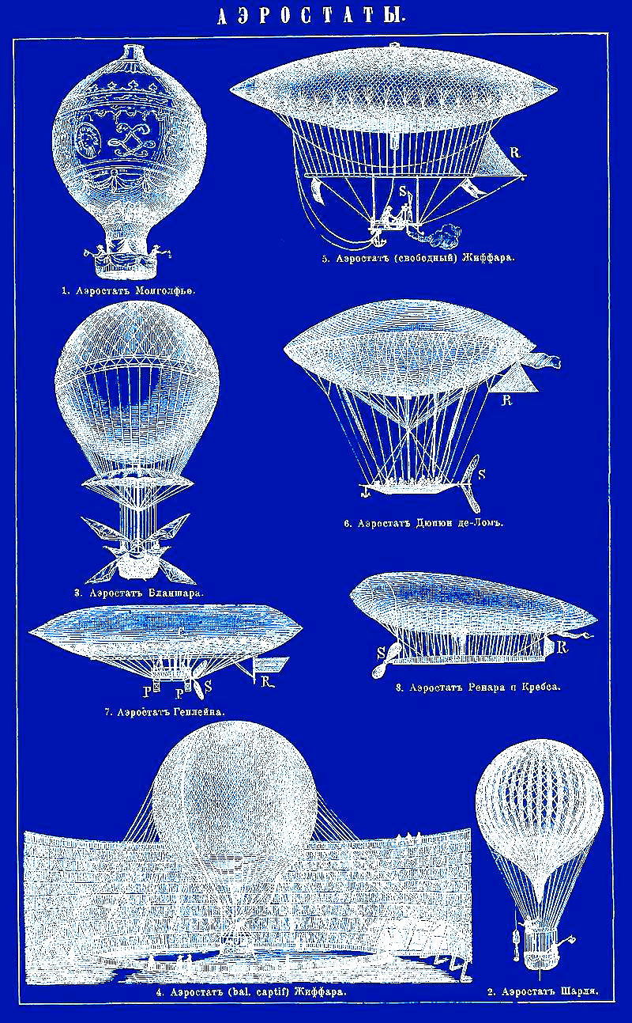

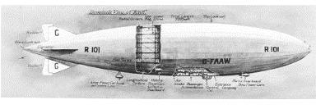
19th Century Air Ships

Slide 10

Kate Carew Interviews the Wright Brothers
“Are you manufacturing any racing machines?”
“Not just now, but we intend to.”
“How much can I buy one for?”
“Seven thousand five hundred-dollars.”
“Is that all? It doesn’t seem like an outside price for a perfectly good airship?”
“Airship!” shouted the Wright brothers indignantly.
“Is that the wrong word?”
“An airship,” said Wilbur contemptuously, “is a big, clumsy balloon filled with gas.”
“Well, I don’t see why your biplane shouldn’t be called an airship, too.”

Slide 11
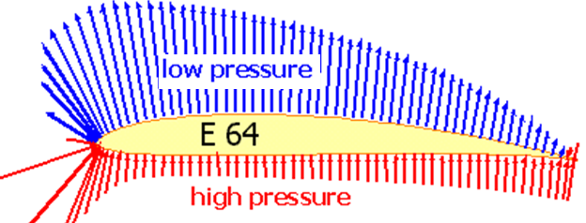
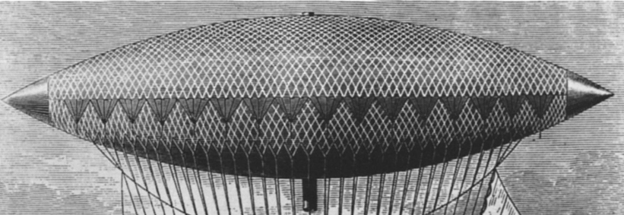
A Ship Can’t Fly
“It’s a flying machine,” said Wilbur.
“The name we prefer is ‘flyer,’” said Orville.
“An airship would cost $50,000,” said Wilbur.
“More like $150,000,” said Orville, and they argued the question.
Right Action to generate Lift

Slide 12

Development of an Ultimate Fluid machine

Slide 13
21st Century Made Fluid Mechanics as Universal Engineering Tool.

Slide 14
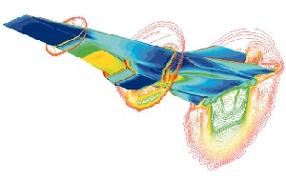
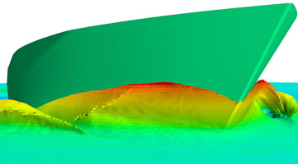
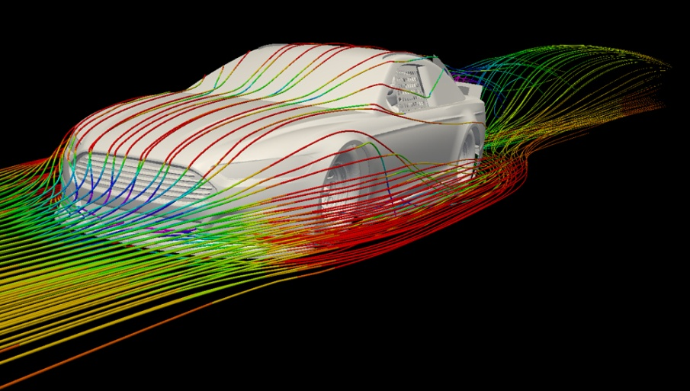
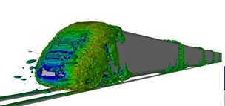
Fluid Flows in Transportation Sector

Slide 15
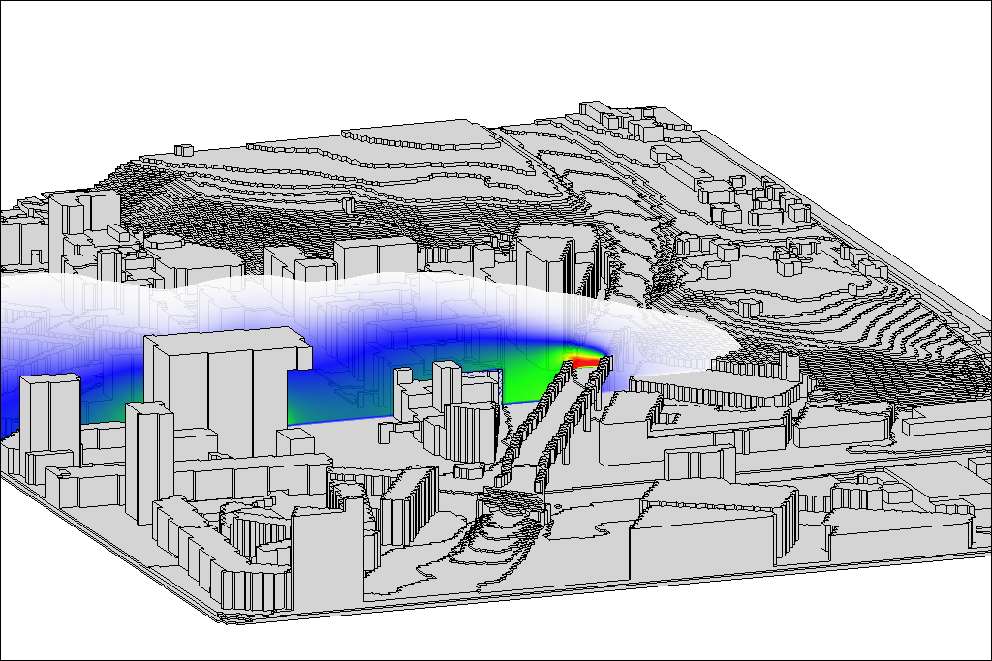
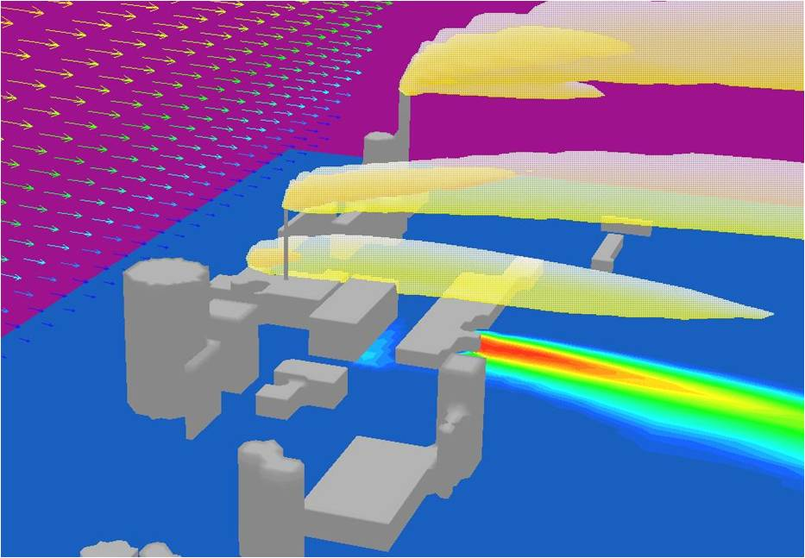
Environmental Fluid Flows

Slide 16
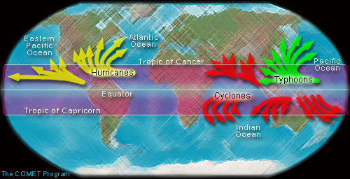
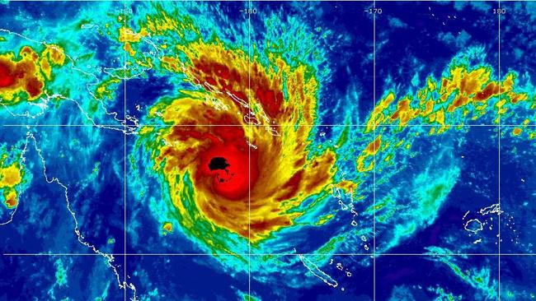
Weather & Fluid Flows

Slide 17
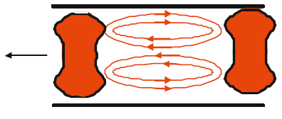
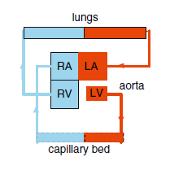
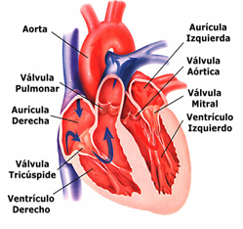
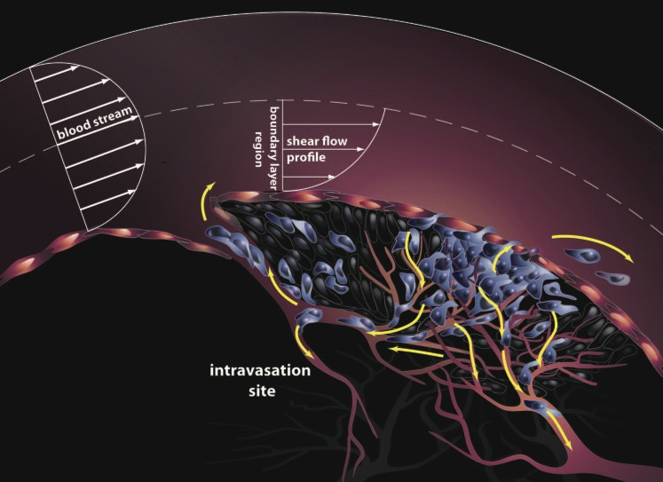
Biological Fluid Flows

Slide 18
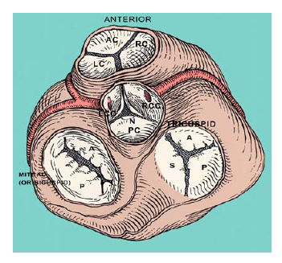


Knowledge of Viscous Fluid Flow for Design of Artificial Heart Valves

Slide 19
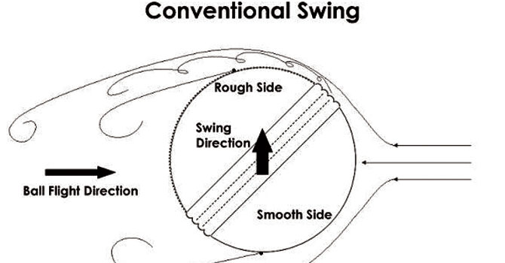
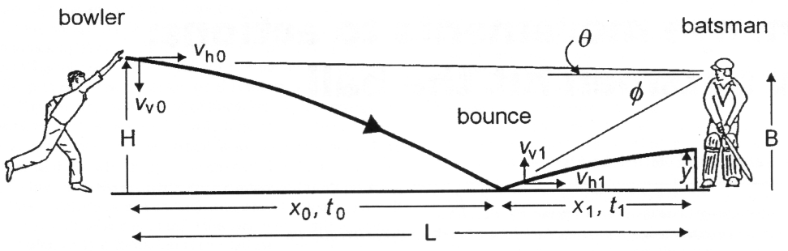
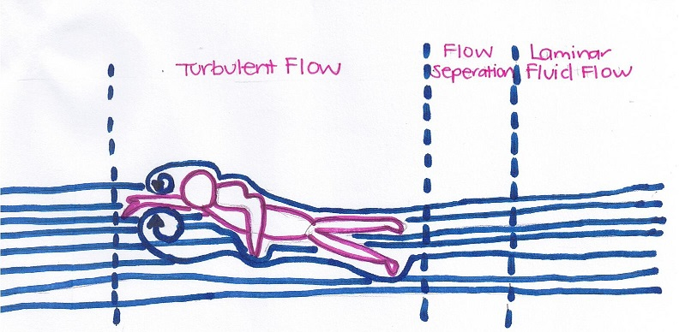
Fluid Flows for Sports

Slide 20
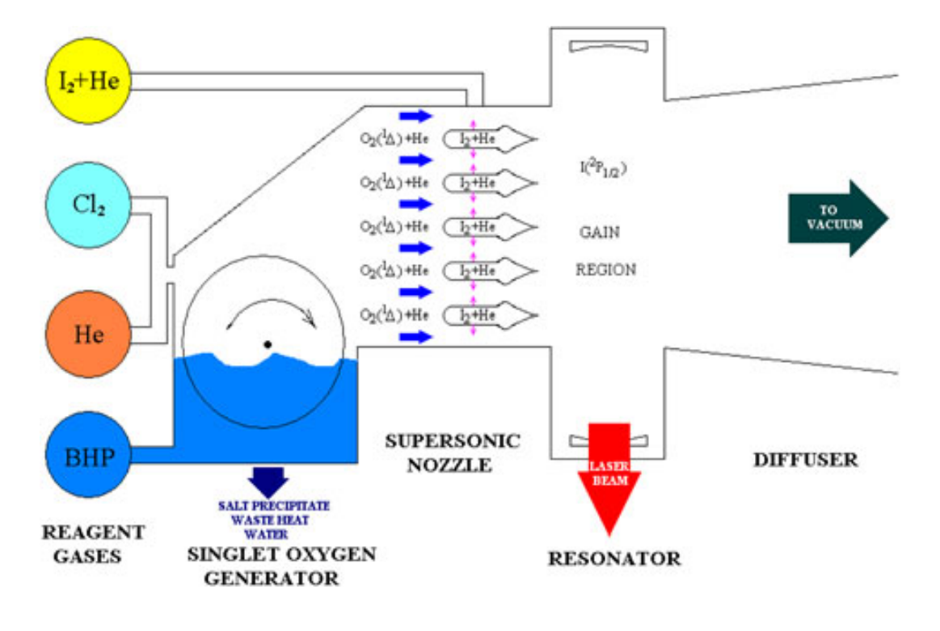
Direct Energy Weapons for Indian Defense
25 March 2023: https://www.drishtiias.com/eng
Recently, India’s Air Chief Marshal highlighted the need to push the development of Directed Energy Weapons (DEWs) and Hypersonic Weapons and integrate them into its airborne platforms to get the desired range and accuracy

Slide 21
Fluid Mechanics: An Inspiring Engineering Science
Attracted the attention of Philosophers, Mathematicians and Skillful engineers.
Professor of Medicine dedicated his life to study of fluid flow through ducts and pipes…
Great painter developed ‘Science of Defence’ to ensure Peace..
…..
…..
….

Slide 22


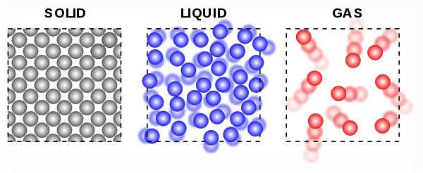
Solids vs Fluids : Microscopic View
Solid
Fluid

Slide 23
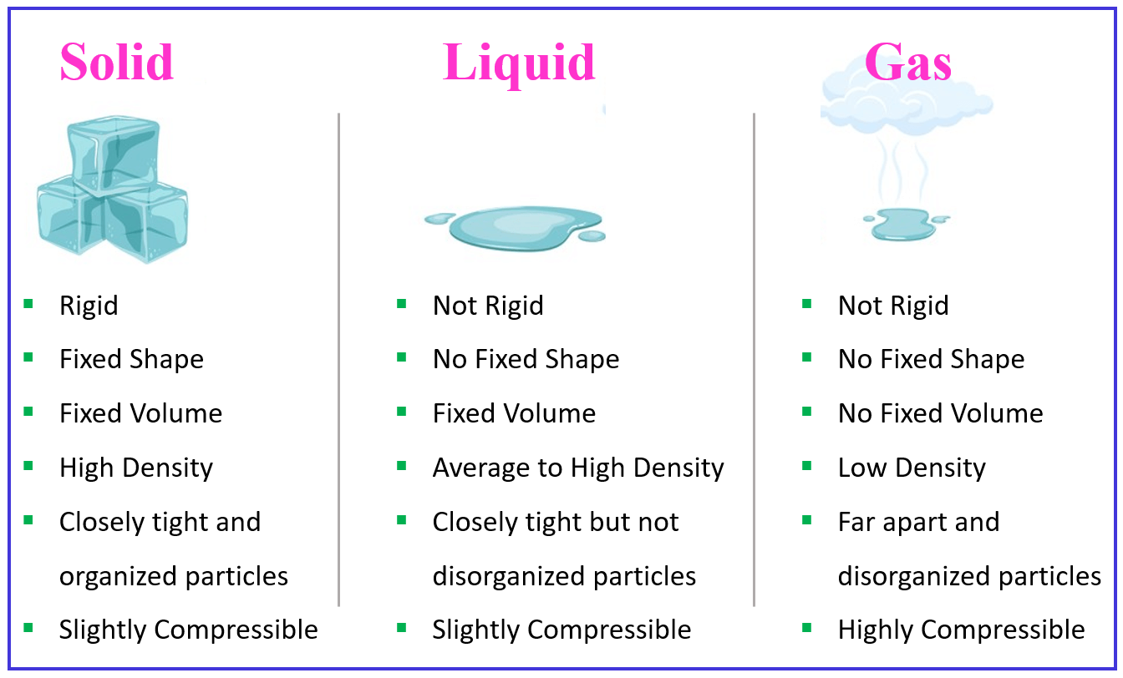
Solids vs Fluids : Macroscopic View

Slide 24
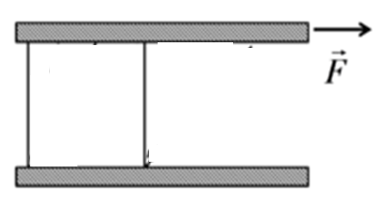
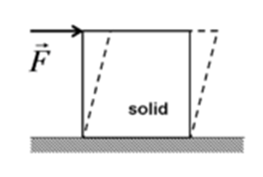
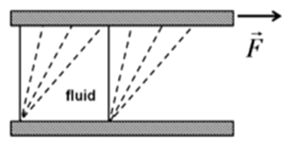
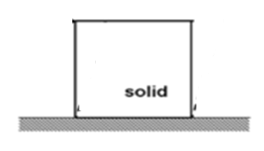

Solids vs Fluids : Ingenuous View
A fluid continually deforms (flows) under an applied shear force regardless of the magnitude of the applied stress.
A solid resists an applied force by static deformation.

