Slide 1

Reynolds Transport Theorem
P M V Subbarao
Professor
Mechanical Engineering Department
An Essential Mathematical Framework to Model and Analyze Fluid Dynamic Devices……

Slide 2


The Need & Origin
The conservation laws are (strictly speaking), valid only for closed systems (Control Mass).
Fluid Dynamics deals with open systems (Control Volume), where the mass flow continuously crosses the system boundary.
Osborne Reynolds (1842–1912), developed a three-dimensional generalization of the Leibniz integral rule.
It is used in formulating the basic conservation equations for control volumes.
This is known as Reynolds Transport Theorem.

Slide 3
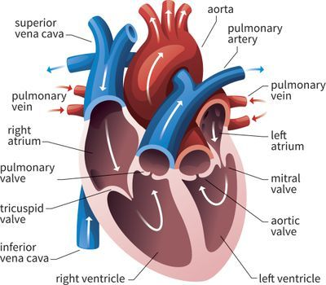
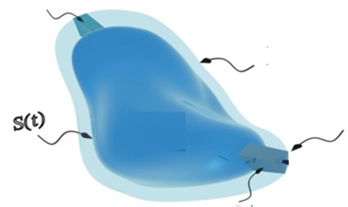
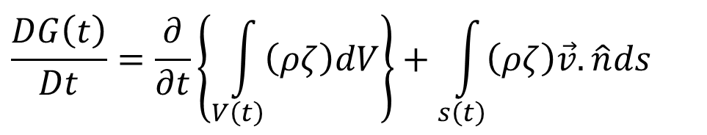
Engineering View of Reynolds Transformation
The Eulerian derivative of any property of an integral flow system is
$$\frac{DG\left(t\right)}{Dt}=\frac{∂}{∂t}\left\{\int_{V\left(t\right)}{\left(ρζ\right)dV}\right\}+\int_{s\left(t\right)}{\left(ρζ\right)\vec{v}.\hat{n}ds}$$
Inflow
$$S\left(t+∆t\right)$$
outflow

Slide 4
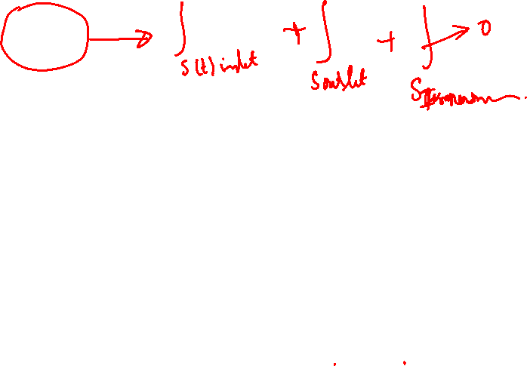
Vector Models of Inflow & Outflow
$$\frac{DG\left(t\right)}{Dt}=\frac{∂}{∂t}\left\{\int_{V\left(t\right)}{\left(ρζ\right)dV}\right\}+\int_{s\left(t\right)}{\left(ρζ\right)\vec{v}.\hat{n}ds}$$
$${\left[\vec{v}.\hat{n}ds\right]}_{inlet}={\vec{v}}_{inlet}∙{d\vec{A}}_{inlet}$$
$${\vec{A}}_{inlet}$$
$${\vec{v}}_{inlet}$$
Inflow
$$S\left(t+∆t\right)$$
outflow
$${\vec{v}}_{outlet}$$
$${\vec{A}}_{outlet}$$
$${\left[\vec{v}.\hat{n}ds\right]}_{outlet}={\vec{v}}_{outlet}∙{d\vec{A}}_{outlet}$$

Slide 5
Vector Models for Inflow & Outflow
$$\frac{DG\left(t\right)}{Dt}=\frac{∂}{∂t}\left\{\int_{V\left(t\right)}{\left(ρζ\right)dV}\right\}+\int_{s\left(t\right)}{\left(ρζ\right)\vec{v}.\hat{n}ds}$$
$${\left[\vec{v}.\hat{n}ds\right]}_{inlet}={\left[vnormal×dS\right]}_{inlet}$$
$${\vec{A}}_{inlet}$$
$${\vec{v}}_{inlet}$$
Inflow
$$S\left(t+∆t\right)$$
outflow
$${\vec{v}}_{outlet}$$
$${\vec{A}}_{outlet}$$
$${\left[\vec{v}.\hat{n}ds\right]}_{outlet}={\left[vnormal×dS\right]}_{outlet}$$

Slide 6
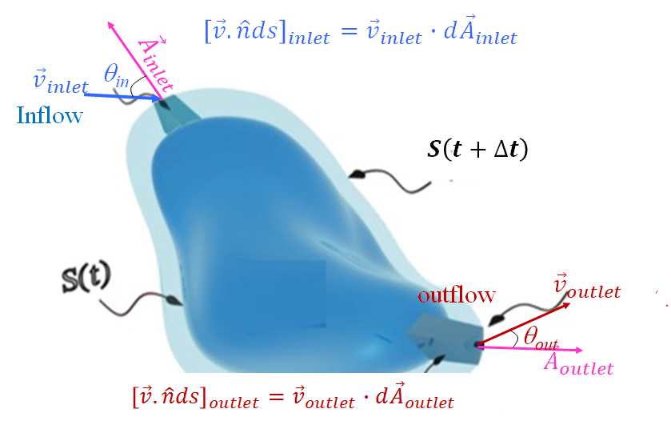
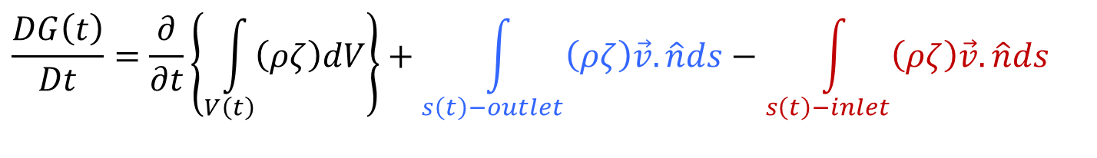
Vectorial Models for Inflow & Outflow in Engineering Fluid Mechanics
$$\frac{DG\left(t\right)}{Dt}=\frac{∂}{∂t}\left\{\int_{V\left(t\right)}{\left(ρζ\right)dV}\right\}+\int_{s\left(t\right)}{\left(ρζ\right)\vec{v}.\hat{n}ds}$$
$$\frac{DG\left(t\right)}{Dt}=\frac{∂}{∂t}\left\{\int_{V\left(t\right)}{\left(ρζ\right)dV}\right\}+\int_{s\left(t\right)−outlet}{\left(ρζ\right)\vec{v}.\hat{n}ds}−\int_{s\left(t\right)−inlet}{\left(ρζ\right)\vec{v}.\hat{n}ds}$$

Slide 7
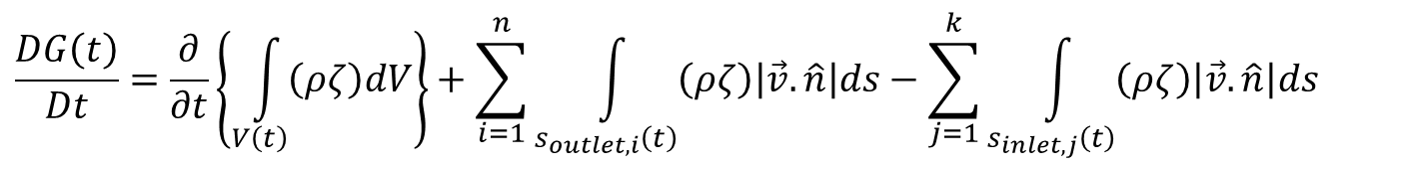

Engineering Version of RTT
$$\frac{DG\left(t\right)}{Dt}=\frac{∂}{∂t}\left\{\int_{V\left(t\right)}{\left(ρζ\right)dV}\right\}+\int_{s\left(t\right)−outlet}{\left(ρζ\right)\vec{v}.\hat{n}ds}−\int_{s\left(t\right)−inlet}{\left(ρζ\right)\vec{v}.\hat{n}ds}$$
Real Flow systems may have multiple inlets and outlets.
$$\frac{DG\left(t\right)}{Dt}=\frac{∂}{∂t}\left\{\int_{V\left(t\right)}{\left(ρζ\right)dV}\right\}+\sum_{i=1}^{n}{\int_{s_{outlet,i}\left(t\right)}{\left(ρζ\right)\left|\vec{v}.\hat{n}\right|ds}}−\sum_{j=1}^{k}{\int_{s_{inlet,j}\left(t\right)}{\left(ρζ\right)\left|\vec{v}.\hat{n}\right|ds}}$$

Slide 8
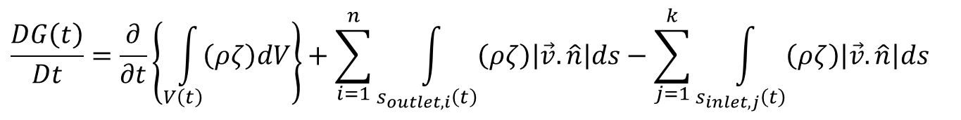
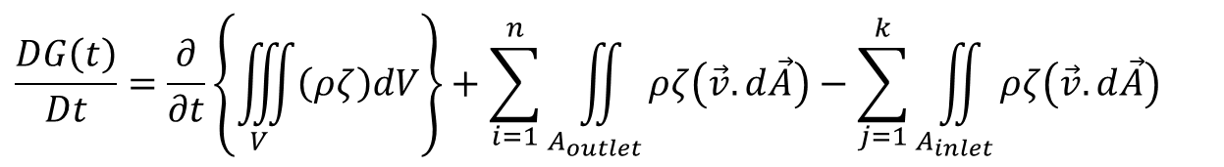
Engineering Version of RTT
Practical Flow systems may have multiple inlets and outlets.
$$\frac{DG\left(t\right)}{Dt}=\frac{∂}{∂t}\left\{\int_{V\left(t\right)}{\left(ρζ\right)dV}\right\}+\sum_{i=1}^{n}{\int_{s_{outlet,i}\left(t\right)}{\left(ρζ\right)\left|\vec{v}.\hat{n}\right|ds}}−\sum_{j=1}^{k}{\int_{s_{inlet,j}\left(t\right)}{\left(ρζ\right)\left|\vec{v}.\hat{n}\right|ds}}$$
$$\frac{DG\left(t\right)}{Dt}=\frac{∂}{∂t}\left\{\iiint_{V}{\left(ρζ\right)dV}\right\}+\sum_{i=1}^{n}{\iint_{A_{outlet}}{ρζ\left(\vec{v}.d\vec{A}\right)}}−\sum_{j=1}^{k}{\iint_{A_{inlet}}{ρζ\left(\vec{v}.d\vec{A}\right)}}$$
$${\left.\frac{dG\left(t\right)}{dt}\right|}_{CM}={\left.\frac{dG\left(t\right)}{dt}\right|}_{CV}+\sum_{i=1}{{\dot{G}}_{outlet,i}}−\sum_{i=1}{{\dot{G}}_{inlet,i}}$$

Slide 9
Conservation of Mass
The conservation law of mass requires that the mass contained in a control mass, must be constant:
Mass contained in a Control volume
$$m=\int_{V\left(t\right)}{ρdV}$$
How to get this value during any engineering action by a CV?
What is the value of ζ to get “conservation of Mass”??
$${\left.\frac{dG\left(t\right)}{dt}\right|}_{CM}=\frac{∂}{∂t}\left\{\iiint_{V}{\left(ρζ\right)dV}\right\}+\sum_{i=1}^{n}{\iint_{A_{exit}}{ρζ\left(\vec{v}.d\vec{A}\right)}}−\sum_{j=1}^{m}{\iint_{A_{inlet}}{ρζ\left(\vec{v}.d\vec{A}\right)}}$$

Slide 10

RTT for Conservation of Mass
$${\left.\frac{dG\left(t\right)}{dt}\right|}_{CM}=\frac{∂}{∂t}\left\{\iiint_{V}{\left(ρζ\right)dV}\right\}+\sum_{i=1}^{n}{\iint_{A_{exit}}{ρζ\left(\vec{v}.d\vec{A}\right)}}−\sum_{j=1}^{m}{\iint_{A_{inlet}}{ρζ\left(\vec{v}.d\vec{A}\right)}}$$
Consider a flow field with field variable value ζ=1 and substitute the same in above equation.
$${\left.\frac{dm\left(t\right)}{dt}\right|}_{CM}=\frac{∂}{∂t}\left\{\iiint_{V}{ρdV}\right\}+\sum_{i=1}{\iint_{A_{exit}}{ρ\left(\vec{v}.d\vec{A}\right)}}−\sum_{j=}{\iint_{A_{inlet}}{ρ\left(\vec{v}.d\vec{A}\right)}}$$
$${\left.\frac{dm\left(t\right)}{dt}\right|}_{CM}={\left.\frac{dm\left(t\right)}{dt}\right|}_{CV}+\sum_{i=1, 2…}{{\dot{m}}_{outlet,i}}−\sum_{i=1,2…}{{\dot{m}}_{inlet,i}}=0$$

Slide 11
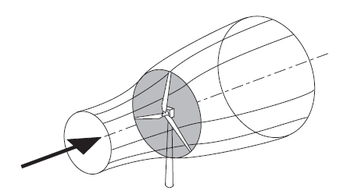
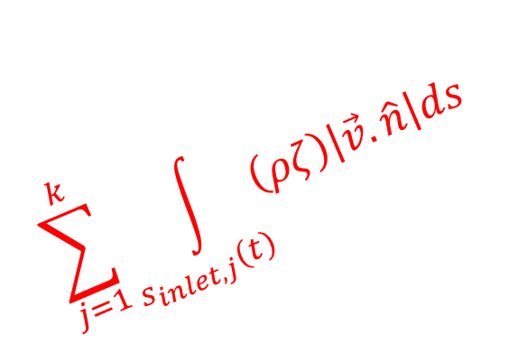
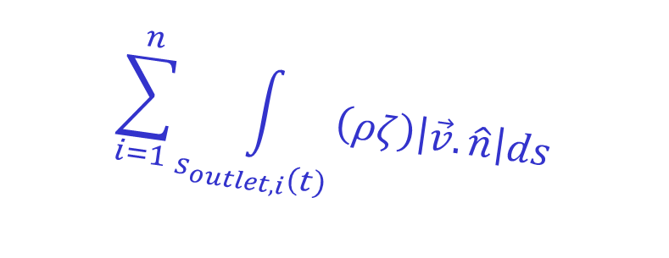
Wind Systems Interacting with A Wind Turbine
$$\sum_{i=1}^{n}{\int_{s_{outlet,i}\left(t\right)}{\left(ρζ\right)\left|\vec{v}.\hat{n}\right|ds}}$$
$$\sum_{j=1}^{k}{\int_{s_{inlet,j}\left(t\right)}{\left(ρζ\right)\left|\vec{v}.\hat{n}\right|ds}}$$

Slide 12
Conservation of Linear Momentum
The momentum equation in integral form applied to a control volume determines the integral flow quantities such as blade lift, drag forces, average pressure.
The motion of a control mass is described by Newton’s second law of motion which states that mass times acceleration is the sum of all external forces acting on the system.
These forces are identified as electrodynamic, electrostatic, and magnetic forces, viscous forces, gravitational forces ….
For a control mass
$m\frac{d\left\{\vec{v}\left(\vec{x},t\right)\right\}}{dt}=\sum{{\vec{F}}_{Body,i}}+$ $\sum{{\vec{F}}_{surface,i}}$
This equation is valid for a closed system with a system boundary that may undergo deformation, rotation, expansion or compression.

Slide 13
Balance of Momentum for Fluid Flow
In a flow, there is no closed system with a defined system boundary.
The mass is continuously flowing from one point to another point.
Thus, in general, we deal with mass flow rate rather than mass.
Consequently, the previous equation must be modified in such a way that it is applicable to a predefined control volume with mass flow rate passing through it.
This requires applying the Reynolds transport theorem to a control volume.

Slide 14
RTT for Conservation of Momentum
$${\left.\frac{dG\left(t\right)}{dt}\right|}_{CM}=\frac{∂}{∂t}\left\{\iiint_{V}{\left(ρζ\right)dV}\right\}+\sum_{i=1}^{n}{\iint_{A_{exit}}{ρζ\left(\vec{v}.d\vec{A}\right)}}−\sum_{j=1}^{m}{\iint_{A_{inlet}}{ρζ\left(\vec{v}.d\vec{A}\right)}}$$
Consider a flow field with field variable value ζ=$\vec{v}$ and substitute the same in above equation.
$${\left.\frac{d\left(m\vec{v}\right)}{dt}\right|}_{CM}=\frac{∂}{∂t}\left\{\iiint_{V}{ρ\vec{v}dV}\right\}+\sum_{i=1}{\iint_{A_{exit}}{ρ\vec{v}\left(\vec{v}.d\vec{A}\right)}}−\sum_{j=}{\iint_{A_{inlet}}{ρ\vec{v}\left(\vec{v}.d\vec{A}\right)}}$$
$$\frac{∂}{∂t}\left\{\iiint_{V}{ρ\vec{v}dV}\right\}+\sum_{i=1}{\iint_{A_{exit}}{ρ\vec{v}\left(\vec{v}.d\vec{A}\right)}}−\sum_{j=}{\iint_{A_{inlet}}{ρ\vec{v}\left(\vec{v}.d\vec{A}\right)=\sum{{\vec{F}}_{Body,i}}+ \sum{{\vec{F}}_{surface,i}} }}$$

Slide 15
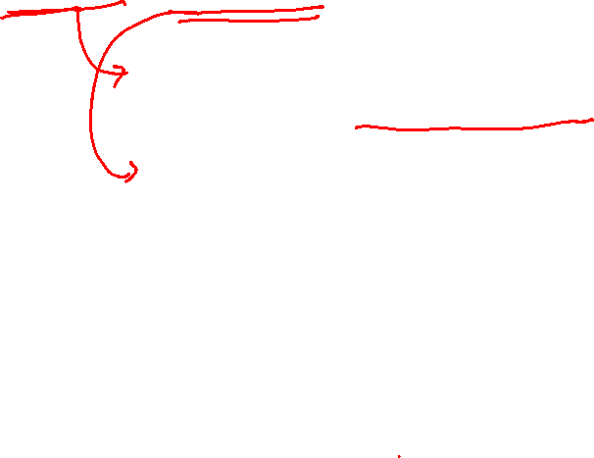
Vector form of Conservation of Momentum for Fluid Flows
$$\frac{∂}{∂t}\left\{\iiint_{V}{ρ\vec{v}dV}\right\}+\sum_{i=1}{\iint_{A_{exit}}{ρ\vec{v}\left(\vec{v}.d\vec{A}\right)}}−\sum_{j=}{\iint_{A_{inlet}}{ρ\vec{v}\left(\vec{v}.d\vec{A}\right)=\sum{{\vec{F}}_{Body,i}}+ \sum{{\vec{F}}_{surface,i}} }}$$
$$\frac{∂}{∂t}\left\{\iiint_{V}{ρ\vec{v}dV}\right\}=\frac{∂}{∂t}\left\{\iiint_{V}{ρ\left(u\hat{i}+v\hat{j}+w\hat{k}\right)dV}\right\}$$
$\iint_{A_{exit}}{ρ\vec{v}\left(\vec{v}.d\vec{A}\right)}$= $\iint_{A_{exit}}{ρ\left(u\hat{i}+v\hat{j}+w\hat{k}\right)\left(udA_{x}+vdA_{y}+wdA_{z}\right)}$
$\left[u\hat{i} v\hat{j} w\hat{k}\right] × \left[\begin{aligned}udA_{x} \\ \\ vdA_{y} \\ \\ wdA_{z}\end{aligned}\right]$

Slide 16
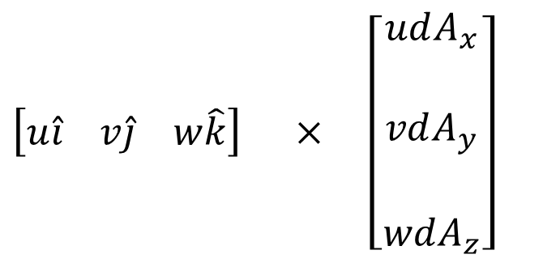
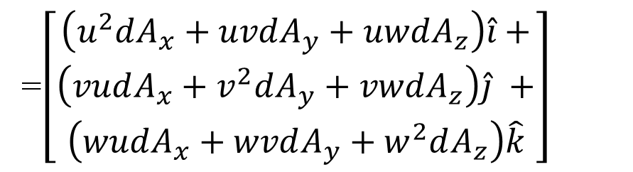
Vector form of Conservation of Momentum for Fluid Flows
$\left[u\hat{i} v\hat{j} w\hat{k}\right] × \left[\begin{aligned}udA_{x} \\ \\ vdA_{y} \\ \\ wdA_{z}\end{aligned}\right]$
=$\left[\begin{aligned}\left(u^{2}dA_{x}+uvdA_{y}+uwdA_{z}\right)\hat{i}+ \\ \left(vudA_{x}+v^{2}dA_{y}+vwdA_{z}\right)\hat{j} + \\ \left(wudA_{x}+wvdA_{y}+w^{2}dA_{z}\right)\hat{k}\end{aligned}\right]$

Slide 17
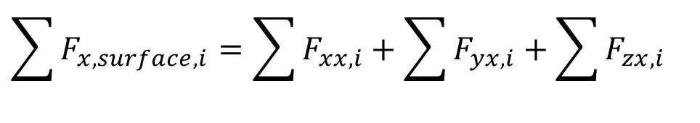
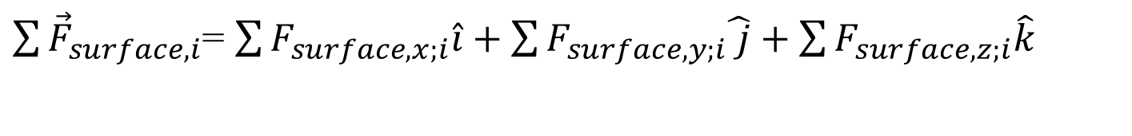
Vector form of Conservation of Momentum for Fluid Flows
$$\frac{∂}{∂t}\left\{\iiint_{V}{ρ\vec{v}dV}\right\}+\sum_{i=1}{\iint_{A_{exit}}{ρ\vec{v}\left(\vec{v}.d\vec{A}\right)}}−\sum_{j=}{\iint_{A_{inlet}}{ρ\vec{v}\left(\vec{v}.d\vec{A}\right)=\sum{{\vec{F}}_{Body,i}}+ \sum{{\vec{F}}_{surface,i}} }}$$
$\sum{{\vec{F}}_{Body,i}}$= $\sum{F_{x,Body,i}\hat{i}}+\sum{F_{y,Body,i}\hat{ j}}+\sum{F_{z,Body,i}\hat{k}}$
$\sum{{\vec{F}}_{surface,i}}$= $\sum{F_{surface,x;i}\hat{i}}+\sum{F_{surface,y;i}\hat{ j}}+\sum{F_{surface,z;i}\hat{k}}$
$$\sum{F_{x,surface,i}}=\sum{F_{xx,i}}+\sum{F_{yx,i}}+\sum{F_{zx,i}}$$

Slide 18
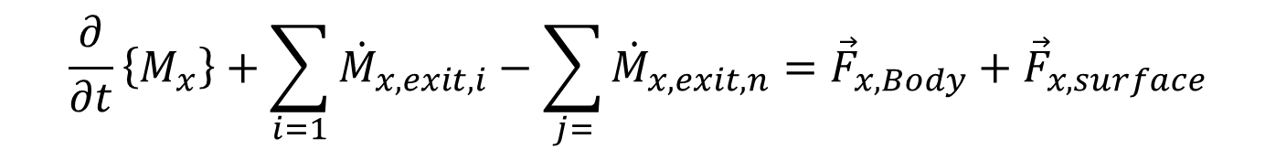
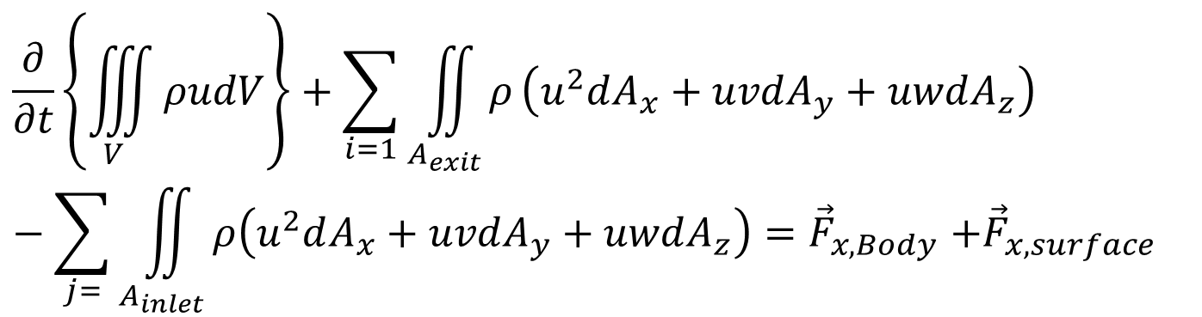
Components of Conservation of Momentum for Fluid Flows
X-Momentum Conservation Equation:
$$\frac{∂}{∂t}\left\{\iiint_{V}{ρudV}\right\}+\sum_{i=1}{\iint_{A_{exit}}{ρ}}\left(u^{2}dA_{x}+uvdA_{y}+uwdA_{z}\right)−\sum_{j=}{\iint_{A_{inlet}}{ρ\left(u^{2}dA_{x}+uvdA_{y}+uwdA_{z}\right){=\vec{F}}_{x,Body}+{\vec{F}}_{x,surface}}}$$
$$\frac{∂}{∂t}\left\{M_{x}\right\}+\sum_{i=1}{{\dot{M}}_{x,exit,i}}−\sum_{j=}{{\dot{M}}_{x,exit,n}}={\vec{F}}_{x,Body}+{\vec{F}}_{x,surface}$$

Slide 19
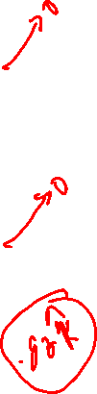
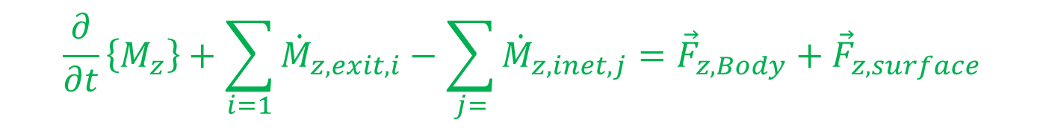
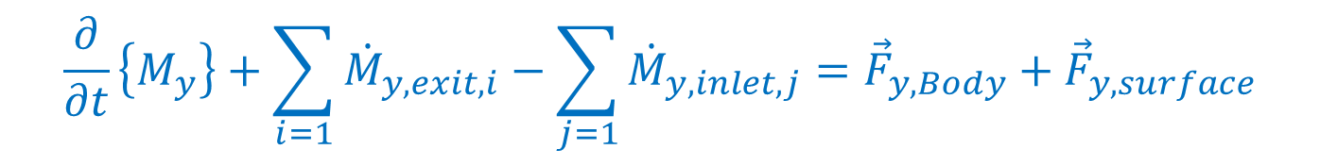
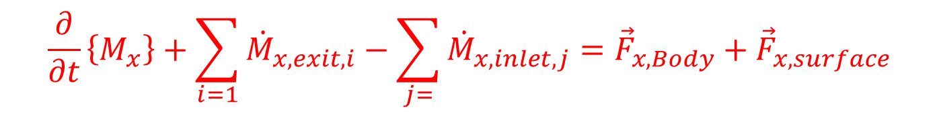
Components of Conservation of Momentum for Fluid Flows
X-Momentum Conservation Equation:
$$\frac{∂}{∂t}\left\{M_{x}\right\}+\sum_{i=1}{{\dot{M}}_{x,exit,i}}−\sum_{j=}{{\dot{M}}_{x,inlet,j}}={\vec{F}}_{x,Body}+{\vec{F}}_{x,surface}$$
Y-Momentum Conservation Equation:
$$\frac{∂}{∂t}\left\{M_{y}\right\}+\sum_{i=1}{{\dot{M}}_{y,exit,i}}−\sum_{j=1}{{\dot{M}}_{y,inlet,j}}={\vec{F}}_{y,Body}+{\vec{F}}_{y,surface}$$
Z-Momentum Conservation Equation:
$$\frac{∂}{∂t}\left\{M_{z}\right\}+\sum_{i=1}{{\dot{M}}_{z,exit,i}}−\sum_{j=}{{\dot{M}}_{z,inet,j}}={\vec{F}}_{z,Body}+{\vec{F}}_{z,surface}$$

Slide 20
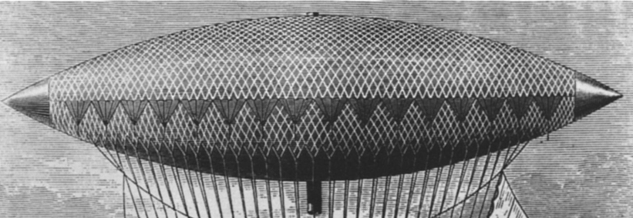
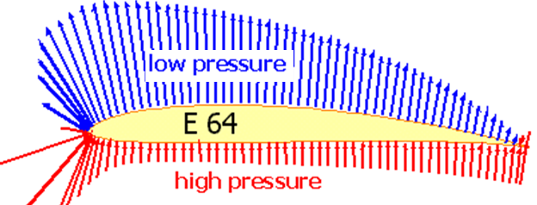
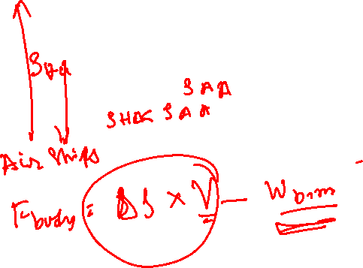
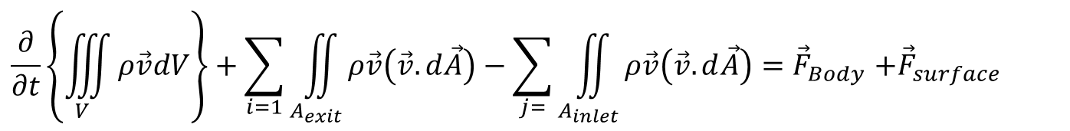
Body Force Vs Surface Forces
$$\frac{∂}{∂t}\left\{\iiint_{V}{ρ\vec{v}dV}\right\}+\sum_{i=1}{\iint_{A_{exit}}{ρ\vec{v}\left(\vec{v}.d\vec{A}\right)}}−\sum_{j=}{\iint_{A_{inlet}}{ρ\vec{v}\left(\vec{v}.d\vec{A}\right){=\vec{F}}_{Body}+{\vec{F}}_{surface}}}$$
Airship using Body Force
Flyer using Surface Force
The body force is proportional to volume of the system.
The body forces refer to long-ranged forces such as gravity.
The Surface force is proportional to surface area.
The Surface forces are short-ranged forces.

