Slide 1


Generalized Mathematical Models for Fluid Dynamic Systems
P M V Subbarao
Professor
Mechanical Engineering Department
Comprehensive Description of Force Generators in Flow Devices……

Slide 2


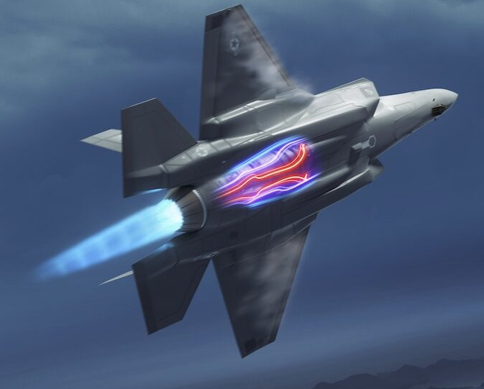
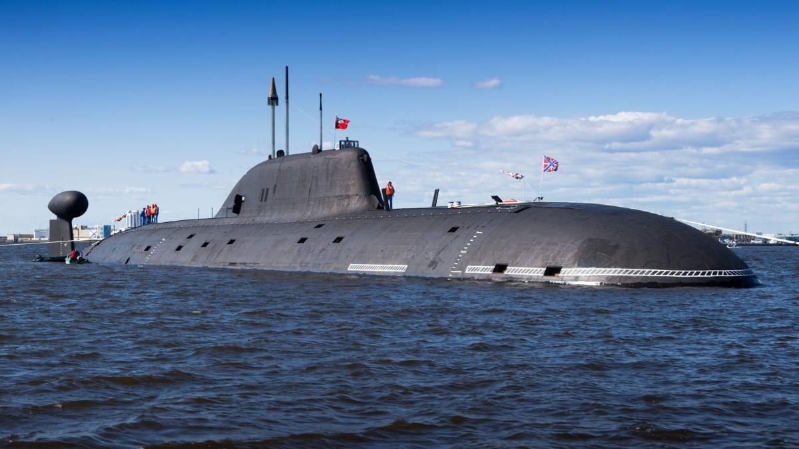
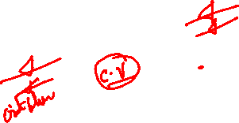
Thermodynamic View of Fluid Systems
Control Mass
Control Volume
Fluid statics
Fluid Dynamics

Slide 3
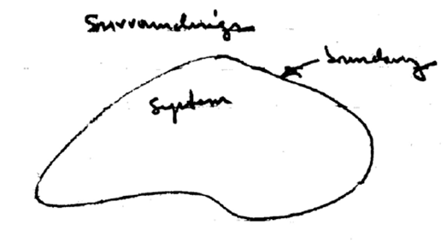
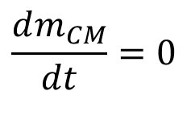
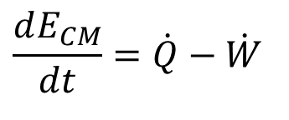
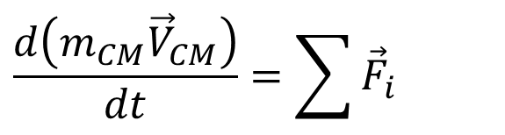
Rate Equations for Laws of Nature :
Control Mass (Closed System)
Control Mass
$$\frac{dm_{CM}}{dt}=0$$
Conservation of Mass :
$$\frac{d\left(m_{CM}{\vec{V}}_{CM}\right)}{dt}=\sum{{\vec{F}}_{i}}$$
Conservation of Momentum :
$$\frac{dE_{CM}}{dt}=\dot{Q}−\dot{W}$$
First law of thermodynamics :

Slide 4
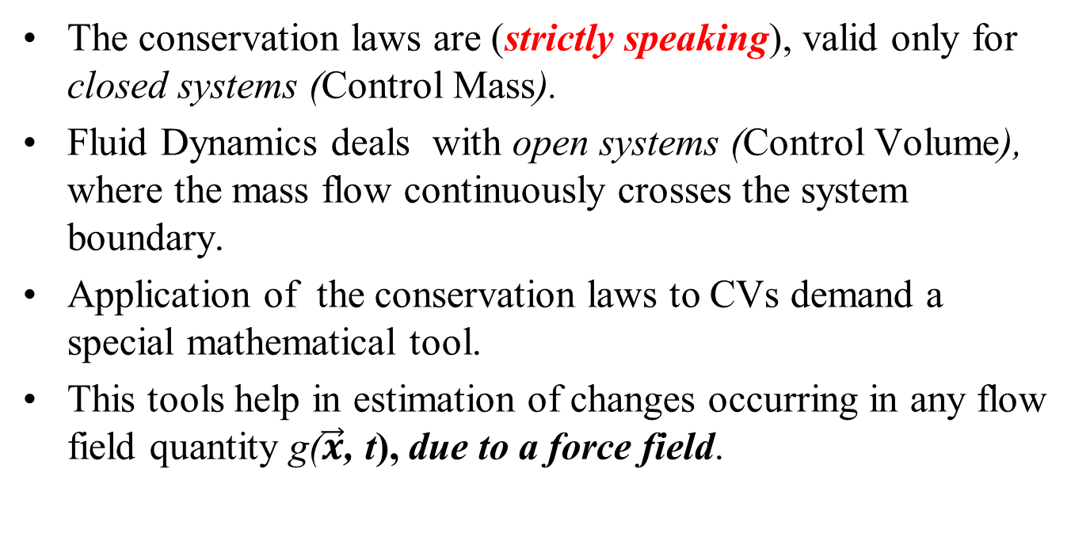
Tools for Comprehensive Description of CVs
The conservation laws are (strictly speaking), valid only for closed systems (Control Mass).
Fluid Dynamics deals with open systems (Control Volume), where the mass flow continuously crosses the system boundary.
Application of the conservation laws to CVs demand a special mathematical tool.
This tools help in estimation of changes occurring in any flow field quantity g($\vec{x}$, t), due to a force field.

Slide 5
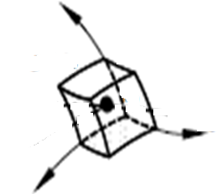
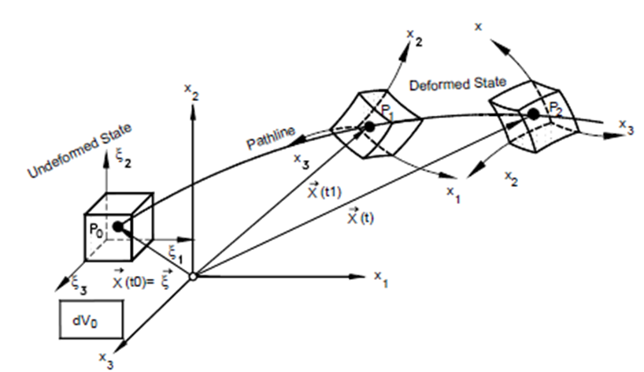
Actions on Fluid Parcel across A Fluid Flow System
z
x
y

Slide 6
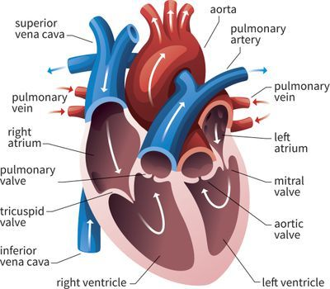
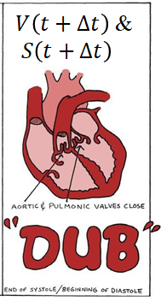
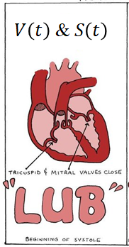

Reynolds Ultimate Flow System

Slide 7

Reynolds Descriptions a Fluid Flow Device
Every fluid system must be treated as “The control mass.”
Consider a simple Fluid System that occupies region I and region II) at time t₀.
II
I
At time t₀
Fluid particles of region – I are trying to enter Region – II (Control Volume) at time t₀.

Slide 8
Reynolds Thinking about a Flow System
At time t₀
III
II
At time t₀+δt
I
II
The same fluid system transforms to regions (II+III) after a time δt.
Fluid particles of region-I fully entered CV (Region-II) in a time δt.
Few other fluid particles which were belonging to CV at t₀ are trying exit CV and occupy III at time t₀ + δt.

Slide 9

Reynolds Description of A Control Volume
At time t₀
At time t₀+δt

Slide 10
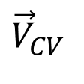
Reynolds Descriptions of a Fluid Flow System
III
I has entered and III has left CV at time t₀+δt
II
I is trying to enter CV at time t₀
II
At time t₀+δt
$${\vec{V}}_{CV}$$
I
The control volume may move as time passes.
At time t₀

Slide 11
Deformation of a differential volume at different instant of time

Slide 12
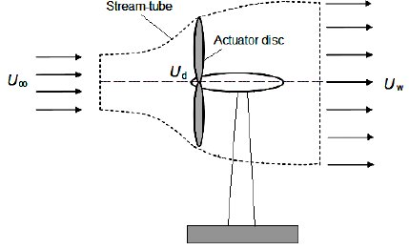
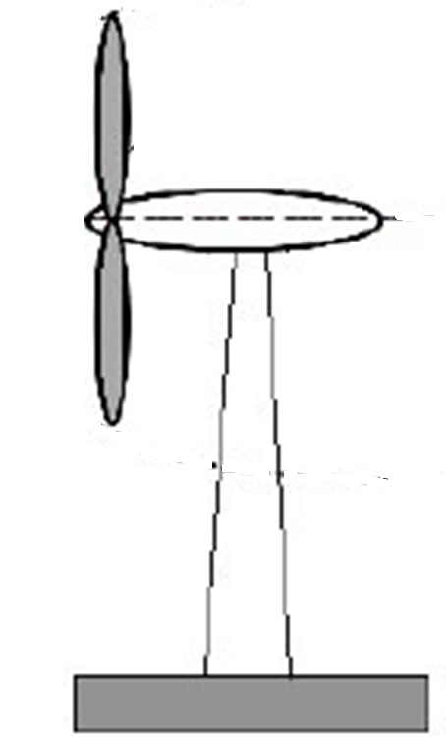
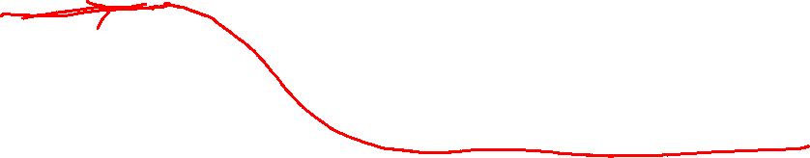
Reynolds View: Every Control Volume is A Heart
Reynolds
Region I
Reynolds
Region III
Reynolds
Region II
Field Quantity
u_{local}

Slide 13
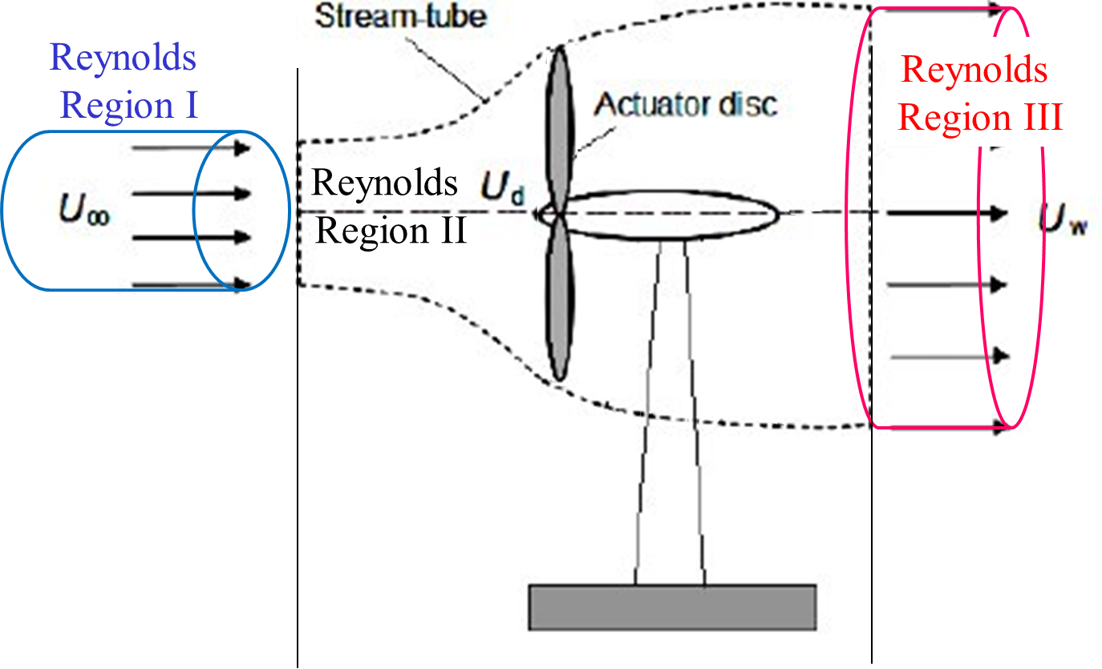
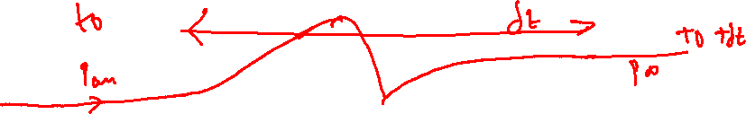
Reynolds View: Every Control Volume is A Heart
Field Quantity
p_{local}

Slide 14
Reynolds View: Every Control Volume is A Heart
Field Quantity
T_{local}

Slide 15
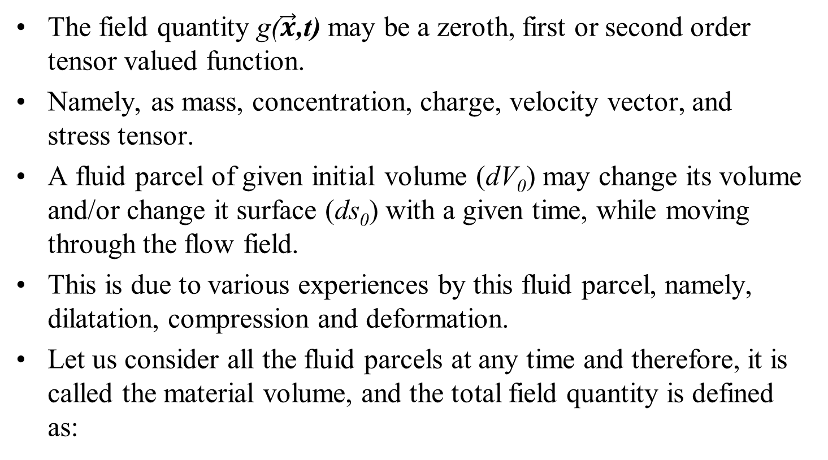
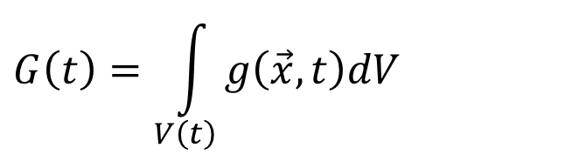
Revisit to The Field Variable
The field quantity g($\vec{x}$,t) may be a zeroth, first or second order tensor valued function.
Namely, as mass, concentration, charge, velocity vector, and stress tensor.
A fluid parcel of given initial volume (dV₀) may change its volume and/or change it surface (ds₀) with a given time, while moving through the flow field.
This is due to various experiences by this fluid parcel, namely, dilatation, compression and deformation.
Let us consider all the fluid parcels at any time and therefore, it is called the material volume, and the total field quantity is defined as:
$$G\left(t\right)=\int_{V\left(t\right)}{g\left(\vec{x},t\right)dV}$$

Slide 16
Change in Field quantity of A Control Volume
The total value of a field quantity g($\vec{x}$,t) for a CV is a volume integral of the quantity :
$$G\left(t\right)=\int_{V\left(t\right)}{g\left(\vec{x},t\right)dV}$$
This is a function of time only.
The integration must be carried out over the varying volume V(t).
The material change of the quantity G(t) is expressed as:
$$\frac{DG\left(t\right)}{Dt}=\frac{D}{Dt}\int_{V\left(t\right)}{g\left(\vec{x},t\right)dV}$$
Since the shape of the volume V(t) changes with time, the differentiation and integration cannot be interchanged.

Slide 17
Need for A Generalized Leibniz Integral Rule
Osborne Reynolds (1842–1912), developed a three-dimensional generalization of the Leibniz integral rule.
It is used to recast time derivatives of integrated quantities and is useful in formulating the basic conservation equations for control volumes.
This is known as Reynolds Transport Theorem.
$$\frac{DG\left(t\right)}{Dt}=\frac{D}{Dt}\int_{V\left(t\right)}{g\left(\vec{x},t\right)dV}$$
$$≅\frac{D}{Dt}\int_{V_{0}}{g\left(\vec{x},t\right)JdV_{0}}$$

Slide 18
Deformation of a differential volume at different instant of time

Slide 19




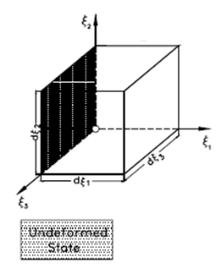
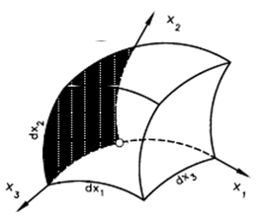


The Fundamental Reynolds Analogy (Algorithm)
$$dV\left(t\right)=J\left(\vec{x},t\right)×dV_{o}$$
Reynolds analogy permits the transformation of the time dependent volume V(t) into the fixed volume V₀ at time t = 0 by using the Jacobian transformation function:
$$J=\left|\begin{aligned}&\frac{∂x}{∂χ} \frac{∂y}{∂χ} \frac{∂z}{∂χ} \\ &\frac{∂x}{∂υ} \frac{∂y}{∂υ} \frac{∂z}{∂υ} \\ &\frac{∂x}{∂ζ} \frac{∂y}{∂ζ} \frac{∂z}{∂ζ}\end{aligned}\right|$$

Slide 20
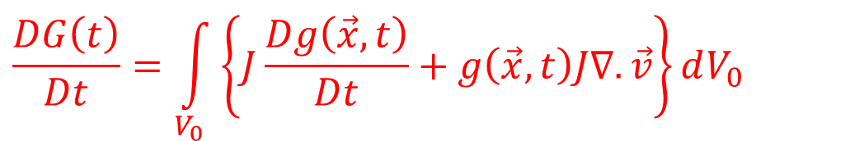
Transformation Function for CM to CV
$$\frac{D}{Dt}\int_{V_{0}}{g\left(\vec{x},t\right)JdV_{0}}$$
$$\frac{DG\left(t\right)}{Dt}=\int_{V_{0}}{\left\{J\frac{Dg\left(\vec{x},t\right)}{Dt}+g\left(\vec{x},t\right)\frac{DJ}{Dt}\right\}dV_{0}}$$
Introducing the material derivative of the Jacobian function and simplifying based on derivatives of transformation functions
$$\frac{DG\left(t\right)}{Dt}=\int_{V_{0}}{\left\{J\frac{Dg\left(\vec{x},t\right)}{Dt}+g\left(\vec{x},t\right)J∇.\vec{v}\right\}dV_{0}}$$
$$\frac{DG\left(t\right)}{Dt}=\int_{V_{0}}{\left\{\frac{∂g\left(\vec{x},t\right)}{∂t}+\vec{v}.∇g\left(\vec{x},t\right)+g\left(\vec{x},t\right)∇.\vec{v}\right\}JdV_{0}}$$
The chain rule applied to the second and third term yields:
$$\frac{DG\left(t\right)}{Dt}=\int_{V_{0}}{\left\{\frac{∂g\left(\vec{x},t\right)}{∂t}+∇.\left\{g\left(\vec{x},t\right)\vec{v}\right\}\right\}JdV_{0}}$$

Slide 21
Transformation Function for CM to CV
$$\frac{DG\left(t\right)}{Dt}=\int_{V_{0}}{\left\{\frac{∂g\left(\vec{x},t\right)}{∂t}+∇.\left\{g\left(\vec{x},t\right)\vec{v}\right\}\right\}JdV_{0}}$$
$$\frac{DG\left(t\right)}{Dt}=\int_{V_{0}}{\left\{\frac{∂g\left(\vec{x},t\right)}{∂t}\right\}JdV_{0}}+\int_{V_{0}}{∇.\left\{g\left(\vec{x},t\right)\vec{v}\right\}J}dV_{0}$$
$$\frac{DG\left(t\right)}{Dt}=\frac{∂}{∂t}\left\{\int_{V_{0}}{g\left(\vec{x},t\right)JdV_{0}}\right\}+\int_{V_{0}}{∇.\left\{g\left(\vec{x},t\right)\vec{v}\right\}J}dV_{0}$$
The Reynolds transformation permits the back transformation of the fixed volume integral into the time dependent volume integral.
$$\frac{DG\left(t\right)}{Dt}=\frac{∂}{∂t}\left\{\int_{V\left(t\right)}{g\left(\vec{x},t\right)dV}\right\}+\int_{V\left(t\right)}{∇.\left\{g\left(\vec{x},t\right)\vec{v}\right\}}dV$$

Slide 22
Result of Reynolds Transformation
$$\frac{DG\left(t\right)}{Dt}=\frac{∂}{∂t}\left\{\int_{V\left(t\right)}{g\left(\vec{x},t\right)dV}\right\}+\int_{V\left(t\right)}{∇.\left\{g\left(\vec{x},t\right)\vec{v}\right\}}dV$$
How to bring inflows and outflows into above model????
The second volume integral in above equation can be converted into a surface integral by applying the Gauss' divergence theorem:
$$\frac{DG\left(t\right)}{Dt}=\frac{∂}{∂t}\left\{\int_{V\left(t\right)}{g\left(\vec{x},t\right)dV}\right\}+\int_{s\left(t\right)}{g\left(\vec{x},t\right)\vec{v}.\hat{n}ds}$$

Slide 23
Engineering Mathematics of Reynolds Transport Theorem
$$\frac{DG\left(t\right)}{Dt}=\frac{∂}{∂t}\left\{\int_{V\left(t\right)}{g\left(\vec{x},t\right)dV}\right\}+\int_{s\left(t\right)}{g\left(\vec{x},t\right)\vec{v}.\hat{n}ds}$$
G is any property of the flow system (mass, energy, momentum, enthalpy, etc.).
Define ζ= dG/dm as the intensive value, or the amount of G per unit mass in any small element of the fluid.
The total amount of G in the control volume is thus
$G=\int_{CV}{ζdm}=\int_{CV}{ρζdV}$
$$\frac{DG\left(t\right)}{Dt}=\frac{∂}{∂t}\left\{\int_{V\left(t\right)}{\left(ρζ\right)dV}\right\}+\int_{s\left(t\right)}{\left(ρζ\right)\vec{v}.\hat{n}ds}$$

Slide 24
Engineering Use of Reynolds Transformation
$$\frac{DG\left(t\right)}{Dt}=\frac{∂}{∂t}\left\{\int_{V\left(t\right)}{\left(ρζ\right)dV}\right\}+\int_{s\left(t\right)}{\left(ρζ\right)\vec{v}.\hat{n}ds}$$
This Equation is valid for any system boundary with time the dependent volume V(t) and surface s(t) at any time.
Also valid at the time t = t₀ , where the volume V = V_{C} and the surface s = s_{C}.
V_{C} and s_{C} are named as control volume and control surface.
These control surfaces can be inlets or outlets.

Slide 25
Application of RTT to A Natural CV
$$\frac{DG\left(t\right)}{Dt}=\frac{∂}{∂t}\left\{\int_{V\left(t\right)}{\left(ρζ\right)dV}\right\}+\int_{s\left(t\right)}{\left(ρζ\right)\vec{v}.\hat{n}ds}$$

Slide 26
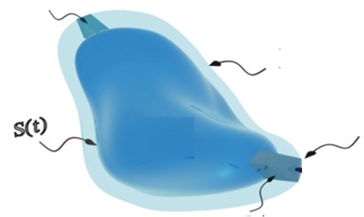
Engineering Use of Reynolds Transformation
$$\frac{DG\left(t\right)}{Dt}=\frac{∂}{∂t}\left\{\int_{V\left(t\right)}{\left(ρζ\right)dV}\right\}+\int_{s\left(t\right)}{\left(ρζ\right)\vec{v}.\hat{n}ds}$$
Inflow
$$S\left(t+∆t\right)$$
outflow

