Slide 1


Fluids Systems in Rigid Body Motion
P M V Subbarao
Professor
Mechanical Engineering Department
Modification of Resultant Acceleration in Hydrostatic Systems……

Slide 2


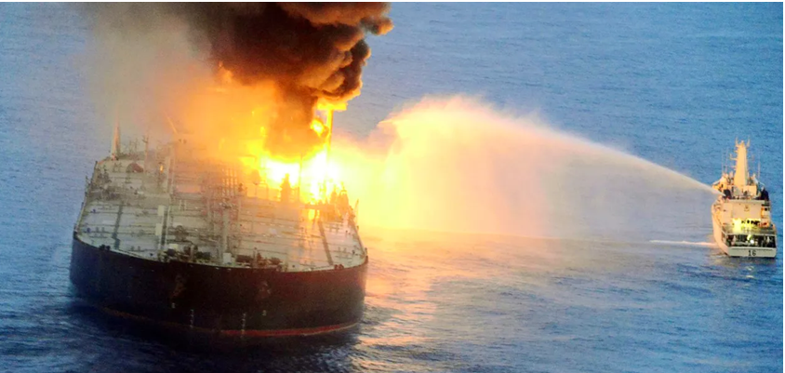
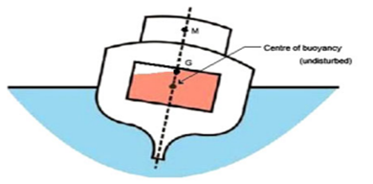
Sloshing : Another Reason or Reaction of Instability??
Sloshing is a Class of Rigid Body Motion of Liquid Containers…

Slide 3
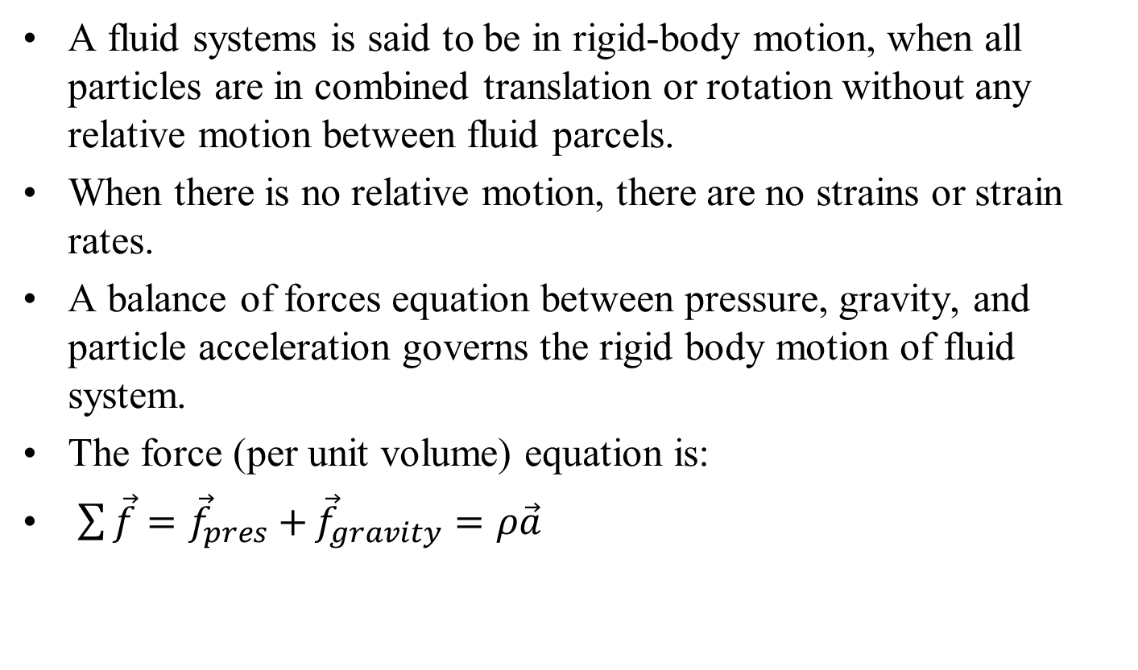
Rigid-Body Motion of Fluid System
A fluid systems is said to be in rigid-body motion, when all particles are in combined translation or rotation without any relative motion between fluid parcels.
When there is no relative motion, there are no strains or strain rates.
A balance of forces equation between pressure, gravity, and particle acceleration governs the rigid body motion of fluid system.
The force (per unit volume) equation is:
$\sum{\vec{f}={\vec{f}}_{pres}+}{\vec{f}}_{gravity}=ρ\vec{a}$

Slide 4
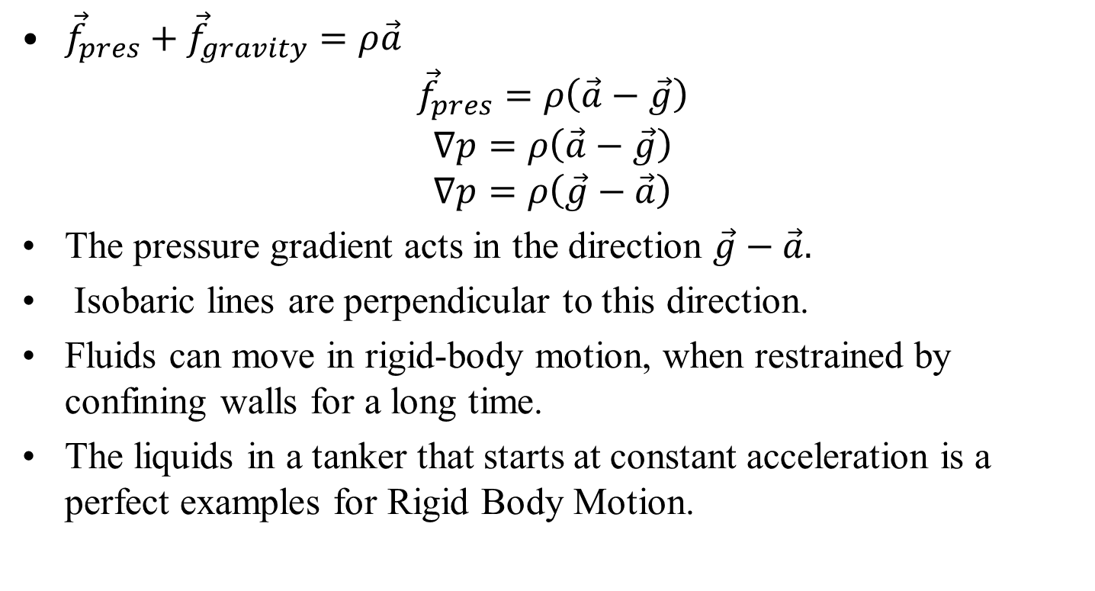
Governing Equation for Rigid Body Motion of Fluid System
${\vec{f}}_{pres}+{\vec{f}}_{gravity}=ρ\vec{a}$
$${\vec{f}}_{pres}=ρ\left(\vec{a}−\vec{g}\right)$$
$$∇p=ρ\left(\vec{a}−\vec{g}\right)$$
$$∇p=ρ\left(\vec{g}−\vec{a}\right)$$
The pressure gradient acts in the direction $\vec{g}−\vec{a}.$
Isobaric lines are perpendicular to this direction.
Fluids can move in rigid-body motion, when restrained by confining walls for a long time.
The liquids in a tanker that starts at constant acceleration is a perfect examples for Rigid Body Motion.

Slide 5
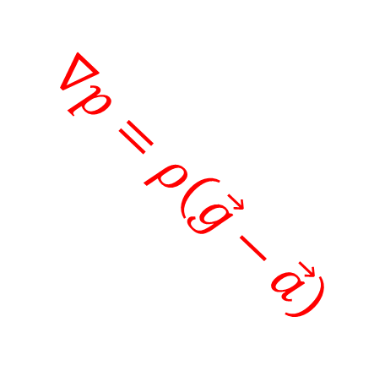



Uniform Linear Acceleration of Fluid Body
Consider the case where the fluid tank (system) is accelerated uniformly in some direction.
Each fluid particle in the container feels exactly the same acceleration vector, which is constant in time.
$$\vec{a}$$
$$−\vec{a}$$
$$\vec{g}$$
$$\vec{g}−\vec{a}$$
$$\vec{a}$$
$$∇p=ρ\left(\vec{g}−\vec{a}\right)$$

Slide 6
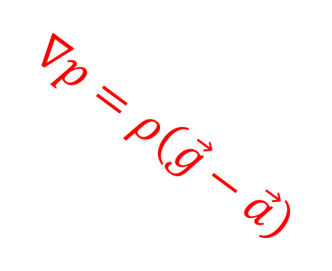


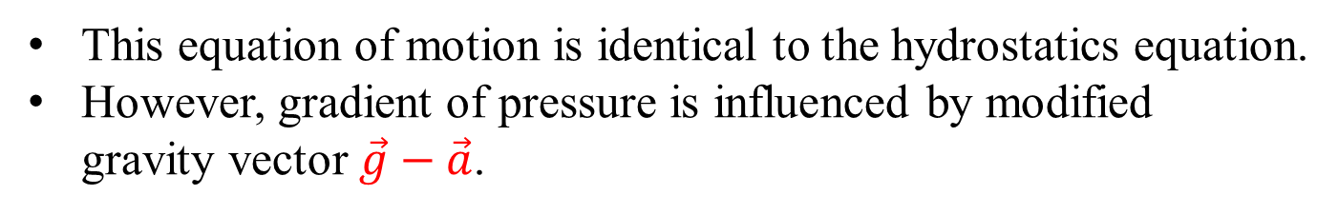

2D Uniform Linear Acceleration of Fluid Body
This Situation is no more difficult than simple hydrostatics!!!
$$\vec{a}$$
$$\vec{a}=a_{x}\hat{i}+ a_{z}\hat{k}$$
$$\vec{g}$$
$$\vec{g}−\vec{a}$$
$$∇p=ρ\left(\vec{g}−\vec{a}\right)$$
This equation of motion is identical to the hydrostatics equation.
However, gradient of pressure is influenced by modified gravity vector $\vec{g}−\vec{a}$.

Slide 7
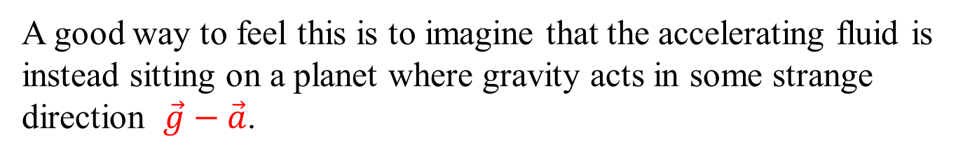
2D Uniform Linear Acceleration of Fluid Body
$$\vec{a}$$
$$\vec{a}=a_{x}\hat{i}+ a_{z}\hat{k}$$
$$\vec{g}$$
$$\vec{g}−\vec{a}$$
$$∇p=ρ\left(\vec{g}−\vec{a}\right)$$
A good way to feel this is to imagine that the accelerating fluid is instead sitting on a planet where gravity acts in some strange direction $\vec{g}−\vec{a}$.

Slide 8
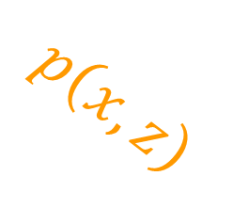
The Reaction of Fluid Body to Modified Gravity Vector
$$\vec{a}$$
$$\vec{a}=a_{x}\hat{i}+ a_{z}\hat{k}$$
$$\vec{g}$$
$$\vec{g}−\vec{a}$$
$$p\left(x,z\right)$$
$$∇p=ρ\left(\vec{g}−\vec{a}\right)$$
s
The pressure increases linearly with distance s, rather than with z.

Slide 9
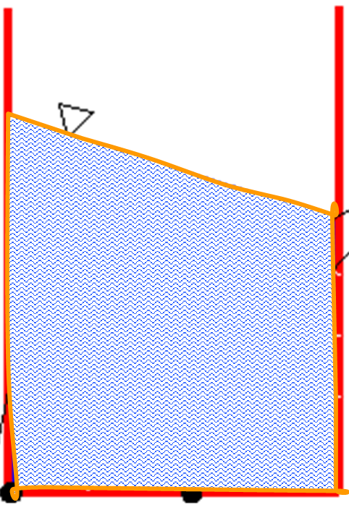

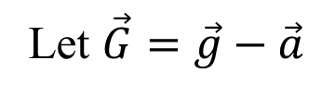
Tilting of Fluid Surface
Let $\vec{G}=\vec{g}−\vec{a}$
Isobars
$$\vec{G}$$

Slide 10
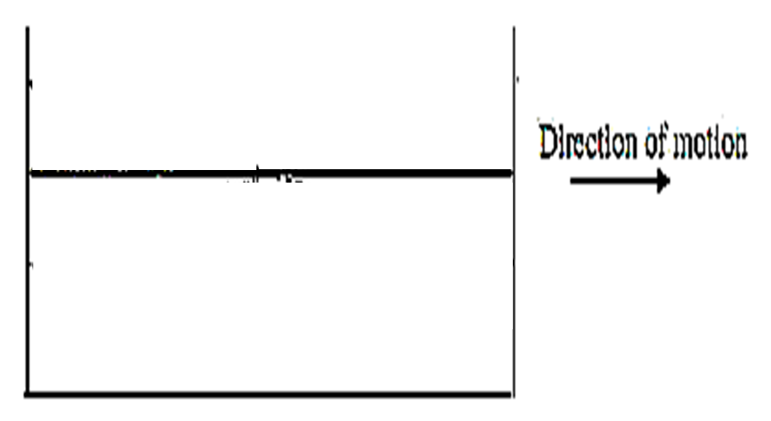
Tilting of Fluid Surface
Constant Deceleration
Constant Acceleration
Constant Velocity

Slide 11

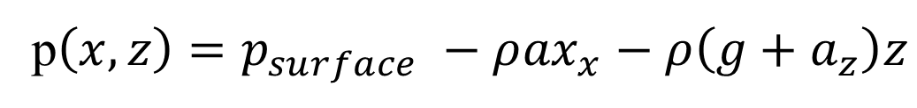


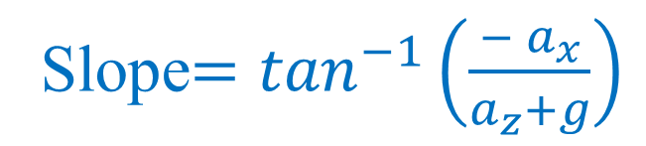
Tilting of Fluid Surface
$$∇p=ρ\left(\vec{g}−\vec{a}\right)$$
Slope$=\tan^{−1}\left(\frac{{− a}_{x}}{a_{z}+g}\right)$
On integration:
$$\vec{G}$$
p$\left(x,z\right)=p_{surface} −ρ{ax}_{x}−ρ\left(g+a_{z}\right)z$

Slide 12
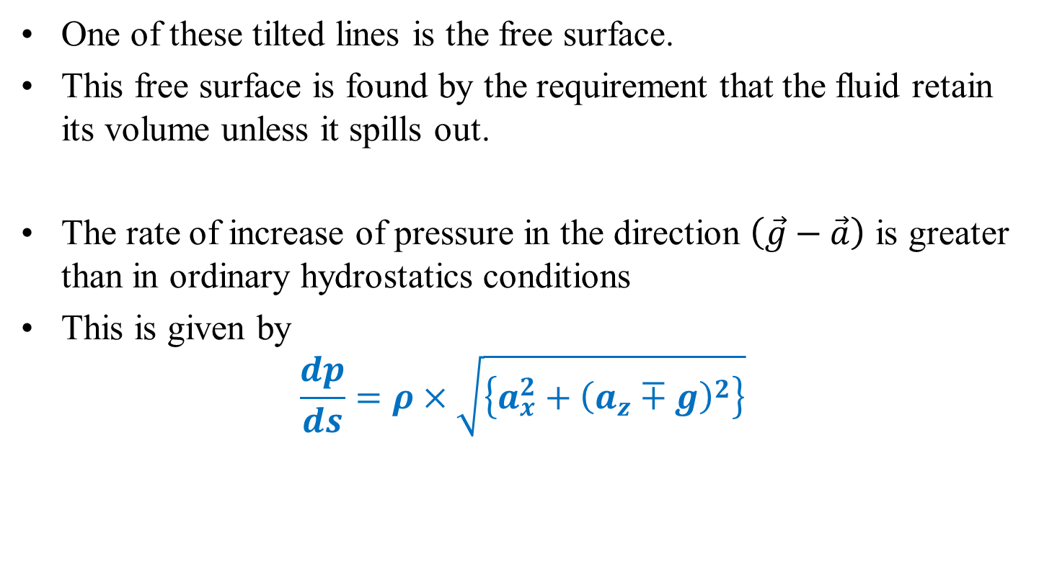
Modified Pressure Field in Rigid Body Motion
One of these tilted lines is the free surface.
This free surface is found by the requirement that the fluid retain its volume unless it spills out.
The rate of increase of pressure in the direction $\left(\vec{g}−\vec{a}\right)$ is greater than in ordinary hydrostatics conditions
This is given by
$$\frac{dp}{ds}=ρ×\sqrt{\left\{a_{x}^{2}+{\left(a_{z}∓g\right)}^{2}\right\}}$$
Pressure gradient due to Constant acceleration of a fluid container is independent of the size or shape of the container as long as the fluid is continuously connected throughout the container

Slide 13
Next to Rigid Body Translation is Rigid Body Rotation of a Fluid System…????

Slide 14
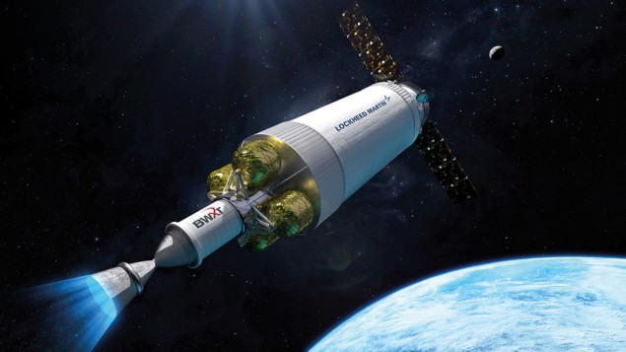
Generation of Gas Bubbles in A Nuclear Spacecraft
Nuclear Thermal Propulsion (NTP) is a highly efficient type of propulsion system that could yield a specific impulse up to 800 s.

Slide 15
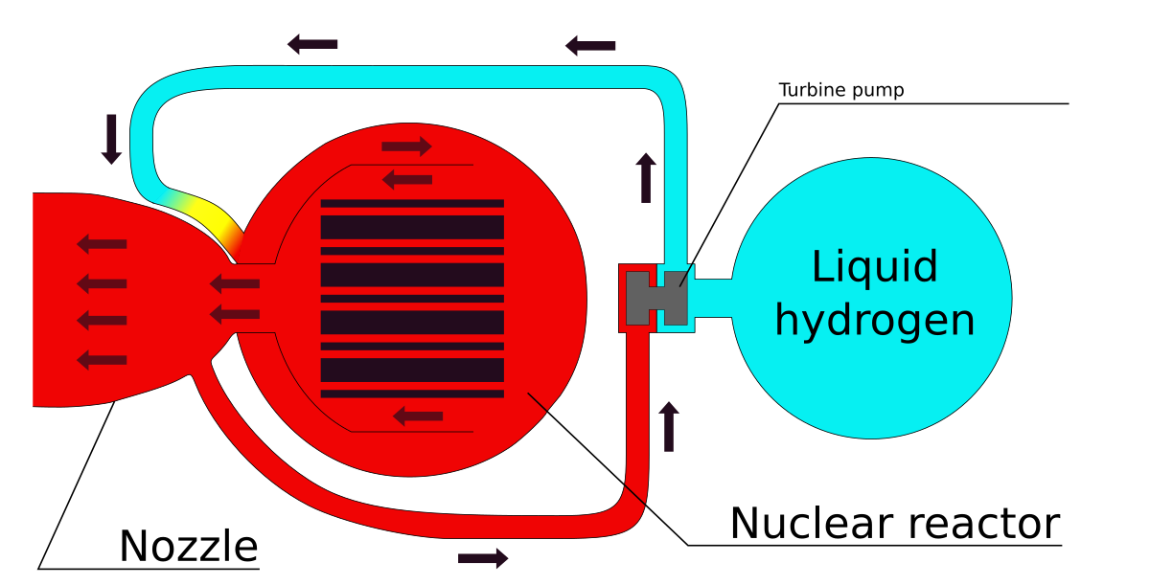
Generation of Gas Bubbles in A Nuclear Spacecraft
High-performance Nuclear Thermal Propulsion allows for possibilities of various mission types from flyby to interplanetary flight, manned or unmanned.

Slide 16
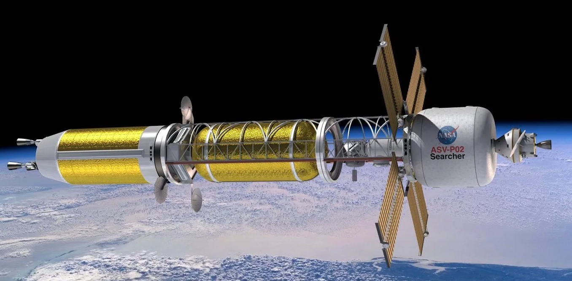
Generation of Gas Bubbles in A Nuclear Spacecraft
NTP requires an interaction between liquid fissile fuel and Gaseous Propellant Bubbles.

Slide 17
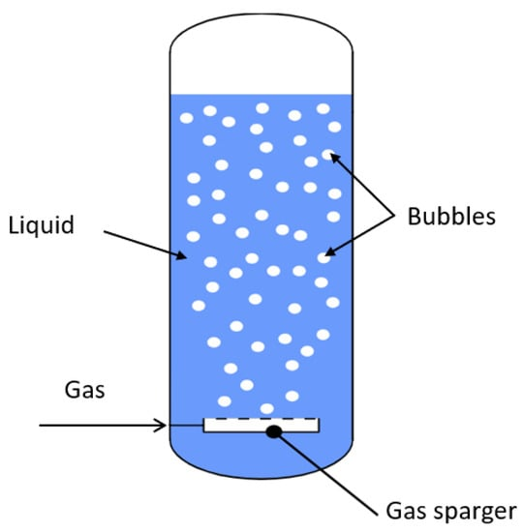
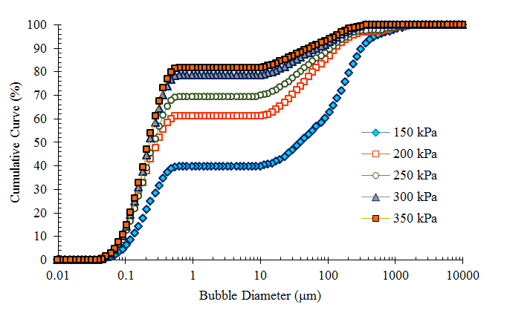
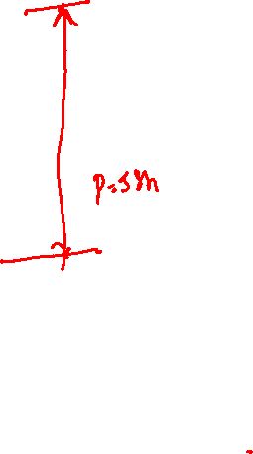
Generation of Gas Bubbles for Exotic Applications

Slide 18
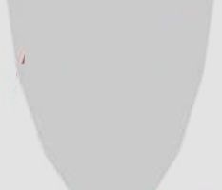
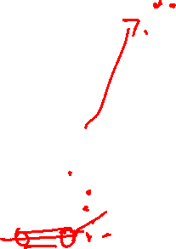
Over speeding and Steady Inflow and Spillage
g
a

Slide 19
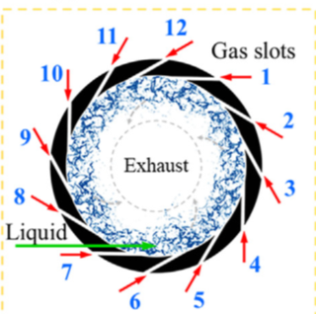
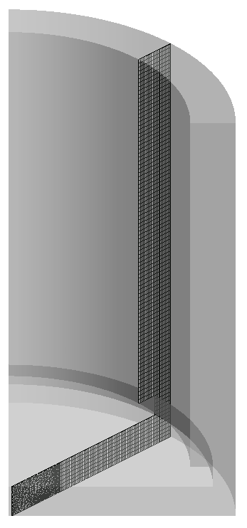
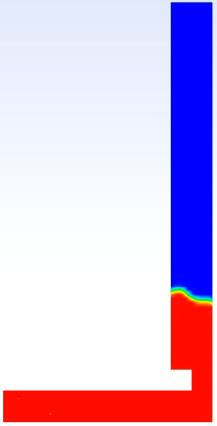

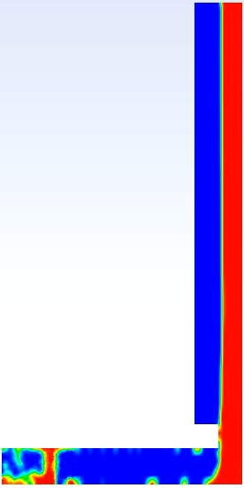
Effect of different rotational speed on film formation
478 rpm
955 rpm
1950 rpm
Instantaneous distribution of water at mid plane
Liquid inlet
Liquid inlet
Liquid inlet
Film thickness ~ 10 mm, nearly independent of rotational speed

Slide 20
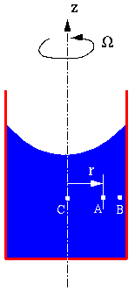
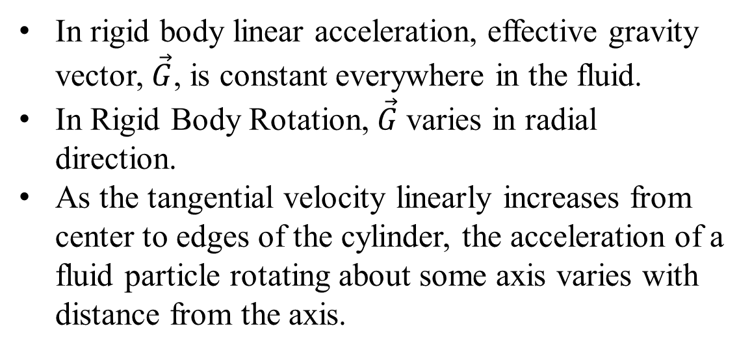
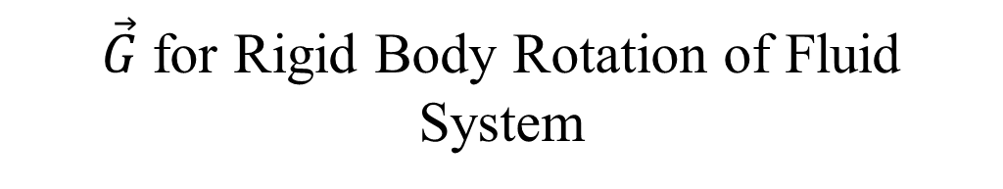

$\vec{G}$for Rigid Body Rotation of Fluid System
$$\vec{Ω}$$
In rigid body linear acceleration, effective gravity vector, $\vec{G}$, is constant everywhere in the fluid.
In Rigid Body Rotation, $\vec{G}$varies in radial direction.
As the tangential velocity linearly increases from center to edges of the cylinder, the acceleration of a fluid particle rotating about some axis varies with distance from the axis.
For circular motion, the acceleration is always inward, towards the center of rotation.
Known as centripetal acceleration.

Slide 21

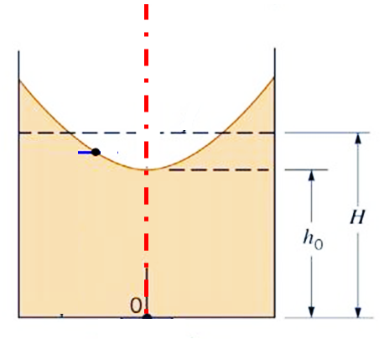

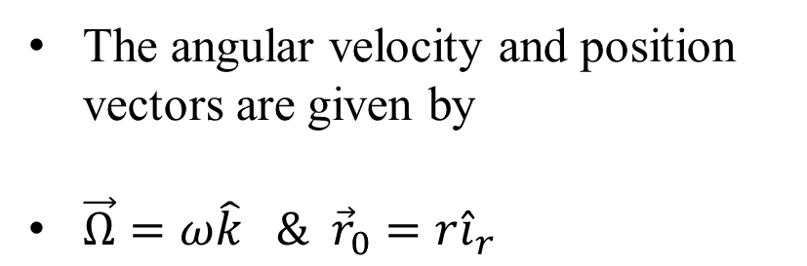


Rigid Body Rotation
The angular velocity and position vectors are given by
$\vec{Ω}=ω\hat{k} \& {\vec{r}}_{0}=r{\hat{i}}_{r}$
$${\vec{r}}_{0}$$
$$\vec{Ω}$$

Slide 22
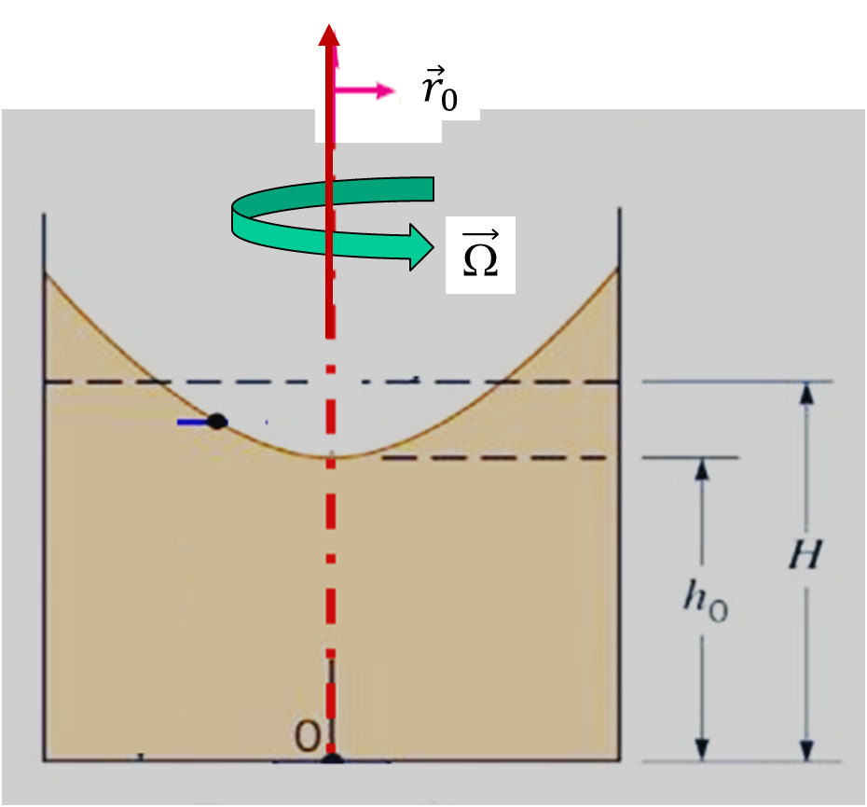
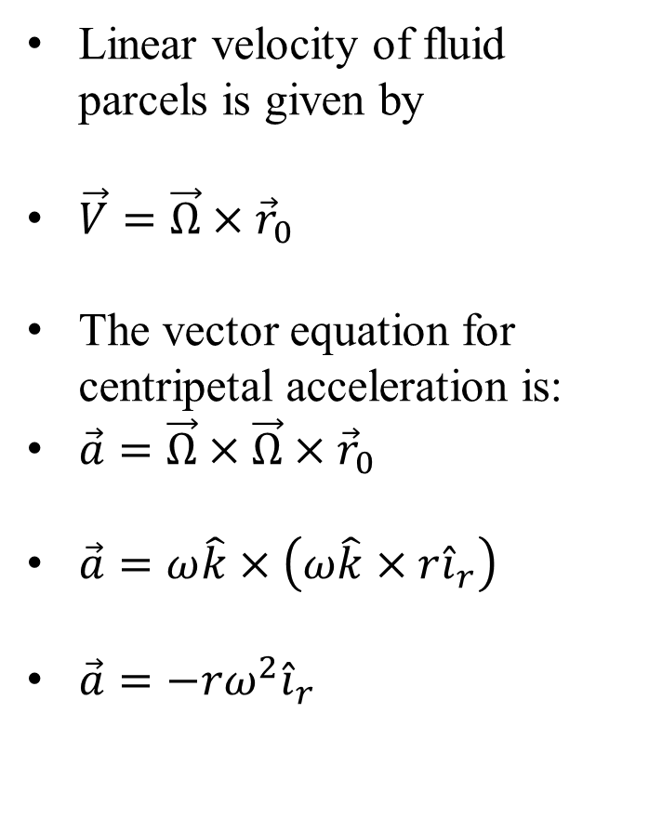
Vector Algebra of Centripetal Acceleration
Linear velocity of fluid parcels is given by
$\vec{V}=\vec{Ω}×{\vec{r}}_{0}$
The vector equation for centripetal acceleration is:
$\vec{a}=\vec{Ω}×\vec{Ω}×{\vec{r}}_{0}$
$\vec{a}=ω\hat{k}×\left(ω\hat{k}×r{\hat{i}}_{r}\right)$
$\vec{a}=−rω^{2}{\hat{i}}_{r}$

Slide 23
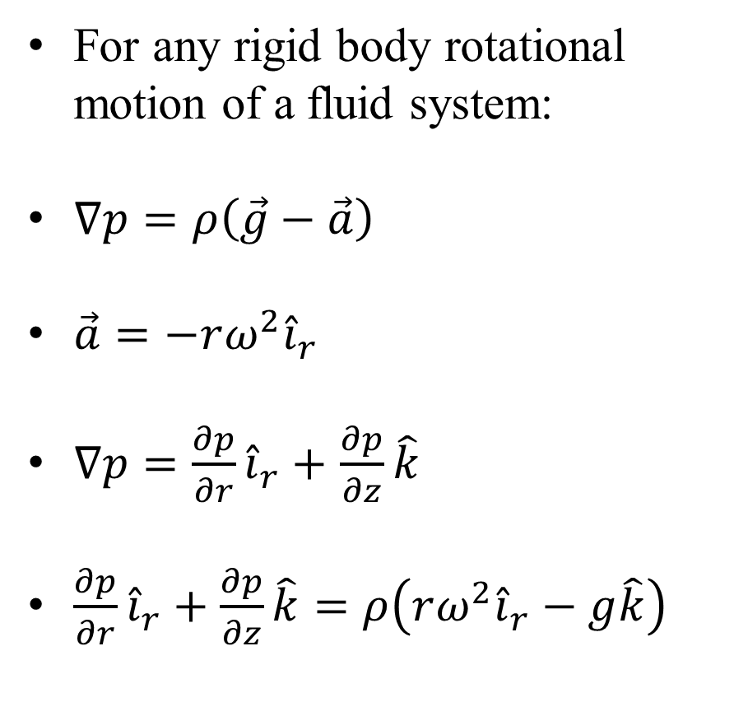
Resultant Force Vector
For any rigid body rotational motion of a fluid system:
$∇p=ρ\left(\vec{g}−\vec{a}\right)$
$\vec{a}=−rω^{2}{\hat{i}}_{r}$
$∇p=\frac{∂p}{∂r}{\hat{i}}_{r}+$ $\frac{∂p}{∂z}\hat{k}$
$\frac{∂p}{∂r}{\hat{i}}_{r}+\frac{∂p}{∂z}\hat{k}=ρ\left(rω^{2}{\hat{i}}_{r}−g\hat{k}\right)$

Slide 24
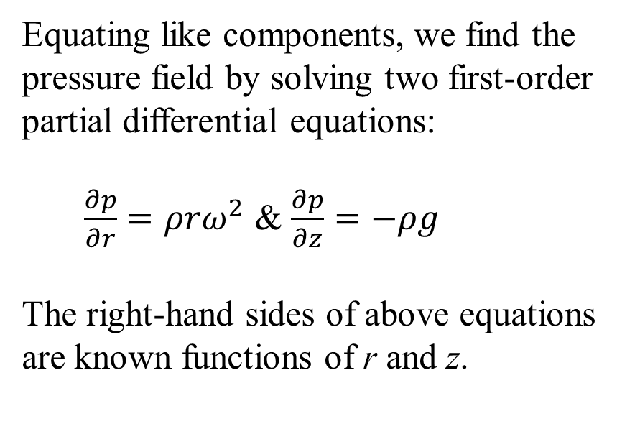
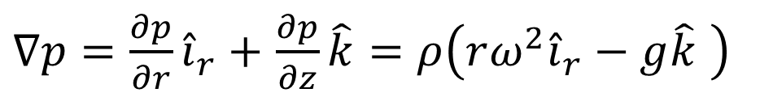
The Pressure Gradient Field due to Rigid Body Rotation
$∇p=\frac{∂p}{∂r}{\hat{i}}_{r}+$ $\frac{∂p}{∂z}\hat{k}=ρ\left(rω^{2}{\hat{i}}_{r}−g\hat{k} \right)$
Equating like components, we find the pressure field by solving two first-order partial differential equations:
$\frac{∂p}{∂r}=ρrω^{2}$ & $\frac{∂p}{∂z}=−ρg$
The right-hand sides of above equations are known functions of r and z.

Slide 25
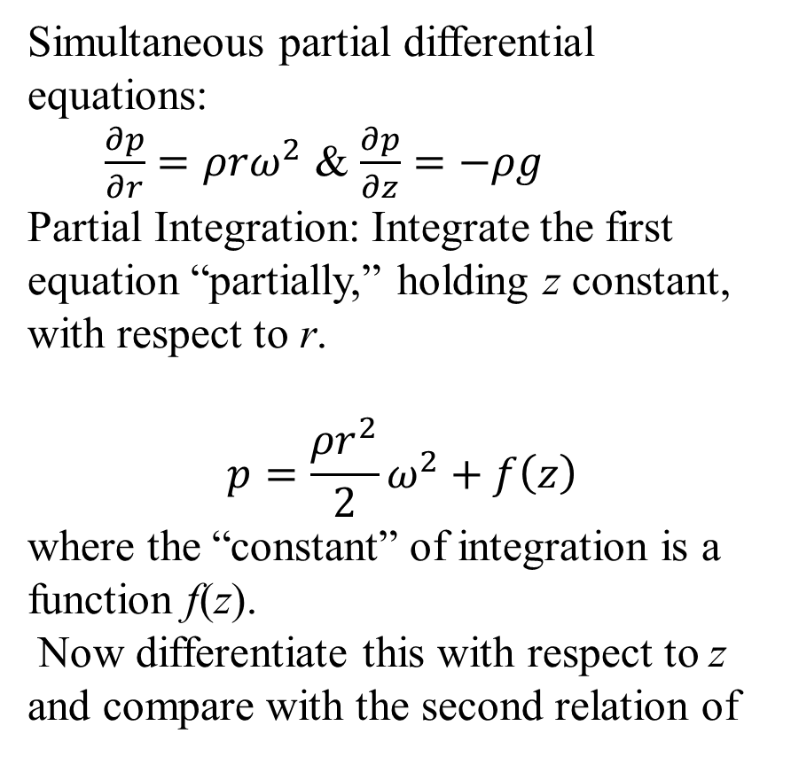
The Pressure Field due to Rigid Body Rotation
Simultaneous partial differential equations:
$\frac{∂p}{∂r}=ρrω^{2}$ & $\frac{∂p}{∂z}=−ρg$
Partial Integration: Integrate the first equation “partially,” holding z constant, with respect to r.
$$p=\frac{ρr^{2}}{2}ω^{2}+f\left(z\right)$$
where the “constant” of integration is a function f(z).
Now differentiate this with respect to z and compare with the second relation of

Slide 26
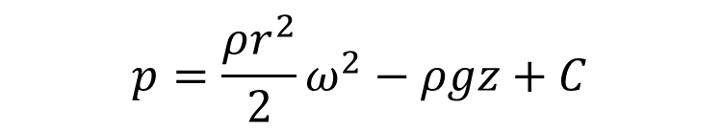
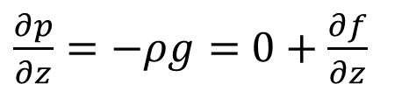
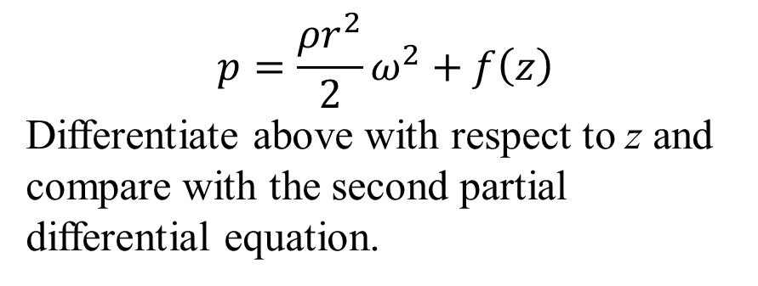
The Pressure Field due to Rigid Body Rotation
$$p=\frac{ρr^{2}}{2}ω^{2}+f\left(z\right)$$
Differentiate above with respect to z and compare with the second partial differential equation.
$\frac{∂p}{∂z}=−ρg=$ $0+\frac{∂f}{∂z}$
$$p=\frac{ρr^{2}}{2}ω^{2}−ρgz+C$$
This is the pressure distribution in the fluid.
The value of C is found by specifying the pressure at any point.
The pressure p(r, z) =p(0, 0)=p_{atm}
C = p_{atm}

Slide 27
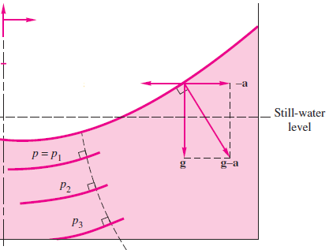
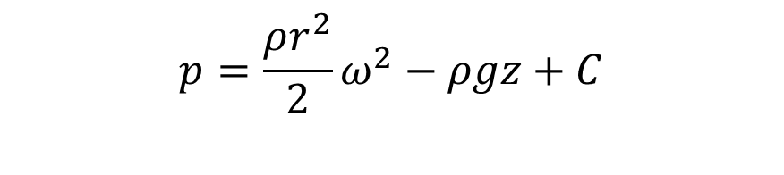
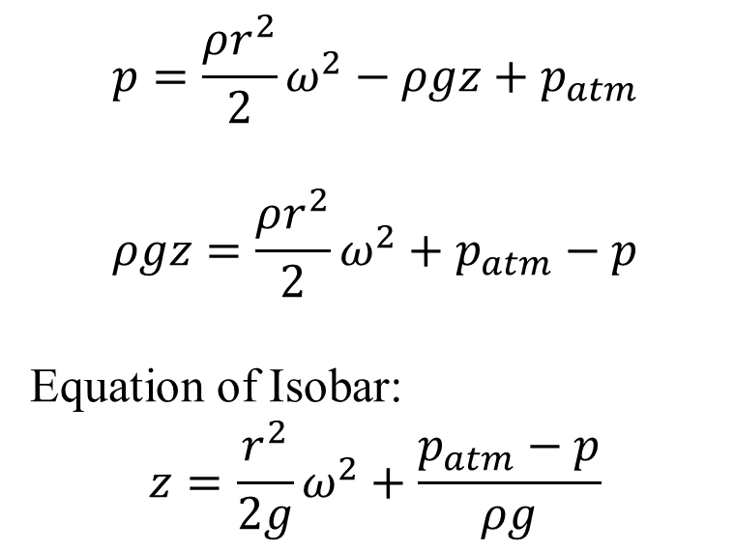
The Pressure Field due to Rigid Body Rotation
$$p=\frac{ρr^{2}}{2}ω^{2}−ρgz+C$$
The final desired distribution is
$$p=\frac{ρr^{2}}{2}ω^{2}−ρgz+p_{atm}$$
$$ρgz=\frac{ρr^{2}}{2}ω^{2}+p_{atm}−p$$
Equation of Isobar:
$$z=\frac{r^{2}}{2g}ω^{2}+\frac{p_{atm}−p}{ρg}$$
A System of Parabolas!

Slide 28
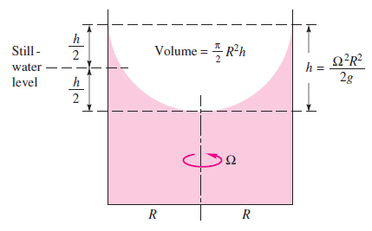
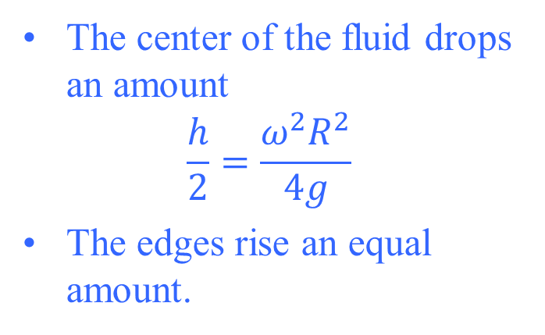
Generation of Pressure Field in Rigid Body Motion
In Rigid body linear motion with constant acceleration, the position of the free surface is found by conserving the volume of fluid.
For a cylinder rotating about its central axis without a spill, the volume of a paraboloid delimited by the free surface is:
one-half the base area times its height.
The center of the fluid drops an amount
$$\frac{h}{2}=\frac{ω^{2}R^{2}}{4g}$$
The edges rise an equal amount.
The initial still-water level is exactly halfway between the high and low points of the free surface

Slide 29
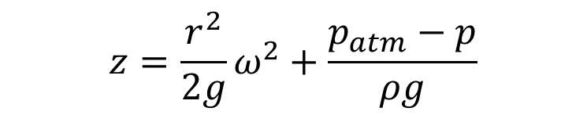
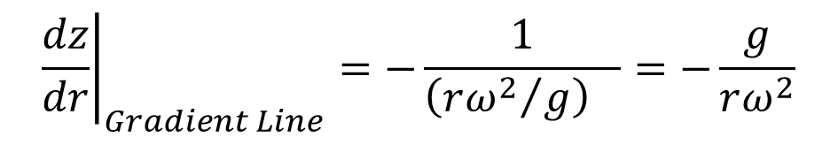
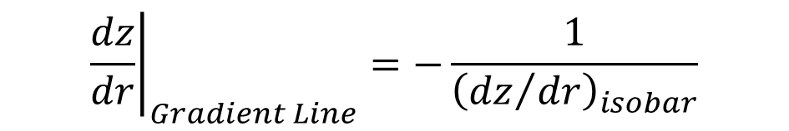
Equation of Pressure Gradient
$$z=\frac{r^{2}}{2g}ω^{2}+\frac{p_{atm}−p}{ρg}$$
All the lines everywhere parallel to the pressure gradient form a family of curved surfaces.
They are everywhere orthogonal to the constant-pressure surfaces.
The slope of this system of curves is the negative inverse of the slope computed using above equation.
$${\left.\frac{dz}{dr}\right|}_{Gradient Line}=−\frac{1}{{\left({dz}/{dr}\right)}_{isobar}}$$
$${\left.\frac{dz}{dr}\right|}_{Gradient Line}=−\frac{1}{{\left({rω^{2}}/g\right)}_{}}=−\frac{g}{rω^{2}}$$

Slide 30
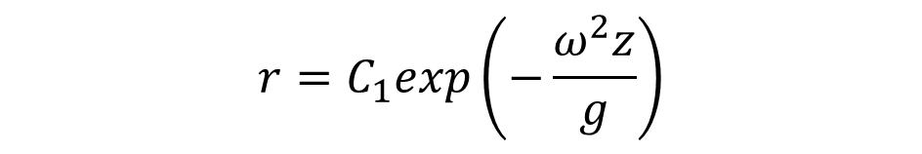

Equation of Pressure Gradient
$${\left.\frac{dz}{dr}\right|}_{Gradient Line}=−\frac{g}{rω^{2}}$$
Separating the variables and integrating, we find the equation of the pressure-gradient surfaces:
$$r=C_{1}exp\left(−\frac{ω^{2}z}{g}\right)$$

