Slide 1
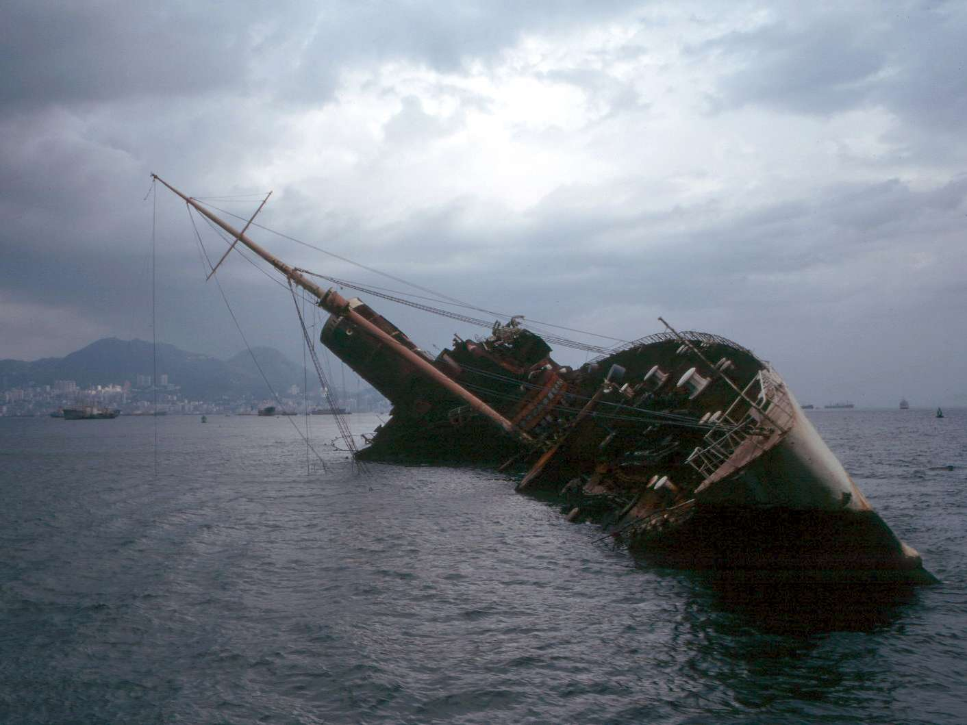


Stability Analysis of Floating Systems
P M V Subbarao
Professor
Mechanical Engineering Department
Stable Operation of Simple and Homogeneous Systems……

Slide 2


Hydrostatics of A Surface Ship
Vertical, Longitudinal and Transverse Center of Gravity
Vertical, Longitudinal and Transverse Center of Buoyancy
Mass Displacement (Δ)
Volume Displacement (∇)
Longitudinal and Transverse Centre of Floatation
Moment to Change Trim 1 cm (MCT)
Tonnes per cm Immersion (TPC)
Metacentre
Metacentric Height
Metacentric Radius

Slide 3
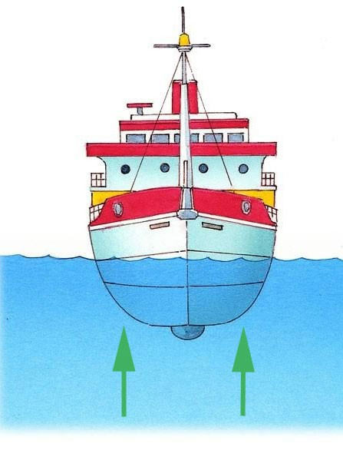
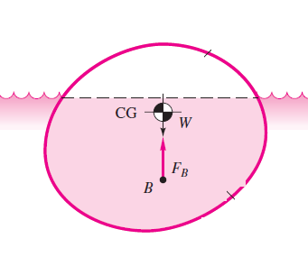
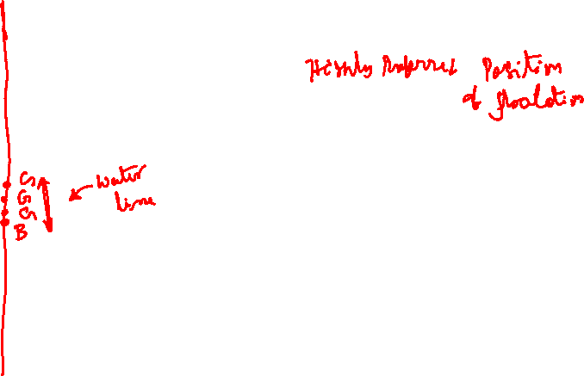
Neutral Flotation of General Body
A floating body as in above Figure may not approve of the position in which it is floating.
It will try to overturn at the first opportunity and is said to be statically unstable.
Even an infinitesimal disturbance will cause it to seek another equilibrium position that is stable.

Slide 4
Stability of Flotation
Engineers must design a submersible/submarine/ship to avoid floating instability.
A floating position of a submersible is said to be stable iff it develops a restoring moment that will return it to its original position under a “disturbance.”

Slide 5
Stability Analysis
Stability analysis is to be carried out;
  to estimate the possible restoring moment.
  To verify whether it develops a restoring moment that will return it to its original position.
If so, it is stable

Slide 6
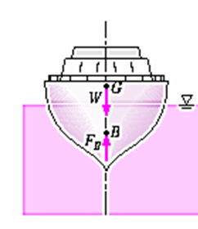
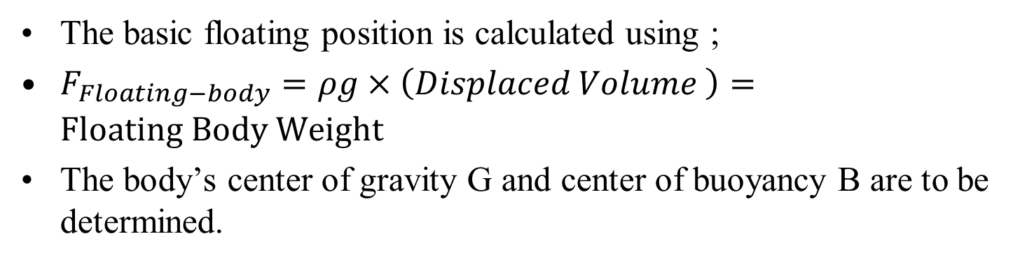
Basic principle of the static stability
The basic floating position is calculated using ;
$F_{Floating−body}=ρg×\left(Displaced Volume \right)=Floating Body Weight$
The body’s center of gravity G and center of buoyancy B are to be determined.

Slide 7
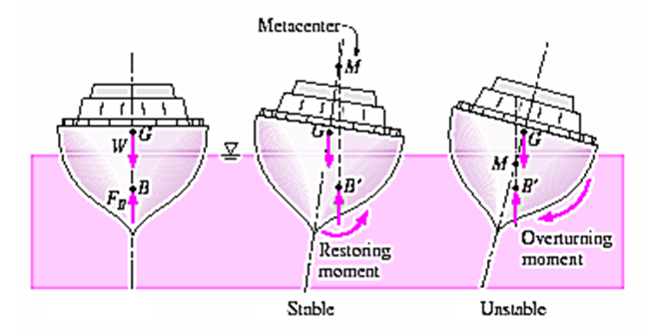

Basic principle of the static stability
Tilt the body through a small angle δθ.
Establish a new waterline for the tilted body to float at an angle δθ.
Calculate the new position B′ of the center of buoyancy.
Draw an upward vertical line from B′ .

Slide 8
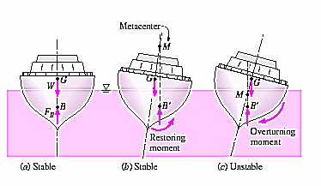
Basic principle of the static stability
Locate the intersection of upward vertical line with line of symmetry M, called the metacenter.
If the metacentric height is positive (that is, point M is above G restoring moment is generated and the original position is restored.
The floating body is in Stable Condition.

Slide 9
Basic principle of the static stability
If metacentric height is negative (M is below G ), the body is unstable.
Even an infinitesimal disturbance can overturn the body.

Slide 10
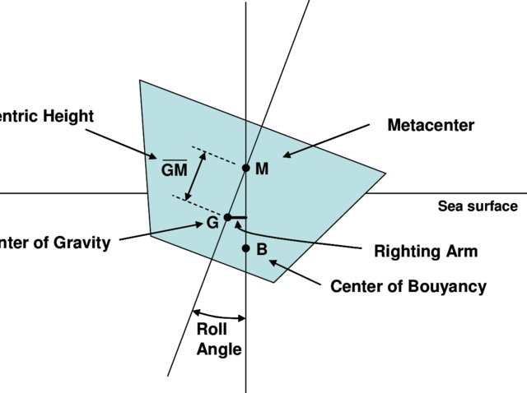
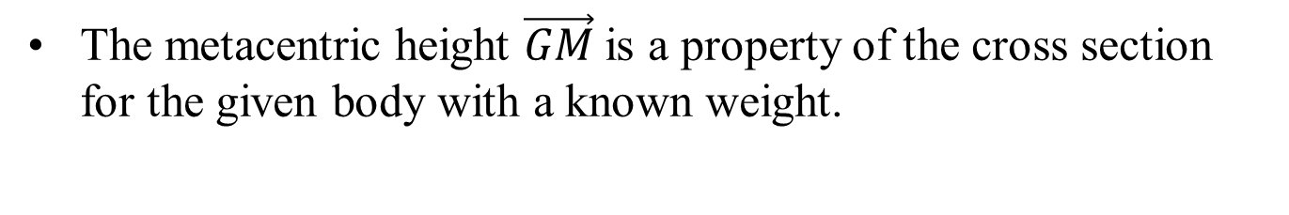
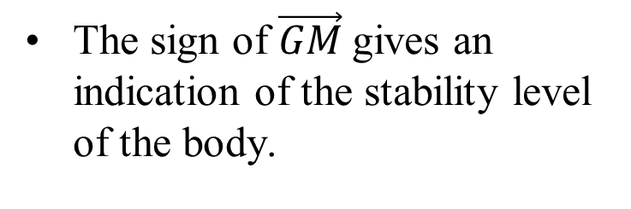
Floating System & Metacentric Height
The metacentric height $\vec{GM}$is a property of the cross section for the given body with a known weight.
Metacentric height
The sign of $\vec{GM}$gives an indication of the stability level of the body.
A Detailed analysis is essential to compute metacentric height for a body of varying cross section and density, such as a ship/ a submarine.

Slide 11
Methods for Stability Analysis
Research and development in Naval architecture studies various stability concepts.

Slide 12
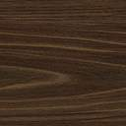


Waterline Area Method of Stability Analysis
y
The line of symmetry of the selected body is considered as y axis.
x
B

Slide 13
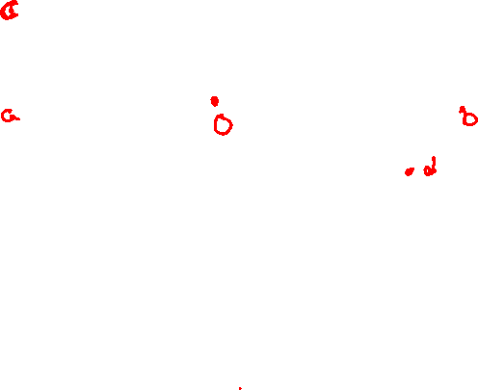
Waterline Area Method of Stability Analysis
Tilt the body through a small angle θ
y
Identify the submerged additional small wedge as ObdO.
θ
B
x
This tilt uncovers an equal wedge OacO, as shown in the figure above.

Slide 14
Waterline Area Method of Stability Analysis
y
c
θ
b
a
x
B
B′
d
The new position B′ of the center of buoyancy is nothing but the
centroid of the submerged portion aOda of the body!

Slide 15
Waterline Area Method of Stability Analysis
y
M
c
a
O,G
b
θ
x
B
B′
d
Draw a vertical line passing through B’ and locate Metacenter, M

Slide 16
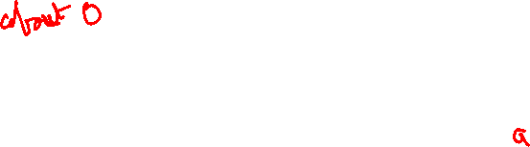

Moment of Waterline Area
y
M
c
a
O,G
b
Assume that the density of the object considered here is uniform to derive a mass-moment equation.
θ
B
B′
d
x
$$xv_{aOda}=\int_{cOdac}{xdv}+\int_{ObdO}{xdv}−\int_{cOdc}{xdv}$$

Slide 17
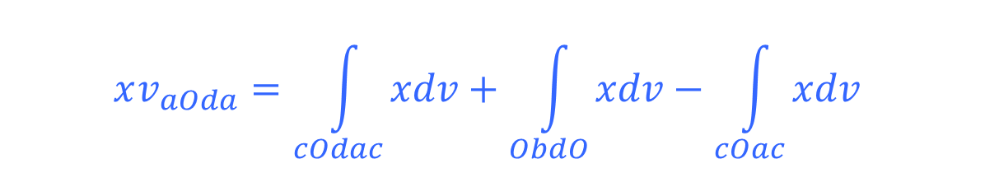
Moment of Waterline Area
y
M
c
a
O,G
b
θ
$$xv_{aOda}=\int_{cOdac}{xdv}+\int_{ObdO}{xdv}−\int_{cOac}{xdv}$$
B
B′
d
x
d
The first integral vanishes because of the symmetry of the originalsubmerged portion.

Slide 18

Moment of Waterline Area
y
M
c
a
O,G
b
θ
B
B′
d
x
$$xv_{aOda}=\int_{ObdO}{xdv}−\int_{cOac}{xdv}$$

Slide 19

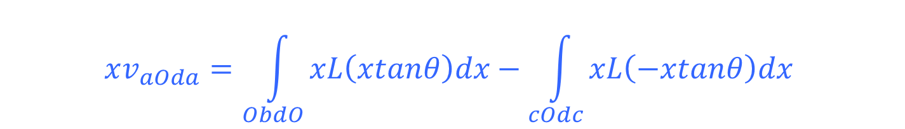
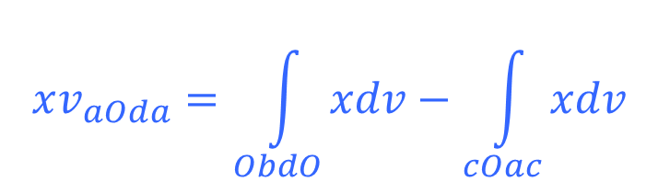
Waterline Area Method of Stability Analysis
y
$$xv_{aOda}=\int_{ObdO}{xdv}−\int_{cOac}{xdv}$$
M
Variable-width
L(x) into screen &
dA= xtanθdx
a
O,G
b
θ
x
B
B′
d
$$xv_{aOda}=tanθ\int_{Waterline}{x^{2}{dA}_{waterline}}$$
$$xv_{aOda}=\int_{ObdO}{xL\left(xtanθ\right)dx}−\int_{cOdc}{xL\left(−xtanθ\right)dx}$$

Slide 20

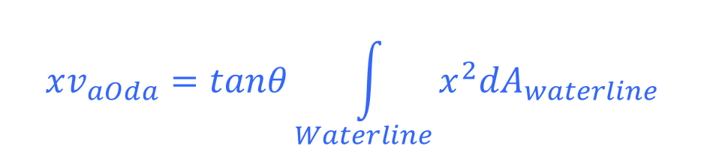
Waterline Area Method of Stability Analysis
y
M
c
a
O,G
b
θ
x
B
B′
d
$$xv_{aOda}=tanθ\int_{Waterline}{x^{2}{dA}_{waterline}}$$
$$xv_{aObdea}=I_{O}tanθ$$

Slide 21
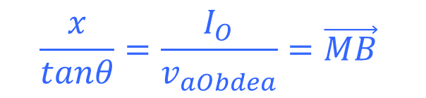
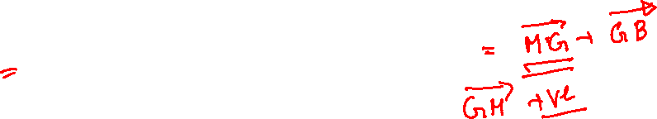

Waterline Area Method of Stability Analysis
y
If the metacentric height is positive (that is, point M is above G restoring moment is generated and the original position is restored.
M
a
O,G
b
θ
x
B
B′
d
$$\frac{x}{tanθ}=\frac{I_{O}}{v_{aObdea}}=\vec{MB}$$
$$xv_{aOda}=I_{O}tanθ$$

Slide 22
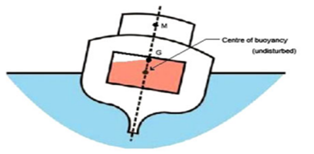
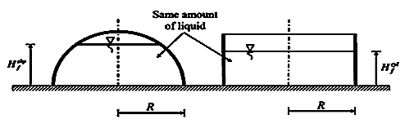
Sloshing : Another Reason or Reaction of Instability??
Sloshing is a Class of Rigid Body Motion of Liquid Containers…

