Slide 1


Flotation Analysis of Submersibles
P M V Subbarao
Professor
Mechanical Engineering Department
Hydrostatics for International Business & National Border Security……

Slide 2


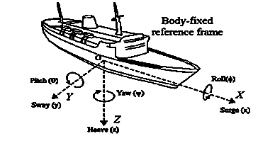
Flotation of Tanker Ships
An oil tanker, despite its immense weight, can float because its large, hollow hull, filled with air, displaces a volume of water that weighs the same as the tanker itself.

Slide 3
Classification of Tanker Ships
Oil Tankers
Product Tankers
Crude Tankers
Gas Tankers
  Ethylene ships
  Fully refrigerated LPG ships
  LNG ships

Slide 4
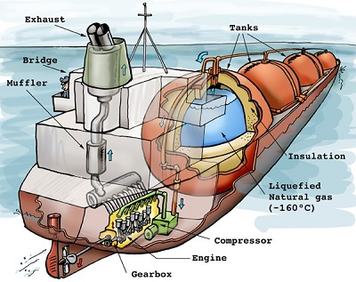
Components of an LNG Carrier

Slide 5
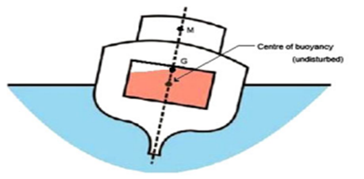
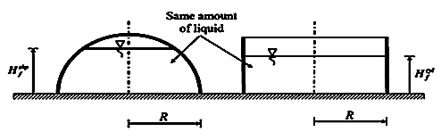
Flotation of Tanker Ships

Slide 6
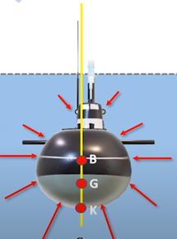
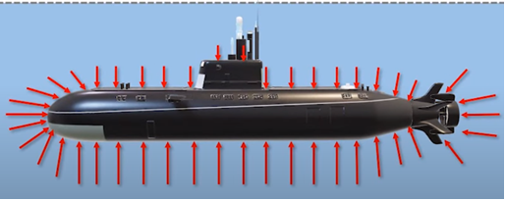
The Submersibles

Slide 7
Indian Submarines
India has 7,000 kilometers of seacoast.
India claims a twelve-nautical-mile territorial sea and an exclusive economic zone of 200 nautical miles.
The territorial seas total 314,400 square kilometers.
Indian Navy Submarines
Kalvari Class
Sindhughosh Class
Shishumar Class

Slide 8
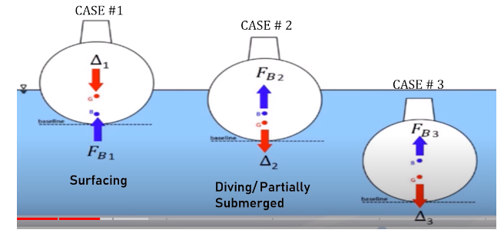
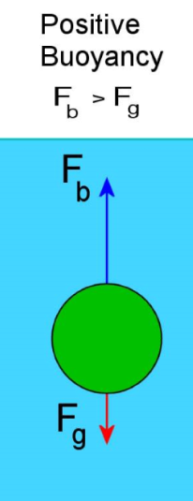
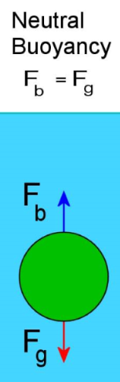
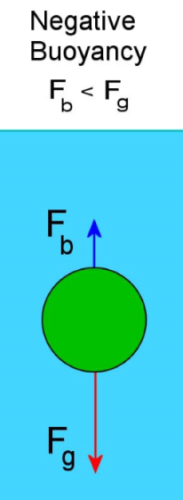
Operational Cases of A Submarine

Slide 9
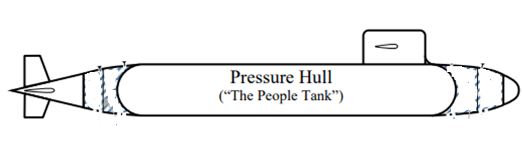

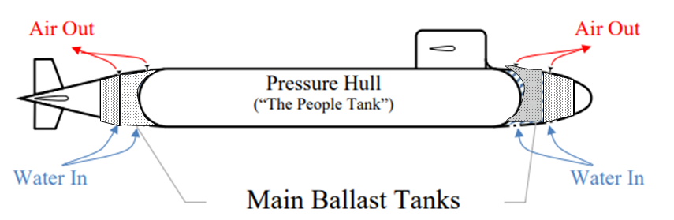
Hydrostatic Layout of A Typical Submarine
Fluid
Chamber
2
Fluid
Chamber
3
Fluid
Chamber
4
Fluid
Chamber
1

Slide 10
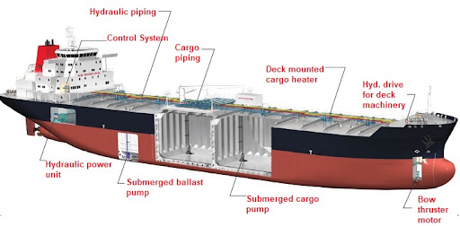
Forces Acting on A floating Submarine/Tanker
Just like an object, ships/submarines obey the principles of static equilibrium and Archimedes.
The forces of concern on a freely floating submarine/ship are the distributed gravitational forces and the distributed buoyant forces.
The forces are said to be distributed because they act over the entire submarine/ship.
Higher level of engineering analysis requires the use of the distributed force system to do the modeling.

Slide 11
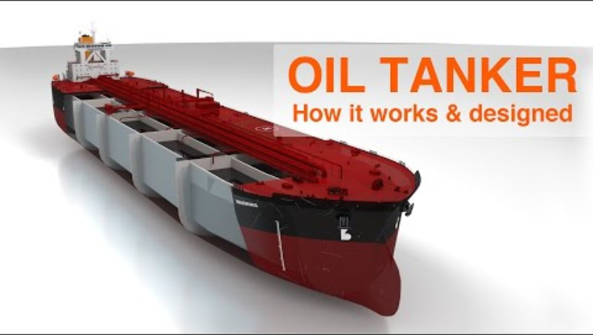
Forces Acting on A floating Submarine/Tanker
Higher level of engineering analysis requires the use of the distributed force system to do the modeling.

Slide 12
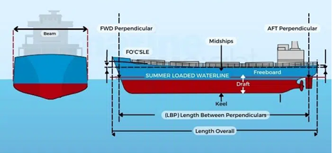
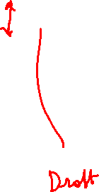
Geometrical Details of Ship

Slide 13
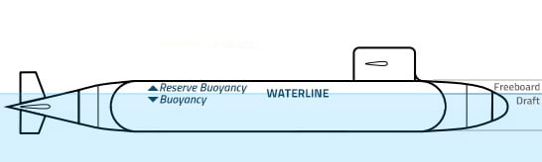
Geometrical Details of Submarine

Slide 14
Equivalent Resultant Vectors
First level analysis allows the engineer to replace the distributed force system with an equivalent single resultant vector.
The resultant vector is the sum of the distributed force system and is considered to act at such a location as to create the same effect on the body as the distributed system.
In this course all distributed forces are replaced with resultant vectors to do the hydrostatic analysis.

Slide 15
Buoyancy and Stability
The same principles used to compute hydrostatic forces on surfaces can be applied to the net pressure force on a completely submerged or floating body.
The results are the two laws of buoyancy discovered by Archimedes in ~ 230 B.C.:
1. A body immersed in a fluid experiences a vertical buoyant force equal to the weight of the fluid it displaces.
2. A floating body displaces its own weight in the fluid in which it floats.

Slide 16

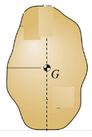
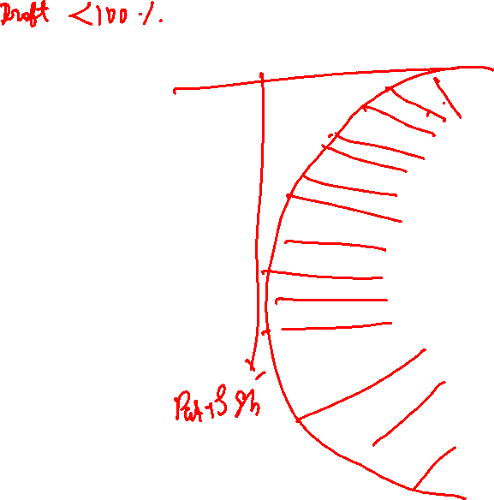
Hydrostatic Pressure Distribution on a Fully Submerged Body
F_{vt}
F_{vt}
F_{vb}
F_{vb}

Slide 17
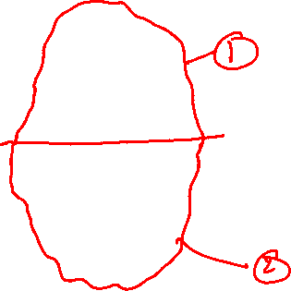
Hydrostatic Pressure Distribution on a Fully Submerged Body
F_{vt}
Archimedes’ two laws can be easily derived by referring to Figure.
The body lies between
an upper curved surface 1 and
a lower curved surface 2.
Balance of vertical force according to Archimedes law the body experiences a net upward force.
$F_{B}=F_{vb}−$ $F_{vt}$
F_{vb}

Slide 18

A Fully Submerged Body Vs Displaced Fluid System
fluid weight above top surface (W_{fluid-ts})
fluid weight above bottom surface (W_{fluid-bs})
$F_{B}=F_{vb}−$ $F_{vt}$
$F_{B}={Weight of Fluid }_{bs}−$ ${Weight of Fluid }_{ts}$
$F_{B}=Weight of Fluid$ equivalent volume of the body

Slide 19


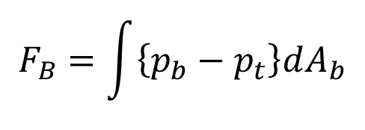


Hydrostatic Pressure Distribution on a Surface of A Fully Submerged Body
An infinitesimal curve surface with horizontal elemental area dAb
$$F_{B}=\int{\left\{p_{b}−p_{t}\right\}dA_{b}}$$
$z_{t}−$ $z_{b}$
$$F_{B}=ρ_{fluid}gV_{body}$$
$F_{B}=F_{vt}−$ $F_{vb}$

Slide 20
The Fully Submerged Body
$$F_{B}=ρ_{fluid}gV_{body}$$
Above equation assumes that the fluid has uniform specific weight.
The line of action of the buoyant force passes through the center of volume of the displaced body.
The point through which F_{B} acts is called the center of buoyancy, CB.
The point CB may or may not correspond to the actual center of mass of the body’s own material.

