Slide 1


Analysis of Forces on Gates used in Fluid Reservoirs
P M V Subbarao
Professor
Mechanical Engineering Department
Design of Safe Gates for Flood Control and More……

Slide 2


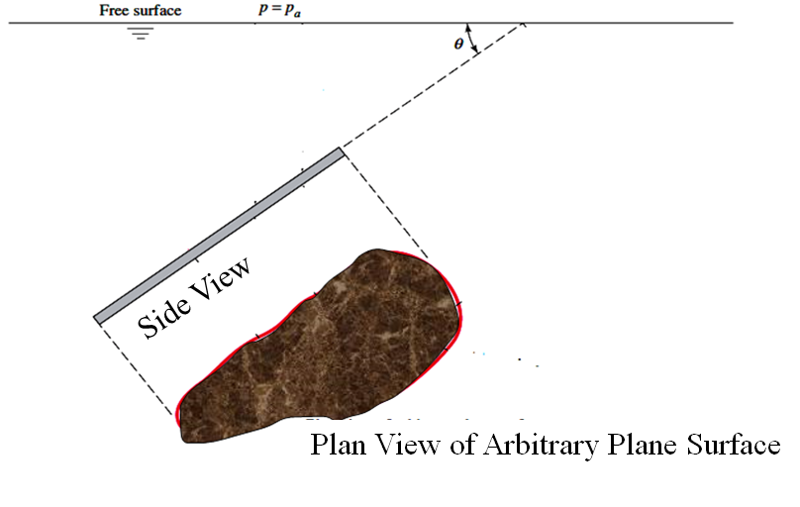
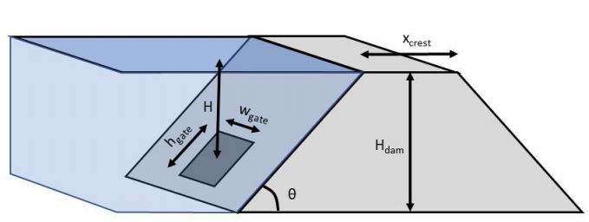
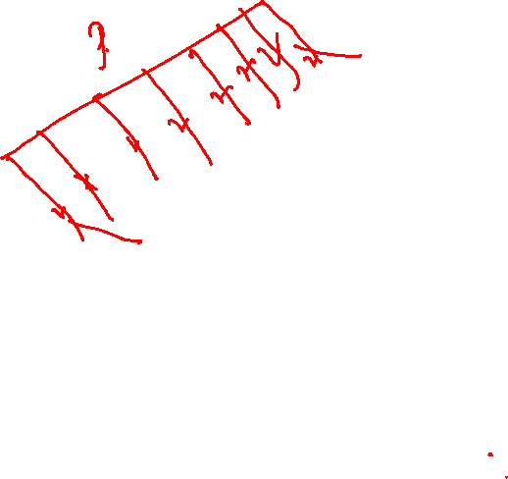
Geometrical Details of a General Inclined Gate

Slide 3
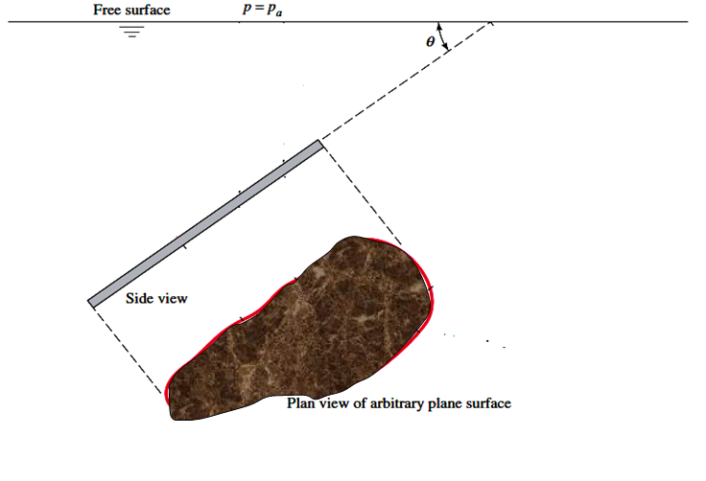
The Line of Action for Pressure Force
The resultant force F_{pressure} acts not through the centroid but below it toward the high-pressure side.
$$F_{pressure}=\int_{h_{t}}^{h_{b}}{pdA}$$
h_{CP}
The line of action passes through the center of pressure CP of the plate.

Slide 4
Gate Shape Vs Pressure Force
$$F_{pressure}=\int_{h_{t}}^{h_{b}}{pdA}$$
h_{CP}
h_{CG}
Final formulas must include the shape of the Gate (plate).
Locate centroid of the plate to include the plate shape into analysis

Slide 5
Centroid of the Gate
$$F_{pressure}=\int_{h_{t}}^{h_{b}}{pdA}$$
h_{CP}
h_{CG}
y
CG
x
Establish an x-y coordinate system in the plane of the plate with the origin at its centroid.

Slide 6
An Intrinsic Coordinate System
$$F_{pressure}=\int_{h_{t}}^{h_{b}}{pdA}$$
h_{CP}
h_{CG}
ξ
y
dA
CG
x
Establish an intrinsic coordinate ξ down from the water surface in the plane of the plate

Slide 7
Total Hydrostatic Force in Intrinsic Coordinate System
$$F_{pressure}=\int_{h_{t}}^{h_{b}}{pdA}$$
h_{CP}
h_{CG}
ξ
y
dA
CG
x
The total hydrostatic force on one side of the plate in ξ coordinate is given
$$F_{pressure}=\int_{ξ_{t}}^{ξ_{b}}{pdA}$$
$$=p_{a}A+\int_{ξ_{t}}^{ξ_{b}}{ρghdA}$$

Slide 8
Force Equation in Intrinsic Coordinate Systems
$$F_{pressure}=p_{a}A+\int_{ξ_{t}}^{ξ_{b}}{ρghdA}$$
h_{CP}
The remaining integral is evaluated by noticing from Figure that
h = ξ sinθ.
h_{CG}
ξ
y
dA
CG
x
$$F_{pressure}=p_{a}A+\int_{ξ_{t}}^{ξ_{b}}{ρgξsinθdA}$$

Slide 9
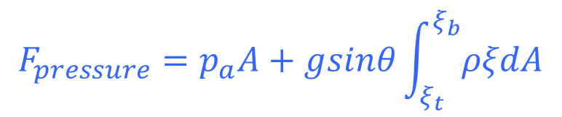
The Force on the Gate in Intrinsic Coordinate System
$$F_{pressure}=p_{a}A+\int_{ξ_{t}}^{ξ_{b}}{ρgξsinθdA}$$
h_{CP}
h_{CG}
is constant along the plate.
Hence Force equation becomes
ξ
y
dA
CG
x
$$F_{pressure}=p_{a}A+gsinθ\int_{ξ_{t}}^{ξ_{b}}{ρξdA}$$

Slide 10

Key Factors in Reservoir Density Variation
$$F_{pressure}=p_{a}A+gsinθ\int_{ξ_{t}}^{ξ_{b}}{ρξdA}$$
Temperature:
As temperature decreases, water generally becomes denser, up to about 4°C for fresh water.
TDS/Salinity:
Higher concentrations of dissolved solids increase density, a critical factor in reservoirs with significant inflows of varying chemical compositions.
First level design approximation consideres constant density model.
y
CG
x

Slide 11
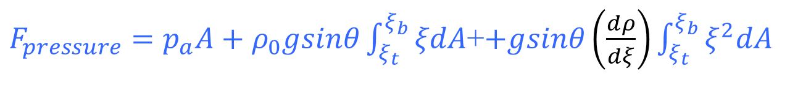
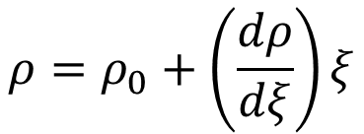
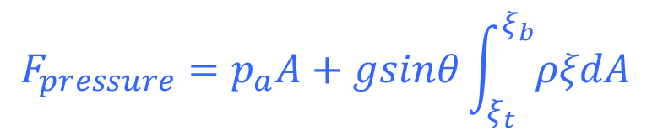
Estimation of Pressure Force: Linear variation of Density
$$F_{pressure}=p_{a}A+gsinθ\int_{ξ_{t}}^{ξ_{b}}{ρξdA}$$
h_{CP}
Consider a linear density variation Model as:
h_{CG}
ξ
y
dA
$$ρ=ρ_{0}+\left(\frac{dρ}{dξ}\right)ξ$$
CG
x
$F_{pressure}=p_{a}A+ρ_{0}gsinθ\int_{ξ_{t}}^{ξ_{b}}{ξdA}$+$+gsinθ\left(\frac{dρ}{dξ}\right)\int_{ξ_{t}}^{ξ_{b}}{ξ^{2}dA}$

Slide 12
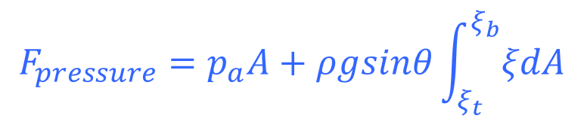
Estimation of Pressure Force: Constant Density Model
$$F_{pressure}=p_{a}A+ρgsinθ\int_{ξ_{t}}^{ξ_{b}}{ξdA}$$
h_{CP}
h_{CG}
ξ
y
dA
CG
x
The centroidal slant distance from the surface to the plate is defined as
$$ξ_{CG}=\frac{1}{A}\int_{ξ_{t}}^{ξ_{b}}{ξdA}$$

Slide 13

The Force on the Gate: Constant Density
$$ξ_{CG}=\frac{1}{A}\int_{ξ_{t}}^{ξ_{b}}{ξdA}$$
h_{CP}
h_{CG}
$$F_{pressure}=p_{a}A+ρgsinθ\int_{ξ_{t}}^{ξ_{b}}{ξdA}$$
ξ
y
dA
ξ_{CG}
CG
x
$$F_{pressure}=p_{a}A+ρgsinθξ_{CG}A$$

Slide 14
Force on the Gate in Pascal’s Coordinates: Constant Density
h_{CP}
$$F_{pressure}=p_{a}A+ρgsinθξ_{CG}A$$
h_{CG}
y
ξ_{CG}
CG
x
Unravel this by noticing that ξCG sinθ = hCG, the depth straight down from the surface to the plate centroid. Thus
$$F_{pressure}=p_{a}A+ρgh_{CG}A$$
= $\left(p_{a}+ρgh_{CG}\right) A$
= $p_{CG} A$

Slide 15
The Force on Gate Constant Density
$$F_{pressure}$$
h_{CP}
h_{CG}
$F_{pressure}$ = $p_{CG} A$
The force on one side of any plane submerged surface in a uniform density fluid equals the pressure at the plate centroid times the plate area!
Independent of the shape of the plate or the angle θ at which it is slanted.

Slide 16
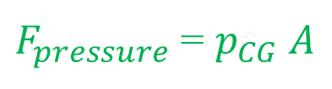
Coordinates of Centre of Pressure
The line of action passes through the center of pressure CP of the plate.
$F_{pressure}$ = $p_{CG} A$
h_{CP}
h_{CG}
(0,0)
y
CG
x
(x_{CP}, y_{CP})
To find the coordinates (x_{CP}, y_{CP}), sum moments of the elemental force p dA about the centroid must be equated to the moment of the resultant F_{pressure}.

Slide 17
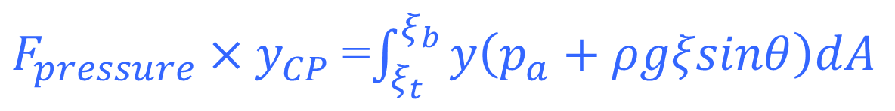
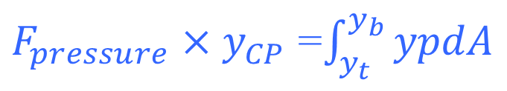
Y-coordinate of CP
To compute y_{CP}, we must equate
h_{CP}
$F_{pressure}×y_{CP}$ =$\int_{y_{t}}^{y_{b}}{ypdA}$
h_{CG}
ξ
(0,0)
y
ξ_{CG}
CG
x
(x_{CP}, y_{CP})
In intrinsic Coordinates:
$F_{pressure}×y_{CP}$=$\int_{ξ_{t}}^{ξ_{b}}{y\left(p_{a}+ρgξsinθ\right)dA}$

Slide 18
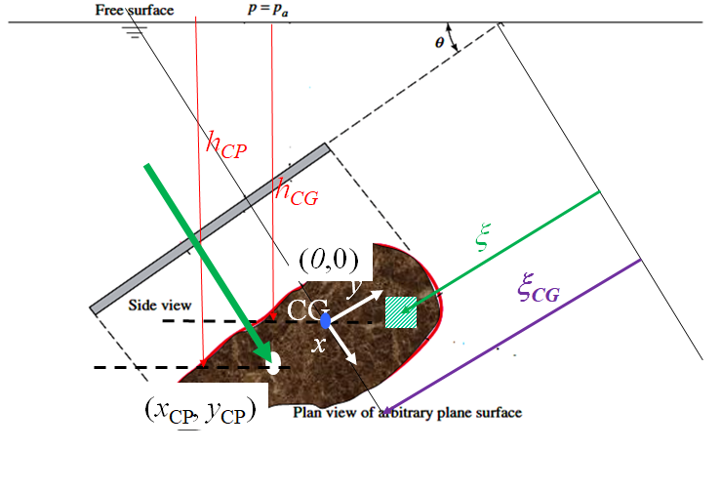

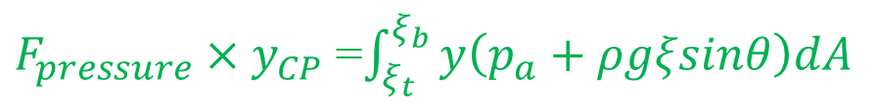
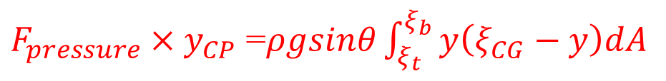
Y-coordinate of CP
$F_{pressure}×y_{CP}$=$\int_{ξ_{t}}^{ξ_{b}}{y\left(p_{a}+ρgξsinθ\right)dA}$
The term p_{a}y dA vanishes of due to the definition of centroidal axes.
$F_{pressure}×y_{CP}$ =$ρgsinθ\int_{ξ_{t}}^{ξ_{b}}{yξdA}$
Introducing ξ = ξ_{CG}-y, we obtain
$F_{pressure}×y_{CP}$ =$ρgsinθ\int_{ξ_{t}}^{ξ_{b}}{y\left(ξ_{CG}−y\right)dA}$
$F_{pressure}×y_{CP}$ =$ρgsinθ\left\{\int_{ξ_{t}}^{ξ_{b}}{ξ_{CG}ydA}−\int_{ξ_{t}}^{ξ_{b}}{y^{2}dA}\right\}$

Slide 19

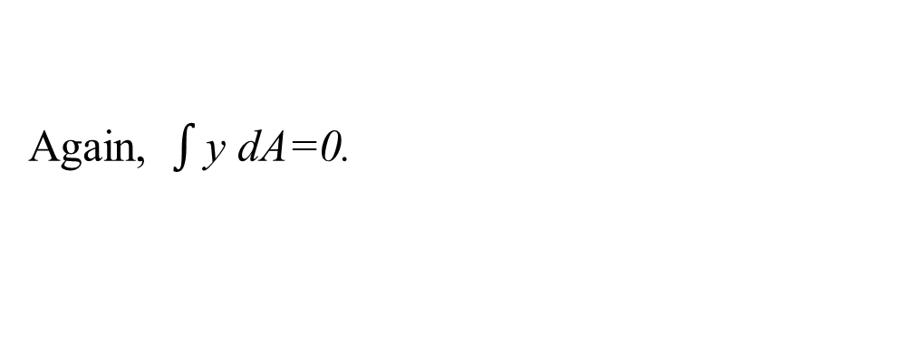
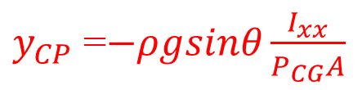

Mechanical Equilibrium of the Gate
$F_{pressure}×y_{CP}$ =$ρgsinθ\left\{\int_{ξ_{t}}^{ξ_{b}}{ξ_{CG}ydA}−\int_{ξ_{t}}^{ξ_{b}}{y^{2}dA}\right\}$
Again, $\int{\text{y} \text{dA}\text{=0}}$.
$F_{pressure}×y_{CP}$ =$−ρgsinθI_{xx}$
Ixx is the area moment of inertia of the plate area about its centroidal x axis, computed in the plane of the plate.
Substituting for F gives the result
The negative sign in this equation shows that yCP is below the centroid at a deeper level
$y_{CP}$ =$−ρgsinθ\frac{I_{xx}}{P_{CG}A}$

Slide 20

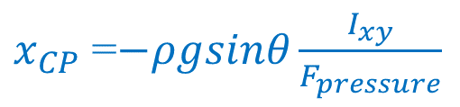


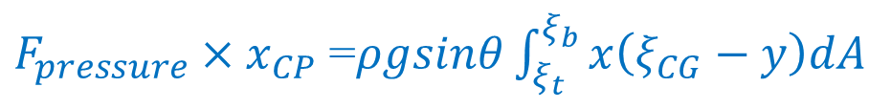
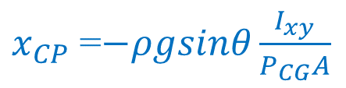
X-location of CP
The determination of x_{CP} is exactly similar:
$F_{pressure}×x_{CP}$ =$\int_{ξ_{t}}^{ξ_{b}}{xpdA}$
$F_{pressure}×x_{CP}$ =$ρgsinθ\int_{ξ_{t}}^{ξ_{b}}{x\left(ξ_{CG}−y\right)dA}$
$F_{pressure}×x_{CP}$ =$−ρgsinθ\int_{ξ_{t}}^{ξ_{b}}{xydA}$
$F_{pressure}×x_{CP}$ =$−ρgsinθI_{xy}$
$x_{CP}$ =$−ρgsinθ\frac{I_{xy}}{F_{pressure}}$
where Ixy is the product of inertia of the plate, again computed in the plane of the plate.
Substituting for F gives
$x_{CP}$ =$−ρgsinθ\frac{I_{xy}}{P_{CG}A}$

Slide 21
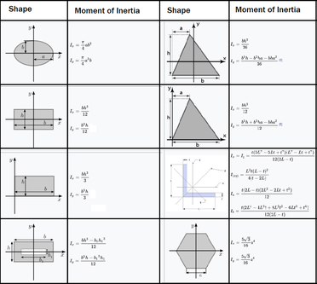
Important Notes on Location of CP
For positive I_{xy}, x_{CP} is negative because the dominant pressure force acts in the third, or lower left, quadrant of the panel.
If I_{xy} = 0, usually implying symmetry, x_{CP} = 0 and the center of pressure lies directly below the centroid on the y axis.

Slide 22
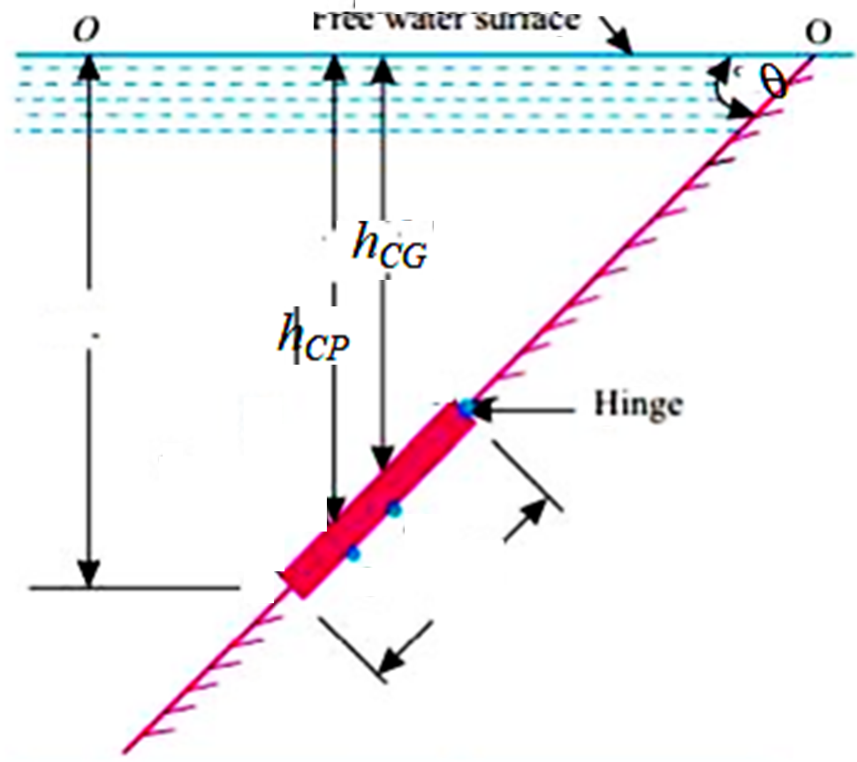



Operation of Gate in A reservoir
$$F_{pressure}$$
$$h_{open}$$
$$F_{open}$$
CG
CP

Slide 23
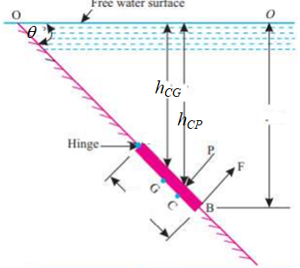
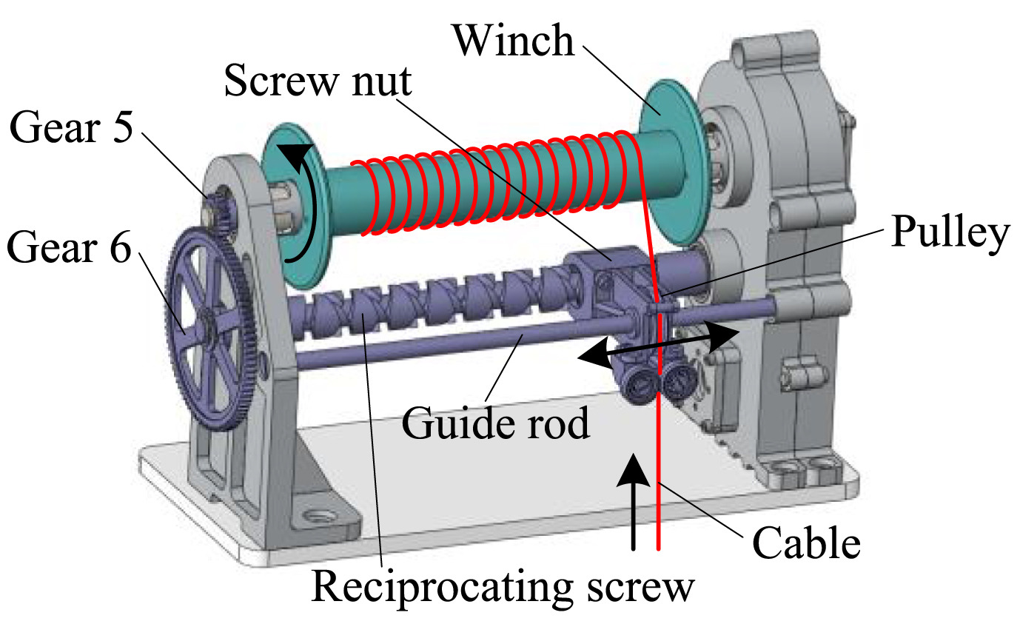

Enhancement of Operational Ease for Gates in A Fluid Reservoir
$$F_{pressure}$$

Slide 24
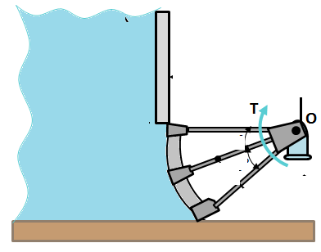
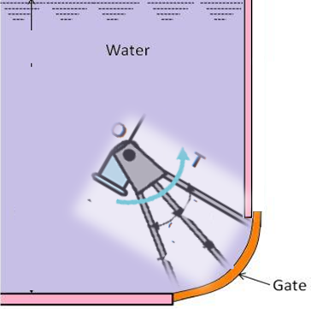
Curved Gates for Operational Comfort

Slide 25
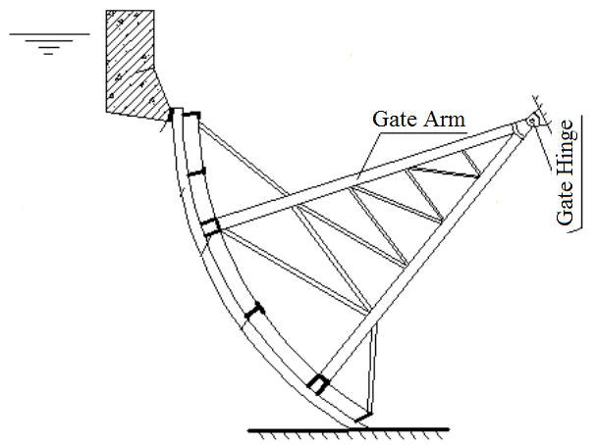
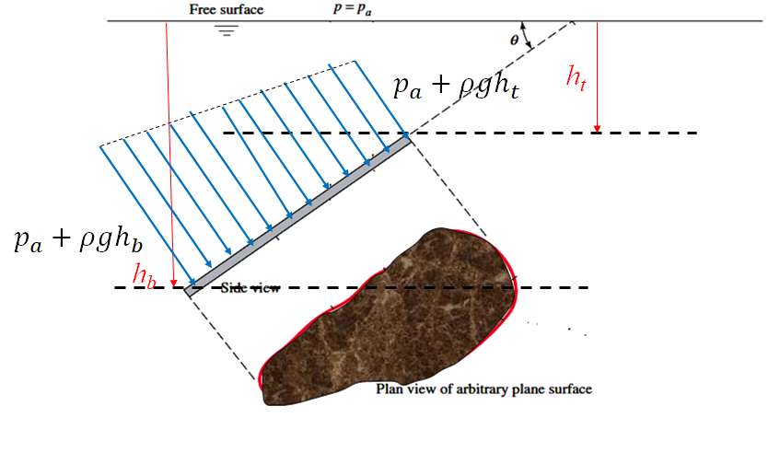


Parallel to Fan type Pressure Forces on Gates
$$p_{a}+ρgh_{t}$$
$$p_{a}+ρgh_{b}$$

Slide 26
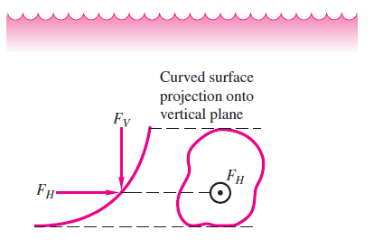
Analysis of Curved Gates
The resultant pressure force on a curved surface is most easily computed by separating it into horizontal and vertical components.
Consider the arbitrary curved surface sketched in Figure.
The incremental pressure forces are normal to the local area element.
The direction of local force will vary along the surface and thus simple addition is not valid.

Slide 27
Simplified Analysis of Curved Gates
Simplification of analysis is possible by identification of three different zones of elemental pressure forces.
However, a laborious three-way integration need to be carried out for complete analysis.

Slide 28
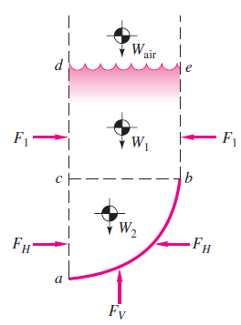
Identification of Different Elemental Pressure Force Zones
Consider a free-body diagram of the column of fluid contained in the vertical projection above the curved surface.
The desired forces FH and FV are exerted by the surface on the fluid column.
Other forces are shown due to fluid weight and horizontal pressure on the vertical sides of this column.
The column of fluid must be in static equilibrium.

Slide 29
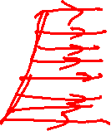
Zonal Analysis of Curved Gates
In the symmetric column bcde, the horizontal components F₁ exactly balance and are not relevant to the discussion.
In the lower, asymmetric portion of fluid abc adjoining the curved gate, summation of horizontal forces shows that the desired force F_{H} due to the curved surface is exactly equal to the force F_{H} on the vertical left side of the fluid column.
This left-side force can be computed by the plane surface formula.

Slide 30
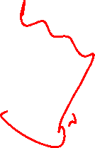
Zonal Analysis of Curved Gates
based on a vertical projection of the area of the curved surface.
This is a general rule and simplifies the analysis:
The horizontal component of force on a curved surface equals the force on the
plane area formed by the projection of the curved surface onto a vertical plane normal to the component.

Slide 31

Zonal Analysis
Summation of vertical forces on the fluid free body then shows that
$$F_{V−pressure}=W_{air}+W_{1}+W_{2}$$
The vertical component of pressure force on a curved surface equals in magnitude and direction the weight of the entire column of fluid, both liquid and atmosphere, above the curved surface.
The calculation of FV involves little more than finding centers of mass of a column of fluid.
An integration of the lower portion abc in Figure has a particularly convexing shape.

Slide 32
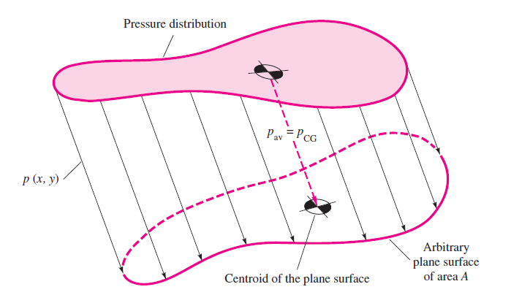
Visualization of Force
$F_{pressure}$ = $p_{CG} A$
Force Equation can be visualized physically in this Figure as the resultant of a linear stress distribution over the plate area.
This simulates combined compression and bending of a gate (as beam of the same cross section).

Slide 33
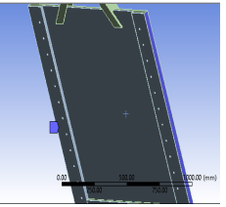
The Mechanical Stresses in the Gate
$F_{pressure}$ = $p_{CG} A$
The “bending” portion of the stress causes no force if its “neutral axis” passes through the plate centroid of area.
The “compression” part must equal the centroid stress times the plate area.

