Slide 1

Hydrostatic Pressure Distribution & Fluid Reservoirs
P M V Subbarao
Professor
Mechanical Engineering Department
Estimation of Force Field In Natural & Static Fluid Systems……

Slide 2


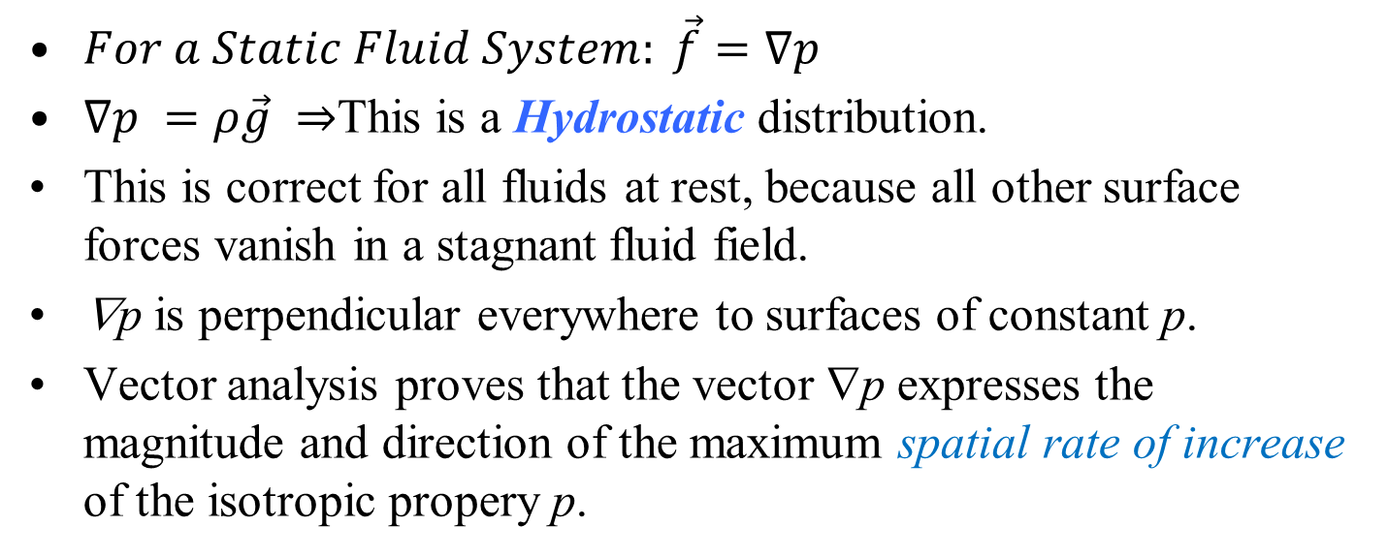
Pressure Distributions in a static Fluid System
$For a Static Fluid System: \vec{f}=∇p$
$∇p =ρ\vec{g} ⇒$This is a Hydrostatic distribution.
This is correct for all fluids at rest, because all other surface forces vanish in a stagnant fluid field.
∇p is perpendicular everywhere to surfaces of constant p.
Vector analysis proves that the vector ∇p expresses the magnitude and direction of the maximum spatial rate of increase of the isotropic propery p.
A fluid in hydrostatic equilibrium will align its constant-pressure surfaces everywhere normal to the local-gravity vector.
The maximum pressure increase will be in the direction of gravity.

Slide 3
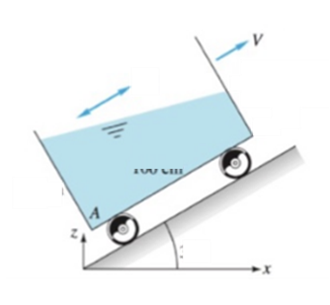
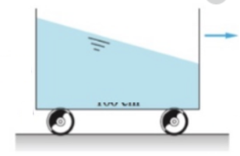


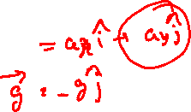
Isobaric Surfaces in A Static Fluid System
$For a Static Fluid System: \vec{f}=∇p=ρ\vec{g}$
A fluid in hydrostatic equilibrium will align its constant-pressure surfaces everywhere normal to the local-gravity vector.
Free surface of any static liquid system is an Isobar.
$$\vec{f}=∇p=ρ\left(\vec{g}−\vec{a}\right)$$
$$\vec{a}$$

Slide 4
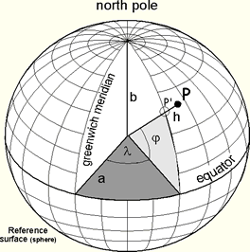
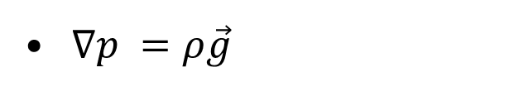
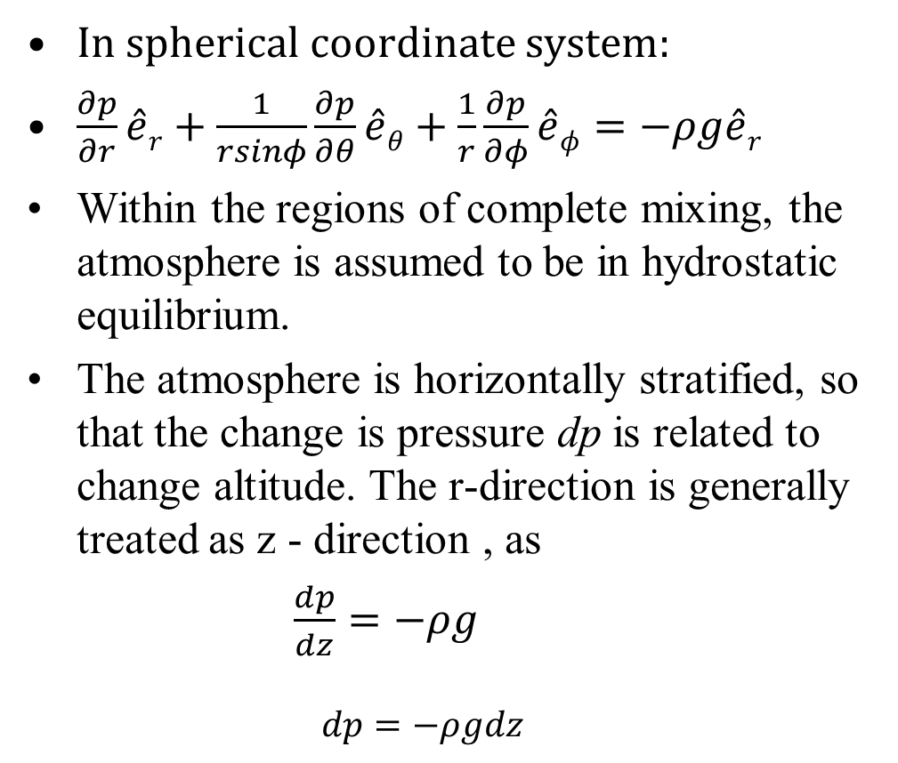
Hydrostatic Pressure Distributions in The Atmosphere
$∇p =ρ\vec{g}$
In spherical coordinate system:
$\frac{∂p}{∂r}\hat{e}r+\frac{1}{rsinφ}\frac{∂p}{∂θ}\hat{e}θ+\frac{1}{r}\frac{∂p}{∂φ}\hat{e}φ=−ρg\hat{e}r$
Within the regions of complete mixing, the atmosphere is assumed to be in hydrostatic equilibrium.
The atmosphere is horizontally stratified, so that the change is pressure dp is related to change altitude. The r-direction is generally treated as z - direction , as
$\frac{dp}{dz}=−ρg$
  $$dp=−ρgdz$$

Slide 5
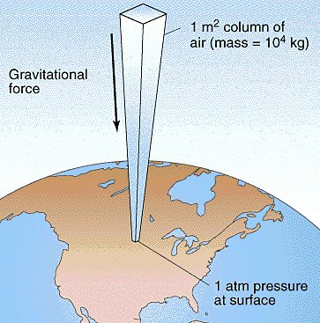

Distribution of Atmospheric Pressure
$$dp=−ρgdz$$
To help aircraft designers, it is essential to define a standard atmosphere model.
There are several models available in literature.
A standard or average day, a hot day, a cold day, and a tropical day.
The models are updated every few years to include the latest atmospheric data.

Slide 6
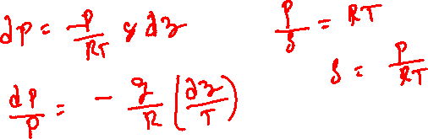


Distribution of Atmospheric Pressure
$$dp=−ρgdz$$
These models were developed from atmospheric measurements that were averaged and curve fit to produce the given equations.
Consider a model, which assumes that the temperature only changes with altitude.
Atmospheric air very closely follows Ideal Gas law.
$$\int_{p_{0}}^{p_{z}}{\frac{dp}{p}}=−\int_{0}^{Z}{\frac{g}{R}\frac{dz}{T(z)}}$$

Slide 7
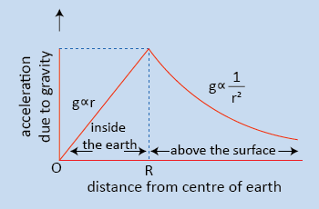
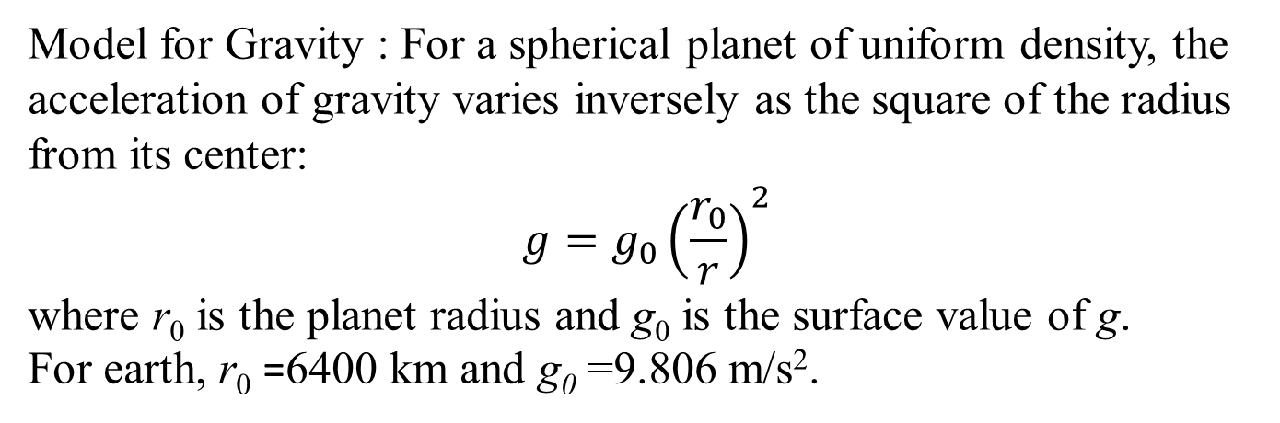
Distribution of Atmospheric Pressure
$$\int_{p_{0}}^{p_{z}}{\frac{dp}{p}}=−\int_{0}^{Z}{\frac{g}{R}\frac{dz}{T(z)}}$$
Model for Gravity : For a spherical planet of uniform density, the acceleration of gravity varies inversely as the square of the radius from its center:
$$g=g_{0}{\left(\frac{r_{0}}{r}\right)}^{2}$$
where r₀ is the planet radius and g₀ is the surface value of g.
For earth, r₀ =6400 km and g₀ =9.806 m/s².

Slide 8
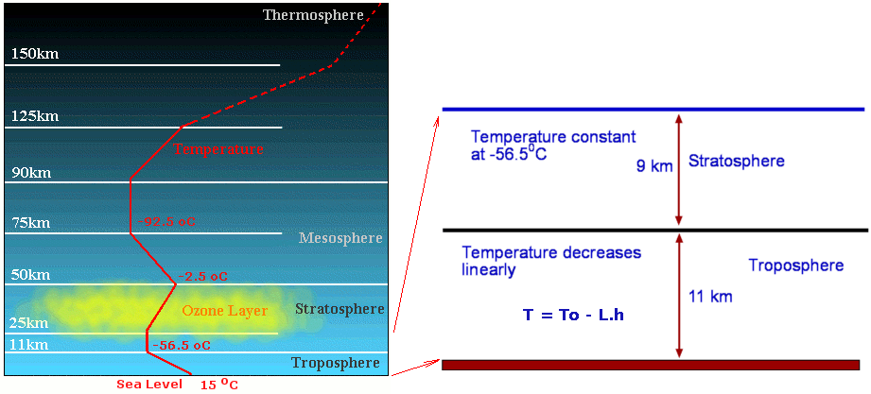
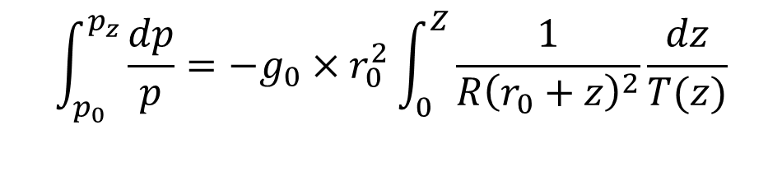
Model for Atmospheric Temperature
$$\int_{p_{0}}^{p_{z}}{\frac{dp}{p}}=−g_{0}×r_{0}^{2}\int_{0}^{Z}{\frac{1}{R{\left(r_{0}+z\right)}^{2}}\frac{dz}{T(z)}}$$
The model for temperature has three zones.
Separate curve fits for the temperature profiles of troposphere, the lower stratosphere, and the upper stratosphere.
The troposphere runs from the surface of the Earth to 11,000 meters.
In the troposphere, the temperature decreases linearly and the pressure decreases exponentially.
The rate of temperature decrease is called the Lapse rate.
$$T\left(z\right)=T_{0}−B×z$$
T0 is sea-level temperature (absolute) and B is the lapse rate, both of which vary somewhat from day to day.

Slide 9
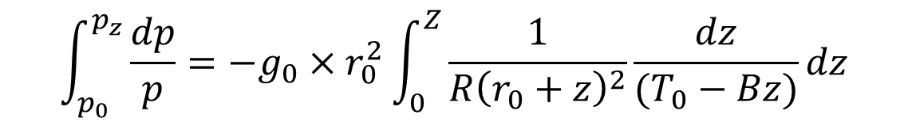

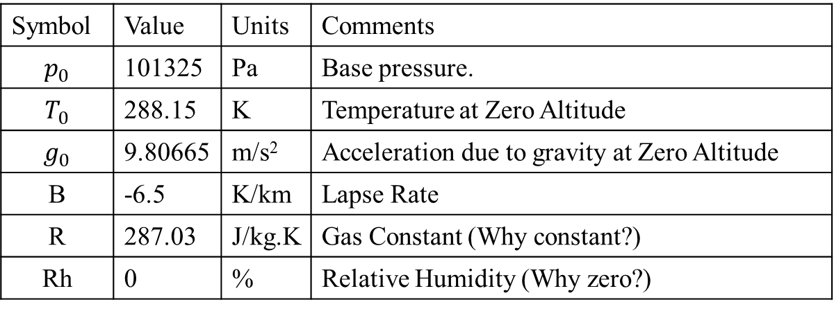
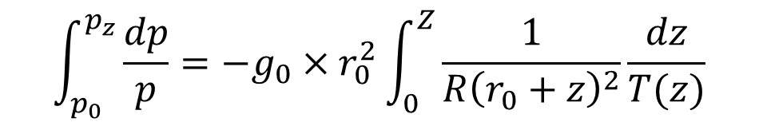
Distribution of Pressure in Troposphere
$$\int_{p_{0}}^{p_{z}}{\frac{dp}{p}}=−g_{0}×r_{0}^{2}\int_{0}^{Z}{\frac{1}{R{\left(r_{0}+z\right)}^{2}}\frac{dz}{T(z)}}$$
$$T\left(z\right)=T_{0}−B×z$$
$$\int_{p_{0}}^{p_{z}}{\frac{dp}{p}}=−g_{0}×r_{0}^{2}\int_{0}^{Z}{\frac{1}{R{\left(r_{0}+z\right)}^{2}}\frac{dz}{(T_{0}−Bz)}dz}$$
Symbol | Value | Units | Comments
$$p_{0}$$ | 101325 | Pa | Base pressure.
$$T_{0}$$ | 288.15 | K | Temperature at Zero Altitude
$$g_{0}$$ | 9.80665 | m/s² | Acceleration due to gravity at Zero Altitude
B | -6.5 | K/km | Lapse Rate
R | 287.03 | J/kg.K | Gas Constant (Why constant?)
Rh | 0 | % | Relative Humidity (Why zero?)

Slide 10
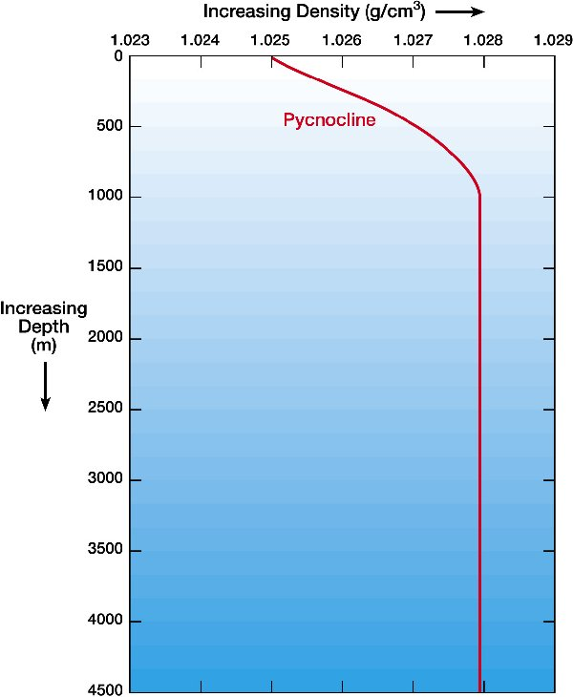
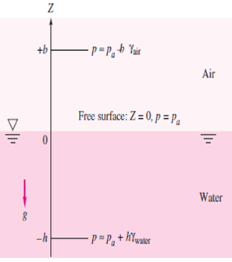
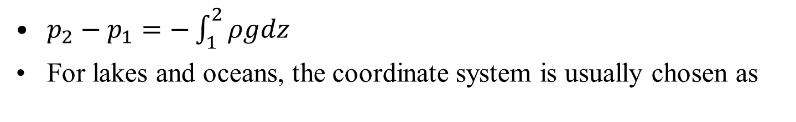
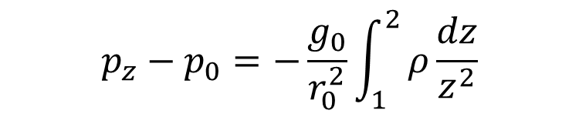
Hydrostatic Pressure Distributions in Lakes and Oceans
$p_{2}−p_{1}=−\int_{1}^{2}{ρgdz}$
For lakes and oceans, the coordinate system is usually chosen as
z=0 at the free surface, where p equals the surface atmospheric pressure p₀.
Introduce the reference value (p₁, z₁) (p_{a}, 0) in above equation to get an equation for p at any (negative) depth z,
$$p_{z}−p_{0}=−\frac{g_{0}}{r_{0}^{2}}\int_{1}^{2}{ρ\frac{dz}{z^{2}}}$$

Slide 11
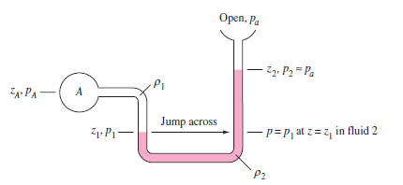
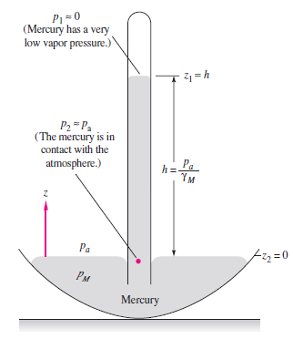
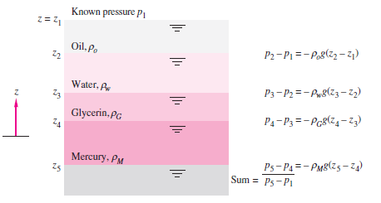

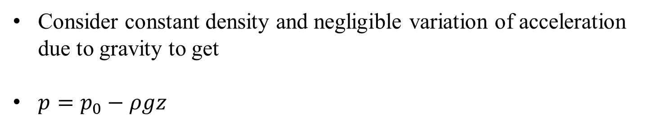
Simple and Highly Valuable Inventions
$$dp=−ρgdz$$
Consider constant density and negligible variation of acceleration due to gravity to get
$p=p_{0}−ρgz$

Slide 12
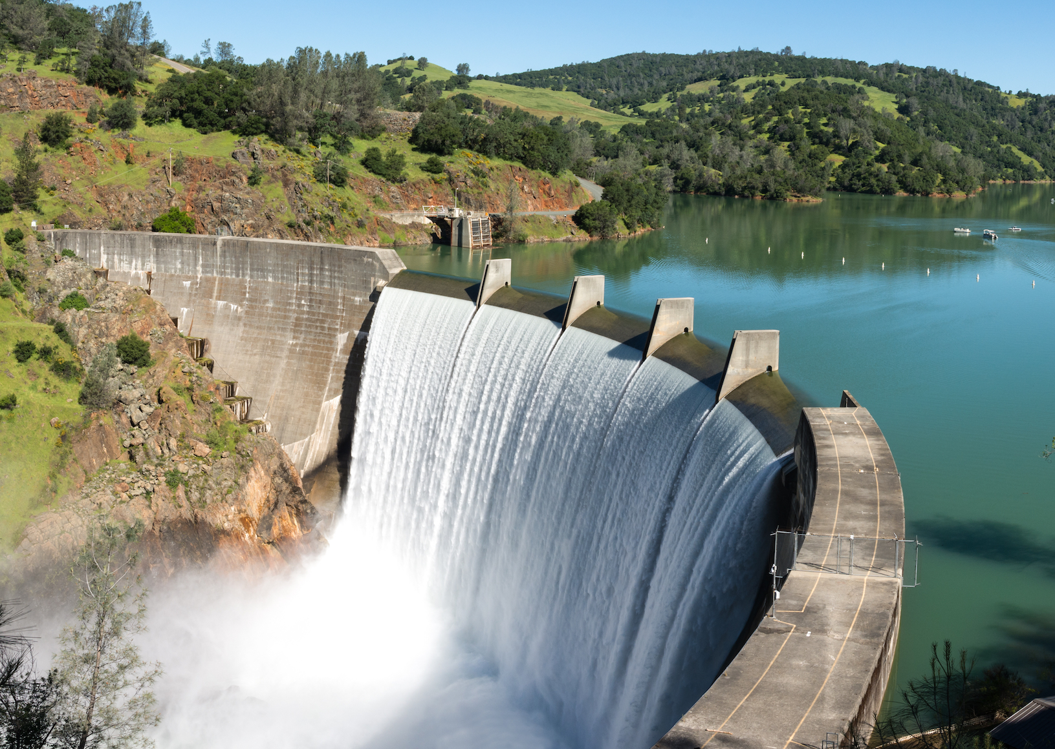

The Dams
$$dp=−ρgdz$$
Experts always understood that water can be a source of life as well as destruction.
Dam was originally constructed around 3,000 BCE in what was then Mesopotamia.
That is why they tried to control it since the dawn of times.
The best-known examples of flood barriers that are closest to those that we know and use date today back to the 500BC territory of the Netherlands.
Floodgate, gate for shutting out or releasing the flow of water over spillways, in connection with the operation of a dam.

Slide 13
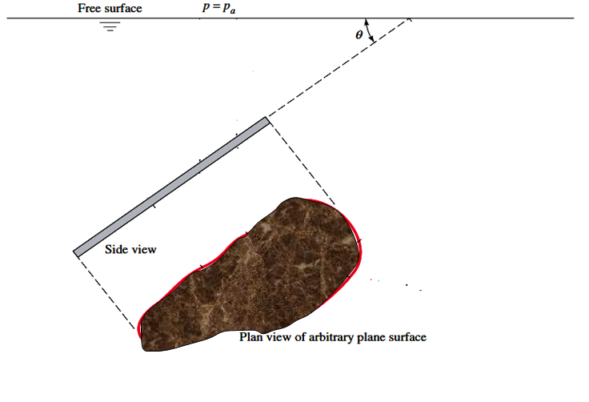
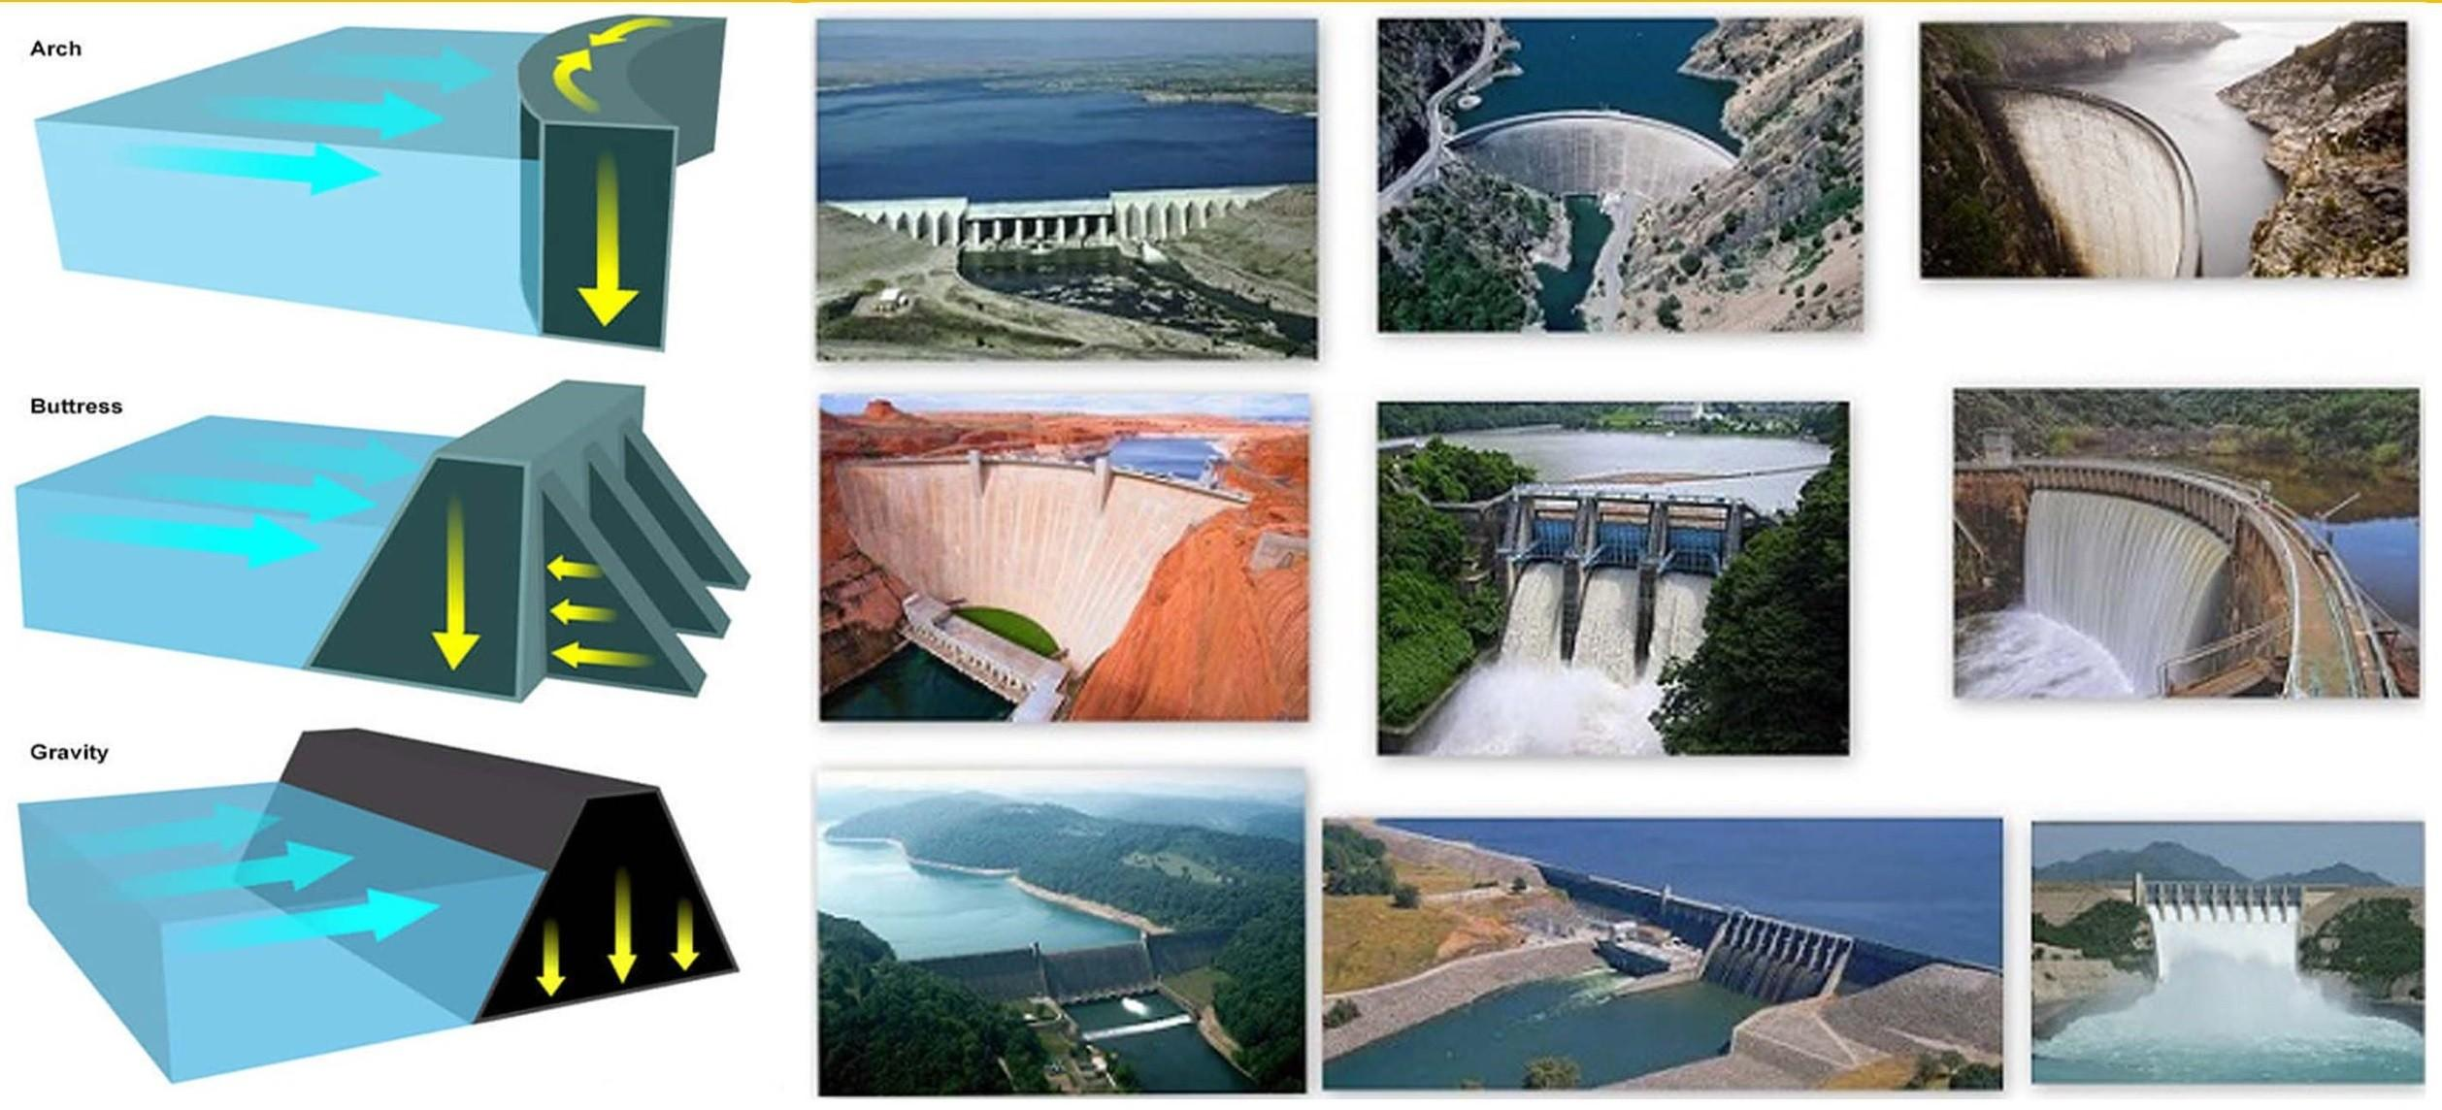
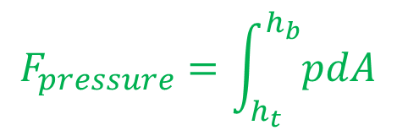
Force Due to Fluid Pressure on An Inclined Gate
h_{CP}
h_{CG}
y
CG
x
$$F_{pressure}=\int_{h_{t}}^{h_{b}}{pdA}$$

Slide 14
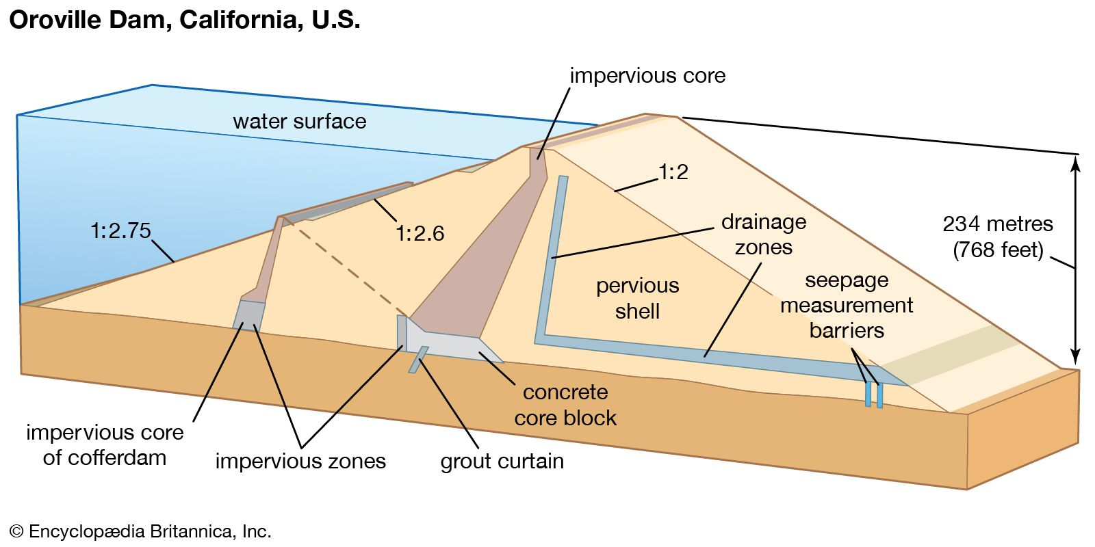

Hydrostatic Forces on solids
$$dp=−ρgdz$$
The walls of reservoirs, sluice gates, flood gates, oil and water tanks and the hulls of ships are exposed to the forces exerted by fluids in contact with them.
A fluid system in contact with a surface exerts a normal force on the surface.
The fluids are generally under static condition.
The design of above structures, demands determination of the total force on them.
Determination of the point of action of this force is very essential.

Slide 15
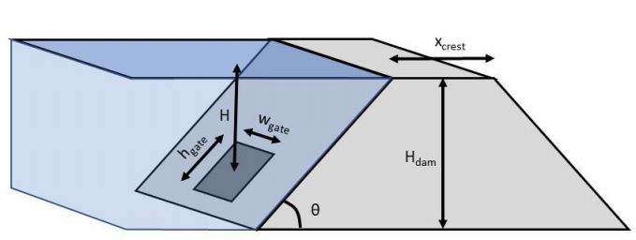
Basics of Gates
$$dp=−ρgdz$$
Study of the basic hydrostatic equation reveals that the force depends on the pressure at the depth considered.
The point of action of the total force is known as centre of pressure or pressure centre.

Slide 16
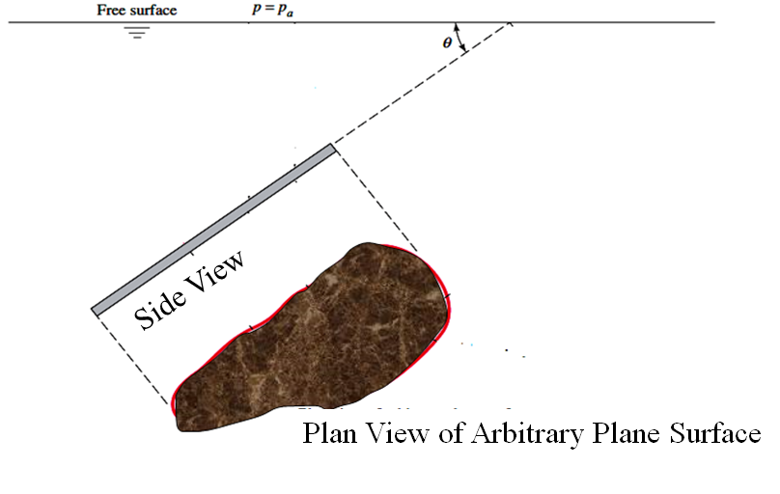
Geometrical Details of a General Inclined Gate

Slide 17
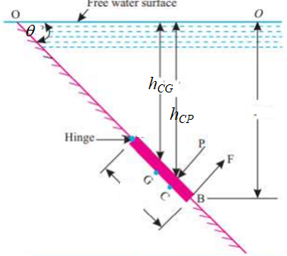
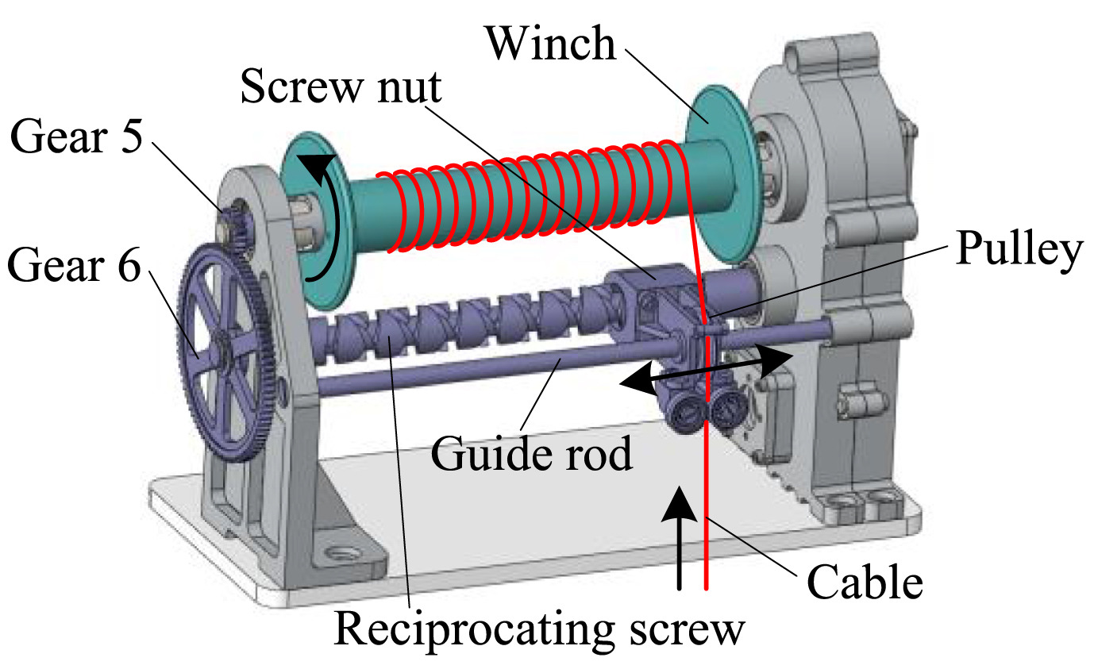

Operation of Gates in A Fluid Reservoir
$$F_{pressure}$$

Slide 18
Analysis of A Gate
Consider the problem of Hydrostatic force on an arbitrary plane surface of area A inclined at an angle θ below the free surface.

Slide 19
Hydrostatic Pressure on an Inclined Gate
$$p_{a}+ρgh_{t}$$
h_{t}
$$p_{a}+ρgh_{b}$$
h_{b}
For a constant density fluid, the pressure on any submerged surface varies linearly with depth.

Slide 20
Estimation of Total Pressure Force
h(x,z)
$$p_{a}+ρgh_{t}$$
$$p_{a}+ρgh_{b}$$
dA
$$F_{pressure}=\int_{h_{t}}^{h_{b}}{pdA}$$

Slide 21
Location of Total Pressure Force
h(x,z)
$$p_{a}+ρgh_{t}$$
$$p_{a}+ρgh_{b}$$
dA
$$F_{pressure}=\int_{h_{t}}^{h_{b}}{pdA}$$

Slide 22
The Line of Action
The resultant force F_{pressure} acts not through the centroid but below it toward the high-pressure side.
$$F_{pressure}=\int_{h_{t}}^{h_{b}}{pdA}$$
h_{CP}
The line of action passes through the center of pressure CP of the plate.

Slide 23
Gate Shape
$$F_{pressure}=\int_{h_{t}}^{h_{b}}{pdA}$$
h_{CP}
h_{CG}
Final formulas must include the shape of the Gate (plate).
Locate centroid of the plate to include the plate shape into analysis

