Slide 1


An Ingress into Analytical Fluid Mechanics
P M V Subbarao
Professor
Mechanical Engineering Department
Quantification of the Fundamental Sources of Forces……

Slide 2


Analytical Fluid Mechanics
Fluid Statics or Hydrostatics.
Fluid Dynamics or Hydrodynamics or Aerodynamics

Slide 3
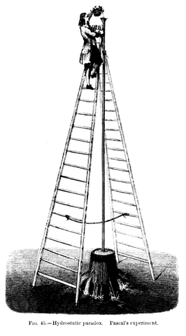
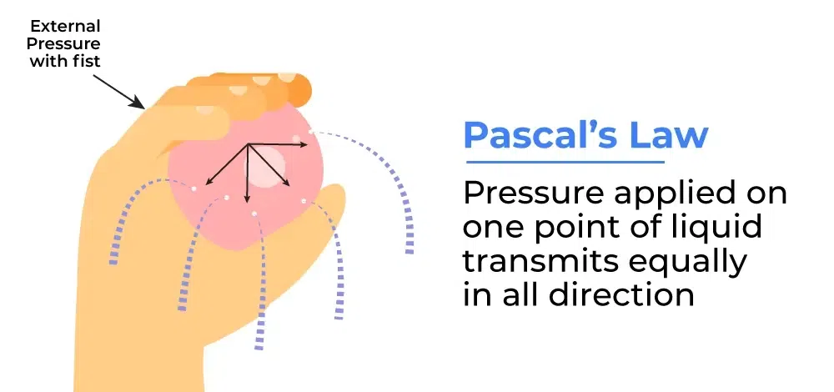
Origin of Fluid Statics
Pascal’s experiment in 1860.

Slide 4
Motivation & Hydrostatics
Many practical applications of fluid systems do not involve motion.
They concern the pressure distribution in a static fluid.
The concern about its effect on floating and submerged bodies is the origin of this subject.
When the fluid velocity is zero, denoted as the hydrostatic condition.
The pressure variation in a static fluid is due only to the weight of the fluid.
A known fluid in each gravitational field is a source of action called “the pressure distribution.”
This may easily be calculated by integration.

Slide 5
Important Hydrostatic Applications
Pressure distribution in the atmosphere and the oceans.
The design of manometer, mechanical, and electronic pressure instruments.
Forces on submerged flat and curved surfaces.
Above three use Pascals Laws.
Buoyancy on a submerged body.
The behavior of floating bodies.
The last two use Archimedes’ principles.
Static fluid in a moving rigid-body is another exotic application of Hydrostatics.
Applications are a tank of liquid that has been spinning for a long time is free of shear stress.

Slide 6
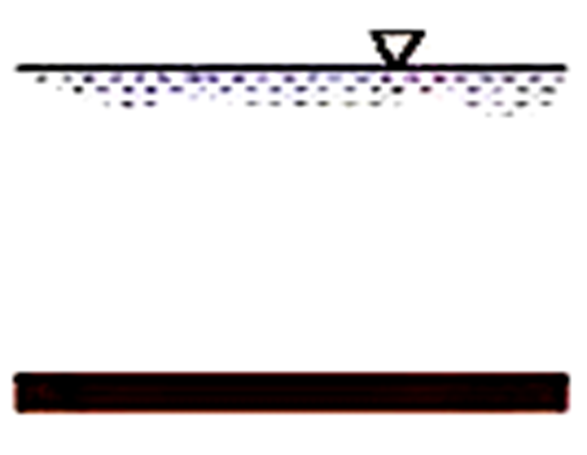
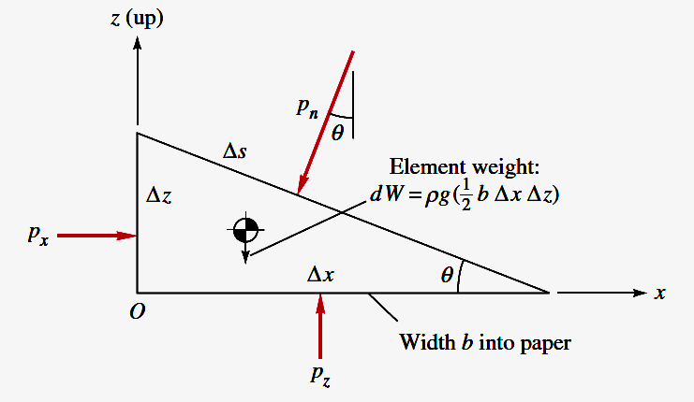
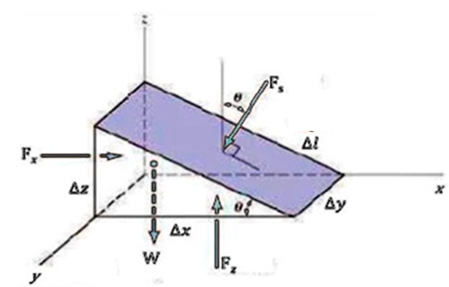
Local Isotropy of Pressure Field in Stagnant Flow Field

Slide 7
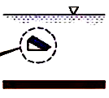
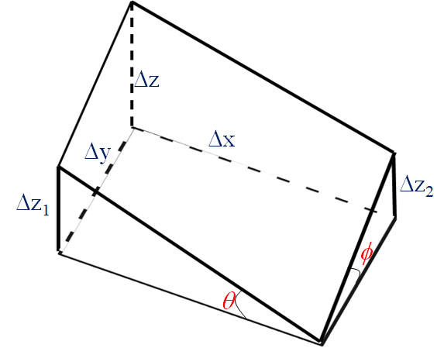
Local Isotropy of Pressure Field in Stagnant Flow Field
Consider an irregular shaped fluid parcel at a selected point in a stagnant fluid body.

Slide 8
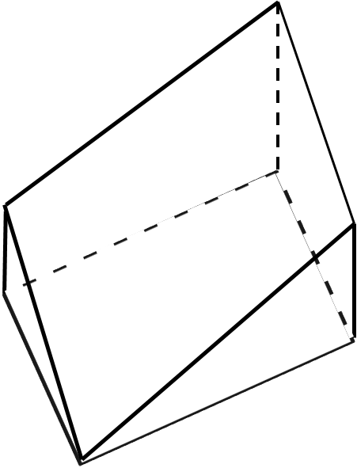
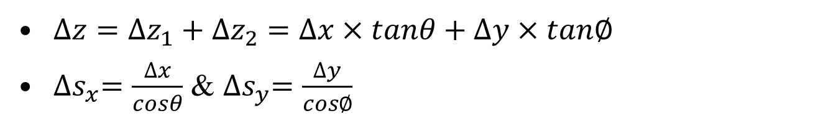
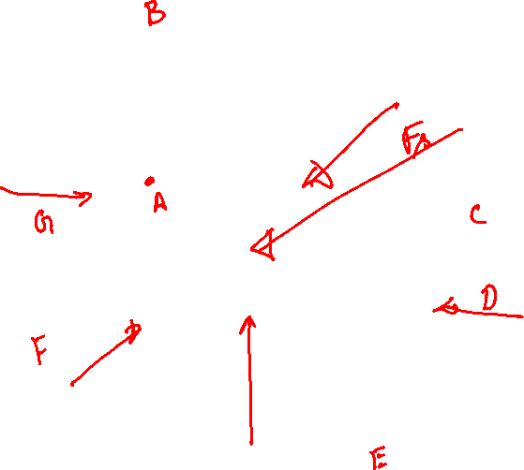
Geometrical Details of Selected Infinitesimal Fluid Element
Δz
Δs_{x}
Δs_{y}
Δx
Δy
Δz₂
Δz₁
φ
θ
$∆z=∆z_{1}+$ $∆z_{2}=∆x×tanθ+∆y×tan∅$
${∆s}_{x}=\frac{∆x}{cosθ}$ & ${∆s}_{y}=\frac{∆y}{cos∅}$

Slide 9
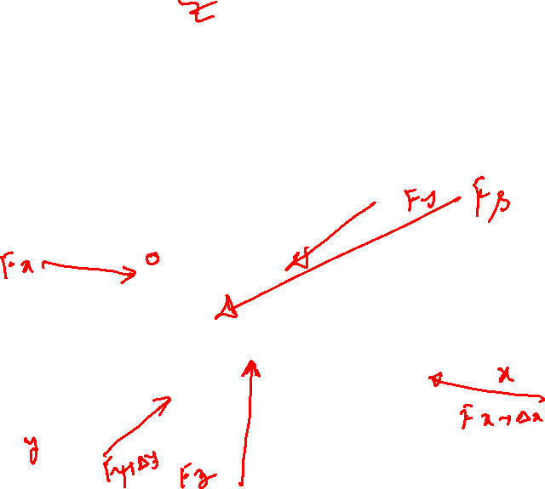
Surfaces of an Infinitesimal Fluid Element
Δz
Δx
Δy
Δz₂
Δz₁
φ
θ

Slide 10
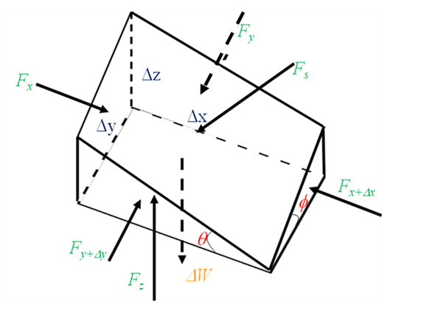
Equilibrium of an Infinitesimal Fluid Element

Slide 11
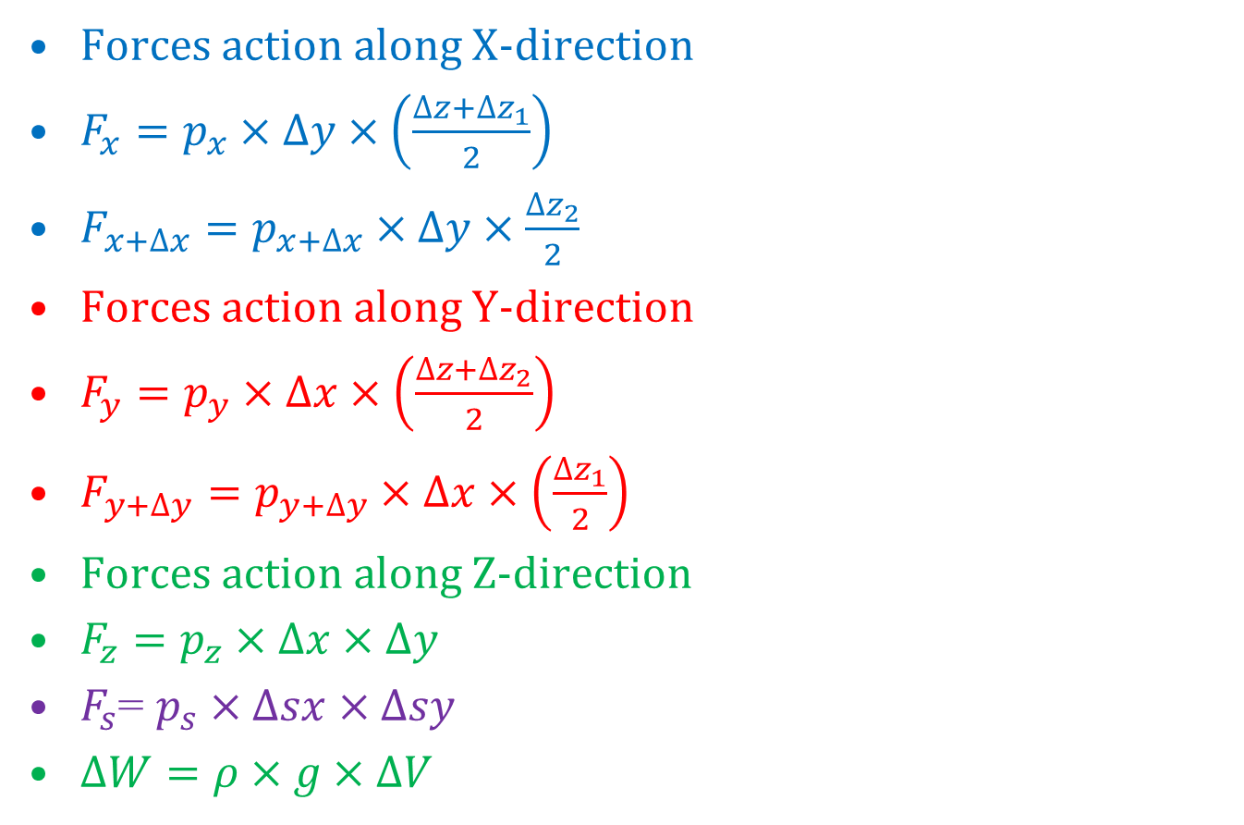
List of Forces Action on Infinitesimal Fluid Parcel
Forces action along X-direction
$F_{x}=p_{x}×∆y×\left(\frac{∆z+{∆z}_{1}}{2}\right)$
$F_{x+∆x}=p_{x+∆x}×∆y×\frac{∆z_{2}}{2}$
Forces action along Y-direction
$F_{y}=p_{y}×∆x×\left(\frac{∆z+{∆z}_{2}}{2}\right)$
$F_{y+∆y}=p_{y+∆y}×∆x×\left(\frac{{∆z}_{1}}{2}\right)$
Forces action along Z-direction
$F_{z}=p_{z}×∆x×∆y$
$F_{s}$= $p_{s}×∆sx×∆sy$
$∆W=ρ×g×∆V$

Slide 12
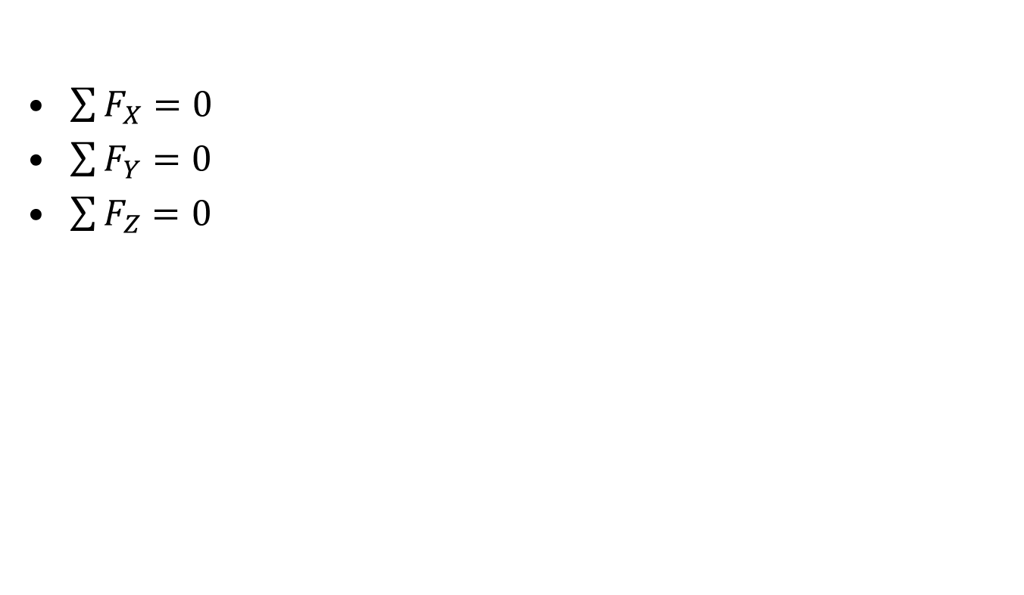
Equilibrium Conditions of Infinitesimal Fluid Parcel
$\sum{F_{X}=0}$
$\sum{F_{Y}=0}$
$\sum{F_{Z}=0}$

Slide 13
List of Forces along Z- Direction
Upward pressure force at the bottom surface of the parcel, F_{z}.
Downward component of force due to pressure on inclined surface, F_{sz}.
Weight of the infinitesimal fluid parcel action at the centroid of the parcel, ΔW.
F_{sz}
Δz
Δy
Δx
Δz₂
Δz₁
φ
θ
F_{z}
ΔW

Slide 14
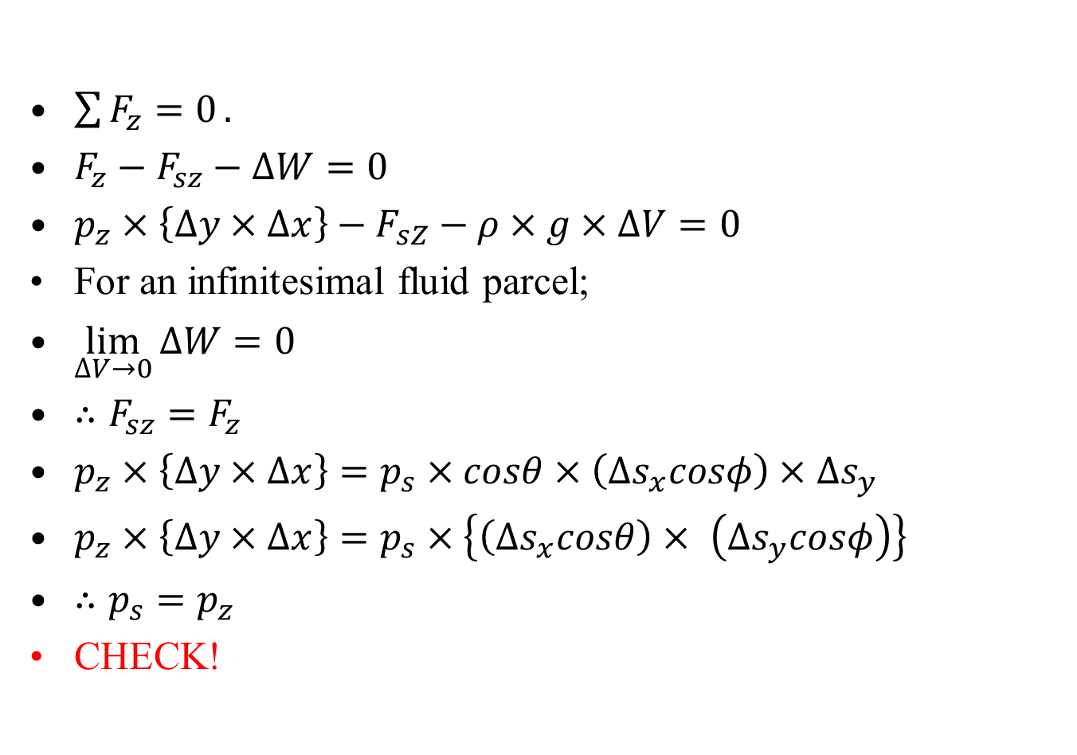
Force Balance along Z- direction
$\sum{F_{z}=0}.$
$F_{z}−F_{sz}−∆W=0$
$p_{z}×\left\{∆y×∆x\right\}−F_{sZ}−ρ×g×∆V=0$
For an infinitesimal fluid parcel;
$\lim_{∆V→0}{∆W=0}$
$∴F_{sz}=F_{z}$
$p_{z}×\left\{∆y×∆x\right\}=p_{s}×cosθ×\left(∆s_{x}cosφ\right)×$ $∆s_{y}$
$p_{z}×\left\{∆y×∆x\right\}=p_{s}×\left\{\left(∆s_{x}cosθ\right)× \left(∆s_{y}cosφ\right)\right\}$
$∴p_{s}=p_{z}$
CHECK!
F_{sz}
Δz
Δy
Δx
Δz₁
Δz₂
φ
θ
F_{z}
ΔW

Slide 15
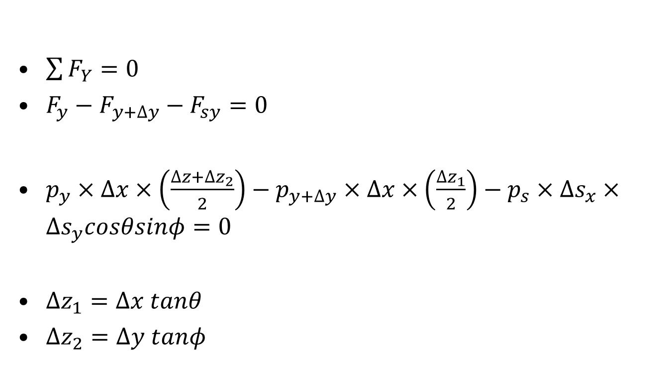
Force Balance along Y- direction
$\sum{F_{Y}=0}$
$F_{y}−F_{y+∆y}−F_{sy}=0$
$p_{y}×∆x×\left(\frac{∆z+∆z_{2}}{2}\right)−p_{y+∆y}×∆x×\left(\frac{∆z_{1}}{2}\right)−p_{s}×∆s_{x}×∆s_{y}cosθsinφ=0$
$∆z_{1}=∆x tanθ$
$∆z_{2}=∆y tanφ$
F_{y}
Δz
F_{sy}
Δy
Δx
Δz₂
Δz₁
φ
F_{y+Δy}
θ

Slide 16
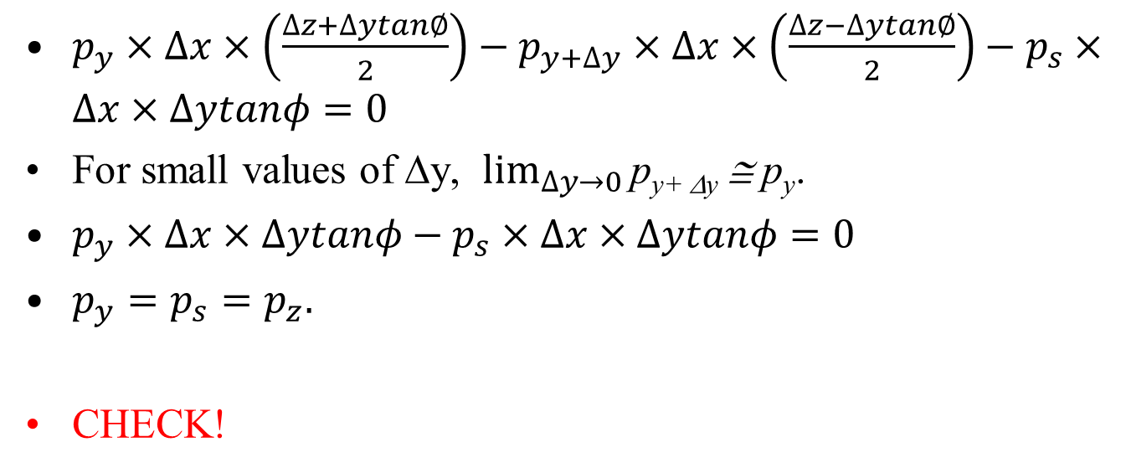
Force Balance along Y- direction
$p_{y}×∆x×\left(\frac{∆z+∆ytan∅}{2}\right)−p_{y+∆y}×∆x×\left(\frac{∆z−∆ytan∅}{2}\right)−p_{s}×∆x×∆ytanφ=0$
For small values of Δy, $\lim_{∆y→0}{\text{p}\text{y}\text{+ Δ}\text{y}}$ ≅ p_{y}.
$p_{y}×∆x×∆ytanφ−p_{s}×∆x×∆ytanφ=0$
$p_{y}=p_{s}=p_{z}.$
CHECK!
F_{y}
Δz
F_{sy}
Δy
Δx
Δz₂
Δz₁
φ
F_{y+Δy}
θ

Slide 17
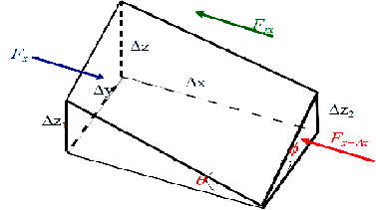
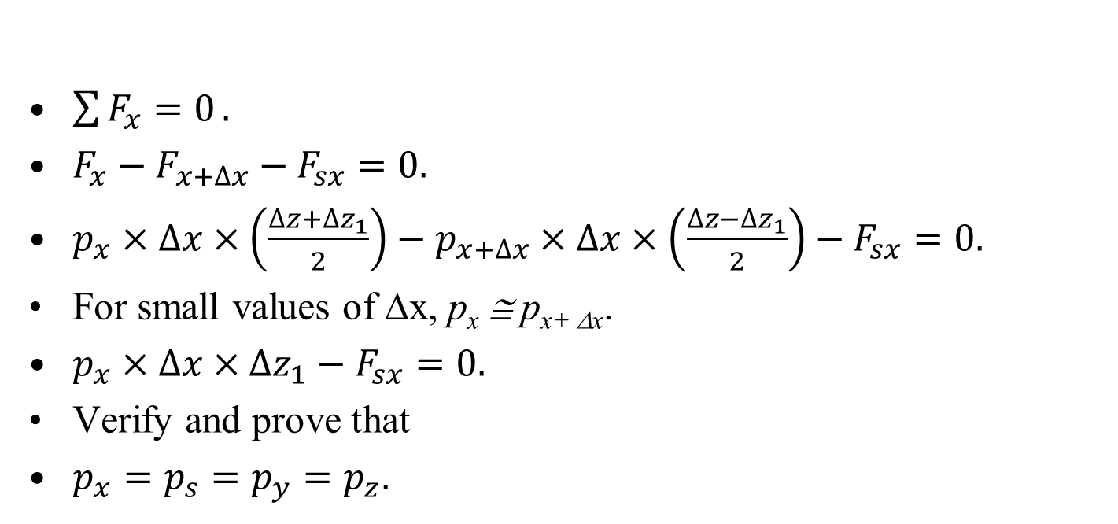
Force Balance along X- direction
$\sum{F_{x}=0}.$
$F_{x}−F_{x+∆x}−F_{sx}=0.$
$p_{x}×∆x×\left(\frac{∆z+{∆z}_{1}}{2}\right)−p_{x+∆x}×∆x×\left(\frac{∆z−{∆z}_{1}}{2}\right)−F_{sx}=0.$
For small values of Δx, p_{x} ≅ p_{x+ Δx}.
$p_{x}×∆x×{∆z}_{1}−F_{sx}=0.$
Verify and prove that
$p_{x}=p_{s}=p_{y}=p_{z}.$

Slide 18
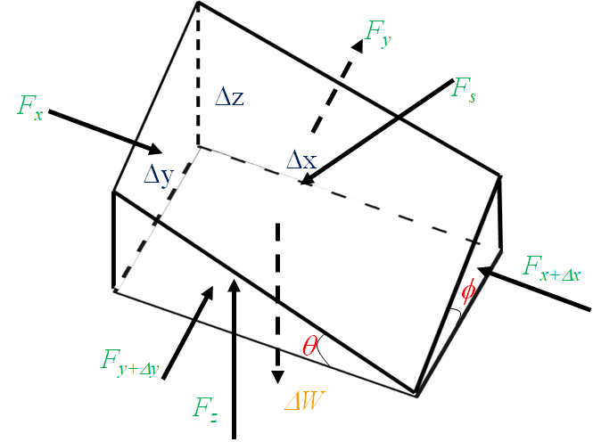
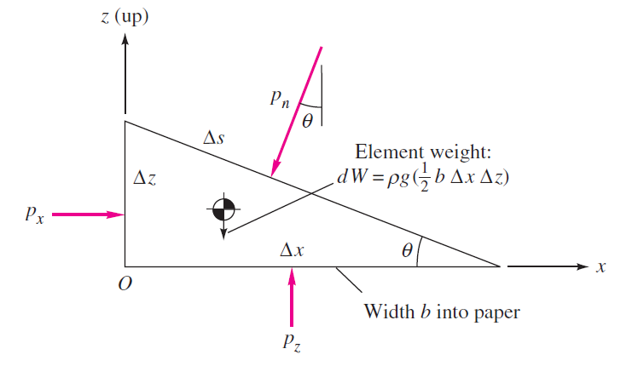
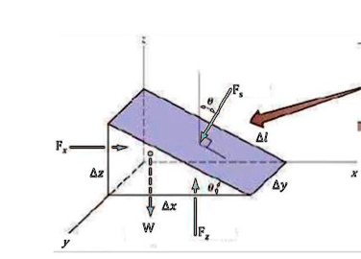
Equilibrium of an Infinitesimal Fluid Element in A Stagnant Fluid
Since, θ and φ are arbitrary, the pressure p in a static fluid is a point property, and independent of orientation.

Slide 19
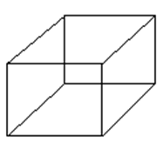
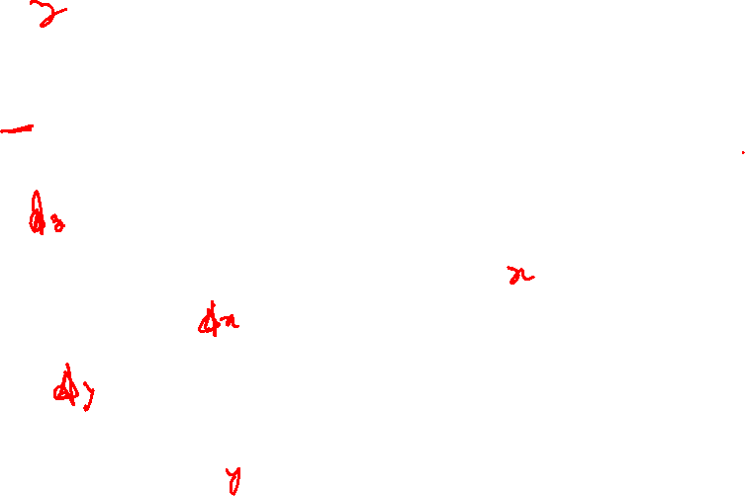
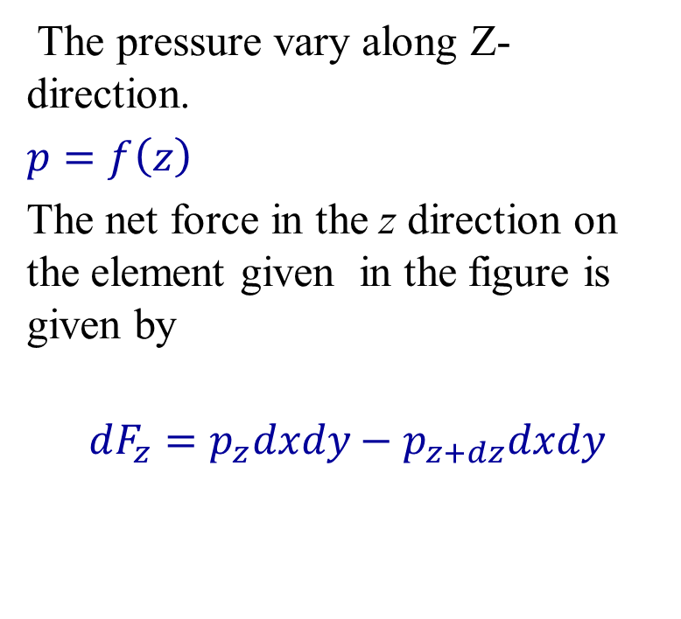
Pressure Force on a Finite Fluid Element in a Stagnant Fluid
Pressure causes a net force on any finite fluid element when it varies spatially.
Consider the pressure acting on a finite size fluid elementat in a stagnant fluid.
The pressure vary along Z-direction.
$p=f\left(z\right)$
The net force in the z direction on the element given in the figure is given by
$$dF_{z}=p_{z}dxdy−p_{z+dz}dxdy$$

Slide 20
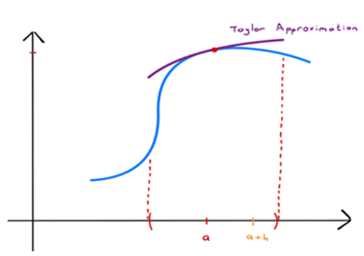
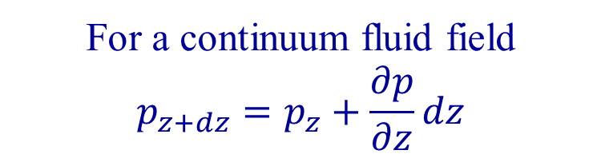
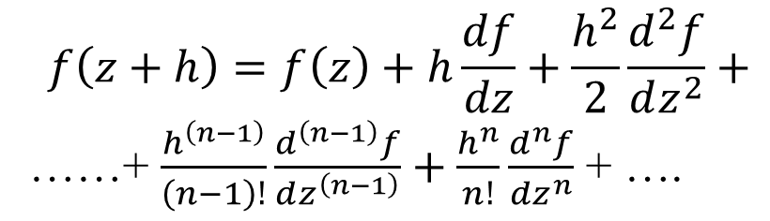
TAYLOR’S THEOREM
Taylor’s Theorem. If f is a function continuous and n times differentiable in an interval [z, z + h], then there exists some point in this interval, denoted by z + λh for some λ ∈ [0, 1], such that
$$f\left(z+h\right)=f\left(z\right)+h\frac{df}{dz}+\frac{h^{2}}{2}\frac{d^{2}f}{dz^{2}}+$$
……+ $\frac{h^{\left(n−1\right)}}{\left(n−1\right)!}\frac{d^{\left(n−1\right)}f}{dz^{\left(n−1\right)}}+\frac{h^{n}}{n!}\frac{d^{n}f}{dz^{n}}$ + ….
f(z)
For a continuum fluid field
$$p_{z+dz}=p_{z}+\frac{∂p}{∂z}dz$$
z

Slide 21
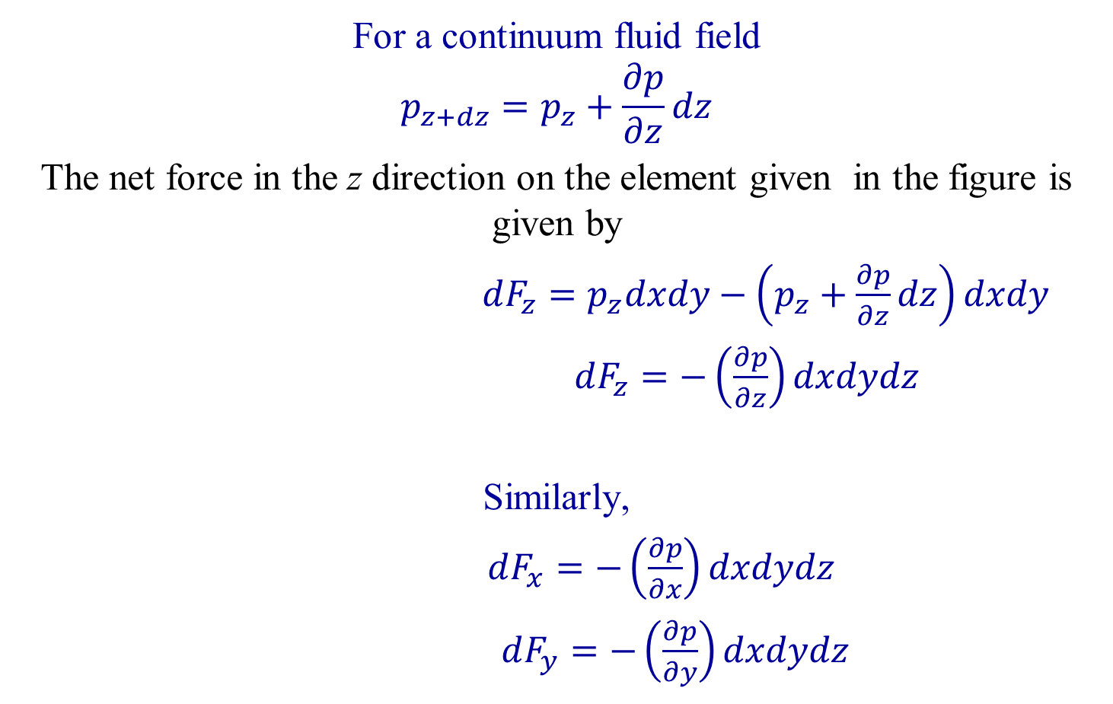
Pressure Force on a Finite Fluid Element
For a continuum fluid field
$$p_{z+dz}=p_{z}+\frac{∂p}{∂z}dz$$
The net force in the z direction on the element given in the figure is given by
$dF_{z}=p_{z}dxdy−\left(p_{z}+\frac{∂p}{∂z}dz\right)dxdy$
$dF_{z}=−\left(\frac{∂p}{∂z}\right)dxdydz$
Similarly,
$dF_{x}=−\left(\frac{∂p}{∂x}\right)dxdydz$
$dF_{y}=−\left(\frac{∂p}{∂y}\right)dxdydz$
p_{z+dz}
p_{z}

Slide 22
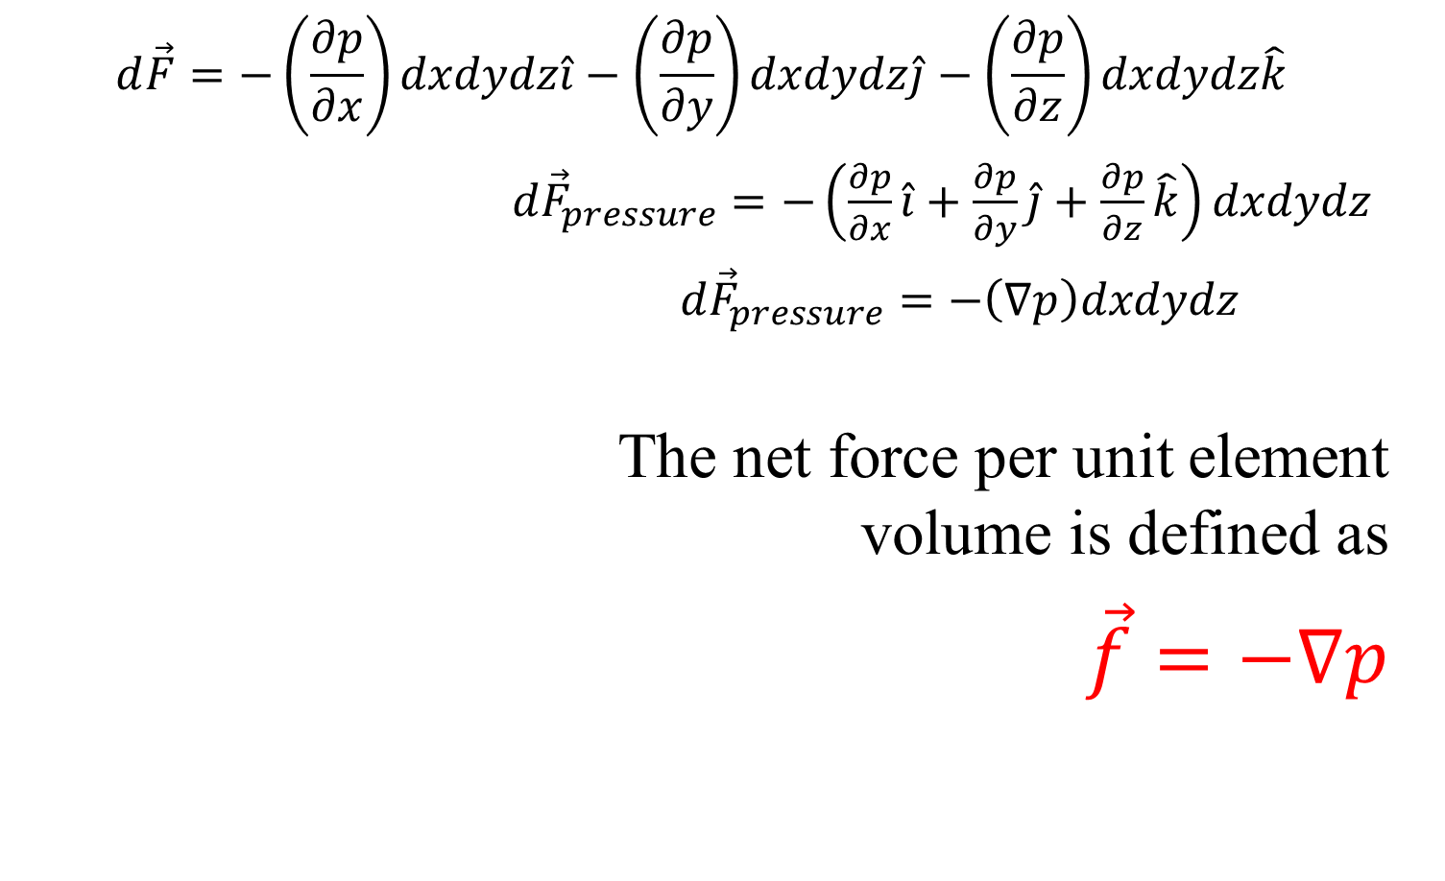
Differential Pressure-force Vector
$$d\vec{F}=−\left(\frac{∂p}{∂x}\right)dxdydz\hat{i}−\left(\frac{∂p}{∂y}\right)dxdydz\hat{j}−\left(\frac{∂p}{∂z}\right)dxdydz\hat{k}$$
${d\vec{F}}_{pressure}=−\left(\frac{∂p}{∂x}\hat{i}+\frac{∂p}{∂y}\hat{j}+\frac{∂p}{∂z}\hat{k}\right)dxdydz$
${d\vec{F}}_{pressure}=−\left(∇p\right)dxdydz$
The net force per unit element volume is defined as
$\vec{f}=−∇p$
It is not the pressure but the pressure gradient causing a net force that is generally generated by gravity or any other acceleration or some other effect in the fluid.
p_{x+dx}

