Slide 1

Creation & Modeling of Trajectories for Fluid Parcels
P M V Subbarao
Professor
Mechanical Engineering Department
Trajectories Responsible for Creation Exotic Fluid dynamic Devices…

Slide 2


Trajectories or Displacement of Fluid Parcels
A general unsteady flow in a Eulerian perspective defines three types of trajectories/ displacement functions for fluid parcels:
Streamlines
Pathlines
Streaklines.
They are all equivalent for steady flows but differ conceptually for unsteady flows.

Slide 3
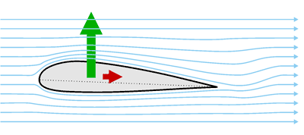
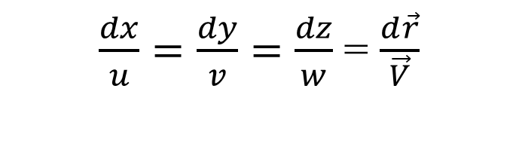
Creation of Hardware to Modify the Streamlines
The Invention of Wright Brothers: An Airfoil
$\frac{dx}{u}=\frac{dy}{v}=$ $\frac{dz}{w}$ = $\frac{d\vec{r}}{\vec{V}}$

Slide 4
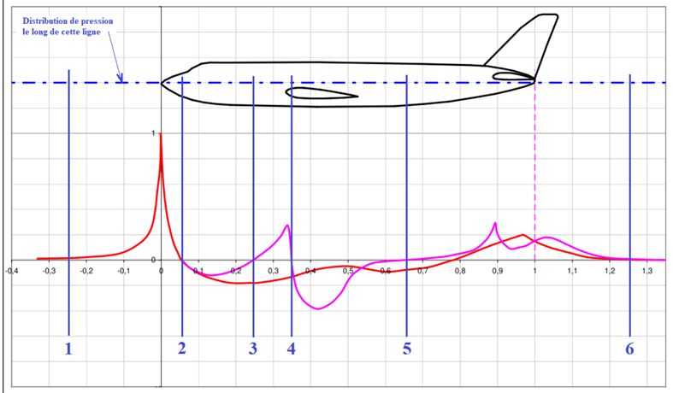
Fuselage of an Aircraft

Slide 5
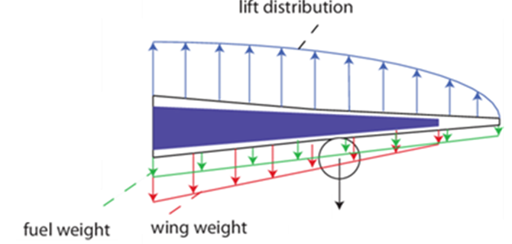
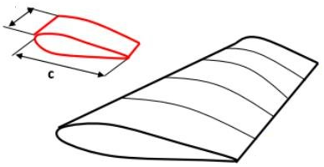
Airfoil as Aircraft Wing
Engine Weight

Slide 6
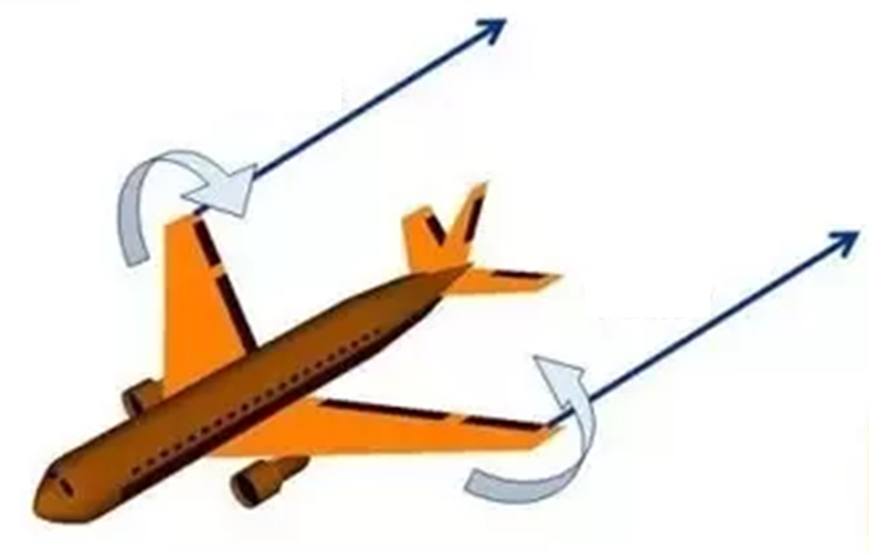
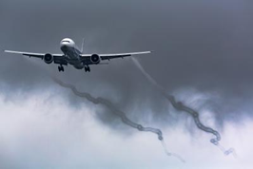
The Invention of Wright Brothers: An Airfoil
Curling of Streamlines
Curling of Streamlines

Slide 7
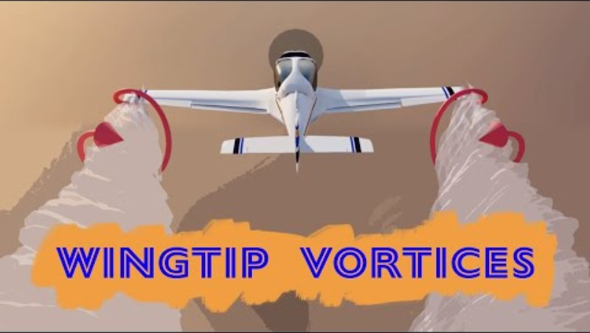
The Invention of Wright Brothers: An Airfoil

Slide 8
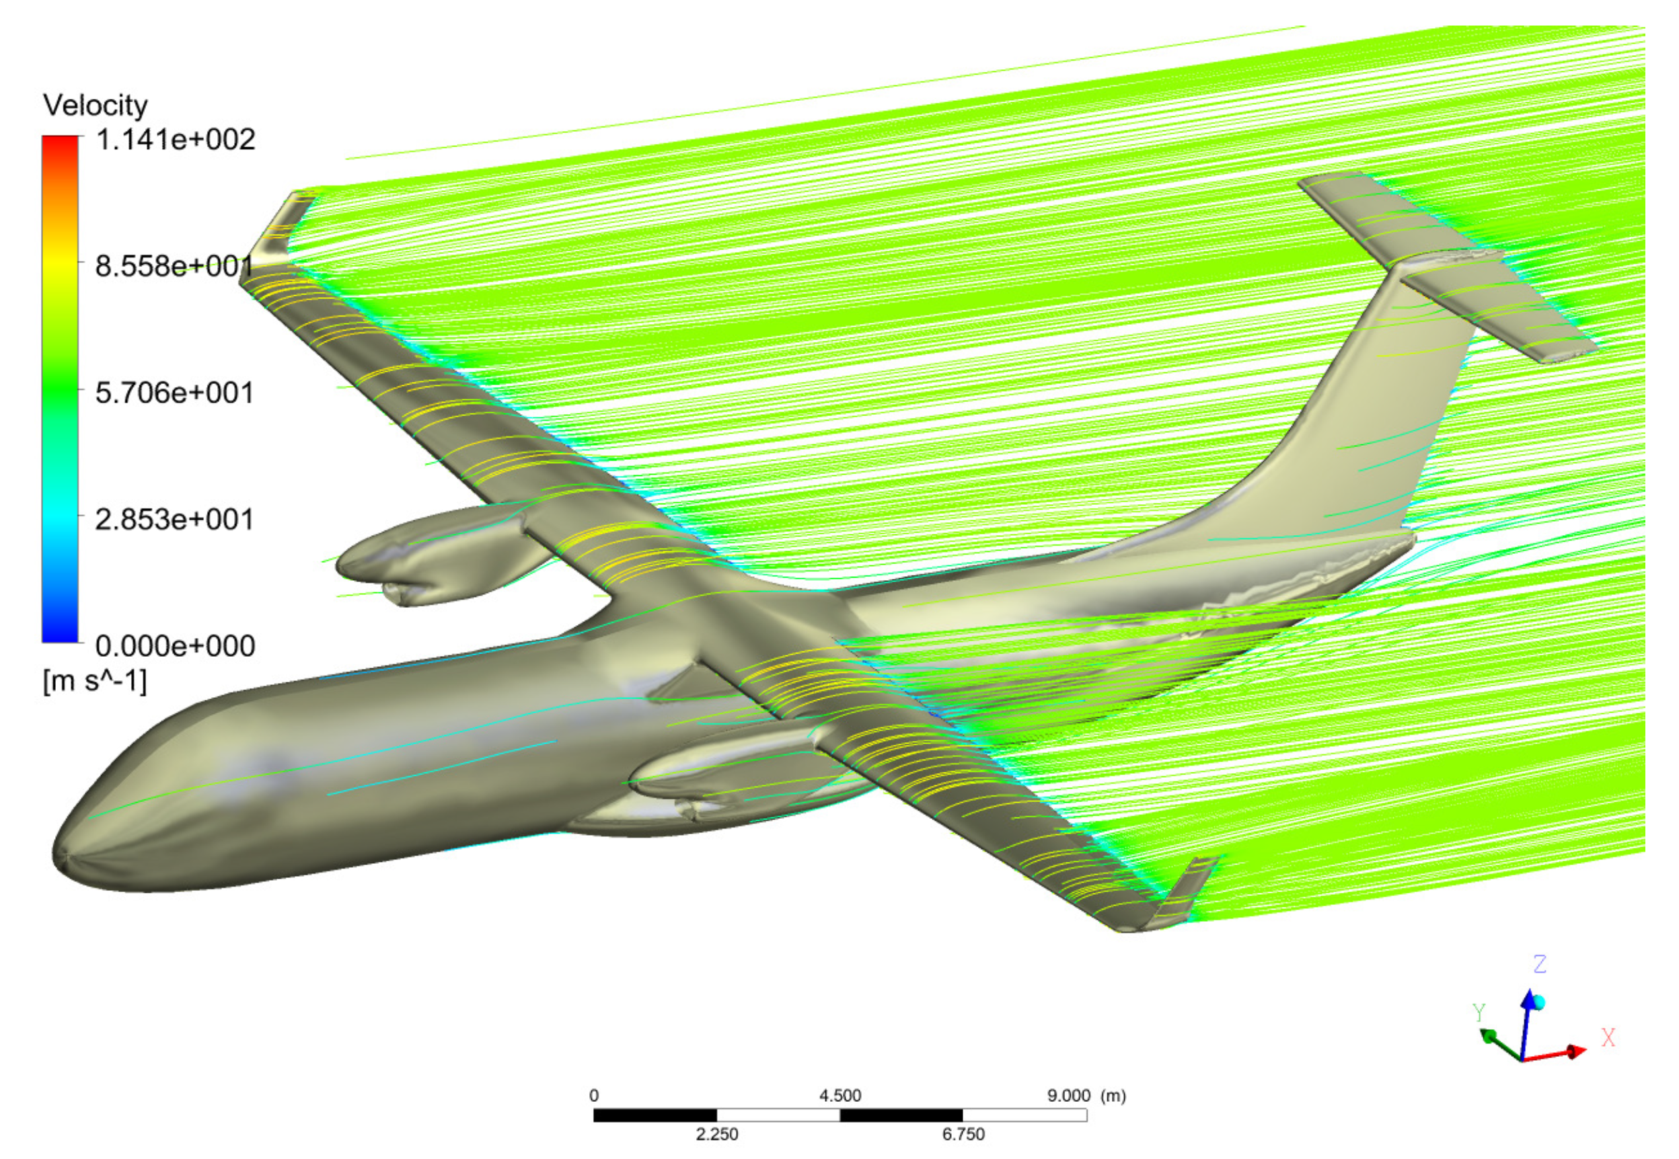
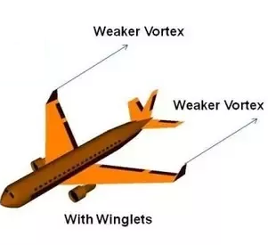
The Invention of Wright Brothers: An Airfoil

Slide 9
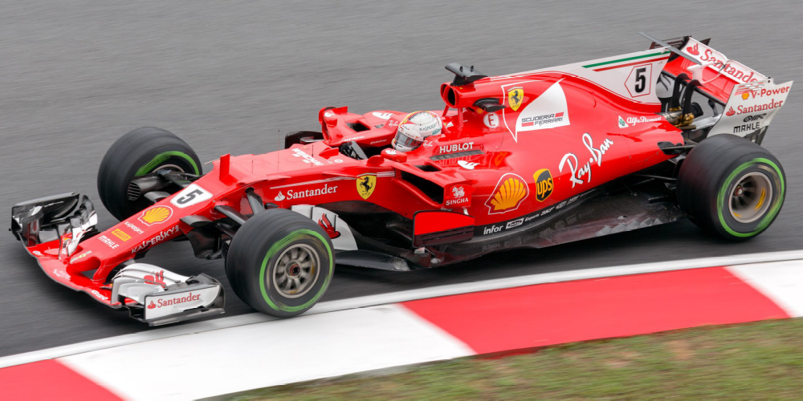
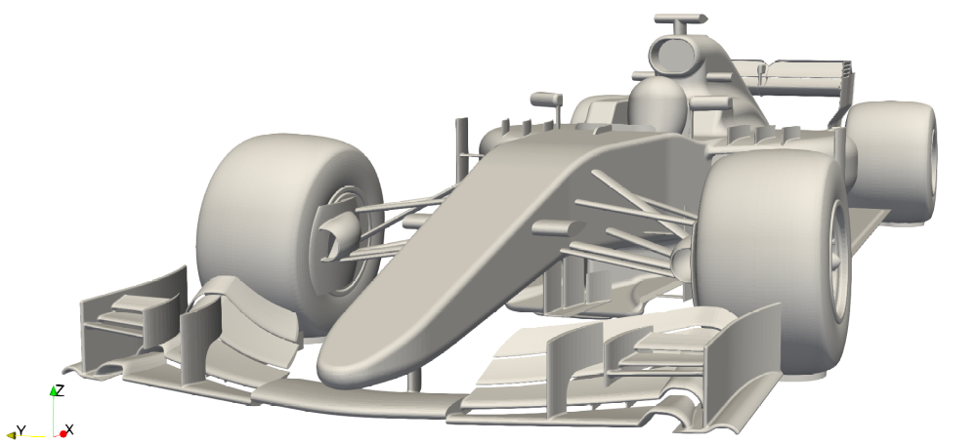
Aerodynamic Design of Formula 1 Car :
Anti-Aircraft
Aerodynamic Study of the Wake Effects on a Formula 1 Car
Alex Guerrero and Robert Castilla *

Slide 10
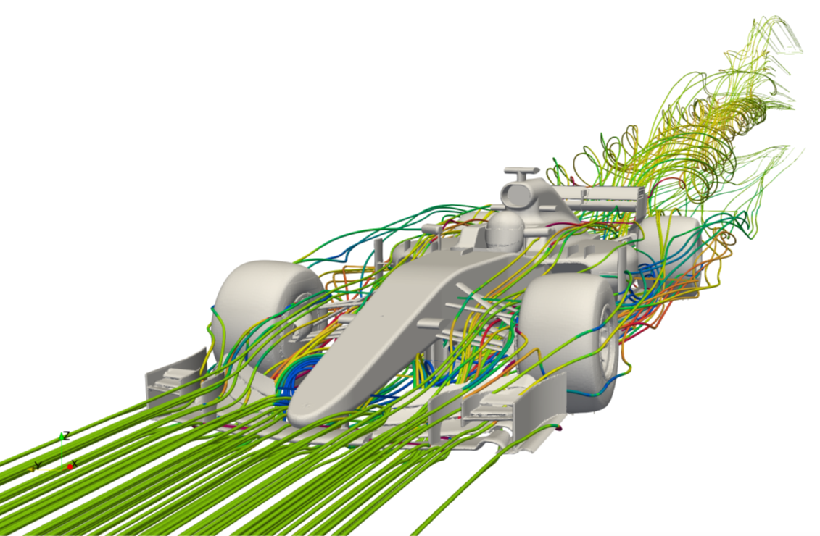
Distribution of Downforce & Drag
Aerodynamic Study of the Wake Effects on a Formula 1 Car
Alex Guerrero and Robert Castilla *

Slide 11
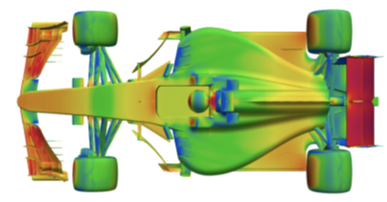

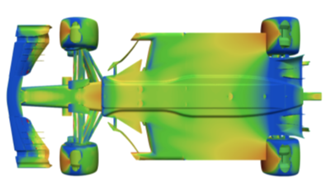
Surface Pressure Distribution.
Top Surface
Bottom Surface
Aerodynamic Study of the Wake Effects on a Formula 1 Car
Alex Guerrero and Robert Castilla *

Slide 12
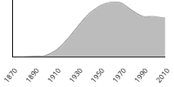
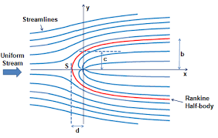
How common is the noun streamline?
Scottish physicist and engineer William John Macquorn Rankine (1820-1872)
1868 in the writing of W. J. Rankine

Slide 13
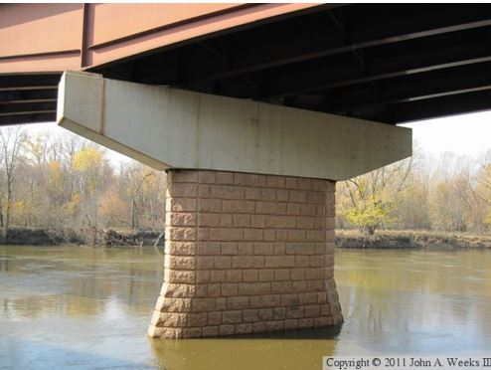
How common is the noun streamline?

Slide 14
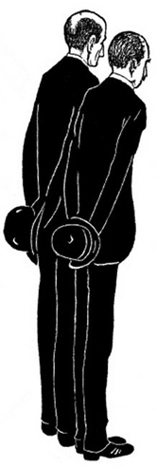
The Strange Natural Geniuses : The Wright Brothers
Wilbur Wright on Their Flying
"The fact that the great scientist believed in flying machines was the one thing that encouraged us to begin our studies.“
"I confess that in 1901, I said to my brother Orville that man would not fly for 50 years.“
"We could hardly wait to get up in the morning.“

Slide 15
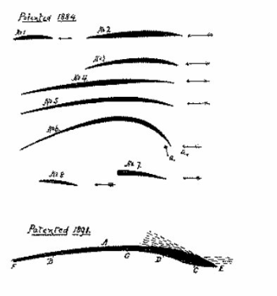
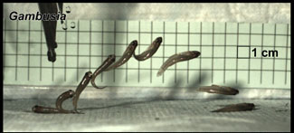
The term “potential theory” arises from the fact that, in 19th century physics, the fundamental forces of nature were believed to be derived from potentials which satisfied
Laplace’s equation.
The Potential (Ideal) Flow Theory

Slide 16

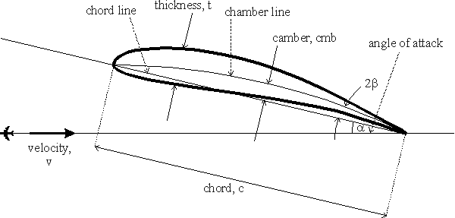
An Ultimate Streamline :
The Frozen C Device

Slide 17
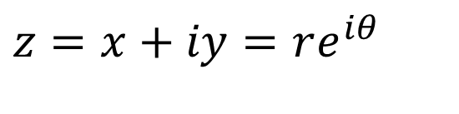

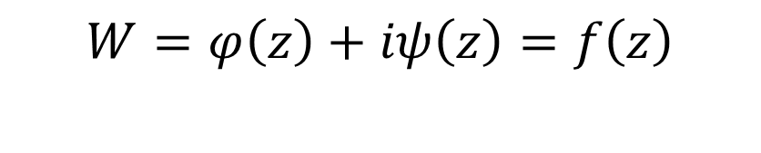
The Complex Potential : Model for Streamlines of Simple Flows
Ideal (Inviscid) Flow field and force generating solid(s) can be invented as a complex potential.
A complex potential is defined as
$$W=φ+iψ$$
In the complex plane every point is associated with a complex variable
$$z=x+iy=re^{iθ}$$
Mathematical Model for streamlines
In general, we can then write
$$W=φ\left(z\right)+iψ\left(z\right)=f\left(z\right)$$

Slide 18
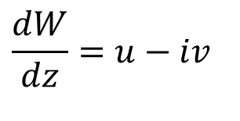
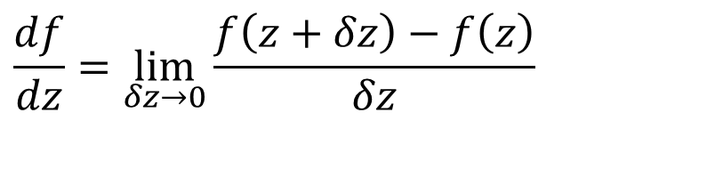
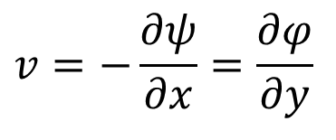
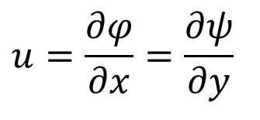
Derivatives of Complex Functions
If the function f is analytic, this implies that it is also differentiable, meaning that the limit
$$\frac{df}{dz}=\lim_{δz→0}{\frac{f\left(z+δz\right)−f\left(z\right)}{δz}}$$
$$\frac{dW}{dz}=u−iv$$
$$u=\frac{∂φ}{∂x}=\frac{∂ψ}{∂y}$$
$$v=−\frac{∂ψ}{∂x}=\frac{∂φ}{∂y}$$
so that the derivative of the complex potential W in the complex z plane gives the complex conjugate of the velocity.
Thus, knowledge of the complex potential as a complex function of z leads to the velocity field through a simple derivative.

Slide 19
Functions for Elementary Ideal Flows
To Create IRROTATIONAL PLANE FLOWS
  The uniform flow function
The perturbation Functions
  The source/sink function
  The vortex function

Slide 20
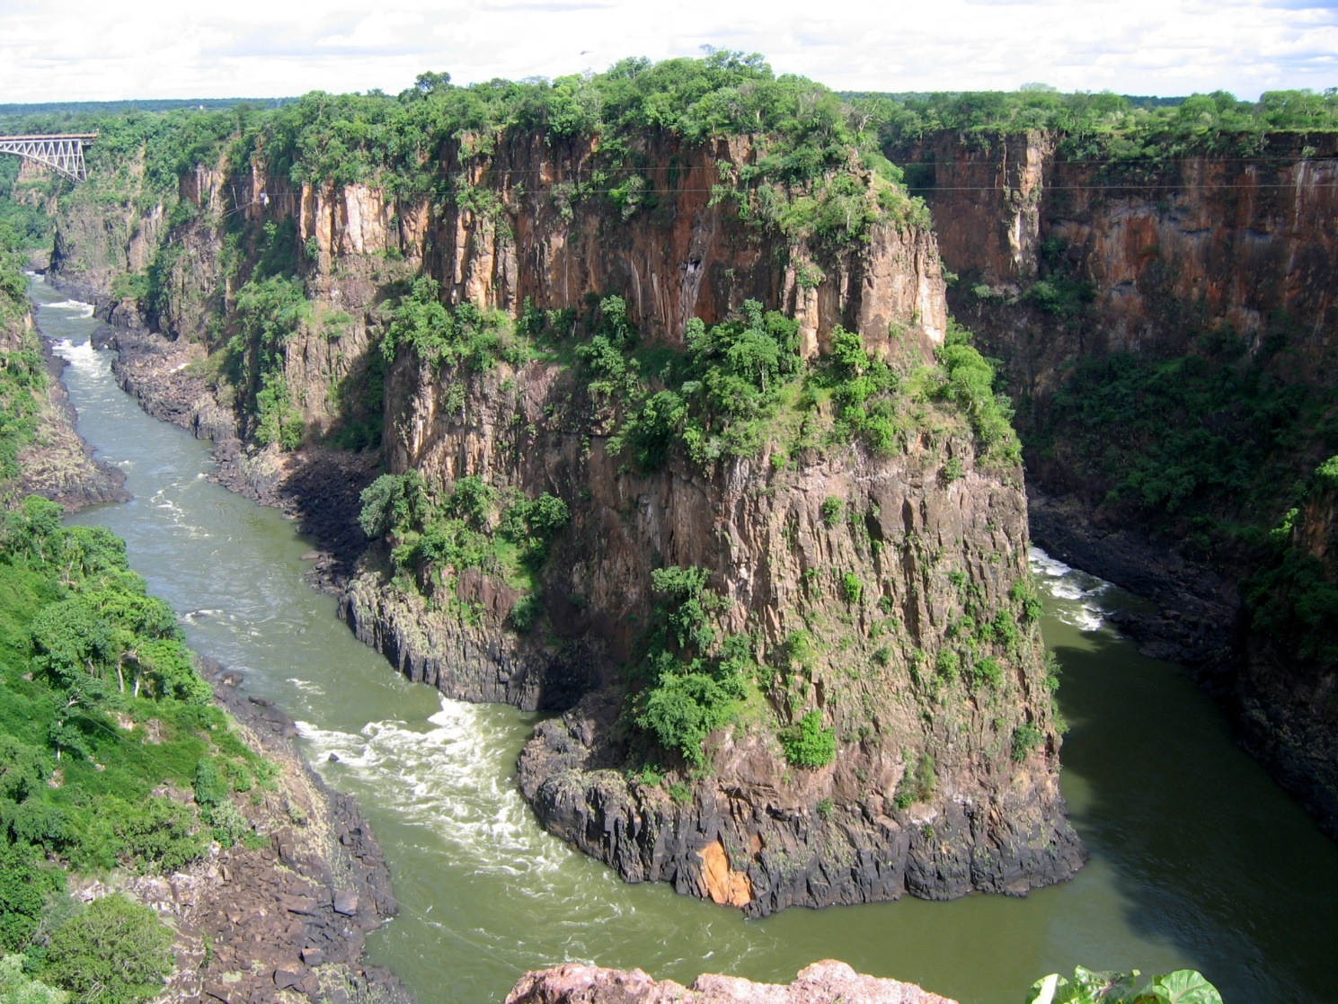
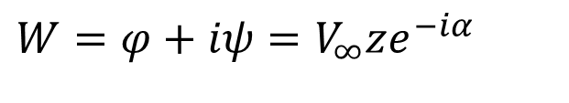
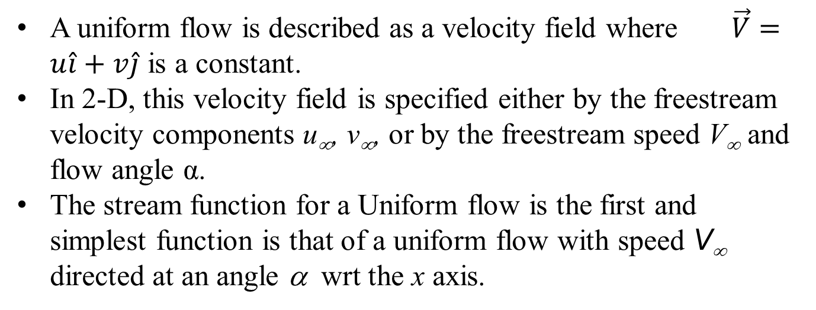
THE UNIFORM FLOW Function
A uniform flow is described as a velocity field where $\vec{V}=u\hat{i}+v\hat{j}$ is a constant.
In 2-D, this velocity field is specified either by the freestream velocity components u∞, v∞, or by the freestream speed V∞ and flow angle α.
The stream function for a Uniform flow is the first and simplest function is that of a uniform flow with speed V∞ directed at an angle α wrt the x axis.
In this case the complex potential is
$$W=φ+iψ=V_{∞}ze^{−iα}$$

Slide 21
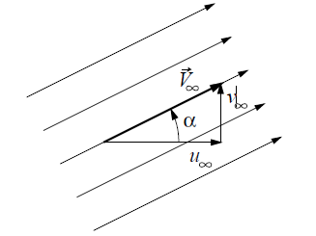
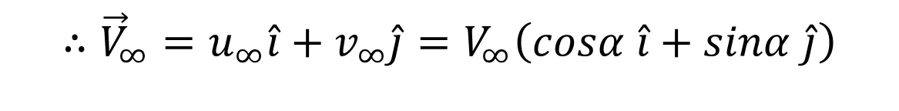
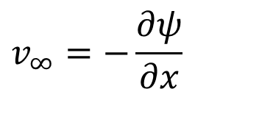
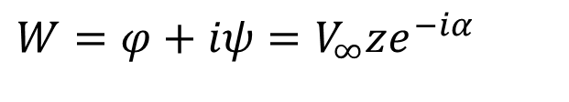
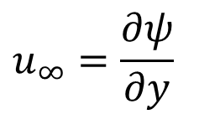
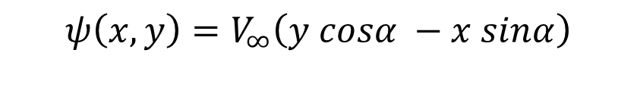
THE UNIFORM FLOW Function
$$W=φ+iψ=V_{∞}ze^{−iα}$$
The function for streamlines (Stream Function) is
$$ψ\left(x,y\right)=V_{∞}\left(y cosα −x sinα\right)$$
$$u_{∞}=\frac{∂ψ}{∂y}$$
$$v_{∞}=−\frac{∂ψ}{∂x}$$
The function for uniform velocity field is
$$∴{\vec{V}}_{∞}={u_{∞}\hat{i}+v_{∞}\hat{j}=V}_{∞}\left(cosα \hat{i}+sinα \hat{j}\right)$$

Slide 22
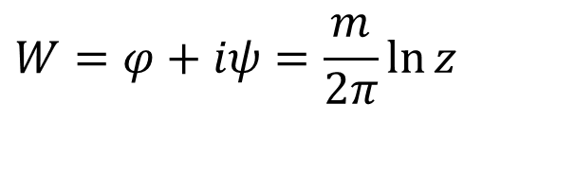
THE SOURCE OR SINK Functions
Source (or sink), the complex potential of which is
$$W=φ+iψ=\frac{m}{2π}\ln{z}$$
This is a pure radial flow, in which all the streamlines converge at the origin, where there is a singularity due to the fact that continuity can not be satisfied.
At the origin there is a source, m > 0 or sink, m < 0 of fluid.

Slide 23
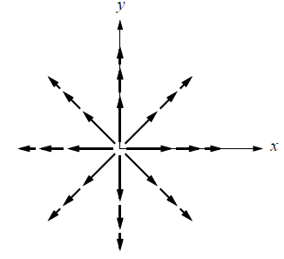
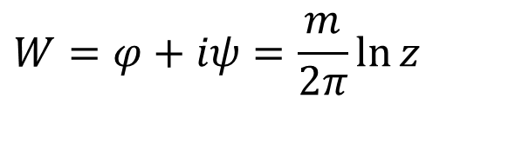
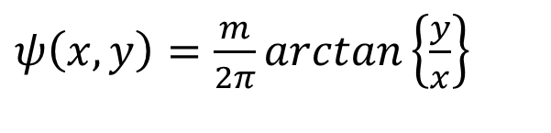
Diagnosis of Source Function
The function for streamlines (Stream Function) is
$ψ\left(x,y\right)=\frac{m}{2π}arctan\left\{\frac{y}{x}\right\}$
Iso ψ lines
The flow field is uniquely determined upon deriving the complex potential W with respect to z.
$$W=φ+iψ=\frac{m}{2π}\ln{z}$$

Slide 24
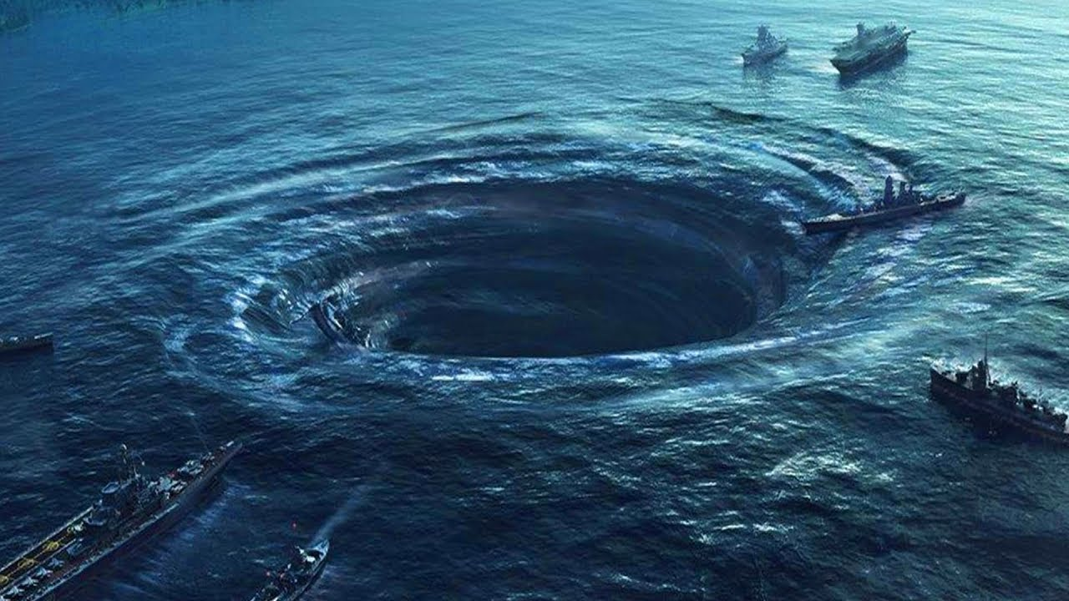
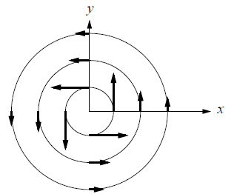
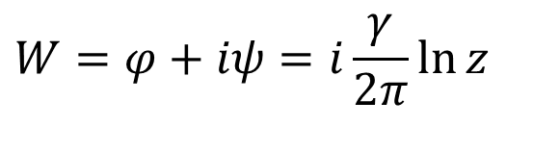
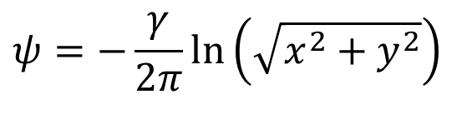
THE VORTEX FUNCTION
In the case of a vortex, the flow field is purely tangential.
The complex potential is
$$W=φ+iψ=i\frac{γ}{2π}\ln{z}$$
$$ψ=−\frac{γ}{2π}\ln\left(\sqrt{x^{2}+y^{2}}\right)$$
There is again a singularity at the origin, this time associated to the fact that the circulation along any closed curve including the origin is nonzero and equal to γ.
If the closed curve does not include the origin, the circulation will be zero.

Slide 25
Algebra of Basic Flow Functions
The potential functions can be directly added to get new flow functions.
This is known as superposition of basic functions.
Popular superpositions are:
Uniform Flow with Source
Uniform Flow with Source and Sink
Doublet
Uniform flow with Doublet
Uniform flow with Doublet and Vortex
Any superposition which generates a zero-value streamline is important for engineering flow devices.

Slide 26
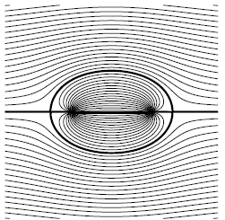
Uniform Flow with Source and Sink
Consider superimposition of a uniform flow in the x-direction, with a source located at (−l/2, 0), and a sink of equal and opposite strength located at (+l/2, 0).
Iso ψ lines
I ψ=0

Slide 27
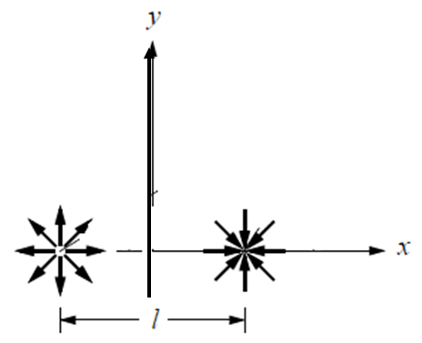
THE DOUBLET
Consider a source-sink pair with strengths ±m, located at (∓l/2, 0).
Let the separation distance l approach zero, while simultaneously increasing the source and sink strengths such that the product m × l remains constant.
The resulting flow is a doublet with strength, μ

Slide 28
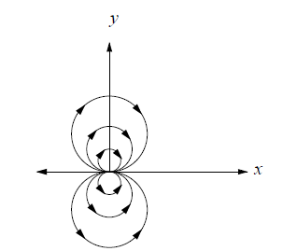
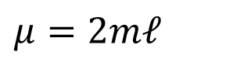
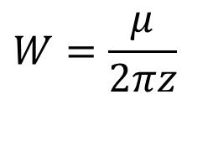

THE DOUBLET
The resulting flow is a doublet with strength, μ
$$W=\frac{μ}{2πz}$$
$$μ=2mℓ$$
$$W=φ+iψ=\frac{μ}{2πz}$$
Iso ψ lines

Slide 29
Eulerian Trajectory of Fluid Parcel: Pathline
The pathline of a fluid element A is simply the path it takes through space as a function of time.
An example of a pathline is the trajectory taken by one puff of smoke which is carried by the steady or unsteady wind.
This path is fully described by the three position functions x_{A}(t), y_{A}(t), z_{A}(t).
These position functions are to be computed by integrating the three velocity-field components u(x, y, z, t), v(x, y, z, t), w(x, y, z, t) along the path.
The integration is started at time t_{o}, from the element’s initial position x_{o}, y_{o}, z_{o}, and proceeds to some later time t.

Slide 30


Pathlines and Major Applications
$x_{A}\left(t\right)=x_{O}+\int_{t_{O}}^{t}{u\left(x_{A}\left\{τ\right\},y_{A}\left\{τ\right\},z_{A}\left\{τ\right\},τ\right)dτ}$
$y_{A}\left(t\right)=y_{O}+\int_{t_{O}}^{t}{v\left(x_{A}\left\{τ\right\},y_{A}\left\{τ\right\},z_{A}\left\{τ\right\},τ\right)dτ}$
$z_{A}\left(t\right)=z_{O}+\int_{t_{O}}^{t}{z\left(x_{A}\left\{τ\right\},y_{A}\left\{τ\right\},z_{A}\left\{τ\right\},τ\right)dτ}$

Slide 31


Eulerian Trajectory of Fluid Parcel: Streakline
A streakline is associated with a particular point P in space which has the fluid parcels moving past it.
All fluid parcels which pass(ed) through this point are said to form the streakline of point P.
Unlike a pathline, which involves the motion of only one fluid element A in time, a streakline involves the motion of all the fluid elements along its length.
The trajectory equations for a pathline are applied to all the fluid elements defining the streakline.

Slide 32


Streaklines & Singing Telephone Wires

Slide 33



Combined View of Eulerian Trajectories
Consider a case the wind everywhere is along one particular direction.
At time t=0
At time t=Γ

Slide 34

Common View of Eulerian Trajectories
Consider a case the wind everywhere is along one particular direction.
In a steady flow, streamlines, pathlines, and streaklines all coincide.

