Slide 1

Eulerian Kinematics for Fluid Flows
P M V Subbarao
Professor
Mechanical Engineering Department
A Framework to Pictorial Description for Motion of Fluid Parcels…

Slide 2


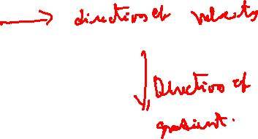
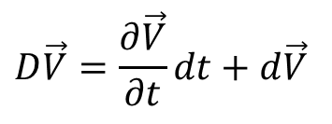
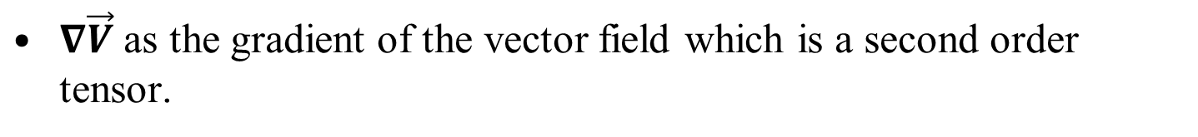
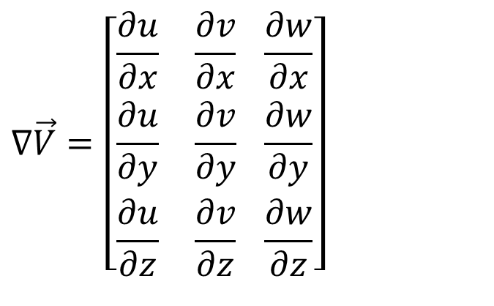
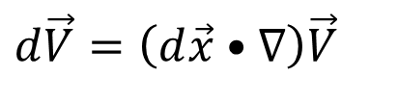
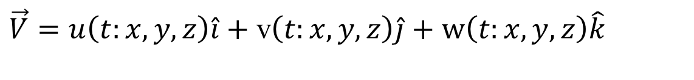
Understanding of Material Derivative of A Vector Field
Eulerian Velocity vector is defined as :
$\vec{V}=u\left(t:x,y,z\right)\hat{i}+$ v$\left(t:x,y,z\right)\hat{j}+\text{w}\left(t:x,y,z\right)\hat{k}$
Substantial or Material Derivative of Velocity vector is defined as :
$$D\vec{V}=\frac{∂\vec{V}}{∂t}dt+d\vec{V}$$
$$d\vec{V}=\left(d\vec{x}•∇\right)\vec{V}$$
$∇\vec{V}$ as the gradient of the vector field which is a second order tensor.
$$∇\vec{V}=\left[\begin{aligned}&\frac{∂u}{∂x} \frac{∂v}{∂x} \frac{∂w}{∂x} \\ &\frac{∂u}{∂y} \frac{∂v}{∂y} \frac{∂w}{∂y} \\ &\frac{∂u}{∂z} \frac{∂v}{∂z} \frac{∂w}{∂z}\end{aligned}\right]$$

Slide 3
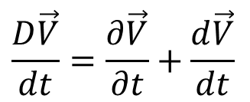
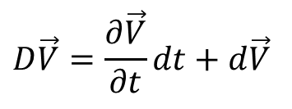
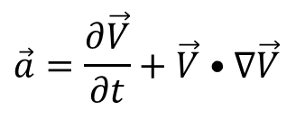
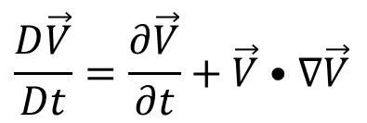
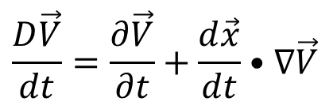
Rate of Change of Material Derivative of A Vector Field
$$D\vec{V}=\frac{∂\vec{V}}{∂t}dt+d\vec{V}$$
Dividing above equation by dt yields the acceleration vector.
$$\frac{D\vec{V}}{dt}=\frac{∂\vec{V}}{∂t}+\frac{d\vec{V}}{dt}$$
$$\frac{D\vec{V}}{dt}=\frac{∂\vec{V}}{∂t}+\frac{d\vec{x}}{dt}•∇\vec{V}$$
The differential dt may symbolically be replaced by Dt indicating the material character of the derivatives.
$$\frac{D\vec{V}}{Dt}=\frac{∂\vec{V}}{∂t}+\vec{V}•∇\vec{V}$$
$$\vec{a}=\frac{∂\vec{V}}{∂t}+\vec{V}•∇\vec{V}$$
Material or substantial acceleration

Slide 4
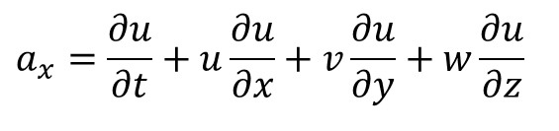
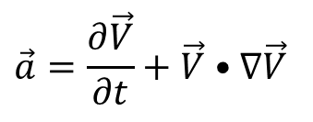
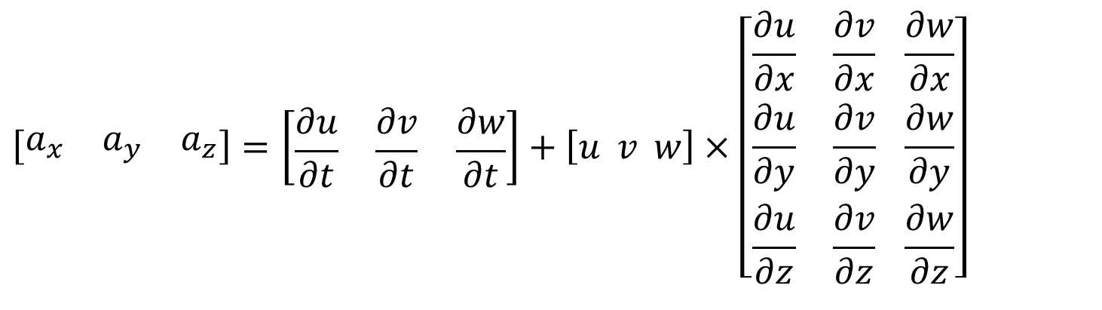
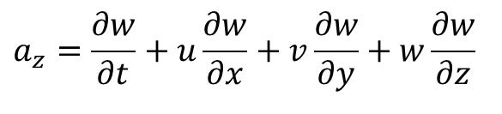
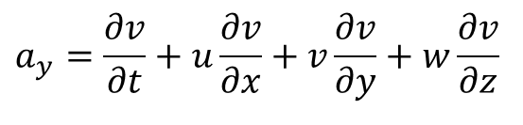
Components of Material Acceleration
$$\vec{a}=\frac{∂\vec{V}}{∂t}+\vec{V}•∇\vec{V}$$
$$a_{x}=\frac{∂u}{∂t}+u\frac{∂u}{∂x}+v\frac{∂u}{∂y}+w\frac{∂u}{∂z}$$
$$a_{y}=\frac{∂v}{∂t}+u\frac{∂v}{∂x}+v\frac{∂v}{∂y}+w\frac{∂v}{∂z}$$
$$a_{z}=\frac{∂w}{∂t}+u\frac{∂w}{∂x}+v\frac{∂w}{∂y}+w\frac{∂w}{∂z}$$
$$\left[\begin{matrix}a_{x} & a_{y} & a_{z}\end{matrix}\right]=\left[\begin{matrix}\frac{∂u}{∂t} & \frac{∂v}{∂t} & \frac{∂w}{∂t}\end{matrix}\right]+\left[u v w\right]×\left[\begin{aligned}&\frac{∂u}{∂x} \frac{∂v}{∂x} \frac{∂w}{∂x} \\ &\frac{∂u}{∂y} \frac{∂v}{∂y} \frac{∂w}{∂y} \\ &\frac{∂u}{∂z} \frac{∂v}{∂z} \frac{∂w}{∂z}\end{aligned}\right]$$

Slide 5
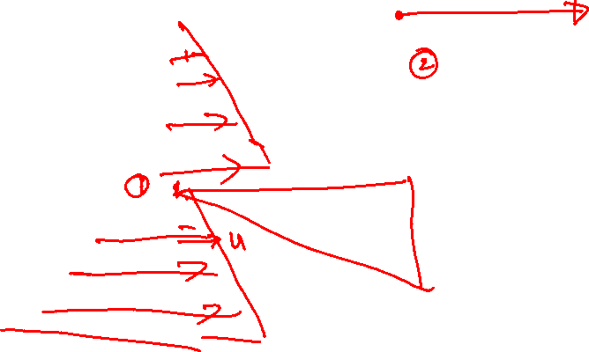
Visualization of Material Acceleration

Slide 6
Trajectories or Displacement of Fluid Parcels
A steady velocity flow will have only one type of trajectory/displacement function for entire flow field.
It is same as Lagrangian displacement.
A general unsteady flow in a Eulerian perspective defines three types of trajectories/ displacement functions for fluid parcels:
Streamlines
Pathlines
Streaklines.
They are all equivalent for steady flows but differ in shape for unsteady flows.

Slide 7
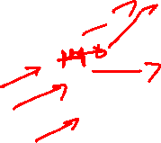
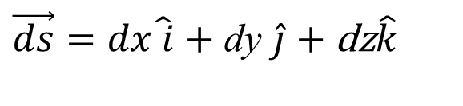
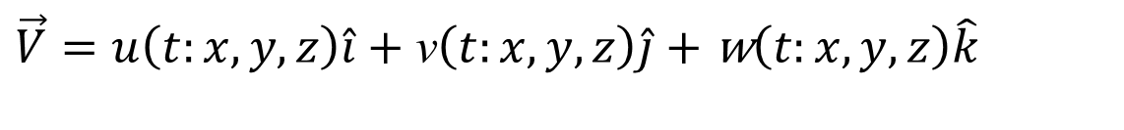
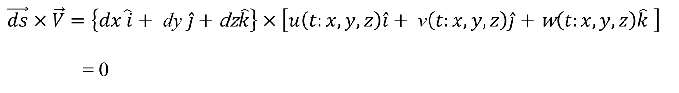
Eulerian Trajectory of Fluid Parcel: Streamline
Streamline equation: A streamline is defined as a line which is everywhere parallel to the local velocity vector
$\vec{V}=u\left(t:x,y,z\right)\hat{i}+$ v$\left(t:x,y,z\right)\hat{j}+\text{w}\left(t:x,y,z\right)\hat{k}$
Define an infinitesimal displacement vector, known as an infinitesimal arc segment along a streamline as
$\vec{ds}=dx\hat{ i}+$ dy $\hat{j}+\text{dz}\hat{k}$
Since this arc segment along the streamline is parallel to velocity vector, a vector relation may be defined as:
$\vec{ds}×\vec{V}=\left\{dx\hat{ i}+ \text{dy} \hat{j}+\text{dz}\hat{k}\right\}×\left[u\left(t:x,y,z\right)\hat{i}+ \text{v}\left(t:x,y,z\right)\hat{j}+\text{w}\left(t:x,y,z\right)\hat{k} \right]$
= 0

Slide 8
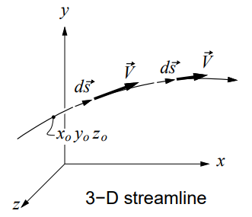
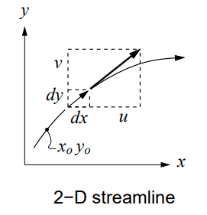
Equation for Streamline
$\vec{ds}×\vec{V}=\left\{dx\hat{ i}+ \text{dy} \hat{j}+\text{dz}\hat{k}\right\}×\left[u\left(t:x,y,z\right)\hat{i}+ \text{v}\left(t:x,y,z\right)\hat{j}+\text{w}\left(t:x,y,z\right)\hat{k} \right]$
=0
Separately set each component to zero to get three differential equations which define the streamline.
The three velocity components u, v, w, must be expressed as functions of x, y, z before these equations can be integrated.
To set the constants of integration, it is sufficient to specify some point x_{o}, y_{o}, z_{o} through which the streamline passes,

Slide 9
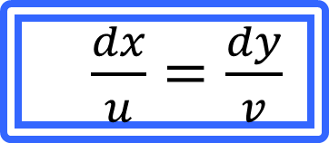
Two-Dimensional Streamline
In 2-D, dz = 0 and w = 0, and only the k component of the equation above is non-trivial.
$\vec{ds}×\vec{V}=\left\{dx\hat{ i}+ \text{dy} \hat{j}\right\}×\left[u\left(t:x,y,z\right)\hat{i}+ \text{v}\left(t:x,y,z\right)\hat{j} \right]$= 0
It can be written as an Ordinary Differential Equation for the streamline shape y(x).
$\frac{dx}{u}=\frac{dy}{v}$
u(t: x, y) and v(t: x, y) must be known to allow integration.
x_{o}, y_{o} must be given to set the integration constants.
In a numerical integration, x_{o}, y_{o} would serve as the initial values.
https://web.mit.edu/16.unified/www/FALL/fluids/Lectures/f08.pdf

Slide 10
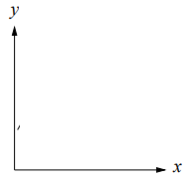
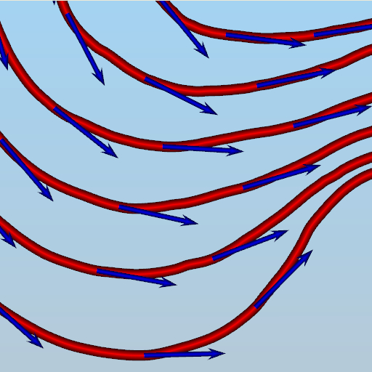
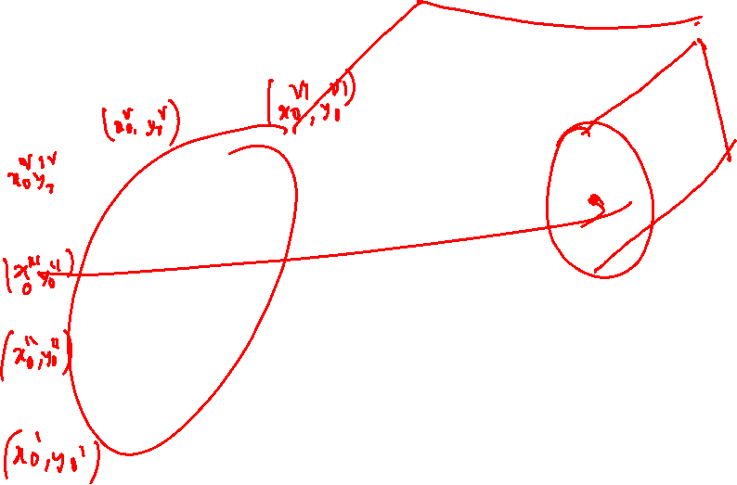
DaVinci View of 2D Streamlines
In 2-D, a stream tube is defined by considering any two streamlines passing through two different (x_{o}, y_{o}) points.

Slide 11
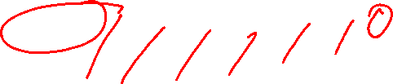
DaVinci View of 2D Streamlines
The flow between these two streamlines carries the same mass flow/span at each cross-section.

Slide 12
DaVinci View of 2D Streamlines
This can be considered as a 2-D channel flow embedded in the rest of the flow field.

Slide 13
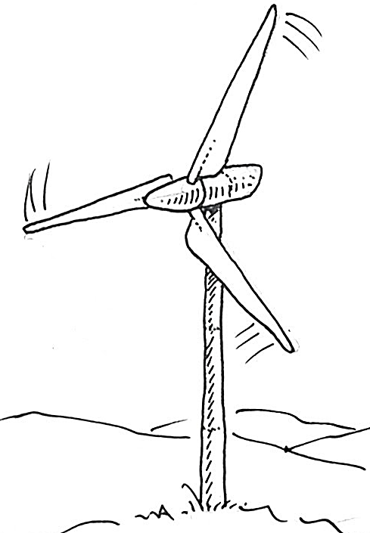
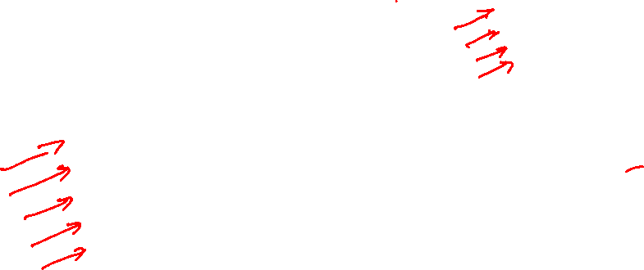
Self Creation of Stream Tube

Slide 14
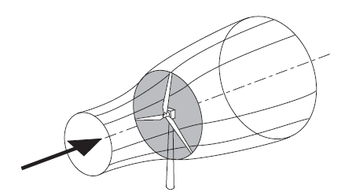
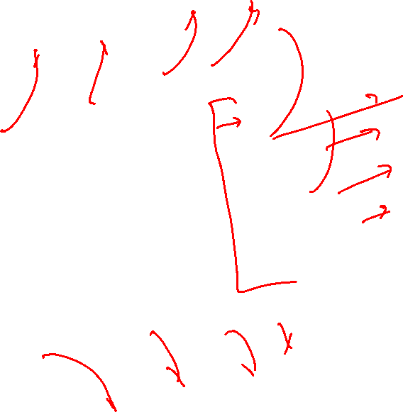
Creation of Stream Tube

Slide 15
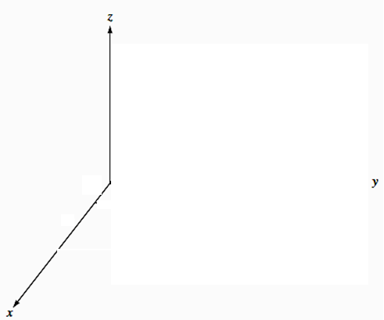
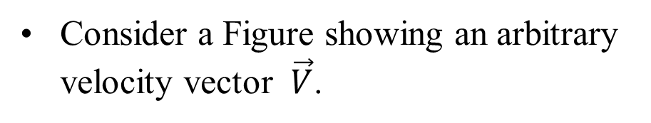
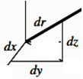
Streamlines in a Three-dimensional Flow
In 3-D, all components along a streamline are non-zero.
$\vec{ds}×\vec{V}=\left\{dx\hat{ i}+ \text{dy} \hat{j}+\text{dz}\hat{k}\right\}×\left[u\left(t:x,y,z\right)\hat{i}+ \text{v}\left(t:x,y,z\right)\hat{j}+\text{w}\left(t:x,y,z\right)\hat{k} \right]$
=0
Consider a Figure showing an arbitrary velocity vector $\vec{V}$.
If the elemental arc length d$\vec{r}$ of a streamline is to be parallel to $\vec{V}$.
Their respective components must be in proportion:
$$\vec{V}$$
w
u
$\frac{dx}{u}=\frac{dy}{v}=$ $\frac{dz}{w}$ = $\frac{d\vec{r}}{\vec{V}}$
v

Slide 16
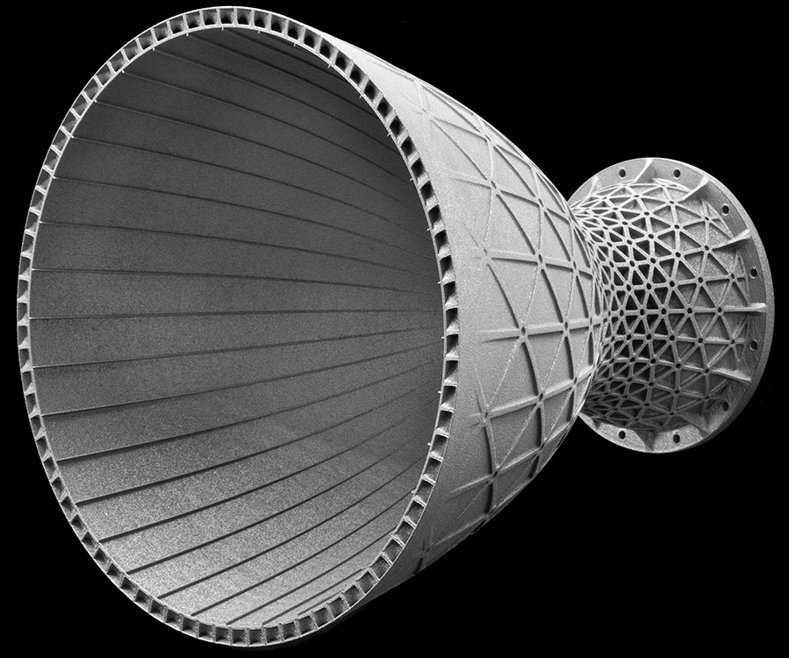
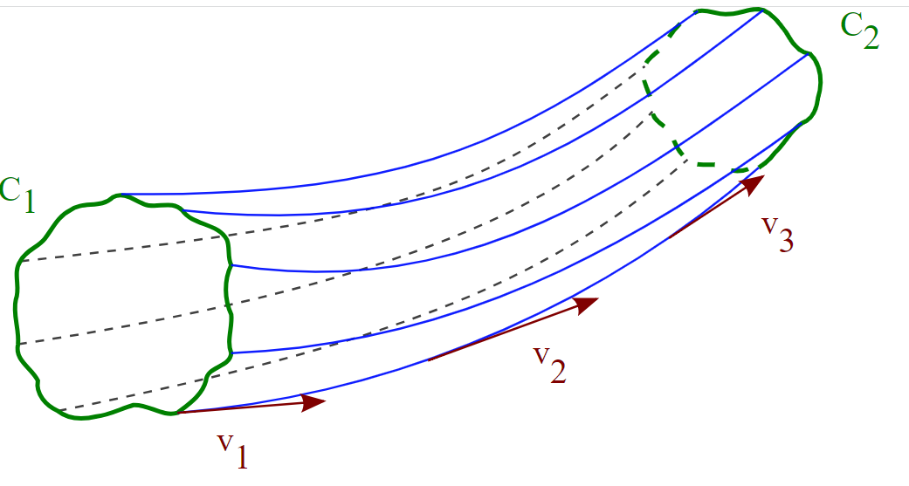
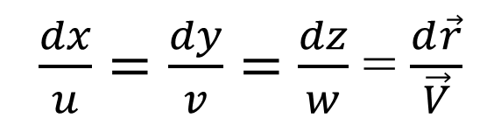
Streamlines in a Three-dimensional Flow
$\frac{dx}{u}=\frac{dy}{v}=$ $\frac{dz}{w}$ = $\frac{d\vec{r}}{\vec{V}}$
If the velocities (u, v, w) are known functions of position and time, above equation can be integrated to find the streamline passing through the initial point (x₀, y₀, z₀, t₀).
The method is straightforward for steady flows but may be laborious for unsteady flow.

Slide 17
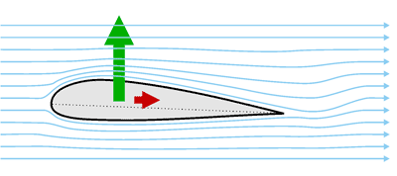
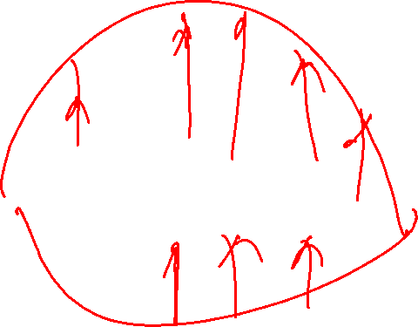
The Invention of Wright Brothers: An Airfoil

