Slide 1

MCL 106 : Fluid Mechanics
Introduction
https://web.iitd.ac.in/~pmvs/course_MCL106.php
P M V Subbarao
Professor
Mechanical Engineering Department
An Engineering Science Emerged out of the Search for Felicitous New Ideas by Ingenious.
Initiated as an “AHA! ”Moment…

Slide 2



Fluid Mechanics : An Exaample of
The Flammarion Engraving
Depicts an Ingenious putting his head through the edge of the cosmic firmament
Symbolizes humanity’s quest for Amalgamation of scientific knowledge.
Engraving from Camille Flammarion, L’atmosphère: météorologie populaire, 1888, p. 163/public domain.)

Slide 3
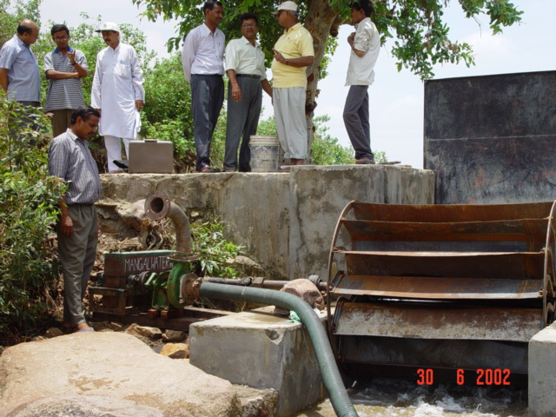

My Experience With Fluid Mechanics
Developing a product and training technicians of NGO (HESCO) to create ~35000 self employed youth.
(2002-2005)
Participation in Developing Laser Weapons for Indian Army in collaboration with CHESS (DRDO)
Started on 23 March 2023

Slide 4


Emerged as an “Aha” Moment
Archimedes, Born in 287 BC in the city of Syracuse, Italy.
He was a great Mathematician, Physicist, Engineer, Inventor, and Astronomer.
https://rufbuk.com/the-real-story-behind-archimedes-eureka-experiment/

Slide 5
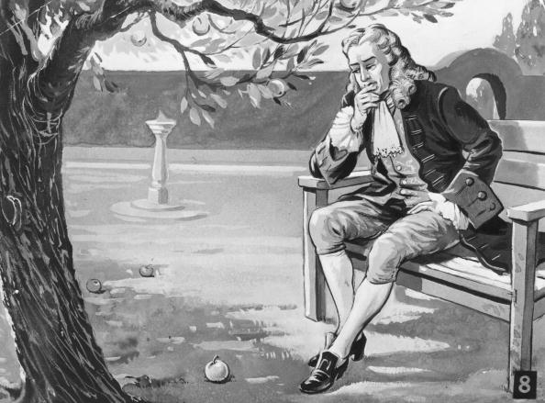
How can a force occur without any countable finite bodies & apparent contact between them?
Fluid System: A New Source of Force Creation
“Action at a distance" has stymied Another Class of the great minds ……

Slide 6


Real Fluids : A Resource of Gradients
At the end of the 1640s, Pascal temporarily focused his experiments on the physical sciences.
Following in Evangelista Torricelli’s footsteps, Pascal experimented with how atmospheric pressure could be estimated in terms of weight.

Slide 7
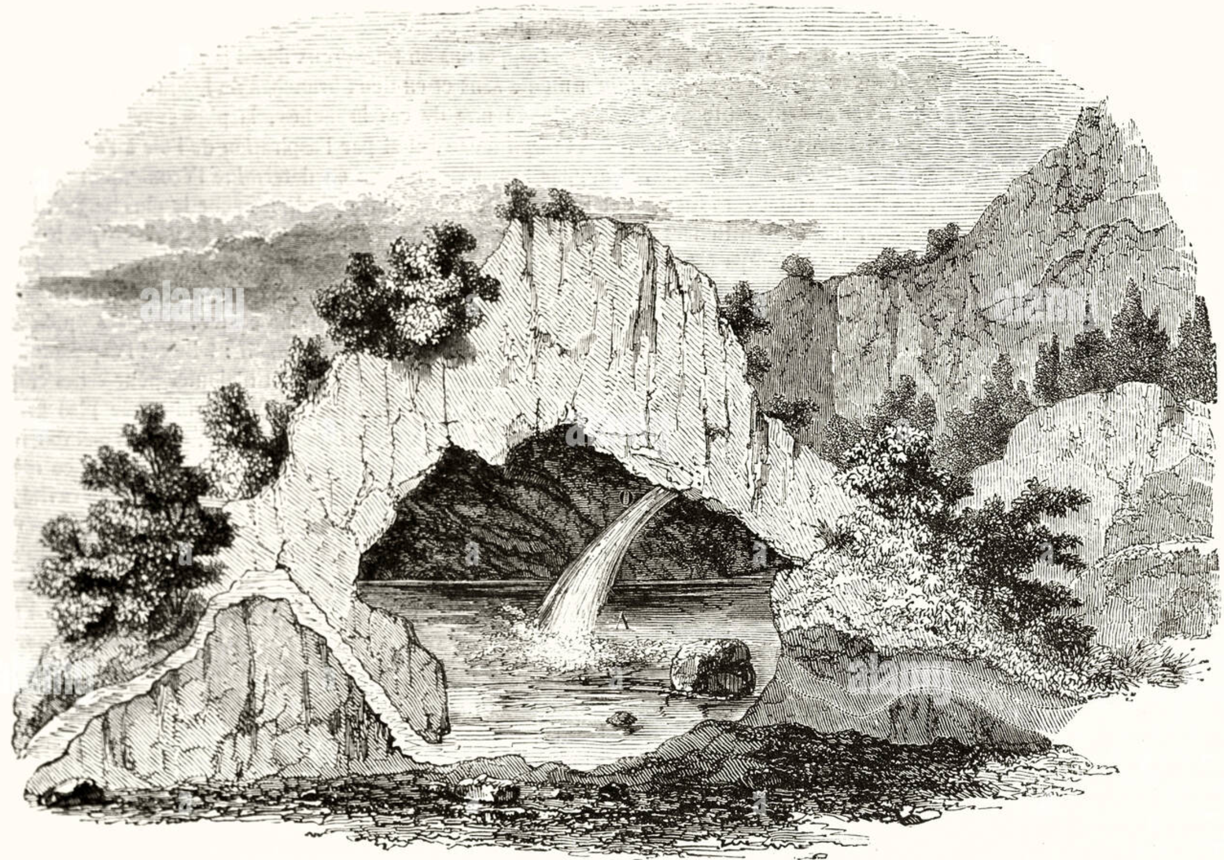
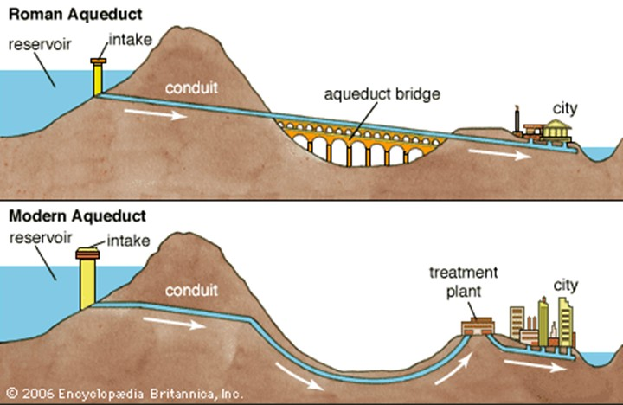
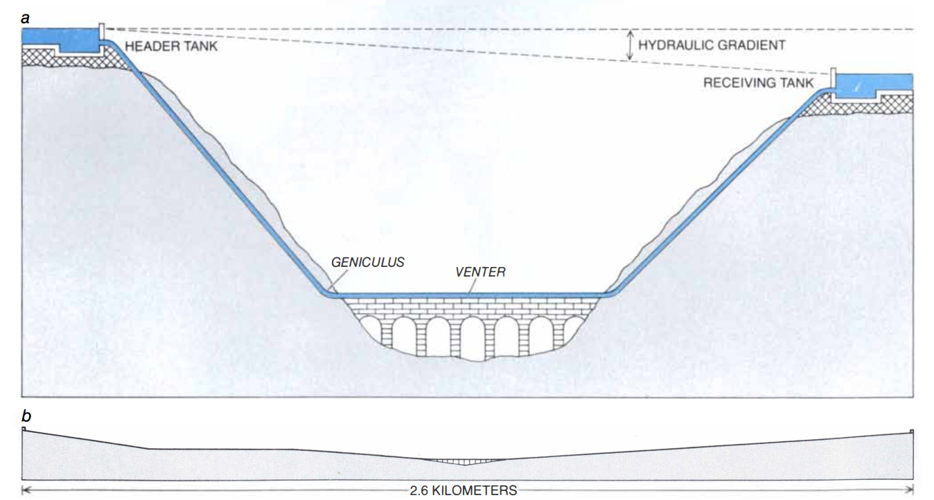
An Obvious Choice for Creation of Civilizations across the planet.
Siphons in Roman Aqueducts

Slide 8
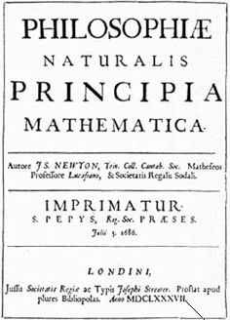
An Exclusive Force only Fluids can Generate by Newton
In 1687, Isaac Newton published his work in the Philosophiae Naturalis Principia Mathematica.
This probably the greatest and more influencing work in the history of science.
Newton paid attention to fluid flow and shear, among many other physical phenomena.

Slide 9
An Exclusive Force only Fluids can Generate by Newton
In the second book of the Principia, in Section IX “The circular motion of fluids”, the following hypothesis was proposed in Latin.
In 1729, Andrew Motte translated this hypothesis as:
The resistance arising from the want of lubricity (lack of slipperiness) in the parts of a fluid, is, other things being equal, proportional to velocity with which parts of the fluid separated from one another.

Slide 10
अंतर्बाहिश्च तत्सर्वं व्याप्य :
(अंदर और बाहर समान रूप से )
Jean-Louis-Marie Poiseuille
Gotthilf Heinrich Ludwig Hagen
A French physician and physiologist.
Poiseuille received his medical degree in 1828 and established his practice in Paris.
He was interested in the circulation of the blood. Poiseuille possess extraordinary sense of experimental precision.
A Civil engineer, teacher, and writer.
He is best known for his study in 1839 of pipe-flow resistance, for water flow.
Published a handbook on hydraulic engineering in 1841.

Slide 11
अंतर्बाहिश्च तत्सर्वं व्याप्य :
(अंदर और बाहर समान रूप से )
Jean-Louis-Marie Poiseuille
Gotthilf Heinrich Ludwig Hagen
He carried out his doctoral research on, ”The force of the aortic heart” in 1828.
Poiseuille invented the U-tube mercury manometer (called the hemodynamometer) and used it to measure pressures in the arteries of horses and dogs.
The Hagen number (Hg) is a dimensionless number used in forced flow calculations.
Hg is the forced flow equivalent of the Grashof number and was named after the German hydraulic engineer G. H. L. Hagen.

Slide 12
अंतर्बाहिश्च तत्सर्वं व्याप्य :
(अंदर और बाहर समान रूप से )
Jean-Louis-Marie Poiseuille
Gotthilf Heinrich Ludwig Hagen
To this day blood pressures are reported in mm Hg due to Poiseuille's invention.
This equation states that the flow rate is determined by the viscosity of the fluid, the drop in pressure along the tube, and the tube diameter.
He is the first person to have used the mercury manometer to measure blood pressure.
The Hagen number (Hg) is defined as: where: The pressure gradient * a characteristic length * the fluid density * ν the kinematic viscosity.

Slide 13
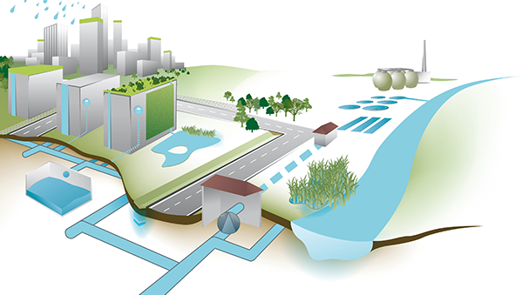
Modern Urban Water Distribution System

Slide 14
The Shocking News in New York Times
1 million to 10 million years they might be able to make a plane that would fly ?!?!?!
People had dreamed of flying for many years.
The United States Army was trying to develop an airplane in 1903, but the plane wouldn't fly.
The New York Times wrote that maybe in
1 million to 10 million years they might be able to make a plane that would fly.
Only eight days later two men were successful in flying the first manned plane.
They were Wilbur Wright and his younger brother, Orville.

Slide 15
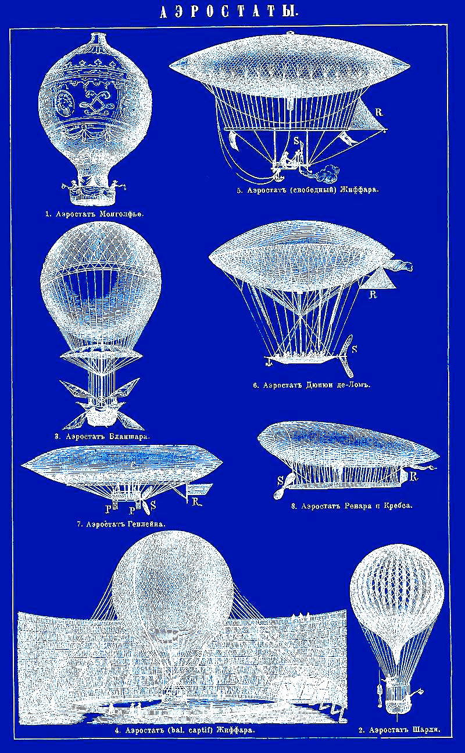
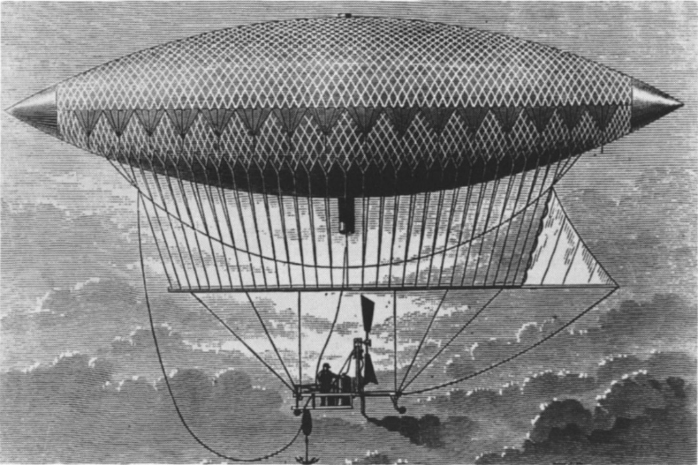

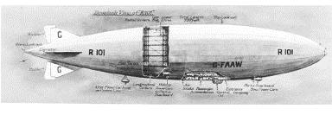
19th Century lift Devices

Slide 16
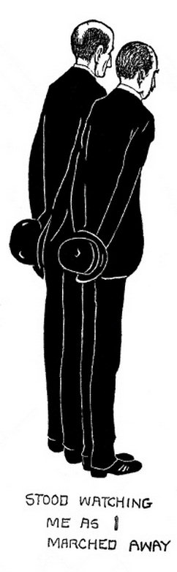
Kate Carew Interviews the Wright Brothers
“Are you manufacturing any racing machines?”
“Not just now, but we intend to.”
“How much can I buy one for?”
“Seven thousand five hundred-dollars.”
“Is that all? It doesn’t seem like an outside price for a perfectly good airship?”
“Airship!” shouted the Wright brothers indignantly.
“Is that the wrong word?”
“An airship,” said Wilbur contemptuously, “is a big, clumsy balloon filled with gas.”
“Well, I don’t see why your biplane shouldn’t be called an airship, too.”

Slide 17
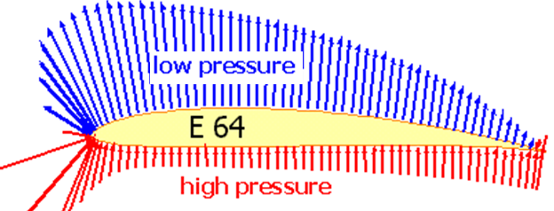
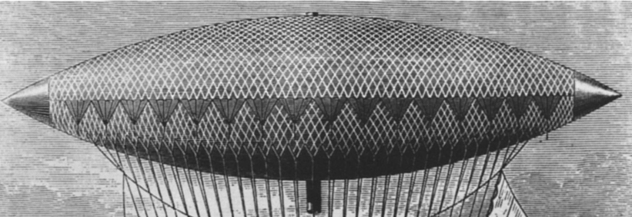
A Ship Can’t Fly
“It’s a flying machine,” said Wilbur.
“The name we prefer is ‘flyer,’” said Orville.
“An airship would cost $50,000,” said Wilbur.
“More like $150,000,” said Orville, and they argued the question.
Right Action to generate Lift

Slide 18

Development of an Ultimate Fluid machine

Slide 19
"It is possible to fly without motors, but not without knowledge and skill."
By
Wright Brothers

Slide 20
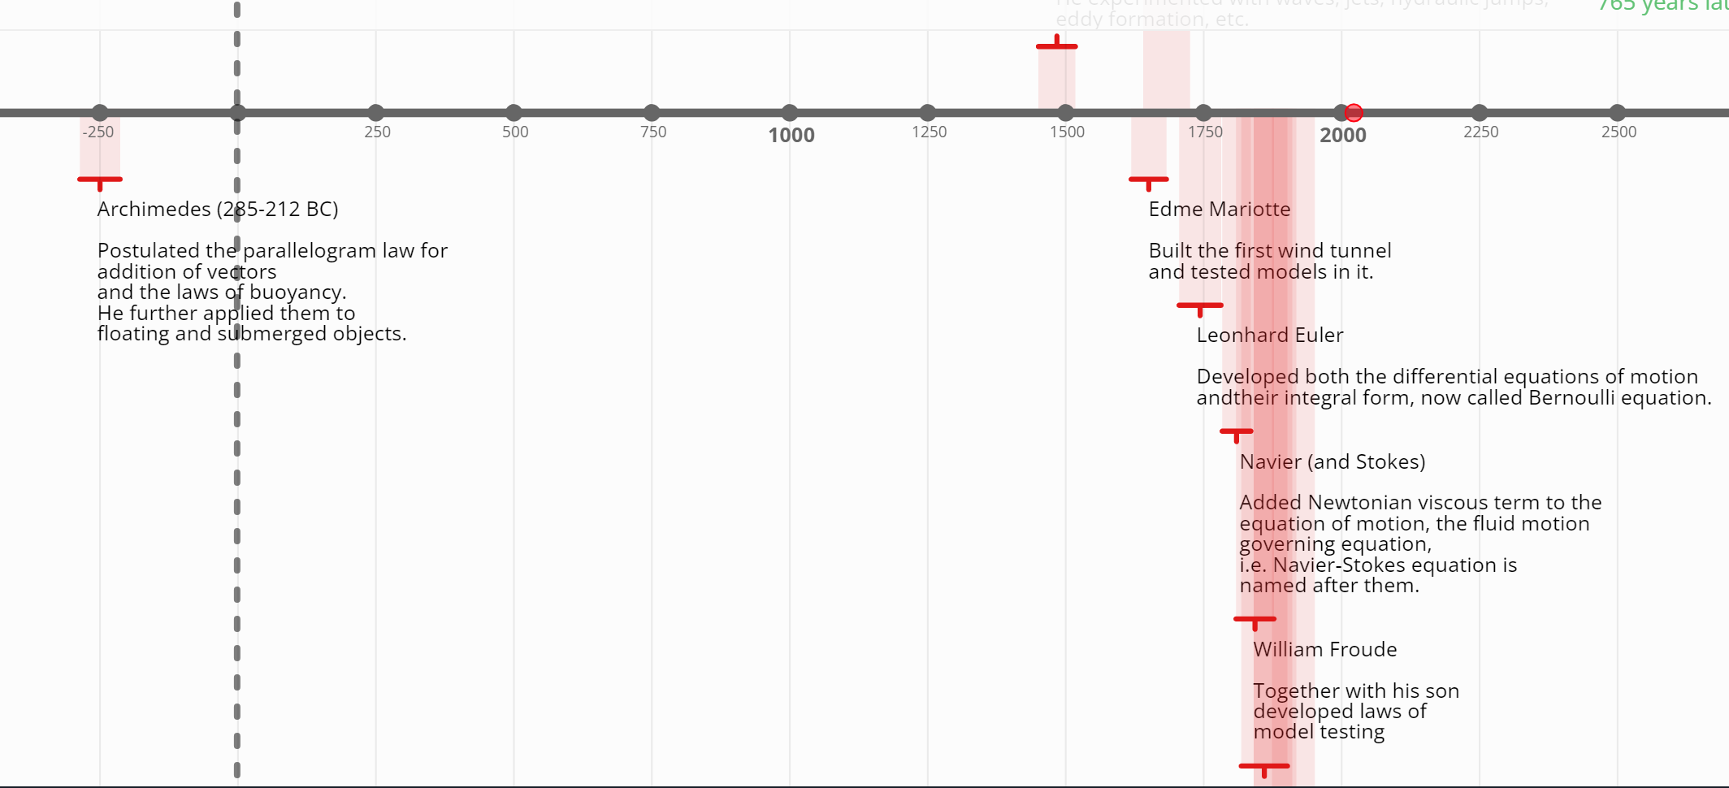
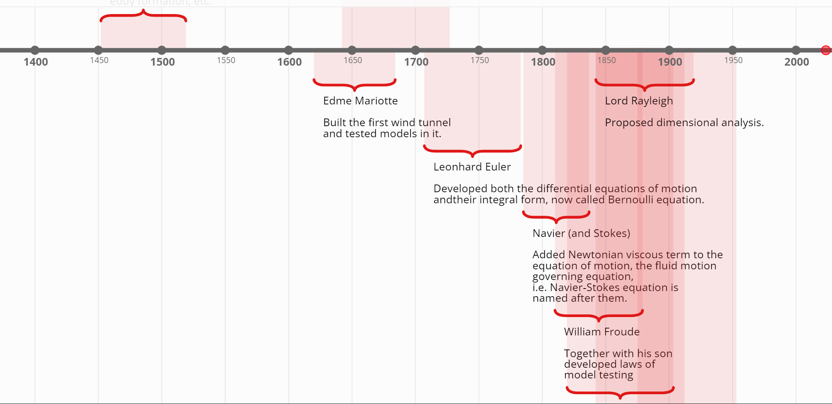
Timeline of Fluid Mechanics History
Leonardo da Vinci
https://time.graphics/line/414039

Slide 21
21st Century Made Fluid Mechanics as Universal Engineering Tool.

Slide 22
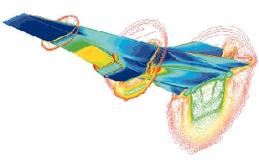
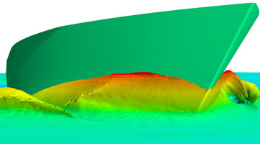
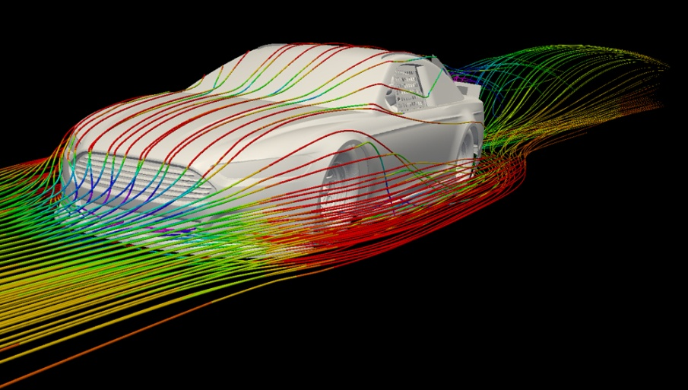
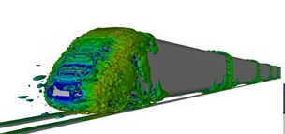
Fluid Flows in Transportation Sector

Slide 23
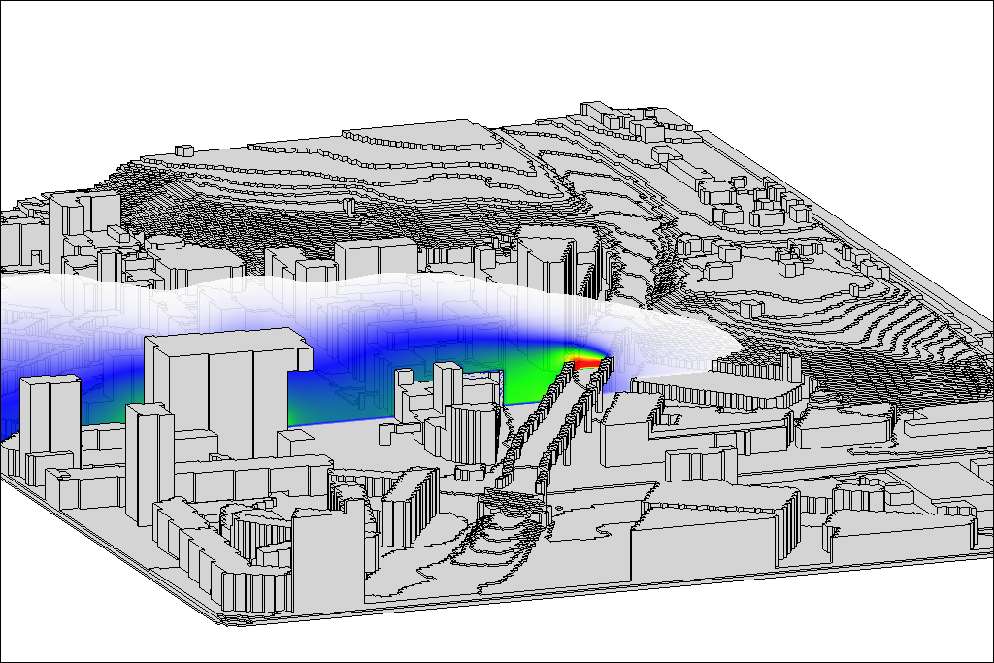
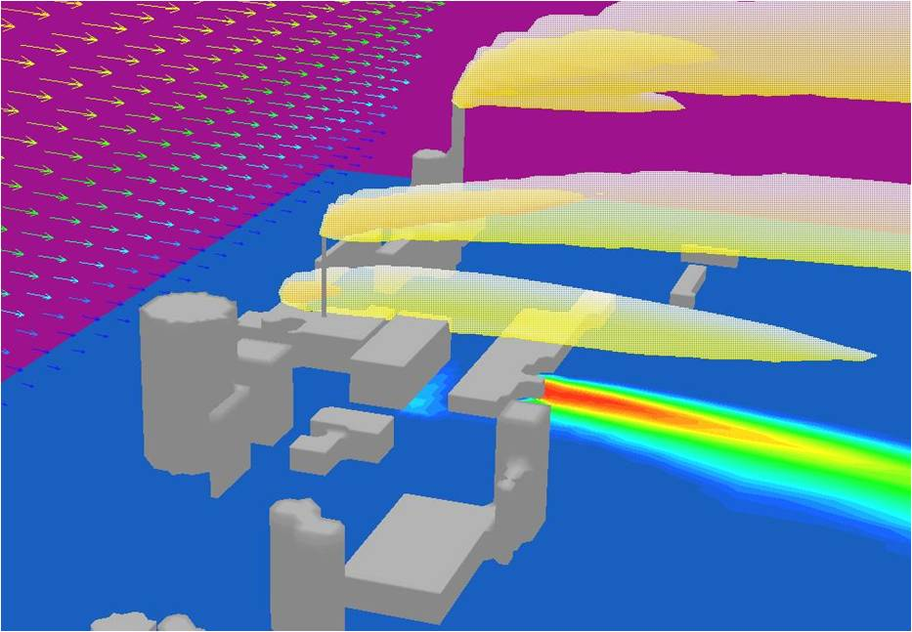
Environmental Fluid Flows

Slide 24
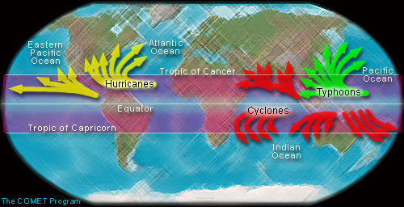
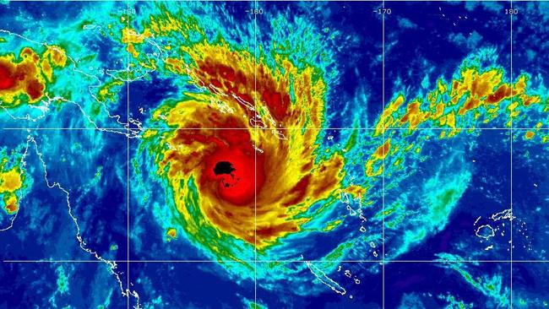
Weather & Fluid Flows

Slide 25
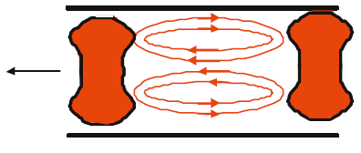
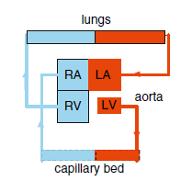
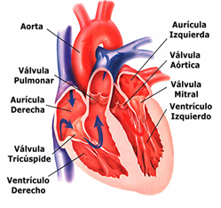
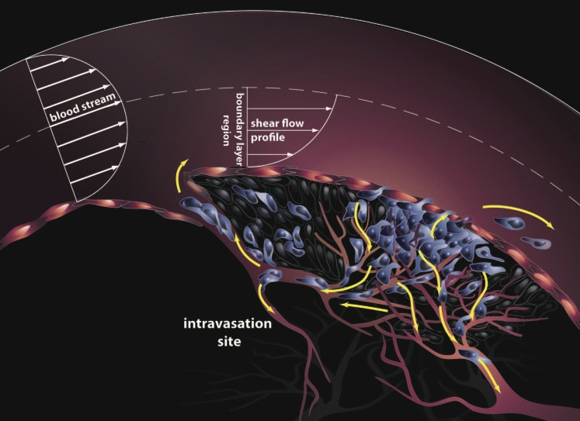
Biological Fluid Flows

Slide 26
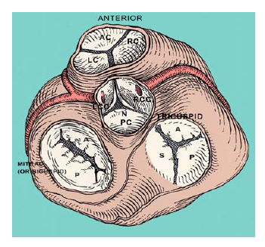


Knowledge of Viscous Fluid Flow for Design of Artificial Heart Valves

Slide 27
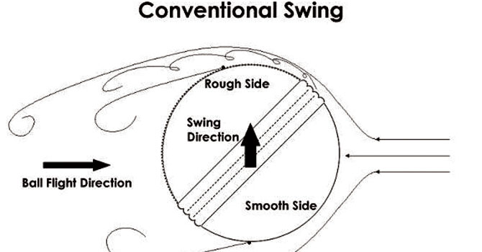
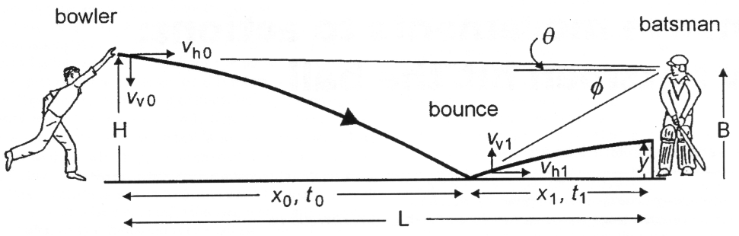
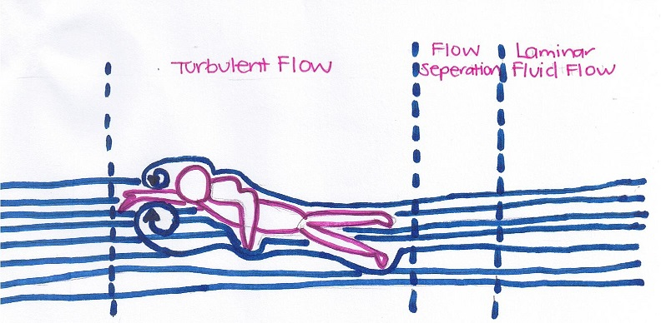
Fluid Flows for Sports

Slide 28
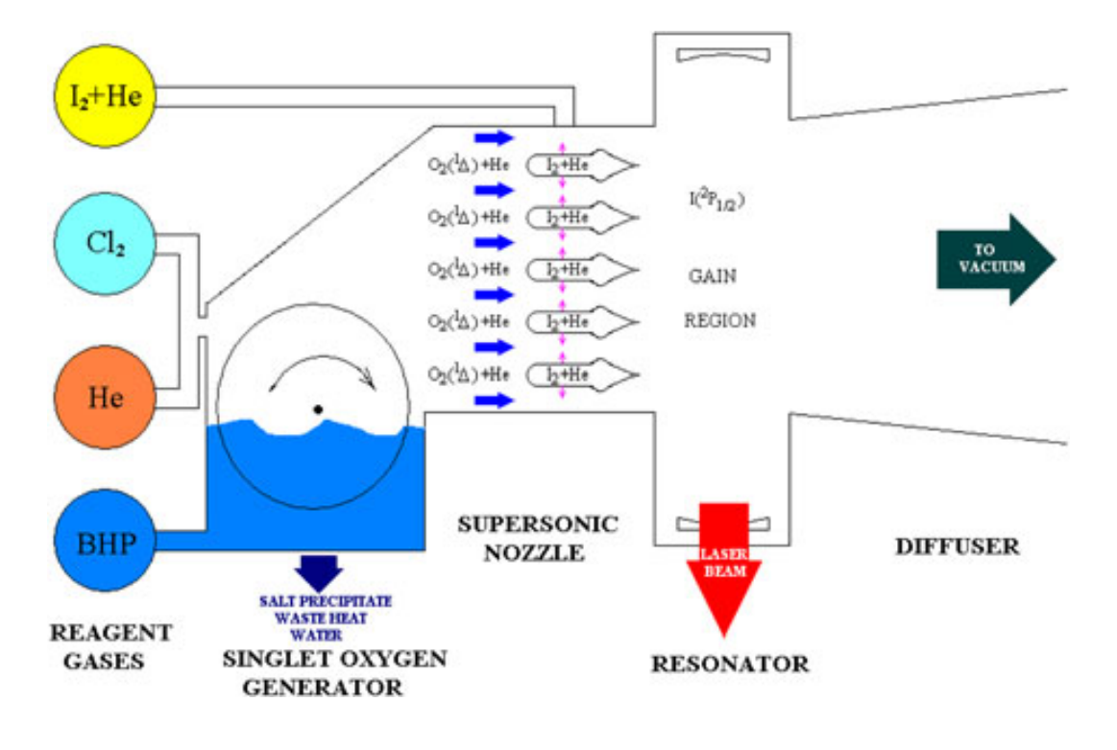
Direct Energy Weapons for Indian Defense
25 March 2023: https://www.drishtiias.com/eng
Recently, India’s Air Chief Marshal highlighted the need to push the development of Directed Energy Weapons (DEWs) and Hypersonic Weapons and integrate them into its airborne platforms to get the desired range and accuracy

